Slide 1


Slide 2
Graves into Gardens
(Elevation Worship)

Slide 3
I searched the World but it couldn’t fill me. Man’s empty praise and treasures that fade Are never

Slide 4
Enough. Then you came along and put me back together And every desire Is now satisfied here in

Slide 5
Your love. Oh’ there’s nothing better than you. There’s nothing better than you. Lord there’s nothing

Slide 6
Nothing is better than you. Im not afraid to show you my weakness. My failures and flaws Lord you’ve

Slide 7
Seen them all and you still call me friend.Cause the God of the mountain. Is the God of the Valley.

Slide 8
There’s not a place. Your mercy and grace. Wont find me again. Oh there’s nothing better than you. There’s

Slide 9
Nothing better than you. Lord there’s nothing. Nothing is better than you. Oh there’s nothing better

Slide 10
Better than you. There’s nothing better than you. Lord’ there’s nothing. Nothing is better than you.

Slide 11
You turn mourning to dancing. You give beauty for ashes. You turn shame into glory. You’re the only one

Slide 12
Who can. You turn mourning to dancing. You give beauty for ashes. You turn shame into glory. You’re

Slide 13
The only one who can. You turn graves into gardens. You turn bones into armies. You turn seas into

Slide 14
Highways. You’re the only one who can you’re the only one who can. Oh there’s nothing better than you

Slide 15
There’s nothing better than you. Lord there’s nothing. Nothing is better than you. Oh there’s nothing better

Slide 16
Than you. There’s nothing better than you. Lord, there’s nothing. Nothing is better than you. You turn

Slide 17
Graves into gardens. You turn bones into armies. You turn seas into highways. You’re the only one who

Slide 18
Can. You turn graves into gardens. You turn bones into armies. You turn seas into highways you’re the

Slide 19
Only one who can. You’re the only one who. You’re the only one who can.

Slide 20
above all names Be exalted now in the heavens As Your glory fills this place You alone deserve our

Slide 21
praise You’re the name above all names Worthy is Your name, Jesus You deserve the praise Worthy is

Slide 22
Your name Worthy is Your name, Jesus You deserve the praise Worthy is Your name Worthy is Your

Slide 23
name, Jesus You deserve the praise Worthy is Your name Worthy is Your name, Jesus You deserve the

Slide 24
praise Worthy is Your name Oh, oh

Slide 25
“Great are you Lord”
(All Sons and Daughters)

Slide 26
You give life, You are love. You bring light in the darkness. You give hope, You restore

Slide 27
Every heart that is broken. And great are you Lord. It’s your breath in our lungs so we

Slide 28
Pour out our praise. We pour out our praise.
It’s your breath in our lungs. So we pour out

Slide 29
Our praise to you only. You give life, you are love. You bring light to the darkness. You

Slide 30
Give hope, You restore. Every heart that is broken. Great are you Lord. It’s your breath

Slide 31
In our lungs. So we pour out our praise we pour out our praise. It’s your breath in our

Slide 32
Lungs so we pour out our praise to you only. It’s your breath in our lungs. So we

Slide 33
Pour out our praise we pour out our praise. It’s your breath in our lungs. So we pour out

Slide 34
Our praise to you only. And all the earth will shout your praise. Our hearts will cry, these

Slide 35
Bones will sing. Great are You, Lord. And all the earth will shout your praise. Our hearts

Slide 36
Will cry these bones will sing. Great are you,Lord. And all the earth will shout your

Slide 37
Praise Our hearts will cry these bones will sing. Great are you, Lord. It’s your breath in

Slide 38
Our Lungs. So we pour out our praise. We pour out our praise. It’s your breath in our

Slide 39
Lungs so we pour out our praise to you only. Great are you, Lord. It’s your breath in

Slide 40
Our lungs so we pour out our praise. Pour out our praise. It’s your breath in our lungs

Slide 41
So we pour out our praise to you only. Great are you , Lord.

Slide 42
“Good Good Father” (Chris Tomlin)

Slide 43
I’ve heard a thousand stories of what they think you’re like. But I’ve heard the tender whispers of love

Slide 44
In the dead of night. And you tell me that you’re pleased and that I’m never alone. You’re a good

Slide 45
Good Father. It’s who you are, it’s who you are, it’s who you are and I am loved by you. It’s who I am

Slide 46
It’s who I am. It’s who I am. I’ve seen many searching for answers far and wide. But I know we’re

Slide 47
All searching for answers only you provide. Cause you know just what we need before we say a word.

Slide 48
You’re a good good Father. It’s who you are, It’s who you are. It’s who you are. And I’m loved by you. It’s

Slide 49
Who I am, It’s who I am, It’s who I am. You are perfect in all of your ways. You are perfect in all of

Slide 50
Your ways. You are perfect in all of your ways to us. You are perfect in all of your ways. You are perfect in

Slide 51
All of your ways. You are perfect in all of your ways to us. You’re a good good Father. It’s who you are, It’s

Slide 52
who you are, It’s who you are. And I’m loved by you. It’s who I am, it’s who I am, It’s who I am.

Slide 53
Love so undeniable I, I , can hardly speak. Peace so unexplainable I , I , can hardly think. As you call me

Slide 54
Deeper still. As you call me deeper still. As you call me deeper still into Love love love. You’re a good

Slide 55
Good father. It’s who you are, It’s who you are, it’s who you are. And I’m loved by you. It’s who I am,

Slide 56
It’s who I am, It’s who I am.

Slide 57
“Worthy Of It All”
(Bethel Music)

Slide 58
All the saints and angels. They bow before the throne. All the elders cast their crowns before the

Slide 59
Lamb of God and sing. All the saints and angels. They bow before your throne. All the elders cast their

Slide 60
Crowns before the lamb of God and sing. You are worthy of it all. You are worthy of it all. For from you

Slide 61
All. For from you are all things and to you are all things. You deserve the glory. Day and night, night

Slide 62
Night and day. Let incense arise. Day and night, night and day. Let incense arise. Day and night, night

Slide 63
And day let incense arise. Day and night night and day. You are worthy of it all. You are worthy of it all

Slide 64
For from you are al things. And to you are all things. You deserve the glory. You are worthy of it all. You

Slide 65
Are worthy of it all. For from you are all things and to you are all things. You deserve the glory. We exalt

Slide 66
Thee. We exalt thee. We exalt thee, Oh, Lord.
We exalt thee. We exalt thee, We exalt thee, Oh

Slide 67
Make Room The Church Will Sing
(Elyssa Smith, Community Music)

Slide 68
Here is where I lay it down Every burden, every crown This is my surrender This is my surrender

Slide 69
Here is where I lay it down Every lie and every doubt
This is my surrender And I will make room for You

Slide 70
To do whatever You want to To do whatever You want to I will make room for You To do whatever You

Slide 71
want to To do whatever You want to Here is where I lay it down Every burden, every crown This is my

Slide 72
surrender This is my surrender Here is where I lay it down Every lie and every doubt This is my surrender

Slide 73
And I will make room for You To do whatever You want to To do whatever You want to And I will make

Slide 74
room for You To do whatever You want to To do whatever You want to And I will make room for You

Slide 75
To do whatever You want to To do whatever You want to And I will make room for You To do

Slide 76
whatever You want to To do whatever You want to (Jesus) Have Your way, have Your way Jesus Have

Slide 77
Your way with us Have Your way with us, ooh We surrender We surrender Jesus Have Your way Jesus

Slide 78
Shake up the ground of all my tradition Break down the walls of all my religion Your way is better Your

Slide 79
way is better Shake up the ground of all my tradition Break down the walls of all my religion Your way is

Slide 80
better Your way is better Shake up the ground of all my tradition Break down the walls of all my religion

Slide 81
Your way is better Your way is better Shake up the ground of all my tradition Break down the walls of all

Slide 82
my religion Your way is better Your way is better And I will make room for You To do whatever You want to

Slide 83
To do whatever You want to I will make room for You To do whatever You want to To do whatever You

Slide 84
want to Here is where I lay it down You are all I'm chasing now This is my surrender This is my

Slide 85
surrender Here is where I lay it down You are all I'm chasing now This is my surrender This is my

Slide 86
surrender.

Slide 88


Slide 89

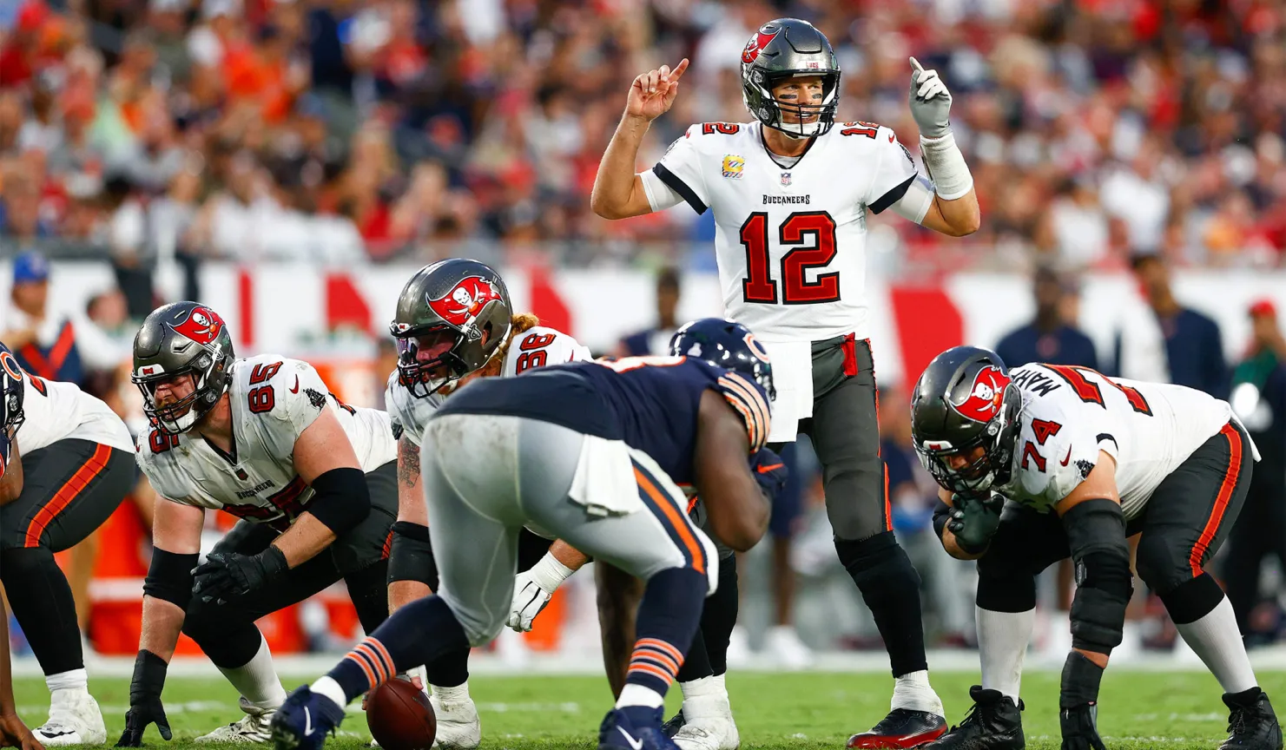
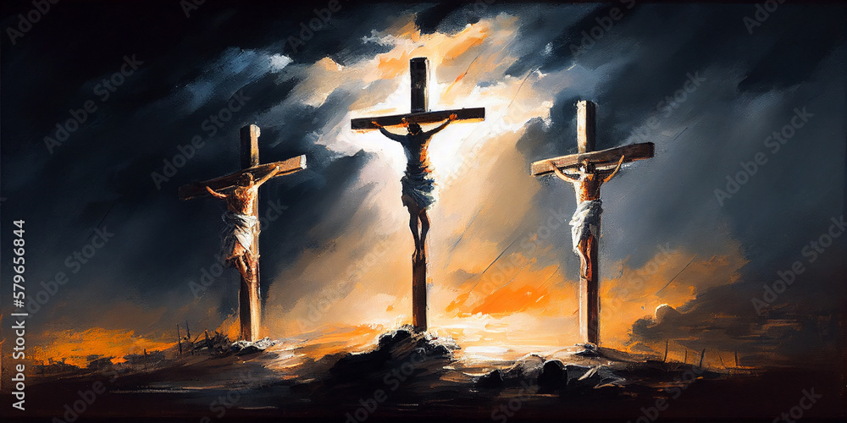
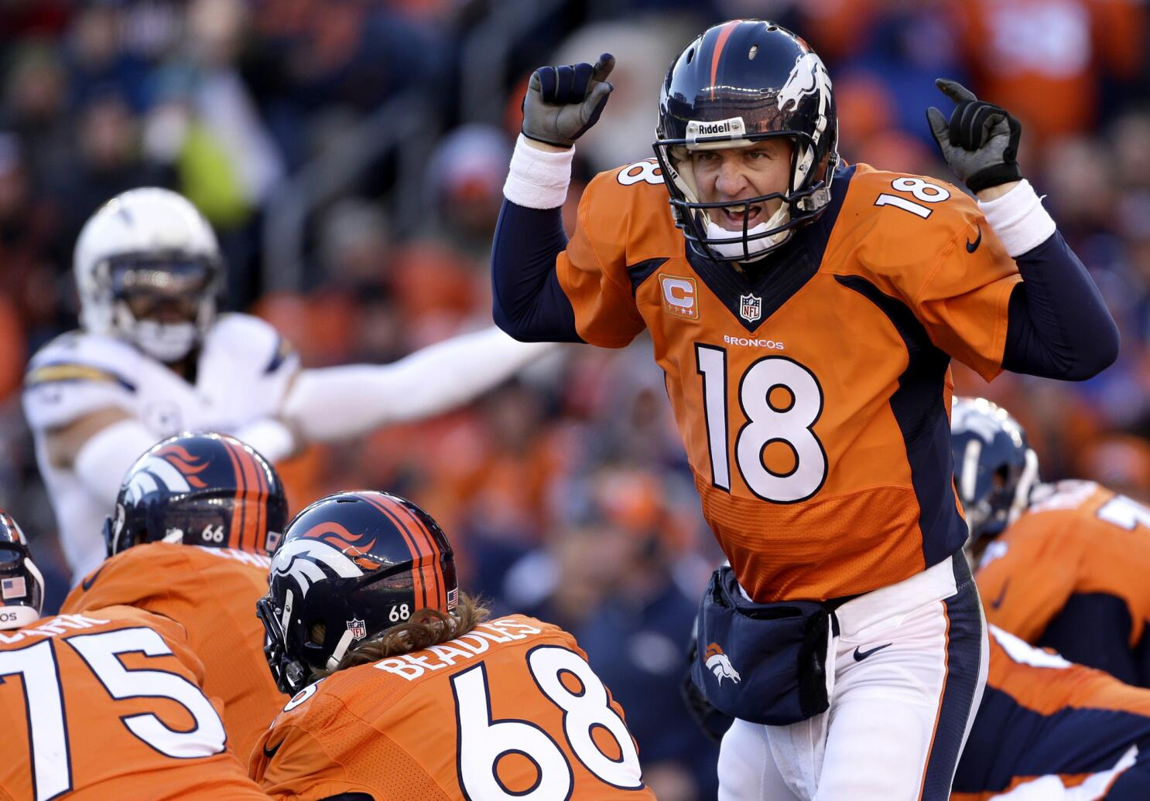
God Called an Audible
by Pastor Fee Soliven
Galatians 4:1-7
Sunday Morning
February 11, 2024

Slide 90
Galatians 4:1-7
1 Now I say that the heir, as long as he is a child, does not differ at all from a slave, though he is master of all, 2 but is under guardians and stewards until the time appointed by the father. 3 Even so we, when we were children, were in bondage under the elements of the world. 4 But when the fullness of the time had come, God sent forth His Son, born of a woman, born under the law,

Slide 91
5 to redeem those who were under the law, that we might receive the adoption as sons. 6 And because you are sons, God has sent forth the Spirit of His Son into your hearts, crying out, "Abba, Father!" 7 Therefore you are no longer a slave but a son, and if a son, then an heir of God through Christ.

Slide 92
23 if indeed you continue in the faith, grounded and steadfast, and are not moved away from the hope of the gospel which you heard, which was preached to every creature under heaven, of which I, Paul, became a minister.

Slide 93
An Audible by God Before the Fall of Man

Slide 94
Revelation 13:8-9
“All who dwell on the earth will worship him, whose names have not been written in the Book of Life of the Lamb slain from the foundation of the world. 9 If anyone has an ear, let him hear”

Slide 95
1 Peter 1:18-21
18 knowing that you were not redeemed with corruptible things, like silver or gold, from your aimless conduct received by tradition from your fathers, 19 but with the precious blood of Christ, as of a lamb without blemish and without spot.

Slide 96
20 He indeed was foreordained before the foundation of the world, but was manifest in these last times for you 21 who through Him believe in God, who raised Him from the dead and gave Him glory, so that your faith and hope are in God.

Slide 97
1 Corinthians 2:7-10
7 But we speak the wisdom of God in a mystery, the hidden wisdom which God ordained before the ages for our glory, 8 which none of the rulers of this age knew; for had they known, they would not have crucified the Lord of glory.

Slide 98
9 But as it is written: "Eye has not seen, nor ear heard, Nor have entered into the heart of man The things which God has prepared for those who love Him." 10 But God has revealed them to us through His Spirit. For the Spirit searches all things, yes, the deep things of God.

Slide 99
God Calls Audibles Throughout the Bible

Slide 100
The Parting of the Red Sea

Slide 101
Exodus 14:15-24
15 And the LORD said to Moses, "Why do you cry to Me? Tell the children of Israel to go forward. 16 But lift up your rod, and stretch out your hand over the sea and divide it. And the children of Israel shall go on dry ground through the midst of the sea.

Slide 102
17 And I indeed will harden the hearts of the Egyptians, and they shall follow them. So I will gain honor over Pharaoh and over all his army, his chariots, and his horsemen.

Slide 103
18 Then the Egyptians shall know that I am the LORD, when I have gained honor for Myself over Pharaoh, his chariots, and his horsemen." 19 And the Angel of God, who went before the camp of Israel, moved and went behind them; and the pillar of cloud went from before them and stood behind them.

Slide 104
20 So it came between the camp of the Egyptians and the camp of Israel. Thus it was a cloud and darkness to the one, and it gave light by night to the other, so that the one did not come near the other all that night.

Slide 105
21 Then Moses stretched out his hand over the sea; and the LORD caused the sea to go back by a strong east wind all that night, and made the sea into dry land, and the waters were divided.

Slide 106
22 So the children of Israel went into the midst of the sea on the dry ground, and the waters were a wall to them on their right hand and on their left. 23 And the Egyptians pursued and went after them into the midst of the sea, all Pharaoh's horses, his chariots, and his horsemen.

Slide 107
Samson’s Final Triumph

Slide 108
Judges 16:28-31
28 Then Samson called to the LORD, saying, "O Lord GOD, remember me, I pray! Strengthen me, I pray, just this once, O God, that I may with one blow take vengeance on the Philistines for my two eyes!"

Slide 109
29 And Samson took hold of the two middle pillars which supported the temple, and he braced himself against them, one on his right and the other on his left.

Slide 110
30 Then Samson said, "Let me die with the Philistines!" And he pushed with all his might, and the temple fell on the lords and all the people who were in it. So the dead that he killed at his death were more than he had killed in his life.

Slide 111
31 And his brothers and all his father's household came down and took him, and brought him up and buried him between Zorah and Eshtaol in the tomb of his father Manoah. He had judged Israel twenty years.

Slide 112
One Giant Terrified an Entire Nation

Slide 113
1 Samuel 17:41-51
41 So the Philistine came, and began drawing near to David, and the man who bore the shield went before him. 42 And when the Philistine looked about and saw David, he disdained him; for he was only a youth, ruddy and good-looking. 43 So the Philistine said to David, "Am I a dog, that you come to me with sticks?" And the Philistine cursed David by his gods.

Slide 114
44 And the Philistine said to David, "Come to me, and I will give your flesh to the birds of the air and the beasts of the field!" 45 Then David said to the Philistine, "You come to me with a sword, with a spear, and with a javelin. But I come to you in the name of the LORD of hosts, the God of the armies of Israel, whom you have defied.

Slide 115
46 This day the LORD will deliver you into my hand, and I will strike you and take your head from you. And this day I will give the carcasses of the camp of the Philistines to the birds of the air and the wild beasts of the earth, that all the earth may know that there is a God in Israel. 47 Then all this assembly shall know that the LORD does not save with sword and spear; for the battle is the LORD's, and He will give you into our hands."

Slide 116
48 So it was, when the Philistine arose and came and drew near to meet David, that David hastened and ran toward the army to meet the Philistine. 49 Then David put his hand in his bag and took out a stone; and he slung it and struck the Philistine in his forehead, so that the stone sank into his forehead, and he fell on his face to the earth.

Slide 117
50 So David prevailed over the Philistine with a sling and a stone, and struck the Philistine and killed him. But there was no sword in the hand of David. 51 Therefore David ran and stood over the Philistine, took his sword and drew it out of its sheath and killed him, and cut off his head with it. And when the Philistines saw that their champion was dead, they fled.

Slide 118
The Very First Church was on the
Verge of Being Destroyed

Slide 119
Acts 9:1-16
1 Then Saul, still breathing threats and murder against the disciples of the Lord, went to the high priest 2 and asked letters from him to the synagogues of Damascus, so that if he found any who were of the Way, whether men or women, he might bring them bound to Jerusalem.

Slide 120
3 And as he journeyed he came near Damascus, and suddenly a light shone around him from heaven. 4 Then he fell to the ground, and heard a voice saying to him, "Saul, Saul, why are you persecuting Me?" 5 And he said, "Who are You, Lord?" And the Lord said, "I am Jesus, whom you are persecuting. It is hard for you to kick against the goads."

Slide 121
6 So he, trembling and astonished, said, "Lord, what do You want me to do?" And the Lord said to him, "Arise and go into the city, and you will be told what you must do." 7 And the men who journeyed with him stood speechless, hearing a voice but seeing no one. 8 Then Saul arose from the ground, and when his eyes were opened he saw no one. But they led him by the hand and brought him into Damascus.

Slide 122
9 And he was three days without sight, and neither ate nor drank. 10 Now there was a certain disciple at Damascus named Ananias; and to him the Lord said in a vision, "Ananias." And he said, "Here I am, Lord." 11 So the Lord said to him, "Arise and go to the street called Straight, and inquire at the house of Judas for one called Saul of Tarsus, for behold, he is praying.

Slide 123
12 And in a vision he has seen a man named Ananias coming in and putting his hand on him, so that he might receive his sight." 13 Then Ananias answered, "Lord, I have heard from many about this man, how much harm he has done to Your saints in Jerusalem.

Slide 124
14 And here he has authority from the chief priests to bind all who call on Your name." 15 But the Lord said to him, "Go, for he is a chosen vessel of Mine to bear My name before Gentiles, kings, and the children of Israel. 16 For I will show him how many things he must suffer for My name's sake."

Slide 125
Saul of Tarsus Became The Greatest Apostle Whoever Lived

Slide 126
2 Corinthians 11:22-31
22 Are they Hebrews? So am I. Are they Israelites? So am I. Are they the seed of Abraham? So am I. 23 Are they ministers of Christ?--I speak as a fool--I am more: in labors more abundant, in stripes above measure, in prisons more frequently, in deaths often.

Slide 127
24 From the Jews five times I received forty stripes minus one. 25 Three times I was beaten with rods; once I was stoned; three times I was shipwrecked; a night and a day I have been in the deep; 26 in journeys often, in perils of waters, in perils of robbers, in perils of my own countrymen, in perils of the Gentiles, in perils in the city, in perils in the wilderness, in perils in the sea, in perils among false brethren;

Slide 128
27 in weariness and toil, in sleeplessness often, in hunger and thirst, in fastings often, in cold and nakedness-- 28 besides the other things, what comes upon me daily: my deep concern for all the churches. 29 Who is weak, and I am not weak? Who is made to stumble, and I do not burn with indignation?

Slide 129
30 If I must boast, I will boast in the things which concern my infirmity. 31 The God and Father of our Lord Jesus Christ, who is blessed forever, knows that I am not lying.

Slide 130
Romans 1:16-17
16 For I am not ashamed of the gospel of Christ, for it is the power of God to salvation for everyone who believes, for the Jew first and also for the Greek. 17 For in it the righteousness of God is revealed from faith to faith; as it is written, "The just shall live by faith."

Slide 131
The Audible of God for our Lives

Slide 132
John 3:16-18
16 For God so loved the world that He gave His only begotten Son, that whoever believes in Him should not perish but have everlasting life. 17 For God did not send His Son into the world to condemn the world, but that the world through Him might be saved.

Slide 133
18 He who believes in Him is not condemned; but he who does not believe is condemned already, because he has not believed in the name of the only begotten Son of God.

Slide 134
Ephesians 2:1-9
1 And you He made alive, who were dead in trespasses and sins, 2 in which you once walked according to the course of this world, according to the prince of the power of the air, the spirit who now works in the sons of disobedience,

Slide 135
3 among whom also we all once conducted ourselves in the lusts of our flesh, fulfilling the desires of the flesh and of the mind, and were by nature children of wrath, just as the others. 4 But God, who is rich in mercy, because of His great love with which He loved us,

Slide 136
5 even when we were dead in trespasses, made us alive together with Christ (by grace you have been saved), 6 and raised us up together, and made us sit together in the heavenly places in Christ Jesus, 7 that in the ages to come He might show the exceeding riches of His grace in His kindness toward us in Christ Jesus.

Slide 137
8 For by grace you have been saved through faith, and that not of yourselves; it is the gift of God, 9 not of works, lest anyone should boast.

Slide 138
Acts 2:38-39
38 Then Peter said to them, "Repent, and let every one of you be baptized in the name of Jesus Christ for the remission of sins; and you shall receive the gift of the Holy Spirit. 39 For the promise is to you and to your children, and to all who are afar off, as many as the Lord our God will call."

Slide 139
1 Thessalonians 4:13-18
13 But I do not want you to be ignorant, brethren, concerning those who have fallen asleep, lest you sorrow as others who have no hope. 14 For if we believe that Jesus died and rose again, even so God will bring with Him those who sleep in Jesus.

Slide 140
15 For this we say to you by the word of the Lord, that we who are alive and remain until the coming of the Lord will by no means precede those who are asleep. 16 For the Lord Himself will descend from heaven with a shout, with the voice of an archangel, and with the trumpet of God. And the dead in Christ will rise first.

Slide 141
17 Then we who are alive and remain shall be caught up together with them in the clouds to meet the Lord in the air. And thus we shall always be with the Lord. 18 Therefore comfort one another with these words.

Slide 142
1 Corinthians 15:50-54
50 Now this I say, brethren, that flesh and blood cannot inherit the kingdom of God; nor does corruption inherit incorruption. 51 Behold, I tell you a mystery: We shall not all sleep, but we shall all be changed-- 52 in a moment, in the twinkling of an eye, at the last trumpet. For the trumpet will sound, and the dead will be raised incorruptible, and we shall be changed.

Slide 143
53 For this corruptible must put on incorruption, and this mortal must put on immortality. 54 So when this corruptible has put on incorruption, and this mortal has put on immortality, then shall be brought to pass the saying that is written: "Death is swallowed up in victory."

Slide 144

20 Again, when a righteous man turns from his righteousness and commits iniquity, and I lay a stumbling block before him, he shall die; because you did not give him warning, he shall die in his sin, and his righteousness which he has done shall not be remembered; but his blood I will require at your hand.

Slide 145
Acts 2:38-39
38 Then Peter said to them, "Repent, and let every one of you be baptized in the name of Jesus Christ for the remission of sins; and you shall receive the gift of the Holy Spirit. 39 For the promise is to you and to your children, and to all who are afar off, as many as the Lord our God will call."

Slide 146

Donate with our QR code app to
Amazing Grace Christian Fellowship
Donations are Deeply Appreciated!

