Slide 1


Slide 2
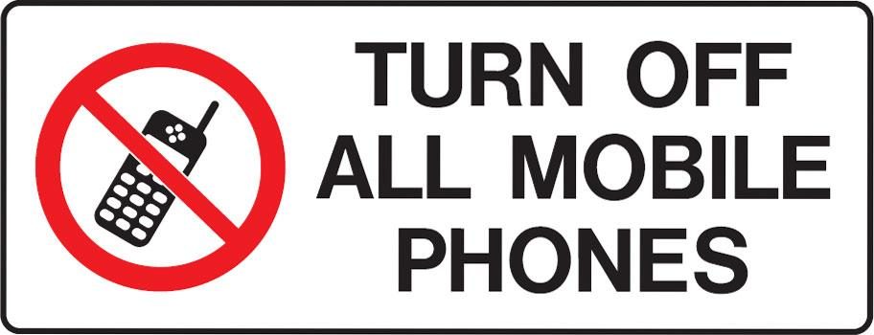

Slide 3


God Leads You to Repentance
by Pastor Fee Soliven
Romans 2:1-10
Wednesday Evening
January 31, 2024

Slide 4
Romans 2:1-10
1 Therefore you are inexcusable, O man, whoever you are who judge, for in whatever you judge another you condemn yourself; for you who judge practice the same things. 2 But we know that the judgment of God is according to truth against those who practice such things.

Slide 5
3 And do you think this, O man, you who judge those practicing such things, and doing the same, that you will escape the judgment of God? 4 Or do you despise the riches of His goodness, forbearance, and longsuffering, not knowing that the goodness of God leads you to repentance?

Slide 6
5 But in accordance with your hardness and your impenitent heart you are treasuring up for yourself wrath in the day of wrath and revelation of the righteous judgment of God, 6 who "will render to each one according to his deeds"

Slide 7
7. :eternal life to those who by patient continuance in doing good seek for glory, honor, and immortality

Slide 8
1 Therefore you are inexcusable, O man, whoever you are who judge, for in whatever you judge another you condemn yourself; for you who judge practice the same things.

Slide 9
Matthew 3:8-9
8 Therefore bear fruits worthy of repentance, 9 and do not think to say to yourselves, 'We have Abraham as our father.' For I say to you that God is able to raise up children to Abraham from these stones.

Slide 10
Matthew 7:2-3
2 For with what judgment you judge, you will be judged; and with the measure you use, it will be measured back to you. 3 And why do you look at the speck in your brother's eye, but do not consider the plank in your own eye?

Slide 11
2 But we know that the judgment of God is according to truth against those who practice such things.

Slide 12
Psalm 68:1-2
1 Let God arise, Let His enemies be scattered; Let those also who hate Him flee before Him. 2 As smoke is driven away, So drive them away; As wax melts before the fire, So let the wicked perish at the presence of God.

Slide 13
3 And do you think this, O man, you who judge those practicing such things, and doing the same, that you will escape the judgment of God?

Slide 14
Matthew 7:1-5
1 "Judge not, that you be not judged. 2 For with what judgment you judge, you will be judged; and with the measure you use, it will be measured back to you. 3 And why do you look at the speck in your brother's eye, but do not consider the plank in your own eye?

Slide 15
4 Or how can you say to your brother, 'Let me remove the speck from your eye'; and look, a plank is in your own eye? 5 Hypocrite! First remove the plank from your own eye, and then you will see clearly to remove the speck out of your brother's eye.

Slide 16
4 Or do you despise the riches of His goodness, forbearance, and longsuffering, not knowing that the goodness of God leads you to repentance?

Slide 17
2 Peter 3:14-15
14 Therefore, beloved, looking forward to these things, be diligent to be found by Him in peace, without spot and blameless; 15 and account that the longsuffering of our Lord is salvation--as also our beloved brother Paul, according to the wisdom given to him, has written to you…

Slide 18
5 But in accordance with your hardness and your impenitent heart you are treasuring up for yourself wrath in the day of wrath and revelation of the righteous judgment of God, 6 who "will render to each one according to his deeds":

Slide 19
Deuteronomy 10:16
“Therefore circumcise the foreskin of your heart, and be stiff-necked no longer”

Slide 20
Jeremiah 4:4
Circumcise yourselves to the LORD, And take away the foreskins of your hearts, You men of Judah and inhabitants of Jerusalem, Lest My fury come forth like fire, And burn so that no one can quench it, Because of the evil of your doings."

Slide 21
Hebrews 9:27
“And as it is appointed for men to die once, but after this the judgment”

Slide 22
Job 34:11
“For He repays man according to his work, And makes man to find a reward according to his way”

Slide 23
Psalm 62:12
“Also to You, O Lord, belongs mercy; For You render to each one according to his work”

Slide 24
Proverbs 24:12
If you say, "Surely we did not know this," Does not He who weighs the hearts consider it? He who keeps your soul, does He not know it? And will He not render to each man according to his deeds?

Slide 25
Jeremiah 17:10
I, the LORD, search the heart, I test the mind, Even to give every man according to his ways, According to the fruit of his doings.

Slide 26
Jeremiah 32:19
You are great in counsel and mighty in work, for your eyes are open to all the ways of the sons of men, to give everyone according to his ways and according to the fruit of his doings.

Slide 27
Matthew 16:27
“For the Son of Man will come in the glory of His Father with His angels, and then He will reward each according to his works”

Slide 28
2 Corinthians 5:10
“For we must all appear before the judgment seat of Christ, that each one may receive the things done in the body, according to what he has done, whether good or bad”

Slide 29
Revelation 20:12
And I saw the dead, small and great, standing before God, and books were opened. And another book was opened, which is the Book of Life. And the dead were judged according to their works, by the things which were written in the books.

Slide 30
Revelation 22:12
"And behold, I am coming quickly, and My reward is with Me, to give to every one according to his work.

Slide 31
7. eternal life to those who by patient continuance in doing good seek for glory, honor, and immortality

Slide 32
Luke 8:15
But the ones that fell on the good ground are those who, having heard the word with a noble and good heart, keep it and bear fruit with patience.

Slide 33
Hebrews 12:1
“Therefore we also, since we are surrounded by so great a cloud of witnesses, let us lay aside every weight, and the sin which so easily ensnares us, and let us run with endurance the race that is set before us”

Slide 34
James 1:3
“knowing that the testing of your faith produces patience”
Again Paul is emphasizing God’s impartial treatment of all people.

Slide 35
Ephesians 2:8-10
8 For by grace you have been saved through faith, and that not of yourselves; it is the gift of God, 9 not of works, lest anyone should boast. 10 For we are His workmanship, created in Christ Jesus for good works, which God prepared beforehand that we should walk in them

Slide 36
1 Thessalonians 4:13-18
13 But I do not want you to be ignorant, brethren, concerning those who have fallen asleep, lest you sorrow as others who have no hope. 14 For if we believe that Jesus died and rose again, even so God will bring with Him those who sleep in Jesus.

Slide 37
15 For this we say to you by the word of the Lord, that we who are alive and remain until the coming of the Lord will by no means precede those who are asleep. 16 For the Lord Himself will descend from heaven with a shout, with the voice of an archangel, and with the trumpet of God. And the dead in Christ will rise first.

Slide 38
17 Then we who are alive and remain shall be caught up together with them in the clouds to meet the Lord in the air. And thus we shall always be with the Lord. 18 Therefore comfort one another with these words.

Slide 39
1 Corinthians 15:50-54
50 Now this I say, brethren, that flesh and blood cannot inherit the kingdom of God; nor does corruption inherit incorruption. 51 Behold, I tell you a mystery: We shall not all sleep, but we shall all be changed-- 52 in a moment, in the twinkling of an eye, at the last trumpet. For the trumpet will sound, and the dead will be raised incorruptible, and we shall be changed.

Slide 40
53 For this corruptible must put on incorruption, and this mortal must put on immortality. 54 So when this corruptible has put on incorruption, and this mortal has put on immortality, then shall be brought to pass the saying that is written: "Death is swallowed up in victory."

Slide 41

20 Again, when a righteous man turns from his righteousness and commits iniquity, and I lay a stumbling block before him, he shall die; because you did not give him warning, he shall die in his sin, and his righteousness which he has done shall not be remembered; but his blood I will require at your hand.

Slide 42
Acts 2:38-39
38 Then Peter said to them, "Repent, and let every one of you be baptized in the name of Jesus Christ for the remission of sins; and you shall receive the gift of the Holy Spirit. 39 For the promise is to you and to your children, and to all who are afar off, as many as the Lord our God will call."

Slide 43

Donate with our QR code app to
Amazing Grace Christian Fellowship
Donations are Deeply Appreciated!

