Slide 1


Slide 2
Child of Love
(We The Kingdom)

Slide 3
I was walking the wayside Lost on a lonely road I was chasing the high life Tryna satisfy my soul All the

Slide 4
lies I believed in Left me crying like the rain Then I saw lightning from Heaven And I've never been the

Slide 5
same I'm gonna climb a mountain I'm gonna shout about it I am a child of love I found a world of

Slide 6
freedom I found a friend in Jesus I am a child of love
I've felt the sting of the fire But I saw You in the

Slide 7
flames Just when I thought it was over You broke me out of the grave I'm gonna climb a mountain I'm

Slide 8
gonna shout about it I am a child of love I found a world of freedom I found a friend in Jesus I am a

Slide 9
child of love I am a child of love, yeah, oh I am a child of love Nothing can change the way You love

Slide 10
me Nothing can change the way I belong to You
Yes I do Nothing can separate Nothing can change

Slide 11
the way You love me Nothing can change the way
I belong to You Yes I do Nothing can separate I'm

Slide 12
gonna climb a mountain I am a child of love I found a world of freedom I am a child of love I'm gonna climb

Slide 13
a mountain I'm gonna shout about it I am a child of love I found a world of freedom I found a friend in

Slide 14
Jesus I am a child of love, oh yeah Yeah, I am a child of love I am a child of love

Slide 15
Been the same. I’m gonna climb the mountain. I’m gonna shout about it. I am a child of love. I found a

Slide 16
World of freedom. I found a friend in Jesus. I am a child of love. I’ve felt the sting of the fire. But I saw

Slide 17
You in the flames. Just when I thought it was over. You broke me out of the grave. I’m gonna climb A

Slide 18
Mountain. I’m gonna shout about it. I am a child of love. I found a world of freedom. I found a friend in

Slide 19
Jesus. I am a child of love. I’m gona climb a mountain, I’m gonna shout about it. I am a child of

Slide 20
Love. I found a world of freedom, I found a friend in Jesus. I am a child of love. Yeah Oh I am a child of

Slide 21
Love. Yeah oh I am a child of love. Nothing can change the way you love me. Nothing can change

Slide 22
The way. I belong to you. Yes’ I do, nothing can separate. Nothing can change the way you love me.

Slide 23
Nothing can change the way. I belong to you. Yes, I do. Nothing can separate. I’m gonna climb a

Slide 24
Mountain, I am a child of love. I found a world of Freedom. I am a child of Love. I’m gonna climb a

Slide 25
Mountain, I’m gonna shout about it. I am a child of love. I found a world of freedom. I found a friend in

Slide 26
Jesus. I am a child of Love. I’m gonna climb a mountain. I’m gonna shout about it. I am a child of

Slide 27
Love. I found a world of freedom. I found a friend in Jesus. I am a child of love. Oh Yeah, oh I am a child

Slide 28
Of love. Oh yeah, oh I am a child of love. Oh yeah ,I am a child of love.

Slide 29
Who You Say I Am
(Hillsong)

Slide 30
Who am I that the highest King would welcome me?
I was lost, but He brought me in Oh His love for me

Slide 31
Oh His love for me Who the Son sets free Oh, is free indeed I'm a child of God, yes, I am Free at last, He

Slide 32
has ransomed me His grace runs deep While I was a slave to sin, Jesus died for me Yes, He died for me

Slide 33
Who the Son sets free Oh is free indeed I'm a child of God, yes, I am In my Father's house There's a

Slide 34
place for me I'm a child of God, yes, I am I am chosen, not forsaken I am who You say I am You are

Slide 35
for me, not against me I am who You say I am I am chosen, not forsaken I am who You say I am You are

Slide 36
for me, not against me I am who You say I am I am who You say I am Who the Son sets free Oh is free

Slide 37
indeed I'm a child of God, yes, I am In my Father's house There's a place for me I'm a child of God, yes,

Slide 38
I am In my Father's house There's a place for me I'm a child of God, yes, I am I am chosen, not forsaken I

Slide 39
am who You say I am You are for me, not against me
I am who You say I am I am chosen, not forsaken I

Slide 40
am who You say I am You are for me, not against me
I am who You say I am I am chosen, not forsaken I

Slide 41
am who You say I am You are for me, not against me I am who You say I am Oh I am who

Slide 42
You say I am Yes, I am who you say I am Who the Son sets free Oh is free indeed I'm a child of God,

Slide 43
yes, I am In my Father's house There's a place for me I'm a child of God, yes, I am

Slide 44
”No Longer Slaves”
(Bethel)

Slide 45
You unravel me. With a melody. You surround me with song of deliverance. From my enemies. Til’ all

Slide 46
My fears are gone.. I’m no longer a slave to fear. I am a child of God. I’m no longer a slave to fear.

Slide 47
I am a child of God. From my mother’s womb you have chosen me. Love has called my name.

Slide 48
I’ve been born again. Into your family. Your blood flows through my veins. I’m no longer slave to fear

Slide 49
I am a child of god. I’m no longer a slave to fear. I am a child of God. Ooh, oooh . Ooh , oooh. Ooh, oooh.

Slide 50
Ooh, oooh . You split the sea so I could walk right through it. My fears are drowned in perfect Love.

Slide 51
You rescue me. So I could stand and say. I am a child of God. You split the sea so I could walk right

Slide 52
Through it. My fears are drowned in perfect love. You rescued me. So I could stand and say. I am a child

Slide 53
Of god. I am a child of God. Yes I am a child of God.

Slide 54
The Blessing
(Kari Jobe)

Slide 55
The Lord bless you and keep you. Make his face shine upon you. And be gracious to you. The Lord

Slide 56
turn his face towards and give you peace. Amen, Amen, Amen, Amen, Amen, Amen. The Lord bless

Slide 57
You and keep you. Make his face shine upon you. And be gracious to you. The Lord turn his. Face

Slide 58
towards you. And give you peace. Amen, Amen, Amen, Amen, Amen, Amen. May his favor be

Slide 59
upon you and a thousand generations. And your family and your children, and their children, and their

Slide 60
children. May his favor be upon you. And a thousand generations. And your family and your

Slide 61
children. And their children, and their children. May his presence. Go before you. And behind you

Slide 62
and beside you. All around you, and within you. He is with you. He is with you. In the morning, In the

Slide 63
evening. In your coming, and your going. In your weeping, and rejoicing. He is for you, He is for you.

Slide 64
He is for you, He is for you, He is for you, He is for you, He is for you, he is for you. Amen, Amen, Amen

Slide 65
Amen, Amen, Amen. May his presence go before you. And behind you, and beside you. All around

Slide 66
you, and with you, he is with you, he is with you. In the morning, In the evening, In your coming, and

Slide 67
your going. In your weeping, and rejoicing. He is for you.

Slide 68
“ Ever Be”
(Bethel)

Slide 69
I have watched how You drove back the sea That swallowed up my every fear I have walked from the

Slide 70
shore to the deep And through it all, You were there
Mighty Redeemer, strong to deliver You are the great

Slide 71
I am We crown You with every crown For the way You saved us Crown You with every crown For the

Slide 72
way You love us High King of Heaven We crown You the Lord of all I have watched how You led

Slide 73
through the wild A cloud by day and fire by night Guiding me to Your promised land Every step, by my

Slide 74
side Mighty Redeemer, strong to deliver You are the great I am We crown You with every crown For the

Slide 75
way You saved us Crown You with every crown For the way You love us High King of Heaven We crown

Slide 76
You the Lord of all We crown You with every crown For the way You saved us Crown You with every

Slide 77
crown For the way You love us High King of Heaven We crown You the Lord of all All hail Redeemer hail

Slide 78
For You have died for me And Your praise will never, never fail Through all eternity All hail Redeemer hail

Slide 79
For You have died for me And Your praise will never, never fail Through all eternity We crown You with

Slide 80
every crown For the way You saved us Crown You with every crown For the way You love us High King

Slide 81
of Heaven We crown You the Lord of all We crown You with every crown For the way You saved us

Slide 82
Crown You with every crown For the way You love us High King of Heaven We crown You the Lord of all

Slide 84


Slide 85
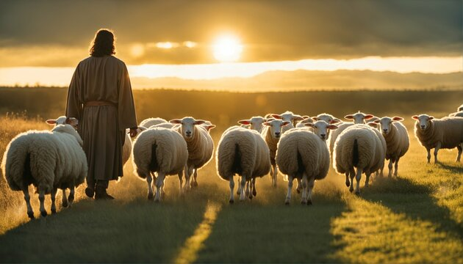

Jesus is Our Greatest Leader!
By Pastor Fee Soliven
Joshua 1:1-9
Sunday Morning
February 4, 2024

Slide 86
Joshua 1:1-9
1 After the death of Moses the servant of the LORD, it came to pass that the LORD spoke to Joshua the son of Nun, Moses' assistant, saying: 2 "Moses My servant is dead. Now therefore, arise, go over this Jordan, you and all this people, to the land which I am giving to them--the children of Israel.

Slide 87
3 Every place that the sole of your foot will tread upon I have given you, as I said to Moses. 4 From the wilderness and this Lebanon as far as the great river, the River Euphrates, all the land of the Hittites, and to the Great Sea toward the going down of the sun, shall be your territory.

Slide 88
5 No man shall be able to stand before you all the days of your life; as I was with Moses, so I will be with you. I will not leave you nor forsake you. 6 Be strong and of good courage, for to this people you shall divide as an inheritance the land which I swore to their fathers to give them.

Slide 89
7 Only be strong and very courageous, that you may observe to do according to all the law which Moses My servant commanded you; do not turn from it to the right hand or to the left, that you may prosper wherever you go.

Slide 90
8 This Book of the Law shall not depart from your mouth, but you shall meditate in it day and night, that you may observe to do according to all that is written in it. For then you will make your way prosperous, and then you will have good success. 9 Have I not commanded you? Be strong and of good courage; do not be afraid, nor be dismayed, for the LORD your God is with you wherever you go."

Slide 91
The Sight of our Current Conditions can Produce Fear

Slide 92
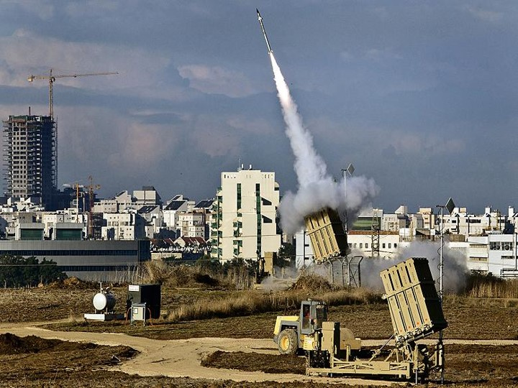
All adversity is not Bad

Slide 93
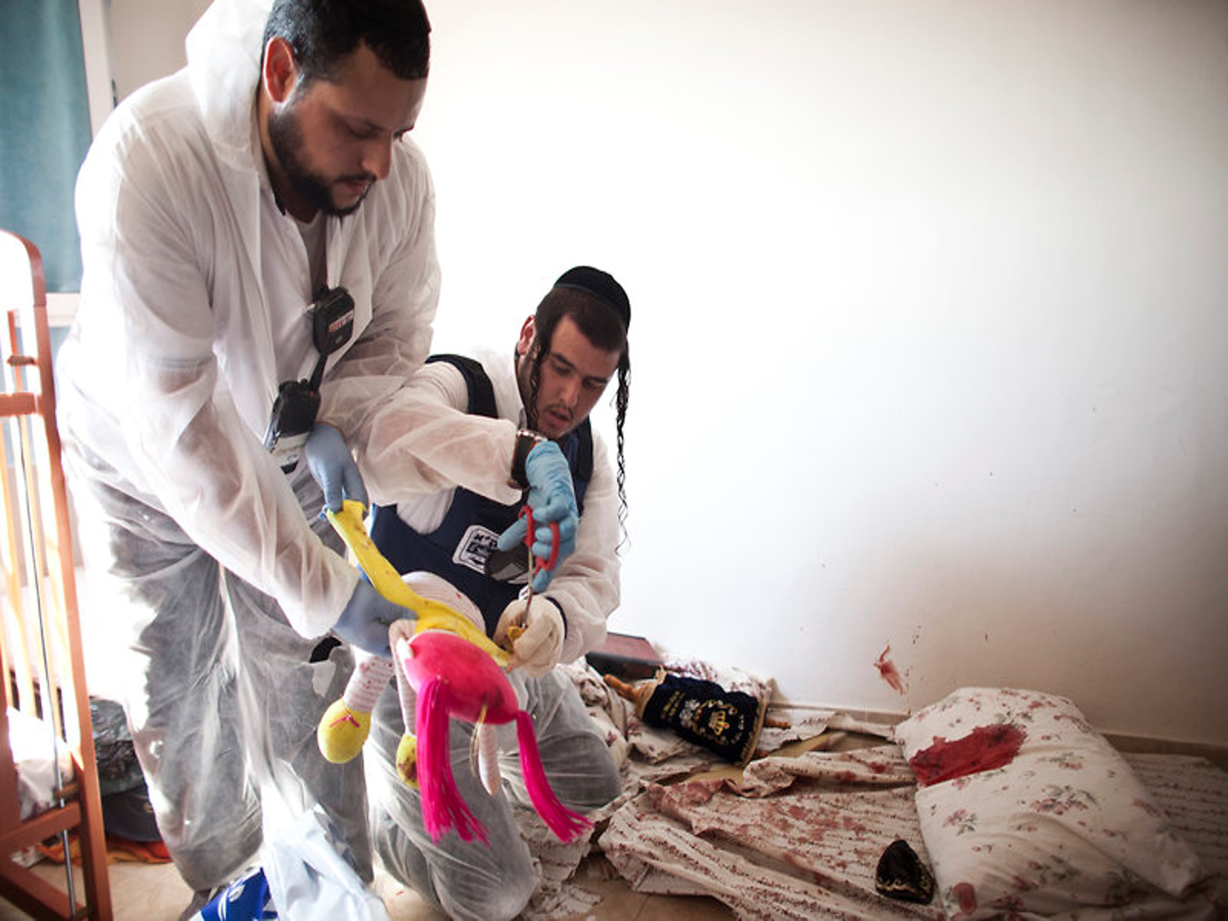
Characteristics of Adversity

Slide 94
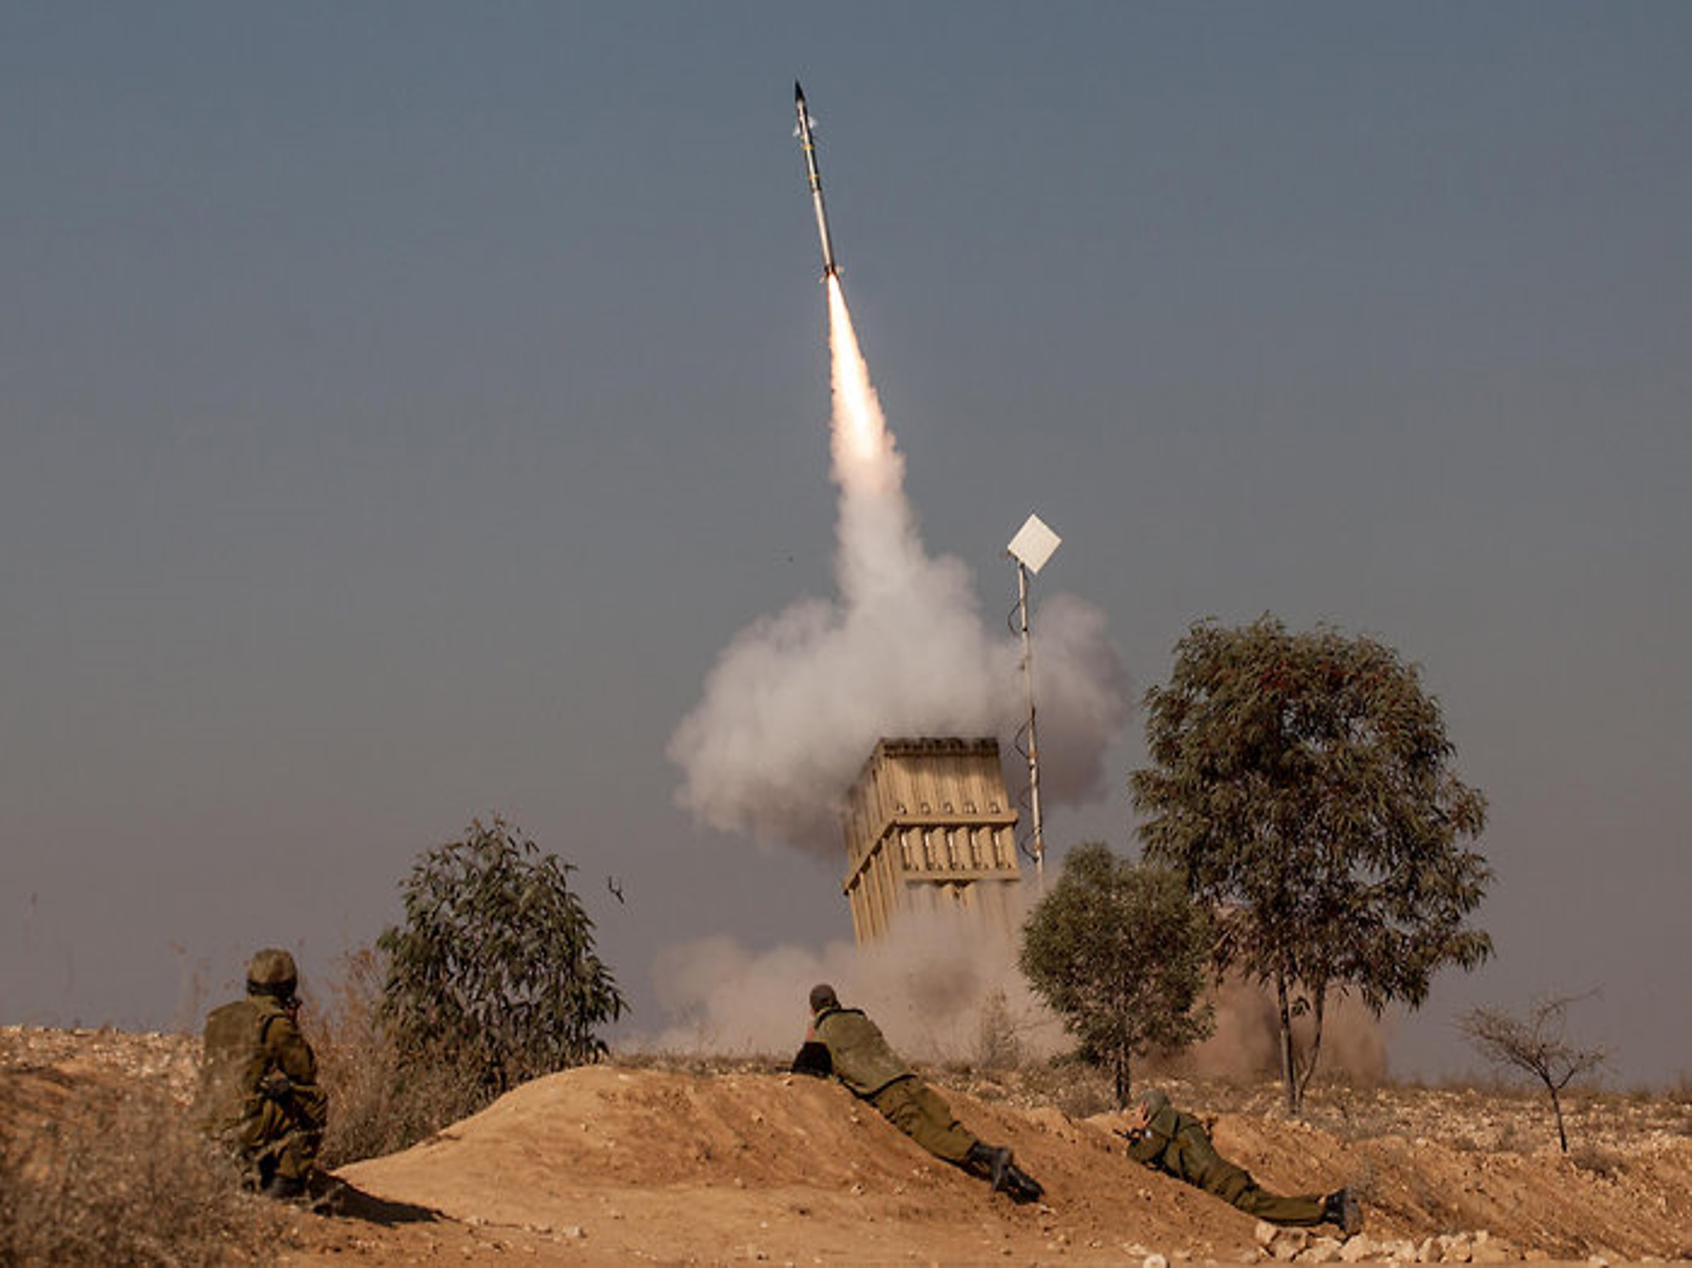
1. Adversity is Universal

Slide 95
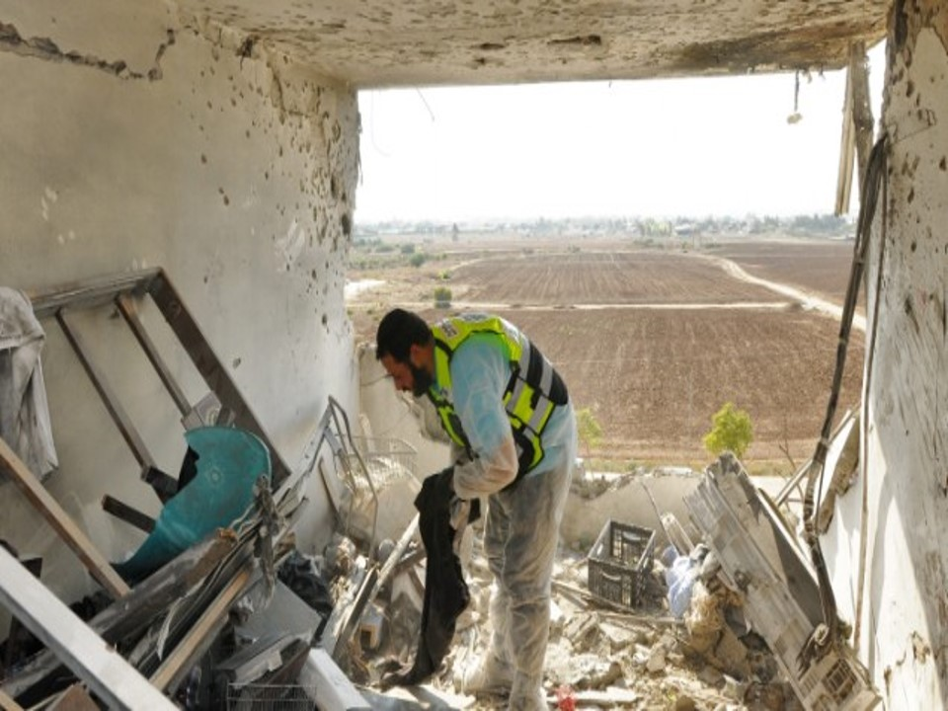
2. It’s Impartial

Slide 96
Let’s look at our Nation

Slide 97
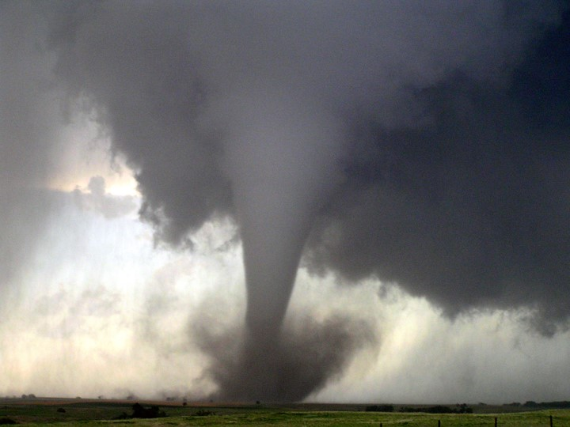
4. Sometimes Adversity comes Suddenly

Slide 98
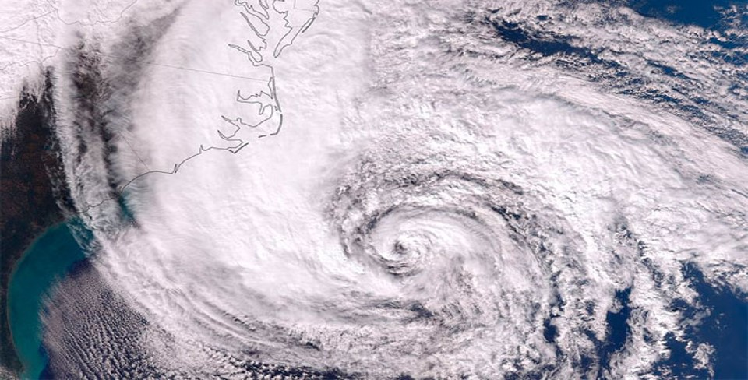
5. Times of Adversity may be Prolonged

Slide 99
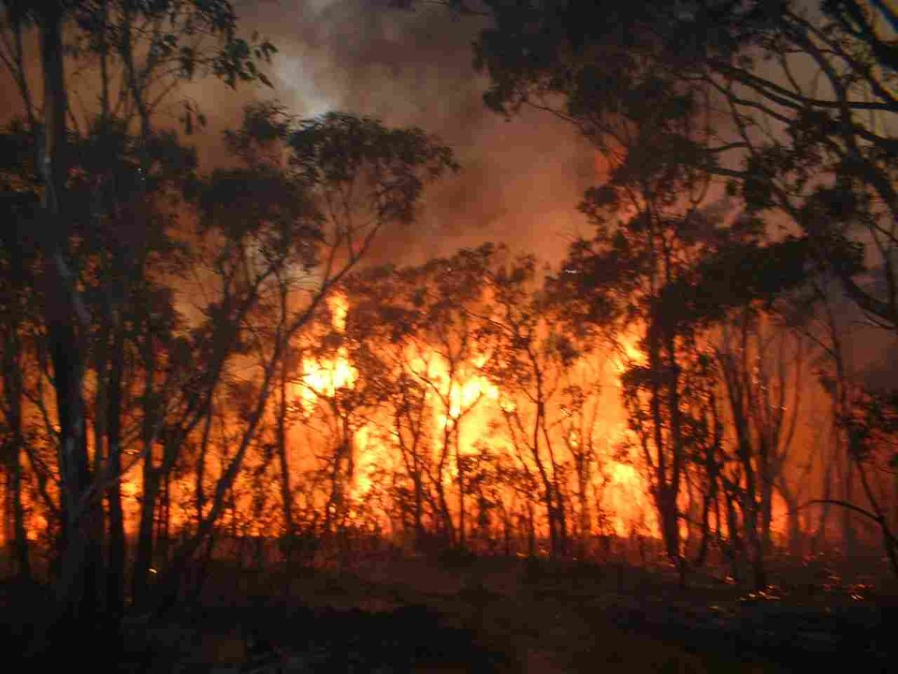
6. It may be so Intense

Slide 100
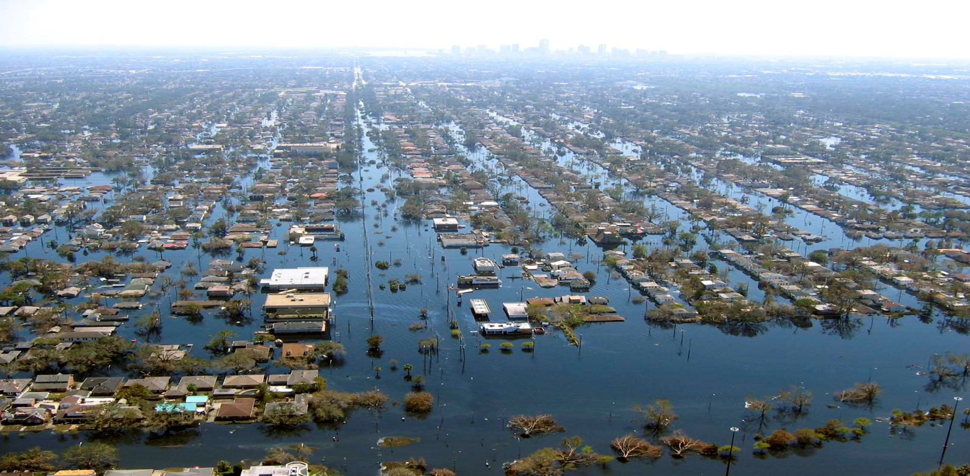
7. Adversity is often beyond our Control

Slide 101
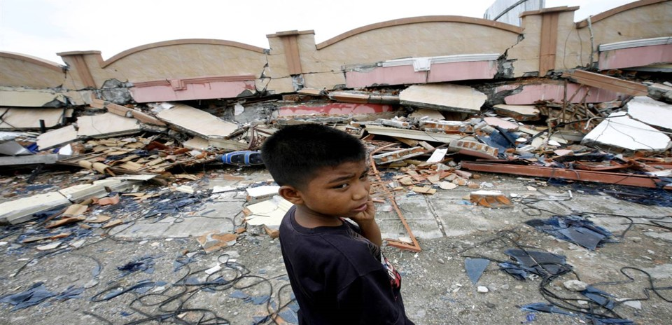
We Sometimes Need to ask Questions Regarding Adversity

Slide 102
Joshua 1:9
“Be strong and courageous! Do not tremble or be dismayed, for the LORD your God is with you wherever you go”

Slide 103
Why did Joshua need Courage?

Slide 104
Joshua 1:5
“Just as I have been with Moses, I will be with you; I will not fail you or forsake you. 6 Be strong and courageous, for you shall give this people possession of the land which I swore to their fathers to give them”

Slide 105
Joshua 1:8-9
8 This Book of the Law shall not depart from your mouth, but you shall meditate in it day and night, that you may observe to do according to all that is written in it. For then you will make your way prosperous, and then you will have good success.

Slide 106
9 Have I not commanded you? Be strong and of good courage; do not be afraid, nor be dismayed, for the LORD your God is with you wherever you go."

Slide 107
What did God command Joshua about being courageous?

Slide 108
Joshua 1:6-8, 9
6 Be strong and of good courage, for to this people you shall divide as an inheritance the land which I swore to their fathers to give them. 7 Only be strong and very courageous, that you may observe to do according to all the law which Moses My servant commanded you; do not turn from it to the right hand or to the left, that you may prosper wherever you go.

Slide 109
9 Have I not commanded you? Be strong and of good courage; do not be afraid, nor be dismayed, for the LORD your God is with you wherever you go."

Slide 110
What is the reason for such repetition?

Slide 111
God also told Joshua to obey the
law of Moses:

Slide 112
Joshua 1:7
7 Only be strong and very courageous, that you may observe to do according to all the law which Moses My servant commanded you; do not turn from it to the right hand or to the left, that you may prosper wherever you go.

Slide 113
2 Timothy 3:16-17
16 All Scripture is given by inspiration of God, and is profitable for doctrine, for reproof, for correction, for instruction in righteousness, 17 that the man of God may be complete, thoroughly equipped for every good work.

Slide 114
Joshua 1:5
5 No man shall be able to stand before you all the days of your life; as I was with Moses, so I will be with you. I will not leave you nor forsake you.

Slide 115
John 14:16-20
16 And I will pray the Father, and He will give you another Helper, that He may abide with you forever-- 17 the Spirit of truth, whom the world cannot receive, because it neither sees Him nor knows Him; but you know Him, for He dwells with you and will be in you. 18 I will not leave you orphans; I will come to you.

Slide 116
19 "A little while longer and the world will see Me no more, but you will see Me. Because I live, you will live also. 20 At that day you will know that I am in My Father, and you in Me, and I in you.

Slide 117
Hebrews 13:5
Let your conduct be without covetousness; be content with such things as you have. For He Himself has said, "I will never leave you nor forsake you."

Slide 118
What can we do to develop courage?

Slide 119
Meditate on God’s Word

Slide 120
Joshua 1:8
8 This Book of the Law shall not depart from your mouth, but you shall meditate in it day and night, that you may observe to do according to all that is written in it. For then you will make your way prosperous, and then you will have good success.

Slide 121
1. Quiet Your Spirit

Slide 122
Psalm 46:10-11
10 Be still, and know that I am God; I will be exalted among the nations, I will be exalted in the earth! 11 The LORD of hosts is with us; The God of Jacob is our refuge.

Slide 123
2. Sharpen Your Perception

Slide 124
Psalm 119:105
“Your word is a lamp to my feet and a light to my path.”

Slide 125
1 Corinthians 2:14-16
14 But the natural man does not receive the things of the Spirit of God, for they are foolishness to him; nor can he know them, because they are spiritually discerned. 15 But he who is spiritual judges all things, yet he himself is rightly judged by no one. 16 For "who has known the mind of the LORD that he may instruct Him?" But we have the mind of Christ.

Slide 126
3. Purify Your Heart

Slide 127
Hebrews 4:12-13
12 For the word of God is living and powerful, and sharper than any two-edged sword, piercing even to the division of soul and spirit, and of joints and marrow, and is a discerner of the thoughts and intents of the heart. 13 And there is no creature hidden from His sight, but all things are naked and open to the eyes of Him to whom we must give account.

Slide 128
4. Clarify your direction.

Slide 129
Proverbs 3:5-6
“Trust in the LORD with all your heart, and lean not on your own understanding; in all your ways acknowledge Him, and He shall direct your paths”

Slide 130
5. Recall God’s Faithfulness in Your Life

Slide 131
Ephesians 2:11-13
11 Therefore remember that you, once Gentiles in the flesh--who are called Uncircumcision by what is called the Circumcision made in the flesh by hands—

Slide 132
12 that at that time you were without Christ, being aliens from the commonwealth of Israel and strangers from the covenants of promise, having no hope and without God in the world. 13 But now in Christ Jesus you who once were far off have been brought near by the blood of Christ.

Slide 133
6. Observe the Courage of Others

Slide 134
Revelation 12:11
“And they overcame him by the blood of the Lamb and by the word of their testimony”

Slide 135
7. Ask the Critical Question

Slide 136
Galatians 6:6-8
6 Let him who is taught the word share in all good things with him who teaches. 7 Do not be deceived, God is not mocked; for whatever a man sows, that he will also reap. 8 For he who sows to his flesh will of the flesh reap corruption, but he who sows to the Spirit will of the Spirit reap everlasting life.

Slide 137
8. Recall His Promise to be with
Us at All Times

Slide 138
Isaiah 43:1-3
1 But now, thus says the LORD, who created you, O Jacob, And He who formed you, O Israel: "Fear not, for I have redeemed you; I have called you by your name; You are Mine.

Slide 139
2 When you pass through the waters, I will be with you; And through the rivers, they shall not overflow you. When you walk through the fire, you shall not be burned, Nor shall the flame scorch you. 3 For I am the LORD your God, The Holy One of Israel, your Savior…

Slide 140
1 Thessalonians 4:13-18
13 But I do not want you to be ignorant, brethren, concerning those who have fallen asleep, lest you sorrow as others who have no hope. 14 For if we believe that Jesus died and rose again, even so God will bring with Him those who sleep in Jesus.

Slide 141
15 For this we say to you by the word of the Lord, that we who are alive and remain until the coming of the Lord will by no means precede those who are asleep. 16 For the Lord Himself will descend from heaven with a shout, with the voice of an archangel, and with the trumpet of God. And the dead in Christ will rise first.

Slide 142
17 Then we who are alive and remain shall be caught up together with them in the clouds to meet the Lord in the air. And thus we shall always be with the Lord. 18 Therefore comfort one another with these words.

Slide 143
1 Corinthians 15:50-54
50 Now this I say, brethren, that flesh and blood cannot inherit the kingdom of God; nor does corruption inherit incorruption. 51 Behold, I tell you a mystery: We shall not all sleep, but we shall all be changed-- 52 in a moment, in the twinkling of an eye, at the last trumpet. For the trumpet will sound, and the dead will be raised incorruptible, and we shall be changed.

Slide 144
53 For this corruptible must put on incorruption, and this mortal must put on immortality. 54 So when this corruptible has put on incorruption, and this mortal has put on immortality, then shall be brought to pass the saying that is written: "Death is swallowed up in victory."

Slide 145

20 Again, when a righteous man turns from his righteousness and commits iniquity, and I lay a stumbling block before him, he shall die; because you did not give him warning, he shall die in his sin, and his righteousness which he has done shall not be remembered; but his blood I will require at your hand.

Slide 146
Acts 2:38-39
38 Then Peter said to them, "Repent, and let every one of you be baptized in the name of Jesus Christ for the remission of sins; and you shall receive the gift of the Holy Spirit. 39 For the promise is to you and to your children, and to all who are afar off, as many as the Lord our God will call."

Slide 147

Donate with our QR code app to
Amazing Grace Christian Fellowship
Donations are Deeply Appreciated!

