Slide 1


Slide 2
“Lion and the Lamb”
(Big Daddy Weave)

Slide 3
He’s coming on the clouds. Kings and Kingdoms will bow down. And every chain will break. As broken

Slide 4
Hearts declare his praise. For who can stop the Lord all mighty. And Our God is the lion. The Lion of Judah

Slide 5
He’s roaring with power.. And fighting our battles. And every knee will bow before him. Our God is

Slide 6
The Lamb. The Lamb that was slain. For the sins of the world. His blood breaks the chains. And every

Slide 7
Knee will bow before the Lion and the Lamb. Yes Every knee will bow before him. So open up the

Slide 8
Gates. Make way before the King of Kings. The God who comes to save. Is here to set the captives free.

Slide 9
For who can stop the Lord Almighty. Our God is the Lion. The Lion of Judah. He’s roaring with power

Slide 10
And fighting our battles. Every knee will bow before him. Our God is the lamb. The lamb that was slain.

Slide 11
For the sins of the world his blood breaks the chains. And every knee will bow before the Lion and the

Slide 12
The Lamb. Every knee will bow before him. For who can stop the Lord almighty. Who can stop the Lord

Slide 13
Almighty. Who can stop the Lord Almighty. No One.
Who can stop the Lord almighty. Who can stop the

Slide 14
Lord almighty. Who can stop the Lord almighty. Who can stop the Lord. And Our God is the Lion. The

Slide 15
Lion of Judah. He’s roaring with power and fighting our battles. Every knee will bow before him.

Slide 16
Our God is the Lamb. The lamb that was slain. For the sins of the world. His blood breaks the chains

Slide 17
And every knee will bow before the Lion ans the Lamb. Every knee will bow before him.

Slide 18
“ What a Beautiful Name”
(Hillsong)

Slide 19
You were the word at the beginning. One with God the Lord most high. Your hidden glory in creation.

Slide 20
Now revealed in you are Christ. What a beautiful name it is. What a beautiful name it is. The name of

Slide 21
Jesus Christ my king. What a beautiful name it is. Nothing compares to this. What a beautiful name it

Slide 22
is the name of Jesus. You didn’t want heaven without us. So Jesus, You brought heaven down.

Slide 23
My sin was great your love was greater. What could separate us now? What a wonderful name it is

Slide 24
what a wonderful name it is. The name of Jesus Christ my King. What a wonderful name it is

Slide 25
Nothing compares to this. What a wonderful name it is. The name of Jesus. Death could not hold you.

Slide 26
The veil tore before you, you silenced the boast of sin and grave. The heavens are roaring the praise

Slide 27
of your glory. For you are raised to life again. You have no rival. You have no equal. Now and forever

Slide 28
god you reign. Yours is the kingdom. Yours is the glory. Yours is the name above all names. What a

Slide 29
powerful name it is. What a powerful name it is. The name of Jesus Christ my king. What a powerful

Slide 30
name it is nothing cn stand against. What a powerful name it is. The name of Jesus. What a powerful

Slide 31
name it is. The name of Jesus.

Slide 32
“Great Are You Lord”
(All Sons & Daughters)

Slide 33
You give life, You are love You bring light to the darkness You give hope, You restore Every heart

Slide 34
that is broken And great are You, Lord It's Your breath in our lungs So we pour out our praise

Slide 35
We pour out our praise It's Your breath in our lungs So we pour out our praise to You only You give life,

Slide 36
You are love You bring light to the darkness You give hope, You restore (You restore) Every heart that

Slide 37
is broken And great are You, Lord It's Your breath in our lungs So we pour out our praise We pour out our

Slide 38
praise It's Your breath in our lungs So we pour out our praise to You only It's Your breath in our lungs

Slide 39
So we pour out our praise We pour out our praise It's Your breath in our lungs So we pour out our praise to

Slide 40
You only And all the earth will shout Your praise Our hearts will cry, these bones will sing Great are You,

Slide 41
Lord And all the earth will shout Your praise Our hearts will cry, these bones will sing Great are You,

Slide 42
Lord And all the earth will shout Your praise Our hearts will cry, these bones will say Great are You,

Slide 43
Lord It's Your breath in our lungs So we pour out our praise We pour out our praise It's Your breath in our

Slide 44
lungs So we pour out our praise to You only It's Your breath in our lungs So we pour out our praise We

Slide 45
pour out our praise It's Your breath in our lungs So we pour out our praise to You only

Slide 46
Nothing Else
(Cody Carnes)

Slide 47
wanna leave Oh, I'm not here for blessings Jesus, You don't owe me anything More than anything that

Slide 48
You can do I just want You I'm sorry when I've just gone through the motions I'm sorry when I just sang

Slide 49
another song Take me back to where we started I open up my heart to You I'm sorry when I've come

Slide 50
with my agenda I'm sorry when I forgot that You're enough Take me back to where we started I open up

Slide 51
my heart to You I'm caught up in Your presence I just want to sit here at Your feet I'm caught up in this holy

Slide 52
moment I never wanna leave Oh, I'm not here for blessings Jesus, You don't owe me anything And

Slide 53
more than anything that You can do I just want You
I just want You Nothing else, nothing else Nothing

Slide 54
else will do I just want You Nothing else, nothing else
Nothing else will do I just want You Nothing else,

Slide 55
nothing else Nothing else will do I just want You Nothing else, nothing else, Jesus Nothing else will do

Slide 56
I just want You Nothing else, nothing else Nothing else will do I just want You Nothing else, nothing

Slide 57
else, Jesus Nothing else will do I'm coming back to where we started I'm coming back to where we

Slide 58
started When I first felt Your love You're all that matters, Jesus You're all that matters I'm coming

Slide 59
back to what really matters Just Your heart I just wanna bless Your heart, Jesus I'm caught up in

Slide 60
Your presence I just want to sit here at Your feet I'm caught up in this holy moment I never wanna leave

Slide 61
And oh, I'm not here for blessings Jesus, You don't owe me anything More than anything that You can

Slide 62
do Oh, I just want You

Slide 63
Give Me Faith
(Elevation Worship)

Slide 64
I need you to soften my heart And break me apart I need you to open my eyes To see that You’re

Slide 65
shaping my life All I am, I surrender Give me faith to trust what you say That you're good and your love is

Slide 66
great I'm broken inside, I give you my life I need you to soften my heart And break me apart I need you to

Slide 67
pierce through the dark And cleanse every part of me
All I am, I surrender Give me faith to trust what you

Slide 68
say That you're good and your love is great I'm broken inside, I give you my life 'Cause I may be

Slide 69
weak But Your spirit strong in me My flesh may fail
My God you never will I may be weak But Your spirit

Slide 70
strong in me My flesh may fail My God you never will
Give me faith to trust what you say That you're good

Slide 71
and your love is great I'm broken inside, I give you my life Give me faith to trust what you say That

Slide 72
you're good and your love is great I'm broken inside, I give you my life 'Cause I may be weak But Your

Slide 73
spirit strong in me My flesh may fail My God you never will I may be weak But Your spirit strong in me

Slide 74
My flesh may fail My God you never will.

Slide 76
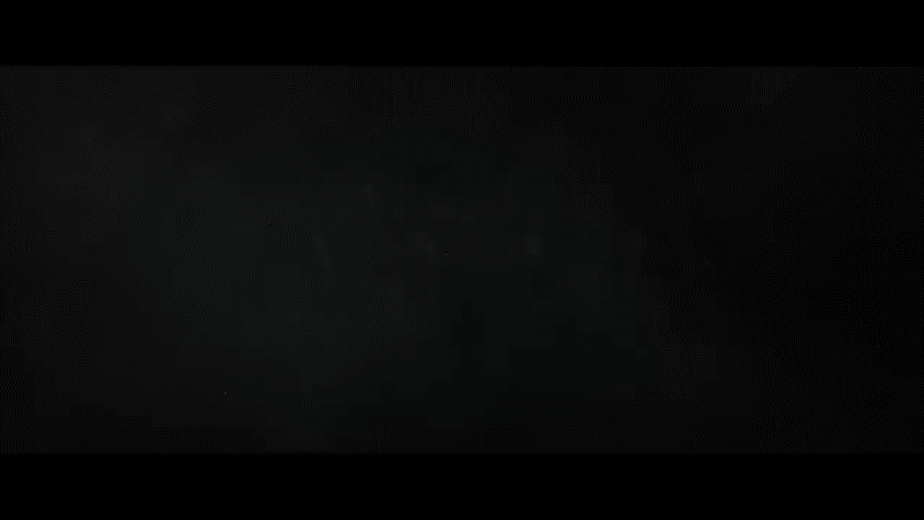

Slide 78


Slide 79

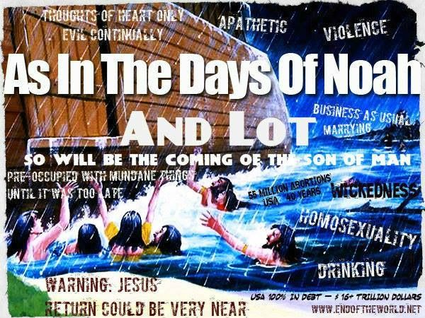
Just Like the Days of Noah & Lot
By Pastor Fee Soliven
Luke 17:26-30
Sunday Morning
March 3, 2024

Slide 80
Luke 17:26-30
26 And as it was in the days of Noah, so it will be also in the days of the Son of Man: 27 They ate, they drank, they married wives, they were given in marriage, until the day that Noah entered the ark, and the flood came and destroyed them all.

Slide 81
28 Likewise as it was also in the days of Lot: They ate, they drank, they bought, they sold, they planted, they built; 29 but on the day that Lot went out of Sodom it rained fire and brimstone from heaven and destroyed them all. 30 Even so will it be in the day when the Son of Man is revealed.

Slide 82
If there’s one story in the Bible most people know, it’s the one about Noah and the ark—even children’s books are written about it.

Slide 83
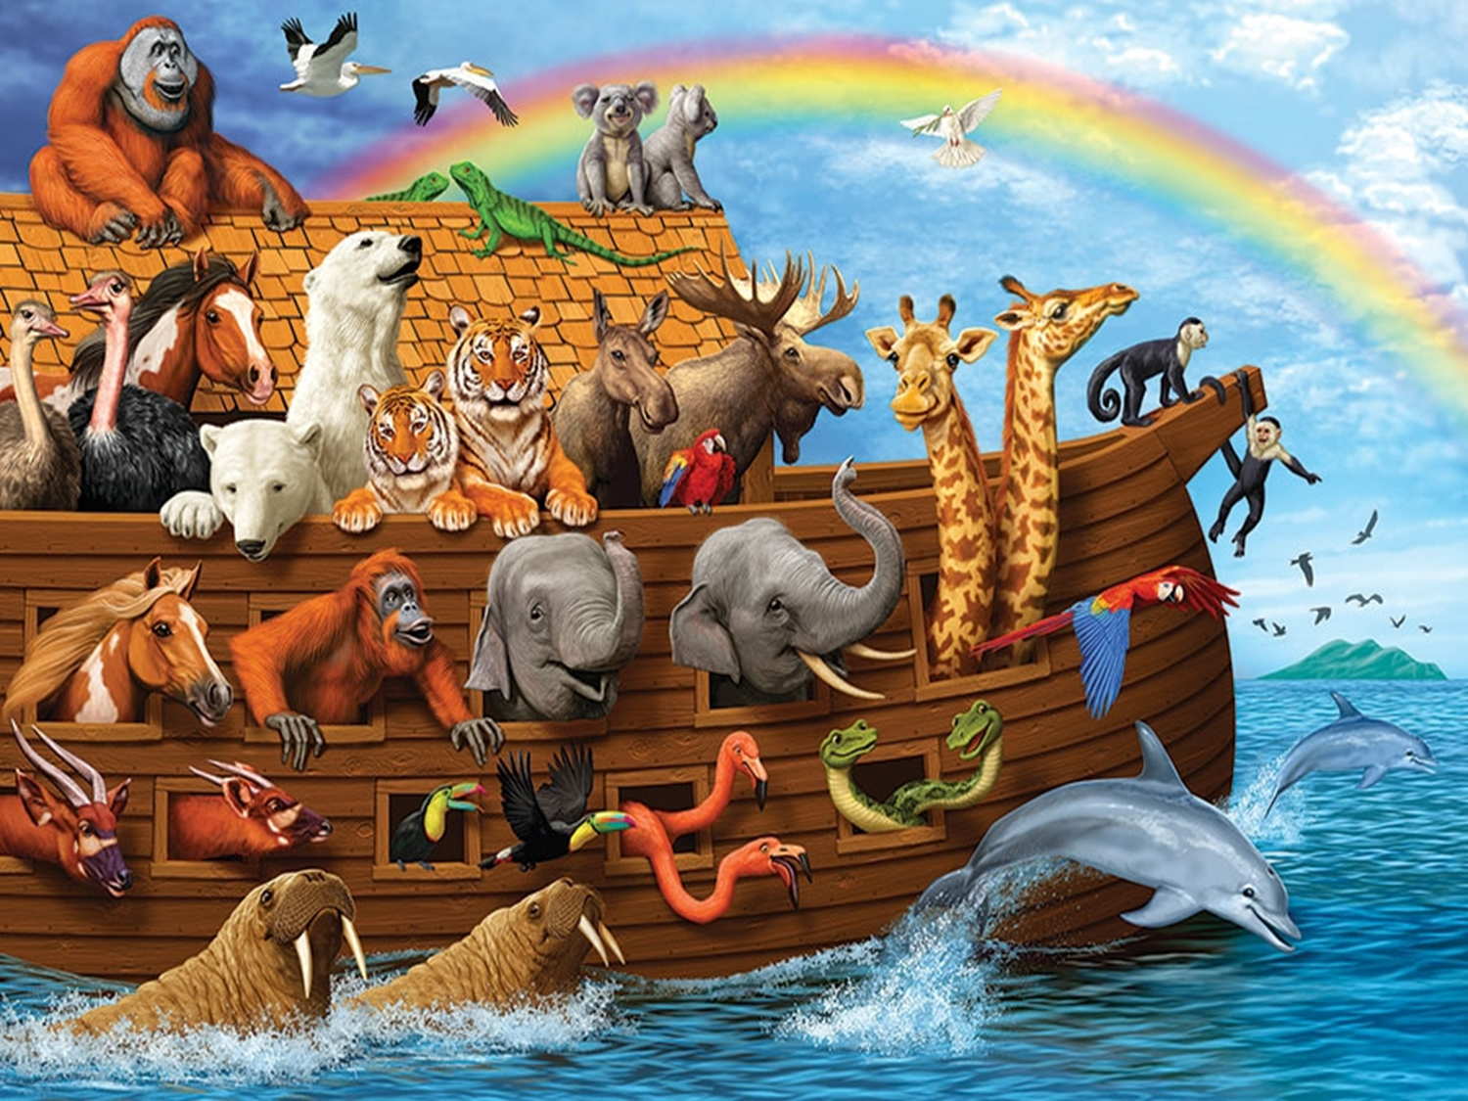
7 When He opened the fourth seal, I heard the voice of the fourth living creature saying, "Come and see." 8 So I looked, and behold, a pale horse. And the name of him who sat on it was Death, and Hades followed with him. And power was given to them over a fourth of the earth, to kill with sword, with hunger, with death, and by the beasts of the earth.

Slide 84
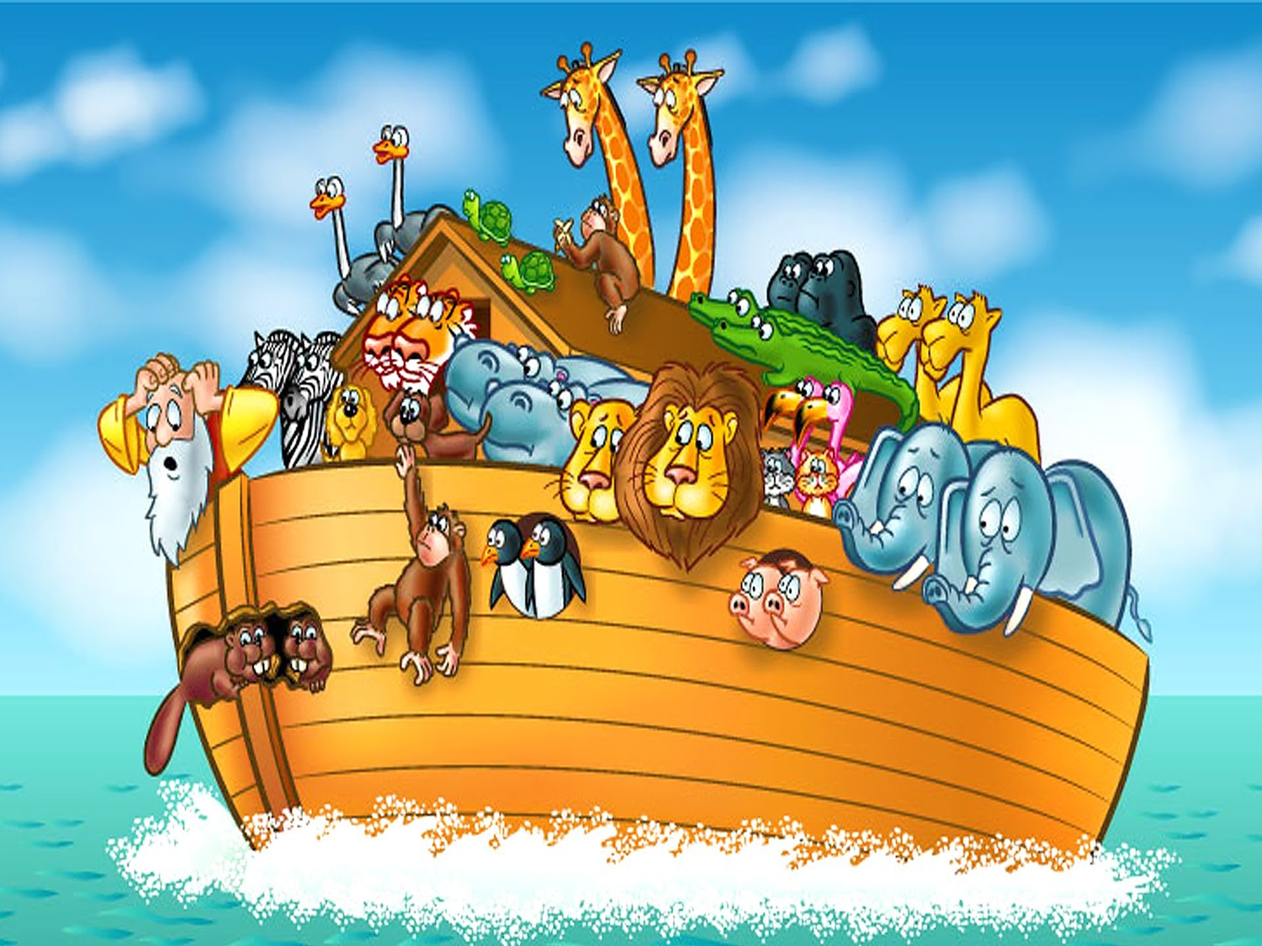
Daniel 12:1-4
1 "At that time Michael shall stand up, The great prince who stands watch over the sons of your people; And there shall be a time of trouble, Such as never was since there was a nation, Even to that time. And at that time your people shall be delivered, Every one who is found written in the book.

Slide 85
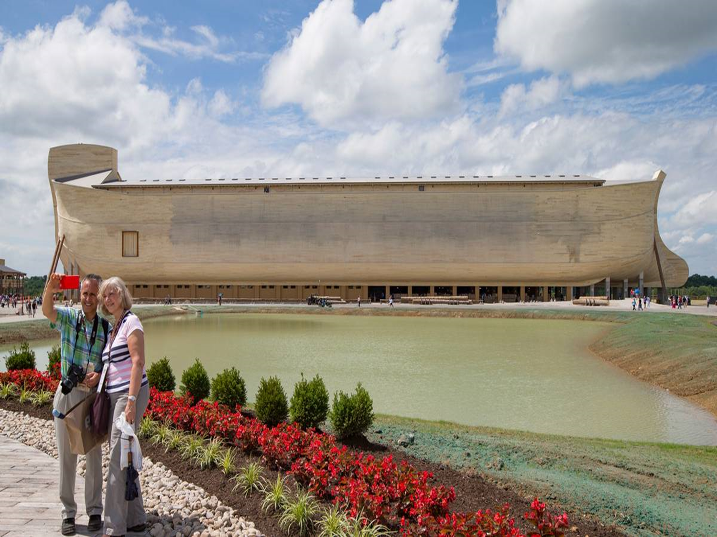
2 And many of those who sleep in the dust of the earth shall awake, Some to everlasting life, Some to shame and everlasting contempt. 3 Those who are wise shall shine Like the brightness of the firmament, And those who turn many to righteousness Like the stars forever and ever.

Slide 86
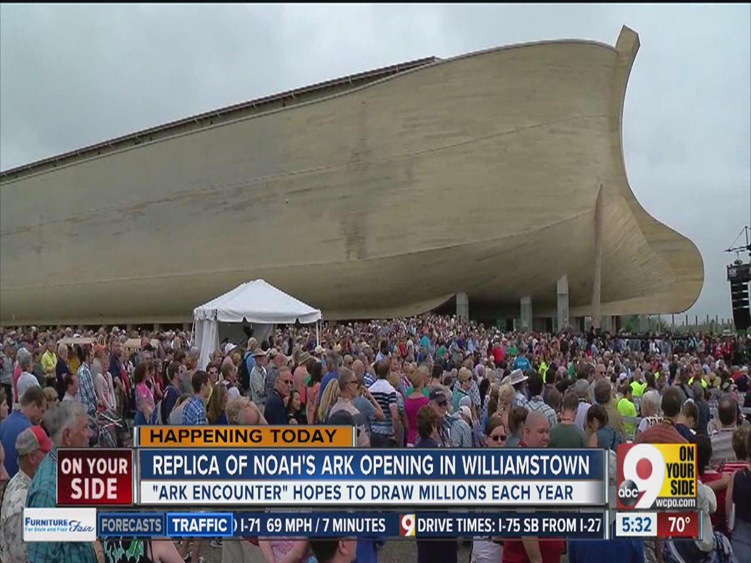
4 "But you, Daniel, shut up the words, and seal the book until the time of the end; many shall run to and fro, and knowledge shall increase."

Slide 87
Genesis 6:5-13
5 Then the LORD saw that the wickedness of man was great in the earth, and that every intent of the thoughts of his heart was only evil continually. 6 And the LORD was sorry that He had made man on the earth, and He was grieved in His heart.

Slide 88
7 So the LORD said, "I will destroy man whom I have created from the face of the earth, both man and beast, creeping thing and birds of the air, for I am sorry that I have made them." 8 But Noah found grace in the eyes of the LORD. 9 This is the genealogy of Noah. Noah was a just man, perfect in his generations. Noah walked with God.

Slide 89
10 And Noah begot three sons: Shem, Ham, and Japheth. 11 The earth also was corrupt before God, and the earth was filled with violence. 12 So God looked upon the earth, and indeed it was corrupt; for all flesh had corrupted their way on the earth.

Slide 90
13 And God said to Noah, "The end of all flesh has come before Me, for the earth is filled with violence through them; and behold, I will destroy them with the earth.

Slide 91
The Character of Noah

Slide 92
Genesis 6:9
This is the genealogy of Noah. Noah was a just man, perfect in his generations. Noah walked with God.

Slide 93
Genesis 6:8
But Noah found grace in the eyes of the LORD.

Slide 94
Matthew 24:37-39
37 But as the days of Noah were, so also will the coming of the Son of Man be. 38 For as in the days before the flood, they were eating and drinking, marrying and giving in marriage, until the day that Noah entered the ark, 39 and did not know until the flood came and took them all away, so also will the coming of the Son of Man be.

Slide 95
The World in Noah’s Day

Slide 96
Genesis 6:5-6
“Then the Lord saw that the wickedness of man was great on the earth, and that every intent of the thoughts of his heart was only evil continually. The Lord was sorry that He had made man on the earth, and He was grieved in His heart.”

Slide 97
Genesis 6:13
"The end of all flesh has come before Me, for the earth is filled with violence through them; and behold, I will destroy them with the earth…

Slide 98
Genesis 1:31
“God saw all that He had made, and behold, it was very good”

Slide 99
What had happened?

Slide 100
The answer is sin!

Slide 101
Noah’s Assignment from God

Slide 102
Genesis 6:13-14
“Then God said to Noah, ‘The end of all flesh has come before Me; for the earth is filled with violence because of them; and behold, I am about to destroy them with the earth. Make for yourself an ark of gopher wood’”

Slide 103
The Flood

Slide 104
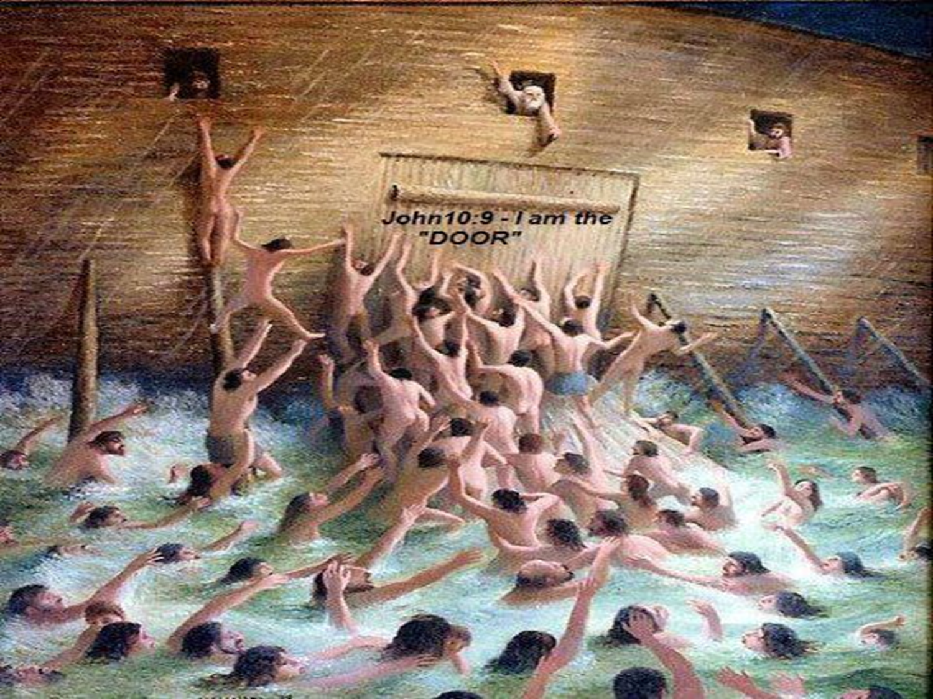
John 12:32
And I, if I am lifted up from the earth, will draw all peoples to Myself."

Slide 105
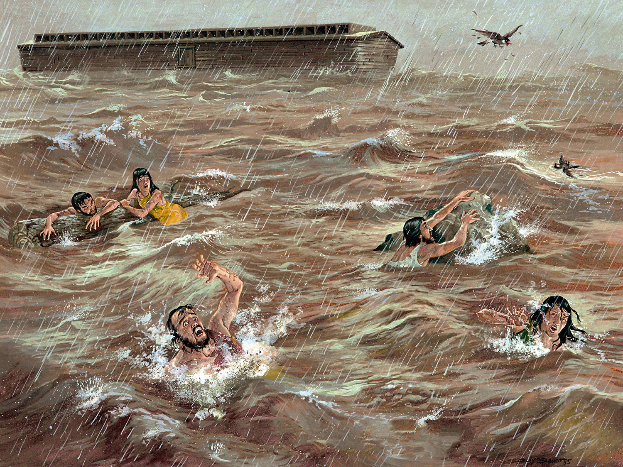
The Sins of the Catholic Church

Slide 106
The Days of Lot

Slide 107
The Marietta Times (West Virginia) February 23, 2024

Slide 108
Upon hearing the appalling news that Planned Parenthood was harvesting aborted baby organs for profit, I fought back tears, and thanked God for the two gifts of life He has given my husband and me!

Slide 109
I was, however, unsettled by the shocking number of babies aborted to date. What an unnecessary and tragic loss of silly giggles, clumsy hugs, sloppy kisses and tiny, innocent voices happily shouting, “I love you, mommy, daddy.”

Slide 110
The satanic Holocaust resulting in the death of six million Jews stunned the world. People were horrified! Yet, the deliberate deaths of nearly seventy million innocent babies have caused nothing more than muted protest across our nation!

Slide 111
How, I questioned, could we have fallen SO far from God? Then, recalling what the Bible tells us about the days of Noah and Lot, I had my answer. We are living in the last days!
Nancy Hamilton

Slide 112
Genesis 19:15-29
15 When the morning dawned, the angels urged Lot to hurry, saying, "Arise, take your wife and your two daughters who are here, lest you be consumed in the punishment of the city." 16 And while he lingered, the men took hold of his hand, his wife's hand, and the hands of his two daughters, the LORD being merciful to him, and they brought him out and set him outside the city.

Slide 113
17 So it came to pass, when they had brought them outside, that he said, "Escape for your life! Do not look behind you nor stay anywhere in the plain. Escape to the mountains, lest you be destroyed." 18 Then Lot said to them, "Please, no, my lords! 19 Indeed now, your servant has found favor in your sight, and you have increased your mercy which you have shown me by saving my life; but I cannot escape to the mountains, lest some evil overtake me and I die.

Slide 114
20 See now, this city is near enough to flee to, and it is a little one; please let me escape there (is it not a little one?) and my soul shall live." 21 And he said to him, "See, I have favored you concerning this thing also, in that I will not overthrow this city for which you have spoken. 22 Hurry, escape there. For I cannot do anything until you arrive there." Therefore the name of the city was called Zoar.

Slide 115
23 The sun had risen upon the earth when Lot entered Zoar. 24 Then the LORD rained brimstone and fire on Sodom and Gomorrah, from the LORD out of the heavens. 25 So He overthrew those cities, all the plain, all the inhabitants of the cities, and what grew on the ground. 26 But his wife looked back behind him, and she became a pillar of salt.

Slide 116
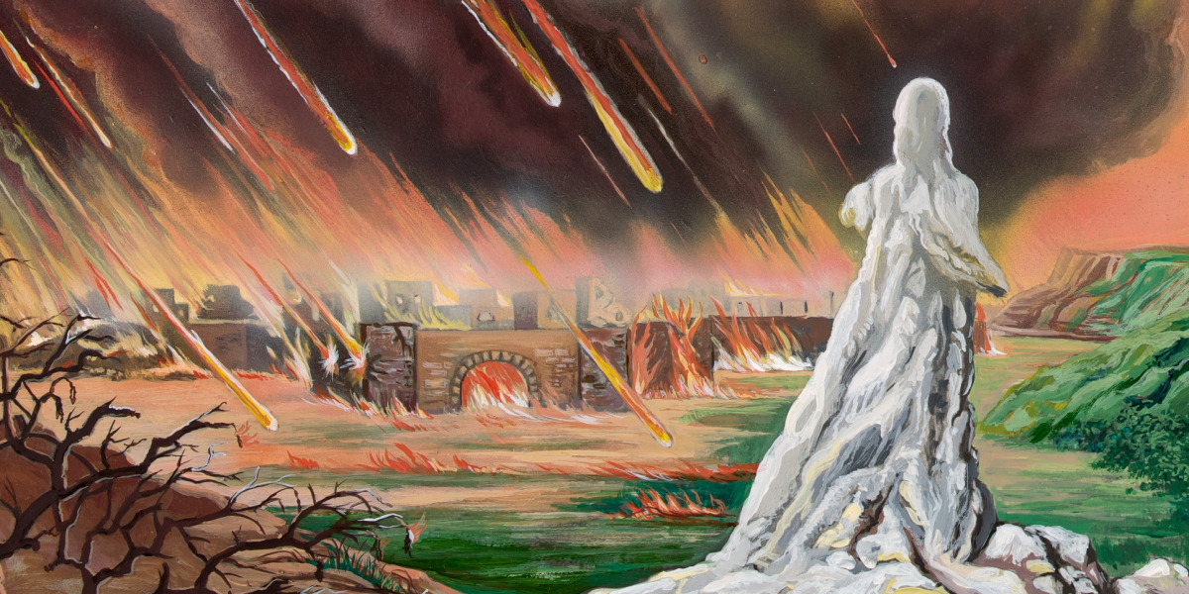

Slide 117
27 And Abraham went early in the morning to the place where he had stood before the LORD. 28 Then he looked toward Sodom and Gomorrah, and toward all the land of the plain; and he saw, and behold, the smoke of the land which went up like the smoke of a furnace.

Slide 118
29 And it came to pass, when God destroyed the cities of the plain, that God remembered Abraham, and sent Lot out of the midst of the overthrow, when He overthrew the cities in which Lot had dwelt.

Slide 119
Revelation 12:7-17
7 And war broke out in heaven: Michael and his angels fought with the dragon; and the dragon and his angels fought, 8 but they did not prevail, nor was a place found for them in heaven any longer. 9 So the great dragon was cast out, that serpent of old, called the Devil and Satan, who deceives the whole world; he was cast to the earth, and his angels were cast out with him.

Slide 120
10 Then I heard a loud voice saying in heaven, "Now salvation, and strength, and the kingdom of our God, and the power of His Christ have come, for the accuser of our brethren, who accused them before our God day and night, has been cast down. 11 And they overcame him by the blood of the Lamb and by the word of their testimony, and they did not love their lives to the death.

Slide 121
12 Therefore rejoice, O heavens, and you who dwell in them! Woe to the inhabitants of the earth and the sea! For the devil has come down to you, having great wrath, because he knows that he has a short time." 13 Now when the dragon saw that he had been cast to the earth, he persecuted the woman who gave birth to the male Child.

Slide 122
14 But the woman was given two wings of a great eagle, that she might fly into the wilderness to her place, where she is nourished for a time and times and half a time, from the presence of the serpent. 15 So the serpent spewed water out of his mouth like a flood after the woman, that he might cause her to be carried away by the flood.

Slide 123
16 But the earth helped the woman, and the earth opened its mouth and swallowed up the flood which the dragon had spewed out of his mouth. 17 And the dragon was enraged with the woman, and he went to make war with the rest of her offspring, who keep the commandments of God and have the testimony of Jesus Christ.

Slide 124
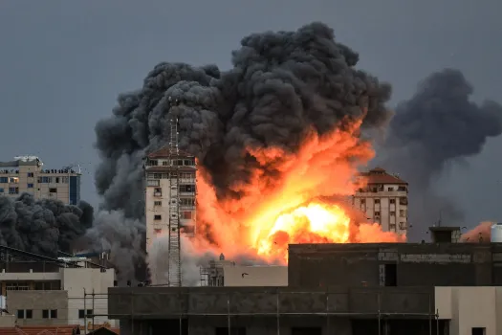
Anxiety

Slide 125
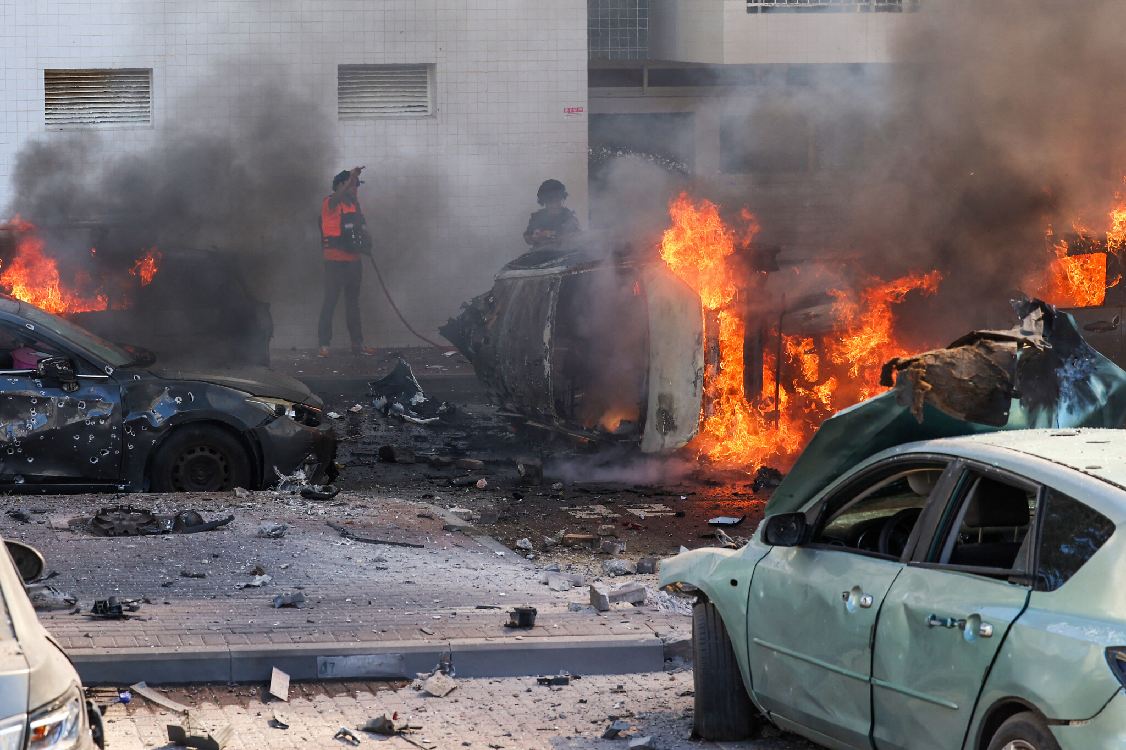
Can also be defined as “dread, apprehension, and uncertainty” and can be caused by past events, present situations, or future possibilities.

Slide 126
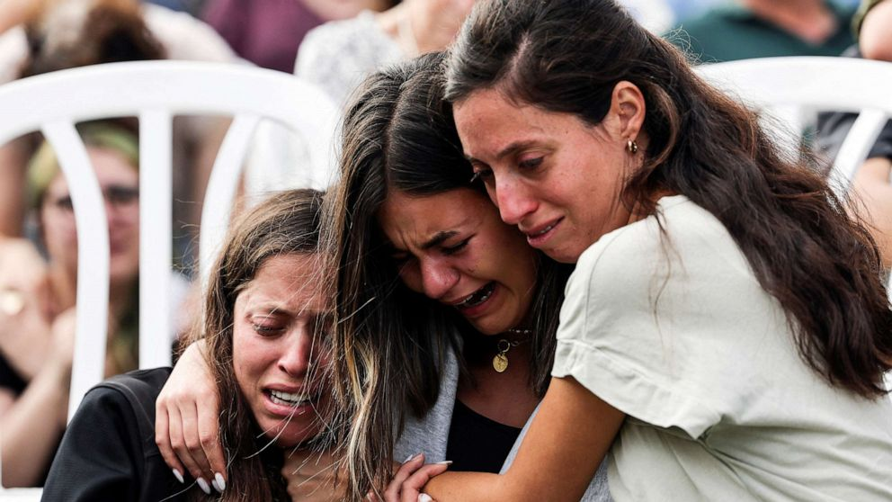
What are the sources of anxiety?

Slide 127

Communist Dictators

Slide 128
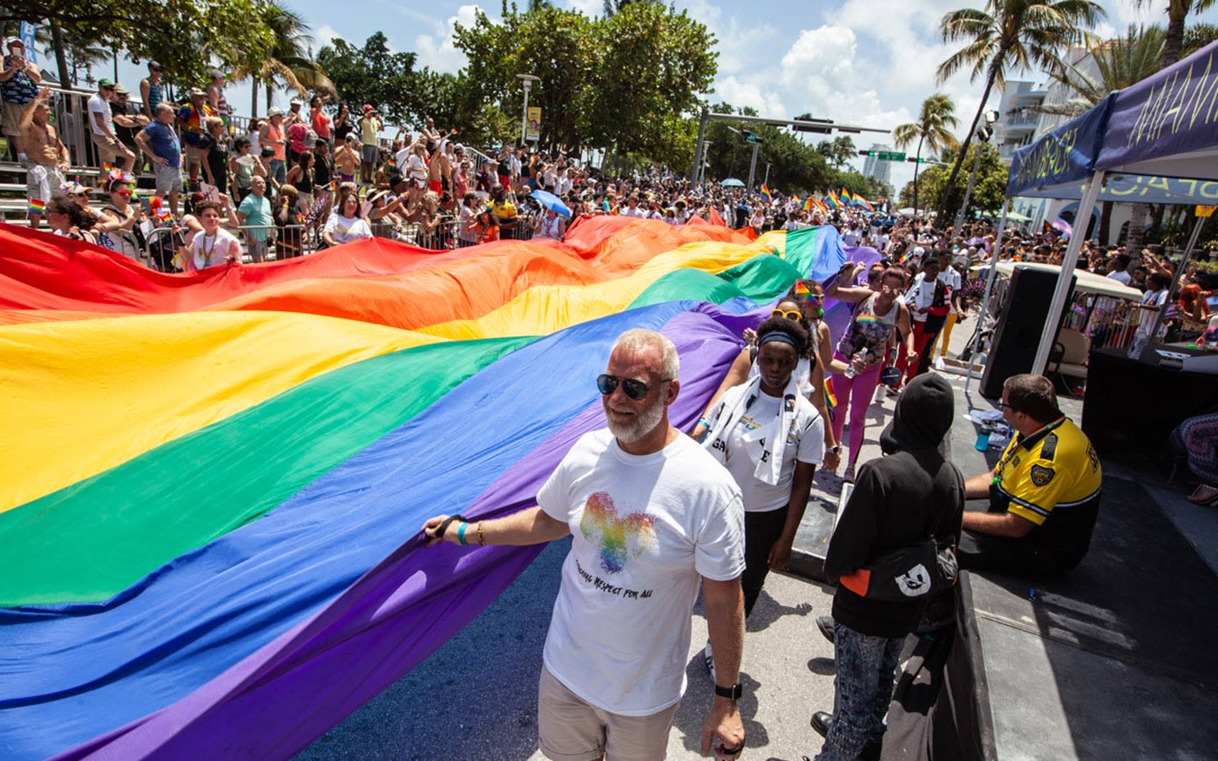
Matthew 6:25-34
25 "Therefore I say to you, do not worry about your life, what you will eat or what you will drink; nor about your body, what you will put on. Is not life more than food and the body more than clothing?

Slide 129

26 Look at the birds of the air, for they neither sow nor reap nor gather into barns; yet your heavenly Father feeds them. Are you not of more value than they? 27 Which of you by worrying can add one cubit to his stature? 28 So why do you worry about clothing? Consider the lilies of the field, how they grow: they neither toil nor spin;

Slide 130
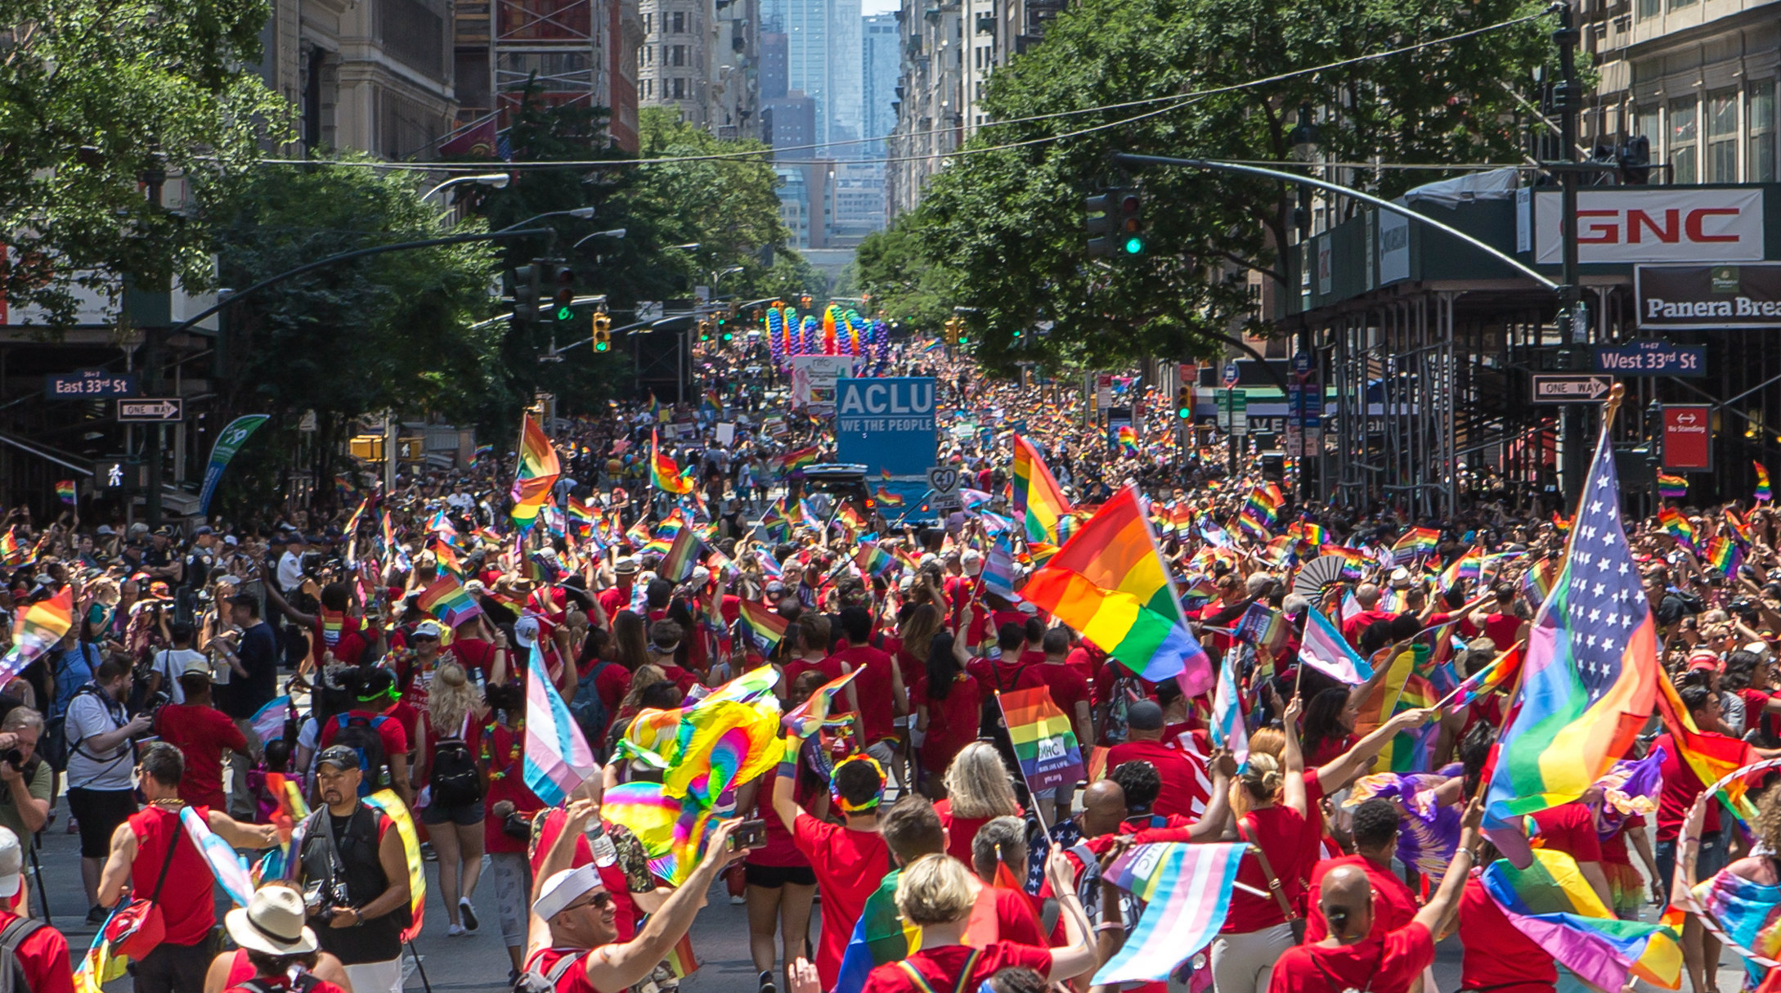

Slide 131
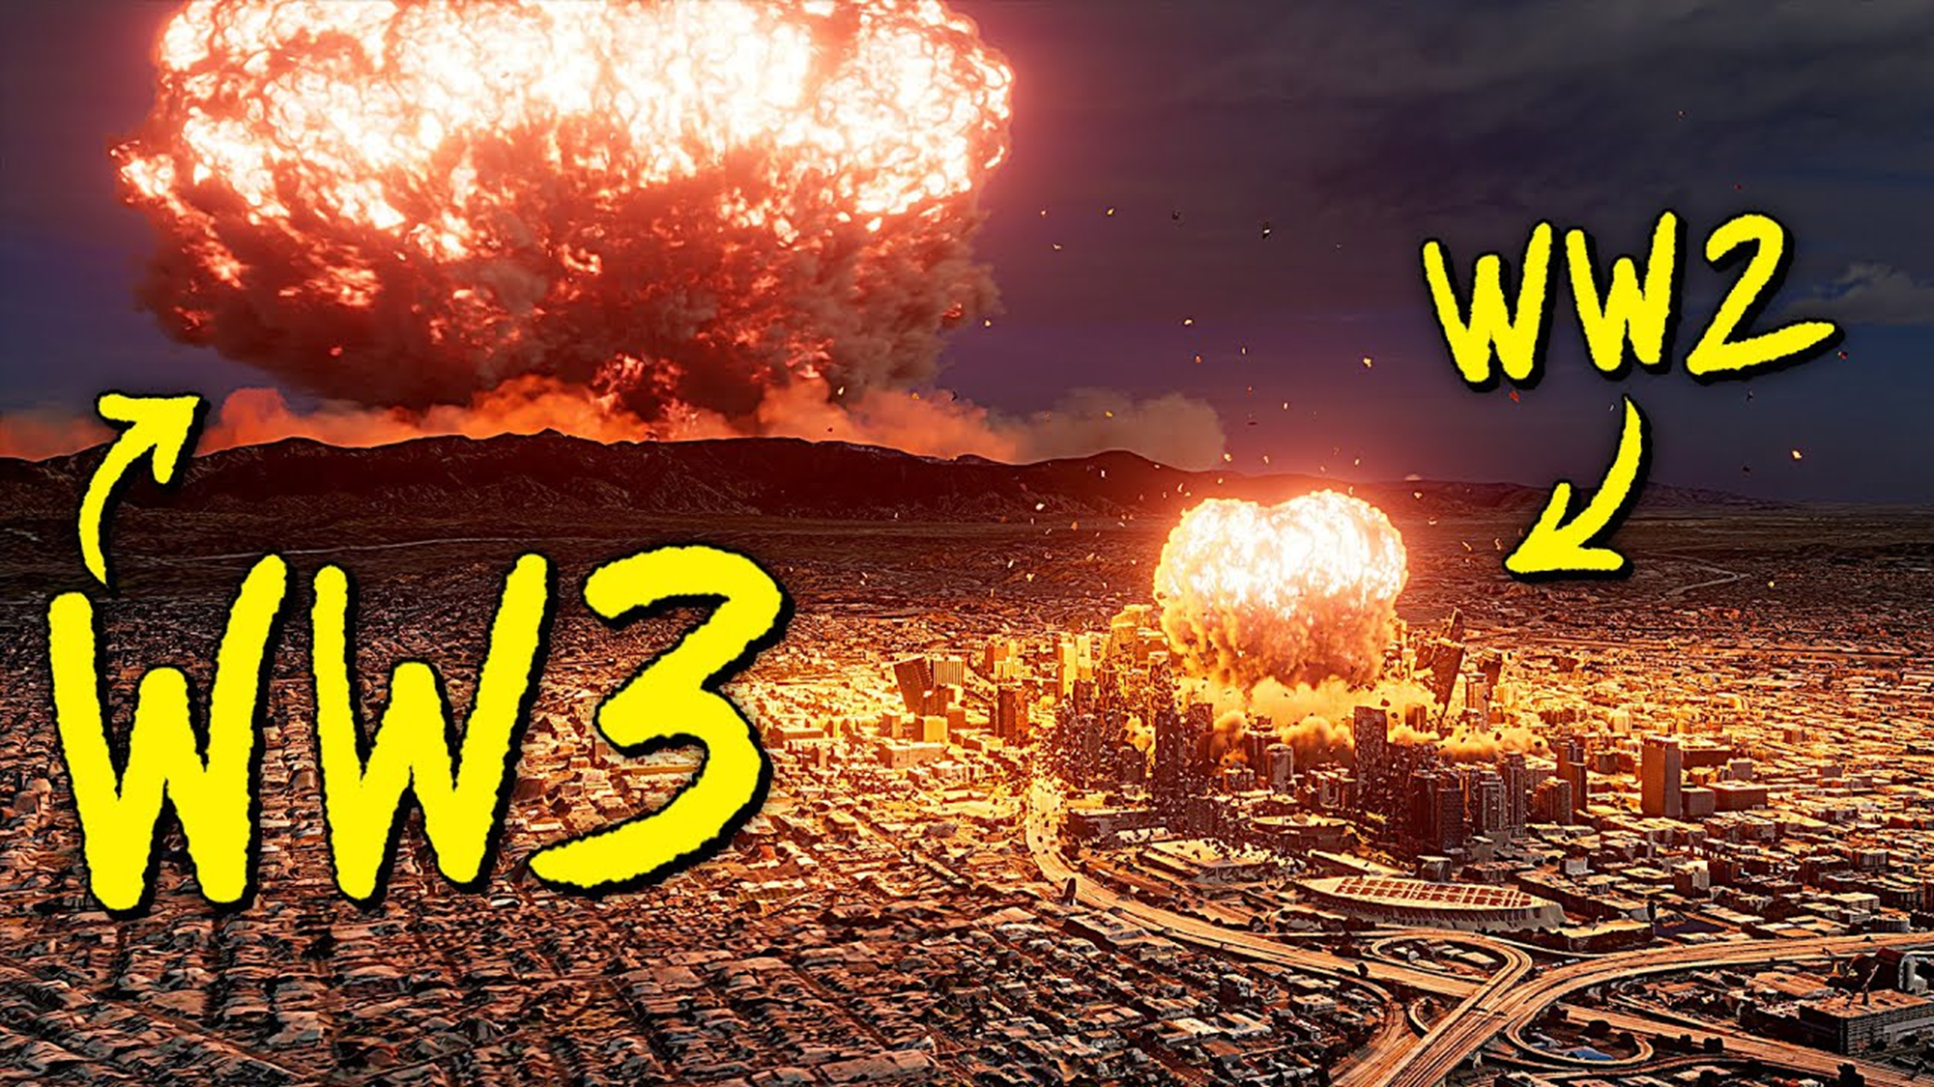

Slide 132
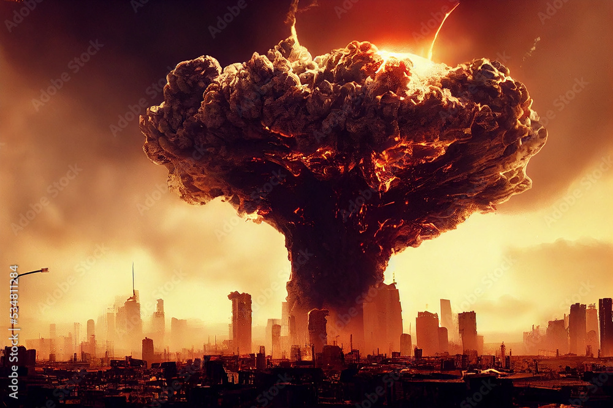

Slide 133
I Thessalonians 4:16-17
16 For the Lord Himself will descend from heaven with a shout, with the voice of an archangel, and with the trumpet of God. And the dead in Christ will rise first. 17 Then we who are alive and remain shall be caught up together with them in the clouds to meet the Lord in the air. And thus we shall always be with the Lord.

Slide 134
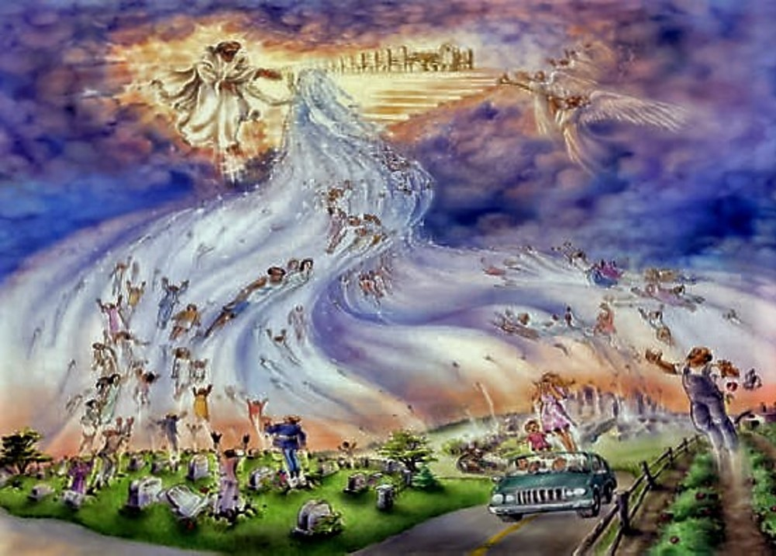
1. Legitimate Causes

Slide 135

1. Legitimate Causes

Slide 136
1 Thessalonians 4:13-18
13 But I do not want you to be ignorant, brethren, concerning those who have fallen asleep, lest you sorrow as others who have no hope. 14 For if we believe that Jesus died and rose again, even so God will bring with Him those who sleep in Jesus.

Slide 137
15 For this we say to you by the word of the Lord, that we who are alive and remain until the coming of the Lord will by no means precede those who are asleep. 16 For the Lord Himself will descend from heaven with a shout, with the voice of an archangel, and with the trumpet of God. And the dead in Christ will rise first.

Slide 138
17 Then we who are alive and remain shall be caught up together with them in the clouds to meet the Lord in the air. And thus we shall always be with the Lord. 18 Therefore comfort one another with these words.

Slide 139
1 Corinthians 15:50-54
50 Now this I say, brethren, that flesh and blood cannot inherit the kingdom of God; nor does corruption inherit incorruption. 51 Behold, I tell you a mystery: We shall not all sleep, but we shall all be changed-- 52 in a moment, in the twinkling of an eye, at the last trumpet. For the trumpet will sound, and the dead will be raised incorruptible, and we shall be changed.

Slide 140
53 For this corruptible must put on incorruption, and this mortal must put on immortality. 54 So when this corruptible has put on incorruption, and this mortal has put on immortality, then shall be brought to pass the saying that is written: "Death is swallowed up in victory."

Slide 141

20 Again, when a righteous man turns from his righteousness and commits iniquity, and I lay a stumbling block before him, he shall die; because you did not give him warning, he shall die in his sin, and his righteousness which he has done shall not be remembered; but his blood I will require at your hand.

Slide 142
Acts 2:38-39
38 Then Peter said to them, "Repent, and let every one of you be baptized in the name of Jesus Christ for the remission of sins; and you shall receive the gift of the Holy Spirit. 39 For the promise is to you and to your children, and to all who are afar off, as many as the Lord our God will call."

Slide 143

Donate with our QR code app to
Amazing Grace Christian Fellowship
Donations are Deeply Appreciated!

