Slide 1


Slide 2
“Goodness of God”
(Bethel)

Slide 3
I love you Lord. For your mercy never fails me. All my days, I’ve been held in your hands. From the

Slide 4
moment when I wake up until I lay my head. Oh, I will sing of the goodness of God. And all my life you

Slide 5
have been faithful. And all my life you have been so so good. With every breath that I am able. Oh, I will

Slide 6
sing of the Goodness of God. I love your voice. You have led me through the fire. In darkest night. You

Slide 7
are close like no other. I’ve known you as a father. I’ve known you as a friend. And I have lived in the

Slide 8
Goodness of God. And all my life you have been faithful. All my life you have been so so good.

Slide 9
With every breath that I am able. Oh, I will sing of the goodness of God. You goodness is running after

Slide 10
It’s running after me. Your goodness is running after. It’s running after me. With my life laid down I

Slide 11
Surrender now I give you everything. Cause your goodness is running after. It’s running after me.

Slide 12
Cause your goodness is running after. It’s running after me. Your goodness is running after. It’s

Slide 13
Running after me. With my life laid down I surrender now. I give you everything. Cause your goodness is

Slide 14
Running after it’s running after me. And all my life you have been faithful. All my life you have been so

Slide 15
So good. With every breath that Iam able. I will sing of the goodness of God.

Slide 16
“I Surrender”
(Hillsong)

Slide 17
Here I am Down on my knees again Surrendering all
Surrendering all And find me here Lord as You draw

Slide 18
me near Desperate for You Desperate for You I surrender Drench my soul As mercy and grace

Slide 19
unfold I hunger and thirst I hunger and thirst With arms stretched wide I know You hear my cry Speak

Slide 20
to me now Speak to me now I surrender I surrender
I wanna know You more I wanna know You more I

Slide 21
surrender I surrender I wanna know You more I wanna know You more Like a rushing wind Jesus

Slide 22
breathe within Lord have Your way Lord have Your way in me Like a mighty storm Stir within my soul

Slide 23
Lord have Your way Lord have Your way in me Like a rushing wind Jesus breathe within Lord have Your

Slide 24
way Lord have Your way in me Like a mighty storm
Stir within my soul Lord have Your way Lord have

Slide 25
Your way in me Like a rushing wind Jesus breathe within Lord have Your way Lord have Your way in me

Slide 26
Like a mighty storm Stir within my soul Lord have Your way Lord have Your way in me Lord have Your

Slide 27
way Lord have Your way in me I surrender I surrender I wanna know You more I wanna know

Slide 28
You more I surrender I surrender I wanna know You more I wanna know You more.

Slide 29
“Dance with Me”
(Paul Wilbur)

Slide 30
Dance with me O lover of my soul To the song of all songs Romance me O lover of my soul To the song

Slide 31
of all songs Behold You have come Over the hills Upon the mountains To me You have run My beloved

Slide 32
You've captured my heart With You I will go You are my love You are my fair one Winter is past And the

Slide 33
springtime has come Dance with me.

Slide 34
“His Name is Jesus”
(Jeremy Riddle)

Slide 35
There's only One strong enough to save There's only One who overcame the grave There's only One

Slide 36
who's worthy of all praise And in His hands, the keys of death and hell And in His name, a power that can

Slide 37
heal And by His blood, our sins are washed away His name is Jesus His name is Jesus His name is

Slide 38
Wonderful Counselor, Almighty God! Nations kneel
And glorify the Lord! Let all the earth Tremble for He

Slide 39
comes! And He will judge the living and the dead!
The Son of Man coming on the clouds With trumpet

Slide 40
sound and every knee will bow And tongue confess the Name above all names! His name is Jesus His

Slide 41
name is Jesus His name is Wonderful Counselor, Almighty God! His name is Jesus His name is Jesus

Slide 42
His name is Wonderful Counselor, Almighty God! HE IS COUNSELOR! HE IS MIGHTY GOD! HE'S THE

Slide 43
PRINCE OF PEACE! THE OMNIPOTENT! HE IS WONDERFUL! HE IS RADIANT! THE ALMIGHTY

Slide 44
GOD! His name is Jesus His name is Jesus His name is Wonderful Counselor, Almighty God! His

Slide 45
name is Jesus His name is Jesus His name is Wonderful Counselor, Almighty God! We worship

Slide 46
You We give our lives to You We sing out We cry out
We worship You We give our lives to You Yes, we

Slide 47
sing out Yes, we cry out His name is Jesus His name is Jesus His name is Wonderful Counselor, Almighty

Slide 48
God! His name is Jesus Jesus Wonderful Counselor, Almighty God!

Slide 49
“Yeshua”
(Jesus Image)

Slide 50
My beloved is the most beautiful Among thousands and thousands My beloved is the most beautiful

Slide 51
Among thousands and thousands My beloved is the most beautiful Among thousands and thousands My

Slide 52
beloved is the most beautiful Among thousands and thousands Yeshua ahh ah ah, ahh ah ah Yeshua ahh

Slide 53
ah ah, ahh ah ah My beloved is the most beautiful
Among thousands and thousands My beloved is the

Slide 54
most beautiful Among thousands and thousands Yeshua ahh ah ah, ahh ah ah (say

Slide 55
his name) Yeshua ahh ah ah, ahh ah ah Yeshua ahh ah ah, ahh ah ah Yeshua ahh ah ah, ahh ah ah Pour

Slide 56
your love on Jesus Pour your all upon his feet Pour your all, pour your all, pour your all Pour your love on

Slide 57
God We behold You tonight Jesus Yeshua ahh ah ah, ahh ah ah (Come on, come on) Yeshua ahh ah

Slide 58
ah, ahh ah ah (come on, look at his face) My beloved is the most beautiful Among thousands and

Slide 59
thousands My beloved is the most beautiful Among thousands and thousands My beloved is

Slide 60
the most beautiful Among thousands and thousands My beloved is the most beautiful Among thousands,

Slide 61
yeah, (come on) Yeshua ahh ah ah, ahh ah ah Yeshua ahh ah ah, ahh ah ah (come on, sing)

Slide 62
Yeshua ahh ah ah, ahh ah ah And Yours is the kingdom Yours is the power Yours is the glory

Slide 63
forever, Amen And Yours is the kingdom Yours is the power Yours is the glory forever, Amen Oh Yours is

Slide 64
the kingdom Yours is the power Yours is the glory forever, Amen Oh Yours is the kingdom

Slide 65
Yours is the power Yours is the glory forever, Amen Yeshua ahh ah ah, ahh ah ah Yeshua ahh ah ah,

Slide 66
ahh ah ah(say His name) Yeshua ahh ah ah, ahh ah ah Yeshua ahh ah ah, ahh ah ah And Yours is the

Slide 67
kingdom Yours is the power Yours is the glory forever, Amen And Yours is the kingdom Yours is the

Slide 68
power Yours is the glory forever, Amen And Yours is the kingdom Yours is the power Yours is the glory

Slide 69
forever, Amen And Yours is the kingdom Yours is the power Yours is the glory forever, Amen Yeshua ahh

Slide 70
ah ah, ahh ah ah Yeshua ahh ah ah, ahh ah ah Yeshua ahh ah ah, ahh ah ah(this is your time to

Slide 71
pour it out) Yeshua ahh ah ah, ahh ah ah Yeshua ahh ah ah, ahh ah ah Yeshua ahh ah ah, ahh ah ah

Slide 72
Yeshua ahh ah ah, ahh ah ah Yeshua ahh ah ah, ahh ah ah Yeshua ahh ah ah.

Slide 74


Slide 75
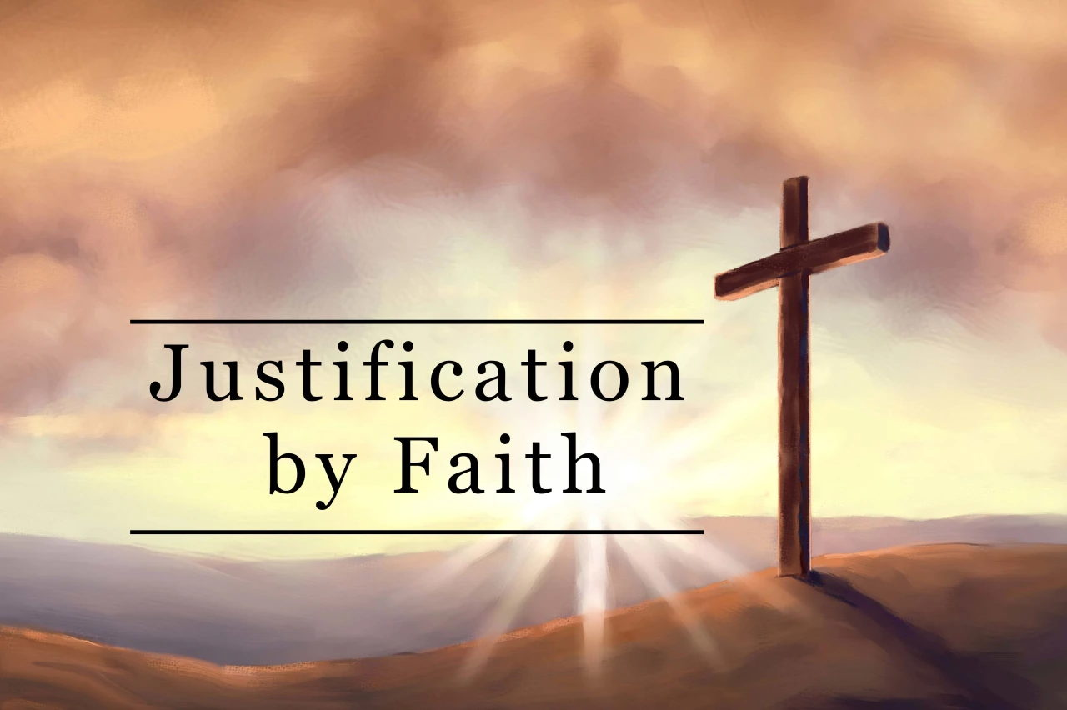

Our God Has Justified Us
by Pastor Fee Soliven
Romans 5:6-9
Sunday Morning
March 17, 2024

Slide 76
Romans 5:6-9
6 For when we were still without strength, in due time Christ died for the ungodly. 7 For scarcely for a righteous man will one die; yet perhaps for a good man someone would even dare to die. 8 But God demonstrates His own love toward us, in that while we were still sinners, Christ died for us. 9 Much more then, having now been justified by His blood, we shall be saved from wrath through Him.

Slide 77
1. A Just God

Slide 78
Acts 10:34
Then Peter opened his mouth and said: "In truth I perceive that God shows no partiality.

Slide 79
Zecheriah 7:10
“Do not oppress the widow or the fatherless, The alien or the poor. Let none of you plan evil in his heart Against his brother.'

Slide 80
2 Thessalonians 1:6
since it is a righteous thing with God to repay with tribulation those who trouble you,

Slide 81
Romans 12:19
“Beloved, do not avenge yourselves, but rather give place to wrath; for it is written, "Vengeance is Mine, I will repay," says the Lord”

Slide 82
Hebrews 6:10
For God is not unjust to forget your work and labor of love which you have shown toward His name, in that you have ministered to the saints, and do minister.

Slide 83
Colossians 3:25
“But he who does wrong will be repaid for what he has done, and there is no partiality”

Slide 84
Psalm 89:14
“Righteousness and justice are the foundation of Your throne; Mercy and truth go before Your face”

Slide 85
2. Justification

Slide 86
Romans 3:21-26
21 But now the righteousness of God apart from the law is revealed, being witnessed by the Law and the Prophets, 22 even the righteousness of God, through faith in Jesus Christ, to all and on all who believe. For there is no difference; 23 for all have sinned and fall short of the glory of God, 24 being justified freely by His grace through the redemption that is in Christ Jesus,

Slide 87
25 whom God set forth as a propitiation by His blood, through faith, to demonstrate His righteousness, because in His forbearance God had passed over the sins that were previously committed, 26 to demonstrate at the present time His righteousness, that He might be just and the justifier of the one who has faith in Jesus.

Slide 88
1. Justification comes apart
from the Law
We cannot earn justification through rule-keeping or our own good works

Slide 89
2. Justification is made possible in the Sacrificial Death of Christ
Only Through the shed blood of Christ

Slide 90
3. Justification is the free and gracious gift of God
It is bestowed on those who receive by faith the sacrifice of Jesus Christ

Slide 91
4. Justification demonstrates the righteousness of God
It’s the Favor of God upon our lives

Slide 92
1. The remission of the penalty of sin, which was Death

Slide 93
Romans 3:23
“for all have sinned and fall short of the glory of God”

Slide 94
1 Peter 2:24
“who Himself bore our sins in His own body on the tree, that we, having died to sins, might live for righteousness--by whose stripes you were healed”

Slide 95
2. The restoration to God’s favor, which had been lost due to our Sin

Slide 96
John 3:36
“He who believes in the Son has everlasting life; and he who does not believe the Son shall not see life, but the wrath of God abides on him."

Slide 97
James 2:23
And the Scripture was fulfilled which says, "Abraham believed God, and it was accounted to him for righteousness." And he was called the friend of God.

Slide 98
Romans 8:17
“and if children, then heirs--heirs of God and joint heirs with Christ, if indeed we suffer with Him, that we may also be glorified together”

Slide 99
3. The imputation of righteousness, which is the reckoning of Christ’s righteousness to our account

Slide 100
The Definition of Imputation: the righteousness of Christ is imputed to them that believe in him, and our sins are imputed to Christ, i.e., he assumed our "law-place," undertook to answer the demands of justice for our sins. In all these cases the nature of imputation is the same

Slide 101
Romans 4:5-8
5 But to him who does not work but believes on Him who justifies the ungodly, his faith is accounted for righteousness, 6 just as David also describes the blessedness of the man to whom God imputes righteousness apart from works: 7 "Blessed are those whose lawless deeds are forgiven, And whose sins are covered; 8 Blessed is the man to whom the LORD shall not impute sin."

Slide 102
2 Corinthians 5:21
“For He made Him who knew no sin to be sin for us, that we might become the righteousness of God in Him”

Slide 103
Romans 5:9
“Much more then, having now been justified by His blood, we shall be saved from wrath through Him”

Slide 104
Romans 4:25
“who was delivered up because of our offenses, and was raised because of our justification”

Slide 105
“Is Justification Just?

Slide 106
If He is holy, how can God forgive
a guilty sinner?”

Slide 107
1 Peter 3:18
For Christ also suffered once for sins, the just for the unjust, that He might bring us to God, being put to death in the flesh but made alive by the Spirit…

Slide 108
Justification Removes our Condemnation

Slide 109
Isaiah 53:4-6
4 Surely He has borne our griefs And carried our sorrows; Yet we esteemed Him stricken, Smitten by God, and afflicted. 5 But He was wounded for our transgressions, He was bruised for our iniquities; The chastisement for our peace was upon Him, And by His stripes we are healed. 6 All we like sheep have gone astray; We have turned, every one, to his own way; And the LORD has laid on Him the iniquity of us all.

Slide 110
Romans 8:1
“There is therefore now no condemnation to those who are in Christ Jesus, who do not walk according to the flesh, but according to the Spirit”

Slide 111
Romans 3:26 (NLT)
for he was looking ahead and including them in what he would do in this present time. God did this to demonstrate his righteousness, for he himself is fair and just, and he makes sinners right in his sight when they believe in Jesus.

Slide 112
Romans 5:1
“Therefore, having been justified by faith, we have peace with God through our Lord Jesus Christ”

Slide 113
Zecheriah 3:4
Then He answered and spoke to those who stood before Him, saying, "Take away the filthy garments from him." And to him He said, "See, I have removed your iniquity from you, and I will clothe you with rich robes."

Slide 114
Luke 15:17-24
17 But when he came to himself, he said, 'How many of my father's hired servants have bread enough and to spare, and I perish with hunger! 18 I will arise and go to my father, and will say to him, "Father, I have sinned against heaven and before you,

Slide 115
19 and I am no longer worthy to be called your son. Make me like one of your hired servants." ' 20 And he arose and came to his father. But when he was still a great way off, his father saw him and had compassion, and ran and fell on his neck and kissed him. 21 And the son said to him, 'Father, I have sinned against heaven and in your sight, and am no longer worthy to be called your son.'

Slide 116
22 But the father said to his servants, 'Bring out the best robe and put it on him, and put a ring on his hand and sandals on his feet. 23 And bring the fatted calf here and kill it, and let us eat and be merry; 24 for this my son was dead and is alive again; he was lost and is found.' And they began to be merry.

Slide 117
Titus 3:14
“And let our people also learn to maintain good works, to meet urgent needs, that they may not be unfruitful”

Slide 118
Romans 5:18-19
18 Therefore, as through one man's offense (Adam’s Sin) judgment came to all men, resulting in condemnation, even so through one Man's righteous act (Jesus Christ) the free gift came to all men, resulting in justification of life. 19 For as by one man's disobedience many were made sinners, so also by one Man's obedience many will be made righteous.

Slide 119
1 Thessalonians 4:13-18
13 But I do not want you to be ignorant, brethren, concerning those who have fallen asleep, lest you sorrow as others who have no hope. 14 For if we believe that Jesus died and rose again, even so God will bring with Him those who sleep in Jesus.

Slide 120
15 For this we say to you by the word of the Lord, that we who are alive and remain until the coming of the Lord will by no means precede those who are asleep. 16 For the Lord Himself will descend from heaven with a shout, with the voice of an archangel, and with the trumpet of God. And the dead in Christ will rise first.

Slide 121
17 Then we who are alive and remain shall be caught up together with them in the clouds to meet the Lord in the air. And thus we shall always be with the Lord. 18 Therefore comfort one another with these words.

Slide 122
1 Corinthians 15:50-54
50 Now this I say, brethren, that flesh and blood cannot inherit the kingdom of God; nor does corruption inherit incorruption. 51 Behold, I tell you a mystery: We shall not all sleep, but we shall all be changed-- 52 in a moment, in the twinkling of an eye, at the last trumpet. For the trumpet will sound, and the dead will be raised incorruptible, and we shall be changed.

Slide 123
53 For this corruptible must put on incorruption, and this mortal must put on immortality. 54 So when this corruptible has put on incorruption, and this mortal has put on immortality, then shall be brought to pass the saying that is written: "Death is swallowed up in victory."

Slide 124

20 Again, when a righteous man turns from his righteousness and commits iniquity, and I lay a stumbling block before him, he shall die; because you did not give him warning, he shall die in his sin, and his righteousness which he has done shall not be remembered; but his blood I will require at your hand.

Slide 125
Acts 2:38-39
38 Then Peter said to them, "Repent, and let every one of you be baptized in the name of Jesus Christ for the remission of sins; and you shall receive the gift of the Holy Spirit. 39 For the promise is to you and to your children, and to all who are afar off, as many as the Lord our God will call."

Slide 126
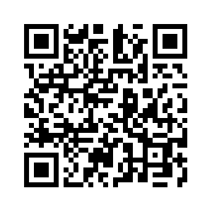
Donate with our QR code app to
Amazing Grace Christian Fellowship
Donations are Deeply Appreciated!

