Slide 1


Slide 2
Stand In Your Love (Bethel)

Slide 3
When darkness tries to roll over my bones When sorrow comes to steal the joy I own When

Slide 4
brokenness and pain is all I know I won't be shaken, no, I won't be shaken 'Cause my fear doesn't stand a

Slide 5
chance When I stand in Your love My fear doesn't stand a chance When I stand in Your love My fear

Slide 6
doesn't stand a chance When I stand in Your love
Shame no longer has a place to hide And I am not a

Slide 7
captive to the lies I'm not afraid to leave my past behind Oh, I won't be shaken, no, I won't be shaken

Slide 8
My fear doesn't stand a chance When I stand in Your love My fear doesn't stand a chance When I stand in

Slide 9
Your love My fear doesn't stand a chance When I stand in Your love Oh, I'm standing There's power

Slide 10
that can break off every chain There's power that can empty out a grave There's resurrection power that

Slide 11
can save There's power in Your name, power in Your name My fear doesn't stand a chance When I stand

Slide 12
in Your love My fear doesn't stand a chance When I stand in Your love My fear doesn't stand a chance

Slide 13
When I stand in Your love Oh, when, when I'm standing in Your love Oh, my fear doesn't stand a

Slide 14
chance When I stand in Your love My fear doesn't stand a chance When I stand in Your love My fear

Slide 15
chance When I stand in Your love My fear doesn't stand a chance When I stand in Your love My fear

Slide 16
doesn't stand a chance When I stand in Your love
Oh, I standing in Your love Oh, standing on the rock

Slide 17
Oh, I am standing, standing in Your love

Slide 18
Lion
(Elevation Worship)

Slide 19
God of Jacob, Great I Am King of angels, Son of Man Voice of many waters Song of Heaven's throne

Slide 20
Louder than the thunder Make Your glory known Hail, hail Lion of Judah Let the Lion roar Hail, hail

Slide 21
Lion of Judah Let the Lion roar Hail, hail Lion of Judah Let the Lion roar Hail, hail Lion of Judah Let

Slide 22
the Lion roar Roar (roar) Roar (roar) Roar Pride of Zion, prophets spoke Our Messiah flesh and bone

Slide 23
You alone are worthy to open up the scroll Like a lamb, You suffered, but the Lion has arose Hail, hail

Slide 24
Lion of Judah Let the Lion roar Hail, hail Lion of Judah Let the Lion roar Hail, hail Lion of Judah Let

Slide 25
the Lion roar Hail, hail Lion of Judah Let the Lion roar! Roar! (Roar!) Roar! (Roar!) Roar! (Roar!) Let it

Slide 26
roar, let it roar, let it roar Let the Lion roar Prepare the way Prepare the way of the Lord

Slide 27
Prepare the way Prepare the way of the Lord Prepare the way Prepare the way of the Lord

Slide 28
Prepare the way Prepare the way of the Lord O valley, be raised up O mountain, be made low O

Slide 29
valley, be raised up O mountain, be made low O valley, be raised up O mountain, be made low O

Slide 30
valley, be raised up O mountain, be made low O valley, be raised up O mountain, be made low O

Slide 31
valley, be raised up O mountain, be made low Roar! (Roar!) Roar! (Roar!) Let the Lion roar! (Roar!) Roar!

Slide 32
(Roar!) Hail, hail Lion of Judah Let the Lion roar Hail, hail Lion of Judah Let the Lion roar Hail, hail Lion of

Slide 33
Judah Let the Lion roar Hail, hail Lion of Judah Let the Lion roar (let the Lion) Hail, hail Lion of Judah

Slide 34
Let the Lion roar Hail, hail Lion of Judah Let the Lion roar O valley, be raised up O mountain, be made low

Slide 35
O valley, be raised up O mountain, be made low O valley, be raised up O mountain, be made low O

Slide 36
valley, be raised up O mountain, be made low O valley, be raised up O mountain, be made low O

Slide 37
valley, be raised up O mountain, be made low.

Slide 38
Only You
(David Crowder)

Slide 39
Take my heart, I lay it down At the feet, of You who's crowned Take my life, letting go I lift it up, to You

Slide 40
who's throned And I will worship You, Lord Only You, Lord And I will bow down before You Only You, Lord

Slide 41
Take my fret, take my fear All I have, I'm leaving here
Be all my hopes, be all my dreams You're my

Slide 42
delights, be my everything And I will worship You, Lord Only You, Lord And I will bow down before You

Slide 43
Only You, Lord And I will worship You, Lord Only You, Lord And I will, I will bow down before You

Slide 44
Only You, Lord And it's just You and me here now
Only You and me here now And it's just You and me

Slide 45
here now Only You and me here now And it's just You and me here now Only You and me here now

Slide 46
And I will worship You, Lord (and it's just You and me here now) Only You, Lord (only You and me here

Slide 47
now) And I will, I will bow down (and it's just You and me here now) Only You, Lord (only You and me here

Slide 48
now) And it's just You and me here now (You should see this view) Only You and me here now (when it's

Slide 49
only You) And it's just You and me here now.

Slide 50
I Give Myself Away
(William McDowell)

Slide 51
I give myself away I give myself away So You can use me I give myself away I give myself away So You

Slide 52
can use me I give myself away I give myself away So You can use me I give myself away I give myself

Slide 53
away So You can use me Here I am Here I am Here I stand Lord, my life is in your hands Lord, I'm longing

Slide 54
to see Your desires revealed in me I give myself away I give myself away (I want to be use by you) So

Slide 55
You can use me I give myself away I give myself away So You can use me Take my heart Take my life

Slide 56
As a living sacrifice All my dreams all my plans Lord I place them in your hands I give myself away (I give

Slide 57
myself away) I give myself away So You can use me
I give myself away I give myself away So You can

Slide 58
use me I give myself away (I give myself away) I belong to you I give myself away (I give myself away)

Slide 59
So You can use me Lord I give myself away I give myself away (my mind doesn't belong to me) I give

Slide 60
myself away I give myself away So You can use me
My life is not my own To you I belong I give myself, I

Slide 61
give myself to you.

Slide 62
Make Room The Church Will Sing
(Elyssa Smith, Community Music)

Slide 63
Here is where I lay it down Every burden, every crown This is my surrender This is my surrender

Slide 64
Here is where I lay it down Every lie and every doubt
This is my surrender And I will make room for You

Slide 65
To do whatever You want to To do whatever You want to I will make room for You To do whatever You

Slide 66
want to To do whatever You want to Here is where I lay it down Every burden, every crown This is my

Slide 67
surrender This is my surrender Here is where I lay it down Every lie and every doubt This is my surrender

Slide 68
And I will make room for You To do whatever You want to To do whatever You want to And I will make

Slide 69
room for You To do whatever You want to To do whatever You want to And I will make room for You

Slide 70
To do whatever You want to To do whatever You want to And I will make room for You To do

Slide 71
whatever You want to To do whatever You want to (Jesus) Have Your way, have Your way Jesus Have

Slide 72
Your way with us Have Your way with us, ooh We surrender We surrender Jesus Have Your way Jesus

Slide 73
Shake up the ground of all my tradition Break down the walls of all my religion Your way is better Your

Slide 74
way is better Shake up the ground of all my tradition Break down the walls of all my religion Your way is

Slide 75
better Your way is better Shake up the ground of all my tradition Break down the walls of all my religion

Slide 76
Your way is better Your way is better Shake up the ground of all my tradition Break down the walls of all

Slide 77
my religion Your way is better Your way is better And I will make room for You To do whatever You want to

Slide 78
To do whatever You want to I will make room for You To do whatever You want to To do whatever You

Slide 79
want to Here is where I lay it down You are all I'm chasing now This is my surrender This is my

Slide 80
surrender Here is where I lay it down You are all I'm chasing now This is my surrender This is my

Slide 81
surrender.

Slide 83


Slide 84

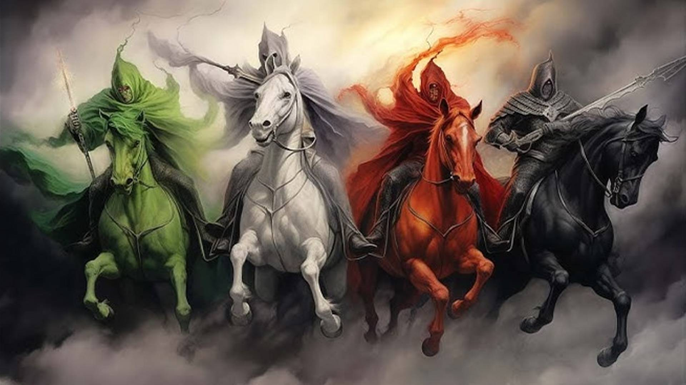
The 4 Horseman of the Apocalypse
by Pastor Fee Soliven
Revelation 6:1-8
Sunday Morning
February 25, 2024

Slide 85
Revelation 6:1-8
1 Now I saw when the Lamb opened one of the seals; and I heard one of the four living creatures saying with a voice like thunder, "Come and see." 2 And I looked, and behold, a white horse. He who sat on it had a bow; and a crown was given to him, and he went out conquering and to conquer.

Slide 86
3 When He opened the second seal, I heard the second living creature saying, "Come and see." 4 Another horse, fiery red, went out. And it was granted to the one who sat on it to take peace from the earth, and that people should kill one another; and there was given to him a great sword.

Slide 87
5 When He opened the third seal, I heard the third living creature say, "Come and see." So I looked, and behold, a black horse, and he who sat on it had a pair of scales in his hand. 6 And I heard a voice in the midst of the four living creatures saying, "A quart of wheat for a denarius, and three quarts of barley for a denarius; and do not harm the oil and the wine."

Slide 88
7 When He opened the fourth seal, I heard the voice of the fourth living creature saying, "Come and see." 8 So I looked, and behold, a pale horse. And the name of him who sat on it was Death, and Hades followed with him. And power was given to them over a fourth of the earth, to kill with sword, with hunger, with death, and by the beasts of the earth.

Slide 89
Daniel 12:1-4
1 "At that time Michael shall stand up, The great prince who stands watch over the sons of your people; And there shall be a time of trouble, Such as never was since there was a nation, Even to that time. And at that time your people shall be delivered, Every one who is found written in the book.

Slide 90
2 And many of those who sleep in the dust of the earth shall awake, Some to everlasting life, Some to shame and everlasting contempt. 3 Those who are wise shall shine Like the brightness of the firmament, And those who turn many to righteousness Like the stars forever and ever.

Slide 91
4 "But you, Daniel, shut up the words, and seal the book until the time of the end; many shall run to and fro, and knowledge shall increase."

Slide 92
1. The White Horse

Slide 93
Revelation 6:1-2
1 Now I saw when the Lamb opened one of the seals; and I heard one of the four living creatures saying with a voice like thunder, "Come and see." 2 And I looked, and behold, a white horse. He who sat on it had a bow; and a crown was given to him, and he went out conquering and to conquer.

Slide 94
The Roman Catholic Church

Slide 95
There are approximately 1.5 billion Catholics living on earth today. It’s a false religion under the guise of Christianity. A type of anti-Christ and False Prophet.

Slide 96
Matthew 24:23-31
23 Then if anyone says to you, 'Look, here is the Christ!' or 'There!' do not believe it. 24 For false christs and false prophets will rise and show great signs and wonders to deceive, if possible, even the elect. 25 See, I have told you beforehand. 26 Therefore if they say to you, 'Look, He is in the desert!' do not go out; or 'Look, He is in the inner rooms!' do not believe it.

Slide 97
27 For as the lightning comes from the east and flashes to the west, so also will the coming of the Son of Man be. 28 For wherever the carcass is, there the eagles will be gathered together.

Slide 98
29 "Immediately after the tribulation of those days the sun will be darkened, and the moon will not give its light; the stars will fall from heaven, and the powers of the heavens will be shaken. 30 Then the sign of the Son of Man will appear in heaven, and then all the tribes of the earth will mourn, and they will see the Son of Man coming on the clouds of heaven with power and great glory.

Slide 99
31 And He will send His angels with a great sound of a trumpet, and they will gather together His elect from the four winds, from one end of heaven to the other.

Slide 100
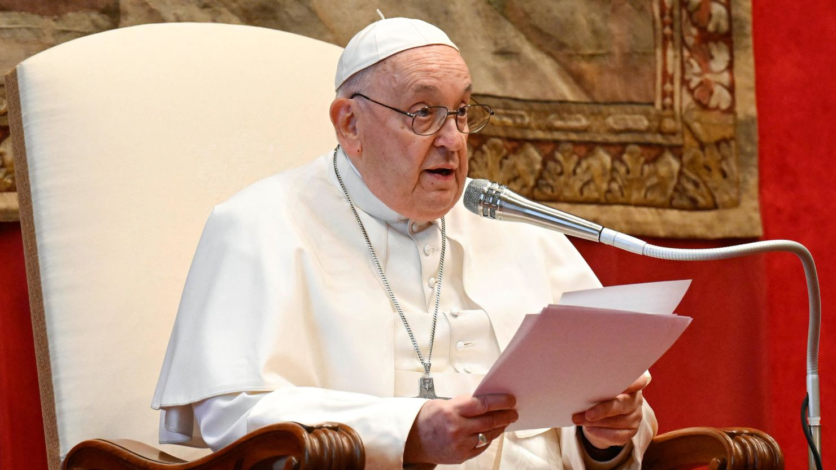
29 and yet I say to you that even Solomon in all his glory was not arrayed like one of these. 30 Now if God so clothes the grass of the field, which today is, and tomorrow is thrown into the oven, will He not much more clothe you, O you of little faith? 31 Therefore do not worry, saying, 'What shall we eat?' or 'What shall we drink?' or 'What shall we wear?'

Slide 101
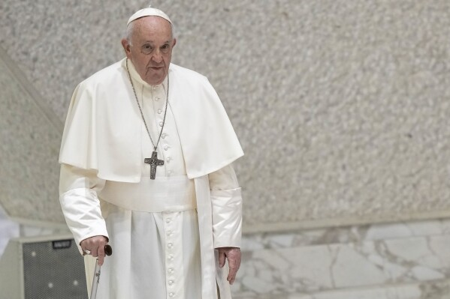
32 "For after all these things the Gentiles seek. For your heavenly Father knows that you need all these things. 33 But seek first the kingdom of God and His righteousness, and all these things shall be added to you. 34 Therefore do not worry about tomorrow, for
tomorrow will worry about its own things. Sufficient for the day is its own trouble.

Slide 102
Catholic Ideology

Slide 103
Mary-ology the Worship of Mary

Slide 104
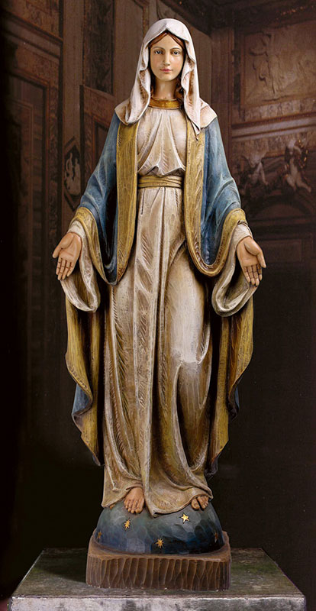
1. Legitimate Causes

Slide 105
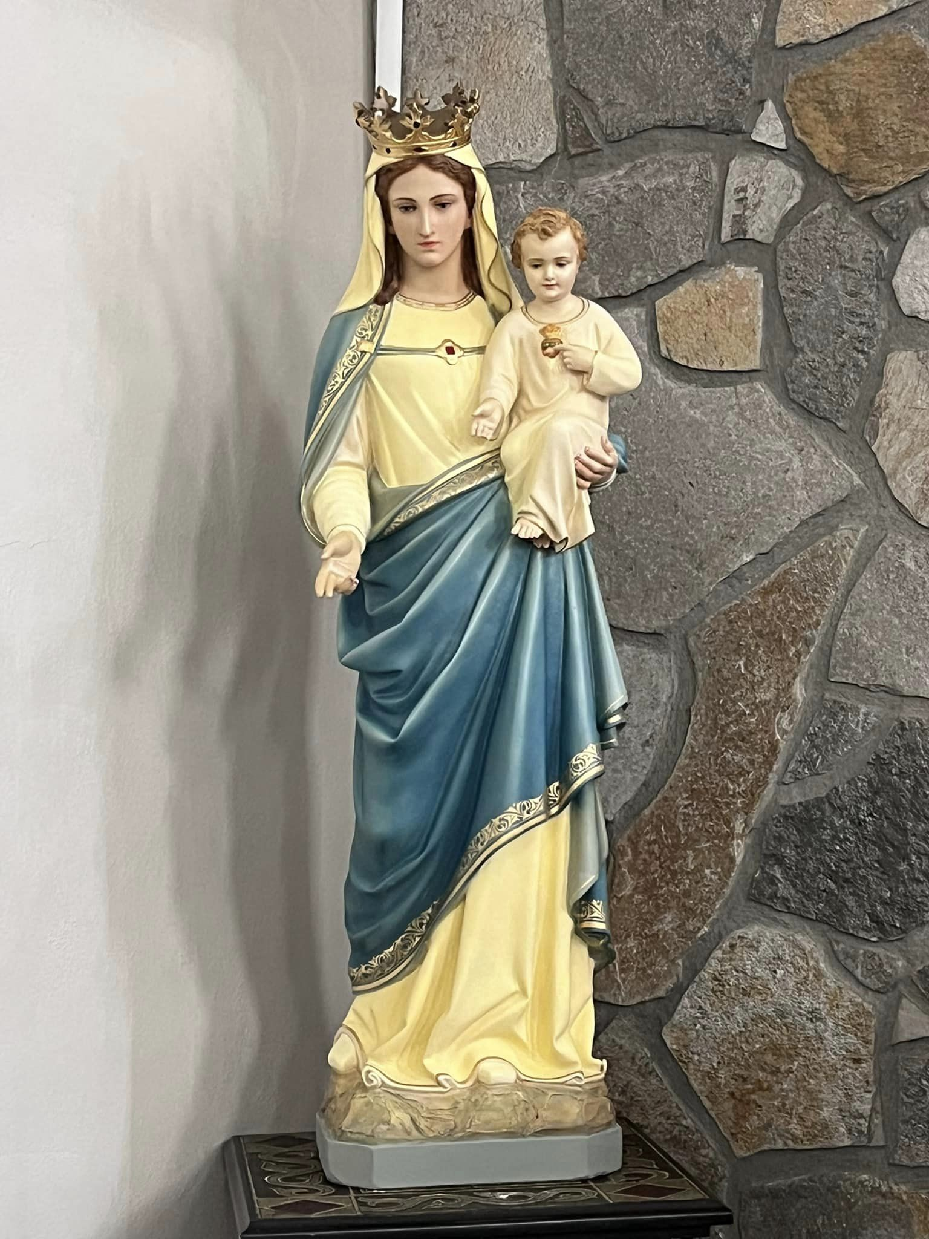

Slide 106
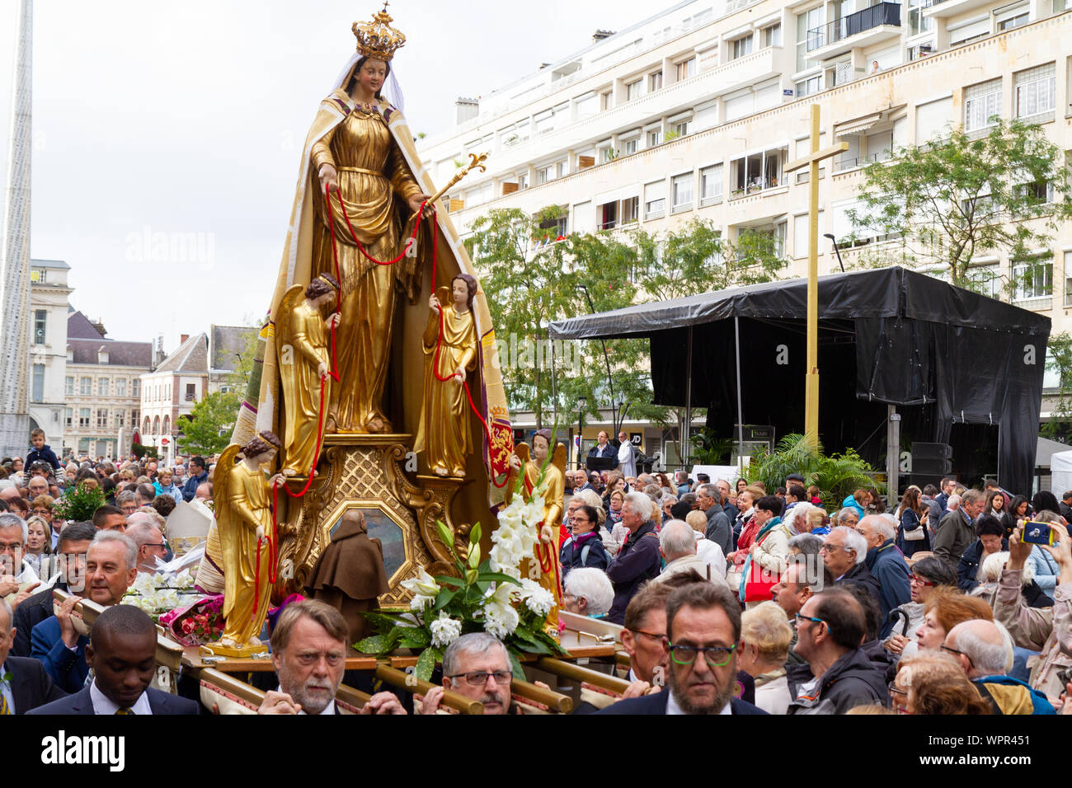
2. Inappropriate Reasons

Slide 107
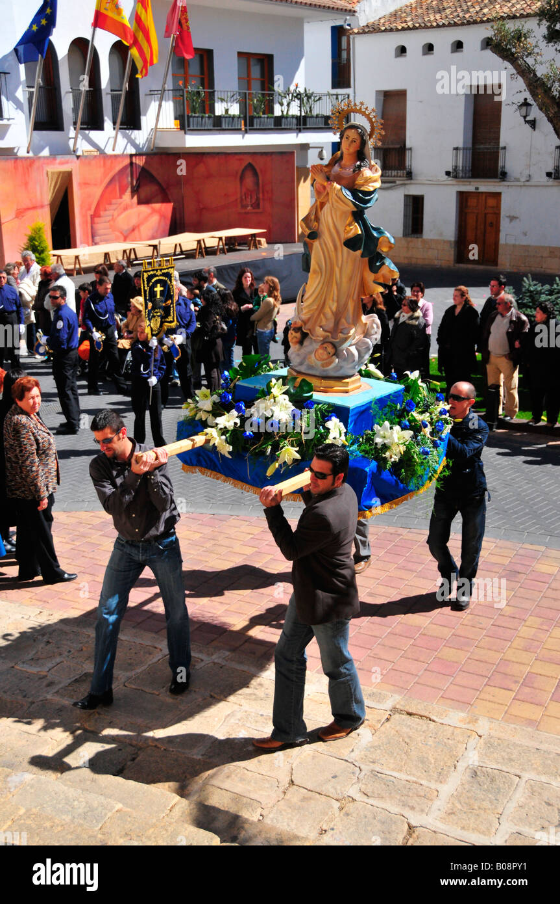

Slide 108
1 Timothy 2:5-6
5 “For there is one God and one Mediator between God and men, the Man Christ Jesus, 6 who gave Himself a ransom for all, to be testified in due time”

Slide 109
John 12:32
And I, if I am lifted up from the earth, will draw all peoples to Myself."

Slide 110
The Sins of the Catholic Church

Slide 111
1. Human Tradition is Elevated to Or Above the Word of God (1545 AD)
2. Wrong Gospel, Wrong Message of Salvation
3. Confession of Sins to Priest to Obtain Absolution of Sins
4. Priests

Slide 112
5. Celibacy of Priests and Nuns (1079 AD)
6. Infant Baptism (370 AD)
7. Other Mediators Between God and Man
8. Prayers to Statue Saints (375 AD)
9. Purgatory (593 AD)

Slide 113
10. Papal Infallibility (1870 AD)
11. Idolatry = Making Images (786 AD)
12. The Worship Mary (431 AD)
13. Peter as the Rock
14. 15 Apocrypha Books Added to the Old Testament Bible (1546 AD)

Slide 114
15. Rosary Prayer Beads (1090 AD)
16. Low Moral Standards
17. Devotion to the Sacred Heart of
Jesus and Mary
18. Crossing Oneself (300 AD)

Slide 115
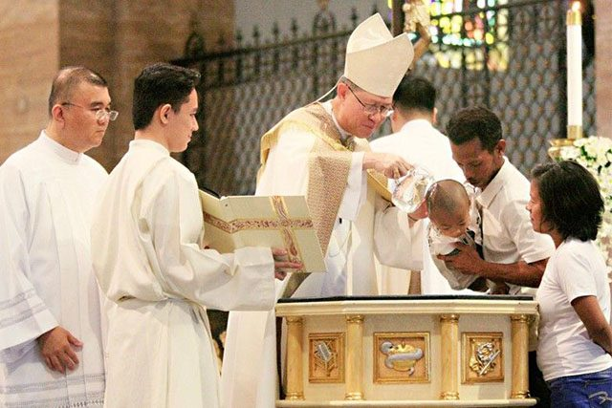
Anxiety has a negative effect on every area of our lives because it:

Slide 116
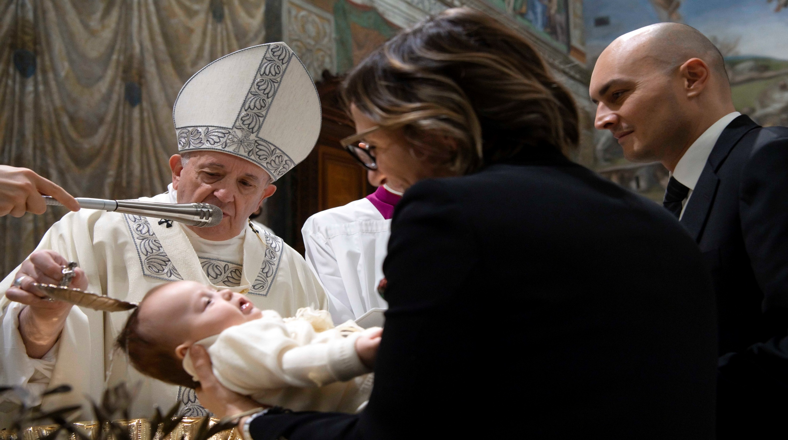
1. Divides our Minds

Slide 117
Galatians 1:6-9
6 I marvel that you are turning away so soon from Him who called you in the grace of Christ, to a different gospel, 7 which is not another; but there are some who trouble you and want to pervert the gospel of Christ.

Slide 118
8 But even if we, or an angel from heaven, preach any other gospel to you than what we have preached to you, let him be accursed. 9 As we have said before, so now I say again, if anyone preaches any other gospel to you than what you have received, let him be accursed.

Slide 119
Acts 2:38-39
38 Then Peter said to them, "Repent, and let every one of you be baptized in the name of Jesus Christ for the remission of sins; and you shall receive the gift of the Holy Spirit. 39 For the promise is to you and to your children, and to all who are afar off, as many as the Lord our God will call."

Slide 120
Matthew 24:4-5
4 And Jesus answered and said to them: "Take heed that no one deceives you. 5 For many will come in My name, saying, 'I am the Christ,' and will deceive many.

Slide 121
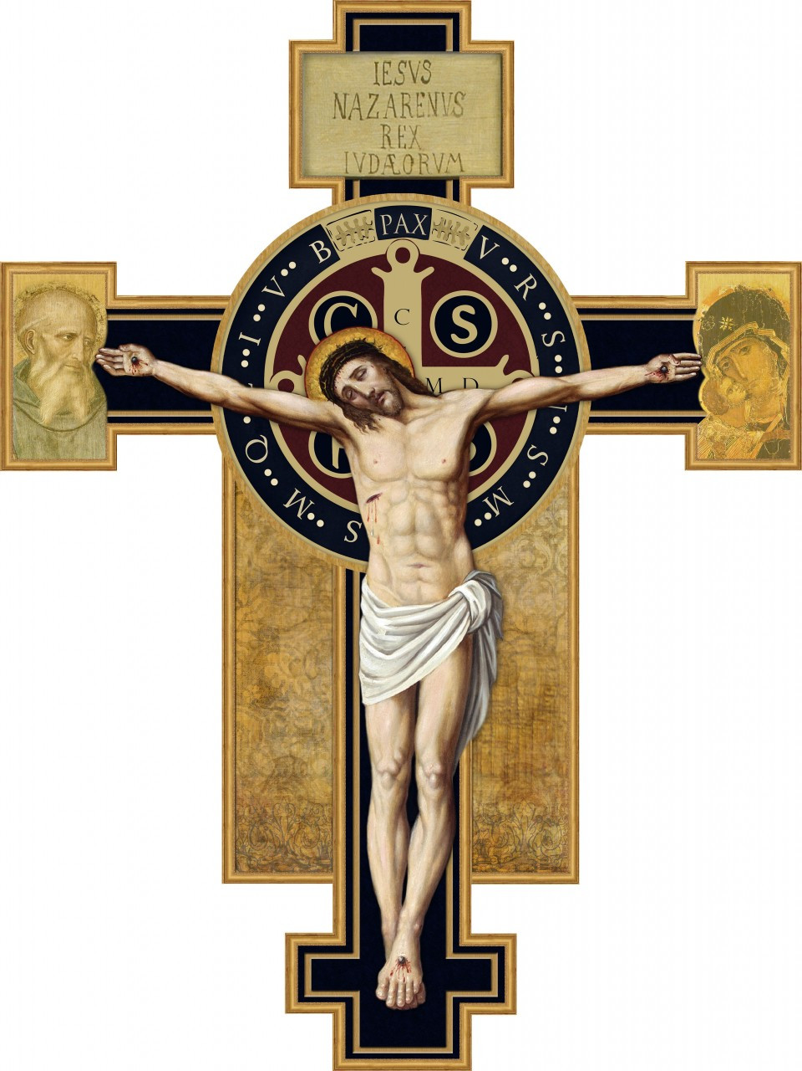

Slide 122
Hosea 4:6
“My people are destroyed for lack of knowledge…”

Slide 123
2. The Red Horse

Slide 124
Revelation 6:3-4
3 When He opened the second seal, I heard the second living creature saying, "Come and see." 4 Another horse, fiery red, went out. And it was granted to the one who sat on it to take peace from the earth, and that people should kill one another; and there was given to him a great sword.

Slide 125
Communism

Slide 126
There are approximately 3 billion Communists living on earth today

Slide 127
The Communist Countries

Slide 128
Presently, there are seven communist countries in the world: China, Cuba, Laos, North Korea, Valenzuela, Russia and Vietnam. In accordance with Marx's theory of the state, communists believe all state formations are under the control of a ruling class.

Slide 129

Anxiety

Slide 130
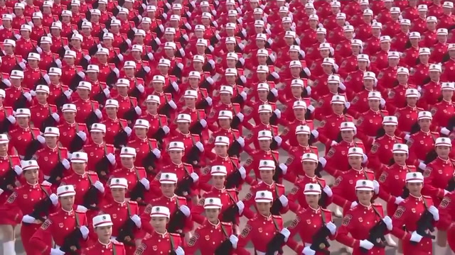
Can also be defined as “dread, apprehension, and uncertainty” and can be caused by past events, present situations, or future possibilities.

Slide 131
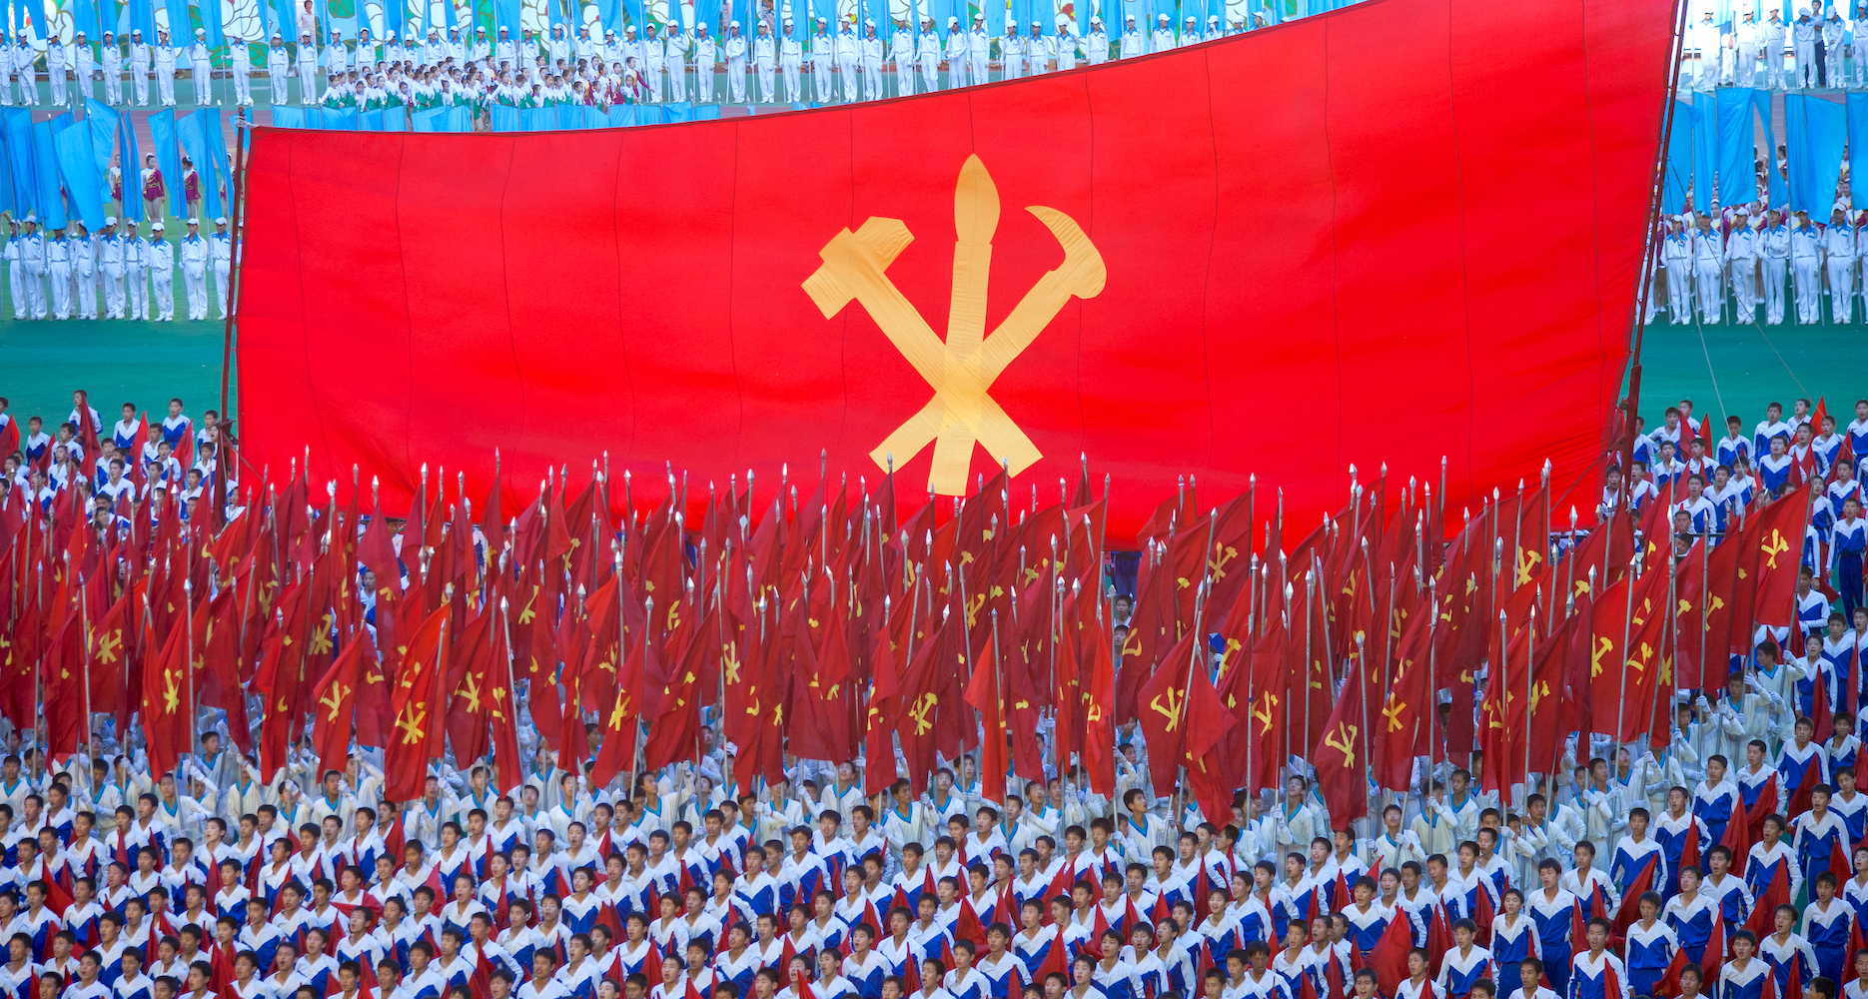
What are the sources of anxiety?

Slide 132
Communist Dictators

Slide 133
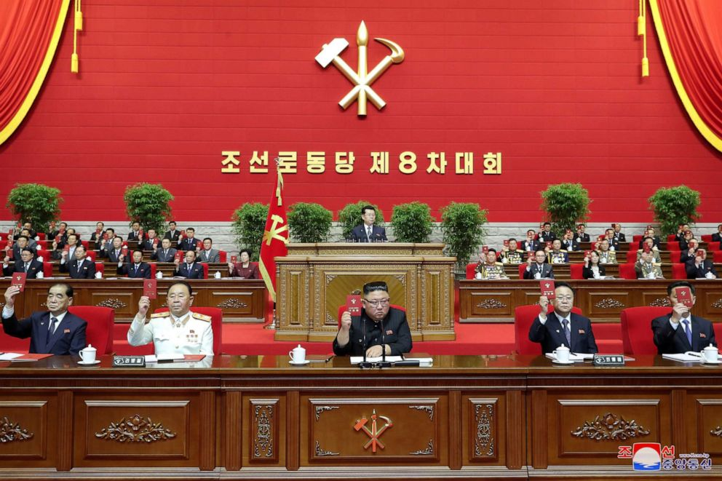
Matthew 6:25-34
25 "Therefore I say to you, do not worry about your life, what you will eat or what you will drink; nor about your body, what you will put on. Is not life more than food and the body more than clothing?

Slide 134
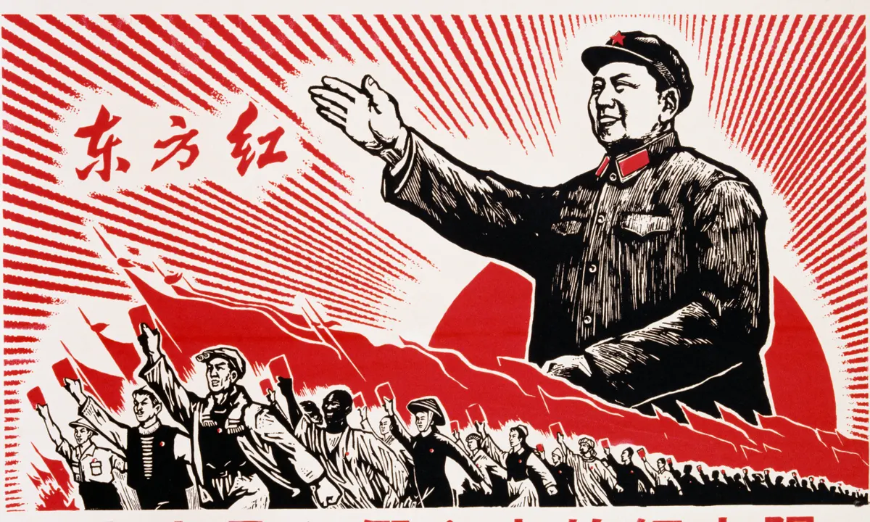
26 Look at the birds of the air, for they neither sow nor reap nor gather into barns; yet your heavenly Father feeds them. Are you not of more value than they? 27 Which of you by worrying can add one cubit to his stature? 28 So why do you worry about clothing? Consider the lilies of the field, how they grow: they neither toil nor spin;

Slide 135
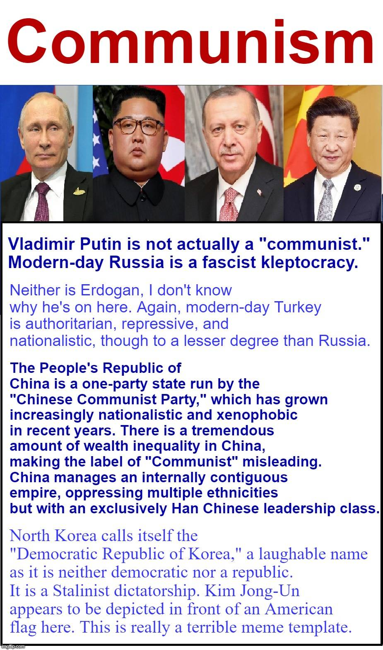

Slide 136
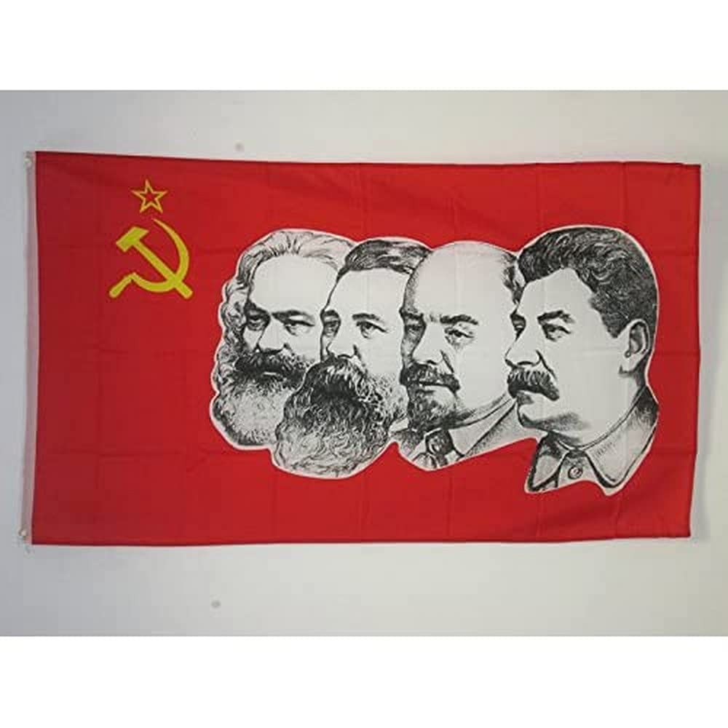

Slide 137
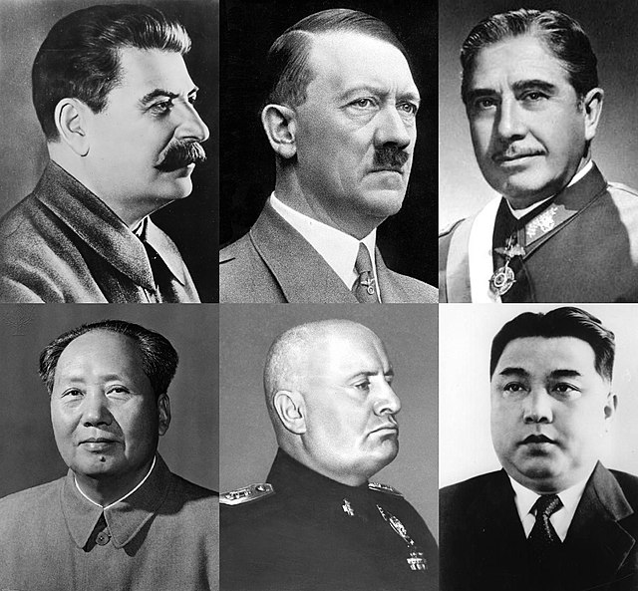
1. Legitimate Causes

Slide 138
Communists Ideology

Slide 139
Atheism (God Doesn’t Exist)

Slide 140
Psalm 14:1-3
1 The fool has said in his heart, "There is no God." They are corrupt, They have done abominable works, There is none who does good. 2 The LORD looks down from heaven upon the children of men, To see if there are any who understand, who seek God. 3 They have all turned aside, They have together become corrupt; There is none who does good, No, not one.

Slide 141
Sins of the Communist Countries

Slide 142
There are many Crimes against humanity under communist regimes that have occurred during the 20th century, including forced deportations, massacres, torture, forced disappearances, extrajudicial killings, terror, ethnic cleansing, and enslavement, as well as deliberate starvation of people.

Slide 143
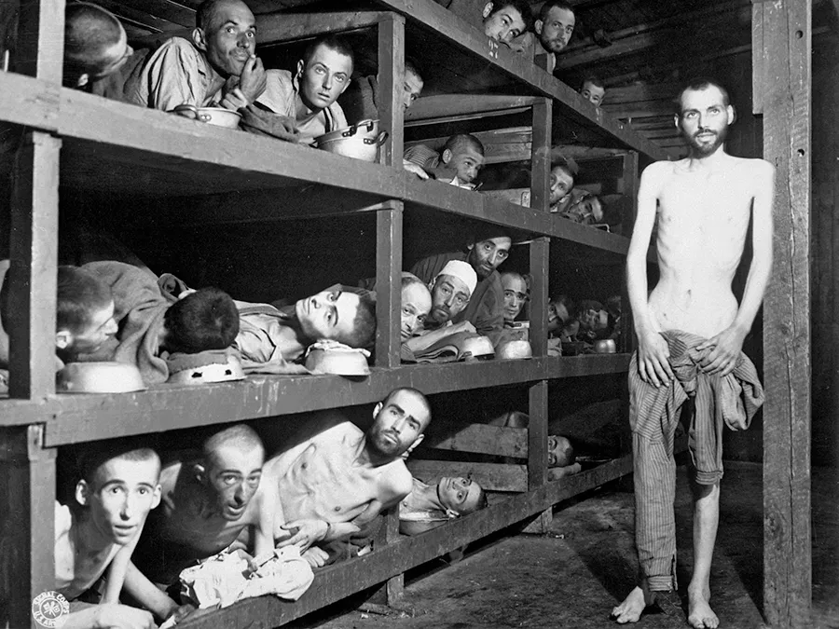
1. It isn’t Scriptural

Slide 144
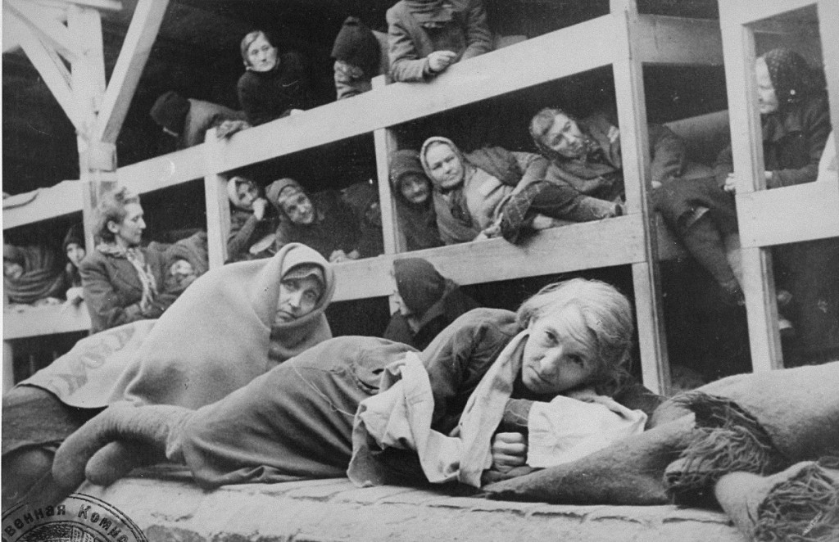
31 Therefore do not worry, saying, 'What shall we eat?' or 'What shall we drink?' or 'What shall we wear?'

Slide 145
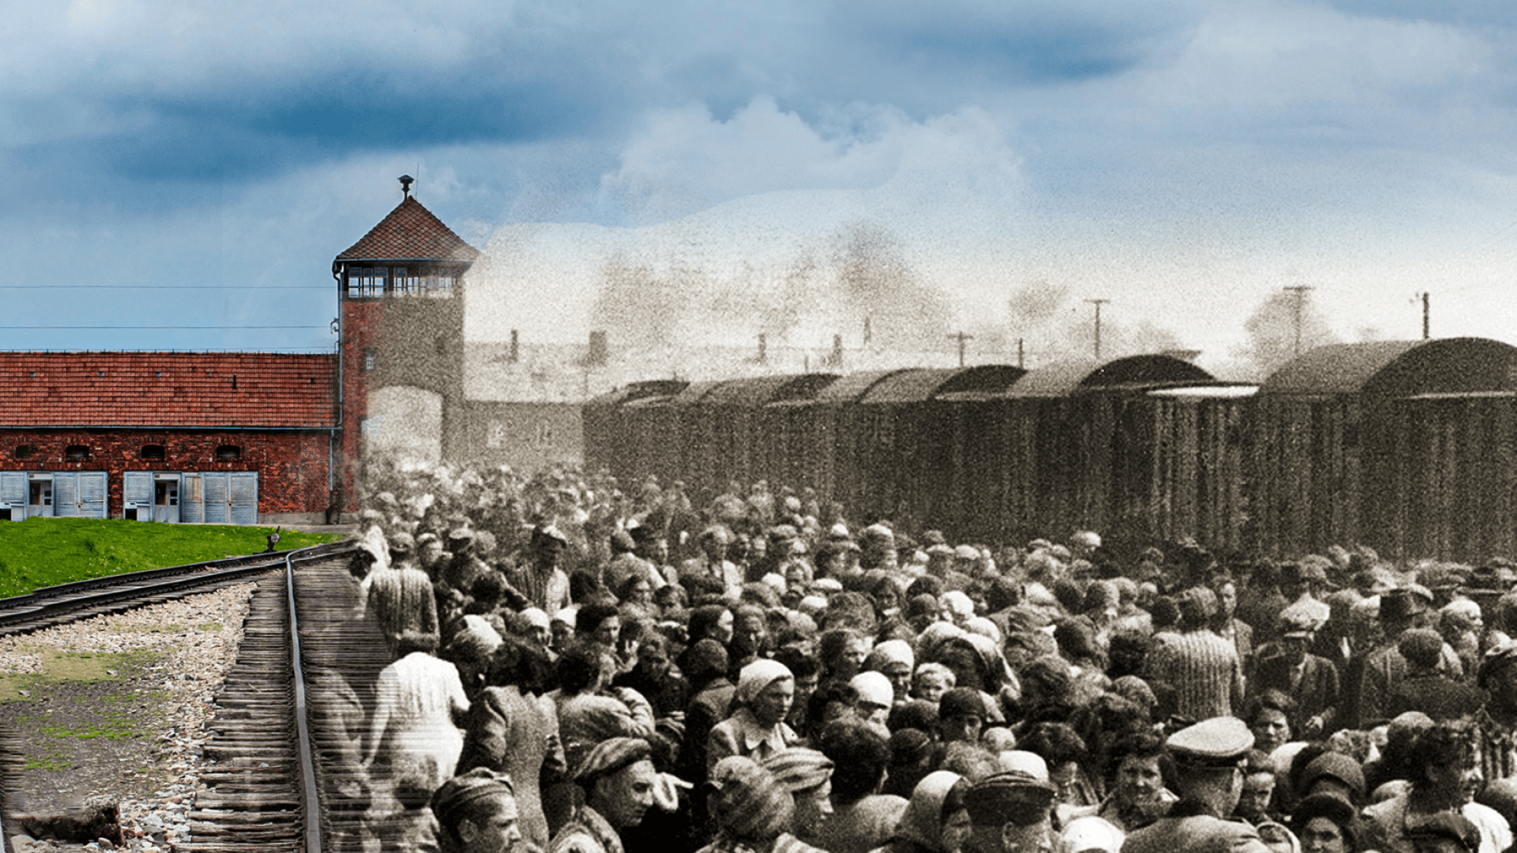
34 Therefore do not worry about tomorrow, for tomorrow will worry about its own things. Sufficient for the day is its own trouble.

Slide 146
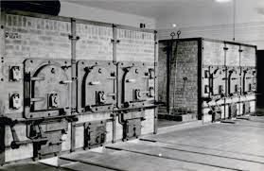
Matthew 6:25,31
25 "Therefore I say to you, do not worry about your life, what you will eat or what you will drink; nor about your body, what you will put on. Is not life more than food and the body more than clothing?

Slide 147
3. The Black Horse

Slide 148
Revelation 6:5-6
5 When He opened the third seal, I heard the third living creature say, "Come and see." So I looked, and behold, a black horse, and he who sat on it had a pair of scales in his hand. 6 And I heard a voice in the midst of the four living creatures saying, "A quart of wheat for a denarius, and three quarts of barley for a denarius; and do not harm the oil and the wine."

Slide 149
Capitalism

Slide 150
Although the continuous development of capitalism as a system dates only from the 16th century, antecedents of capitalist institutions existed in the ancient world, and flourishing pockets of capitalism were present in Europe during the later Middle Ages through our present age.

Slide 151
Capitalist Countries

Slide 152
There are approximately 2 billion Capitalist living on earth today. This entity created Commerce, Trade, Corporations, Economic Markets and Banks. The main currency used around the world is the US Dollar

Slide 153
USA, Canada, Mexico, Europe, England, Australia, Spain Most South American Countries

Slide 154
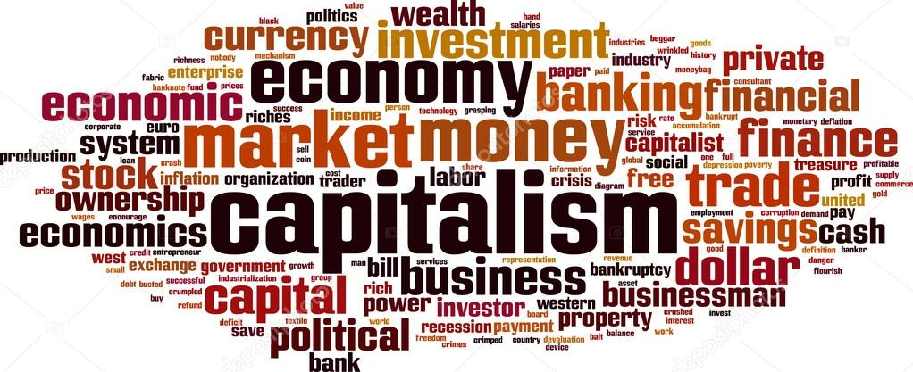
3. Anxiety Affects our Relationships

Slide 155
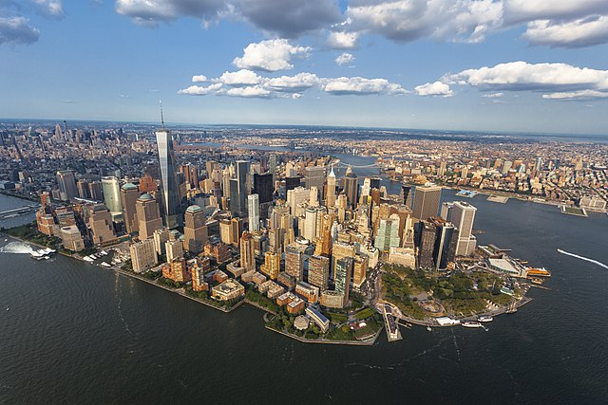
1 Peter 5:6-7
6 Therefore humble yourselves under the mighty hand of God, that He may exalt you in due time, 7 casting all your care upon Him, for He cares for you.

Slide 156
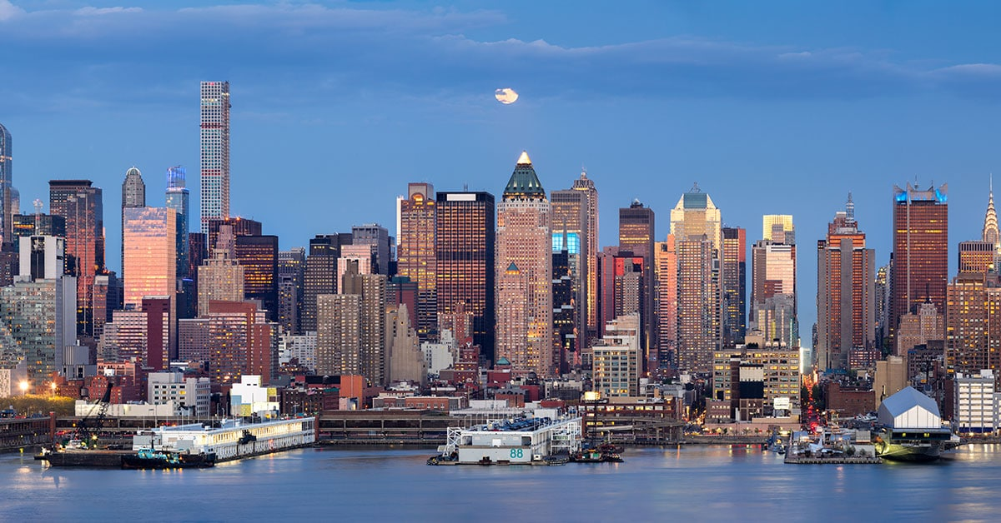
4. Anxiety Leads to Unwise Decisions

Slide 157
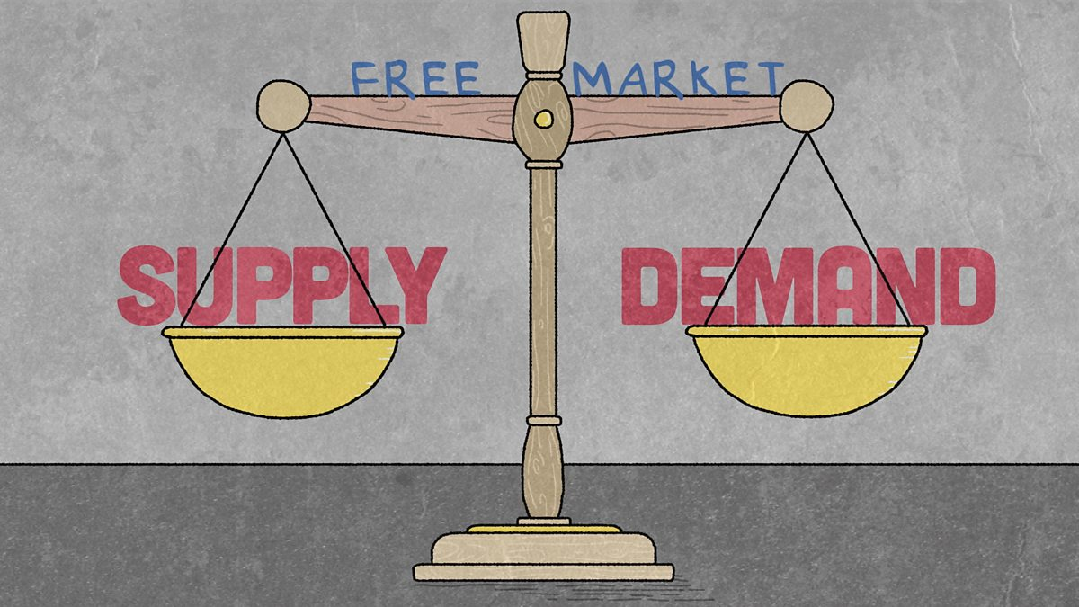
5. Anxiety Steals our Joy and Peace

Slide 158


Slide 159

What is the best way to handle Anxiety?

Slide 160
Capitalist Ideology

Slide 161
A Melting Pot of Religion
(Once was a Christian Nation)
A people driven by political power of Republicans and Democrats

Slide 162
Sins of the Most Powerful
Capitalist Country
(America)

Slide 163
1. Sanctions
2. 70,000,000 Million Babies Aborted
3. 5 Billion Dollars Annually in Profits from Pornography
4. #1 rated country for sex trafficking

Slide 164
6. Most Violent Cities in the world
7. On an average is 2 Mass Shootings per day
8. Most Unsheltered people in
Sanctuary Democratic States
9. Most Brutal and Vicious Gangs throughout US Cities

Slide 165
10. It Dropped the First 2 Atomic Nuclear Bombs on Japan in Modern History
It Killed 210,000 People total
from Hiroshima and Nagasaki

Slide 166
4. The Pale Horse (Green Horse)

Slide 167
Revelation 6:7-8
7 When He opened the fourth seal, I heard the voice of the fourth living creature saying, "Come and see." 8 So I looked, and behold, a pale horse. And the name of him who sat on it was Death, and Hades followed with him. And power was given to them over a fourth of the earth, to kill with sword, with hunger, with death, and by the beasts of the earth.

Slide 168
While many English translations use terms such as "pale" or "ashen," the original language describes this horse's color as chlōros. This is a yellow-tinged green color

Slide 169
Islam

Slide 170
The Islamic Countries

Slide 171
There are approximately 1.5 billion Islamic people living on earth today. Saudi Arabia, Iran, Iraq, Jordan, Turkey Syria, Lebanon, Yemen, Egypt, Africa

Slide 172

Isaiah 43:25
I, even I, am He who blots out your transgressions for My own sake; And I will not remember your sins

Slide 173
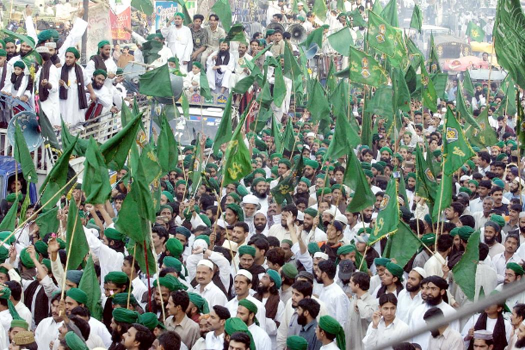
Romans 6:23
"For the wages of sin is death, but the gift of God is eternal life in Christ Jesus our Lord"

Slide 174
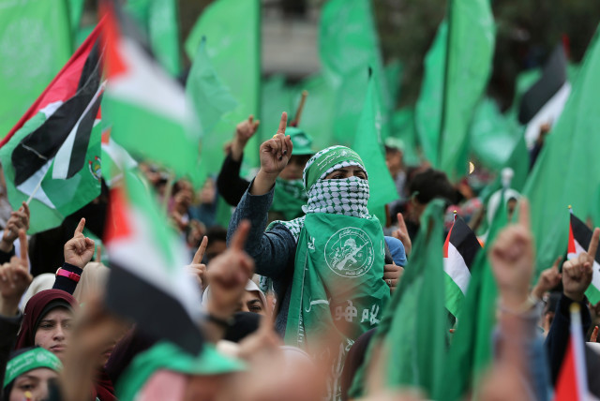
J. Vernon Magee)
"As great as all God's promises are, they will not be yours if you give Jesus your worries with one hand and take them back with the other.

Slide 175
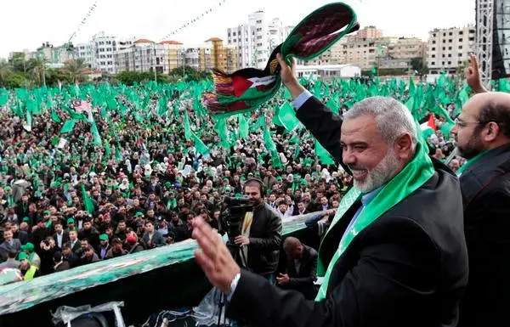
True freedom is only possible when we finally admit that a burden is too heavy to carry. We must completely surrender our apprehensive thoughts to God because we’ll never be free as long as we hold onto them and focus on what could happen.

Slide 176
Islamic Ideology
The Koran and their Messenger is Mohamad
Chaos Will Bring Their Messiah which is called the 12th Iman

Slide 177
Sins of the Islamic Countries

Slide 178
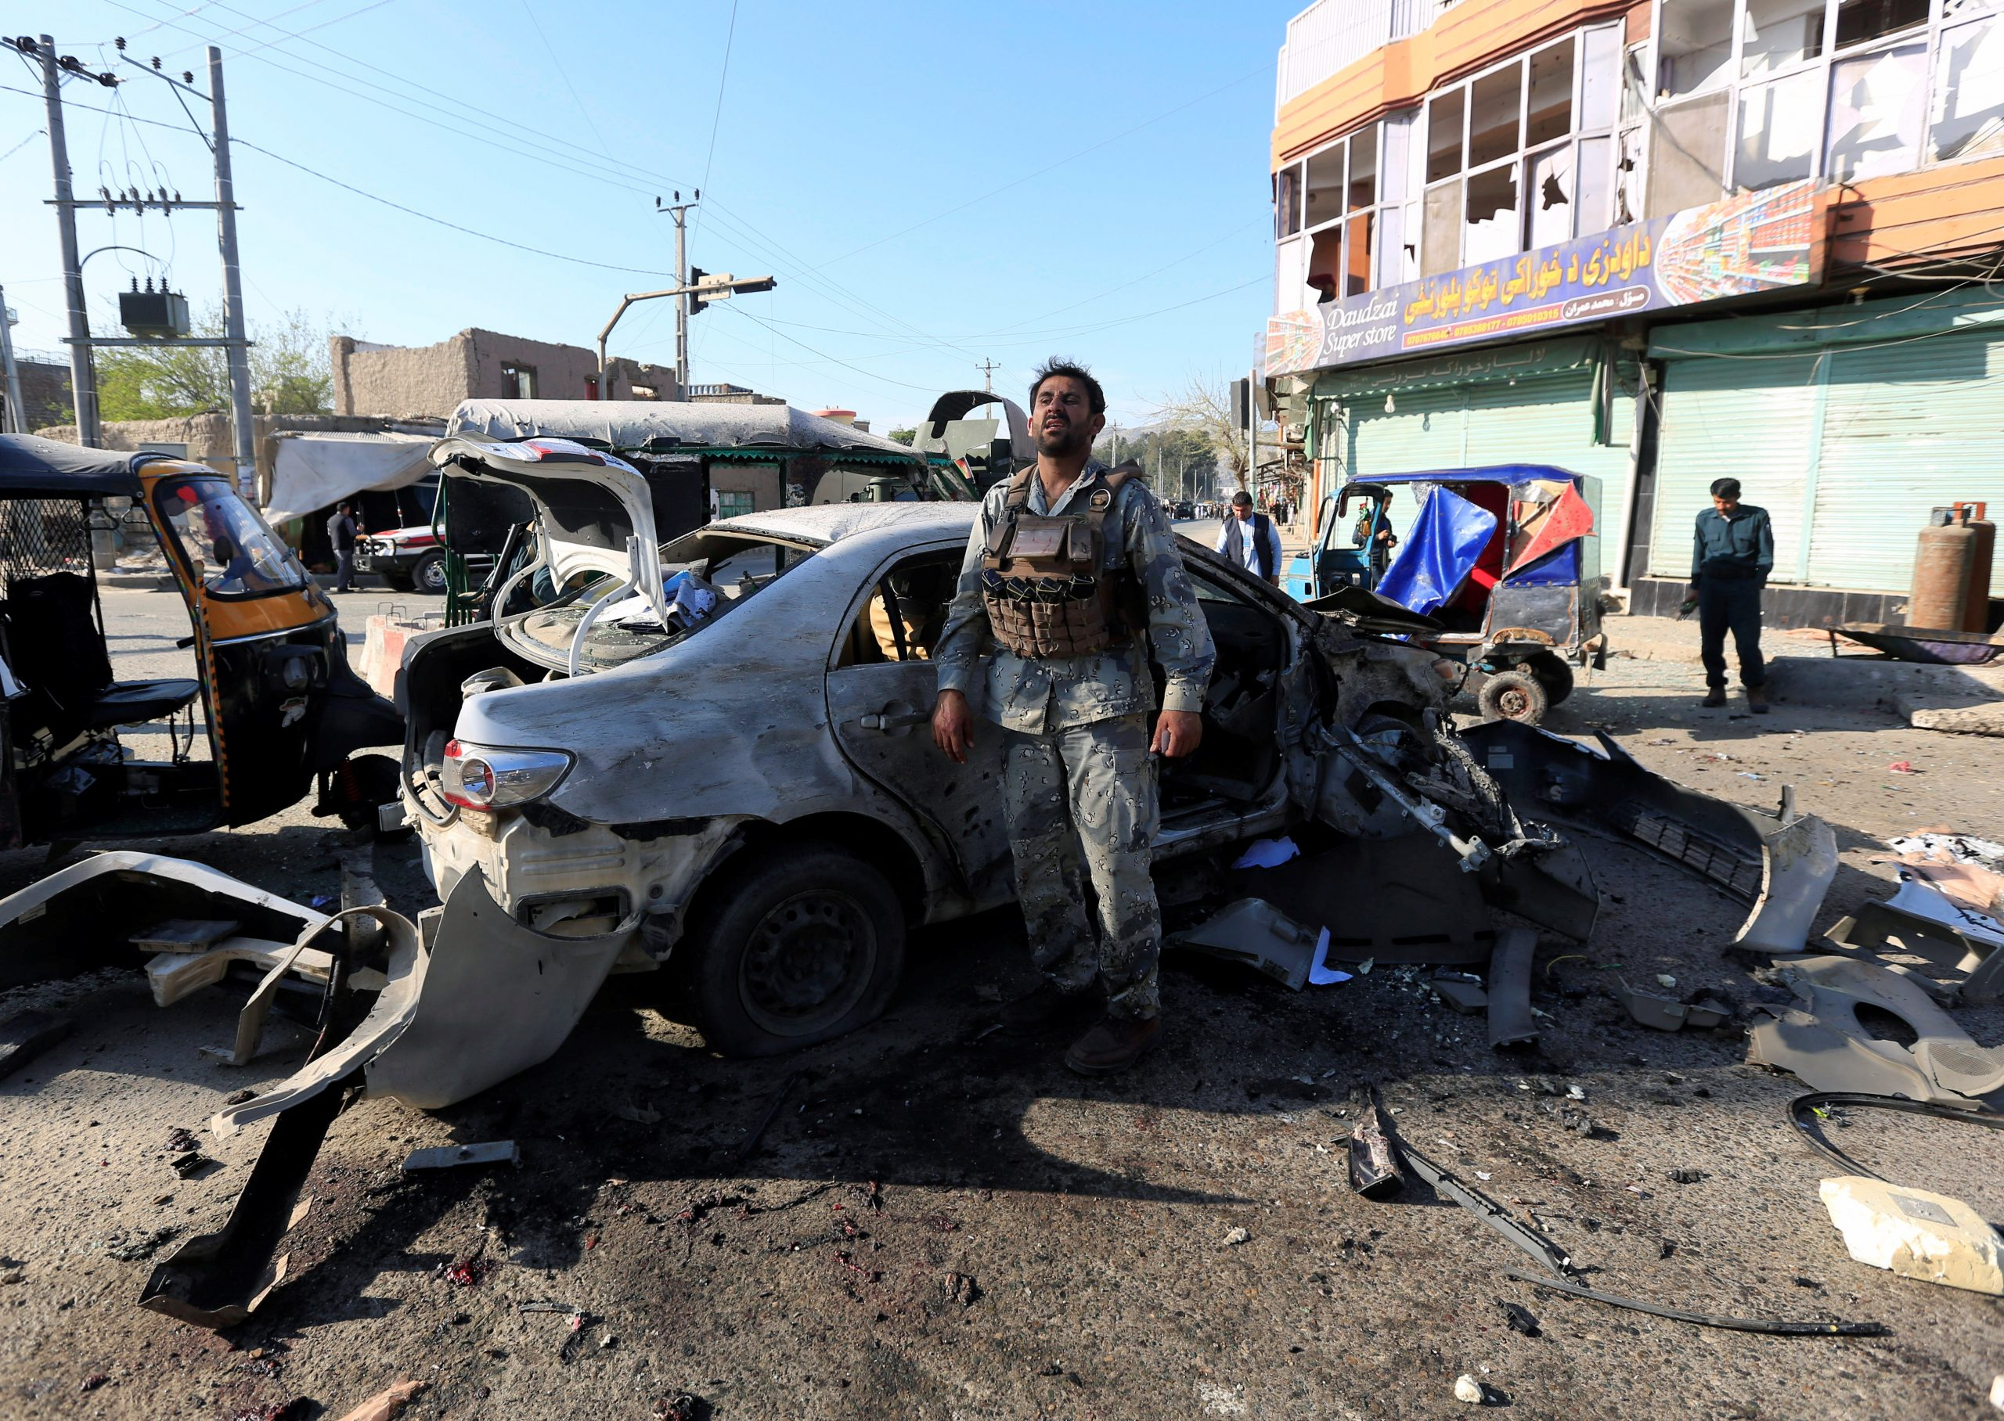
Many times people who have been freed from anxiety it was like a light had been turned on—their smiles came back, and their attitudes completely changed.

Slide 179
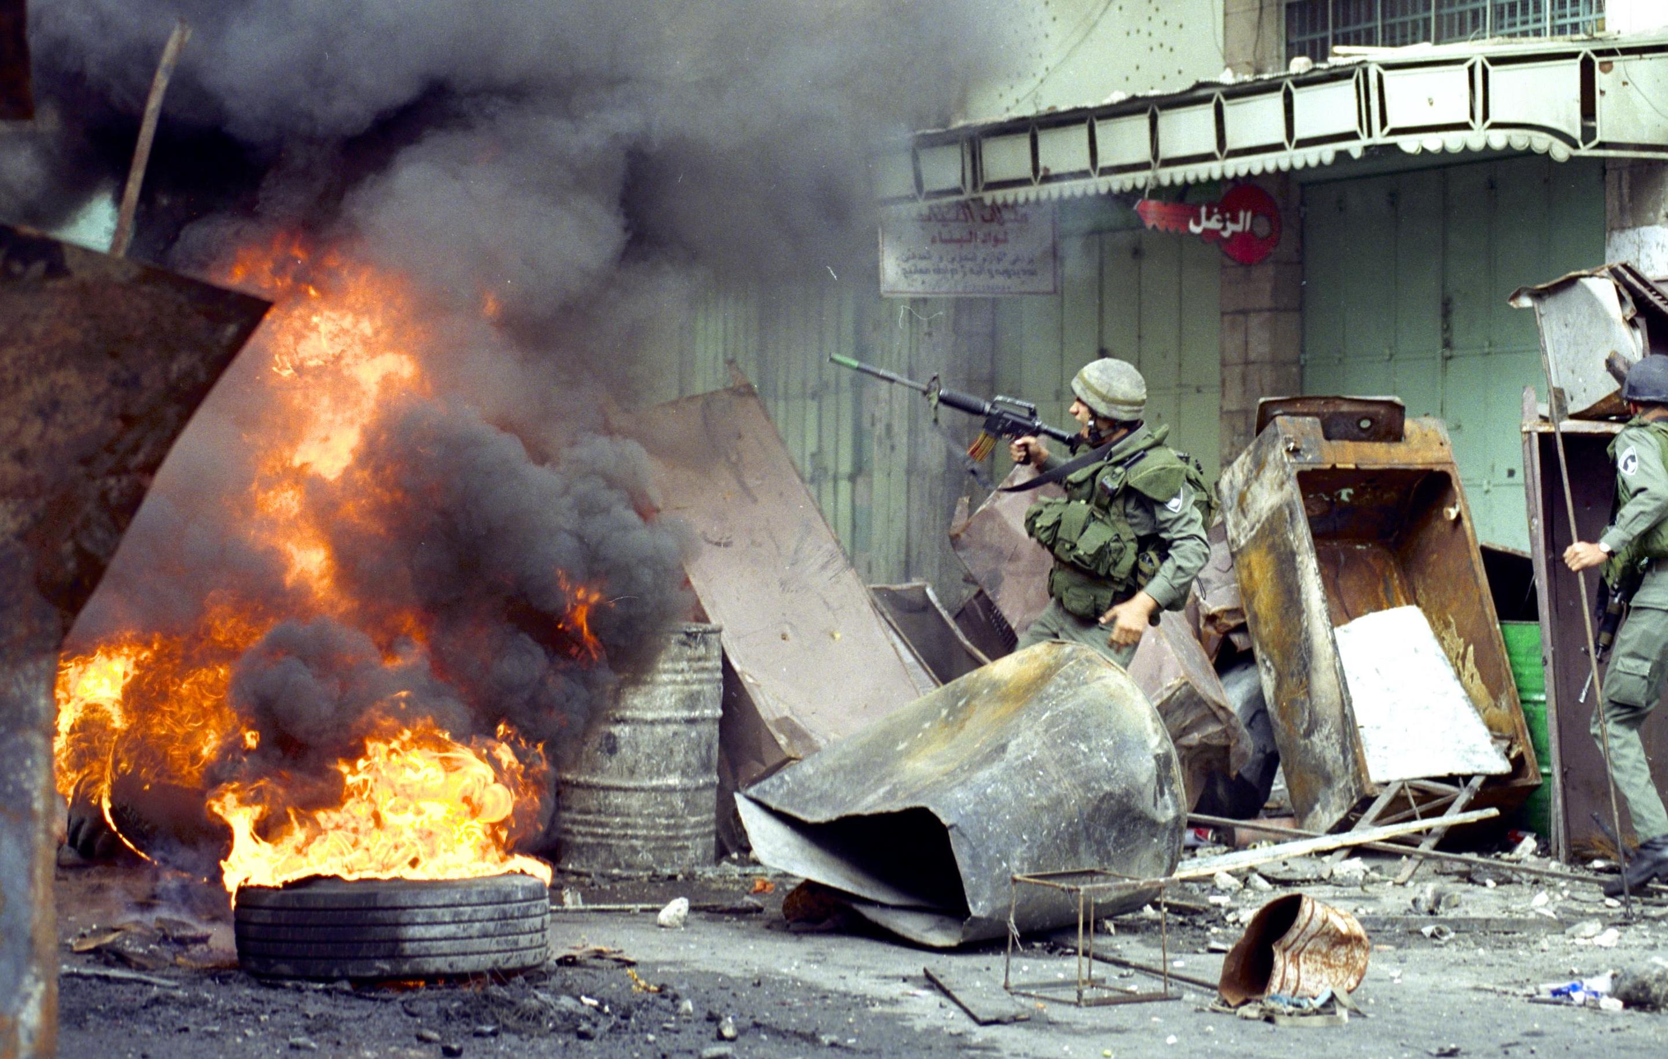
Many times people who have been freed from anxiety it was like a light had been turned on—their smiles came back, and their attitudes completely changed.

Slide 180
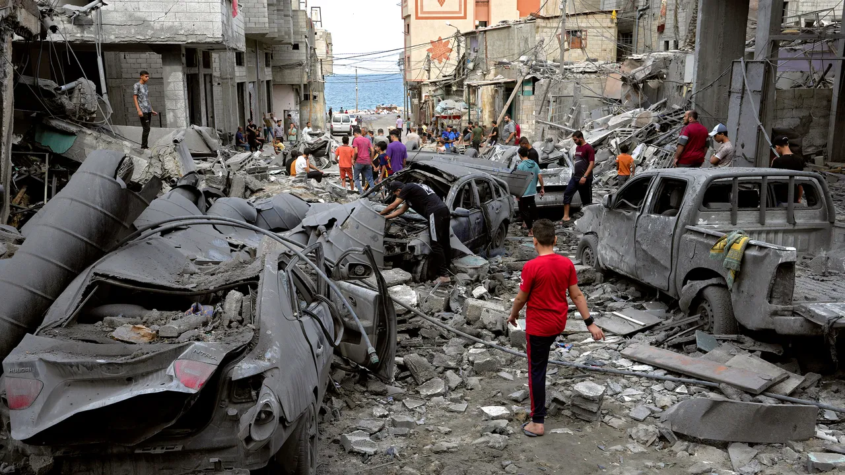
Many times people who have been freed from anxiety it was like a light had been turned on—their smiles came back, and their attitudes completely changed.

Slide 181
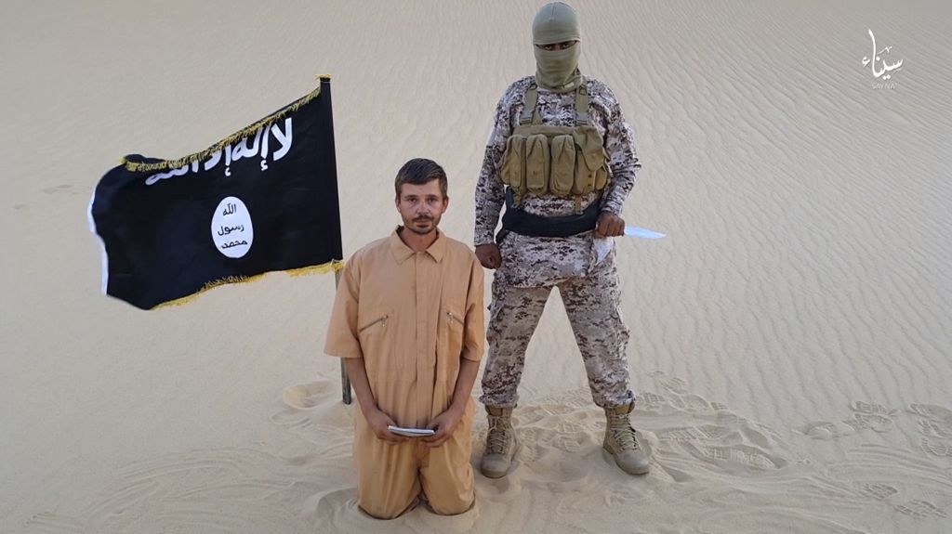
Many times people who have been freed from anxiety it was like a light had been turned on—their smiles came back, and their attitudes completely changed.

Slide 182
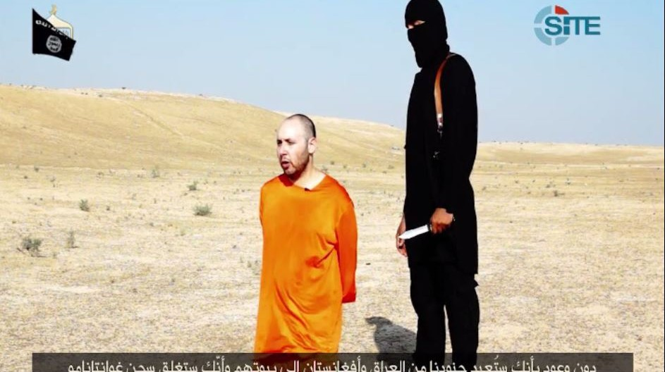
Many times people who have been freed from anxiety it was like a light had been turned on—their smiles came back, and their attitudes completely changed.

Slide 183
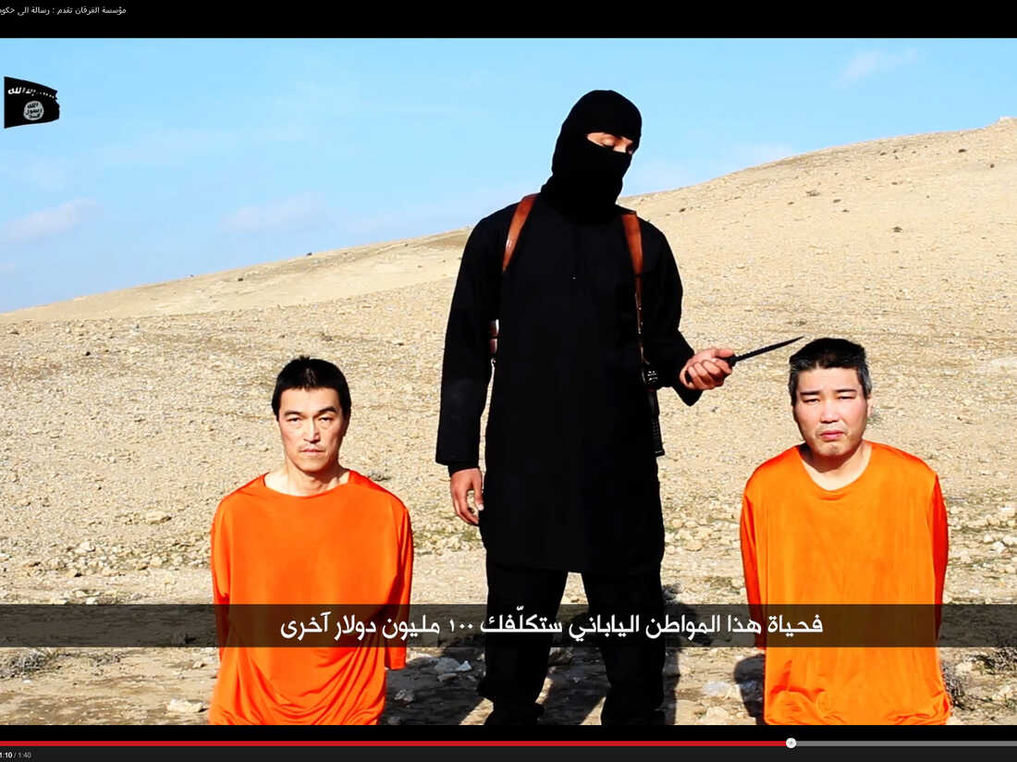
Many times people who have been freed from anxiety it was like a light had been turned on—their smiles came back, and their attitudes completely changed.

Slide 184
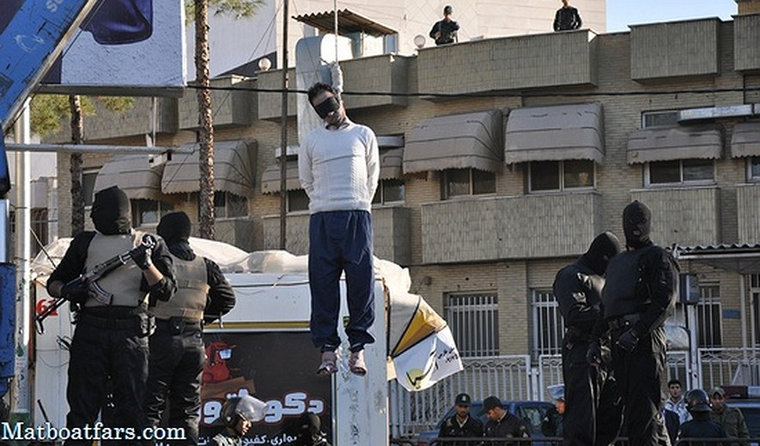
Many times people who have been freed from anxiety it was like a light had been turned on—their smiles came back, and their attitudes completely changed.

Slide 185
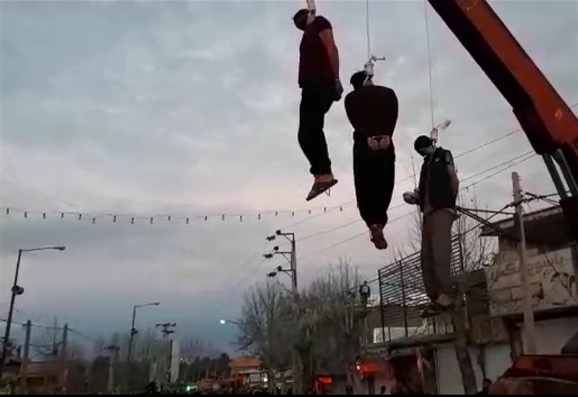
Photos Of the Islamic Colors
Islamic Ideology
The Koran and their Messenger is Mohamad
Sins of the Islamic Countries
Photos of Beheadings>

Slide 186
Judgement and War is now
on our Doorstep!

Slide 187
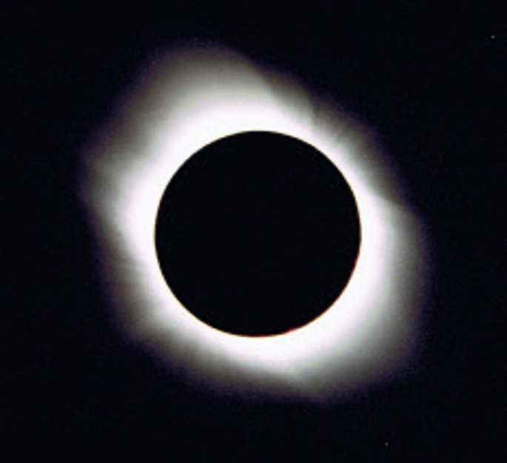
Judgement and War is now
on our Doorstep!

Slide 188
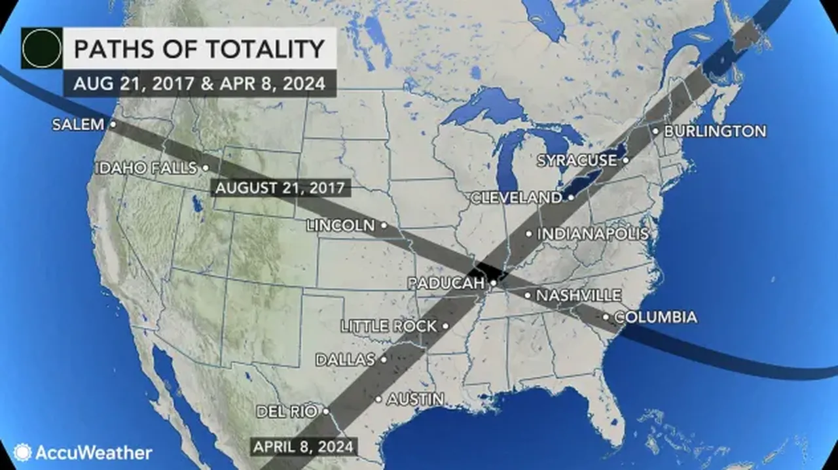
1 Thessalonians 4:13-18
13 But I do not want you to be ignorant, brethren, concerning those who have fallen asleep, lest you sorrow as others who have no hope. 14 For if we believe that Jesus died and rose again, even so God will bring with Him those who sleep in Jesus.

Slide 189
What does a solar eclipse mean to Jews?
“In Jewish tradition, a total solar eclipse is a warning to the Gentiles and a sign of judgment on the nations," Mark Blitz said in an interview with WND March 19, 2015

Slide 190
Psalm 9:17
“The wicked shall be turned into hell, And all the nations that forget God”

Slide 191
1 Thessalonians 4:13-18
13 But I do not want you to be ignorant, brethren, concerning those who have fallen asleep, lest you sorrow as others who have no hope. 14 For if we believe that Jesus died and rose again, even so God will bring with Him those who sleep in Jesus.

Slide 192
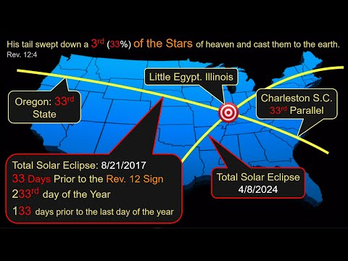
1 Thessalonians 4:13-18
13 But I do not want you to be ignorant, brethren, concerning those who have fallen asleep, lest you sorrow as others who have no hope. 14 For if we believe that Jesus died and rose again, even so God will bring with Him those who sleep in Jesus.

Slide 193
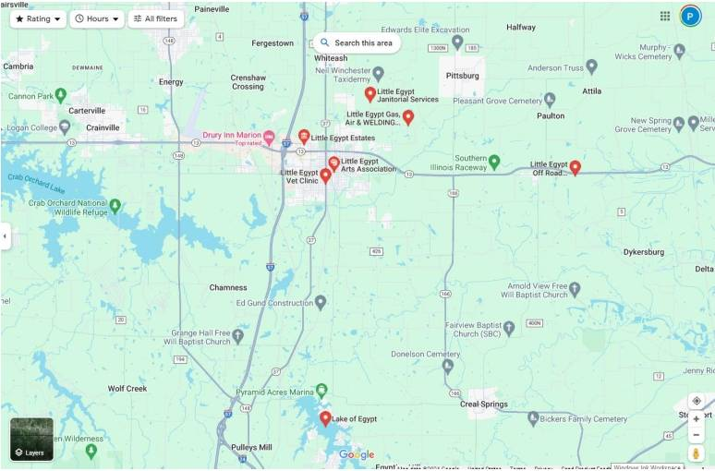
1 Thessalonians 4:13-18
13 But I do not want you to be ignorant, brethren, concerning those who have fallen asleep, lest you sorrow as others who have no hope. 14 For if we believe that Jesus died and rose again, even so God will bring with Him those who sleep in Jesus.

Slide 194
1 Thessalonians 4:13-18
13 But I do not want you to be ignorant, brethren, concerning those who have fallen asleep, lest you sorrow as others who have no hope. 14 For if we believe that Jesus died and rose again, even so God will bring with Him those who sleep in Jesus.

Slide 195
1 Thessalonians 4:13-18
13 But I do not want you to be ignorant, brethren, concerning those who have fallen asleep, lest you sorrow as others who have no hope. 14 For if we believe that Jesus died and rose again, even so God will bring with Him those who sleep in Jesus.

Slide 196
15 For this we say to you by the word of the Lord, that we who are alive and remain until the coming of the Lord will by no means precede those who are asleep. 16 For the Lord Himself will descend from heaven with a shout, with the voice of an archangel, and with the trumpet of God. And the dead in Christ will rise first.

Slide 197
17 Then we who are alive and remain shall be caught up together with them in the clouds to meet the Lord in the air. And thus we shall always be with the Lord. 18 Therefore comfort one another with these words.

Slide 198
1 Corinthians 15:50-54
50 Now this I say, brethren, that flesh and blood cannot inherit the kingdom of God; nor does corruption inherit incorruption. 51 Behold, I tell you a mystery: We shall not all sleep, but we shall all be changed-- 52 in a moment, in the twinkling of an eye, at the last trumpet. For the trumpet will sound, and the dead will be raised incorruptible, and we shall be changed.

Slide 199
53 For this corruptible must put on incorruption, and this mortal must put on immortality. 54 So when this corruptible has put on incorruption, and this mortal has put on immortality, then shall be brought to pass the saying that is written: "Death is swallowed up in victory."

Slide 200

20 Again, when a righteous man turns from his righteousness and commits iniquity, and I lay a stumbling block before him, he shall die; because you did not give him warning, he shall die in his sin, and his righteousness which he has done shall not be remembered; but his blood I will require at your hand.

Slide 201
Acts 2:38-39
38 Then Peter said to them, "Repent, and let every one of you be baptized in the name of Jesus Christ for the remission of sins; and you shall receive the gift of the Holy Spirit. 39 For the promise is to you and to your children, and to all who are afar off, as many as the Lord our God will call."

Slide 202

Donate with our QR code app to
Amazing Grace Christian Fellowship
Donations are Deeply Appreciated!

