Slide 2
“This is Amazing Grace”
(Phil Wickham)

Slide 3
Who breaks the power of sin and darkness. Who’s love is mighty and so much stronger. The King of

Slide 4
glory ,the king above all kings. Who shakes the whole earth with holy thunder. And leaves us

Slide 5
in awe and wonder? The King of Glory, the King above all Kings. This is amazing grace. This is

Slide 6
unfailing love. That you would would take my place. That you would bear my cross. You laid down your

Slide 7
life. That I would be set free. Oh, Jesus I sing for all that you’ve done for me. Who brings our chaos back

Slide 8
into order. Who makes the orphans a son and daughter. The King of Glory, The King of Glory

Slide 9
into order. Who makes the orphans a son and daughter. The King of Glory, The King of Glory

Slide 10
Who rules the nation. With truth and justice.Shines like the sun in all of his brilliance. The King of Glory

Slide 11
The King above all Kings. This is Amazing Grace. This is unfailing love. That you would take my place.

Slide 12
That you would bear my cross. You laid down your life. That I would be set free. Oh, Jesus, I sing for

Slide 13
All that you,ve done for me. Worthy is the Lamb who was slain. Worthy is the King who conquered the

Slide 14
grave. Worthy is the Lamb who was slain. Worthy is the King who conquered the grave. Worthy is the

Slide 15
Lamb who was slain. Worthy, Worthy,Worthy. This is Amazing Grace. This is unfailing love. That you

Slide 16
would take my place. That you would bear my cross. You laid down your life. That I would be set free

Slide 17
Oh, Jesus I sing for. All that you’ve done for me.

Slide 18
Goodness of God
(by Bethel)

Slide 19
I love You, Lord For Your mercy never fails me All my days, I've been held in Your hands From the moment

Slide 20
that I wake up Until I lay my head Oh, I will sing of the goodness of God And all my life You have been

Slide 21
faithful And all my life You have been so, so good With every breath that I am able Oh, I will sing of the

Slide 22
goodness of God I love Your voice You have led me through the fire In the darkest night You are close

Slide 23
God (yeah) And all my life You have been faithful (oh) And all my life You have been so, so good With

Slide 24
every breath that I am able Oh, I will sing of the goodness of God (yeah) 'Cause Your goodness is

Slide 25
running after It's running after me Your goodness is running after It's running after me With my life laid

Slide 26
down I'm surrendered now I give You everything
'Cause Your goodness is running after It's running

Slide 27
after me (oh-oh) 'Cause Your goodness is running after It's running after me Your goodness is running

Slide 28
after It's running after me With my life laid down I'm surrendered now I give You everything 'Cause Your

Slide 29
goodness is running after It keeps running after me
And all my life You have been faithful And all my life

Slide 30
You have been so, so good With every breath that I am able Oh, I'm gonna sing of the goodness of God

Slide 31
(I'm gonna sing, I'm gonna sing) 'Cause all my life You have been faithful And all my life You have been

Slide 32
so, so good With every breath that I am able Oh, I'm gonna sing of the goodness of God Oh, I'm gonna

Slide 33
sing of the goodness of God

Slide 34
“Worthy Of It All”
(Bethel Music)

Slide 35
All the saints and angels. They bow before the throne. All the elders cast their crowns before the

Slide 36
Lamb of God and sing. All the saints and angels. They bow before your throne. All the elders cast their

Slide 37
Crowns before the lamb of God and sing. You are worthy of it all. You are worthy of it all. For from you

Slide 38
All. For from you are all things and to you are all things. You deserve the glory. Day and night, night

Slide 39
Night and day. Let incense arise. Day and night, night and day. Let incense arise. Day and night, night

Slide 40
And day let incense arise. Day and night night and day. You are worthy of it all. You are worthy of it all

Slide 41
For from you are al things. And to you are all things. You deserve the glory. You are worthy of it all. You

Slide 42
Are worthy of it all. For from you are all things and to you are all things. You deserve the glory. We exalt

Slide 43
Thee. We exalt thee. We exalt thee, Oh, Lord.
We exalt thee. We exalt thee, We exalt thee, Oh

Slide 44
“Great are you Lord”
(All Sons and Daughters)

Slide 45
You give life, You are love. You bring light in the darkness. You give hope, You restore

Slide 46
Every heart that is broken. And great are you Lord. It’s your breath in our lungs so we

Slide 47
Pour out our praise. We pour out our praise.
It’s your breath in our lungs. So we pour out

Slide 48
Our praise to you only. You give life, you are love. You bring light to the darkness. You

Slide 49
Give hope, You restore. Every heart that is broken. Great are you Lord. It’s your breath

Slide 50
In our lungs. So we pour out our praise we pour out our praise. It’s your breath in our

Slide 51
Lungs so we pour out our praise to you only. It’s your breath in our lungs. So we

Slide 52
Pour out our praise we pour out our praise. It’s your breath in our lungs. So we pour out

Slide 53
Our praise to you only. And all the earth will shout your praise. Our hearts will cry, these

Slide 54
Bones will sing. Great are You, Lord. And all the earth will shout your praise. Our hearts

Slide 55
Will cry these bones will sing. Great are you,Lord. And all the earth will shout your

Slide 56
Praise Our hearts will cry these bones will sing. Great are you, Lord. It’s your breath in

Slide 57
Our Lungs. So we pour out our praise. We pour out our praise. It’s your breath in our

Slide 58
Lungs so we pour out our praise to you only. Great are you, Lord. It’s your breath in

Slide 59
Our lungs so we pour out our praise. Pour out our praise. It’s your breath in our lungs

Slide 60
So we pour out our praise to you only. Great are you , Lord.

Slide 61
Gratitude
(Brandon Lake)

Slide 62
All my words fall short I got nothing new How could I express All my gratitude? I could sing these songs

Slide 63
As I often do But every song must end And You never do So I throw up my hands And praise You

Slide 64
again and again 'Cause all that I have is a hallelujah
Hallelujah And I know it's not much But I've nothing

Slide 65
else fit for a King Except for a heart singing hallelujah Hallelujah I've got one response I've got

Slide 66
just one move With my arm stretched wide I will worship You So I throw up my hands And praise You

Slide 67
again and again 'Cause all that I have is a hallelujah
Hallelujah And I know it's not much But I've nothing

Slide 68
else fit for a King Except for a heart singing hallelujah Hallelujah So come on, my soul Oh, don't

Slide 69
you get shy on me Lift up your song 'Cause you've got a lion inside of those lungs Get up and praise the

Slide 70
Lord Oh come on, my soul Oh, don't you get shy on me Lift up your song 'Cause you've got a lion inside

Slide 71
of those lungs Get up and praise the Lord Come on, my soul Oh, don't you get shy on me Lift up your

Slide 72
song 'Cause you've got a lion inside of those lungs Get up and praise the Lord, hey Praise the Lord

Slide 73
Praise the Lord Praise the Lord So I throw up my hands Praise You again and again 'Cause all that I

Slide 74
have is a hallelujah Hallelujah And I know it's not much But I've nothing else fit for a King Except for a

Slide 75
heart singing hallelujah Hallelujah

Slide 78
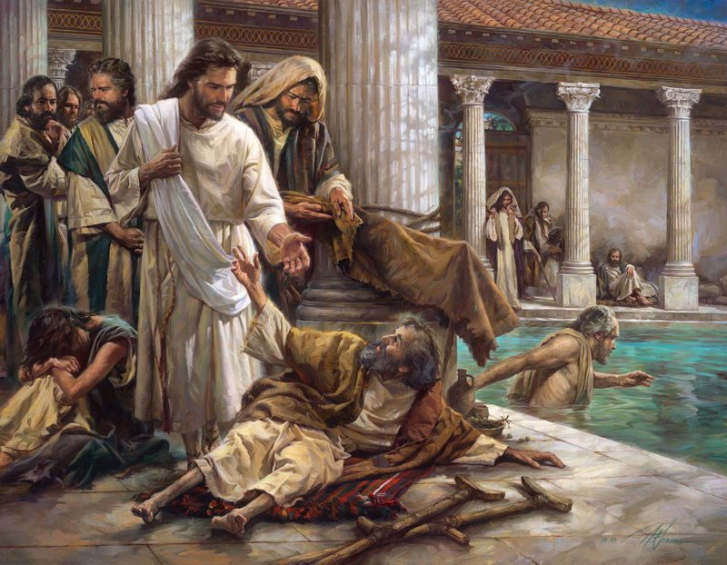
Jesus Will Always Be With Us
By Pastor Fee Soliven
Psalm 23:1-6
Sunday Morning
April 7, 2024

Slide 79
Psalm 23: 1-6
1 The LORD is my shepherd; I shall not want. 2 He makes me to lie down in green pastures; He leads me beside the still waters. 3 He restores my soul; He leads me in the paths of righteousness For His name's sake. 4 Yea, though I walk through the valley of the shadow of death, I will fear no evil; For You are with me; Your rod and Your staff, they comfort me.

Slide 80
5 You prepare a table before me in the presence of my enemies; You anoint my head with oil; My cup runs over. 6 Surely goodness and mercy shall follow me All the days of my life; And I will dwell in the house of the LORD Forever.

Slide 81
Psalm 23:4
“Yea, though I walk through the valley of the shadow of death, I will fear no evil; For You are with me; Your rod and Your staff, they comfort me”

Slide 82
Valley Experiences Are Inevitable

Slide 83
Psalm 34:17-18
17 The righteous cry out, and the LORD hears, And delivers them out of all their troubles. 18 The LORD is near to those who have a broken heart, And saves such as have a contrite spirit.

Slide 84
Psalm 73:25-26
25 Whom have I in heaven but You? And there is none upon earth that I desire besides You. 26 My flesh and my heart fail; But God is the strength of my heart and my portion forever.

Slide 85
Deuteronomy 31:6
“Be strong and of good courage, do not fear nor be afraid of them; for the LORD your God, He is the One who goes with you. He will not leave you nor forsake you."

Slide 86
Psalm 34:19-22
19 Many are the afflictions of the righteous, But the LORD delivers him out of them all. 20 He guards all his bones; Not one of them is broken. 21 Evil shall slay the wicked, And those who hate the righteous shall be condemned. 22 The LORD redeems the soul of His servants, And none of those who trust in Him shall be condemned.

Slide 87
God Controls the Depth and The Length of a Valley Experience

Slide 88
2 Corinthians 6:4-10
4 But in all things we commend ourselves as ministers of God: in much patience, in tribulations, in needs, in distresses, 5 in stripes, in imprisonments, in tumults, in labors, in sleeplessness, in fastings; 6 by purity, by knowledge, by longsuffering, by kindness, by the Holy Spirit, by sincere love, 7 by the word of truth, by the power of God, by the armor of righteousness on the right hand and on the left,

Slide 89
8 by honor and dishonor, by evil report and good report; as deceivers, and yet true; 9 as unknown, and yet well known; as dying, and behold we live; as chastened, and yet not killed; 10 as sorrowful, yet always rejoicing; as poor, yet making many rich; as having nothing, and yet possessing all things.

Slide 90
Psalm 37:23-24
23 The steps of a good man are ordered by the LORD, And He delights in his way. 24 Though he fall, he shall not be utterly cast down; For the LORD upholds him with His hand.

Slide 91
Sometimes People Respond Negatively in
a Valley

Slide 92
We do not have a solid belief system

Slide 93
Ephesians 3:17-19
17 that Christ may dwell in your hearts through faith; that you, being rooted and grounded in love, 18 may be able to comprehend with all the saints what is the width and length and depth and height-- 19 to know the love of Christ which passes knowledge; that you may be filled with all the fullness of God.

Slide 94
We don’t understand the ways of the Lord

Slide 95
Psalm 25:4-7
4 Show me Your ways, O LORD; Teach me Your paths. 5 Lead me in Your truth and teach me, For You are the God of my salvation;On You I wait all the day. 6 Remember, O LORD, Your tender mercies and Your lovingkindnesses, For they are from of old. 7 Do not remember the sins of my youth, nor my transgressions; According to Your mercy remember me, For Your goodness' sake, O LORD.

Slide 96
We Don’t Know His Promises

Slide 97
Psalm 119:1-12
1 Blessed are the undefiled in the way, Who walk in the law of the LORD! 2 Blessed are those who keep His testimonies, Who seek Him with the whole heart! 3 They also do no iniquity; They walk in His ways. 4 You have commanded us To keep Your precepts diligently. 5 Oh, that my ways were directed To keep Your statutes! 6 Then I would not be ashamed, When I look into all Your commandments.

Slide 98
7 I will praise You with uprightness of heart, When I learn Your righteous judgments. 8 I will keep Your statutes; Oh, do not forsake me utterly! 9 How can a young man cleanse his way? By taking heed according to Your word. 10 With my whole heart I have sought You; Oh, let me not wander from Your commandments! 11 Your word I have hidden in my heart, That I might not sin against You! 12 Blessed are You, O LORD! Teach me Your statutes!

Slide 99
There Is A Correct Way To Respond To Life’s Valleys

Slide 100
Surrender To God

Slide 101
Romans 8:13-16
13 For as many as are led by the Spirit of God, these are sons of God. 15 For you did not receive the spirit of bondage again to fear, but you received the Spirit of adoption by whom we cry out, "Abba, Father." 16 The Spirit Himself bears witness with our spirit that we are children of God,

Slide 102
Believe That the Lord Will Use
This Experience for Good

Slide 103
Romans 8:28
“And we know that all things work together for good to those who love God, to those who are the called according to His purpose”
Saints, God has the best in mind for us.

Slide 104
Rest in His Wisdom, Love, And Power

Slide 105
Ephesians 6:10
“Finally, my brethren, be strong in the Lord and in the power of His might”

Slide 106
Thank Him For Bringing You
Through The Valley

Slide 107
Colossians 1:10-14
10 that you may have a walk worthy of the Lord, fully pleasing Him, being fruitful in every good work and increasing in the knowledge of God; 11 strengthened with all might, according to His glorious power, for all patience and longsuffering with joy;

Slide 108
12 giving thanks to the Father who has qualified us to be partakers of the inheritance of the saints in the light. 13 He has delivered us from the power of darkness and conveyed us into the kingdom of the Son of His love, 14 in whom we have redemption through His blood, the forgiveness of sins.

Slide 109
1 Thessalonians 4:13-18
13 But I do not want you to be ignorant, brethren, concerning those who have fallen asleep, lest you sorrow as others who have no hope. 14 For if we believe that Jesus died and rose again, even so God will bring with Him those who sleep in Jesus.

Slide 110
15 For this we say to you by the word of the Lord, that we who are alive and remain until the coming of the Lord will by no means precede those who are asleep. 16 For the Lord Himself will descend from heaven with a shout, with the voice of an archangel, and with the trumpet of God. And the dead in Christ will rise first.

Slide 111
17 Then we who are alive and remain shall be caught up together with them in the clouds to meet the Lord in the air. And thus we shall always be with the Lord. 18 Therefore comfort one another with these words.

Slide 112
1 Corinthians 15:50-54
50 Now this I say, brethren, that flesh and blood cannot inherit the kingdom of God; nor does corruption inherit incorruption. 51 Behold, I tell you a mystery: We shall not all sleep, but we shall all be changed-- 52 in a moment, in the twinkling of an eye, at the last trumpet. For the trumpet will sound, and the dead will be raised incorruptible, and we shall be changed.

Slide 113
53 For this corruptible must put on incorruption, and this mortal must put on immortality. 54 So when this corruptible has put on incorruption, and this mortal has put on immortality, then shall be brought to pass the saying that is written: "Death is swallowed up in victory."

Slide 114
20 Again, when a righteous man turns from his righteousness and commits iniquity, and I lay a stumbling block before him, he shall die; because you did not give him warning, he shall die in his sin, and his righteousness which he has done shall not be remembered; but his blood I will require at your hand.

Slide 115
Acts 2:38-39
38 Then Peter said to them, "Repent, and let every one of you be baptized in the name of Jesus Christ for the remission of sins; and you shall receive the gift of the Holy Spirit. 39 For the promise is to you and to your children, and to all who are afar off, as many as the Lord our God will call."

Slide 116
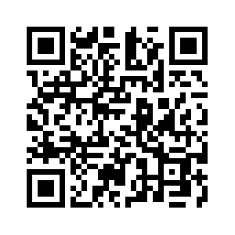
Donate with our QR code app to
Amazing Grace Christian Fellowship
Donations are Deeply Appreciated!

