Slide 1


Slide 2
We’re Here For You
(Jeremy Riddle)

Slide 3
Jesus we are here, we're here for You We’ve gathered in this place to honor You To worship You in

Slide 4
Spirit and in truth Oh Jesus we are here, we're for You Lift up your hands Let your praises rise Open

Slide 5
are here, we're here for You We've gathered in this place to honor You (You alone) To worship You in

Slide 6
Spirit and in truth Oh Jesus we are here, we're for You (Oh we're here for You!) Break out in praise Let

Slide 7
your shout arise For our God redeemed us With His mighty power Oh let's sing together Let us magnify

Slide 8
His name! Jesus we are here, we're here for You We've gathered in this place to honor You To worship

Slide 9
You in Spirit and in truth Oh Jesus we are here, we're for You (To glorify Your name) (To lift up holy

Slide 10
praise) (To lift up holy praise) Jesus we are here, we're here for You We've gathered in this

Slide 11
place to honor You (You alone) To worship You in Spirit and in truth Oh Jesus we are here, we're for

Slide 12
You (Oh God, how good it is to praise You) (How good it is to worship) (Oh how good it is to pour out,

Slide 13
praise You) (To lift up holy praise) Jesus we are here, we're here for You We've gathered in this place

Slide 14
to honor You To worship You in Spirit and in truth Jesus we are here, we're for You (Here for You)

Slide 15
(We're here for You, Lord) (We're here for You).

Slide 16
Stand In Your Love
(Bethel)

Slide 17
When darkness tries to roll over my bones When sorrow comes to steal the joy I own When

Slide 18
brokenness and pain is all I know I won't be shaken, no, I won't be shaken 'Cause my fear doesn't stand a

Slide 19
chance When I stand in Your love My fear doesn't stand a chance When I stand in Your love My fear

Slide 20
doesn't stand a chance When I stand in Your love
Shame no longer has a place to hide And I am not a

Slide 21
captive to the lies I'm not afraid to leave my past behind Oh, I won't be shaken, no, I won't be shaken

Slide 22
My fear doesn't stand a chance When I stand in Your love My fear doesn't stand a chance When I stand in

Slide 23
Your love My fear doesn't stand a chance When I stand in Your love Oh, I'm standing There's power

Slide 24
that can break off every chain There's power that can empty out a grave There's resurrection power that

Slide 25
can save There's power in Your name, power in Your name My fear doesn't stand a chance When I stand

Slide 26
in Your love My fear doesn't stand a chance When I stand in Your love My fear doesn't stand a chance

Slide 27
When I stand in Your love Oh, when, when I'm standing in Your love Oh, my fear doesn't stand a

Slide 28
chance When I stand in Your love My fear doesn't stand a chance When I stand in Your love My fear

Slide 29
chance When I stand in Your love My fear doesn't stand a chance When I stand in Your love My fear

Slide 30
doesn't stand a chance When I stand in Your love
Oh, I standing in Your love Oh, standing on the rock

Slide 31
Oh, I am standing, standing in Your love

Slide 32
“His Name is Jesus”
(Jeremy Riddle)

Slide 33
There's only One strong enough to save There's only One who overcame the grave There's only One

Slide 34
who's worthy of all praise And in His hands, the keys of death and hell And in His name, a power that can

Slide 35
heal And by His blood, our sins are washed away His name is Jesus His name is Jesus His name is

Slide 36
Wonderful Counselor, Almighty God! Nations kneel
And glorify the Lord! Let all the earth Tremble for He

Slide 37
comes! And He will judge the living and the dead!
The Son of Man coming on the clouds With trumpet

Slide 38
sound and every knee will bow And tongue confess the Name above all names! His name is Jesus His

Slide 39
name is Jesus His name is Wonderful Counselor, Almighty God! His name is Jesus His name is Jesus

Slide 40
His name is Wonderful Counselor, Almighty God! HE IS COUNSELOR! HE IS MIGHTY GOD! HE'S THE

Slide 41
PRINCE OF PEACE! THE OMNIPOTENT! HE IS WONDERFUL! HE IS RADIANT! THE ALMIGHTY

Slide 42
GOD! His name is Jesus His name is Jesus His name is Wonderful Counselor, Almighty God! His

Slide 43
name is Jesus His name is Jesus His name is Wonderful Counselor, Almighty God! We worship

Slide 44
You We give our lives to You We sing out We cry out
We worship You We give our lives to You Yes, we

Slide 45
sing out Yes, we cry out His name is Jesus His name is Jesus His name is Wonderful Counselor, Almighty

Slide 46
God! His name is Jesus Jesus Wonderful Counselor, Almighty God!

Slide 47
“Dance with Me”
(Paul Wilbur)

Slide 48
Dance with me O lover of my soul To the song of all songs Romance me O lover of my soul To the song

Slide 49
of all songs Behold You have come Over the hills Upon the mountains To me You have run My beloved

Slide 50
You've captured my heart With You I will go You are my love You are my fair one Winter is past And the

Slide 51
springtime has come Dance with me.

Slide 52
“Revelation Song”
(Kari Jobe)

Slide 53
Worthy is the Lamb who was slain. Holy holy is he.Sing a new songto him who sits on Heaven’s

Slide 54
Mercy seat. Worthy is the Lamb who was slain. Holy, holy is he. Sing a new song to him who sits on

Slide 55
Heaven’s mercy seat. Holy, Holy, holy is the Lord God almighty. Who was and is to come. With all

Slide 56
Creation I sing. Praise to the King of Kings. You are my everything and I will Adore you. Clothed in

Slide 57
Rainbows of living color. Flashes of lightning rolls of thunder. Blessing and honor strength and glory and

Slide 58
Power be. To you the only wise King. Holy, holy, holy is the Lord god Almighty. Who was and is to come.

Slide 59
With all Creation I sing praise to the King of Kings. You are my everything and I will adore you. Filled

Slide 60
With wonder. Awe struck Wonder at the mention of your name. Jesus your name is power, breath and

Slide 61
Living water. Such a marvelous mystery. Holy,holy, holy is the Lord God almighty. Who was and is and is

Slide 62
To come. With all creation I sing. Praise to the king of Kings. You are my everything. And I will Adore you.

Slide 64


Slide 65
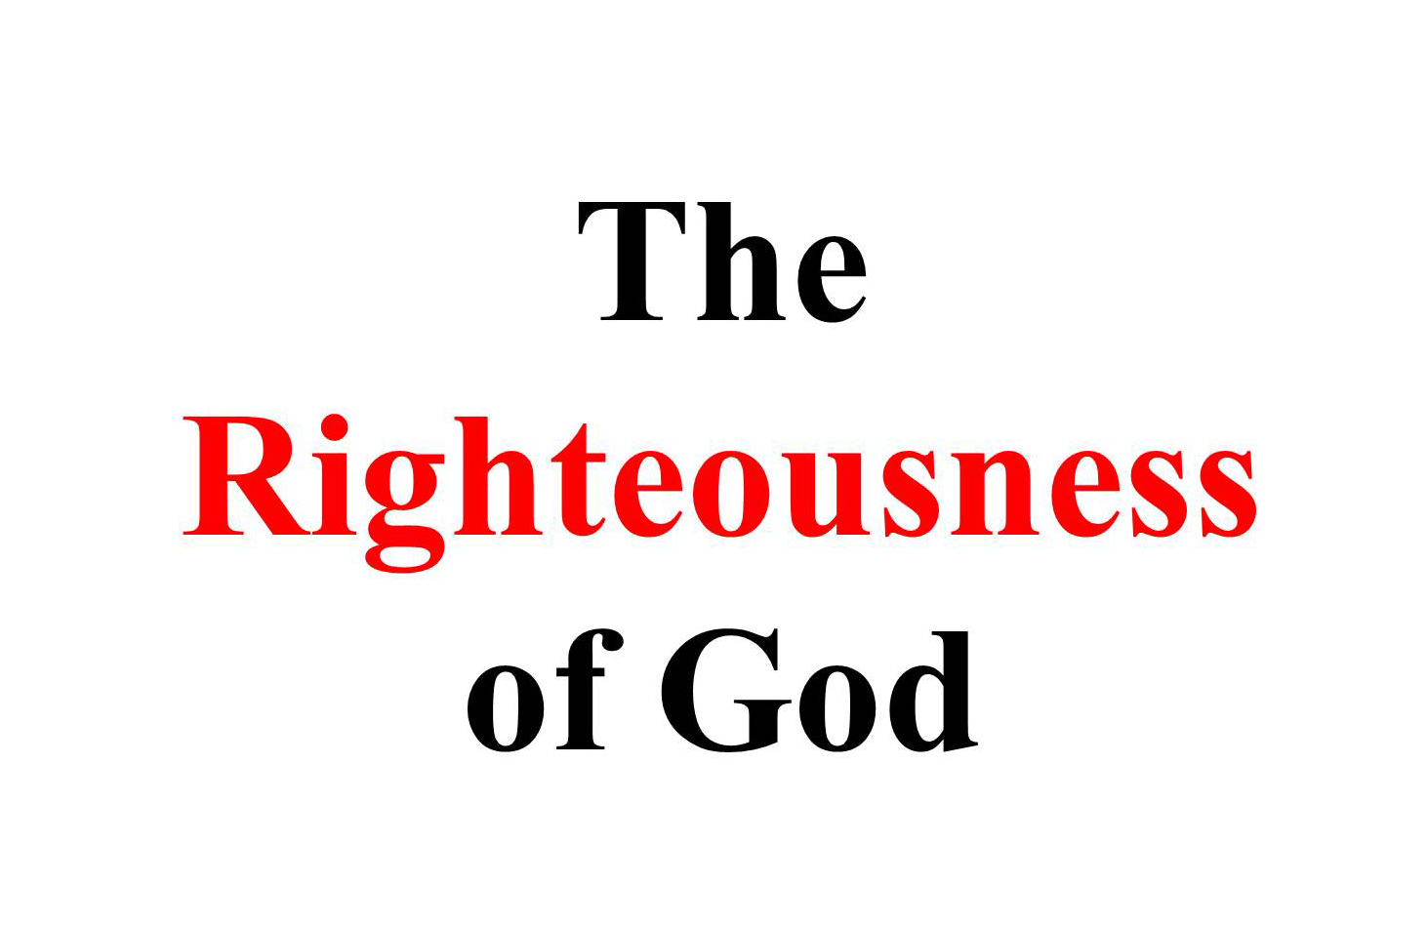

God Loves Righteousness
By Pastor Fee Soliven
1 Peter 3:18-22
Sunday Morning
May 19, 2024

Slide 66
1 Peter 3:18-22
18 Christ himself suffered for sins once. He was not guilty, but he suffered for those who are guilty to bring you to God. His body was killed, but he was made alive in the spirit. 19 And in the spirit he went and preached to the spirits in prison 20 who refused to obey God long ago in the time of Noah. God was waiting patiently for them while Noah was building the boat. Only a few people eight in all were saved by water.

Slide 67
21 And that water is like baptism that now saves you—not the washing of dirt from the body, but the promise made to God from a good conscience. And this is because Jesus Christ was raised from the dead. 22 Now Jesus has gone into heaven and is at God’s right side ruling over angels, authorities, and powers.

Slide 68
1. For thousands of years humankind never exceeded the speed of a horse (40-45 miles per hour). Now, not only do we speed down the interstate in our automobiles, but astronauts travel at 17,000 miles per hour in the space shuttle.

Slide 69
2. For thousands of years weapons of war were limited to a few war machines that could throw things, break down walls, and so forth. Most battles were hand-to-hand combat. One man could kill only one man at a time. Today one nuclear blast could kill millions instantly.

Slide 70
3. Only a few years ago homosexuality was considered an anomaly and looked upon as grossly perverted. Today it is celebrated by many as something to be admired.

Slide 71
4. The proliferation of Internet pornography and other media venues has caused our society to lose the ability to blush.

Slide 72
5. The epidemic of illegal drug use makes the days of prohibition seem surreal.

Slide 73
6. There was only one divorce in thirty at the turn of the twentieth century and now it’s one in two. Some are even predicting that marriage is becoming obsolete.

Slide 74
7. The explosion of computer technology is amazing. We find our daily lives changed by notebook computers, iPads, iPods, iPhones, GPSs, Internet, telecommunications, Facebook, Tweeter, Instagram and many other high-tech breakthroughs.

Slide 75
8. Doctors are transplanting hearts, livers, and other organs. New drugs are prolonging life for many, yet new diseases are cropping up that defy medication.

Slide 76
9. Innovative technology has caused traditional careers to evaporate. Employees must now plan to change their occupation two or three times in a lifetime.

Slide 77
10. Over 70,000,000 (million) babies aborted just in the USA alone. Their blood would fill lake Michigan!

Slide 78
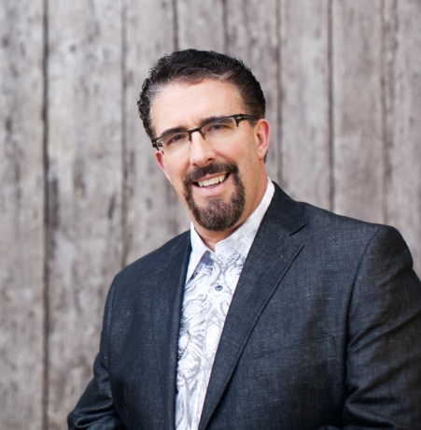
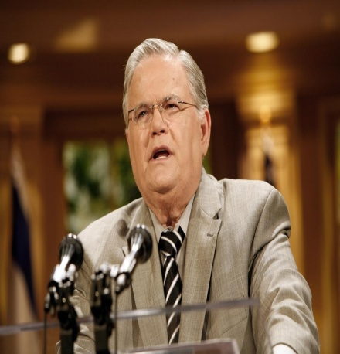
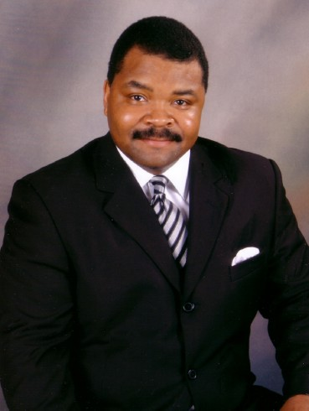
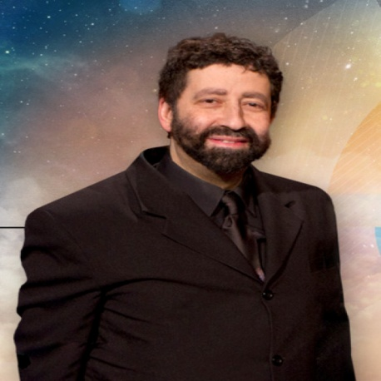
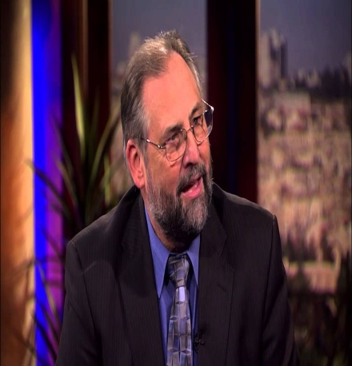
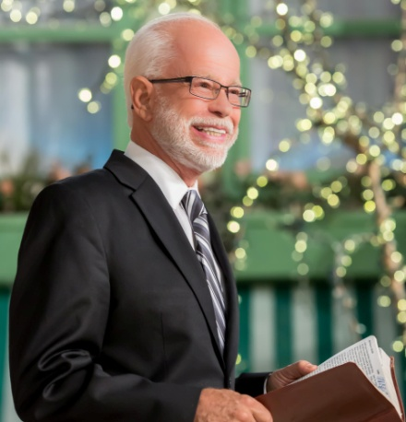
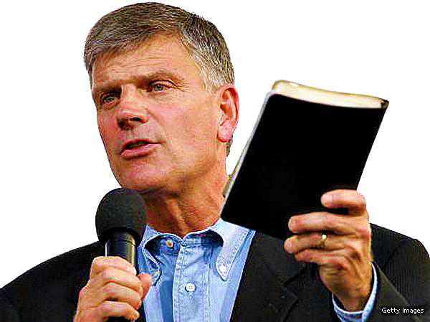
The Prophet’s of God
Warning Our World
Of The Soon Coming Judgments!

Slide 79
1. Noah Found Grace

Slide 80
Romans 9:14-19
(New Century Translation)
14 So what should we say about this? Is God unfair? In no way. 15 God said to Moses, “I will show kindness to anyone to whom I want to show kindness, and I will show mercy to anyone to whom I want to show mercy.”

Slide 81
16 So God will choose the one to whom he decides to show mercy; his choice does not depend on what people want or try to do. 17 The Scripture says to the king of Egypt: “I made you king for this reason: to show my power in you so that my name will be talked about in all the earth.”

Slide 82
18 So God shows mercy where he wants to show mercy, and he makes stubborn the people he wants to make stubborn.

Slide 83
Genesis 6:9
"This is the genealogy of Noah. Noah was a just man, perfect in his generations. Noah walked with God."

Slide 84
Matthew 5:16
"Let your light so shine before men, that they may see your good works and glorify your Father in heaven."

Slide 85
Proverbs 14:34-35
34 Righteousness exalts a nation, But sin is a reproach to any people. 35 The king's favor is toward a wise servant, But his wrath is against him who causes shame.

Slide 86
Acts 10:34-35
34 Then Peter opened his mouth and said: "In truth I perceive that God shows no partiality. 35 But in every nation whoever fears Him and works righteousness is accepted by Him.

Slide 87
1 John 2:28-29
28 And now, little children, abide in Him, that when He appears, we may have confidence and not be ashamed before Him at His coming. 29 If you know that He is righteous, you know that everyone who practices righteousness is born of Him.

Slide 88
2 Peter 3:9
"The Lord is not slack concerning His promise, as some count slackness, but is longsuffering toward us, not willing that any should perish but that all should come to repentance."

Slide 89
2. Noah Built an Escape

Slide 90
2 Peter 2:1-7
1 But there were also false prophets among the people, even as there will be false teachers among you, who will secretly bring in destructive heresies, even denying the Lord who bought them, and bring on themselves swift destruction. 2 And many will follow their destructive ways, because of whom the way of truth will be blasphemed.

Slide 91
3 By covetousness they will exploit you with deceptive words; for a long time their judgment has not been idle, and their destruction does not slumber. 4 For if God did not spare the angels who sinned, but cast them down to hell and delivered them into chains of darkness, to be reserved for judgment;

Slide 92
5 and did not spare the ancient world, but saved Noah, one of eight people, a preacher of righteousness, bringing in the flood on the world of the ungodly; 6 and turning the cities of Sodom and Gomorrah into ashes, condemned them to destruction, making them an example to those who afterward would live ungodly...

Slide 93
Genesis 6:22
"Thus Noah did; according to all that God commanded him, so he did."

Slide 94
Isaiah 1:19-20
(New Century Translation)
19 If you become willing and obey me, you will eat good crops from the land. 20 But if you refuse to obey and if you turn against me, you will be destroyed by your enemies’ swords.” The Lord himself said these things.

Slide 95
Romans 5:19
"For as by one man's disobedience many were made sinners, so also by one Man's obedience many will be made righteous."

Slide 96
1 Corinthians 1:21
"For since, in the wisdom of God, the world through wisdom did not know God, it pleased God through the foolishness of the message preached to save those who believe."

Slide 97
3. Noah Escaped God’s Judgment

Slide 98
1 Thessalonians 5:9-11
9 For God did not appoint us to wrath, but to obtain salvation through our Lord Jesus Christ, 10 who died for us, that whether we wake or sleep, we should live together with Him. 11 Therefore comfort each other and edify one another, just as you also are doing.

Slide 99
Hebrews 11:7
By faith Noah, being divinely warned of things not yet seen, moved with godly fear, prepared an ark for the saving of his household, by which he condemned the world and became heir of the righteousness which is according to faith.

Slide 100
John 10:27-30
27 My sheep hear My voice, and I know them, and they follow Me. 28 And I give them eternal life, and they shall never perish; neither shall anyone snatch them out of My hand. 29 My Father, who has given them to Me, is greater than all; and no one is able to snatch them out of My Father's hand. 30 I and My Father are one."

Slide 101
1 John 4:17-19
17 Love has been perfected among us in this: that we may have boldness in the day of judgment; because as He is, so are we in this world. 18 There is no fear in love; but perfect love casts out fear, because fear involves torment. But he who fears has not been made perfect in love. 19 We love Him because He first loved us.

Slide 102
2 Corinthians 5:11-15
(New Century Translation)
11 Since we know what it means to fear the Lord, we try to help people accept the truth about us. God knows what we really are, and I hope that in your hearts you know, too.

Slide 103
12 We are not trying to prove ourselves to you again, but we are telling you about ourselves so you will be proud of us. Then you will have an answer for those who are proud about things that can be seen rather than what is in the heart. 13 If we are out of our minds, it is for God. If we have our right minds, it is for you.

Slide 104
14 The love of Christ controls us, because we know that One died for all, so all have died. 15 Christ died for all so that those who live would not continue to live for themselves. He died for them and was raised from the dead so that they would live for him.

Slide 105
1 Thessalonians 4:13-18
13 But I do not want you to be ignorant, brethren, concerning those who have fallen asleep, lest you sorrow as others who have no hope. 14 For if we believe that Jesus died and rose again, even so God will bring with Him those who sleep in Jesus.

Slide 106
15 For this we say to you by the word of the Lord, that we who are alive and remain until the coming of the Lord will by no means precede those who are asleep. 16 For the Lord Himself will descend from heaven with a shout, with the voice of an archangel, and with the trumpet of God. And the dead in Christ will rise first.

Slide 107
17 Then we who are alive and remain shall be caught up together with them in the clouds to meet the Lord in the air. And thus we shall always be with the Lord. 18 Therefore comfort one another with these words.

Slide 108
1 Corinthians 15:50-54
50 Now this I say, brethren, that flesh and blood cannot inherit the kingdom of God; nor does corruption inherit incorruption. 51 Behold, I tell you a mystery: We shall not all sleep, but we shall all be changed-- 52 in a moment, in the twinkling of an eye, at the last trumpet. For the trumpet will sound, and the dead will be raised incorruptible, and we shall be changed.

Slide 109
53 For this corruptible must put on incorruption, and this mortal must put on immortality. 54 So when this corruptible has put on incorruption, and this mortal has put on immortality, then shall be brought to pass the saying that is written: "Death is swallowed up in victory."

Slide 110

20 Again, when a righteous man turns from his righteousness and commits iniquity, and I lay a stumbling block before him, he shall die; because you did not give him warning, he shall die in his sin, and his righteousness which he has done shall not be remembered; but his blood I will require at your hand.

Slide 111
Acts 2:38-39
38 Then Peter said to them, "Repent, and let every one of you be baptized in the name of Jesus Christ for the remission of sins; and you shall receive the gift of the Holy Spirit. 39 For the promise is to you and to your children, and to all who are afar off, as many as the Lord our God will call."

Slide 112
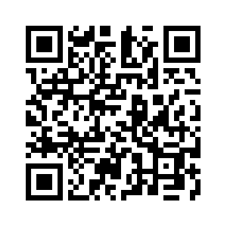
Donate with our QR code app to
Amazing Grace Christian Fellowship
Donations are Deeply Appreciated!

