Slide 2
Graves into Gardens
(Elevation Worship)

Slide 3
I searched the World but it couldn’t fill me. Man’s empty praise and treasures that fade Are never

Slide 4
Enough. Then you came along and put me back together And every desire Is now satisfied here in

Slide 5
Your love. Oh’ there’s nothing better than you. There’s nothing better than you. Lord there’s nothing

Slide 6
Nothing is better than you. Im not afraid to show you my weakness. My failures and flaws Lord you’ve

Slide 7
Seen them all and you still call me friend.Cause the God of the mountain. Is the God of the Valley.

Slide 8
There’s not a place. Your mercy and grace. Wont find me again. Oh there’s nothing better than you. There’s

Slide 9
Nothing better than you. Lord there’s nothing. Nothing is better than you. Oh there’s nothing better

Slide 10
Better than you. There’s nothing better than you. Lord’ there’s nothing. Nothing is better than you.

Slide 11
You turn mourning to dancing. You give beauty for ashes. You turn shame into glory. You’re the only one

Slide 12
Who can. You turn mourning to dancing. You give beauty for ashes. You turn shame into glory. You’re

Slide 13
The only one who can. You turn graves into gardens. You turn bones into armies. You turn seas into

Slide 14
Highways. You’re the only one who can you’re the only one who can. Oh there’s nothing better than you

Slide 15
There’s nothing better than you. Lord there’s nothing. Nothing is better than you. Oh there’s nothing better

Slide 16
Than you. There’s nothing better than you. Lord, there’s nothing. Nothing is better than you. You turn

Slide 17
Graves into gardens. You turn bones into armies. You turn seas into highways. You’re the only one who

Slide 18
Can. You turn graves into gardens. You turn bones into armies. You turn seas into highways you’re the

Slide 19
Only one who can. You’re the only one who. You’re the only one who can.

Slide 20
above all names Be exalted now in the heavens As Your glory fills this place You alone deserve our

Slide 21
praise You’re the name above all names Worthy is Your name, Jesus You deserve the praise Worthy is

Slide 22
Your name Worthy is Your name, Jesus You deserve the praise Worthy is Your name Worthy is Your

Slide 23
name, Jesus You deserve the praise Worthy is Your name Worthy is Your name, Jesus You deserve the

Slide 24
praise Worthy is Your name Oh, oh

Slide 25
“Build My Life”
(Pat Barret / Housefires)

Slide 26
Worthy of every song we could ever sing Worthy of all the praise we could ever bring Worthy of every

Slide 27
breath we could ever breathe We live for you Oh, we live for you Jesus, the Name above every other

Slide 28
name Jesus, the only One who could ever save (worthy...) Worthy of every breath we could ever

Slide 29
breathe We live for you Holy, there is no one like You There is none beside You Open up my eyes in

Slide 30
Jesus, the Name above every other name Jesus, the only One who could ever save Worthy of every

Slide 31
breathe we could ever breathe We live for You, Oh! We live for for You Holy, there is no one like You

Slide 32
There is none beside You Open up my eyes I wonder Show me who You are and fill me With Your

Slide 33
heart and lead me In your love to those around me I will build my life upon Your love It is a firm foundation

Slide 34
I will put my trust in You alone And I will not be shaken I will build my life upon Your love It is a firm

Slide 35
foundation I will put my trust in You alone And I will not be shaken Holy, there is no one like You There is

Slide 36
none beside You Open up my eyes in wonder Show me who You are and fill me With Your heart and lead

Slide 37
me In your love to those around me I will build my life upon Your love It is a firm foundation I will put my

Slide 38
trust in You alone And I will not be shaken I will build my life upon Your love It is a firm foundation I will put

Slide 39
my trust in You alone And I will not be shaken Lord

Slide 40
“Here I Am To Worship”
(Hillsong Worship)

Slide 41
Light of the world You stepped down into darkness
Opened my eyes, let me see Beauty that made this

Slide 42
heart adore You Hope of a life spent with You Here I am to worship Here I am to bow down Here I am to

Slide 43
say that You're my God You're altogether lovely
Altogether worthy Altogether wonderful to me King of all days Oh, so highly exalted Glorious in heaven

Slide 44
above Humbly You came to the earth You created All for love's sake became poor Here I am to worship

Slide 45
Here I am to bow down Here I am to say that You're my God You're altogether lovely Altogether worthy

Slide 46
Altogether wonderful to me Well, I'll never know how much it cost To see my sin upon that cross Well, I'll

Slide 47
never know how much it cost To see my sin upon that cross Well, I'll never know how much it cost To

Slide 48
see my sin upon that cross Well, I'll never know how much it cost To see my sin upon that cross

Slide 49
“Holy Spirit”
(Kim Walker)

Slide 50
There’s nothing worth more. That could ever come close. No thing can compare. You’re our living hope.

Slide 51
Your presence Lord. I’ve tasted and seen of the sweetest of loves. Where my heart becomes free

Slide 52
And my shame is undone. Your presence, Lord.
Holy spirit you are welcome here. Come flood this

Slide 53
place and fill the atmosphere. Your glory God is what our hearts long for. To be overcomed, By your

Slide 54
presence Lord. There’s nothing worth more. That could ever come close. No thing can compare.

Slide 55
you’re living hope. Your presence, Lord. I’ve tasted and seen of the sweetest of loves. Where my heart

Slide 56
becomes free and my shame is undone. Your presence, Lord. Holy Spirit you are welcome here

Slide 57
Come flood this place and fill the atmosphere. Your glory God is what our hearts long for. To be

Slide 58
overcome by your presence Lord. Your presence Lord. Let us become more aware of your presence

Slide 59
Let us experience the Glory of your goodness. Let us become. More aware of your presence. Let us

Slide 60
experience the Glory of your goodness. Let us become more aware of your presence. Let us

Slide 61
the atmosphere, Your glory God is what our heart longs for to be overcome. By your presence Lord.

Slide 62
Nothing Else
(Cody Carnes)

Slide 63
wanna leave Oh, I'm not here for blessings Jesus, You don't owe me anything More than anything that

Slide 64
You can do I just want You I'm sorry when I've just gone through the motions I'm sorry when I just sang

Slide 65
another song Take me back to where we started I open up my heart to You I'm sorry when I've come

Slide 66
with my agenda I'm sorry when I forgot that You're enough Take me back to where we started I open up

Slide 67
my heart to You I'm caught up in Your presence I just want to sit here at Your feet I'm caught up in this holy

Slide 68
moment I never wanna leave Oh, I'm not here for blessings Jesus, You don't owe me anything And

Slide 69
more than anything that You can do I just want You
I just want You Nothing else, nothing else Nothing

Slide 70
else will do I just want You Nothing else, nothing else
Nothing else will do I just want You Nothing else,

Slide 71
nothing else Nothing else will do I just want You Nothing else, nothing else, Jesus Nothing else will do

Slide 72
I just want You Nothing else, nothing else Nothing else will do I just want You Nothing else, nothing

Slide 73
else, Jesus Nothing else will do I'm coming back to where we started I'm coming back to where we

Slide 74
started When I first felt Your love You're all that matters, Jesus You're all that matters I'm coming

Slide 75
back to what really matters Just Your heart I just wanna bless Your heart, Jesus I'm caught up in

Slide 76
Your presence I just want to sit here at Your feet I'm caught up in this holy moment I never wanna leave

Slide 77
And oh, I'm not here for blessings Jesus, You don't owe me anything More than anything that You can

Slide 78
do Oh, I just want You

Slide 81
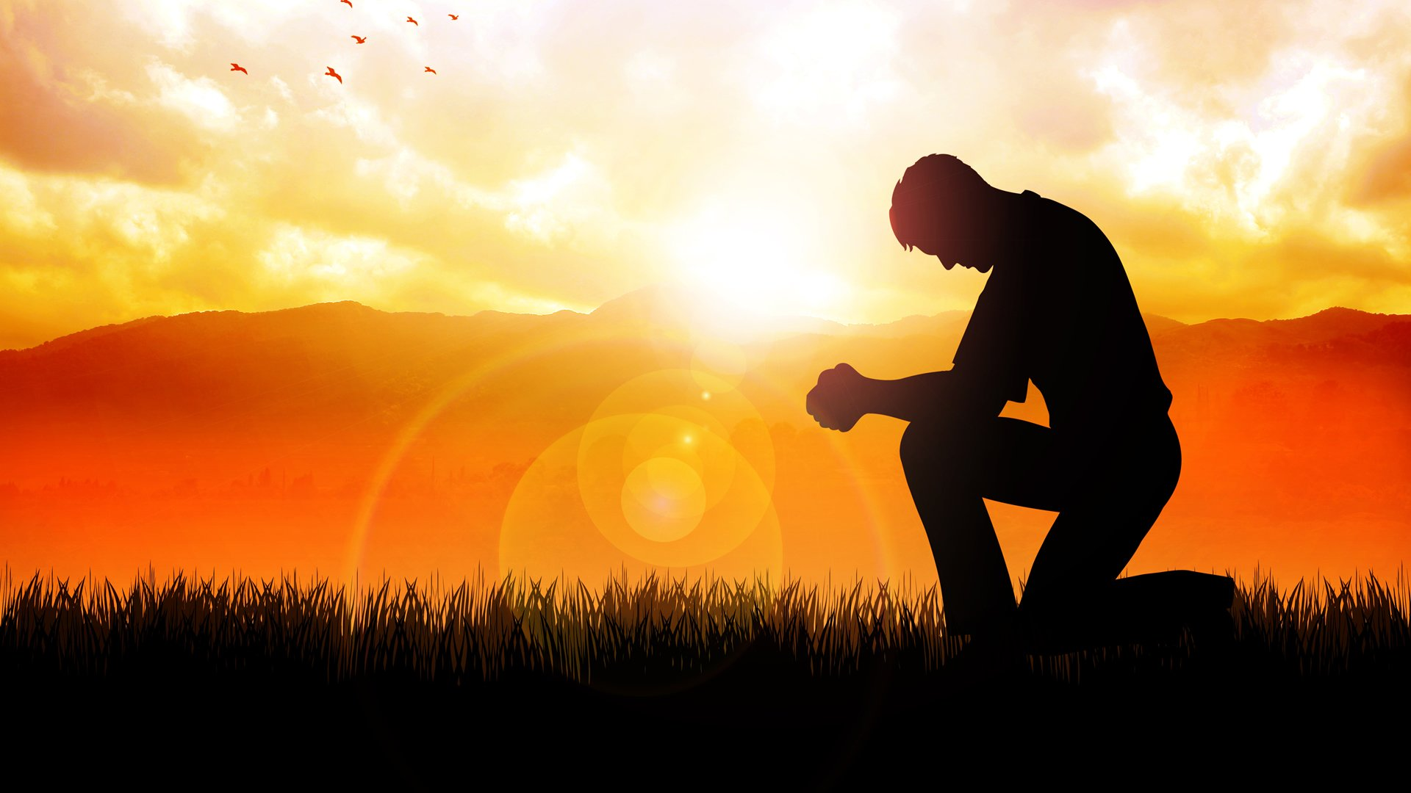
Humble Thyself in the Sight of The Lord
By Pastor Fee Soliven
James 4:5-10
Sunday Morning
June 2, 2024

Slide 82
James 4:5-10
5 Or do you think that the Scripture says in vain, "The Spirit who dwells in us yearns jealously"? 6 But He gives more grace. Therefore He says: "God resists the proud, But gives grace to the humble." 7 Therefore submit to God. Resist the devil and he will flee from you.

Slide 83
8 Draw near to God and He will draw near to you. Cleanse your hands, you sinners; and purify your hearts, you double-minded. 9 Lament and mourn and weep! Let your laughter be turned to mourning and your joy to gloom. 10 Humble yourselves in the sight of the Lord, and He will lift you up.

Slide 84
James 4:6-7
6 But He gives more grace. Therefore He says: "God resists the proud, But gives grace to the humble." 7 Therefore submit to God. Resist the devil and he will flee from you.

Slide 85
1. Pride

Slide 86
Proverbs 16:18
“Pride goes before destruction, and a haughty spirit before a fall”

Slide 87
Ezekiel 16:49-50
49 Look, this was the iniquity of your sister Sodom: She and her daughter had pride, fullness of food, and abundance of idleness; neither did she strengthen the hand of the poor and needy. 50 And they were haughty and committed abomination before Me; therefore I took them away as I saw fit.

Slide 88
“Committing abomination” was the last item on the list, and it came only after the statement, “And they were haughty.”

Slide 89
Proverbs 28:13
“He who covers his sins will not prosper, But whoever confesses and forsakes them will have mercy”

Slide 90
1 Peter 5:5-7
5 Likewise you younger people, submit yourselves to your elders. Yes, all of you be submissive to one another, and be clothed with humility, for "God resists the proud, But gives grace to the humble." 6 Therefore humble yourselves under the mighty hand of God, that He may exalt you in due time, 7 casting all your care upon Him, for He cares for you.

Slide 91
2. Pride is a Product of Worldliness

Slide 92
(1) the lust of the flesh
(2) the lust of the eyes
(3) the pride of life

Slide 93
1 John 2:16-17
16 For all that is in the world--the lust of the flesh, the lust of the eyes, and the pride of life--is not of the Father but is of the world. 17 And the world is passing away, and the lust of it; but he who does the will of God abides forever.

Slide 94
“a Longing especially for what is Forbidden”

Slide 95
“Inordinate Desire”

Slide 96
“exceeding reasonable limits; immoderate,” or “not regulated; disorderly”

Slide 97
3. Pride is Founded on a False Impression

Slide 98
2 Corinthians 10:12
“For we dare not class ourselves or compare ourselves with those who commend themselves. But they, measuring themselves by themselves, and comparing themselves among themselves, are not wise”

Slide 99
4. The Way Up Is Down

Slide 100
Isaiah 55:8-9
8 "For My thoughts are not your thoughts, Nor are your ways My ways," says the LORD. 9 "For as the heavens are higher than the earth, So are My ways higher than your ways, And My thoughts than your thoughts.

Slide 101
Proverbs 15:33
“The fear of the LORD is the instruction of wisdom, And before honor is humility”

Slide 102
Proverbs 22:4
“By humility and the fear of the LORD are riches, and honour, and life”

Slide 103
Philippians 2:8-9
8 And being found in appearance as a man, He humbled Himself and became obedient to the point of death, even the death of the cross. 9 Therefore God also has highly exalted Him and given Him the name which is above every name…

Slide 104
5. Humility Brings Grace

Slide 105
Titus 2:11-15
11 For the grace of God that brings salvation has appeared to all men, 12 teaching us that, denying ungodliness and worldly lusts, we should live soberly, righteously, and godly in the present age, 13 looking for the blessed hope and glorious appearing of our great God and Savior Jesus Christ,

Slide 106
14 who gave Himself for us, that He might redeem us from every lawless deed and purify for Himself His own special people, zealous for good works. 15 Speak these things, exhort, and rebuke with all authority. Let no one despise you.

Slide 107
Pride does not just disqualify one from receiving grace, but it causes God to resist an individual

Slide 108
Pride does not just put God out of reach; it puts God on the offensive, actively preventing a person from finding Him

Slide 109
Romans 1:28-32
28 And even as they did not like to retain God in their knowledge, God gave them over to a debased mind, to do those things which are not fitting;

Slide 110
29 being filled with all unrighteousness, sexual immorality, wickedness, covetousness, maliciousness; full of envy, murder, strife, deceit, evil-mindedness; they are whisperers, 30 backbiters, haters of God, violent, proud, boasters, inventors of evil things, disobedient to parents,

Slide 111
31 undiscerning, untrustworthy, unloving, unforgiving, unmerciful; 32 who, knowing the righteous judgment of God, that those who practice such things are worthy of death, not only do the same but also approve of those who practice them.

Slide 112
6. Our Greatest Example of
Humility is Jesus

Slide 113
Hebrews 2:9
“But we see Jesus, who was made a little lower than the angels, for the suffering of death crowned with glory and honor, that He, by the grace of God, might taste death for everyone”

Slide 114
Philippians 2:6-7
6 who, being in the form of God, did not consider it robbery to be equal with God, 7 but made Himself of no reputation, taking the form of a bondservant, and coming in the likeness of men.

Slide 115
1 Thessalonians 4:13-18
13 But I do not want you to be ignorant, brethren, concerning those who have fallen asleep, lest you sorrow as others who have no hope. 14 For if we believe that Jesus died and rose again, even so God will bring with Him those who sleep in Jesus.

Slide 116
15 For this we say to you by the word of the Lord, that we who are alive and remain until the coming of the Lord will by no means precede those who are asleep. 16 For the Lord Himself will descend from heaven with a shout, with the voice of an archangel, and with the trumpet of God. And the dead in Christ will rise first.

Slide 117
17 Then we who are alive and remain shall be caught up together with them in the clouds to meet the Lord in the air. And thus we shall always be with the Lord. 18 Therefore comfort one another with these words.

Slide 118
1 Corinthians 15:50-54
50 Now this I say, brethren, that flesh and blood cannot inherit the kingdom of God; nor does corruption inherit incorruption. 51 Behold, I tell you a mystery: We shall not all sleep, but we shall all be changed-- 52 in a moment, in the twinkling of an eye, at the last trumpet. For the trumpet will sound, and the dead will be raised incorruptible, and we shall be changed.

Slide 119
53 For this corruptible must put on incorruption, and this mortal must put on immortality. 54 So when this corruptible has put on incorruption, and this mortal has put on immortality, then shall be brought to pass the saying that is written: "Death is swallowed up in victory."

Slide 120
20 Again, when a righteous man turns from his righteousness and commits iniquity, and I lay a stumbling block before him, he shall die; because you did not give him warning, he shall die in his sin, and his righteousness which he has done shall not be remembered; but his blood I will require at your hand.

Slide 121
Acts 2:38-39
38 Then Peter said to them, "Repent, and let every one of you be baptized in the name of Jesus Christ for the remission of sins; and you shall receive the gift of the Holy Spirit. 39 For the promise is to you and to your children, and to all who are afar off, as many as the Lord our God will call."

Slide 122
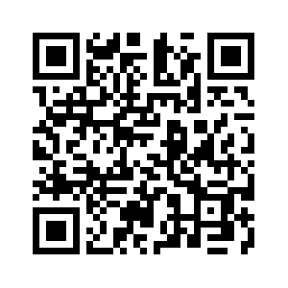
Donate with our QR code app to
Amazing Grace Christian Fellowship
Donations are Deeply Appreciated!

