Slide 2
Lord You Are Good
(by Israel Houghton)

Slide 3
Lord You are good And Your mercy endureth forever
Lord You are good And Your mercy endureth forever

Slide 4
People from every nation and tongue From generation to generation We worship you Hallelujah,

Slide 5
Hallelujah We worship you for who you are We worship you Hallelujah, Hallelujah We worship you

Slide 6
for who you are You are good! Lord You are good And Your mercy endureth forever Lord You are good

Slide 7
And Your mercy endureth forever People from every nation and tongue From generation to generation

Slide 8
We worship you Hallelujah, Hallelujah We worship you for who you are We worship you Hallelujah,

Slide 9
Hallelujah We worship you for who you are You are good! You are good all the time All the time You are

Slide 10
good You are good all the time All the time You are good You are good all the time All the time You are

Slide 11
good You are good all the time All the time You are good You are good all the time All the time You are

Slide 12
good Lord You are good And Your mercy endureth forever Lord You are good And Your mercy endureth

Slide 13
forever Lord You are good And Your mercy endureth forever People from every nation and tongue From

Slide 14
generation to generation We worship you Hallelujah, Hallelujah We worship you for who you are We

Slide 15
worship you Hallelujah, Hallelujah We worship you for who you are We worship you Hallelujah,

Slide 16
Hallelujah We worship you for who you are We worship you Hallelujah, Hallelujah We worship you

Slide 17
for who you are For who you are, for who you are...
And You are good You are good all the time All the

Slide 18
time You are good You are good all the time All the time You are good You are good all the time All the

Slide 19
time You are good You are good all the time All the time You are good.

Slide 20
“Great are you Lord”
(All Sons and Daughters)

Slide 21
You give life, You are love. You bring light in the darkness. You give hope, You restore

Slide 22
Every heart that is broken. And great are you Lord. It’s your breath in our lungs so we

Slide 23
Pour out our praise. We pour out our praise.
It’s your breath in our lungs. So we pour out

Slide 24
Our praise to you only. You give life, you are love. You bring light to the darkness. You

Slide 25
Give hope, You restore. Every heart that is broken. Great are you Lord. It’s your breath

Slide 26
In our lungs. So we pour out our praise we pour out our praise. It’s your breath in our

Slide 27
Lungs so we pour out our praise to you only. It’s your breath in our lungs. So we

Slide 28
Pour out our praise we pour out our praise. It’s your breath in our lungs. So we pour out

Slide 29
Our praise to you only. And all the earth will shout your praise. Our hearts will cry, these

Slide 30
Bones will sing. Great are You, Lord. And all the earth will shout your praise. Our hearts

Slide 31
Will cry these bones will sing. Great are you,Lord. And all the earth will shout your

Slide 32
Praise Our hearts will cry these bones will sing. Great are you, Lord. It’s your breath in

Slide 33
Our Lungs. So we pour out our praise. We pour out our praise. It’s your breath in our

Slide 34
Lungs so we pour out our praise to you only. Great are you, Lord. It’s your breath in

Slide 35
Our lungs so we pour out our praise. Pour out our praise. It’s your breath in our lungs

Slide 36
So we pour out our praise to you only. Great are you , Lord.

Slide 37
“We Need a Miracle”
(Charity Gayle)

Slide 38
You're the same God today And the same God tomorrow Help me see the victory You already see

Slide 39
Let my faith be today What it will be tomorrow When I've seen the victory You already see Oh Jesus, I

Slide 40
believe, oh We need a miracle, You are the miracle maker God of the impossible, there is no power

Slide 41
greater Exceeding, abundant, beyond what we could ask or think We call on Your Name, Jesus By

Slide 42
the power of Your Name And all for Your glory The sick are healed, the soul is filled The battle has been

Slide 43
won On Your promise I stand And in faith I believe it
That what I pray in Your Name It's already done Oh,

Slide 44
let Your will be done, oh We need a miracle, You are the miracle maker God of the impossible, there is no

Slide 45
power greater Exceeding, abundant, beyond what we could ask or think We call on Your Name, Jesus

Slide 46
In the waiting You get the glory In the healing You get the glory In the breaking You get the glory In the

Slide 47
breakthrough You get the glory In the waiting You get the glory In the healing You get the glory In the

Slide 48
breaking You get the glory In the breakthrough You get the glory You get the glory, You get the glory You

Slide 49
get the glory, You get the glory You get the glory, You get the glory You get the glory, You get the glory We

Slide 50
need a miracle, You are the miracle maker God of the impossible, there is no power greater Exceeding,

Slide 51
abundant, beyond what we could ask or think We call on Your Name We need a miracle, You are the

Slide 52
miracle maker God of the impossible, there is no power greater Exceeding, abundant, beyond

Slide 53
what we could ask or think We call on Your Name We call on Your Name We call on Your Name

Slide 54
Jesus...

Slide 55
Jireh
(Maverick City)

Slide 56
I'll never be more loved than I am right now Wasn't holding You up So there's nothing I can do to let You

Slide 57
down It doesn't take a trophy to make You proud I'll never be more loved than I am right now, oh Going

Slide 58
through a storm but I won't go down I hear Your voice
Carried in the rhythm of the wind to call me out You

Slide 59
would cross an ocean so I wouldn't drown You've never been closer than You are right now (Let's sing

Slide 60
it loud y'all) You are Jireh, You are enough Jireh, You are enough And I will be content in every

Slide 61
circumstance You are Jireh, You are enough Forever enough Always enough More than enough Forever

Slide 62
enough Always enough More than enough I don’t wanna forget how I feel right now On the

Slide 63
mountaintop I can see so clear what it's all about So stay by my side when the sun goes down Don’t

Slide 64
wanna forget how I feel right now (Jireh) Jireh, You are enough Jireh, You are enough (so I will be) I will

Slide 65
be content in every circumstance Jireh, You are enough (He is always enough) He's forever enough

Slide 66
Always enough Always more than enough He is, He is Forever enough Always enough (He's everything,

Slide 67
He's always) More than enough (yeah) I'm already loved I'm already chosen I know who I am I know

Slide 68
what You've spoken I'm already loved More than I could imagine And that is enough, oh-oh I'm already

Slide 69
loved (I'm already loved) I'm already chosen (I’m already chosen) I know who I am (I know

Slide 70
who I am) I know what You've spoken (I know what You’ve spoken) I'm already loved (I'm already loved)

Slide 71
More than I could imagine (more than I could imagine) That is enough (that is enough) It's enough

Slide 72
for me, oh I'm already loved (I'm already loved) I'm already chosen (I'm already chosen) I know who I

Slide 73
am (I know who I am) I know, I know what You've spoken (I know what You've spoken) I'm already

Slide 74
loved (I'm already loved) More than I could even fathom (more than I could imagine) And that is

Slide 75
enough (and that is enough) Yes it is, it's enough, it's enough And that is enough (that is enough) What His

Slide 76
truth says is better than anything That is enough (that is enough) What He's declared over us, it's true That

Slide 77
is enough (that is enough) That is enough (that is enough) That is enough (that is enough) Jehovah,

Slide 78
You are (that is enough) El Shaddai, You are (that is enough) When I have You, I have everything (that is

Slide 79
enough) When I have Jesus, I have everything (that is enough) That is enough (that is enough) 'Cause

Slide 80
You are enough (You are enough) You're my portion (You are enough) You're my portion (You are

Slide 81
enough) More than enough for me (You are enough) Say, You are enough (You are enough) So I am

Slide 82
enough (so I am enough) You are enough (You are enough) So I am enough (so I am enough) Say, Jireh

Slide 83
Jireh, You are enough (Jireh) Jireh, You are enough (yes Your are) I will be content in every circumstance

Slide 84
Jireh, You are enough, oh-ooh (You are) If He dresses the lilies with beauty and splendor How

Slide 85
much more will He clothe you? How much more will He clothe you? If He watched over every sparrow

Slide 86
How much more does He love you? How much more does He love you? If He dresses the lilies

Slide 87
with beauty and splendor How much more will He clothe you? How much more will He clothe you? If

Slide 88
He watched over every sparrow How much more does He love you? How much more does He love

Slide 89
you? If He dresses the lilies with beauty and splendor How much more will He clothe you? How

Slide 90
much more will He clothe you? If He watched over every sparrow (don't you worry!) How much more

Slide 91
does He love you? (Our Father loves you) How much more does He love you? (How much more?)

Slide 92
How much more does He love you? (How much more?) How much more does He love you? (How

Slide 93
much more?) How much more does He love you? (How much more?) How much more does He love

Slide 94
you? (How much more?) How much more does He love you? It's more than you ask, think or imagine

Slide 95
According to His power working in us It's more than enough It's more than you ask, think or imagine, oh

Slide 96
yeah According to His power working in us It's more than enough (let's go y'all) It's more than you ask,

Slide 97
think or imagine (so according) According to His power, it's working in us (how much more does He

Slide 98
love you?) It's more than enough (how much more? Sing!) More than you ask, think or imagine (so

Slide 99
according) According to His power working in us (how much more does He love you?) It's more than

Slide 100
enough (one more time, sing!) More than you ask, think or imagine According to His power working in

Slide 101
us (how much more does He love you?) It's more than enough (how much more?) It's more than

Slide 102
enough (how much more?) More than you know (more than enough) It's more than enough (more

Slide 103
than you know) More than you know (more) Jireh, You are enough Jireh, You are enough (You’ve

Slide 104
always been enough) And I will be content in every circumstance Jireh, You are enough And I will be

Slide 105
content (yes) in every circumstance Jireh, You are enough

Slide 106
Gratitude
(Brandon Lake)

Slide 107
All my words fall short I got nothing new How could I express All my gratitude? I could sing these songs

Slide 108
As I often do But every song must end And You never do So I throw up my hands And praise You

Slide 109
again and again 'Cause all that I have is a hallelujah
Hallelujah And I know it's not much But I've nothing

Slide 110
else fit for a King Except for a heart singing hallelujah Hallelujah I've got one response I've got

Slide 111
just one move With my arm stretched wide I will worship You So I throw up my hands And praise You

Slide 112
again and again 'Cause all that I have is a hallelujah
Hallelujah And I know it's not much But I've nothing

Slide 113
else fit for a King Except for a heart singing hallelujah Hallelujah So come on, my soul Oh, don't

Slide 114
you get shy on me Lift up your song 'Cause you've got a lion inside of those lungs Get up and praise the

Slide 115
Lord Oh come on, my soul Oh, don't you get shy on me Lift up your song 'Cause you've got a lion inside

Slide 116
of those lungs Get up and praise the Lord Come on, my soul Oh, don't you get shy on me Lift up your

Slide 117
song 'Cause you've got a lion inside of those lungs Get up and praise the Lord, hey Praise the Lord

Slide 118
Praise the Lord Praise the Lord So I throw up my hands Praise You again and again 'Cause all that I

Slide 119
have is a hallelujah Hallelujah And I know it's not much But I've nothing else fit for a King Except for a

Slide 120
heart singing hallelujah Hallelujah

Slide 123
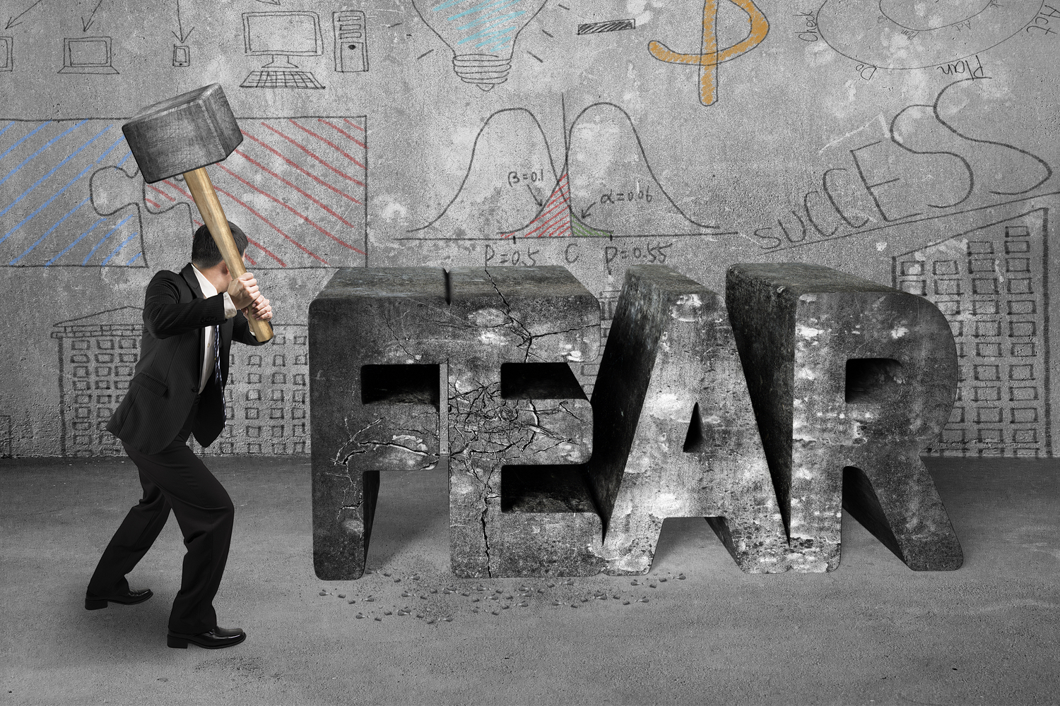
Overcoming the Spirit of Fear!
by Pastor Fee Soliven
Isaiah 41:10-13
Sunday Morning
June 23, 2024

Slide 124
Isaiah 41:10-13
10 Fear not, for I am with you; Be not dismayed, for I am your God. I will strengthen you, Yes, I will help you, I will uphold you with My righteous right hand.' 11 "Behold, all those who were incensed against you Shall be ashamed and disgraced; They shall be as nothing, And those who strive with you shall perish.

Slide 125
12 You shall seek them and not find them--Those who contended with you. Those who war against you Shall be as nothing, As a nonexistent thing. 13 For I, the LORD your God, will hold your right hand, Saying to you, 'Fear not, I will help you.'

Slide 126
From WikiPedia. The mass shootings that took place in the United States in 2024. Mass shootings are incidents in which several people are injured or killed due to firearm-related violence, specifically for the purposes of this article, a total of four or more victims. As of May 31, a total of 318 people have been killed and 836 people have been wounded in 225 shootings.

Slide 127
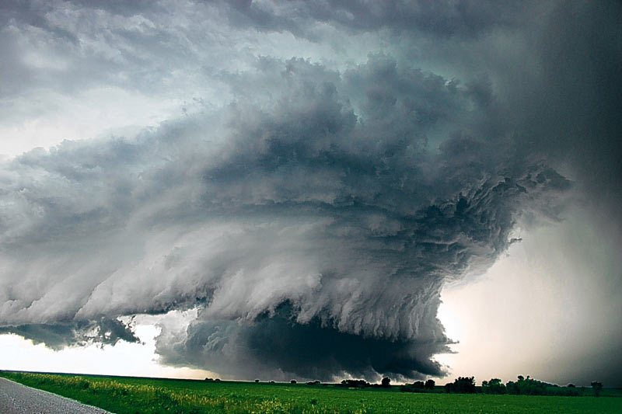
2189 Violent Destroying Tornados from 2013 - 2024

Slide 128
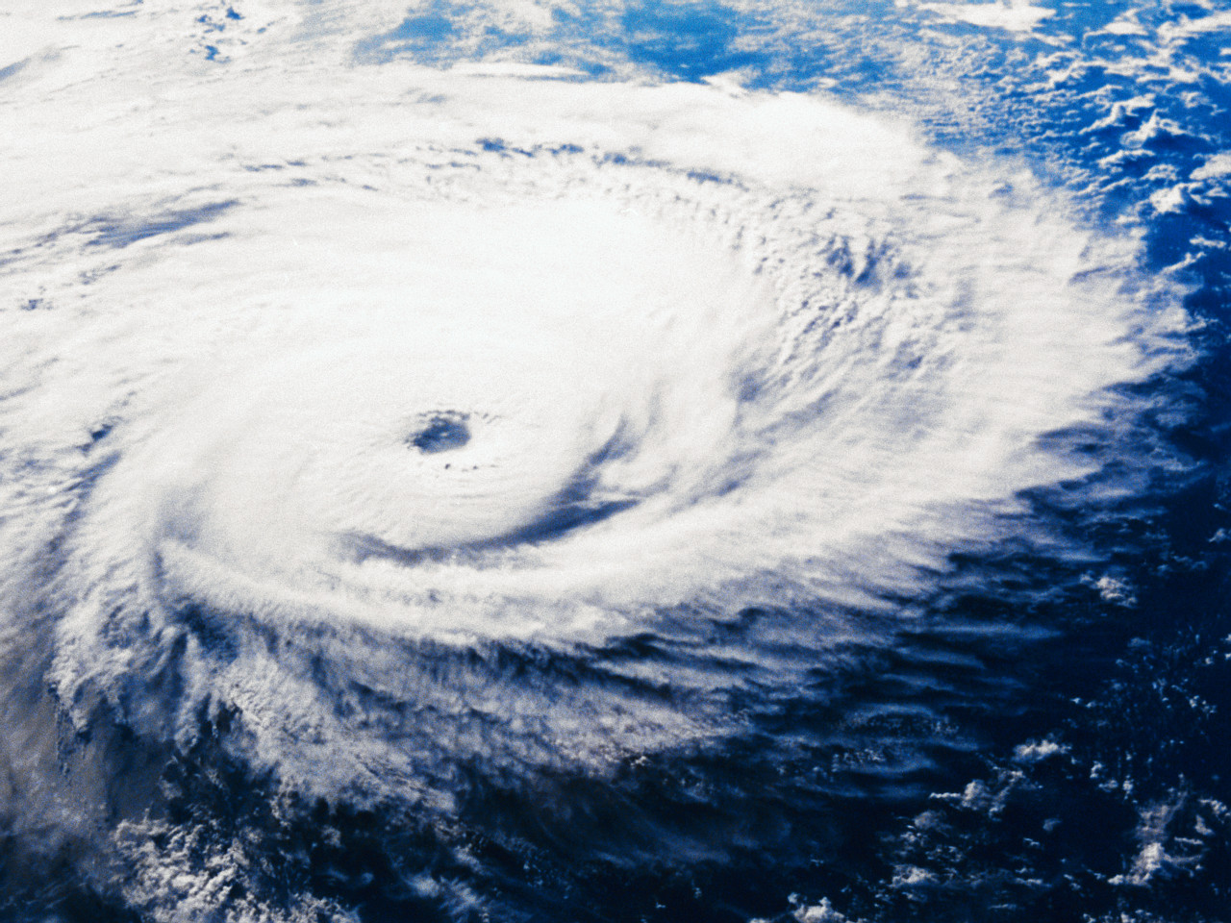
Devastating Hurricanes

Slide 129
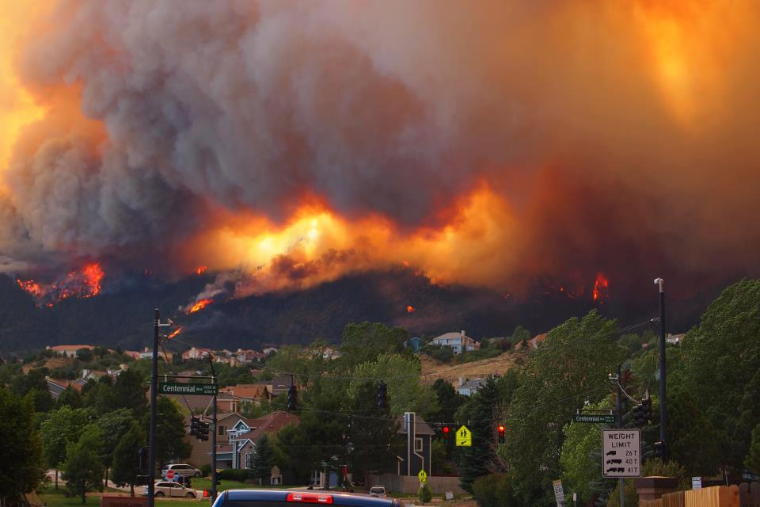
Hundreds of Wildfires every year in the US

Slide 130
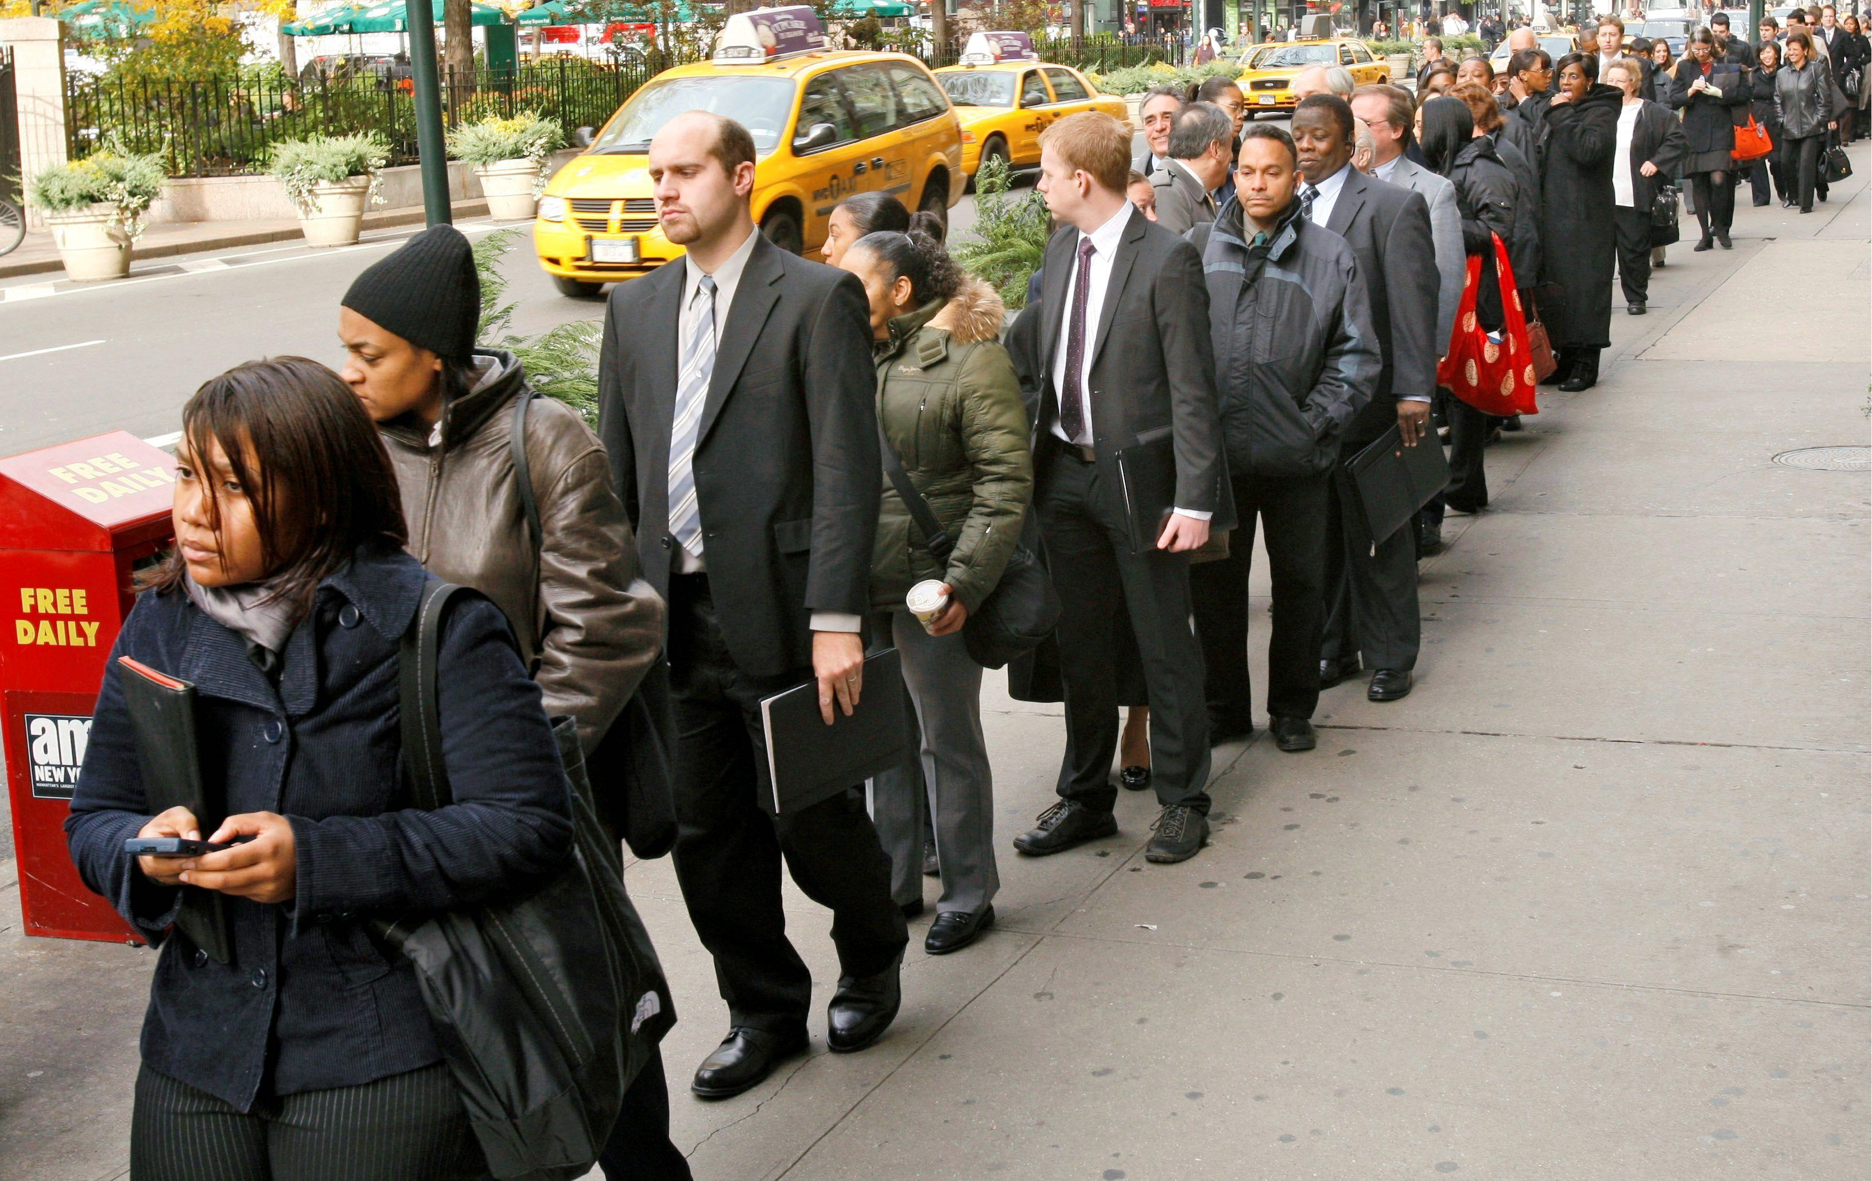
Unemployment Rate rising in 2024

Slide 131
Thousands of Homeowners are Leaving California because of High Interest Rates and Inflation

Slide 132
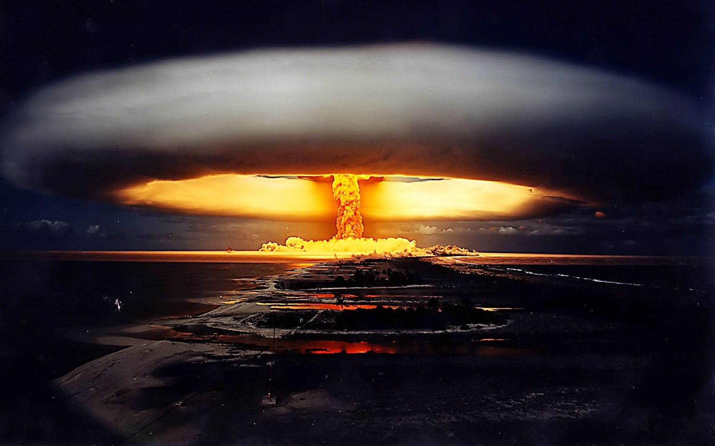
Continual Threats of Nuclear War from Russia, Iran & North Korea

Slide 133
What is Fear and what is its Origin?

Slide 134
Genesis 3:8-11
8 And they heard the sound of the LORD God walking in the garden in the cool of the day, and Adam and his wife hid themselves from the presence of the LORD God among the trees of the garden. 9 Then the LORD God called to Adam and said to him, "Where are you?" 10 So he said, "I heard Your voice in the garden, and I was afraid because I was naked; and I hid myself."

Slide 135
1. Fear is an uneasy feeling of dread—like an alarm that warns us when something bad is going to happen

Slide 136
Proverbs 29:25
"The fear of man brings a snare, But whoever trusts in the LORD shall be safe"

Slide 137
2. When the Bible speaks about the fear of the Lord, it isn’t a negative feeling. Instead, it is a good fear—one created by a healthy reverence for a holy, righteous God.

Slide 138
Proverbs 1:7
"The fear of the LORD is the beginning of knowledge, But fools despise wisdom and instruction"

Slide 139
3. Remember that fear itself is not bad. But when it’s continually with us, it becomes a problem.

Slide 140
1. Greed is Fear of not having Enough

Slide 141
Proverbs 28:25
"A greedy man stirs up dissension, but he who trusts in the LORD will prosper"

Slide 142
2. Rejection is concern about not being Accepted brings on Fear

Slide 143
Psalm 139:13-14
13 For You formed my inward parts; You covered me in my mother's womb. 14 I will praise You, for I am fearfully and wonderfully made; Marvelous are Your works, And that my soul knows very well.

Slide 144
2. Guilt is apprehension that our wrongs might be discovered or exposed

Slide 145
Romans 8:1-2
1 There is therefore now no condemnation to those who are in Christ Jesus, who do not walk according to the flesh, but according to the Spirit. 2 For the law of the Spirit of life in Christ Jesus has made me free from the law of sin and death.

Slide 146
3. Discouragement is a fear of failure caused by a lack of confidence

Slide 147
2 Corinthians 12:9-10
9 And He said to me, "My grace is sufficient for you, for My strength is made perfect in weakness." Therefore most gladly I will rather boast in my infirmities, that the power of Christ may rest upon me. 10 Therefore I take pleasure in infirmities, in reproaches, in needs, in persecutions, in distresses, for Christ's sake. For when I am weak, then I am strong.

Slide 148
4. Anger is caused by a fear that we may not get our way

Slide 149
Ephesians 4:31-32
31 Let all bitterness, wrath, anger, clamor, and evil speaking be put away from you, with all malice. 32 And be kind to one another, tenderhearted, forgiving one another, just as God in Christ forgave you.

Slide 150
5. Jealousy is the fear of losing control of things we desire

Slide 151
Proverbs 6:34-35
34 For jealousy makes a man furious, and he will not spare when he takes revenge. 35 He will accept no compensation, nor be appeased though you multiply gifts.

Slide 152
6. Indecision is caused when we worry about making a wrong choice

Slide 153
Proverbs 3:5-6
5 Trust in the LORD with all your heart, And lean not on your own understanding; 6 In all your ways acknowledge Him, And He shall direct your paths.

Slide 154
Why are we afraid?

Slide 155
2 Timothy 1:7
For God has not given us a spirit of fear, but of power and of love and of a sound mind"

Slide 156
Where do these type of fears come from?

Slide 157
1. Childhood Lessons

Slide 158
Proverbs 22:6
"Train up a child in the way he should go, And when he is old he will not depart from it"

Slide 159
2. Imagination

Slide 160
2 Corinthians 10:4-5
4 For the weapons of our warfare are not carnal but mighty in God for pulling down strongholds, 5 casting down arguments and every high thing that exalts itself against the knowledge of God, bringing every thought into captivity to the obedience of Christ...

Slide 161
3. Sin

Slide 162
Proverbs 28:13
"He who covers his sins will not prosper, But whoever confesses and forsakes them will have mercy"

Slide 163
4. Ignorance

Slide 164
John 17:17-19
17 Sanctify them by Your truth. Your word is truth. 18 As You sent Me into the world, I also have sent them into the world. 19 And for their sakes I sanctify Myself, that they also may be sanctified by the truth.

Slide 165
5. Doubt

Slide 166
James 1:5-8
5 If any of you lacks wisdom, let him ask of God, who gives to all liberally and without reproach, and it will be given to him. 6 But let him ask in faith, with no doubting, for he who doubts is like a wave of the sea driven and tossed by the wind.

Slide 167
7 For let not that man suppose that he will receive anything from the Lord; 8 he is a double-minded man, unstable in all his ways.

Slide 168
8. A Wrong View of God

Slide 169
John 3:16-17
16 For God so loved the world that He gave His only begotten Son, that whoever believes in Him should not perish but have everlasting life. 17 For God did not send His Son into the world to condemn the world, but that the world through Him might be saved.

Slide 170
What are the Consequences of Fear?

Slide 171
1. Divides your Mind

Slide 172
Psalm 119:15
"I meditate on your precepts (Commandments) and consider your ways"

Slide 173
2. Stifles your Ability to Think and Act Rightly

Slide 174
Hebrews 13:6
"So we say with confidence, "The Lord is my helper; I will not be afraid. What can man do to me?"

Slide 175
3. Results in Panic

Slide 176
1 Peter 5:7
"casting all your care upon Him, for He cares for you"

Slide 177
4. Enslaves you with Feelings of Uncertainty

Slide 178
Philippians 4:19
"And my God shall supply all your need according to His riches in glory by Christ Jesus"

Slide 179
5. Steals Joy and Peace

Slide 180
Nehemiah 8:10
"Do not sorrow, for the joy of the LORD is your strength"...

Slide 181
6. Affects Health

Slide 182
Proverbs 4:20-22
20 My son, give attention to my words; Incline your ear to my sayings. 21 Do not let them depart from your eyes; Keep them in the midst of your heart; 22 For they are life to those who find them, And health to all their flesh.

Slide 183
How should you Deal with Fear?

Slide 184
1. Acknowledge It

Slide 185
2. Identify its Source

Slide 186
3. Change your Focus

Slide 187
4. Rely on God’s Word

Slide 188
Isaiah 41:10
Fear not, for I am with you; Be not dismayed, for I am your God. I will strengthen you, Yes, I will help you, I will uphold you with My righteous right hand.'

Slide 189
5. Lay Down your Fear

Slide 190
1 Thessalonians 4:13-18
13 But I do not want you to be ignorant, brethren, concerning those who have fallen asleep, lest you sorrow as others who have no hope. 14 For if we believe that Jesus died and rose again, even so God will bring with Him those who sleep in Jesus.

Slide 191
15 For this we say to you by the word of the Lord, that we who are alive and remain until the coming of the Lord will by no means precede those who are asleep. 16 For the Lord Himself will descend from heaven with a shout, with the voice of an archangel, and with the trumpet of God. And the dead in Christ will rise first.

Slide 192
17 Then we who are alive and remain shall be caught up together with them in the clouds to meet the Lord in the air. And thus we shall always be with the Lord. 18 Therefore comfort one another with these words.

Slide 193
1 Corinthians 15:50-54
50 Now this I say, brethren, that flesh and blood cannot inherit the kingdom of God; nor does corruption inherit incorruption. 51 Behold, I tell you a mystery: We shall not all sleep, but we shall all be changed-- 52 in a moment, in the twinkling of an eye, at the last trumpet. For the trumpet will sound, and the dead will be raised incorruptible, and we shall be changed.

Slide 194
53 For this corruptible must put on incorruption, and this mortal must put on immortality. 54 So when this corruptible has put on incorruption, and this mortal has put on immortality, then shall be brought to pass the saying that is written: "Death is swallowed up in victory."

Slide 195
20 Again, when a righteous man turns from his righteousness and commits iniquity, and I lay a stumbling block before him, he shall die; because you did not give him warning, he shall die in his sin, and his righteousness which he has done shall not be remembered; but his blood I will require at your hand.

Slide 196
Acts 2:38-39
38 Then Peter said to them, "Repent, and let every one of you be baptized in the name of Jesus Christ for the remission of sins; and you shall receive the gift of the Holy Spirit. 39 For the promise is to you and to your children, and to all who are afar off, as many as the Lord our God will call."

Slide 197
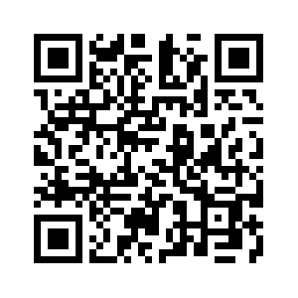
Donate with our QR code app to
Amazing Grace Christian Fellowship
Donations are Deeply Appreciated!

