Slide 1


Slide 2
“ Praise”
(Elevation Worship)

Slide 3
Let's clap, one, two, hey Oh, yea Let everything that has breath Praise the Lord (You got it), praise the

Slide 4
Lord Let everything, let everything that has breath
Praise the Lord, praise the Lord (Let everything)

Slide 5
Let everything (Hey) that has breath (Hey) [Verse 1: I'll praise in the valley, praise on the mountain (Yeah)

Slide 6
I'll praise when I'm sure, praise when I'm doubting I'll praise when outnumbered, praise when surrounded

Slide 7
'Cause praise is the waters my enemies drown in Chorus: As long as I'm breathing I've got a reason to

Slide 8
Praise the Lord, oh my soul (C'mon) Praise the Lord, oh my soul [Verse 2: I'll praise when I feel it, and I'll

Slide 9
praise when I don’t (Yeah) I'll praise 'cause I know You’re still in control 'Cause my praise is a weapon,

Slide 10
it's more than a sound (More than a sound) Oh, my praise is the shout that brings Jericho down (Yeah)

Slide 11
[Chorus: As long as I'm breathing I've got a reason to
Praise the Lord (C'mon), oh my soul Praise the Lord,

Slide 12
oh my soul I won't be quiet, my God is alive So how could I keep it inside? (I gotta) Praise the Lord, oh

Slide 13
my soul (Yeah, praise the Lord) C'mon let me see that dance, put a dance on it tonight (Yeah) If you're

Slide 14
grateful, c’mon Hey, hey, yeah [Bridge: I'll praise 'cause You're sovereign, praise 'cause You reign

Slide 15
Praise 'cause You rose and defeated the grave I'll praise 'cause You're faithful, praise 'cause You’re true

Slide 16
Praise 'cause there's nobody greater than You I'll praise 'cause You're sovereign, praise 'cause You

Slide 17
reign (You reign) Praise 'cause You rose and defeated the grave I'll praise 'cause You're faithful,

Slide 18
praise 'cause You’re true Praise 'cause there's nobody greater than You [Chorus: Praise the Lord,

Slide 19
oh my soul (C'mon, c'mon, c'mon, c'mon) Praise the Lord, oh my soul (Praise the Lord, oh my soul) Praise

Slide 20
the Lord, oh my soul Praise the Lord, oh my soul I won't be quiet, my God is alive How could I keep it

Slide 21
inside? (How could I) I won't be quiet, my God is alive How could I keep it inside? (I won't keep quiet) I

Slide 22
won't be quiet, my God is alive How could I keep it inside? (I gotta) Praise the Lord, oh my soul Jump,

Slide 23
jump, jump, jump Let everything that has breath (Hey, hey) Praise the Lord (Hey, hey), praise the

Slide 24
Lord Let everything, let everything that has breath
(C'mon, c'mon, c'mon) Praise the Lord (C'mon,

Slide 25
c'mon) Praise the Lord (C'mon, c'mon) (Let everything), Let everything that has breath Praise the

Slide 26
Lord, praise the Lord, praise the Lord (Let everything), Let everything that has breath (Praise

Slide 27
the Lord) Praise the Lord, praise the Lord, praise the Lord

Slide 28
“Worthy”
(by Elevation Worship)

Slide 29
[Verse 1] It was my cross You bore So I could live in the freedom You died for And now my life is Yours

Slide 30
And I will sing of Your goodness forevermore [Chorus] Worthy is Your name, Jesus You deserve

Slide 31
the praise Worthy is Your name Worthy is Your name, Jesus You deserve the praise Worthy is Your

Slide 32
name [Verse 2] And now my shame is gone I stand amazed in Your love undeniable Your grace goes on

Slide 33
and on And I will sing of Your goodness forevermore
[Chorus] Worthy is Your name, Jesus You deserve

Slide 34
the praise Worthy is Your name Worthy is Your name, Jesus You deserve the praise Worthy is Your

Slide 35
name Worthy is Your name, Jesus You deserve the praise Worthy is Your name Worthy is Your name,

Slide 36
Jesus You deserve the praise Worthy is Your name
[Bridge] Be exalted now in the heavens As Your glory

Slide 37
fills this place You alone deserve our praise You're the name above all names Be exalted now in the

Slide 38
heavens As Your glory fills this place You alone deserve our praise You're the name above all names

Slide 39
Be exalted now in the heavens As Your glory fills this place You alone deserve our praise You're the name

Slide 40
above all names Be exalted now in the heavens
As Your glory fills this place You alone deserve our

Slide 41
praise You're the name above all names Be exalted now in the heavens As Your glory fills this place You

Slide 42
alone deserve our praise You're the name above all names Be exalted now in the heavens As Your glory

Slide 43
fills this place You alone deserve our praise You're the name above all names [Chorus] Worthy is Your

Slide 44
name, Jesus You deserve the praise Worthy is Your name Worthy is Your name, Jesus You deserve the

Slide 45
praise Worthy is Your name.

Slide 46
“I Speak Jesus”
(by Charity Gayle)

Slide 47
I just want to speak the name of Jesus Over every heart and every mind 'Cause I know there is peace

Slide 48
within Your presence I speak Jesus [Verse 2: I just want to speak the name of Jesus 'Til every dark

Slide 49
addiction starts to break Declaring there is hope and there is freedom I speak Jesus [Chorus: Your name

Slide 50
is power Your name is healing Your name is life Break every stronghold Shine through the shadows

Slide 51
Burn like a fire [Verse 3: I just want to speak the name of Jesus Over fear and all anxiety To every

Slide 52
soul held captive by depression I speak Jesus [Chorus: 'Cause Your name is power Your name is

Slide 53
healing Your name is life (Yes, it is) Break every stronghold Shine through the shadows Burn like a

Slide 54
fire (Your name is power) Your name is power (And we declare it now) Your name is healing (Your name

Slide 55
is life) Your name is life (Break every stronghold) Break every stronghold And shine through the

Slide 56
shadows Burn like a fire [Bridge: Shout Jesus from the mountains, Jesus in the streets Jesus in the

Slide 57
darkness over every enemy And Jesus for my family I speak the holy name, Jesus Oh-oh-oh-oh (

Slide 58
Oh-oh-oh-oh) Shout Jesus from the mountains, Jesus in the streets (Oh-oh-oh-oh) Jesus in the

Slide 59
darkness over every enemy Jesus for my family I speak the holy name, Jesus [Chorus: (Your name)

Slide 60
Your name is power (Your name is healing) Your name is healing (Your name is life) Your name is life

Slide 61
(Break every stronghold) Break every stronghold (Shine through the shadows) Shine through the

Slide 62
shadows (Burn like a fire) Burn like a fire (Come Holy Spirit) (Your name) Your name is power (Your name

Slide 63
is power) Your name is healing (Your name is healing, oh) Your name is life Break every stronghold

Slide 64
Shine through the shadows Burn like a fire [Verse 1: I just want to speak the name of Jesus Over every

Slide 65
heart and every mind 'Cause I know there is peace within Your presence I speak Jesus [Bridge: Shout

Slide 66
Jesus from the mountains, Jesus in the streets Jesus in the darkness over every enemy Jesus for

Slide 67
my family I speak the holy name, Jesus Shout Jesus from the mountains, Jesus in the streets Jesus in the

Slide 68
darkness over every enemy (Jesus for my family) Jesus for my family (Yeah) I speak the

Slide 69
holy name, Jesus (Shout Jesus, Jesus) Shout Jesus from the mountains, and Jesus in the streets (Oh-oh)

Slide 70
Jesus in the darkness over every enemy Jesus for my family I speak the holy name, Jesus [Outro:

Slide 71
Shout Jesus for my family Shout Jesus for our city I speak the holy name, Jesus.

Slide 72
“Holy Forever”
(by Chris Tomlin)

Slide 73
A thousand generations falling down in worship To sing the song of ages to the Lamb And all who've

Slide 74
gone before us, and all who will believe Will sing the song of ages to the Lamb Your name is the highest

Slide 75
Your name is the greatest Your name stands above them all All thrones and dominions All powers and

Slide 76
positions Your name stands above them all And the angels cry, "Holy“ All creation cries, "Holy“ You are

Slide 77
lifted high, holy Holy forever If you've been forgiven, if you've been redeemed Sing the

Slide 78
song forever to the Lamb If you walk in freedom, if you bear His name Sing the song forever to the

Slide 79
Lamb We'll sing the song forever and amen And the angels cry, "Holy“ All creation cries, "Holy“ You are

Slide 80
lifted high, holy Holy forever Hear your people sing, "Holy“ To the King of kings, "Holy“ You will always be

Slide 81
holy Holy forever Your name is the highest Your name is the greatest Your name stands above them

Slide 82
all All thrones and dominions All powers and positions Your name stands above them all, Jesus

Slide 83
Your name is the highest Your name is the greatest Your name stands above them all (oh, stands above)

Slide 84
All thrones and dominions All powers and positions Your name stands above them all And the angels

Slide 85
cry, "Holy“ All creation cries, "Holy“ You are lifted high, holy Holy forever (we cry "Holly forever") Hear

Slide 86
Your people sing "Holy" (we will sing) To the King of kings, (holy) holy (holy forever) You will always be

Slide 87
holy Holy forever You will always be holy Holy forever

Slide 88
Gratitude
(Brandon Lake)

Slide 89
All my words fall short I got nothing new How could I express All my gratitude? I could sing these songs

Slide 90
As I often do But every song must end And You never do So I throw up my hands And praise You

Slide 91
again and again 'Cause all that I have is a hallelujah
Hallelujah And I know it's not much But I've nothing

Slide 92
else fit for a King Except for a heart singing hallelujah Hallelujah I've got one response I've got

Slide 93
just one move With my arm stretched wide I will worship You So I throw up my hands And praise You

Slide 94
again and again 'Cause all that I have is a hallelujah
Hallelujah And I know it's not much But I've nothing

Slide 95
else fit for a King Except for a heart singing hallelujah Hallelujah So come on, my soul Oh, don't

Slide 96
you get shy on me Lift up your song 'Cause you've got a lion inside of those lungs Get up and praise the

Slide 97
Lord Oh come on, my soul Oh, don't you get shy on me Lift up your song 'Cause you've got a lion inside

Slide 98
of those lungs Get up and praise the Lord Come on, my soul Oh, don't you get shy on me Lift up your

Slide 99
song 'Cause you've got a lion inside of those lungs Get up and praise the Lord, hey Praise the Lord

Slide 100
Praise the Lord Praise the Lord So I throw up my hands Praise You again and again 'Cause all that I

Slide 101
have is a hallelujah Hallelujah And I know it's not much But I've nothing else fit for a King Except for a

Slide 102
heart singing hallelujah Hallelujah

Slide 104
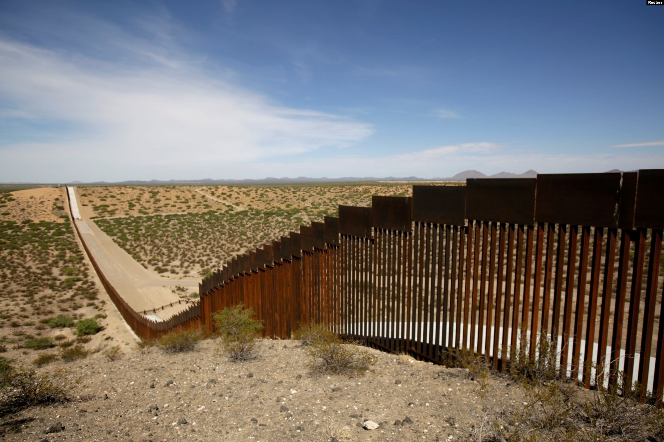

Friendship with the World is Enmity with God
By Pastor Fee Soliven
James 4:1-4
Sunday Afternoon
July 7, 2024

Slide 105
James 4:1-4
1 Where do wars and fights come from among you? Do they not come from your desires for pleasure that war in your members? 2 You lust and do not have. You murder and covet and cannot obtain. You fight and war. Yet you do not have because you do not ask.

Slide 106
3 You ask and do not receive, because you ask amiss, that you may spend it on your pleasures. 4 Adulterers and adulteresses! Do you not know that friendship with the world is enmity with God? Whoever therefore wants to be a friend of the world makes himself an enemy of God.

Slide 107
1 Where do wars and fights come from among you? Do they not come from your desires for pleasure that war in your members?

Slide 108
1 John 3:18-19
18 My little children, let us not love in word or in tongue, but in deed and in truth. 19 And by this we know that we are of the truth, and shall assure our hearts before Him.

Slide 109
Proverbs 15:18
“A wrathful man stirs up strife, But he who is slow to anger allays contention.”

Slide 110
Proverbs 16:32
“He who is slow to anger is better than the mighty, And he who rules his spirit than he who takes a city.”

Slide 111
Jeremiah 17:9-10
9 "The heart is deceitful above all things, And desperately wicked; Who can know it? 10 I, the LORD, search the heart, I test the mind, Even to give every man according to his ways, According to the fruit of his doings.

Slide 112
2 You lust and do not have. You murder and covet and cannot obtain. You fight and war. Yet you do not have because you do not ask.

Slide 113
1 John 3:13-15
13 Do not marvel, my brethren, if the world hates you. 14 We know that we have passed from death to life, because we love the brethren. He who does not love his brother abides in death. 15 Whoever hates his brother is a murderer, and you know that no murderer has eternal life abiding in him.

Slide 114
Romans 14:10-13
10 But why do you judge your brother? Or why do you show contempt for your brother? For we shall all stand before the judgment seat of Christ. 11 For it is written: "As I live, says the LORD, Every knee shall bow to Me, And every tongue shall confess to God."

Slide 115
12 So then each of us shall give account of himself to God. 13 Therefore let us not judge one another anymore, but rather resolve this, not to put a stumbling block or a cause to fall in our brother's way.

Slide 116
3 You ask and do not receive, because you ask amiss, that you may spend it on your pleasures.

Slide 117
Psalm 66:18
“If I regard wickedness in my heart, The Lord will not hear;”

Slide 118
Proverbs 1:28
"Then they will call on me, but I will not answer; They will seek me diligently but they will not find me”

Slide 119
Proverbs 1:28-30
28 "Then they will call on me, but I will not answer; They will seek me diligently, but they will not find me. 29 Because they hated knowledge And did not choose the fear of the LORD, 30 They would have none of my counsel And despised my every rebuke.

Slide 120
1 Peter 5:5-8
5 Likewise you younger people, submit yourselves to your elders. Yes, all of you be submissive to one another, and be clothed with humility, for "God resists the proud, But gives grace to the humble."

Slide 121
6 Therefore humble yourselves under the mighty hand of God, that He may exalt you in due time, 7 casting all your care upon Him, for He cares for you.

Slide 122
1 Peter 3:12
“For the eyes of the Lord are on the righteous, and his ears are open to their prayer. But the face of the Lord is against those who do evil.”

Slide 123
4 Adulterers and adulteresses! Do you not know that friendship with the world is enmity with God? Whoever therefore wants to be a friend of the world makes himself an enemy of God.

Slide 124
1 John 2:15-17
15 Do not love the world or the things in the world. If anyone loves the world, the love of the Father is not in him. 16 For all that is in the world--the lust of the flesh, the lust of the eyes, and the pride of life--is not of the Father but is of the world.

Slide 125
17 And the world is passing away, and the lust of it; but he who does the will of God abides forever.

Slide 126
Romans 8:7-11
7 Because the carnal mind is enmity against God; for it is not subject to the law of God, nor indeed can be. 8 So then, those who are in the flesh cannot please God.

Slide 127
9 But you are not in the flesh but in the Spirit, if indeed the Spirit of God dwells in you. Now if anyone does not have the Spirit of Christ, he is not His. 10 And if Christ is in you, the body is dead because of sin, but the Spirit is life because of righteousness.

Slide 128
11 But if the Spirit of Him who raised Jesus from the dead dwells in you, He who raised Christ from the dead will also give life to your mortal bodies through His Spirit who dwells in you.

Slide 129
2 Timothy 4:9-11
9 Be diligent to come to me quickly; 10 for Demas has forsaken me, having loved this present world, and has departed for Thessalonica--Crescens for Galatia, Titus for Dalmatia. 11 Only Luke is with me. Get Mark and bring him with you, for he is useful to me for ministry.

Slide 130
1 John 2:15-17
15 Do not love the world or the things in the world. If anyone loves the world, the love of the Father is not in him. 16 For all that is in the world--the lust of the flesh, the lust of the eyes, and the pride of life--is not of the Father but is of the world. 17 And the world is passing away, and the lust of it; but he who does the will of God abides forever.

Slide 131
What then is a believer’s proper relationship to the world?

Slide 132
John 17:14-17
14 I have given them Your word; and the world has hated them because they are not of the world, just as I am not of the world. 15 I do not pray that You should take them out of the world, but that You should keep them from the evil one. 16 They are not of the world, just as I am not of the world. 17 Sanctify them by Your truth. Your word is truth.

Slide 133
1 John 3:15-17
15 Whoever hates his brother is a murderer, and you know that no murderer has eternal life abiding in him. 16 By this we know love, because He laid down His life for us. And we also ought to lay down our lives for the brethren.

Slide 134
17 But whoever has this world's goods, and sees his brother in need, and shuts up his heart from him, how does the love of God abide in him?

Slide 135
1 Thessalonians 4:13-18
13 But I do not want you to be ignorant, brethren, concerning those who have fallen asleep, lest you sorrow as others who have no hope. 14 For if we believe that Jesus died and rose again, even so God will bring with Him those who sleep in Jesus.

Slide 136
15 For this we say to you by the word of the Lord, that we who are alive and remain until the coming of the Lord will by no means precede those who are asleep. 16 For the Lord Himself will descend from heaven with a shout, with the voice of an archangel, and with the trumpet of God. And the dead in Christ will rise first.

Slide 137
17 Then we who are alive and remain shall be caught up together with them in the clouds to meet the Lord in the air. And thus we shall always be with the Lord. 18 Therefore comfort one another with these words.

Slide 138
1 Corinthians 15:50-54
50 Now this I say, brethren, that flesh and blood cannot inherit the kingdom of God; nor does corruption inherit incorruption. 51 Behold, I tell you a mystery: We shall not all sleep, but we shall all be changed-- 52 in a moment, in the twinkling of an eye, at the last trumpet. For the trumpet will sound, and the dead will be raised incorruptible, and we shall be changed.

Slide 139
53 For this corruptible must put on incorruption, and this mortal must put on immortality. 54 So when this corruptible has put on incorruption, and this mortal has put on immortality, then shall be brought to pass the saying that is written: "Death is swallowed up in victory."

Slide 140

20 Again, when a righteous man turns from his righteousness and commits iniquity, and I lay a stumbling block before him, he shall die; because you did not give him warning, he shall die in his sin, and his righteousness which he has done shall not be remembered; but his blood I will require at your hand.

Slide 141
Acts 2:38-39
38 Then Peter said to them, "Repent, and let every one of you be baptized in the name of Jesus Christ for the remission of sins; and you shall receive the gift of the Holy Spirit. 39 For the promise is to you and to your children, and to all who are afar off, as many as the Lord our God will call."

Slide 142

Donate with our QR code app to
Amazing Grace Christian Fellowship
Donations are Deeply Appreciated!

