Slide 1


Slide 2
“ Praise”
(Elevation Worship)

Slide 3
Let's clap, one, two, hey Oh, yea Let everything that has breath Praise the Lord (You got it), praise the

Slide 4
Lord Let everything, let everything that has breath
Praise the Lord, praise the Lord (Let everything)

Slide 5
Let everything (Hey) that has breath (Hey) [Verse 1: I'll praise in the valley, praise on the mountain (Yeah)

Slide 6
I'll praise when I'm sure, praise when I'm doubting I'll praise when outnumbered, praise when surrounded

Slide 7
'Cause praise is the waters my enemies drown in Chorus: As long as I'm breathing I've got a reason to

Slide 8
Praise the Lord, oh my soul (C'mon) Praise the Lord, oh my soul [Verse 2: I'll praise when I feel it, and I'll

Slide 9
praise when I don’t (Yeah) I'll praise 'cause I know You’re still in control 'Cause my praise is a weapon,

Slide 10
it's more than a sound (More than a sound) Oh, my praise is the shout that brings Jericho down (Yeah)

Slide 11
[Chorus: As long as I'm breathing I've got a reason to
Praise the Lord (C'mon), oh my soul Praise the Lord,

Slide 12
oh my soul I won't be quiet, my God is alive So how could I keep it inside? (I gotta) Praise the Lord, oh

Slide 13
my soul (Yeah, praise the Lord) C'mon let me see that dance, put a dance on it tonight (Yeah) If you're

Slide 14
grateful, c’mon Hey, hey, yeah [Bridge: I'll praise 'cause You're sovereign, praise 'cause You reign

Slide 15
Praise 'cause You rose and defeated the grave I'll praise 'cause You're faithful, praise 'cause You’re true

Slide 16
Praise 'cause there's nobody greater than You I'll praise 'cause You're sovereign, praise 'cause You

Slide 17
reign (You reign) Praise 'cause You rose and defeated the grave I'll praise 'cause You're faithful,

Slide 18
praise 'cause You’re true Praise 'cause there's nobody greater than You [Chorus: Praise the Lord,

Slide 19
oh my soul (C'mon, c'mon, c'mon, c'mon) Praise the Lord, oh my soul (Praise the Lord, oh my soul) Praise

Slide 20
the Lord, oh my soul Praise the Lord, oh my soul I won't be quiet, my God is alive How could I keep it

Slide 21
inside? (How could I) I won't be quiet, my God is alive How could I keep it inside? (I won't keep quiet) I

Slide 22
won't be quiet, my God is alive How could I keep it inside? (I gotta) Praise the Lord, oh my soul Jump,

Slide 23
jump, jump, jump Let everything that has breath (Hey, hey) Praise the Lord (Hey, hey), praise the

Slide 24
Lord Let everything, let everything that has breath
(C'mon, c'mon, c'mon) Praise the Lord (C'mon,

Slide 25
c'mon) Praise the Lord (C'mon, c'mon) (Let everything), Let everything that has breath Praise the

Slide 26
Lord, praise the Lord, praise the Lord (Let everything), Let everything that has breath (Praise

Slide 27
the Lord) Praise the Lord, praise the Lord, praise the Lord

Slide 28
“Gratitude”
(Brandon Lake)

Slide 29
All my words fall short I got nothing new How could I express All my gratitude? I could sing these songs

Slide 30
As I often do But every song must end And You never do So I throw up my hands And praise You

Slide 31
again and again 'Cause all that I have is a hallelujah
Hallelujah And I know it's not much But I've nothing

Slide 32
else fit for a King Except for a heart singing hallelujah Hallelujah I've got one response I've got

Slide 33
just one move With my arm stretched wide I will worship You So I throw up my hands And praise You

Slide 34
again and again 'Cause all that I have is a hallelujah
Hallelujah And I know it's not much But I've nothing

Slide 35
else fit for a King Except for a heart singing hallelujah Hallelujah So come on, my soul Oh, don't

Slide 36
you get shy on me Lift up your song 'Cause you've got a lion inside of those lungs Get up and praise the

Slide 37
Lord Oh come on, my soul Oh, don't you get shy on me Lift up your song 'Cause you've got a lion inside

Slide 38
of those lungs Get up and praise the Lord Come on, my soul Oh, don't you get shy on me Lift up your

Slide 39
song 'Cause you've got a lion inside of those lungs Get up and praise the Lord, hey Praise the Lord

Slide 40
Praise the Lord Praise the Lord So I throw up my hands Praise You again and again 'Cause all that I

Slide 41
have is a hallelujah Hallelujah And I know it's not much But I've nothing else fit for a King Except for a

Slide 42
heart singing hallelujah Hallelujah

Slide 43
Make Room The Church Will Sing
(Elyssa Smith, Community Music)

Slide 44
Here is where I lay it down Every burden, every crown This is my surrender This is my surrender

Slide 45
Here is where I lay it down Every lie and every doubt
This is my surrender And I will make room for You

Slide 46
To do whatever You want to To do whatever You want to I will make room for You To do whatever You

Slide 47
want to To do whatever You want to Here is where I lay it down Every burden, every crown This is my

Slide 48
surrender This is my surrender Here is where I lay it down Every lie and every doubt This is my surrender

Slide 49
And I will make room for You To do whatever You want to To do whatever You want to And I will make

Slide 50
room for You To do whatever You want to To do whatever You want to And I will make room for You

Slide 51
To do whatever You want to To do whatever You want to And I will make room for You To do

Slide 52
whatever You want to To do whatever You want to (Jesus) Have Your way, have Your way Jesus Have

Slide 53
Your way with us Have Your way with us, ooh We surrender We surrender Jesus Have Your way Jesus

Slide 54
Shake up the ground of all my tradition Break down the walls of all my religion Your way is better Your

Slide 55
way is better Shake up the ground of all my tradition Break down the walls of all my religion Your way is

Slide 56
better Your way is better Shake up the ground of all my tradition Break down the walls of all my religion

Slide 57
Your way is better Your way is better Shake up the ground of all my tradition Break down the walls of all

Slide 58
my religion Your way is better Your way is better And I will make room for You To do whatever You want to

Slide 59
To do whatever You want to I will make room for You To do whatever You want to To do whatever You

Slide 60
want to Here is where I lay it down You are all I'm chasing now This is my surrender This is my

Slide 61
surrender Here is where I lay it down You are all I'm chasing now This is my surrender This is my

Slide 62
surrender.

Slide 63
“Good Good Father”
(Chris Tomlin)

Slide 64
I’ve heard a thousand stories of what they think you’re like. But I’ve heard the tender whispers of love

Slide 65
In the dead of night. And you tell me that you’re pleased and that I’m never alone. You’re a good

Slide 66
Good Father. It’s who you are, it’s who you are, it’s who you are and I am loved by you. It’s who I am

Slide 67
It’s who I am. It’s who I am. I’ve seen many searching for answers far and wide. But I know we’re

Slide 68
All searching for answers only you provide. Cause you know just what we need before we say a word.

Slide 69
You’re a good good Father. It’s who you are, It’s who you are. It’s who you are. And I’m loved by you. It’s

Slide 70
Who I am, It’s who I am, It’s who I am. You are perfect in all of your ways. You are perfect in all of

Slide 71
Your ways. You are perfect in all of your ways to us. You are perfect in all of your ways. You are perfect in

Slide 72
All of your ways. You are perfect in all of your ways to us. You’re a good good Father. It’s who you are, It’s

Slide 73
who you are, It’s who you are. And I’m loved by you. It’s who I am, it’s who I am, It’s who I am.

Slide 74
Love so undeniable I, I , can hardly speak. Peace so unexplainable I , I , can hardly think. As you call me

Slide 75
Deeper still. As you call me deeper still. As you call me deeper still into Love love love. You’re a good

Slide 76
Good father. It’s who you are, It’s who you are, it’s who you are. And I’m loved by you. It’s who I am,

Slide 77
It’s who I am, It’s who I am.

Slide 78
Goodness of God
(by Bethel)

Slide 79
I love You, Lord For Your mercy never fails me All my days, I've been held in Your hands From the moment

Slide 80
that I wake up Until I lay my head Oh, I will sing of the goodness of God And all my life You have been

Slide 81
faithful And all my life You have been so, so good With every breath that I am able Oh, I will sing of the

Slide 82
goodness of God I love Your voice You have led me through the fire In the darkest night You are close

Slide 83
God (yeah) And all my life You have been faithful (oh) And all my life You have been so, so good With

Slide 84
every breath that I am able Oh, I will sing of the goodness of God (yeah) 'Cause Your goodness is

Slide 85
running after It's running after me Your goodness is running after It's running after me With my life laid

Slide 86
down I'm surrendered now I give You everything
'Cause Your goodness is running after It's running

Slide 87
after me (oh-oh) 'Cause Your goodness is running after It's running after me Your goodness is running

Slide 88
after It's running after me With my life laid down I'm surrendered now I give You everything 'Cause Your

Slide 89
goodness is running after It keeps running after me
And all my life You have been faithful And all my life

Slide 90
You have been so, so good With every breath that I am able Oh, I'm gonna sing of the goodness of God

Slide 91
(I'm gonna sing, I'm gonna sing) 'Cause all my life You have been faithful And all my life You have been

Slide 92
so, so good With every breath that I am able Oh, I'm gonna sing of the goodness of God Oh, I'm gonna

Slide 93
sing of the goodness of God

Slide 95


Slide 96
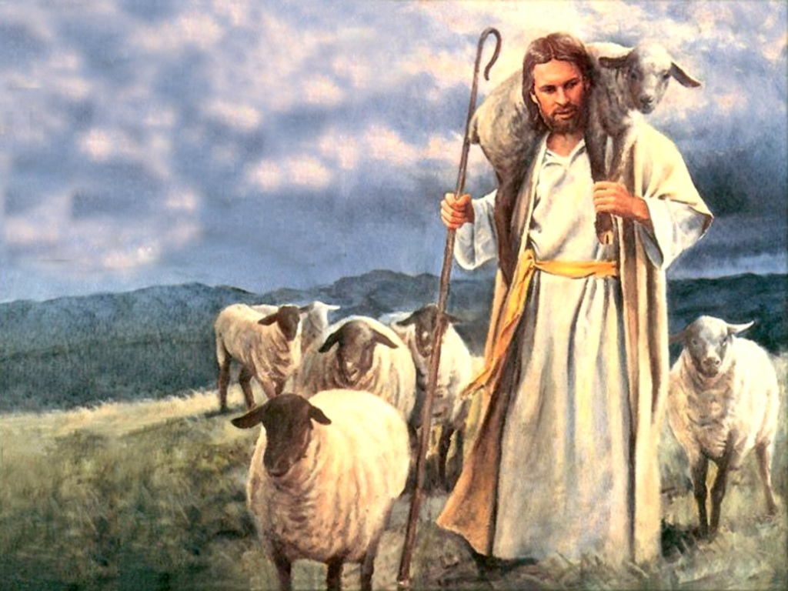

Jesus Told Us So
By Pastor Fee Soliven
Matthew 24:32-35
Sunday Afternoon
August 4, 2024

Slide 97
Matthew 24:32-35
32 "Now learn this parable from the fig tree: When its branch has already become tender and puts forth leaves, you know that summer is near. 33 So you also, when you see all these things, know that it is near--at the doors! 34 Assuredly, I say to you, this generation will by no means pass away till all these things take place. 35 Heaven and earth will pass away, but My words will by no means pass away.

Slide 98
Revelation 19:10
10 And I fell at his feet to worship him. But he said to me, "See that you do not do that! I am your fellow servant, and of your brethren who have the testimony of Jesus. Worship God! For the testimony of Jesus is the spirit of prophecy."

Slide 99
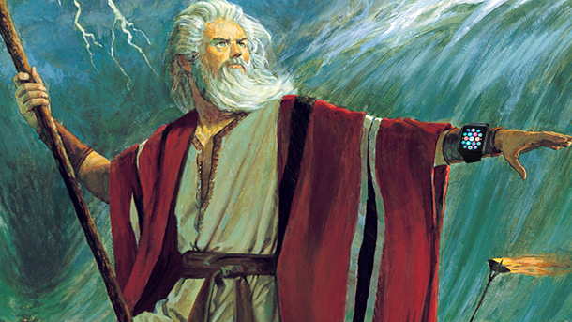
The Shepherd
The Shepherd’s Leading
The Shepherd’s Provision

Slide 100
Deuteronomy 18:17-18
17 "And the LORD said to me: 'What they have spoken is good. 18 I will raise up for them a Prophet like you from among their brethren, and will put My words in His mouth, and He shall speak to them all that I command Him.

Slide 101
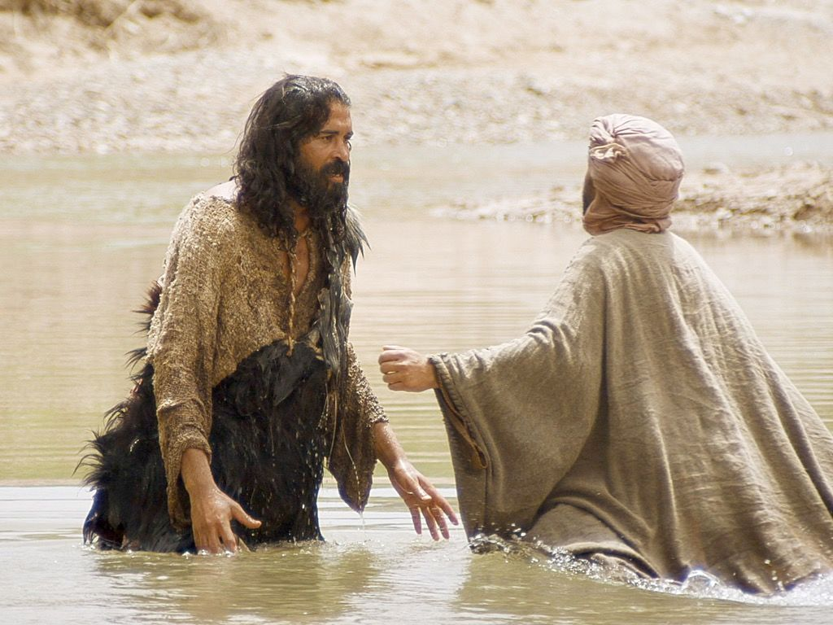
2. The spiritual application as it applies to Jesus Christ and Christians

Slide 102
John 1:19-23
19 Now this is the testimony of John, when the Jews sent priests and Levites from Jerusalem to ask him, "Who are you?" 20 He confessed, and did not deny, but confessed, "I am not the Christ." 21 And they asked him, "What then? Are you Elijah?" He said, "I am not." "Are you the Prophet?" And he answered, "No."

Slide 103
22 Then they said to him, "Who are you, that we may give an answer to those who sent us? What do you say about yourself?" 23 He said: "I am 'The voice of one crying in the wilderness: "Make straight the way of the LORD," '

Slide 104
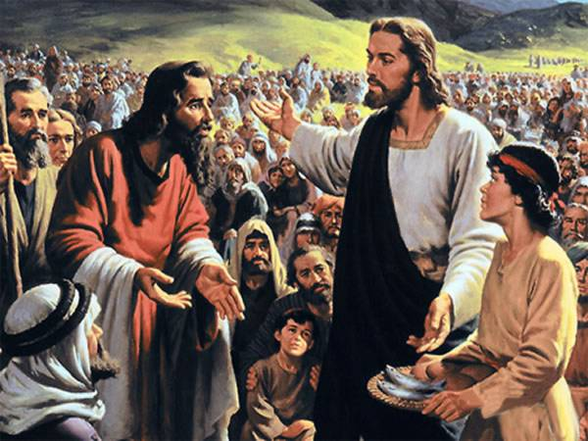
The Shepherd

Slide 105
John 6:11-14
11 And Jesus took the loaves, and when He had given thanks He distributed them to the disciples, and the disciples to those sitting down; and likewise of the fish, as much as they wanted. 12 So when they were filled, He said to His disciples, "Gather up the fragments that remain, so that nothing is lost."

Slide 106
13 Therefore they gathered them up, and filled twelve baskets with the fragments of the five barley loaves which were left over by those who had eaten. 14 Then those men, when they had seen the sign that Jesus did, said, "This is truly the Prophet who is to come into the world."

Slide 107
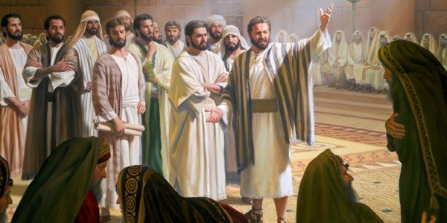
13 The hireling flees because he is a hireling and does not care about the sheep. 14 I am the good shepherd; and I know My sheep, and am known by My own. 15 As the Father knows Me, even so I know the Father; and I lay down My life for the sheep.

Slide 108
Acts 3:22-26
22 For Moses truly said to the fathers, 'The LORD your God will raise up for you a Prophet like me from your brethren. Him you shall hear in all things, whatever He says to you. 23'And it shall be that every soul who will not hear that Prophet shall be utterly destroyed from among the people.'

Slide 109
24 Yes, and all the prophets, from Samuel and those who follow, as many as have spoken, have also foretold these days. 25 You are sons of the prophets, and of the covenant which God made with our fathers, saying to Abraham, 'And in your seed all the families of the earth shall be blessed.'

Slide 110
26 To you first, God, having raised up His Servant Jesus, sent Him to bless you, in turning away every one of you from your iniquities."

Slide 111
Matthew 20:18-19
18 Behold, we are going up to Jerusalem, and the Son of Man will be betrayed to the chief priests and to the scribes; and they will condemn Him to death, 19 and deliver Him to the Gentiles to mock and to scourge and to crucify. And the third day He will rise again."

Slide 112
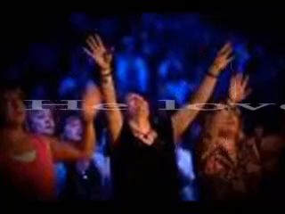
Hebrews 13:20
“Now may the God of peace who brought up our Lord Jesus from the dead, that great Shepherd of the sheep, through the blood of the everlasting covenant.”

Slide 113
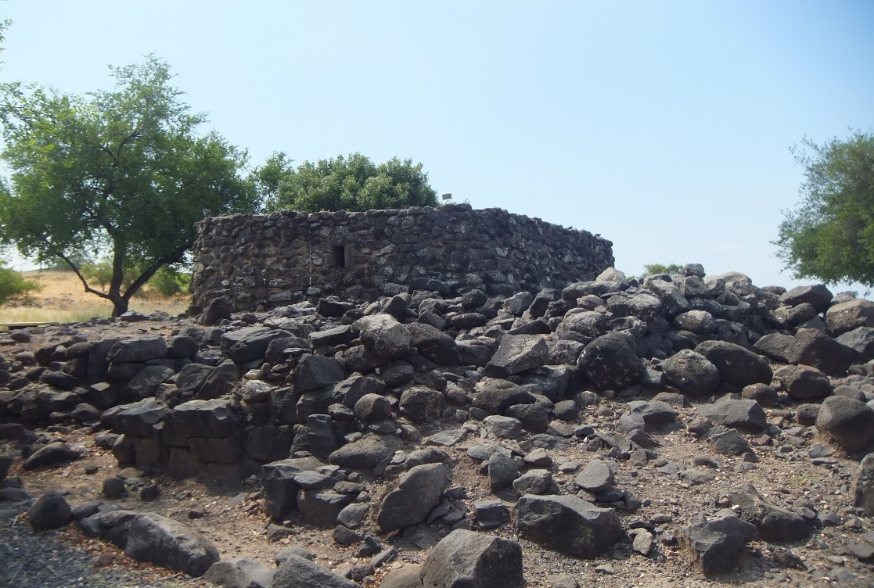
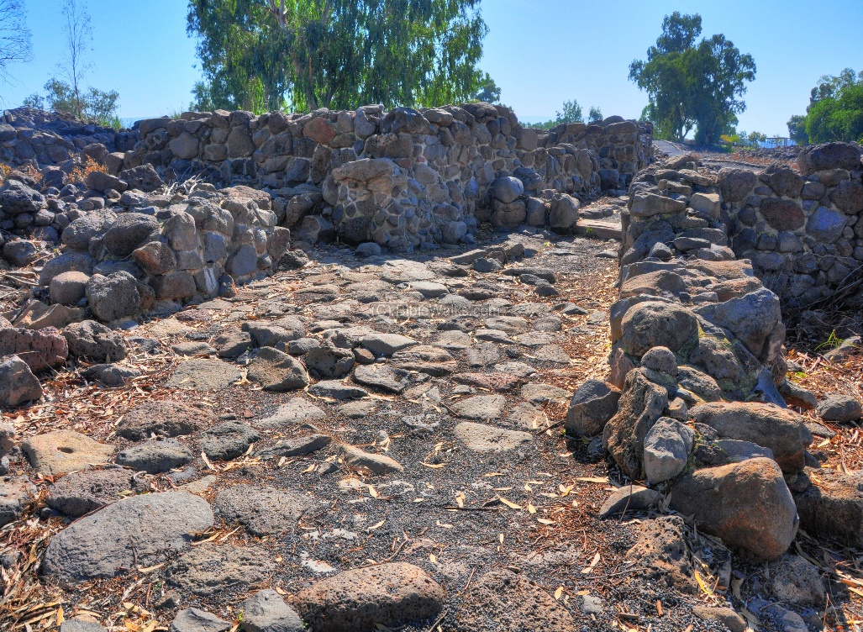
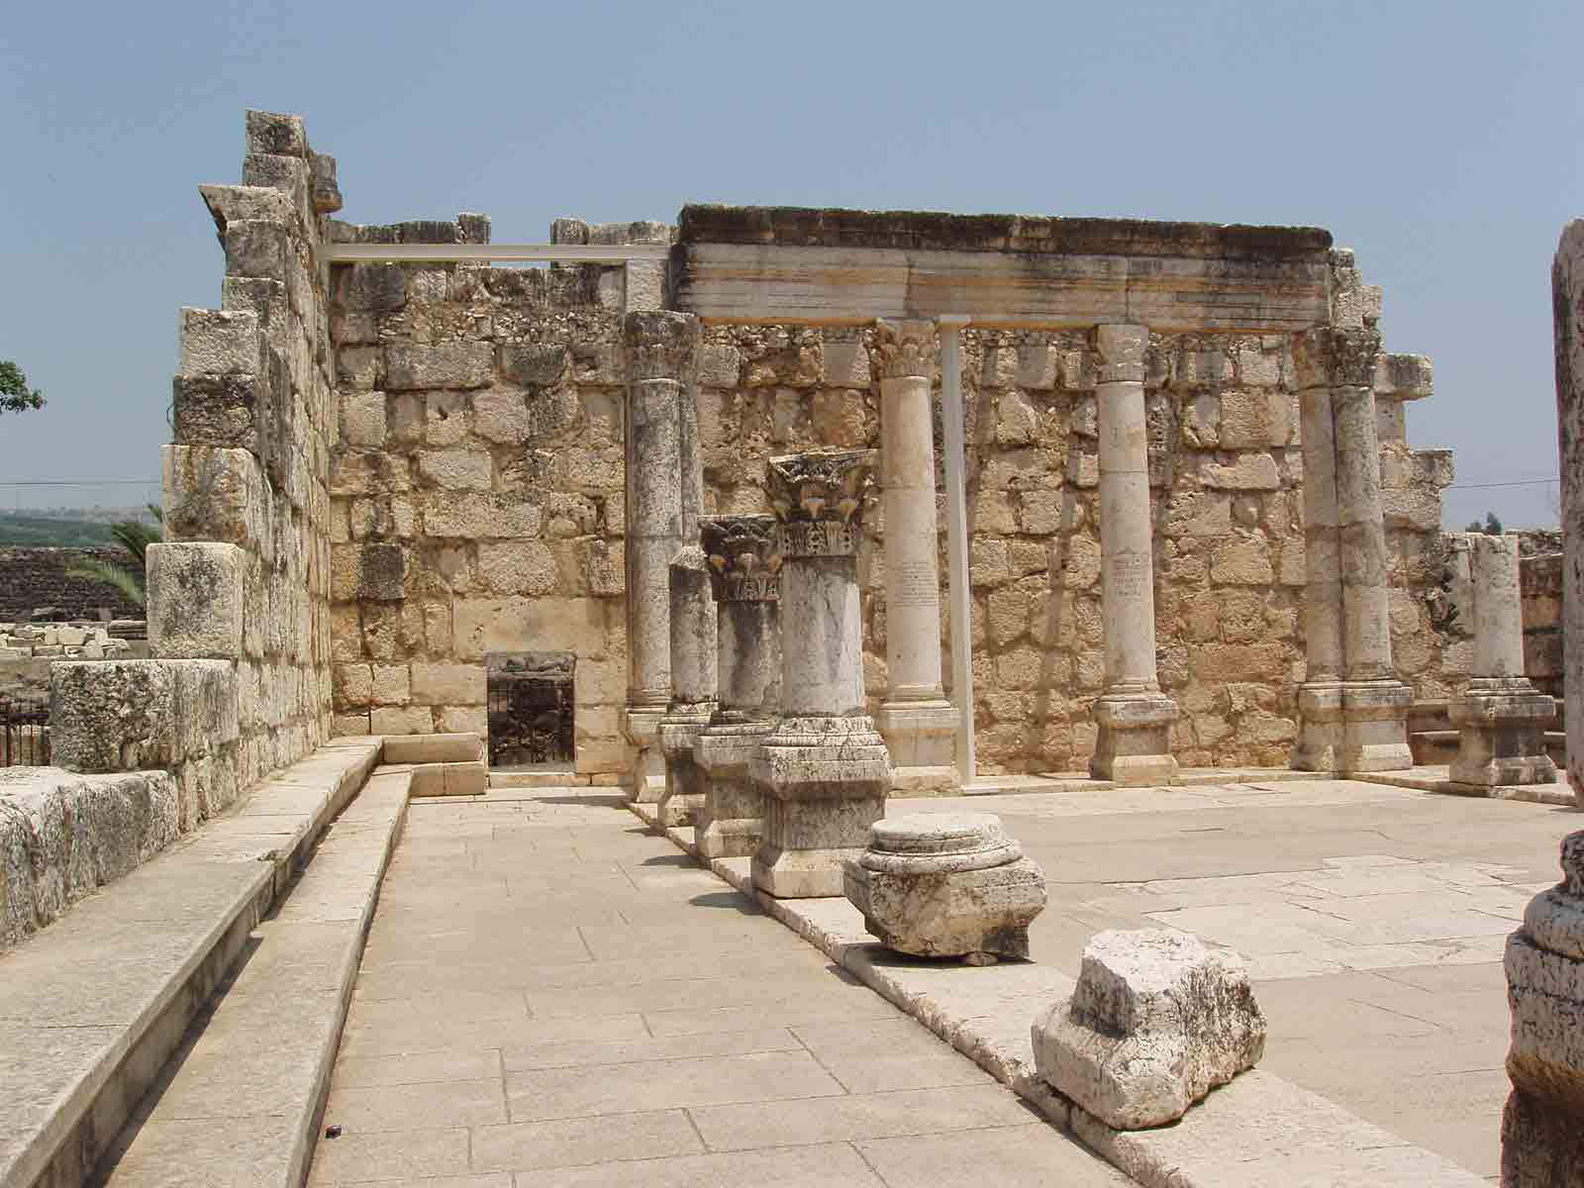

Slide 114
Matthew 11:20-24
20 Then He began to rebuke the cities in which most of His mighty works had been done, because they did not repent: 21 "Woe to you, Chorazin! Woe to you, Bethsaida! For if the mighty works which were done in you had been done in Tyre and Sidon, they would have repented long ago in sackcloth and ashes.

Slide 115
22 But I say to you, it will be more tolerable for Tyre and Sidon in the day of judgment than for you. 23 And you, Capernaum, who are exalted to heaven, will be brought down to Hades; for if the mighty works which were done in you had been done in Sodom, it would have remained until this day. 24 But I say to you that it shall be more tolerable for the land of Sodom in the day of judgment than for you."

Slide 116
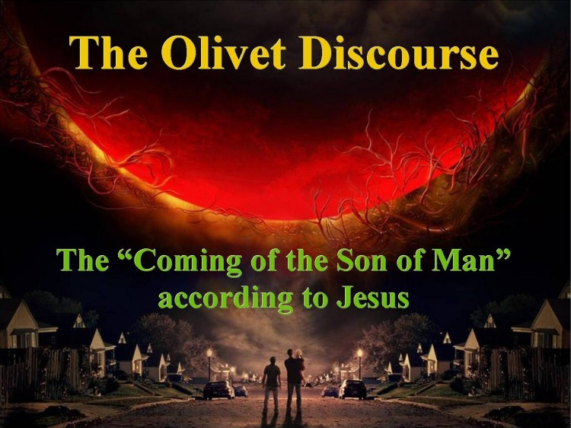
They feed themselves instead of feeding the flock.
•
They eat the fat and clothe themselves with wool.
•
They kill the sheep that are fed.

Slide 117
Matthew 24:1-2
1 Then Jesus went out and departed from the temple, and His disciples came up to show Him the buildings of the temple. 2 And Jesus said to them, "Do you not see all these things? Assuredly, I say to you, not one stone shall be left here upon another, that shall not be thrown down."

Slide 118
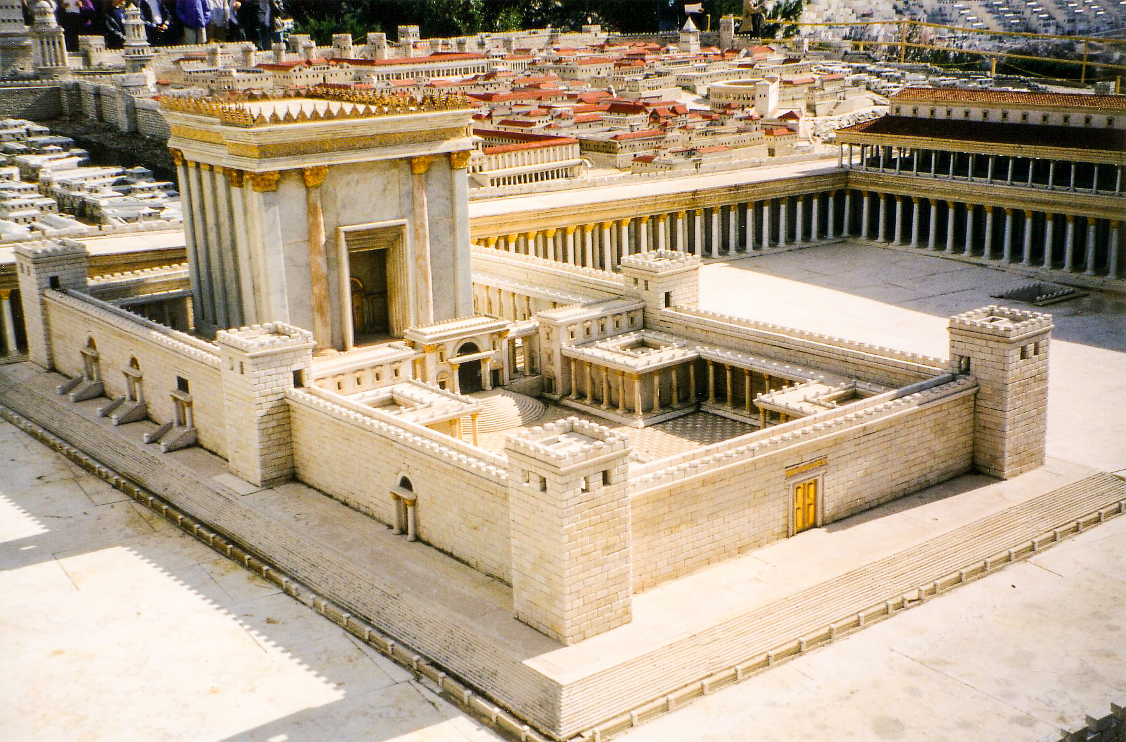
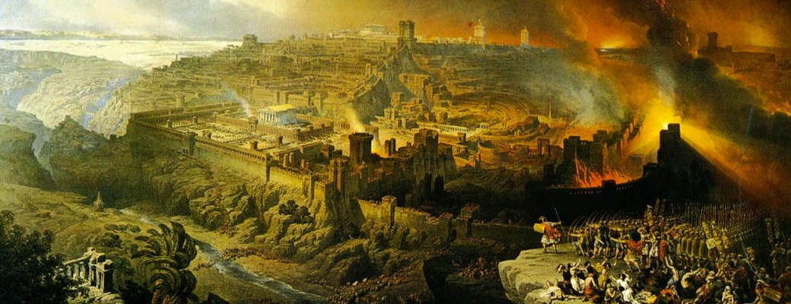

Slide 119
1. Cults False Christs

Slide 120
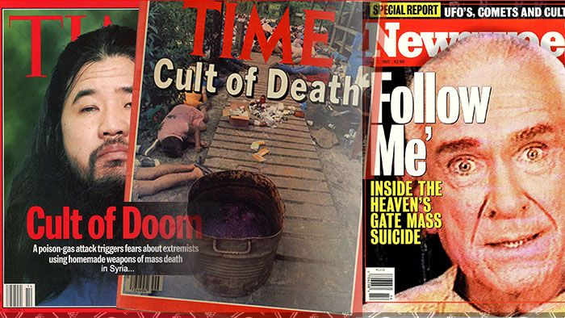
Psalm 100:3
“Know that the LORD, He is God; It is He who has made us, and not we ourselves; We are His people and the sheep of His pasture.”

Slide 121
Matthew 24:5
“For many will come in My name, saying, 'I am the Christ,' and will deceive many.”

Slide 122
Matthew 24:11
“Then many false prophets will rise up and deceive many.”

Slide 123
Matthew 24:24
“For false christs and false prophets will rise and show great signs and wonders to deceive, if possible, even the elect.”

Slide 124
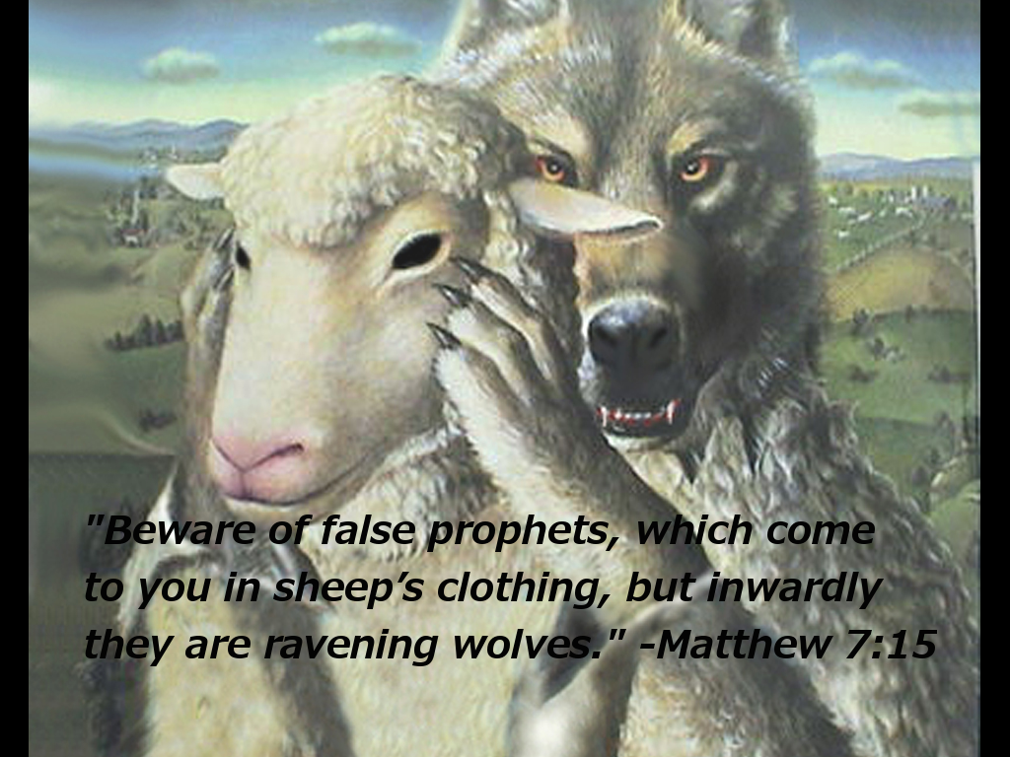
The Paths of Righteousness

Slide 125
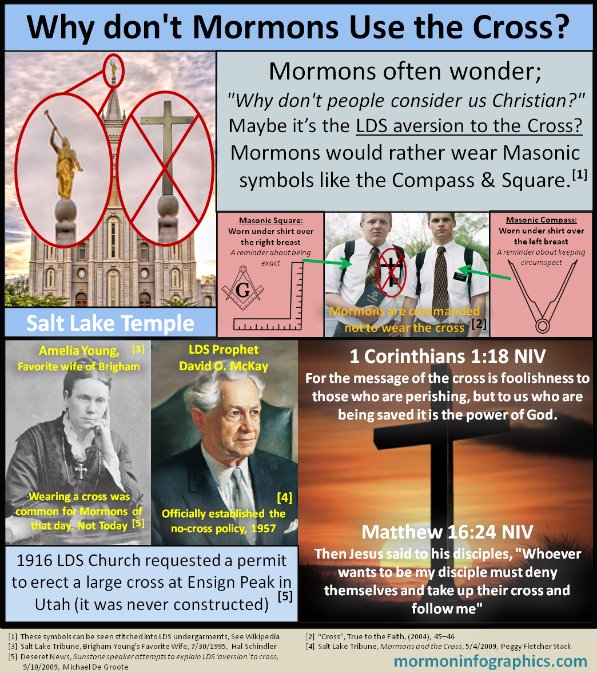


Slide 126
2. Sign of World Politics

Slide 127

2 Samuel 12:7
“Thou art the man”

Slide 128
Matthew 24:6-7
6 And you will hear of wars and rumors of wars. See that you are not troubled; for all these things must come to pass, but the end is not yet. 7 For nation will rise against nation, and kingdom against kingdom…

Slide 129


Slide 130
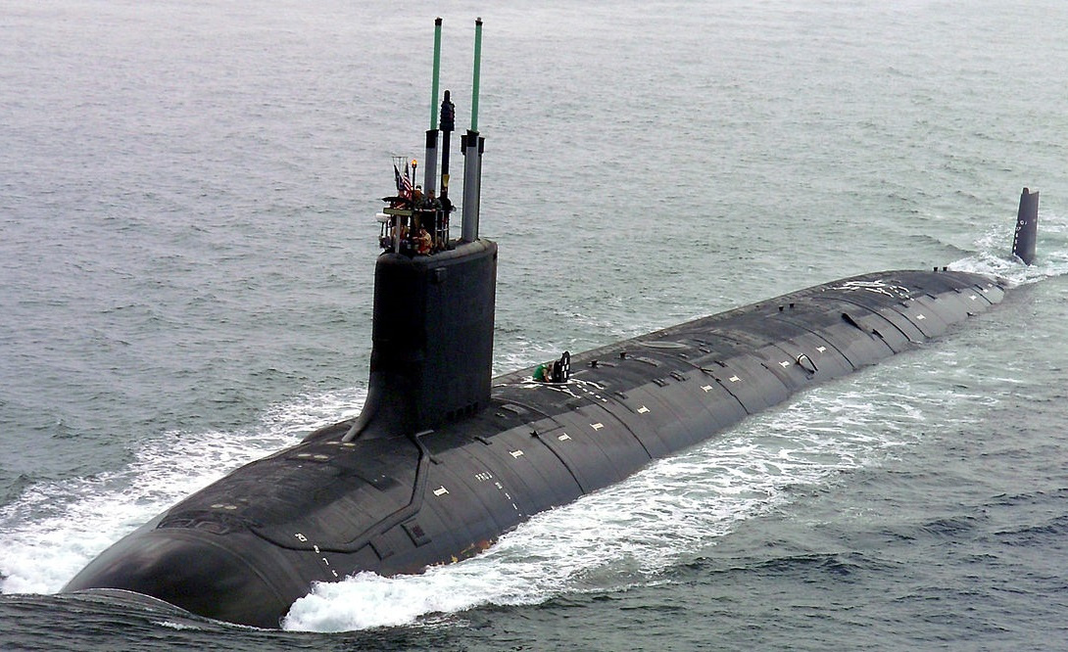

Slide 131
Luke 21:26
men's hearts failing them from fear and the expectation of those things which are coming on the earth, for the powers of heaven will be shaken.

Slide 132
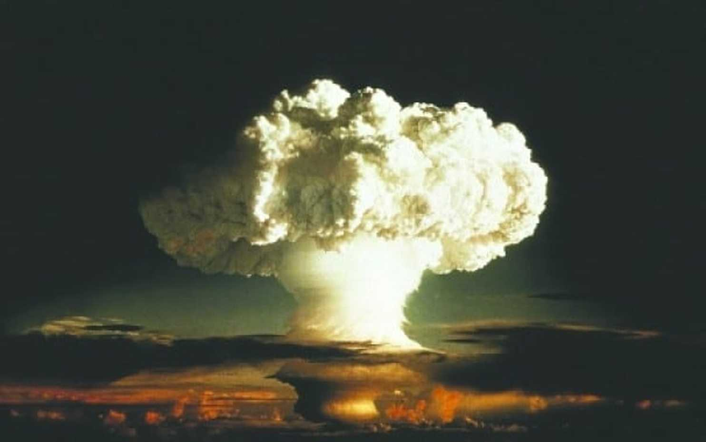
The Shepherd’s Rod and the Staff, The Table and the Cup, Goodness, Mercy, and Grace and He is the Protector

Slide 133
3. Natural Disasters

Slide 134
Matthew 24:7
…And there will be famines, pestilences, and earthquakes in various places.

Slide 135
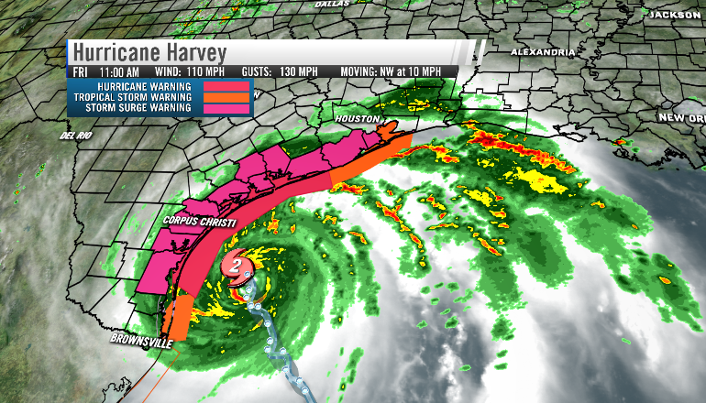
The Table and the Cup

Slide 136
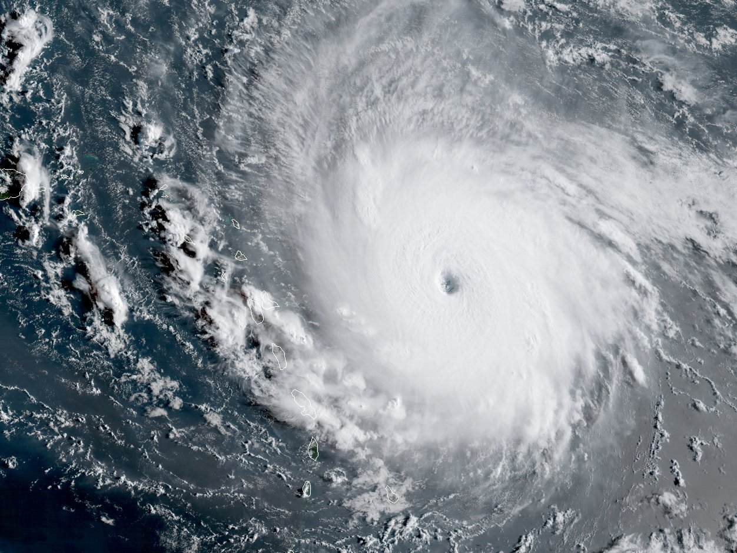
Goodness, Mercy, and Grace

Slide 137
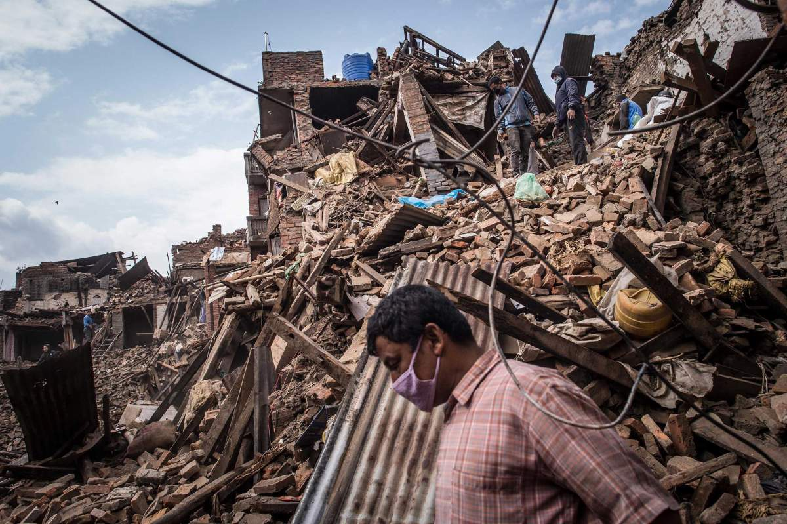

Slide 138
Luke 21:11, 25
11 “And there will be great earthquakes in various places, and famines and pestilences; and there will be fearful sights and great signs from heaven.”

Slide 139
25 "And there will be signs in the sun, in the moon, and in the stars; and on the earth distress of nations, with perplexity, the sea and the waves roaring…”

Slide 140
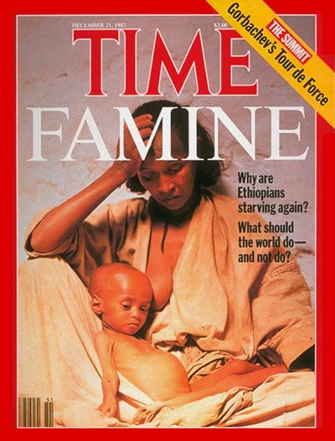
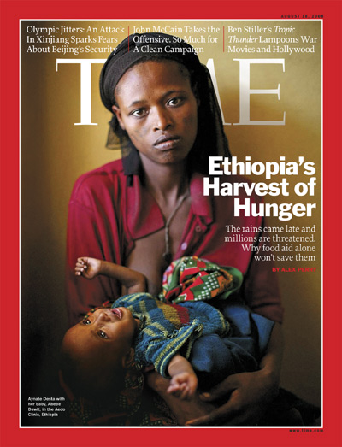

Slide 141
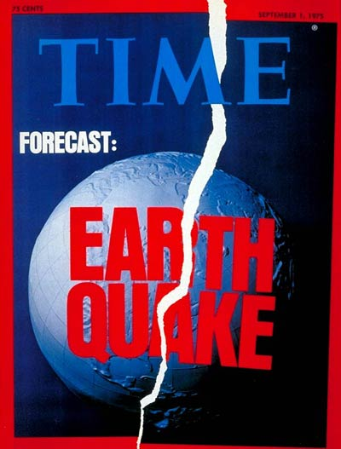

Slide 142



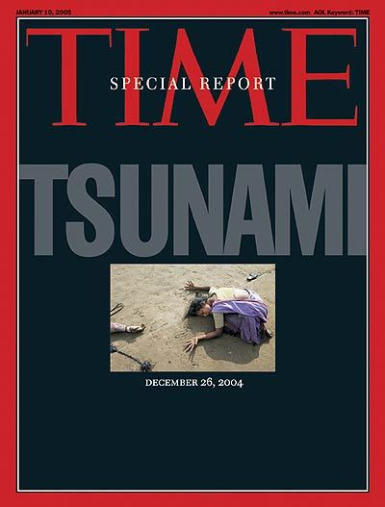
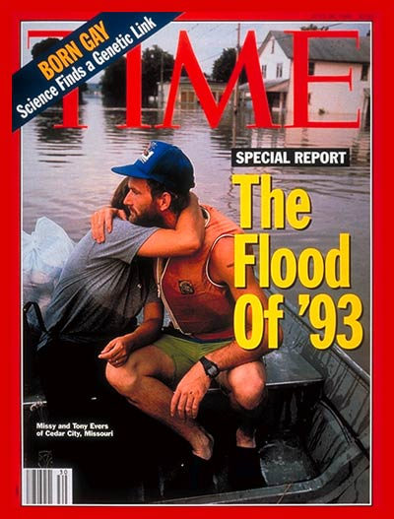

Slide 143

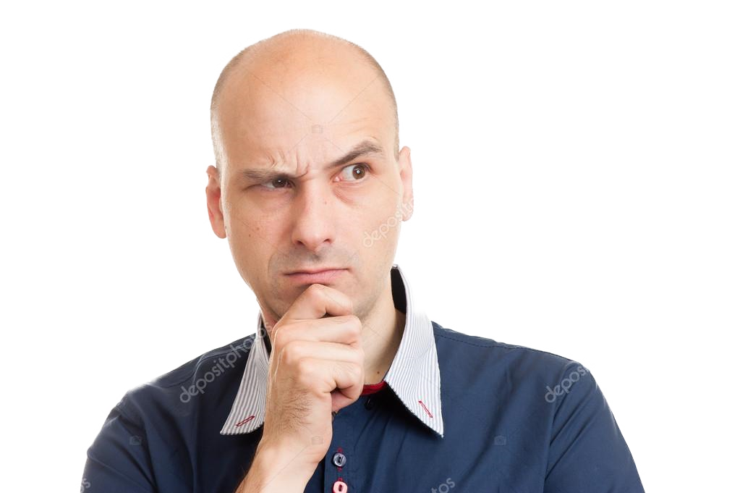
“What else is new? There have always been floods, famines, hurricanes, tsunamis, tornados, earthquakes, plagues and Strange Signs in the Heavens”

Slide 144
Matthew 24:8
"But all these things are merely the beginning of birth pangs”

Slide 145
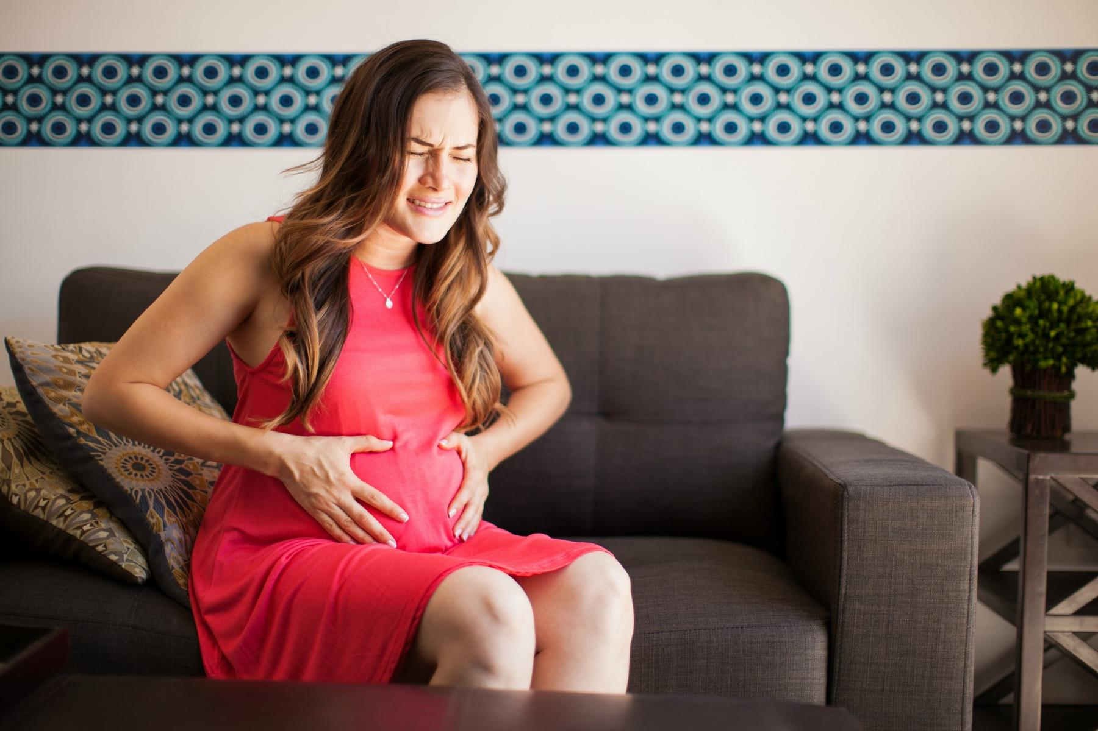
The Shepherd’s Rod and the Staff, The Table and the Cup, Goodness, Mercy, and Grace and He is the Protector

Slide 146
Summary on disasters that Jesus prophesied:

Slide 147
Between
October 1991 – July 2024

Slide 148
1. 9 out of 10 greatest natural disasters as ranked by insurance costs.

Slide 149
2. 5 of the costliest hurricanes in US history now 6 with Harvey

Slide 150
3. 3 of the 4 largest tornado swarms in US History All this before
Katrina in 2005

Slide 151
4. Christian Persecution

Slide 152

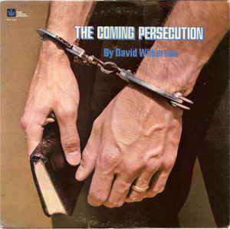

Slide 153
Matthew 24:9
“Then they will deliver you up to tribulation and kill you, and you will be hated by all nations for My name's sake.”

Slide 154
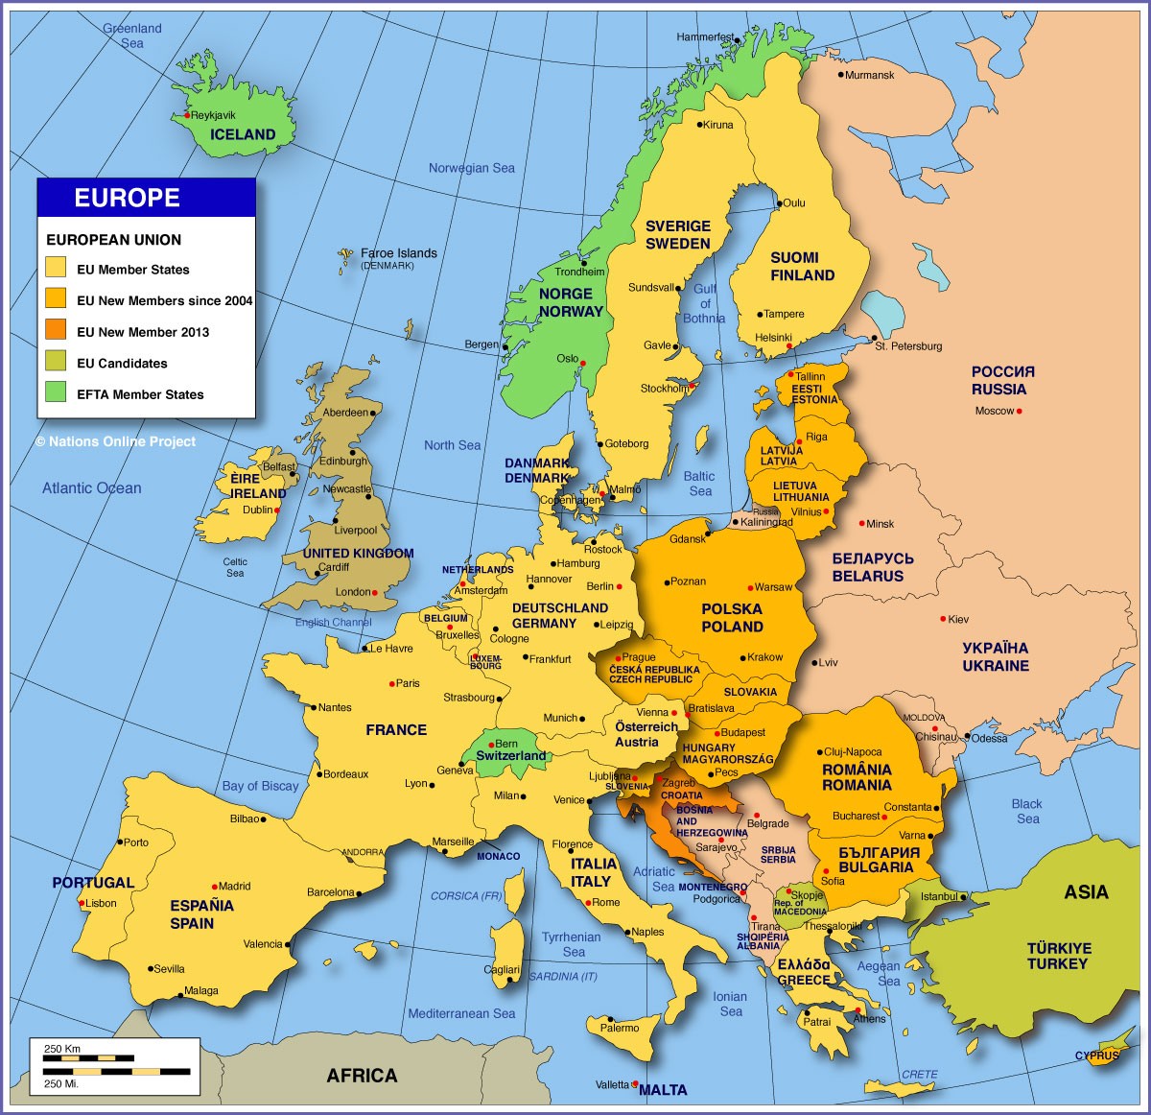

The Shepherd’s Rod and the Staff, The Table and the Cup, Goodness, Mercy, and Grace and He is the Protector

Slide 155
5. Apostasy

Slide 156
Matthew 24:10
“And then many will fall away, and betray one another, and hate one another.”

Slide 157


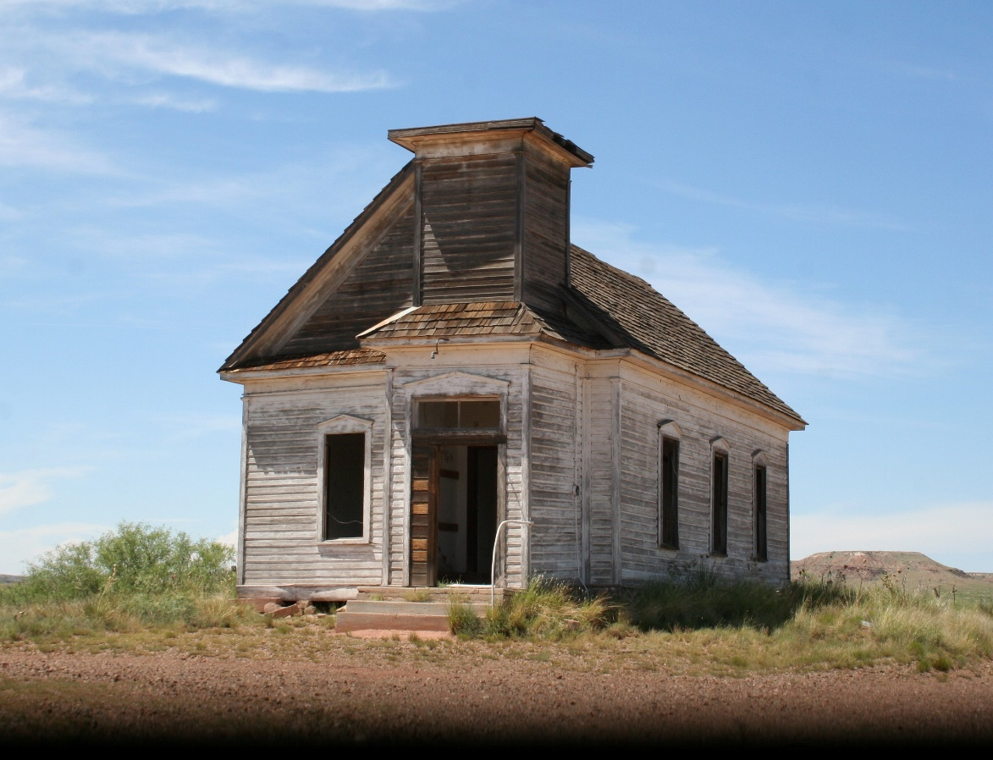

Slide 158
Declining Membership 1960 – 2024
United Church of Christ………………………..64%
American Baptist…………………………………57%
Disciples of Christ……………………………….56%
Episcopal Church…………………………………50%
Presbyterian Church…………………………….41%
United Methodist Church………………………33%

Slide 159
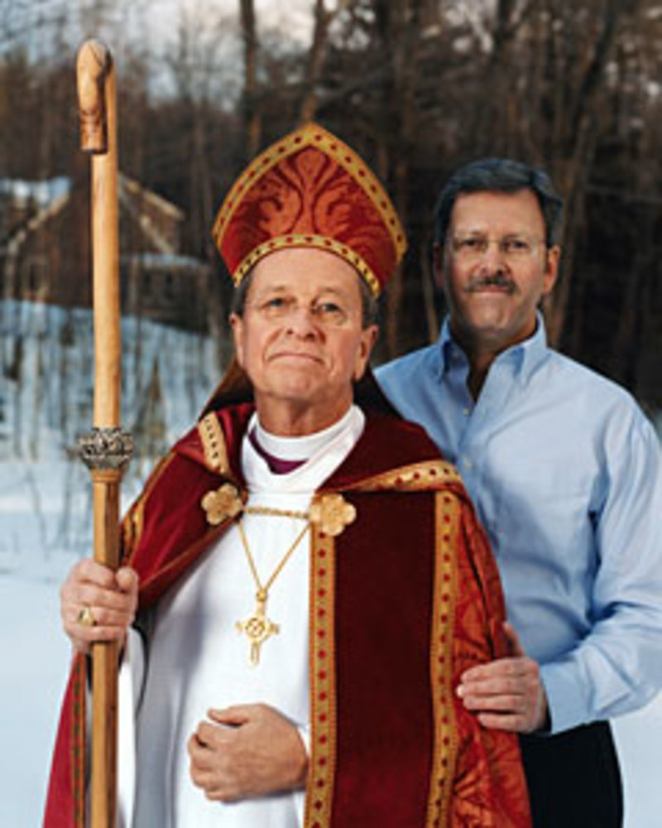
Bishop Gene Robinson was the first Homosexual that was ordained by the Episcopal Church U.S.A. on November 3, 2003

Slide 160
6. The Breakdown of Society

Slide 161
Matthew 24:12
“And because lawlessness will abound, the love of many will grow cold.”

Slide 162
Matthew 24:37
“But as the days of Noah were, so also will the coming of the Son of Man be.”

Slide 163



Slide 164
7. The Preaching of The Gospel

Slide 165
Matthew 24:14
“And this gospel of the kingdom will be preached in all the world as a witness to all the nations, and then the end will come.”

Slide 166
Matthew 24:32-34
32 "Now learn this parable from the fig tree: When its branch has already become tender and puts forth leaves, you know that summer is near. 33 So you also, when you see all these things, know that it is near--at the doors!

Slide 167
34 Assuredly, I say to you, this generation will by no means pass away till all these things take place. 35 Heaven and earth will pass away, but My words will by no means pass away.

Slide 168
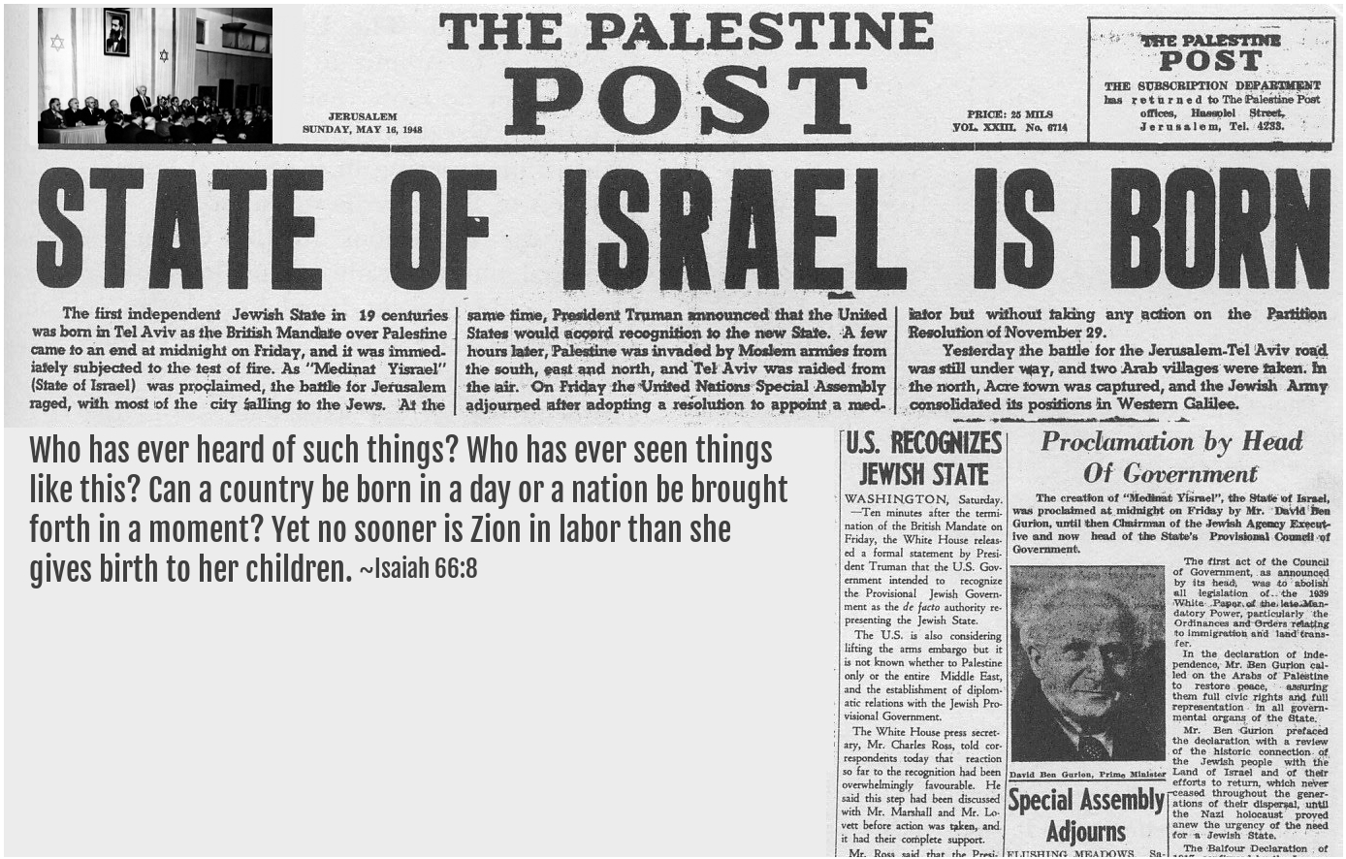
Hebrews 12:6
“For whom the Lord loves he chastens, and scourges every son whom he receives”.

Slide 169
1 Thessalonians 4:13-18
13 But I do not want you to be ignorant, brethren, concerning those who have fallen asleep, lest you sorrow as others who have no hope. 14 For if we believe that Jesus died and rose again, even so God will bring with Him those who sleep in Jesus.

Slide 170
15 For this we say to you by the word of the Lord, that we who are alive and remain until the coming of the Lord will by no means precede those who are asleep. 16 For the Lord Himself will descend from heaven with a shout, with the voice of an archangel, and with the trumpet of God. And the dead in Christ will rise first.

Slide 171
17 Then we who are alive and remain shall be caught up together with them in the clouds to meet the Lord in the air. And thus we shall always be with the Lord. 18 Therefore comfort one another with these words.

Slide 172
1 Corinthians 15:50-54
50 Now this I say, brethren, that flesh and blood cannot inherit the kingdom of God; nor does corruption inherit incorruption. 51 Behold, I tell you a mystery: We shall not all sleep, but we shall all be changed-- 52 in a moment, in the twinkling of an eye, at the last trumpet. For the trumpet will sound, and the dead will be raised incorruptible, and we shall be changed.

Slide 173
53 For this corruptible must put on incorruption, and this mortal must put on immortality. 54 So when this corruptible has put on incorruption, and this mortal has put on immortality, then shall be brought to pass the saying that is written: "Death is swallowed up in victory."

Slide 174

20 Again, when a righteous man turns from his righteousness and commits iniquity, and I lay a stumbling block before him, he shall die; because you did not give him warning, he shall die in his sin, and his righteousness which he has done shall not be remembered; but his blood I will require at your hand.

Slide 175
Acts 2:38-39
38 Then Peter said to them, "Repent, and let every one of you be baptized in the name of Jesus Christ for the remission of sins; and you shall receive the gift of the Holy Spirit. 39 For the promise is to you and to your children, and to all who are afar off, as many as the Lord our God will call."

Slide 176

Donate with our QR code app to
Amazing Grace Christian Fellowship
Donations are Deeply Appreciated!

Slide 177
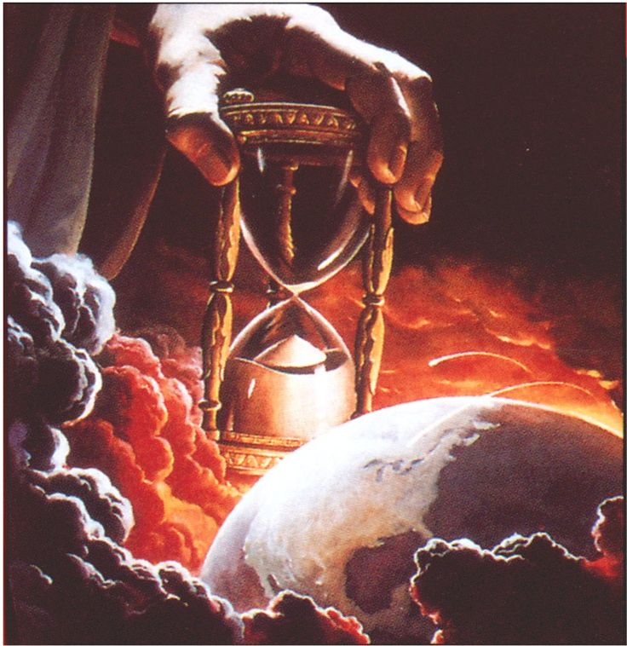
The Message
Jesus is Returning Soon!
We are living on Bowered Time!
Are You Ready To Meet King Jesus?

