Slide 1


Slide 2
We Crown You
(by Jeremy Riddle)

Slide 3
To the One who wore A crown of thorns To the One who took The lash and scourge For the hands and

Slide 4
feet That were pierced by nails For the sacrifice That has torn the veil We crown You We fall face down

Slide 5
and we worship We all cry out, "You are worthy, God“ "You are worthy, God, yes“ We crown You We

Slide 6
fall face down and we worship We all cry out, "You are worthy, God“ "You are worthy, God“ You are

Slide 7
worthy So worthy To the One who gave His very life away Who took upon Himself All our guilt and shame

Slide 8
Hanging on a cross For the world He loved With His precious blood Purchased men for God And we

Slide 9
crown You We fall face down and we worship We all cry out, "You are worthy, God“ "You are worthy, God"

Slide 10
Yes, and we crown You We fall face down and we worship We all cry out, "You are worthy, God“ "You

Slide 11
are worthy, God“ Worthy, worthy, God To the One who endured All the shame of the cross To the Lamb

Slide 12
who was slain As atonement for us To the Son who overcame All the power of death We praise! For the

Slide 13
stripes, for the wounds For the beating You bore For the tears, for the blood That was willingly poured For

Slide 14
the merciful, for wonderful, for majesty of Your love To the One who endured All the shame of the cross

Slide 15
To the Lamb who was slain As atonement for us To the Son who overcame All the power of death We

Slide 16
praise! For the stripes, for the wounds For the beating You bore For the tears and the blood That

Slide 17
was willingly poured For the merciful, for wonderful, for majesty of Your love! We crown You We fall face

Slide 18
down and we worship We all cry out, "You are worthy, God", You are "You are worthy, God“ We

Slide 19
crown You We fall face down and we worship We all cry out, "You are worthy, God“ "You are worthy, Lord"

Slide 20
To the One who endured All the shame of the cross To the Lamb who was slain As atonement for us To

Slide 21
the Son who overcame All the power of death We praise! For the stripes, for the wounds For the

Slide 22
beating You bore For the tears, for the blood That was willingly poured For the merciful, for wonderful,

Slide 23
for majesty of Your love! We crown You We fall face down and we worship We all cry out, "You are

Slide 24
worthy, God“ "You are worthy, God“ We crown You We fall face down and we worship We all cry out, "

Slide 25
You are worthy, God“ "You are worthy, God", yeah, we crown We crown You We fall face down and we

Slide 26
worship We all cry out, "You are worthy, God“ "You are worthy, God“

Slide 27
When You Walk Into the Room
(Katie Torwait)

Slide 28
When You walk into the room Everything changes
Darkness starts to tremble At the light that You bring

Slide 29
And when You walk into the room Every heart starts burning And nothing matters more Than just to sit

Slide 30
here at Your feet And worship You We worship You, oh We love You We'll never stop We can't live

Slide 31
without You, Jesus We love You And we can't get enough All this is for You, Jesus When You walk into

Slide 32
the room Sickness starts to vanish Every hopeless situation ceases to exist And when You walk into the

Slide 33
room The dead begin to rise 'Cause there is resurrection life in all You do We love You We'll never

Slide 34
stop Can't live without You, Jesus We love You And we can't get enough All this is for You, Jesus Oh,

Slide 35
Jesus Come and consume, God All we are We give You permission Our hearts are Yours We want You,

Slide 36
we want You Come and consume, God All we are We give You permission Our hearts are Yours We

Slide 37
want You, we want You Come and consume, God All we are We give You permission Our hearts are Yours

Slide 38
We want You, we want You Come and consume, God All we are We give You permission Our hearts

Slide 39
are Yours We want You, we want You We love You We'll never stop Can't live without You, Jesus We

Slide 40
love You And we can't get enough All this is for You, Jesus Oh, how we love You Oh, how we love You

Slide 41
“Reckless Love”
(Cory Asbury)

Slide 42
Before I spoke a word, You were singing over me You have been so, so good to me Before I took a

Slide 43
breath, you breathed Your life in me You have been so so kind to me Oh, the overwhelming,

Slide 44
never-ending, reckless love of God Oh, it chases me down, fights 'til I'm found, leaves the 99 And I

Slide 45
couldn't earn it I don't deserve it, still You give yourself away Oh, the overwhelming, never-ending,

Slide 46
reckless love of God When I was Your foe, still Your love fought for me You have been so, so good to me

Slide 47
When I felt no worth, You paid it all for me You have been so, so kind to me Oh, the overwhelming,

Slide 48
never-ending, reckless love of God Oh, it chases me down, fights 'til I'm found, leaves the 99 And I

Slide 49
couldn't earn it I don't deserve it, still You give yourself away Oh, the overwhelming, never-ending,

Slide 50
reckless love of God There's no shadow You won't light up Mountain You won't climb up Coming after

Slide 51
me There's no wall You won't kick down Lie You won't tear down Coming after me Oh, the

Slide 52
overwhelming, never-ending, reckless love of God Oh, it chases me down, fights 'til I'm found, leaves

Slide 53
the 99 And I couldn't earn it I don't deserve it, still You give yourself away Oh, the overwhelming,

Slide 54
never-ending, reckless love of God.

Slide 55
The More I Seek You
(by Kari Jobe)

Slide 56
The more I seek you The more I find you The more I find you, the more I love you I wanna sit at your feet

Slide 57
Drink from the cup in your hand Lay back against you and breath, feel your heart beat This love is so deep,

Slide 58
it's more than I can stand I melt in your peace, it's overwhelming The more I seek you The more I find

Slide 59
you The more I find you, the more I love you I wanna sit at your feet Drink from the cup in your

Slide 60
stand I melt in your peace, it's overwhelming I wanna sit at your feet Drink from the cup in your hand Lay

Slide 61
back against you and breath, feel your heart beat This love is so deep, it's more than I can stand I

Slide 62
melt in your peace, it's overwhelming, oh your love is overwhelming me And now my love, your love is

Slide 63
overwhelming me, over me I wanna sit at your feet Drink from the cup in your hand Lay back against

Slide 64
you and breath, feel your heart beat This love is so deep, it’s m ore than I can stand I melt in your peace

Slide 65
“Holy Spirit”
(Kim Walker)

Slide 66
There’s nothing worth more. That could ever come close. No thing can compare. You’re our living hope.

Slide 67
Your presence Lord. I’ve tasted and seen of the sweetest of loves. Where my heart becomes free

Slide 68
And my shame is undone. Your presence, Lord.
Holy spirit you are welcome here. Come flood this

Slide 69
place and fill the atmosphere. Your glory God is what our hearts long for. To be overcomed, By your

Slide 70
presence Lord. There’s nothing worth more. That could ever come close. No thing can compare.

Slide 71
you’re living hope. Your presence, Lord. I’ve tasted and seen of the sweetest of loves. Where my heart

Slide 72
becomes free and my shame is undone. Your presence, Lord. Holy Spirit you are welcome here

Slide 73
Come flood this place and fill the atmosphere. Your glory God is what our hearts long for. To be

Slide 74
overcome by your presence Lord. Your presence Lord. Let us become more aware of your presence

Slide 75
Let us experience the Glory of your goodness. Let us become. More aware of your presence. Let us

Slide 76
experience the Glory of your goodness. Let us become more aware of your presence. Let us

Slide 77
the atmosphere, Your glory God is what our heart longs for to be overcome. By your presence Lord.

Slide 79


Slide 80
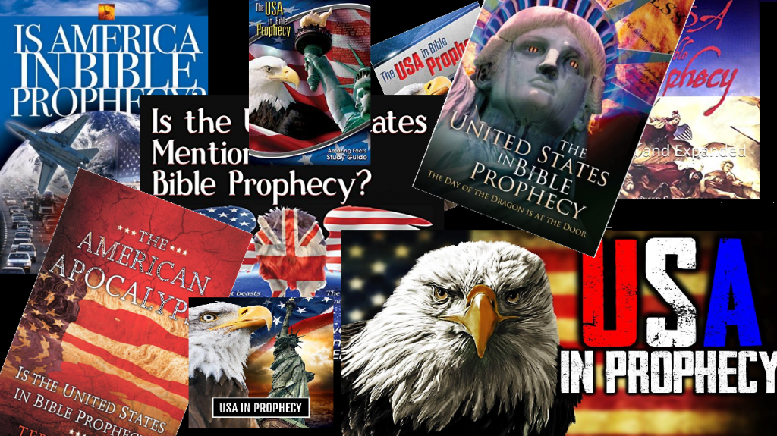

Mystery Babylon Part 2
by Pastor Fee Soliven
Revelation 18:1-24
Sunday Afternoon
September 15, 2024

Slide 81
Revelation 18:1-24
1 After these things I saw another angel coming down from heaven, having great authority, and the earth was illuminated with his glory. 2 And he cried mightily with a loud voice, saying, "Babylon the great is fallen, is fallen, and has become a dwelling place of demons, a prison for every foul spirit, and a cage for every unclean and hated bird!

Slide 82
3 For all the nations have drunk of the wine of the wrath of her fornication, the kings of the earth have committed fornication with her, and the merchants of the earth have become rich through the abundance of her luxury." 4 And I heard another voice from heaven saying, "Come out of her, my people, lest you share in her sins, and lest you receive of her plagues.

Slide 83
5 For her sins have reached to heaven, and God has remembered her iniquities. 6 Render to her just as she rendered to you, and repay her double according to her works; in the cup which she has mixed, mix double for her. 7 In the measure that she glorified herself and lived luxuriously, in the same measure give her torment and sorrow; for she says in her heart, 'I sit as queen, and am no widow, and will not see sorrow.'

Slide 84
8 "Therefore her plagues will come in one day--death and mourning and famine. And she will be utterly burned with fire, for strong is the Lord God who judges her. 9 "The kings of the earth who committed fornication and lived luxuriously with her will weep and lament for her, when they see the smoke of her burning,

Slide 85
10 standing at a distance for fear of her torment, saying, 'Alas, alas, that great city Babylon, that mighty city! For in one hour your judgment has come.' 11 "And the merchants of the earth will weep and mourn over her, for no one buys their merchandise anymore: 12 merchandise of gold and silver, precious stones and pearls, fine linen and purple, silk and scarlet, every kind of citron wood, every kind of object of ivory, every kind of object of most precious wood, bronze, iron, and marble;

Slide 86
13 and cinnamon and incense, fragrant oil and frankincense, wine and oil, fine flour and wheat, cattle and sheep, horses and chariots, and bodies and souls of men. 14 The fruit that your soul longed for has gone from you, and all the things which are rich and splendid have gone from you, and you shall find them no more at all. 15 The merchants of these things, who became rich by her, will stand at a distance for fear of her torment, weeping and wailing,

Slide 87
16 and saying, 'Alas, alas, that great city that was clothed in fine linen, purple, and scarlet, and adorned with gold and precious stones and pearls! 17 For in one hour such great riches came to nothing.' Every shipmaster, all who travel by ship, sailors, and as many as trade on the sea, stood at a distance 18 and cried out when they saw the smoke of her burning, saying, 'What is like this great city?'

Slide 88
19 "They threw dust on their heads and cried out, weeping and wailing, and saying, 'Alas, alas, that great city, in which all who had ships on the sea became rich by her wealth! For in one hour she is made desolate.' 20 "Rejoice over her, O heaven, and you holy apostles and prophets, for God has avenged you on her!"

Slide 89
21 Then a mighty angel took up a stone like a great millstone and threw it into the sea, saying, "Thus with violence the great city Babylon shall be thrown down, and shall not be found anymore. 22 The sound of harpists, musicians, flutists, and trumpeters shall not be heard in you anymore. No craftsman of any craft shall be found in you anymore, and the sound of a millstone shall not be heard in you anymore.

Slide 90
23 The light of a lamp shall not shine in you anymore, and the voice of bridegroom and bride shall not be heard in you anymore. For your merchants were the great men of the earth, for by your sorcery all the nations were deceived. 24 And in her was found the blood of prophets and saints, and of all who were slain on the earth."

Slide 91
Revelation 17:3
So he carried me away in the Spirit into the wilderness. And I saw a woman sitting on a scarlet beast which was full of names of blasphemy, having seven heads and ten horns.

Slide 92
Daniel 12:4
“seal the book” for the mysteries of prophecy were appointed for the “time of the end” when “knowledge shall be increased”

Slide 93
John 16:13
However, when He, the Spirit of truth, has come, He will guide you into all truth; for He will not speak on His own authority, but whatever He hears He will speak; and He will tell you things to come.

Slide 94
Amos 3:7
Surely the Lord GOD does nothing, Unless He reveals His secret to His servants the prophets.

Slide 95
14. Babylon Has Wisdom and Knowledge Above Other Nations

Slide 96
The U.S. is ranked #1 in higher
education institutions

Slide 97
Isaiah 47:10
"For you have trusted in your wickedness; You have said, 'No one sees me'; Your wisdom and your knowledge have warped you; And you have said in your heart, 'I am, and there is no one else besides me.'

Slide 98
Proverbs 2:5-9
5 Then you will understand the fear of the LORD, And find the knowledge of God. 6 For the LORD gives wisdom; From His mouth come knowledge and understanding; 7 He stores up sound wisdom for the upright; He is a shield to those who walk uprightly; 8 He guards the paths of justice, And preserves the way of His saints. 9 Then you will understand righteousness and justice, Equity and every good path.

Slide 99
15) Babylon is Proud, Haughty and “Says in Her Heart, I Am, and None Else Beside Me.”

Slide 100
Isaiah 47:8
"Therefore hear this now, you who are given to pleasures, Who dwell securely, Who say in your heart, 'I am, and there is no one else besides me; I shall not sit as a widow, Nor shall I know the loss of children'…

Slide 101
U.S. Falls into Darkness

Slide 102
Since 1973 Roe vs Wade, 70,000,000 babies have been murdered in the womb

Slide 103
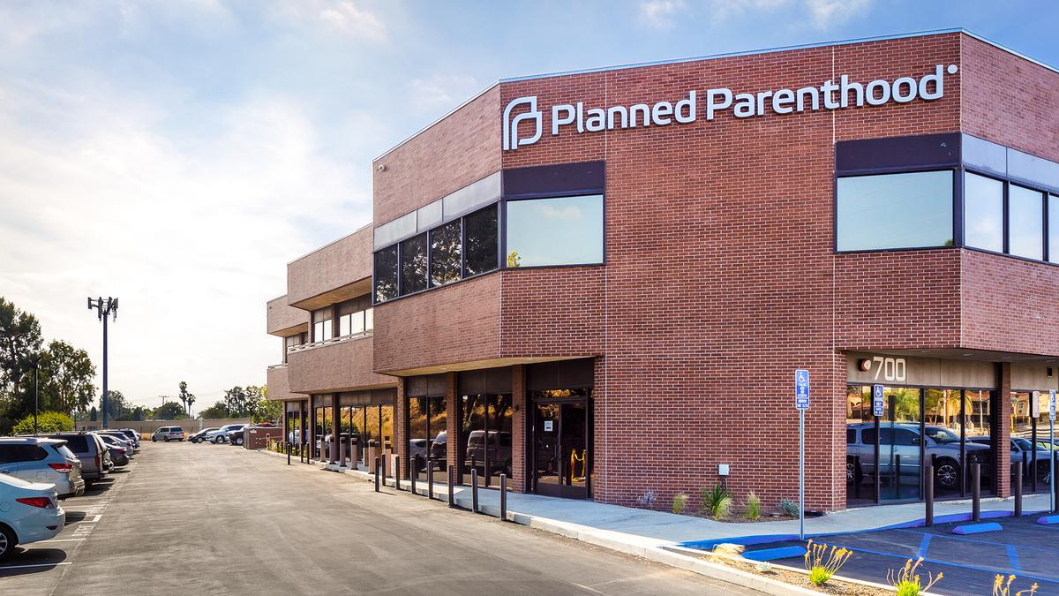
Planned Parenthood Photos 3>

Slide 104
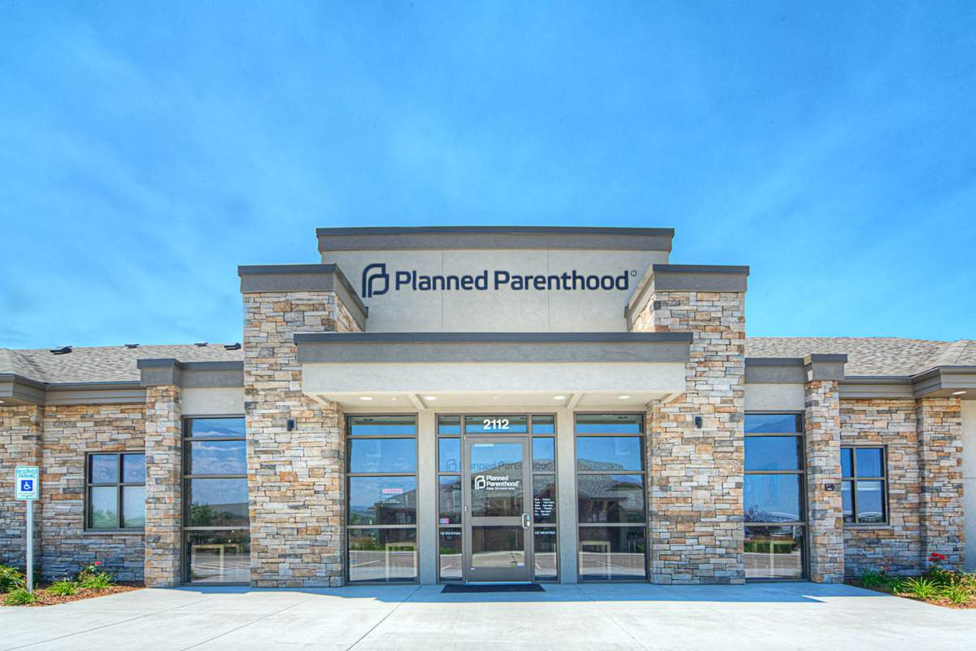
Planned Parenthood Photos 3>

Slide 105
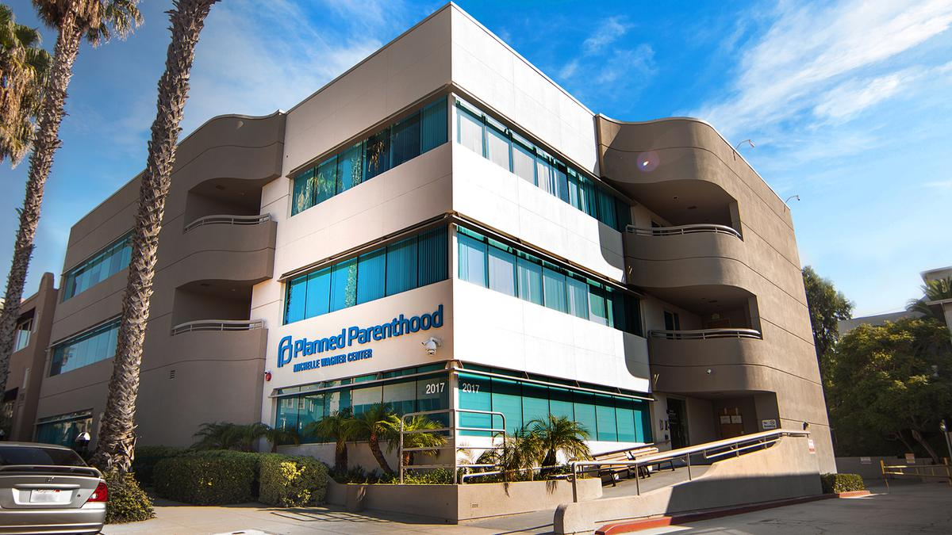
Planned Parenthood Photos 3>

Slide 106
A Presidential Executive Order by Obama allowed Same sex marriage in all 50 states before he left office on June 26, 2015

Slide 107
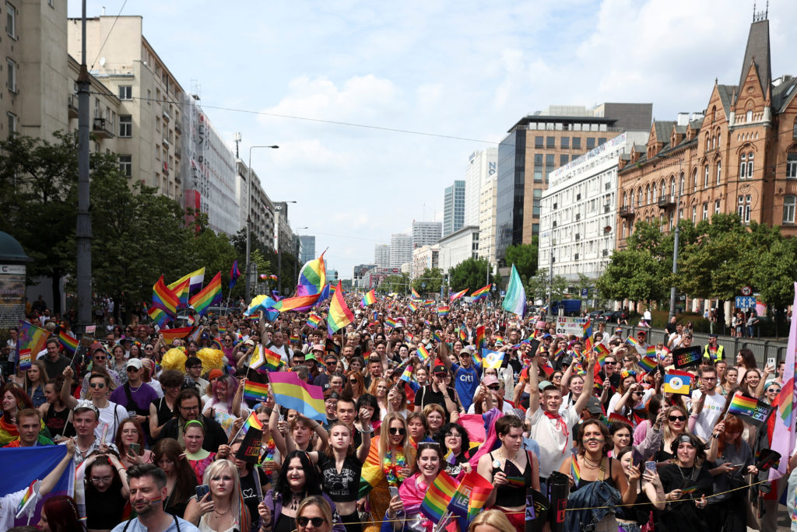
Homosexual Marches Photos 3>

Slide 108
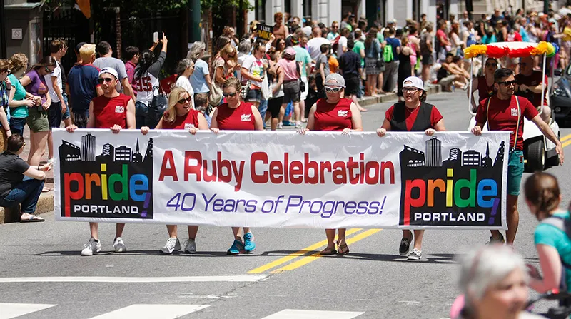
Homosexual Marches Photos 3>

Slide 109
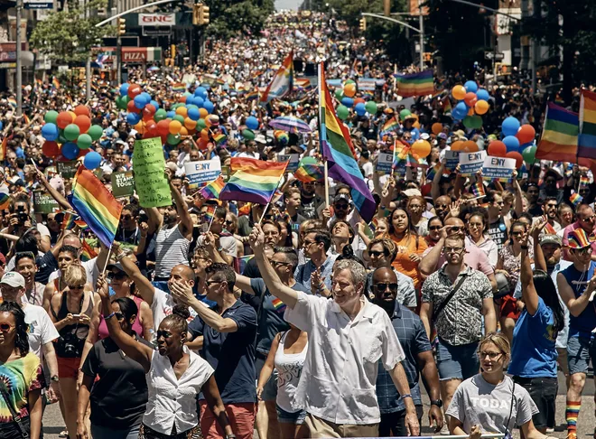
Homosexual Marches Photos 3>

Slide 110
June 17, 2021 have passed a bill to allow 6 states to teach children about Transgenderism

Slide 111
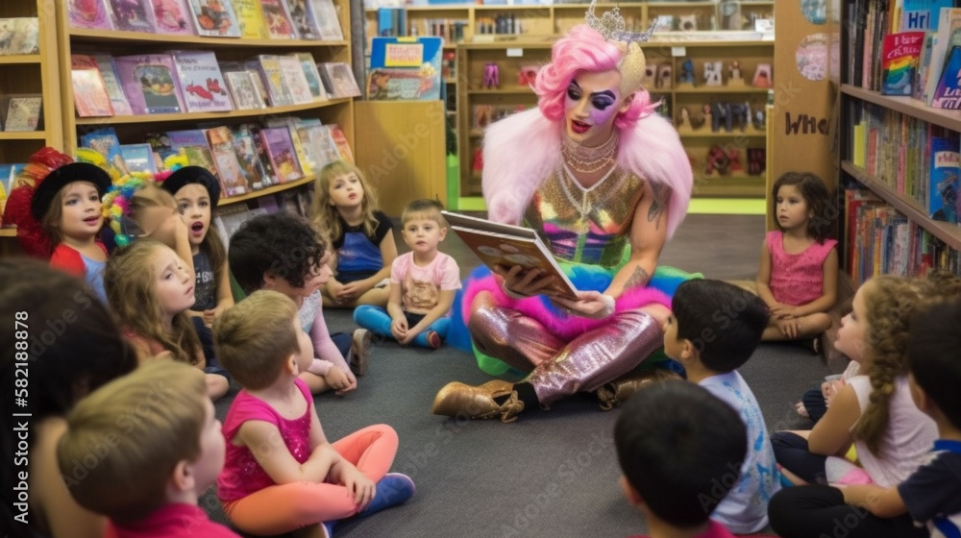
Transgenders Story Time with Children Photos 3>

Slide 112
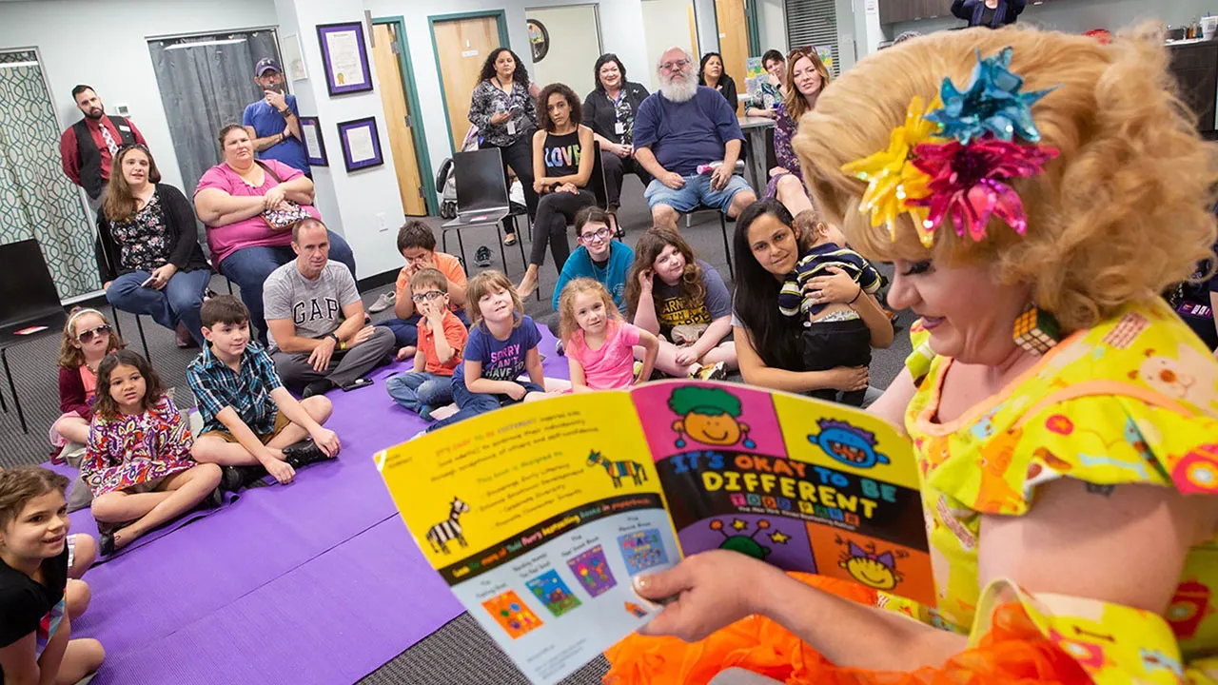
Transgenders Story Time with Children Photos 3>

Slide 113
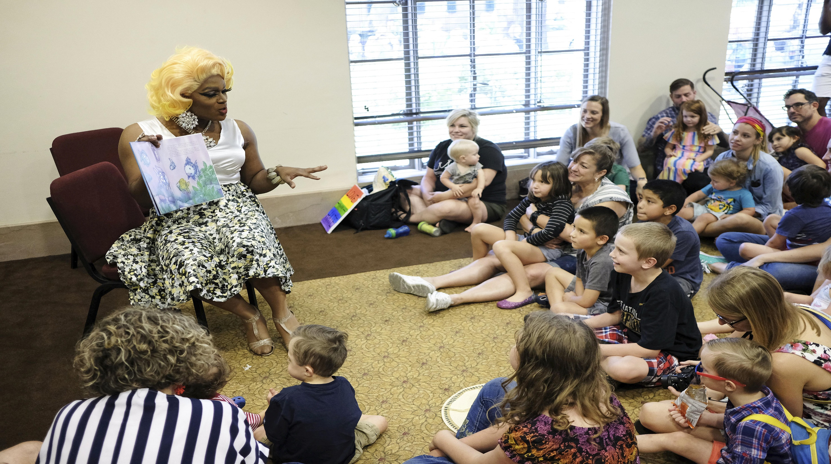
Transgenders Story Time with Children Photos 3>

Slide 114
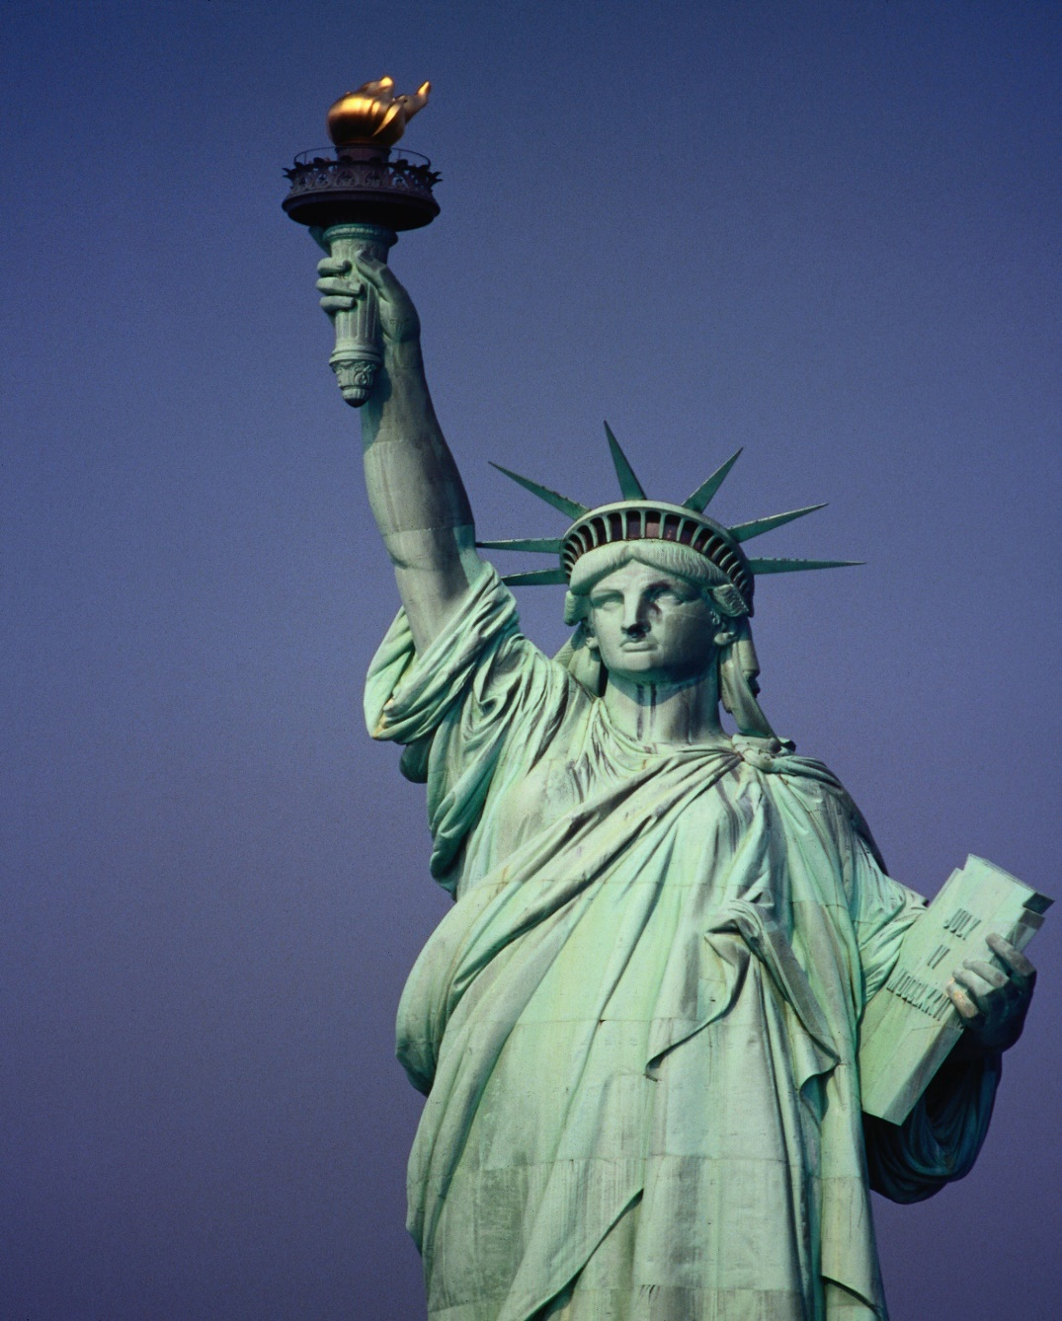
16. Babylon Says, “I Sit a Queen and Shall See No Sorrow.”

Slide 115
Revelation 18:7
In the measure that she glorified herself and lived luxuriously, in the same measure give her torment and sorrow; for she says in her heart, 'I sit as queen, and am no widow, and will not see sorrow.'

Slide 116
17. Babylon “Falls” Spiritually in God’s Eyes.

Slide 117
Isaiah 47:1-5
1 "Come down and sit in the dust, O virgin daughter of Babylon; Sit on the ground without a throne, O daughter of the Chaldeans!
For you shall no more be called Tender and delicate. 2 Take the millstones and grind meal. Remove your veil, Take off the skirt, Uncover the thigh, Pass through the rivers.

Slide 118
3 Your nakedness shall be uncovered, Yes, your shame will be seen; I will take vengeance, And I will not arbitrate with a man." 4 As for our Redeemer, the LORD of hosts is His name, The Holy One of Israel. 5 "Sit in silence, and go into darkness, O daughter of the Chaldeans; For you shall no longer be called The Lady of Kingdoms.

Slide 119
Revelation 18:1-2
1 After these things I saw another angel coming down from heaven, having great authority, and the earth was illuminated with his glory. 2 And he cried mightily with a loud voice, saying, "Babylon the great is fallen, is fallen, and has become a dwelling place of demons, a prison for every foul spirit, and a cage for every unclean and hated bird!

Slide 120
18. Babylon is Literally Driven into Darkness

Slide 121
Isaiah 47:5
"Sit in silence, and go into darkness, O daughter of the Chaldeans; For you shall no longer be called The Lady of Kingdoms.

Slide 122
Revelation 18:2
And he cried mightily with a loud voice, saying, "Babylon the great is fallen, is fallen, and has become a dwelling place of demons, a prison for every foul spirit, and a cage for every unclean and hated bird!

Slide 123
19. Babylon Embraces Ancient Babylonian Religions

Slide 124
Isaiah 47:9-12
9 But these two things shall come to you In a moment, in one day: The loss of children, and widowhood. They shall come upon you in their fullness Because of the multitude of your sorceries, For the great abundance of your enchantments.

Slide 125
10 "For you have trusted in your wickedness; You have said, 'No one sees me'; Your wisdom and your knowledge have warped you; And you have said in your heart, 'I am, and there is no one else besides me.'

Slide 126
11 Therefore evil shall come upon you; You shall not know from where it arises. And trouble shall fall upon you; You will not be able to put it off. And desolation shall come upon you suddenly, Which you shall not know.

Slide 127
12 "Stand now with your enchantments And the multitude of your sorceries, In which you have labored from your youth--Perhaps you will be able to profit, Perhaps you will prevail.

Slide 128
20) Babylon has Enchantments,
Pagan Paraphernalia

Slide 129
Isaiah 47:9
But these two things shall come to you In a moment, in one day: The loss of children, and widowhood. They shall come upon you in their fullness Because of the multitude of your sorceries, For the great abundance of your enchantments.

Slide 130
21. Babylon Practices Necromancy and Has Mediums

Slide 131
Isaiah 47:12-13
12 "Stand now with your enchantments And the multitude of your sorceries, In which you have labored from your youth--Perhaps you will be able to profit, Perhaps you will prevail. 13 You are wearied in the multitude of your counsels; Let now the astrologers, the stargazers, And the monthly prognosticators Stand up and save you From what shall come upon you.

Slide 132
Deuteronomy 18:10-12
10 There shall not be found among you anyone who makes his son or his daughter pass through the fire, or one who practices witchcraft, or a soothsayer, or one who interprets omens, or a sorcerer, 11 or one who conjures spells, or a medium, or a spiritist, or one who calls up the dead.

Slide 133
22. Babylon has Star Gazers (Astrologers)

Slide 134
Isaiah 47:13
You are wearied in the multitude of your counsels; Let now the astrologers, the stargazers, And the monthly prognosticators Stand up and save you From what shall come upon you.

Slide 135
23. Babylon has Witchcraft, Including
Satan Worship

Slide 136
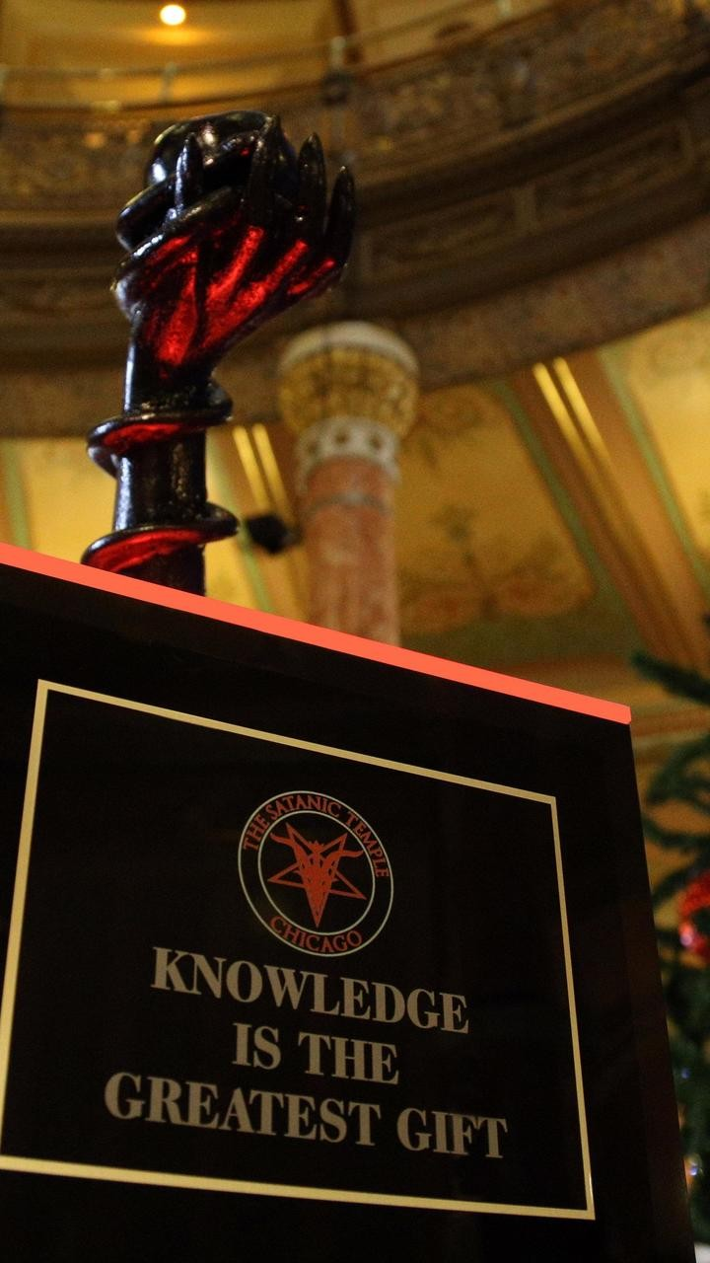
See Photo>

Slide 137
Isaiah 47:9
But these two things shall come to you In a moment, in one day: The loss of children, and widowhood. They shall come upon you in their fullness Because of the multitude of your sorceries, For the great abundance of your enchantments.

Slide 138
Revelation 18:1-2
18:1 After these things I saw another angel coming down from heaven, having great authority, and the earth was illuminated with his glory. 2 And he cried mightily with a loud voice, saying, "Babylon the great is fallen, is fallen, and has become a dwelling place of demons, a prison for every foul spirit, and a cage for every unclean and hated bird!

Slide 139
24. Babylon is A World Leader in Producing Pornography

Slide 140
The U.S. is the number one producer of pornography mostly coming from Simi Valley and Los Angeles

Slide 141
Revelation 17:1-5
1 Then one of the seven angels who had the seven bowls came and talked with me, saying to me, "Come, I will show you the judgment of the great harlot who sits on many waters, 2 with whom the kings of the earth committed fornication, and the inhabitants of the earth were made drunk with the wine of her fornication."

Slide 142
3 So he carried me away in the Spirit into the wilderness. And I saw a woman sitting on a scarlet beast which was full of names of blasphemy, having seven heads and ten horns. 4 The woman was arrayed in purple and scarlet, and adorned with gold and precious stones and pearls, having in her hand a golden cup full of abominations and the filthiness of her fornication.

Slide 143
5 And on her forehead a name was written: MYSTERY, BABYLON THE GREAT, THE MOTHER OF HARLOTS AND OF THE ABOMINATIONS OF THE EARTH.

Slide 144
25. Babylon is A World Leader in Selling Pornography

Slide 145
The U.S. is the number one seller of pornography. No other nation rivals this Billion Dollar Industry

Slide 146
Revelation 18:3
For all the nations have drunk of the wine of the wrath of her fornication, the kings of the earth have committed fornication with her, and the merchants of the earth have become rich through the abundance of her luxury."

Slide 147
26. Babylon is A Drug-Induced Nation Filled with A “Multitude Of . . . Sorceries.”

Slide 148
The U.S. is #1 country in the world for consumption of illegal drugs

Slide 149
Isaiah 47:9-12
9 But these two things shall come to you In a moment, in one day: The loss of children, and widowhood. They shall come upon you in their fullness Because of the multitude of your sorceries, For the great abundance of your enchantments.

Slide 150
10 "For you have trusted in your wickedness; You have said, 'No one sees me'; Your wisdom and your knowledge have warped you; And you have said in your heart, 'I am, and there is no one else besides me.' 11 Therefore evil shall come upon you; You shall not know from where it arises. And trouble shall fall upon you; You will not be able to put it off. And desolation shall come upon you suddenly, Which you shall not know.

Slide 151
12 "Stand now with your enchantments And the multitude of your sorceries, In which you have labored from your youth--Perhaps you will be able to profit, Perhaps you will prevail.

Slide 152
1 Thessalonians 4:13-18
13 But I do not want you to be ignorant, brethren, concerning those who have fallen asleep, lest you sorrow as others who have no hope. 14 For if we believe that Jesus died and rose again, even so God will bring with Him those who sleep in Jesus.

Slide 153
15 For this we say to you by the word of the Lord, that we who are alive and remain until the coming of the Lord will by no means precede those who are asleep. 16 For the Lord Himself will descend from heaven with a shout, with the voice of an archangel, and with the trumpet of God. And the dead in Christ will rise first.

Slide 154
17 Then we who are alive and remain shall be caught up together with them in the clouds to meet the Lord in the air. And thus we shall always be with the Lord. 18 Therefore comfort one another with these words.

Slide 155
1 Corinthians 15:50-54
50 Now this I say, brethren, that flesh and blood cannot inherit the kingdom of God; nor does corruption inherit incorruption. 51 Behold, I tell you a mystery: We shall not all sleep, but we shall all be changed-- 52 in a moment, in the twinkling of an eye, at the last trumpet. For the trumpet will sound, and the dead will be raised incorruptible, and we shall be changed.

Slide 156
53 For this corruptible must put on incorruption, and this mortal must put on immortality. 54 So when this corruptible has put on incorruption, and this mortal has put on immortality, then shall be brought to pass the saying that is written: "Death is swallowed up in victory."

Slide 157

20 Again, when a righteous man turns from his righteousness and commits iniquity, and I lay a stumbling block before him, he shall die; because you did not give him warning, he shall die in his sin, and his righteousness which he has done shall not be remembered; but his blood I will require at your hand.

Slide 158
Acts 2:38-39
38 Then Peter said to them, "Repent, and let every one of you be baptized in the name of Jesus Christ for the remission of sins; and you shall receive the gift of the Holy Spirit. 39 For the promise is to you and to your children, and to all who are afar off, as many as the Lord our God will call."

Slide 159
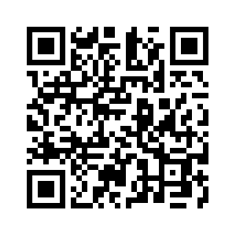
Donate with our QR code app to
Amazing Grace Christian Fellowship
Donations are Deeply Appreciated!

Slide 160
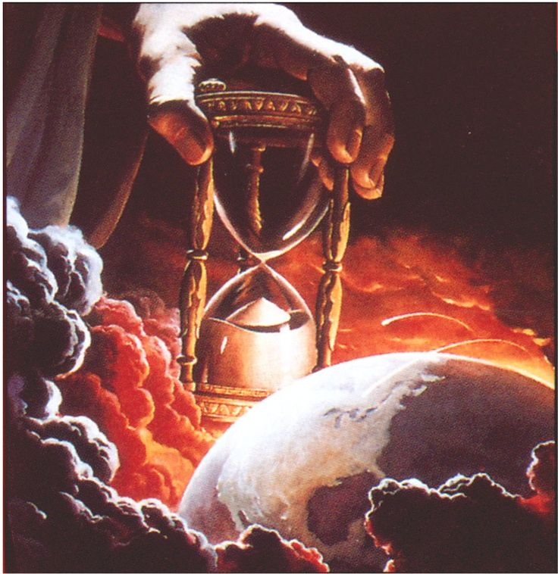
The Message
Jesus is Returning Soon!
We are living on Bowered Time!
Are You Ready To Meet King Jesus?

