Slide 1


Slide 2
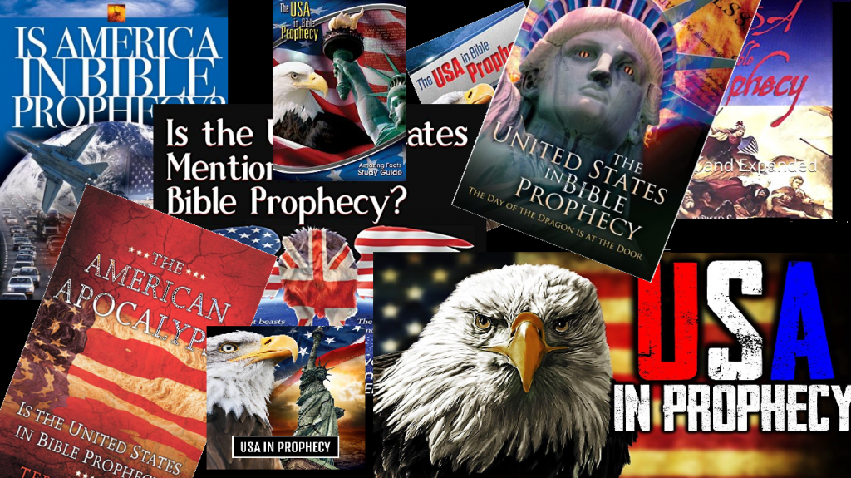

Mystery Babylon Part 3
by Pastor Fee Soliven
Revelation 18:1-24
Sunday Morning
October 6, 2024

Slide 3
Revelation 18:1-24
1 After these things I saw another angel coming down from heaven, having great authority, and the earth was illuminated with his glory. 2 And he cried mightily with a loud voice, saying, "Babylon the great is fallen, is fallen, and has become a dwelling place of demons, a prison for every foul spirit, and a cage for every unclean and hated bird!

Slide 4
3 For all the nations have drunk of the wine of the wrath of her fornication, the kings of the earth have committed fornication with her, and the merchants of the earth have become rich through the abundance of her luxury." 4 And I heard another voice from heaven saying, "Come out of her, my people, lest you share in her sins, and lest you receive of her plagues.

Slide 5
5 For her sins have reached to heaven, and God has remembered her iniquities. 6 Render to her just as she rendered to you, and repay her double according to her works; in the cup which she has mixed, mix double for her. 7 In the measure that she glorified herself and lived luxuriously, in the same measure give her torment and sorrow; for she says in her heart, 'I sit as queen, and am no widow, and will not see sorrow.'

Slide 6
8 "Therefore her plagues will come in one day--death and mourning and famine. And she will be utterly burned with fire, for strong is the Lord God who judges her. 9 "The kings of the earth who committed fornication and lived luxuriously with her will weep and lament for her, when they see the smoke of her burning,

Slide 7
10 standing at a distance for fear of her torment, saying, 'Alas, alas, that great city Babylon, that mighty city! For in one hour your judgment has come.' 11 "And the merchants of the earth will weep and mourn over her, for no one buys their merchandise anymore: 12 merchandise of gold and silver, precious stones and pearls, fine linen and purple, silk and scarlet, every kind of citron wood, every kind of object of ivory, every kind of object of most precious wood, bronze, iron, and marble;

Slide 8
13 and cinnamon and incense, fragrant oil and frankincense, wine and oil, fine flour and wheat, cattle and sheep, horses and chariots, and bodies and souls of men. 14 The fruit that your soul longed for has gone from you, and all the things which are rich and splendid have gone from you, and you shall find them no more at all. 15 The merchants of these things, who became rich by her, will stand at a distance for fear of her torment, weeping and wailing,

Slide 9
16 and saying, 'Alas, alas, that great city that was clothed in fine linen, purple, and scarlet, and adorned with gold and precious stones and pearls! 17 For in one hour such great riches came to nothing.' Every shipmaster, all who travel by ship, sailors, and as many as trade on the sea, stood at a distance 18 and cried out when they saw the smoke of her burning, saying, 'What is like this great city?'

Slide 10
19 "They threw dust on their heads and cried out, weeping and wailing, and saying, 'Alas, alas, that great city, in which all who had ships on the sea became rich by her wealth! For in one hour she is made desolate.' 20 "Rejoice over her, O heaven, and you holy apostles and prophets, for God has avenged you on her!"

Slide 11
21 Then a mighty angel took up a stone like a great millstone and threw it into the sea, saying, "Thus with violence the great city Babylon shall be thrown down, and shall not be found anymore. 22 The sound of harpists, musicians, flutists, and trumpeters shall not be heard in you anymore. No craftsman of any craft shall be found in you anymore, and the sound of a millstone shall not be heard in you anymore.

Slide 12
23 The light of a lamp shall not shine in you anymore, and the voice of bridegroom and bride shall not be heard in you anymore. For your merchants were the great men of the earth, for by your sorcery all the nations were deceived. 24 And in her was found the blood of prophets and saints, and of all who were slain on the earth."

Slide 13
Revelation 17:3
So he carried me away in the Spirit into the wilderness. And I saw a woman sitting on a scarlet beast which was full of names of blasphemy, having seven heads and ten horns.

Slide 14
Daniel 12:4
“seal the book” for the mysteries of prophecy were appointed for the “time of the end” when “knowledge shall be increased”

Slide 15
John 16:13
However, when He, the Spirit of truth, has come, He will guide you into all truth; for He will not speak on His own authority, but whatever He hears He will speak; and He will tell you things to come.

Slide 16
Amos 3:7
Surely the Lord GOD does nothing, Unless He reveals His secret to His servants the prophets.

Slide 17
27. Babylon Meets the Twenty-Three Characteristics of a Reprobate Society

Slide 18
Romans 1:28-32
28 And even as they did not like to retain God in their knowledge, God gave them over to a debased mind, to do those things which are not fitting; 29 being filled with all unrighteousness, sexual immorality, wickedness, covetousness, maliciousness; full of envy, murder, strife, deceit, evil-mindedness; they are whisperers,

Slide 19
30 backbiters, haters of God, violent, proud, boasters, inventors of evil things, disobedient to parents, 31 undiscerning, untrustworthy, unloving, unforgiving, unmerciful; 32 who, knowing the righteous judgment of God, that those who practice such things are worthy of death, not only do the same but also approve of those who practice them.

Slide 20
28. Babylon Becomes a Debtor
Nation not a Lender

Slide 21
The U.S. has the #1 highest
national debt in the world

Slide 22
Deuteronomy 15:6
For the LORD your God will bless you just as He promised you; you shall lend to many nations, but you shall not borrow; you shall reign over many nations, but they shall not reign over you.

Slide 23
Deuteronomy 28:43-44
43 The alien who is among you shall rise higher and higher above you, and you shall come down lower and lower. 44 He shall lend to you, but you shall not lend to him; he shall be the head, and you shall be the tail.

Slide 24
29. Babylon Becomes the Habitation of Every Form of Immorality

Slide 25
Revelation 18:2
And he cried mightily with a loud voice, saying, "Babylon the great is fallen, is fallen, and has become a dwelling place of demons, a prison for every foul spirit, and a cage for every unclean and hated bird!

Slide 26
U.S. AND CHRISTIANITY

Slide 27
30. Babylon is a Nation That has a Large Amount of God’s People Within Her

Slide 28
The U.S. has the largest Christian Population in the world

Slide 29
Revelation 18:4
And I heard another voice from heaven saying, "Come out of her, my people, lest you share in her sins, and lest you receive of her plagues.

Slide 30
Jeremiah 51:14
The LORD of hosts has sworn by Himself: "Surely I will fill you with men, as with locusts, And they shall lift up a shout against you."

Slide 31
31. Babylon has Within Her Christians Who have Lost Their “First Love” For Christ

Slide 32
Revelation 2:2-4
2 "I know your works, your labor, your patience, and that you cannot bear those who are evil. And you have tested those who say they are apostles and are not, and have found them liars;

Slide 33
3 and you have persevered and have patience, and have labored for My name's sake and have not become weary. 4 Nevertheless I have this against you, that you have left your first love.

Slide 34
32. Babylon has Christians within Her Who have “Dead Works.”

Slide 35
Revelation 3:1
"And to the angel of the church in Sardis write, 'These things says He who has the seven Spirits of God and the seven stars: "I know your works, that you have a name that you are alive, but you are dead.

Slide 36
33. Babylon Has Christians within Her Who Are Persecuted

Slide 37
Revelation 2:9-11
9 "I know your works, tribulation, and poverty (but you are rich); and I know the blasphemy of those who say they are Jews and are not, but are a synagogue of Satan.

Slide 38
10 Do not fear any of those things which you are about to suffer. Indeed, the devil is about to throw some of you into prison, that you may be tested, and you will have tribulation ten days. Be faithful until death, and I will give you the crown of life.

Slide 39
34. Babylon has Christian (Nicolaitan) Leadership That Deny Hell, Sin, or Eternal Consequences

Slide 40
Revelation 2:13-14
13 "I know your works, and where you dwell, where Satan's throne is. And you hold fast to My name, and did not deny My faith even in the days in which Antipas was My faithful martyr, who was killed among you, where Satan dwells.

Slide 41
14 But I have a few things against you, because you have there those who hold the doctrine of Balaam, who taught Balak to put a stumbling block before the children of Israel, to eat things sacrificed to idols, and to commit sexual immorality.

Slide 42
35. Babylon Has Christian Leadership Who Promote The Jezebel Spirit Of Immorality
(Baal Worship)

Slide 43
Revelation 2:20-21
20 Nevertheless I have a few things against you, because you allow that woman Jezebel, who calls herself a prophetess, to teach and seduce My servants to commit sexual immorality and eat things sacrificed to idols. 21 And I gave her time to repent of her sexual immorality, and she did not repent.

Slide 44
36. Babylon Has Over 3,500 Strip Clubs (Ashtoreth Poles)
Firmly Establishing Temples Of Baal Worship (High Places)
Throughout The Nation

Slide 45
Isaiah 47:12-13
12 "Stand now with your enchantments And the multitude of your sorceries, In which you have labored from your youth--Perhaps you will be able to profit, Perhaps you will prevail. 13 You are wearied in the multitude of your counsels; Let now the astrologers, the stargazers, And the monthly prognosticators Stand up and save you From what shall come upon you.

Slide 46
Revelation 2:14
But I have a few things against you, because you have there those who hold the doctrine of Balaam, who taught Balak to put a stumbling block before the children of Israel, to eat things sacrificed to idols, and to commit sexual immorality.

Slide 47
Revelation 2:20
Nevertheless I have a few things against you, because you allow that woman Jezebel, who calls herself a prophetess, to teach and seduce My servants to commit sexual immorality and eat things sacrificed to idols.

Slide 48
LAODICEA: THE U.S. AND MONEY

Slide 49
37. Babylon has the Richest Believers in The History of the World within Her

Slide 50
Revelation 3:17
Because you say, 'I am rich, have become wealthy, and have need of nothing'--and do not know that you are wretched, miserable, poor, blind, and naked…

Slide 51
Revelation 3:19
As many as I love, I rebuke and chasten. Therefore be zealous and repent.

Slide 52
38. Babylon has Majority of Believers not “Tithing” their First Fruits of their Substance.

Slide 53
The Question Remains, are “Tithers” or “Non-Tithers” Rich (Generous) Toward God?

Slide 54
Revelation 3:18
I counsel you to buy from Me gold refined in the fire, that you may be rich; and white garments, that you may be clothed, that the shame of your nakedness may not be revealed; and anoint your eyes with eye salve, that you may see.

Slide 55
Malachi 3:8-11
8 "Will a man rob God? Yet you have robbed Me! But you say, 'In what way have we robbed You?' In tithes and offerings. 9 You are cursed with a curse, For you have robbed Me, Even this whole nation.

Slide 56
10 Bring all the tithes into the storehouse, That there may be food in My house, And try Me now in this," Says the LORD of hosts, "If I will not open for you the windows of heaven And pour out for you such blessing That there will not be room enough to receive it.

Slide 57
11 "And I will rebuke the devourer for your sakes, So that he will not destroy the fruit of your ground, Nor shall the vine fail to bear fruit for you in the field," Says the LORD of hosts;

Slide 58
PHILADELPHIA: THE U.S. AND HER ESCAPE

Slide 59
39. The Church of Philadelphia and Her “Open Door” Will Deliver Believers from Babylon’s Judgment

Slide 60
Revelation 3:8-13
8 "I know your works. See, I have set before you an open door, and no one can shut it; for you have a little strength, have kept My word, and have not denied My name.

Slide 61
9 Indeed I will make those of the synagogue of Satan, who say they are Jews and are not, but lie--indeed I will make them come and worship before your feet, and to know that I have loved you.

Slide 62
10 Because you have kept My command to persevere, I also will keep you from the hour of trial which shall come upon the whole world, to test those who dwell on the earth. 11 Behold, I am coming quickly! Hold fast what you have, that no one may take your crown.

Slide 63
12 He who overcomes, I will make him a pillar in the temple of My God, and he shall go out no more. And I will write on him the name of My God and the name of the city of My God, the New Jerusalem, which comes down out of heaven from My God. And I will write on him My new name.

Slide 64
Revelation 19:2
For true and righteous are His judgments, because He has judged the great harlot who corrupted the earth with her fornication; and He has avenged on her the blood of His servants shed by her."

Slide 65
Revelation 19:6-9
6 And I heard, as it were, the voice of a great multitude, as the sound of many waters and as the sound of mighty thunderings, saying, "Alleluia! For the Lord God Omnipotent reigns! 7 Let us be glad and rejoice and give Him glory, for the marriage of the Lamb has come, and His wife has made herself ready."

Slide 66
8 And to her it was granted to be arrayed in fine linen, clean and bright, for the fine linen is the righteous acts of the saints. 9 Then he said to me, "Write: 'Blessed are those who are called to the marriage supper of the Lamb!' " And he said to me, "These are the true sayings of God."

Slide 67
1 Thessalonians 4:13-18
13 But I do not want you to be ignorant, brethren, concerning those who have fallen asleep, lest you sorrow as others who have no hope. 14 For if we believe that Jesus died and rose again, even so God will bring with Him those who sleep in Jesus.

Slide 68
15 For this we say to you by the word of the Lord, that we who are alive and remain until the coming of the Lord will by no means precede those who are asleep. 16 For the Lord Himself will descend from heaven with a shout, with the voice of an archangel, and with the trumpet of God. And the dead in Christ will rise first.

Slide 69
17 Then we who are alive and remain shall be caught up together with them in the clouds to meet the Lord in the air. And thus we shall always be with the Lord. 18 Therefore comfort one another with these words.

Slide 70
1 Corinthians 15:50-54
50 Now this I say, brethren, that flesh and blood cannot inherit the kingdom of God; nor does corruption inherit incorruption. 51 Behold, I tell you a mystery: We shall not all sleep, but we shall all be changed-- 52 in a moment, in the twinkling of an eye, at the last trumpet. For the trumpet will sound, and the dead will be raised incorruptible, and we shall be changed.

Slide 71
53 For this corruptible must put on incorruption, and this mortal must put on immortality. 54 So when this corruptible has put on incorruption, and this mortal has put on immortality, then shall be brought to pass the saying that is written: "Death is swallowed up in victory."

Slide 72

20 Again, when a righteous man turns from his righteousness and commits iniquity, and I lay a stumbling block before him, he shall die; because you did not give him warning, he shall die in his sin, and his righteousness which he has done shall not be remembered; but his blood I will require at your hand.

Slide 73
Acts 2:38-39
38 Then Peter said to them, "Repent, and let every one of you be baptized in the name of Jesus Christ for the remission of sins; and you shall receive the gift of the Holy Spirit. 39 For the promise is to you and to your children, and to all who are afar off, as many as the Lord our God will call."

Slide 74

Donate with our QR code app to
Amazing Grace Christian Fellowship
Donations are Deeply Appreciated!

Slide 75
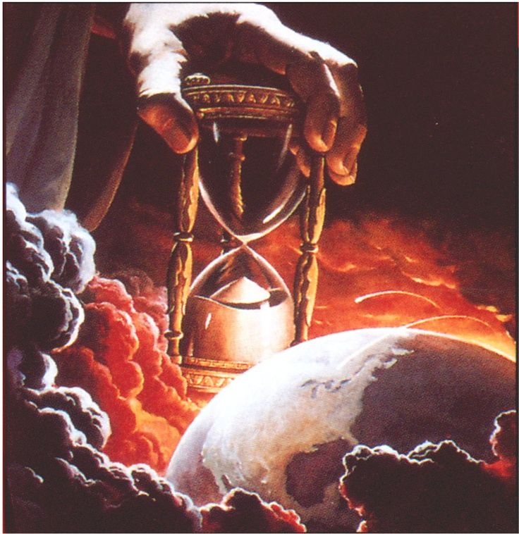
The Message
Jesus is Returning Soon!
We are living on Bowered Time!
Are You Ready To Meet King Jesus?

