Slide 1


Slide 2
Freedom
(by Eddie James)

Slide 3
I wanna clap a little louder than before I wanna sing a little louder than before (Ooh)I wanna jump higher

Slide 4
than before I wanna shout louder than before yeah
Freedom (freedom) Freedom (freedom) Freedom

Slide 5
Freedom (God thank you for freedom!) Freedom (freedom) Freedom (I love you Jesus) Freedom (for

Slide 6
freedom) Freedom I wanna clap a little louder than before I wanna sing a little louder than before (Ooh)

Slide 7
I wanna spin wilder than before I wanna shout louder yeah Freedom (freedom) Freedom (freedom)

Slide 8
Freedom Freedom (freedom) Freedom (freedom)
Freedom (freedom) Freedom (freedom) Freedom

Slide 9
I wanna lift my hands higher than before I want to love you more than before I wanna worship deeper

Slide 10
than before I gotta scream louder yeah yeah Freedom (freedom) Freedom (freedom) Freedom

Slide 11
(freedom) Freedom Freedom (freedom) Freedom (freedom) Freedom (thank you for freedom)

Slide 12
Freedom No more shackles, no more chains No more bondage I am free yeah Lift your hands to the

Slide 13
father I say No more shackles, no more chains No more bondage I am free Come on, lift your hands to

Slide 14
Jesus No more shackles, no more chains No more bondage I am free Now help me dance the dance of

Slide 15
freedom, say Halleluiah Halleluiah Halleluiah Halleluiah Halleluiah Halleluiah Halleluiah Halleluiah

Slide 16
No more shackles Halleluiah No more bondage
Halleluiah No more chains Halleluiah And I'm free

Slide 17
Halleluiah Lift your voice and help me say No more shackles, and no more chains No more bondage I

Slide 18
am fee yeah Lift your hands and help me say No more shackles, no more chains No more bondage I

Slide 19
am fee yeah Come on if you believe it help me say
No more shackles, no more chains No more

Slide 20
bondage I am fee yeah Now if you believe in it sing with me and say

Slide 21
Open The Eyes of My Heart
(Michael W. Smith)

Slide 22
Open the eyes of my heart, Lord Open the eyes of my heart I want to see You I want to see You Open

Slide 23
the eyes of my heart, Lord Open the eyes of my heart I want to see You I want to see You To see You

Slide 24
high and lifted up Shinin' in the light of Your glory Pour out Your power and love As we sing holy, holy,

Slide 25
holy Open the eyes of my heart, Lord Open the eyes of my heart I want to see You I want to see You Open

Slide 26
the eyes of my heart, Lord Open the eyes of my heart I want to see You I want to see You To see You

Slide 27
high and lifted up Shinin' in the light of Your glory Pour out Your power and love As we sing holy, holy,

Slide 28
holy To see You high and lifted up Shinin' in the light of Your glory Pour out Your power and love As we

Slide 29
sing holy, holy, holy To see You high and lifted up Shinin' in the light of Your glory Pour out Your power

Slide 30
and love As we sing holy, holy, holy Holy, holy, holy We cry holy, holy, holy You are holy, holy, holy I want

Slide 31
to see you Holy, holy, holy Holy, holy, holy You are holy, holy, holy I want to see you Holy, holy, holy

Slide 32
Holy, holy, holy Holy, holy, holy, I want to see you Holy, holy, holy Holy, holy, holy Holy, holy, holy, I

Slide 33
want to see you Holy, holy, holy Holy, holy, holy Holy, holy, holy, I want to see you Holy, holy, holy

Slide 34
Holy, holy, holy Holy, holy, holy, I want to see you Holy, holy, holy Holy, holy, holy Holy, holy, holy, I

Slide 35
want to see you Holy, holy, holy Holy, holy, holy Holy, holy, holy, I want to see you.

Slide 36
No One Like the Lord
(Jen Johnson)

Slide 37
Yeah, yeah, yeah, yeah, ay Oh There is One on the throne Jesus, holy He is worthy of praise Honor and

Slide 38
glory Hey, hey, hey There is One on the throne Jesus, holy, You are, You are He is worthy of praise

Slide 39
Honor and glory So we sing worthy is the Lamb Who was slain and seated on the throne There's no one

Slide 40
like the Lord And the elders, creatures bow Giving praise to Him and Him alone 'Cause there's no one

Slide 41
like the Lord, yeah There is One on the throne Jesus, holy He is worthy of praise All the honor and glory

Slide 42
You are, You are Worthy is the Lamb Who was slain and seated on the throne And there's no one like the

Slide 43
Lord, whoa And the elders, creatures bow Giving praise to Him and Him alone 'Cause there's no one

Slide 44
like the Lord Oh, and we cry Worthy is the Lamb Who was slain and seated on the throne There's no

Slide 45
one like the Lord And all of the elders, creatures bow Giving praise to Him and Him alone 'Cause there’s

Slide 46
no one like the Lord And we crown You King of glory We crown You King of glory We crown You King of

Slide 47
glory We crown You Lord of all We crown You, You are worthy We crown You, You are worthy We crown

Slide 48
You, You are worthy Oh, we crown You Lord of all We crown You King of glory We crown You Lord of all

Slide 49
Oh, we sing worthy is the Lamb Who was slain and seated on the throne And there's no one like the Lord

Slide 50
All of the elders, creatures bow Giving praise to Him and Him alone 'Cause there's no one like

Slide 51
the Lord Oh, You are Worthy is the Lamb Who was slain and seated on the throne And there's no one

Slide 52
like the Lord And all the elders, creatures bow Giving praise to You and You alone There's no one like the

Slide 53
Lord There's no one like You There's just no one like You Lord Yeah (there's no one like the Lord) There's

Slide 54
no one like You, Lord (there's no one like the Lord) So wonderful in all His way (there's no one like the

Slide 55
Lord) So beautiful in all His ways (there's no one like the Lord) So majestic (there's no one like the Lord)

Slide 56
Oh, the King above all kings, oh (there's no one like the Lord) Ay, ah (there's no one like the Lord) All the

Slide 57
angels around Your throne (there's no one like the Lord) Every time they say they see a new side of

Slide 58
Your face (there's no one like the Lord) They cry holy, holy, holy (there's no one like the Lord) They cry

Slide 59
worthy, worthy, worthy (there's no one like the Lord)
'Cause there's no one like You, Lord (there's no one

Slide 60
like the Lord) We crown You King of glory.

Slide 61
More Precious than Silver
(Cassie Camble)

Slide 62
Lord, you are More precious than silver. Lord, you are More costly than gold. Lord, you are More

Slide 63
beautiful than diamonds, And nothing I desire
Compares with you. Who can weigh the value Of

Slide 64
knowing you? Who can judge the worth Of who you are? Who can count the blessings Of loving you?

Slide 65
Who can say just how great you are?

Slide 66
“Worthy Of It All”
(Bethel Music)

Slide 67
All the saints and angels. They bow before the throne. All the elders cast their crowns before the

Slide 68
Lamb of God and sing. All the saints and angels. They bow before your throne. All the elders cast their

Slide 69
Crowns before the lamb of God and sing. You are worthy of it all. You are worthy of it all. For from you

Slide 70
All. For from you are all things and to you are all things. You deserve the glory. Day and night, night

Slide 71
Night and day. Let incense arise. Day and night, night and day. Let incense arise. Day and night, night

Slide 72
And day let incense arise. Day and night night and day. You are worthy of it all. You are worthy of it all

Slide 73
For from you are al things. And to you are all things. You deserve the glory. You are worthy of it all. You

Slide 74
Are worthy of it all. For from you are all things and to you are all things. You deserve the glory. We exalt

Slide 75
Thee. We exalt thee. We exalt thee, Oh, Lord.
We exalt thee. We exalt thee, We exalt thee, Oh

Slide 77


Slide 78
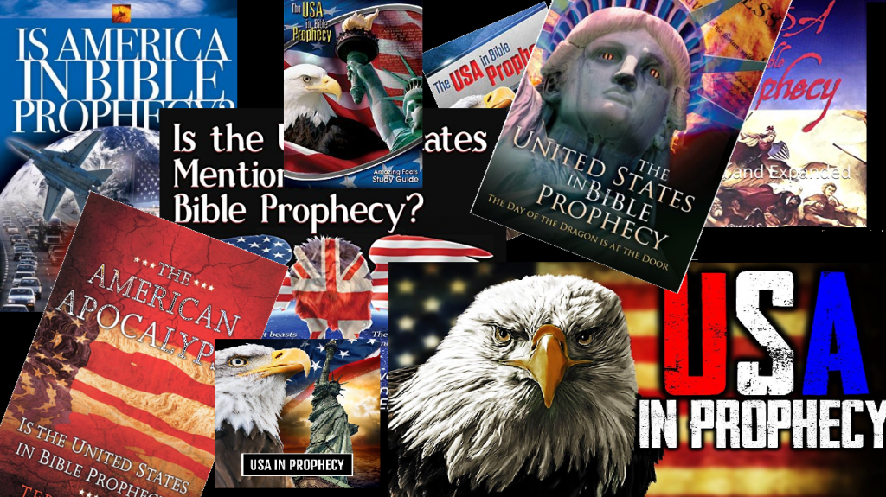

Mystery Babylon Part 4
by Pastor Fee Soliven
Revelation 18:1-24
Sunday Morning
October 20, 2024

Slide 79
Revelation 18:1-24
1 After these things I saw another angel coming down from heaven, having great authority, and the earth was illuminated with his glory. 2 And he cried mightily with a loud voice, saying, "Babylon the great is fallen, is fallen, and has become a dwelling place of demons, a prison for every foul spirit, and a cage for every unclean and hated bird!

Slide 80
3 For all the nations have drunk of the wine of the wrath of her fornication, the kings of the earth have committed fornication with her, and the merchants of the earth have become rich through the abundance of her luxury." 4 And I heard another voice from heaven saying, "Come out of her, my people, lest you share in her sins, and lest you receive of her plagues.

Slide 81
5 For her sins have reached to heaven, and God has remembered her iniquities. 6 Render to her just as she rendered to you, and repay her double according to her works; in the cup which she has mixed, mix double for her. 7 In the measure that she glorified herself and lived luxuriously, in the same measure give her torment and sorrow; for she says in her heart, 'I sit as queen, and am no widow, and will not see sorrow.'

Slide 82
8 "Therefore her plagues will come in one day--death and mourning and famine. And she will be utterly burned with fire, for strong is the Lord God who judges her. 9 "The kings of the earth who committed fornication and lived luxuriously with her will weep and lament for her, when they see the smoke of her burning,

Slide 83
10 standing at a distance for fear of her torment, saying, 'Alas, alas, that great city Babylon, that mighty city! For in one hour your judgment has come.' 11 "And the merchants of the earth will weep and mourn over her, for no one buys their merchandise anymore: 12 merchandise of gold and silver, precious stones and pearls, fine linen and purple, silk and scarlet, every kind of citron wood, every kind of object of ivory, every kind of object of most precious wood, bronze, iron, and marble;

Slide 84
13 and cinnamon and incense, fragrant oil and frankincense, wine and oil, fine flour and wheat, cattle and sheep, horses and chariots, and bodies and souls of men. 14 The fruit that your soul longed for has gone from you, and all the things which are rich and splendid have gone from you, and you shall find them no more at all. 15 The merchants of these things, who became rich by her, will stand at a distance for fear of her torment, weeping and wailing,

Slide 85
16 and saying, 'Alas, alas, that great city that was clothed in fine linen, purple, and scarlet, and adorned with gold and precious stones and pearls! 17 For in one hour such great riches came to nothing.' Every shipmaster, all who travel by ship, sailors, and as many as trade on the sea, stood at a distance 18 and cried out when they saw the smoke of her burning, saying, 'What is like this great city?'

Slide 86
19 "They threw dust on their heads and cried out, weeping and wailing, and saying, 'Alas, alas, that great city, in which all who had ships on the sea became rich by her wealth! For in one hour she is made desolate.' 20 "Rejoice over her, O heaven, and you holy apostles and prophets, for God has avenged you on her!"

Slide 87
21 Then a mighty angel took up a stone like a great millstone and threw it into the sea, saying, "Thus with violence the great city Babylon shall be thrown down, and shall not be found anymore. 22 The sound of harpists, musicians, flutists, and trumpeters shall not be heard in you anymore. No craftsman of any craft shall be found in you anymore, and the sound of a millstone shall not be heard in you anymore.

Slide 88
23 The light of a lamp shall not shine in you anymore, and the voice of bridegroom and bride shall not be heard in you anymore. For your merchants were the great men of the earth, for by your sorcery all the nations were deceived. 24 And in her was found the blood of prophets and saints, and of all who were slain on the earth."

Slide 89
Revelation 17:3
So he carried me away in the Spirit into the wilderness. And I saw a woman sitting on a scarlet beast which was full of names of blasphemy, having seven heads and ten horns.

Slide 90
Daniel 12:4
“seal the book” for the mysteries of prophecy were appointed for the “time of the end” when “knowledge shall be increased”

Slide 91
John 16:13
However, when He, the Spirit of truth, has come, He will guide you into all truth; for He will not speak on His own authority, but whatever He hears He will speak; and He will tell you things to come.

Slide 92
Amos 3:7
Surely the Lord GOD does nothing, Unless He reveals His secret to His servants the prophets.

Slide 93
40. Babylon has the Voice of The Bride And Bridegroom of Christ inside her before The Rapture and Subsequent Destruction

Slide 94
Revelation 18:23
The light of a lamp shall not shine in you anymore, and the voice of bridegroom and bride shall not be heard in you anymore. For your merchants were the great men of the earth, for by your sorcery all the nations were deceived.

Slide 95
Revelation 19:7-9
7 Let us be glad and rejoice and give Him glory, for the marriage of the Lamb has come, and His wife has made herself ready." 8 And to her it was granted to be arrayed in fine linen, clean and bright, for the fine linen is the righteous acts of the saints. 9 Then he said to me, "Write: 'Blessed are those who are called to the marriage supper of the Lamb!' " And he said to me, "These are the true sayings of God."

Slide 96
Two Signs: The U.S. And Her Moral Culture

Slide 97
41. Babylon has a Culture Like the Time of Sodom and Gomorrah

Slide 98
(The U.S. government is advancing the rights of LGBT Queer, Bisexual, transgender globally)

Slide 99
Isaiah 13:19
And Babylon, the glory of kingdoms, The beauty of the Chaldeans' pride, Will be as when God overthrew Sodom and Gomorrah.

Slide 100
Jeremiah 49:18
As in the overthrow of Sodom and Gomorrah And their neighbors," says the LORD, "No one shall remain there, Nor shall a son of man dwell in it.

Slide 101
Jude 7
as Sodom and Gomorrah, and the cities around them in a similar manner to these, having given themselves over to sexual immorality and gone after strange flesh, are set forth as an example, suffering the vengeance of eternal fire.

Slide 102
Romans 1:18-32
18 For the wrath of God is revealed from heaven against all ungodliness and unrighteousness of men, who suppress the truth in unrighteousness, 19 because what may be known of God is manifest in them, for God has shown it to them.

Slide 103
20 For since the creation of the world His invisible attributes are clearly seen, being understood by the things that are made, even His eternal power and Godhead, so that they are without excuse,

Slide 104
21 because, although they knew God, they did not glorify Him as God, nor were thankful, but became futile in their thoughts, and their foolish hearts were darkened.

Slide 105
22 Professing to be wise, they became fools, 23 and changed the glory of the incorruptible God into an image made like corruptible man--and birds and four-footed animals and creeping things. 24 Therefore God also gave them up to uncleanness, in the lusts of their hearts, to dishonor their bodies among themselves,

Slide 106
25 who exchanged the truth of God for the lie, and worshiped and served the creature rather than the Creator, who is blessed forever. Amen. 26 For this reason God gave them up to vile passions. For even their women exchanged the natural use for what is against nature.

Slide 107
27 Likewise also the men, leaving the natural use of the woman, burned in their lust for one another, men with men committing what is shameful, and receiving in themselves the penalty of their error which was due. 28 And even as they did not like to retain God in their knowledge, God gave them over to a debased mind, to do those things which are not fitting;

Slide 108
29 being filled with all unrighteousness, sexual immorality, wickedness, covetousness, maliciousness; full of envy, murder, strife, deceit, evil-mindedness; they are whisperers, 30 backbiters, haters of God, violent, proud, boasters, inventors of evil things, disobedient to parents,

Slide 109
31 undiscerning, untrustworthy, unloving, unforgiving, unmerciful; 32 who, knowing the righteous judgment of God, that those who practice such things are worthy of death, not only do the same but also approve of those who practice them.

Slide 110
42. Babylon has a Culture Like the Days Of Noah.

Slide 111
Luke 17:26-29
26 And as it was in the days of Noah, so it will be also in the days of the Son of Man: 27 They ate, they drank, they married wives, they were given in marriage, until the day that Noah entered the ark, and the flood came and destroyed them all.

Slide 112
28 Likewise as it was also in the days of Lot: They ate, they drank, they bought, they sold, they planted, they built; 29 but on the day that Lot went out of Sodom it rained fire and brimstone from heaven and destroyed them all.

Slide 113
Genesis 6:5-8
5 Then the LORD saw that the wickedness of man was great in the earth, and that every intent of the thoughts of his heart was only evil continually. 6 And the LORD was sorry that He had made man on the earth, and He was grieved in His heart.

Slide 114
7 So the LORD said, "I will destroy man whom I have created from the face of the earth, both man and beast, creeping thing and birds of the air, for I am sorry that I have made them." 8 But Noah found grace in the eyes of the LORD.

Slide 115
The U.S. and Her Religious Culture

Slide 116
43. Babylon has Temples of Molech Sacrificing her Children
(The U.S. aborts between
1,500 and 2,500 babies per day)
Since 1973 Roe vs Wade there is over
70 Billion Babies Aborted

Slide 117
Revelation 17:6
I saw the woman, drunk with the blood of the saints and with the blood of the martyrs of Jesus. And when I saw her, I marveled with great amazement.

Slide 118
44. Babylon Sacrifices Children (Saints) To Baal, For the Purpose of Financial Gain

Slide 119
Revelation 17:4-6
4 The woman was arrayed in purple and scarlet, and adorned with gold and precious stones and pearls, having in her hand a golden cup full of abominations and the filthiness of her fornication. 5 And on her forehead a name was written: MYSTERY, BABYLON THE GREAT, THE MOTHER OF HARLOTS AND OF THE ABOMINATIONS OF THE EARTH. 6 I saw the woman, drunk with the blood of the saints and with the blood of the martyrs of Jesus. And when I saw her, I marveled with great amazement.

Slide 120
Revelation 2:20-24
20 Nevertheless I have a few things against you, because you allow that woman Jezebel, who calls herself a prophetess, to teach and seduce My servants to commit sexual immorality and eat things sacrificed to idols. 21 And I gave her time to repent of her sexual immorality, and she did not repent.

Slide 121
22 Indeed I will cast her into a sickbed, and those who commit adultery with her into great tribulation, unless they repent of their deeds. 23 I will kill her children with death, and all the churches shall know that I am He who searches the minds and hearts. And I will give to each one of you according to your works.

Slide 122
45. Babylon “Shows No Mercy” to God’s People...” You Have Heavily Laid Thy Yoke.”

Slide 123
(U.S. Christians are verbally persecuted for standing UP for Biblical values.)

Slide 124
Isaiah 47:6
I was angry with My people; I have profaned My inheritance, And given them into your hand. You showed them no mercy; On the elderly you laid your yoke very heavily.

Slide 125
46. Babylon’s Land is Defiled by Her Shedding of Innocent Blood

Slide 126
Numbers 35:33
So you shall not pollute the land where you are; for blood defiles the land, and no atonement can be made for the land, for the blood that is shed on it, except by the blood of him who shed it.

Slide 127
Revelation 2:23
I will kill her children with death, and all the churches shall know that I am He who searches the minds and hearts. And I will give to each one of you according to your works.

Slide 128
47. Babylon has Written Warnings in Scripture “Not to Partake in The Sin.”

Slide 129
Revelation 18:4
And I heard another voice from heaven saying, "Come out of her, my people, lest you share in her sins, and lest you receive of her plagues.

Slide 130
48. Babylon Has Verbal (Rhema) Warnings “Not to Partake in Her Plagues.”

Slide 131
Revelation 18:4-6
4 And I heard another voice from heaven saying, "Come out of her, my people, lest you share in her sins, and lest you receive of her plagues. 5 For her sins have reached to heaven, and God has remembered her iniquities. 6 Render to her just as she rendered to you, and repay her double according to her works; in the cup which she has mixed, mix double for her.

Slide 132
Jeremiah 51:14
The LORD of hosts has sworn by Himself: "Surely I will fill you with men, as with locusts, And they shall lift up a shout against you."

Slide 133
49. Babylon has Prophets within Her Before Her Destruction

Slide 134
Revelation 18:24
And in her was found the blood of prophets and saints, and of all who were slain on the earth."

Slide 135
50. Babylon Persecutes Those Who “Raise Up a Shout.”

Slide 136
Isaiah 47:6
I was angry with My people; I have profaned My inheritance, And given them into your hand. You showed them no mercy; On the elderly you laid your yoke very heavily.

Slide 137
Revelation 17:6
I saw the woman, drunk with the blood of the saints and with the blood of the martyrs of Jesus. And when I saw her, I marveled with great amazement.

Slide 138
Revelation 18:24
And in her was found the blood of prophets and saints, and of all who were slain on the earth."

Slide 139
THE HOUR: THE U.S. AND PERSECUTION

Slide 140
51. Babylon will be Hated by the Antichrist Spirit and The Ten Nations before they are Empowered!

Slide 141
Revelation 17:16
And the ten horns which you saw on the beast, these will hate the harlot, make her desolate and naked, eat her flesh and burn her with fire.

Slide 142
52. Babylon will have Believers within Her who will be Persecuted and Hated by the Antichrist Spirit dwelling both in Her and outside of Her

Slide 143
Revelation 17:12-14
12 The ten horns which you saw are ten kings who have received no kingdom as yet, but they receive authority for one hour as kings with the beast. 13 These are of one mind, and they will give their power and authority to the beast. 14 These will make war with the Lamb, and the Lamb will overcome them, for He is Lord of lords and King of kings; and those who are with Him are called, chosen, and faithful."

Slide 144
Revelation 17:16
And the ten horns which you saw on the beast, these will hate the harlot, make her desolate and naked, eat her flesh and burn her with fire.

Slide 145
Revelation 18:24
And in her was found the blood of prophets and saints, and of all who were slain on the earth."

Slide 146
53. Babylon will be a Supporter of Israel and will Stand Up for Israel as A “Young Lion” of Tarshish

Slide 147
Ezekiel 38:13
Sheba, Dedan, the merchants of Tarshish, and all their young lions will say to you, 'Have you come to take plunder? Have you gathered your army to take booty, to carry away silver and gold, to take away livestock and goods, to take great plunder?' " '

Slide 148
Ezekiel 39:6
And I will send fire on Magog and on those who live in security in the coastlands. Then they shall know that I am the LORD.

Slide 149
Isaiah 47:8-9
8 "Therefore hear this now, you who are given to pleasures, Who dwell securely, Who say in your heart, 'I am, and there is no one else besides me; I shall not sit as a widow, Nor shall I know the loss of children';

Slide 150
9 But these two things shall come to you In a moment, in one day: The loss of children, and widowhood. They shall come upon you in their fullness Because of the multitude of your sorceries, For the great abundance of your enchantments.

Slide 151
Isaiah 47:14
Behold, they shall be as stubble, The fire shall burn them; They shall not deliver themselves From the power of the flame; It shall not be a coal to be warmed by, Nor a fire to sit before!

Slide 152
1 Thessalonians 4:13-18
13 But I do not want you to be ignorant, brethren, concerning those who have fallen asleep, lest you sorrow as others who have no hope. 14 For if we believe that Jesus died and rose again, even so God will bring with Him those who sleep in Jesus.

Slide 153
15 For this we say to you by the word of the Lord, that we who are alive and remain until the coming of the Lord will by no means precede those who are asleep. 16 For the Lord Himself will descend from heaven with a shout, with the voice of an archangel, and with the trumpet of God. And the dead in Christ will rise first.

Slide 154
17 Then we who are alive and remain shall be caught up together with them in the clouds to meet the Lord in the air. And thus we shall always be with the Lord. 18 Therefore comfort one another with these words.

Slide 155
1 Corinthians 15:50-54
50 Now this I say, brethren, that flesh and blood cannot inherit the kingdom of God; nor does corruption inherit incorruption. 51 Behold, I tell you a mystery: We shall not all sleep, but we shall all be changed-- 52 in a moment, in the twinkling of an eye, at the last trumpet. For the trumpet will sound, and the dead will be raised incorruptible, and we shall be changed.

Slide 156
53 For this corruptible must put on incorruption, and this mortal must put on immortality. 54 So when this corruptible has put on incorruption, and this mortal has put on immortality, then shall be brought to pass the saying that is written: "Death is swallowed up in victory."

Slide 157

20 Again, when a righteous man turns from his righteousness and commits iniquity, and I lay a stumbling block before him, he shall die; because you did not give him warning, he shall die in his sin, and his righteousness which he has done shall not be remembered; but his blood I will require at your hand.

Slide 158
Acts 2:38-39
38 Then Peter said to them, "Repent, and let every one of you be baptized in the name of Jesus Christ for the remission of sins; and you shall receive the gift of the Holy Spirit. 39 For the promise is to you and to your children, and to all who are afar off, as many as the Lord our God will call."

Slide 159
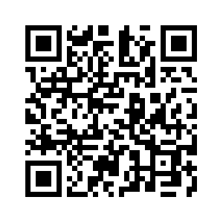
Donate with our QR code app to
Amazing Grace Christian Fellowship
Donations are Deeply Appreciated!

Slide 160
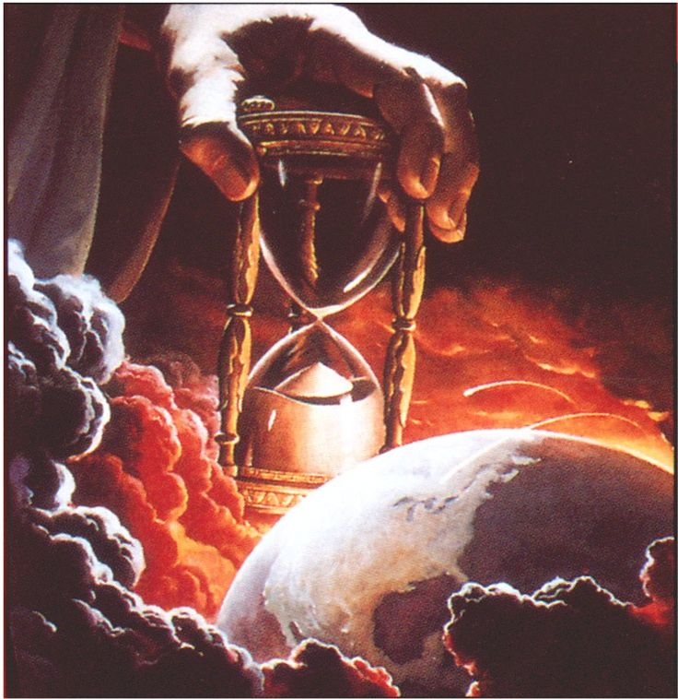
The Message
Jesus is Returning Soon!
We are living on Bowered Time!
Are You Ready To Meet King Jesus?

