Slide 2
We’re Here For You
(Jeremy Riddle)

Slide 3
Jesus we are here, we're here for You We’ve gathered in this place to honor You To worship You in

Slide 4
Spirit and in truth Oh Jesus we are here, we're for You Lift up your hands Let your praises rise Open

Slide 5
are here, we're here for You We've gathered in this place to honor You (You alone) To worship You in

Slide 6
Spirit and in truth Oh Jesus we are here, we're for You (Oh we're here for You!) Break out in praise Let

Slide 7
your shout arise For our God redeemed us With His mighty power Oh let's sing together Let us magnify

Slide 8
His name! Jesus we are here, we're here for You We've gathered in this place to honor You To worship

Slide 9
You in Spirit and in truth Oh Jesus we are here, we're for You (To glorify Your name) (To lift up holy

Slide 10
praise) (To lift up holy praise) Jesus we are here, we're here for You We've gathered in this

Slide 11
place to honor You (You alone) To worship You in Spirit and in truth Oh Jesus we are here, we're for

Slide 12
You (Oh God, how good it is to praise You) (How good it is to worship) (Oh how good it is to pour out,

Slide 13
praise You) (To lift up holy praise) Jesus we are here, we're here for You We've gathered in this place

Slide 14
to honor You To worship You in Spirit and in truth Jesus we are here, we're for You (Here for You)

Slide 15
(We're here for You, Lord) (We're here for You).

Slide 16
”Waymaker”
(Tasha Cobbs )

Slide 17
[Verse 1] You are here, moving in our midst I worship You, I worship You You are here,

Slide 18
working in this place I worship You, I worship You
You are here, moving in our midst I worship You, I

Slide 19
worship You You are here, working in this place
I worship You, I worship You [Chorus] You are

Slide 20
Waymaker, miracle worker Promise keeper, light in the darkness My God, that is who You are You are

Slide 21
Waymaker, miracle worker Promise keeper, light in the darkness My God, that is who You are [Verse 2]

Slide 22
You are here, touching every heart I worship You, I worship You You are here, healing every heart I

Slide 23
worship You, I worship You [Verse 3] You are here, turning lives around I worship You, I worship You You

Slide 24
are here, mending every heart I worship You, yeah, I worship You, Lord [Chorus] And You are Waymaker,

Slide 25
miracle worker Promise keeper, light in the darkness
My God, that is who You are Yeah, You are the

Slide 26
waymaker Waymaker, miracle worker Promise keeper, light in the darkness My God, that is who

Slide 27
You are Yeah, sing it again You are, yeah Waymaker, miracle worker Promise keeper, light in the darkness

Slide 28
My God, that is who You are Oh, it's who You are, Jesus, yeah Waymaker, miracle worker Promise

Slide 29
keeper, light in the darkness My God, that is who You are You might also like Way Maker [Refrain]

Slide 30
Sing that is who You are Oh, that is who You are

Slide 31
(That is who You are) Oh, and that is who You are (That is who You are) My Jesus, that is who You are

Slide 32
(That is who You are) Oh, we lift You up, that is who You are (That is who You are) My Jesus [Chorus]

Slide 33
Waymaker, miracle worker Promise keeper, light in the darkness My God, that is who You are Yes it is,

Slide 34
that is who You are Waymaker, miracle worker Promise keeper, light in the darkness My God, that is

Slide 35
who You are [Bridge] Let's sing this together, even when I don't see it Come on, even when Even when

Slide 36
I don't see it, You're working Even when I don't feel it, You're working You never stop, You never stop

Slide 37
working You never stop, You never stop working Come on And even when I don't see it, You’re

Slide 38
working Even when I don't feel it, You're working You never stop, You never stop working You never stop,

Slide 39
You never stop working Oh-oh Even when I don't see it, You're working Even when I don't feel it, You’re

Slide 40
working You never stop, You never stop working You never stop, You never stop working Even when I

Slide 41
don't see it, You're working Even when I don't feel it, You're working You never stop, You never stop

Slide 42
working You never stop, You never stop working
[Chorus] You are the way maker, yeah Waymaker,

Slide 43
miracle worker Promise keeper, light in the darkness
My God, that is who You are Waymaker, miracle

Slide 44
worker Promise keeper, light in the darkness My God, that is who You are

Slide 45
Goodness of God
(by Bethel)

Slide 46
I love You, Lord For Your mercy never fails me All my days, I've been held in Your hands From the moment

Slide 47
that I wake up Until I lay my head Oh, I will sing of the goodness of God And all my life You have been

Slide 48
faithful And all my life You have been so, so good With every breath that I am able Oh, I will sing of the

Slide 49
goodness of God I love Your voice You have led me through the fire In the darkest night You are close

Slide 50
God (yeah) And all my life You have been faithful (oh) And all my life You have been so, so good With

Slide 51
every breath that I am able Oh, I will sing of the goodness of God (yeah) 'Cause Your goodness is

Slide 52
running after It's running after me Your goodness is running after It's running after me With my life laid

Slide 53
down I'm surrendered now I give You everything
'Cause Your goodness is running after It's running

Slide 54
after me (oh-oh) 'Cause Your goodness is running after It's running after me Your goodness is running

Slide 55
after It's running after me With my life laid down I'm surrendered now I give You everything 'Cause Your

Slide 56
goodness is running after It keeps running after me
And all my life You have been faithful And all my life

Slide 57
You have been so, so good With every breath that I am able Oh, I'm gonna sing of the goodness of God

Slide 58
(I'm gonna sing, I'm gonna sing) 'Cause all my life You have been faithful And all my life You have been

Slide 59
so, so good With every breath that I am able Oh, I'm gonna sing of the goodness of God Oh, I'm gonna

Slide 60
sing of the goodness of God

Slide 61
“ Draw Me Close To You”
(Michael W. Smith)

Slide 62
[Verse] Draw me close to You Never let me go I lay it all down again To hear You say that I'm Your friend

Slide 63
You are my desire No one else will do 'Cause nothing else can take Your place To feel the warmth

Slide 64
of Your embrace Help me find the way Bring me back to You [Chorus] You're all I want You're all I've

Slide 65
ever needed You're all I want Help me know You are near [Verse] Draw me close to You Never let me go

Slide 66
I lay it all down again To hear You say that I'm Your friend You are my desire No one else will do 'Cause

Slide 67
nothing else can take Your place To feel the warmth of Your embrace Help me find the way Bring me

Slide 68
back to You [Chorus] You're all I want You're all I've ever needed You're all I want Help me know You are

Slide 69
near You're all I want You're all I've ever needed You're all I want Help me know You are near [Outro]

Slide 70
Help me know You are near Help me know You are near

Slide 71
“Here I Am To Worship”
(Hillsong Worship)

Slide 72
Light of the world You stepped down into darkness
Opened my eyes, let me see Beauty that made this

Slide 73
heart adore You Hope of a life spent with You Here I am to worship Here I am to bow down Here I am to

Slide 74
say that You're my God You're altogether lovely
Altogether worthy Altogether wonderful to me King of all days Oh, so highly exalted Glorious in heaven

Slide 75
above Humbly You came to the earth You created All for love's sake became poor Here I am to worship

Slide 76
Here I am to bow down Here I am to say that You're my God You're altogether lovely Altogether worthy

Slide 77
Altogether wonderful to me Well, I'll never know how much it cost To see my sin upon that cross Well, I'll

Slide 78
never know how much it cost To see my sin upon that cross Well, I'll never know how much it cost To

Slide 79
see my sin upon that cross Well, I'll never know how much it cost To see my sin upon that cross

Slide 82
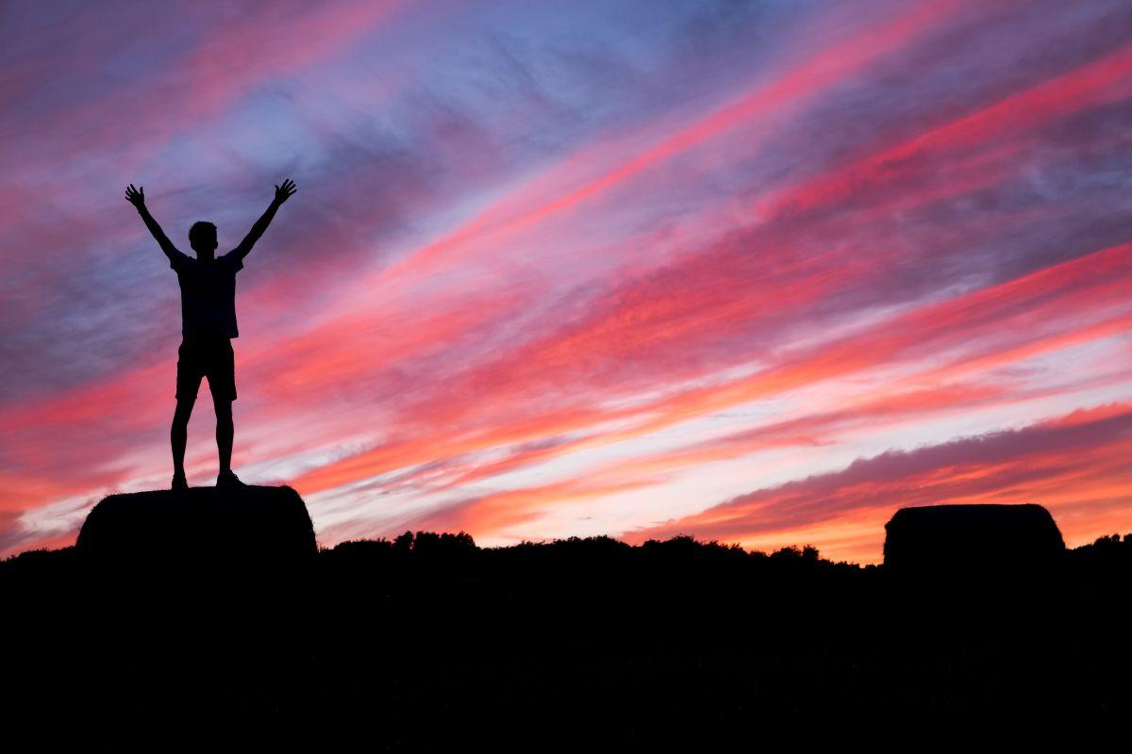
Give Jesus All the Praise and Thanksgiving
By Pastor Fee Soliven
Psalm 92:1-5
Sunday Morning
November 24, 2024

Slide 83
Psalm 92:1-5
1 It is good to give thanks to the LORD, And to sing praises to Your name, O Most High; 2 To declare Your lovingkindness in the morning, And Your faithfulness every night, 3 On an instrument of ten strings, On the lute, And on the harp, With harmonious sound.

Slide 84
4 For You, LORD, have made me glad through Your work; I will triumph in the works of Your hands. 5 O LORD, how great are Your works! Your thoughts are very deep.

Slide 85
What comes to mind when you think about Thanksgiving Day?

Slide 86
But what comes after dessert?

Slide 87
Gratitude to God not only honors Him, but it is good for us!

Slide 88
Psalm 92:1
“It is good to give thanks to the LORD, And to sing praises to Your name, O Most High”

Slide 89
(1) God is Holy
(2) Man is Sinful
(3) Obedience is Essential

Slide 90
Leviticus 22:29-33
29 And when you offer a sacrifice of thanksgiving to the LORD, offer it of your own free will. 30 On the same day it shall be eaten; you shall leave none of it until morning: I am the LORD. 31 "Therefore you shall keep My commandments, and perform them: I am the LORD.

Slide 91
32 You shall not profane My holy name, but I will be hallowed among the children of Israel. I am the LORD who sanctifies you, 33 who brought you out of the land of Egypt, to be your God: I am the LORD."

Slide 92
Should we do less than the Hebrews—giving thanks to God every morning and evening in recognition of Him as the source of everything we have?

Slide 93
How can we follow the example taught by the daily sacrifice of thanksgiving?

Slide 94
A grateful heart keeps our minds focused on the Lord

Slide 95
Gratitude Honors God

Slide 96
Psalm 50:23
“But true praise is a worthy sacrifice; this really honors me. Those who walk my paths will receive salvation from the Lord.”

Slide 97
Thankfulness is expressed in a
Variety of Ways

Slide 98
A Spirit of Thanksgiving is the result of remembering all God has done for us.

Slide 99
God chose us before the foundation of the world

Slide 100
Ephesians 1:4
“just as He chose us in Him before the foundation of the world”

Slide 101
We are Indwelt and Sealed by the
Holy Spirit

Slide 102
2 Timothy 1:14
“That good thing which was committed to you, keep by the Holy Spirit who dwells in us.”

Slide 103
We are Eternally Secure

Slide 104
2 Corinthians 1:21-22
21 Now He who establishes us with you in Christ and has anointed us is God, 22 who also has sealed us and given us the Spirit in our hearts as a guarantee.

Slide 105
We have been given gifts of the Spirit

Slide 106
1 Corinthians 12:28
“And God has appointed in the church, first apostles, second prophets, third teachers, then miracles, then gifts of healings, helps, administrations, various kinds of tongues.”

Slide 107
We have an Intimate Relationship
with the Lord

Slide 108
John 15:4
“Abide in me, and I in you. As the branch cannot bear fruit of itself, except it abide in the vine; no more can ye, except ye abide in me.”

Slide 109
We have the Peace of God in our Hearts

Slide 110
Philippians 4:7
“and the peace of God, which surpasses all understanding, will guard your hearts and minds through Christ Jesus.”

Slide 111
The Lord Loves us Unconditionally

Slide 112
Romans 8:38-39
38 For I am persuaded that neither death nor life, nor angels nor principalities nor powers, nor things present nor things to come, 39 nor height nor depth, nor any other created thing, shall be able to separate us from the love of God which is in Christ Jesus our Lord.

Slide 113
We’re never distant from God because we always live in His presence

Slide 114
Hebrews 13:5
“For He Himself has said, "I will never leave you nor forsake you."

Slide 115
The Lord Provides for our Needs

Slide 116
Philippians 4:19
“And my God shall supply all your need according to His riches in glory by Christ Jesus.”

Slide 117
We have His divine Protection Each Day

Slide 118
Psalm 34:7
“For the angel of the LORD is a guard; he surrounds and defends all who fear him.”

Slide 119
We have the Promise of a
Bodily Resurrection
\

Slide 120
1 Corinthians 15:50-54
50 Now this I say, brethren, that flesh and blood cannot inherit the kingdom of God; nor does corruption inherit incorruption. 51 Behold, I tell you a mystery: We shall not all sleep, but we shall all be changed—

Slide 121
52 in a moment, in the twinkling of an eye, at the last trumpet. For the trumpet will sound, and the dead will be raised incorruptible, and we shall be changed. 53 For this corruptible must put on incorruption, and this mortal must put on immortality.

Slide 122
We have the blessing of God’s atonement through Christ and total forgiveness of our sins

Slide 123
Ephesians 1:7
“In him we have redemption through his blood, the forgiveness of sins, in accordance with the riches of God's grace”

Slide 124
We have an Eternal Home in Heaven and the Promise of the Resurrection

Slide 125
Philippians 3:20-21
20 For our citizenship is in heaven, from which we also eagerly wait for the Savior, the Lord Jesus Christ, 21 who will transform our lowly body that it may be conformed to His glorious body, according to the working by which He is able even to subdue all things to Himself.

Slide 126
We’ve been given the
Word of God, the source of all
Knowledge and Understanding

Slide 127
Colossians 1:9
“For this reason we also, since the day we heard it, do not cease to pray for you, and to ask that you may be filled with the knowledge of His will in all wisdom and spiritual understanding”

Slide 128
True, Heartfelt, Daily Thanksgiving has a Powerful Impact on our lives!

Slide 129
Results of Gratitude and Thankfulness

Slide 130
1. God Removes Anxiety

Slide 131
2. Praise and Gratitude drive out fretting and worry. It Keeps our focus on the Lord, the situation may not change, but our Attitude Will

Slide 132
3. God Energizes us Physically, Mentally, Emotionally, and Spiritually!

Slide 133
1 Thessalonians 4:13-18
13 But I do not want you to be ignorant, brethren, concerning those who have fallen asleep, lest you sorrow as others who have no hope. 14 For if we believe that Jesus died and rose again, even so God will bring with Him those who sleep in Jesus.

Slide 134
15 For this we say to you by the word of the Lord, that we who are alive and remain until the coming of the Lord will by no means precede those who are asleep. 16 For the Lord Himself will descend from heaven with a shout, with the voice of an archangel, and with the trumpet of God. And the dead in Christ will rise first.

Slide 135
17 Then we who are alive and remain shall be caught up together with them in the clouds to meet the Lord in the air. And thus we shall always be with the Lord. 18 Therefore comfort one another with these words.

Slide 136
1 Corinthians 15:50-54
50 Now this I say, brethren, that flesh and blood cannot inherit the kingdom of God; nor does corruption inherit incorruption. 51 Behold, I tell you a mystery: We shall not all sleep, but we shall all be changed-- 52 in a moment, in the twinkling of an eye, at the last trumpet. For the trumpet will sound, and the dead will be raised incorruptible, and we shall be changed.

Slide 137
53 For this corruptible must put on incorruption, and this mortal must put on immortality. 54 So when this corruptible has put on incorruption, and this mortal has put on immortality, then shall be brought to pass the saying that is written: "Death is swallowed up in victory."

Slide 138
20 Again, when a righteous man turns from his righteousness and commits iniquity, and I lay a stumbling block before him, he shall die; because you did not give him warning, he shall die in his sin, and his righteousness which he has done shall not be remembered; but his blood I will require at your hand.

Slide 139
Acts 2:38-39
38 Then Peter said to them, "Repent, and let every one of you be baptized in the name of Jesus Christ for the remission of sins; and you shall receive the gift of the Holy Spirit. 39 For the promise is to you and to your children, and to all who are afar off, as many as the Lord our God will call."

Slide 140
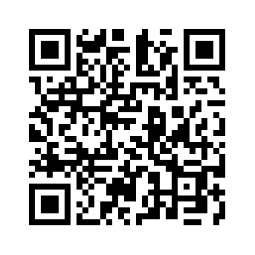
Donate with our QR code app to
Amazing Grace Christian Fellowship
Donations are Deeply Appreciated!

