Slide 2
“I Give You Glory”
(Dennis Campo)

Slide 3
Oh, how beautiful Are You, Lord It's Your words It's Your love Oh, how glorious Are You, Lord It's Your

Slide 4
power It was Your cross That saved me And rescued me Just a moment there Set me free I give You glory,

Slide 5
glory I give You glory, glory I give You glory, glory
Jesus I give You glory, glory I give You glory, glory I

Slide 6
give You glory, glory Jesus Oh, how beautiful Are You, Lord It's Your words It's Your love Oh, how

Slide 7
glorious Are You, Lord It's Your power It was Your cross That saved me And rescued me Just a

Slide 8
moment there Set me free I give You glory, glory I give You glory, glory I give You glory, glory Jesus

Slide 9
I give You glory, glory I give You glory, glory I give You glory, glory Jesus And With a crown of thorns

Slide 10
You became my King forever And With a crown of thorns You became my King forever And With a

Slide 11
crown of thorns You became my King forever And with a crown of thorns You became my king forever

Slide 12
That saved me And rescued me Just a moment there Set me free That saved me And rescued me

Slide 13
Just a moment there Set me free Te doy gloria, gloria
Te doy gloria, gloria Te doy gloria, gloria A ti Hesus

Slide 14
Te doy gloria, gloria Te doy gloria, gloria Te doy gloria, gloria A ti Hesus

Slide 15
“Great are you Lord”
(All Sons and Daughters)

Slide 16
You give life, You are love. You bring light in the darkness. You give hope, You restore

Slide 17
Every heart that is broken. And great are you Lord. It’s your breath in our lungs so we

Slide 18
Pour out our praise. We pour out our praise.
It’s your breath in our lungs. So we pour out

Slide 19
Our praise to you only. You give life, you are love. You bring light to the darkness. You

Slide 20
Give hope, You restore. Every heart that is broken. Great are you Lord. It’s your breath

Slide 21
In our lungs. So we pour out our praise we pour out our praise. It’s your breath in our

Slide 22
Lungs so we pour out our praise to you only. It’s your breath in our lungs. So we

Slide 23
Pour out our praise we pour out our praise. It’s your breath in our lungs. So we pour out

Slide 24
Our praise to you only. And all the earth will shout your praise. Our hearts will cry, these

Slide 25
Bones will sing. Great are You, Lord. And all the earth will shout your praise. Our hearts

Slide 26
Will cry these bones will sing. Great are you,Lord. And all the earth will shout your

Slide 27
Praise Our hearts will cry these bones will sing. Great are you, Lord. It’s your breath in

Slide 28
Our Lungs. So we pour out our praise. We pour out our praise. It’s your breath in our

Slide 29
Lungs so we pour out our praise to you only. Great are you, Lord. It’s your breath in

Slide 30
Our lungs so we pour out our praise. Pour out our praise. It’s your breath in our lungs

Slide 31
So we pour out our praise to you only. Great are you , Lord.

Slide 32
“Build My Life”
(Pat Barret / Housefires)

Slide 33
Worthy of every song we could ever sing Worthy of all the praise we could ever bring Worthy of every

Slide 34
breath we could ever breathe We live for you Oh, we live for you Jesus, the Name above every other

Slide 35
name Jesus, the only One who could ever save (worthy...) Worthy of every breath we could ever

Slide 36
breathe We live for you Holy, there is no one like You There is none beside You Open up my eyes in

Slide 37
Jesus, the Name above every other name Jesus, the only One who could ever save Worthy of every

Slide 38
breathe we could ever breathe We live for You, Oh! We live for for You Holy, there is no one like You

Slide 39
There is none beside You Open up my eyes I wonder Show me who You are and fill me With Your

Slide 40
heart and lead me In your love to those around me I will build my life upon Your love It is a firm foundation

Slide 41
I will put my trust in You alone And I will not be shaken I will build my life upon Your love It is a firm

Slide 42
foundation I will put my trust in You alone And I will not be shaken Holy, there is no one like You There is

Slide 43
none beside You Open up my eyes in wonder Show me who You are and fill me With Your heart and lead

Slide 44
me In your love to those around me I will build my life upon Your love It is a firm foundation I will put my

Slide 45
trust in You alone And I will not be shaken I will build my life upon Your love It is a firm foundation I will put

Slide 46
my trust in You alone And I will not be shaken Lord

Slide 47
Pour My Love On You
(Phillips, Craig and Dean)

Slide 48
I don't know how to say exactly how I feel And I can't begin to tell you what your love has meant I'm lost

Slide 49
for words Is there a way to show the passion in my heart Can I express how truly great I think you are

Slide 50
My dearest friend Lord, this is my desire To pour my love on You Like oil upon your feet Like wine for you

Slide 51
to drink Like water from my heart I pour my love on you If praise is like perfume I'll lavish mine on you

Slide 52
Till every drop is gone I'll pour my love on you Is there a way to show the passion in my heart Can I

Slide 53
express how truly great I think you are My dearest friend Lord, this is my desire To pour my love on you

Slide 54
Like oil upon your feet Like wine for you to drink Like water from my heart I pour my love on you If praise

Slide 55
is like perfume I'll lavish mine on you Till every drop is gone I'll pour my love on you Like oil

Slide 56
upon your feet Like wine for you to drink Like water from my heart I pour my love on you If praise is like

Slide 57
perfume I'll lavish mine on you Till every drop is gone Pour my love on you Yeah Like oil upon your feet

Slide 58
Like wine for you to drink Like water from my heart I pour my love on you If praise is like perfume I'll

Slide 59
lavish mine on you Till every drop is gone Like oil upon your feet Like wine for you to drink Like water

Slide 60
from my heart I pour my love on you If praise is like perfume I’ll lavish mine on you Till every drop is gone

Slide 61
I'll pour my love on you Pour my love on you Yeah, yeah.

Slide 62
The More I Seek You (by Kari Jobe)

Slide 63
The more I seek you The more I find you The more I find you, the more I love you I wanna sit at your feet

Slide 64
Drink from the cup in your hand Lay back against you and breath, feel your heart beat This love is so deep,

Slide 65
it's more than I can stand I melt in your peace, it's overwhelming The more I seek you The more I find

Slide 66
you The more I find you, the more I love you I wanna sit at your feet Drink from the cup in your

Slide 67
stand I melt in your peace, it's overwhelming I wanna sit at your feet Drink from the cup in your hand Lay

Slide 68
back against you and breath, feel your heart beat This love is so deep, it's more than I can stand I

Slide 69
melt in your peace, it's overwhelming, oh your love is overwhelming me And now my love, your love is

Slide 70
overwhelming me, over me I wanna sit at your feet Drink from the cup in your hand Lay back against

Slide 71
you and breath, feel your heart beat This love is so deep, it’s m ore than I can stand I melt in your peace

Slide 74
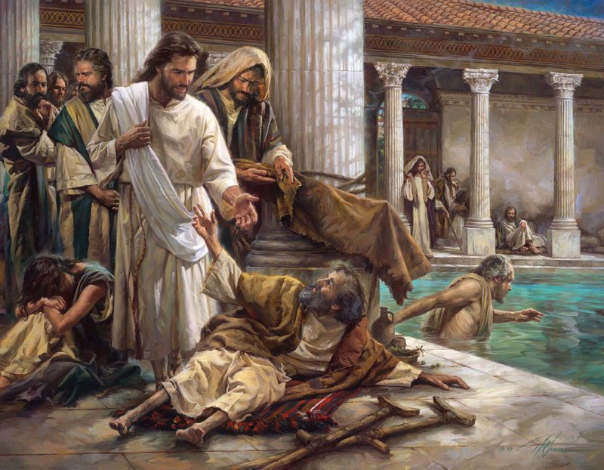
Jesus Our Encourager
by Pastor Fee Soliven
Romans 15:4-6
Sunday Morning
November 17, 2024

Slide 75
Romans 15:4-6
4 For whatever things were written before were written for our learning, that we through the patience and comfort of the Scriptures might have hope. 5 Now may the God of patience and comfort grant you to be like-minded toward one another, according to Christ Jesus, 6 that you may with one mind and one mouth glorify the God and Father of our Lord Jesus Christ.

Slide 76
Encouragement

Slide 77
2 Corinthians 1:3-4
3 Blessed be the God and Father of our Lord Jesus Christ, the Father of mercies and God of all comfort, 4 who comforts us in all our tribulation, that we may be able to comfort those who are in any trouble, with the comfort with which we ourselves are comforted by God.

Slide 78
What Attributes of God make Him our Great Encourager?

Slide 79
Merciful

Slide 80
2 Corinthians 1:3
"Blessed be the God and Father of our Lord Jesus Christ, the Father of mercies and God of all comfort...

Slide 81
Omnipresent

Slide 82
Psalm 139:7-10
7 Where can I go from Your Spirit? Or where can I flee from Your presence? 8 If I ascend into heaven, You are there; If I make my bed in hell, behold, You are there. 9 If I take the wings of the morning, And dwell in the uttermost parts of the sea, 10 Even there Your hand shall lead me, And Your right hand shall hold me.

Slide 83
Omnipotent

Slide 84
Colossians 1:16-17
16 For by Him all things were created that are in heaven and that are on earth, visible and invisible, whether thrones or dominions or principalities or powers. All things were created through Him and for Him. 17 And He is before all things, and in Him all things consist.

Slide 85
Omniscient

Slide 86
Psalm 147:5
"Great is our Lord, and mighty in power; His understanding is infinite." (Meaning Beyond Measure)

Slide 87
Gracious

Slide 88
1 John 1:9-10
9 If we confess our sins, He is faithful and just to forgive us our sins and to cleanse us from all unrighteousness. 10 If we say that we have not sinned, we make Him a liar, and His word is not in us.

Slide 89
Patient

Slide 90
2 Peter 3:9
The Lord is not slack concerning His promise, as some count slackness, but is longsuffering toward us, not willing that any should perish but that all should come to repentance.

Slide 91
Wise

Slide 92
Romans 11:33-35
33 Oh, the depth of the riches both of the wisdom and knowledge of God! How unsearchable are His judgments and His ways past finding out! 34 "For who has known the mind of the LORD? Or who has become His counselor?" 35 "Or who has first given to Him And it shall be repaid to him?"

Slide 93
Faithful

Slide 94
2 Timothy 2:13
"If we are faithless, He remains faithful; He cannot deny Himself"

Slide 95
1 Corinthians 1:9
God is faithful, by whom you were called into the fellowship of His Son, Jesus Christ our Lord

Slide 96
Good

Slide 97
Psalm 107:1-2
1 Oh, give thanks to the LORD, for He is good! For His mercy endures forever. 2 Let the redeemed of the LORD say so, Whom He has redeemed from the hand of the enemy...

Slide 98
Unchanging

Slide 99
Malachi 3:6
"For I am the LORD, I do not change..."

Slide 100
Hebrews 13:8
"Jesus Christ is the same yesterday, today, and forever."

Slide 101
How does God encourage us?

Slide 102
His Word

Slide 103
Proverbs 4:20-22
20 My son, give attention to my words; Incline your ear to my sayings. 21 Do not let them depart from your eyes; Keep them in the midst of your heart; 22 For they are life to those who find them, And health to all their flesh.

Slide 104
Prayer

Slide 105
Philippians 4:6-7
6 Be anxious for nothing, but in everything by prayer and supplication, with thanksgiving, let your requests be made known to God; 7 and the peace of God, which surpasses all understanding, will guard your hearts and minds through Christ Jesus.

Slide 106
His Plans

Slide 107
Jeremiah 29:11
"For I know the thoughts that I think toward you, says the LORD, thoughts of peace and not of evil, to give you a future and a hope."

Slide 108
Godly Friendships

Slide 109
1 Corinthians 15:33
"Do not be deceived: "Evil company corrupts good habits."

Slide 110
Proverbs 12:26
"The righteous should choose his friends carefully, For the way of the wicked leads them astray."

Slide 111
Worship Music
\

Slide 112
Ephesians 5:19
Speaking to one another in psalms and hymns and spiritual songs, singing and making melody in your heart to the Lord...

Slide 113
His Presence

Slide 114
Psalm 16:11
"You will show me the path of life; In Your presence is fullness of joy; At Your right hand are pleasures forevermore."

Slide 115
1. What do you normally do when you feel discouraged?

Slide 116
2. Has this response lifted your spirits or left you feeling disheartened?

Slide 117
3. Have you ever felt trapped in discouragement?

Slide 118
4. How does it make you feel to know that you can choose to step out of the trap?

Slide 119
5. Which of God’s attributes would bring you the most hope in the face of disheartening circumstances?

Slide 120
6. As you consider the ways the Lord wants to encourage you, which ones do you need to remember and focus upon?

Slide 121
1 Thessalonians 4:13-18
13 But I do not want you to be ignorant, brethren, concerning those who have fallen asleep, lest you sorrow as others who have no hope. 14 For if we believe that Jesus died and rose again, even so God will bring with Him those who sleep in Jesus.

Slide 122
15 For this we say to you by the word of the Lord, that we who are alive and remain until the coming of the Lord will by no means precede those who are asleep. 16 For the Lord Himself will descend from heaven with a shout, with the voice of an archangel, and with the trumpet of God. And the dead in Christ will rise first.

Slide 123
17 Then we who are alive and remain shall be caught up together with them in the clouds to meet the Lord in the air. And thus we shall always be with the Lord. 18 Therefore comfort one another with these words.

Slide 124
1 Corinthians 15:50-54
50 Now this I say, brethren, that flesh and blood cannot inherit the kingdom of God; nor does corruption inherit incorruption. 51 Behold, I tell you a mystery: We shall not all sleep, but we shall all be changed-- 52 in a moment, in the twinkling of an eye, at the last trumpet. For the trumpet will sound, and the dead will be raised incorruptible, and we shall be changed.

Slide 125
53 For this corruptible must put on incorruption, and this mortal must put on immortality. 54 So when this corruptible has put on incorruption, and this mortal has put on immortality, then shall be brought to pass the saying that is written: "Death is swallowed up in victory."

Slide 126
20 Again, when a righteous man turns from his righteousness and commits iniquity, and I lay a stumbling block before him, he shall die; because you did not give him warning, he shall die in his sin, and his righteousness which he has done shall not be remembered; but his blood I will require at your hand.

Slide 127
Acts 2:38-39
38 Then Peter said to them, "Repent, and let every one of you be baptized in the name of Jesus Christ for the remission of sins; and you shall receive the gift of the Holy Spirit. 39 For the promise is to you and to your children, and to all who are afar off, as many as the Lord our God will call."

Slide 128
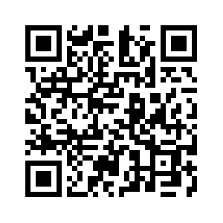
Donate with our QR code app to
Amazing Grace Christian Fellowship
Donations are Deeply Appreciated!

