Slide 1


Slide 2


Slide 3
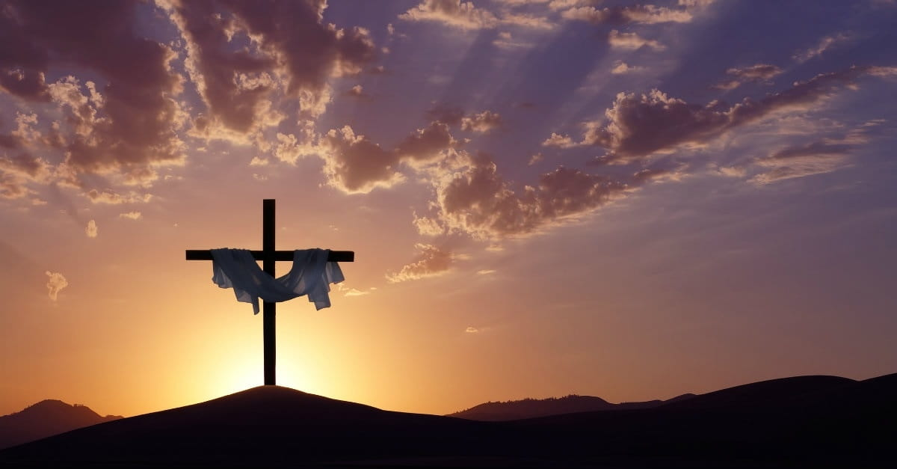

By the Power of Jesus You Can Make It!
By Pastor Fee Soliven
Acts 14:18-22
Sunday Morning
December 8, 2024

Slide 4
Acts 14:18-23
18 And with these sayings they could scarcely restrain the multitudes from sacrificing to them. 19 Then Jews from Antioch and Iconium came there; and having persuaded the multitudes, they stoned Paul and dragged him out of the city, supposing him to be dead.

Slide 5
20 However, when the disciples gathered around him, he rose up and went into the city. And the next day he departed with Barnabas to Derbe. 21 And when they had preached the gospel to that city and made many disciples, they returned to Lystra, Iconium, and Antioch,

Slide 6
22 strengthening the souls of the disciples, exhorting them to continue in the faith, and saying, "We must through many tribulations enter the kingdom of God."

Slide 7
Do you remember the last time you felt down or discouraged?

Slide 8
What caused you to feel this way?

Slide 9
The apostle Paul is an inspiring example of someone who was down but not out.

Slide 10
Acts 14:8-15
8 And in Lystra a certain man without strength in his feet was sitting, a cripple from his mother's womb, who had never walked. 9 This man heard Paul speaking. Paul, observing him intently and seeing that he had faith to be healed,

Slide 11
10 said with a loud voice, "Stand up straight on your feet!" And he leaped and walked. 11 Now when the people saw what Paul had done, they raised their voices, saying in the Lycaonian language, "The gods have come down to us in the likeness of men!" 12 And Barnabas they called Zeus, and Paul, Hermes, because he was the chief speaker.

Slide 12
13 Then the priest of Zeus, whose temple was in front of their city, brought oxen and garlands to the gates, intending to sacrifice with the multitudes. 14 But when the apostles Barnabas and Paul heard this, they tore their clothes and ran in among the multitude, crying out

Slide 13
15 and saying, "Men, why are you doing these things? We also are men with the same nature as you, and preach to you that you should turn from these useless things to the living God, who made the heaven, the earth, the sea, and all things that are in them…

Slide 14
Acts 14:19
“Then Jews from Antioch and Iconium came there; and having persuaded the multitudes, they stoned Paul and dragged him out of the city, supposing him to be dead.”

Slide 15
Acts 14:20
“However, when the disciples gathered around him, he rose up and went into the city. And the next day he departed with Barnabas to Derbe.”

Slide 16
What helped Paul and can help us get up, too, when we’re feeling down?

Slide 17
Paul’s Conversion

Slide 18
Acts 9:4-5
4 Then he fell to the ground, and heard a voice saying to him, "Saul, Saul, why are you persecuting Me?" 5 And he said, "Who are You, Lord?" And the Lord said, "I am Jesus, whom you are persecuting. It is hard for you to kick against the goads."

Slide 19
Paul’s Conviction

Slide 20
Philippians 1:15-16
15 Some indeed preach Christ even from envy and strife, and some also from good will: 16 The former preach Christ from selfish ambition, not sincerely, supposing to add affliction to my chains;

Slide 21
Philippians 4:13
I can do all things through Christ who strengthens me.

Slide 22
Paul’s Confidence

Slide 23
Romans 8:38-39
38 For I am persuaded that neither death nor life, nor angels nor principalities nor powers, nor things present nor things to come, 39 nor height nor depth, nor any other created thing, shall be able to separate us from the love of God which is in Christ Jesus our Lord.

Slide 24
Romans 8:37
Yet in all these things we are more than conquerors through Him who loved us.

Slide 25
Paul’s Courage

Slide 26
2 Corinthians 5:5-9
5 Now He who has prepared us for this very thing is God, who also has given us the Spirit as a guarantee. 6 So we are always confident, knowing that while we are at home in the body we are absent from the Lord.

Slide 27
7 For we walk by faith, not by sight. 8 We are confident, yes, well pleased rather to be absent from the body and to be present with the Lord.

Slide 28
9 Therefore we make it our aim, whether present or absent, to be well pleasing to Him.

Slide 29
Paul’s Commitment

Slide 30
Romans 1:16-17
16 For I am not ashamed of the gospel of Christ, for it is the power of God to salvation for everyone who believes, for the Jew first and also for the Greek. 17 For in it the righteousness of God is revealed from faith to faith; as it is written, "The just shall live by faith."

Slide 31
Paul’s Companions

Slide 32
Acts 14:21-22
21 And when they had preached the gospel to that city and made many disciples, they returned to Lystra, Iconium, and Antioch, 22 strengthening the souls of the disciples, exhorting them to continue in the faith, and saying, "We must through many tribulations enter the kingdom of God."

Slide 33
What should you do when you’re discouraged?

Slide 34
Philippians 3:12-14
12 Not that I have already attained, or am already perfected; but I press on, that I may lay hold of that for which Christ Jesus has also laid hold of me.

Slide 35
13 Brethren, I do not count myself to have apprehended; but one thing I do, forgetting those things which are behind and reaching forward to those things which are ahead, 14 I press toward the goal for the prize of the upward call of God in Christ Jesus.

Slide 36
Romans 15:13
“Now may the God of hope fill you with all joy and peace in believing, that you may abound in hope by the power of the Holy Spirit.”

Slide 37
1. What kinds of situations cause you to feel discouraged?

Slide 38
2. How do you usually respond?

Slide 39
3. When you’re feeling down, where is your focus?

Slide 40
4. How would focusing on the Lord change your response to discouragement?
\

Slide 41
5. Who in your life has been an example of perseverance through hardship? For whom are you setting an example?

Slide 42
1 Thessalonians 4:13-18
13 But I do not want you to be ignorant, brethren, concerning those who have fallen asleep, lest you sorrow as others who have no hope. 14 For if we believe that Jesus died and rose again, even so God will bring with Him those who sleep in Jesus.

Slide 43
15 For this we say to you by the word of the Lord, that we who are alive and remain until the coming of the Lord will by no means precede those who are asleep. 16 For the Lord Himself will descend from heaven with a shout, with the voice of an archangel, and with the trumpet of God. And the dead in Christ will rise first.

Slide 44
17 Then we who are alive and remain shall be caught up together with them in the clouds to meet the Lord in the air. And thus we shall always be with the Lord. 18 Therefore comfort one another with these words.

Slide 45
1 Corinthians 15:50-54
50 Now this I say, brethren, that flesh and blood cannot inherit the kingdom of God; nor does corruption inherit incorruption. 51 Behold, I tell you a mystery: We shall not all sleep, but we shall all be changed-- 52 in a moment, in the twinkling of an eye, at the last trumpet. For the trumpet will sound, and the dead will be raised incorruptible, and we shall be changed.

Slide 46
53 For this corruptible must put on incorruption, and this mortal must put on immortality. 54 So when this corruptible has put on incorruption, and this mortal has put on immortality, then shall be brought to pass the saying that is written: "Death is swallowed up in victory."

Slide 47

20 Again, when a righteous man turns from his righteousness and commits iniquity, and I lay a stumbling block before him, he shall die; because you did not give him warning, he shall die in his sin, and his righteousness which he has done shall not be remembered; but his blood I will require at your hand.

Slide 48
Acts 2:38-39
38 Then Peter said to them, "Repent, and let every one of you be baptized in the name of Jesus Christ for the remission of sins; and you shall receive the gift of the Holy Spirit. 39 For the promise is to you and to your children, and to all who are afar off, as many as the Lord our God will call."

Slide 49

Donate with our QR code app to
Amazing Grace Christian Fellowship
Donations are Deeply Appreciated!

