Slide 1


Slide 2
“Holy Forever”
(by Chris Tomlin)

Slide 3
A thousand generations falling down in worship To sing the song of ages to the Lamb And all who've

Slide 4
gone before us, and all who will believe Will sing the song of ages to the Lamb Your name is the highest

Slide 5
Your name is the greatest Your name stands above them all All thrones and dominions All powers and

Slide 6
positions Your name stands above them all And the angels cry, "Holy“ All creation cries, "Holy“ You are

Slide 7
lifted high, holy Holy forever If you've been forgiven, if you've been redeemed Sing the

Slide 8
song forever to the Lamb If you walk in freedom, if you bear His name Sing the song forever to the

Slide 9
Lamb We'll sing the song forever and amen And the angels cry, "Holy“ All creation cries, "Holy“ You are

Slide 10
lifted high, holy Holy forever Hear your people sing, "Holy“ To the King of kings, "Holy“ You will always be

Slide 11
holy Holy forever Your name is the highest Your name is the greatest Your name stands above them

Slide 12
all All thrones and dominions All powers and positions Your name stands above them all, Jesus

Slide 13
Your name is the highest Your name is the greatest Your name stands above them all (oh, stands above)

Slide 14
All thrones and dominions All powers and positions Your name stands above them all And the angels

Slide 15
cry, "Holy“ All creation cries, "Holy“ You are lifted high, holy Holy forever (we cry "Holly forever") Hear

Slide 16
Your people sing "Holy" (we will sing) To the King of kings, (holy) holy (holy forever) You will always be

Slide 17
holy Holy forever You will always be holy Holy forever

Slide 18
“Jesus We Love You”
(Bethal Music)

Slide 19
Old things have passed away Your love has stayed the same Your constant grace remains the

Slide 20
cornerstone Things that we thought were dead Are breathing in life again You cause your Son to shine

Slide 21
on darkest nights For all that you've done, we will pour out our love This will be our anthem song Jesus

Slide 22
we love you Oh how we love you You are the one our, our hearts adore The hopeless have found their

Slide 23
hope The orphans now have a home All that was lost has found its place in you You lift our weary

Slide 24
head You make us strong instead You took these rags and made us beautiful For all that you've done,

Slide 25
we will pour out our love This will be our anthem song Jesus we love you Oh how we love you You

Slide 26
are the on our, our hearts adore Oh, Jesus we love you Oh how we love you You are the one our, our

Slide 27
hearts adore Our hearts adore (we adore you) Our hearts adore Our hearts adore Our affection, our

Slide 28
devotion Poured out on the feet of Jesus Our affection, our devotion Poured out on the feet of

Slide 29
Jesus Our affection, our devotion Poured out on the feet of Jesus Our affection, our devotion Poured out

Slide 30
on the feet of Jesus We love you Oh how we love you You are the one our, our hearts adore Jesus we

Slide 31
love you Oh how we love you You are the one our, our hearts adore Oh, Jesus we love you Oh how we

Slide 32
love you You are the one our, our hearts adore Just sing out a new song today Oh, oh how we love you

Slide 33
Oh, you are worthy Jesus, of our love, our adoration, we love you God Oh lift your voice, oh Oh we love

Slide 34
you, oh we love you, oh Oh how we love you (sing Jesus) Oh, Jesus we love you Oh how we love you

Slide 35
(you are) You are the one our, our hearts adore

Slide 36
“Holy Spirit”
(Kim Walker)

Slide 37
There’s nothing worth more. That could ever come close. No thing can compare. You’re our living hope.

Slide 38
Your presence Lord. I’ve tasted and seen of the sweetest of loves. Where my heart becomes free

Slide 39
And my shame is undone. Your presence, Lord.
Holy spirit you are welcome here. Come flood this

Slide 40
place and fill the atmosphere. Your glory God is what our hearts long for. To be overcomed, By your

Slide 41
presence Lord. There’s nothing worth more. That could ever come close. No thing can compare.

Slide 42
you’re living hope. Your presence, Lord. I’ve tasted and seen of the sweetest of loves. Where my heart

Slide 43
becomes free and my shame is undone. Your presence, Lord. Holy Spirit you are welcome here

Slide 44
Come flood this place and fill the atmosphere. Your glory God is what our hearts long for. To be

Slide 45
overcome by your presence Lord. Your presence Lord. Let us become more aware of your presence

Slide 46
Let us experience the Glory of your goodness. Let us become. More aware of your presence. Let us

Slide 47
experience the Glory of your goodness. Let us become more aware of your presence. Let us

Slide 48
the atmosphere, Your glory God is what our heart longs for to be overcome. By your presence Lord.

Slide 49
“Show Me Your Glory”
(Jesus Culture)

Slide 50
I see the cloud, I step in I want to see Your glory like Moses did Flashes of light and rolls of thunder But

Slide 51
I'm not afraid I'm not afraid Show me Your glory Show me Your glory, yes Show me Your glory Show

Slide 52
me Your glory I'm marked by Your beauty, lost in Your eyes I long to walk in Your presence like Jesus

Slide 53
did Your glory surrounds me and I'm overwhelmed But I'm not afraid I'm not afraid Show me Your glory

Slide 54
Show me Your glory, my God Show me Your glory Show me Your glory, yeah I long to look on the face

Slide 55
of the One that I love Long to stay in Your presence, it's where I belong Long to look on the face of the

Slide 56
One that I love Long to stay in Your presence, it's where I belong It's where I belong It's where I belong

Slide 57
I belong in Your presence I belong in Your presence
Jesus, yeah Oh Yeah Yeah This is where I belong

Slide 58
'Cause I was made for love And I was born for love Jesus And I see the cloud I step in I see the cloud

Slide 59
And I run in I see the cloud And I jump in But I'm not afraid I'm not afraid I'm not afraid Show me

Slide 60
Your glory Show me Your glory (I long to sing) Show me Your glory Show me Your glory, yeah I long to

Slide 61
look on the face of the One that I love Long to stay in Your presence, it's where I belong Long to look on

Slide 62
the face of the One that I love Long to stay in Your presence, it's where I belong I belong to You I belong

Slide 63
to You I belong to You I belong to You I belong to You I belong to You Yeah Oh yeah Show me Your glory

Slide 64
God (yeah) Show me Your glory Show me Your glory (Jesus) Show me Your glory (I long to sing) Show

Slide 65
me Your glory, God (Show me Your glory) (Show me Your glory) (Show me Your glory)

Slide 67
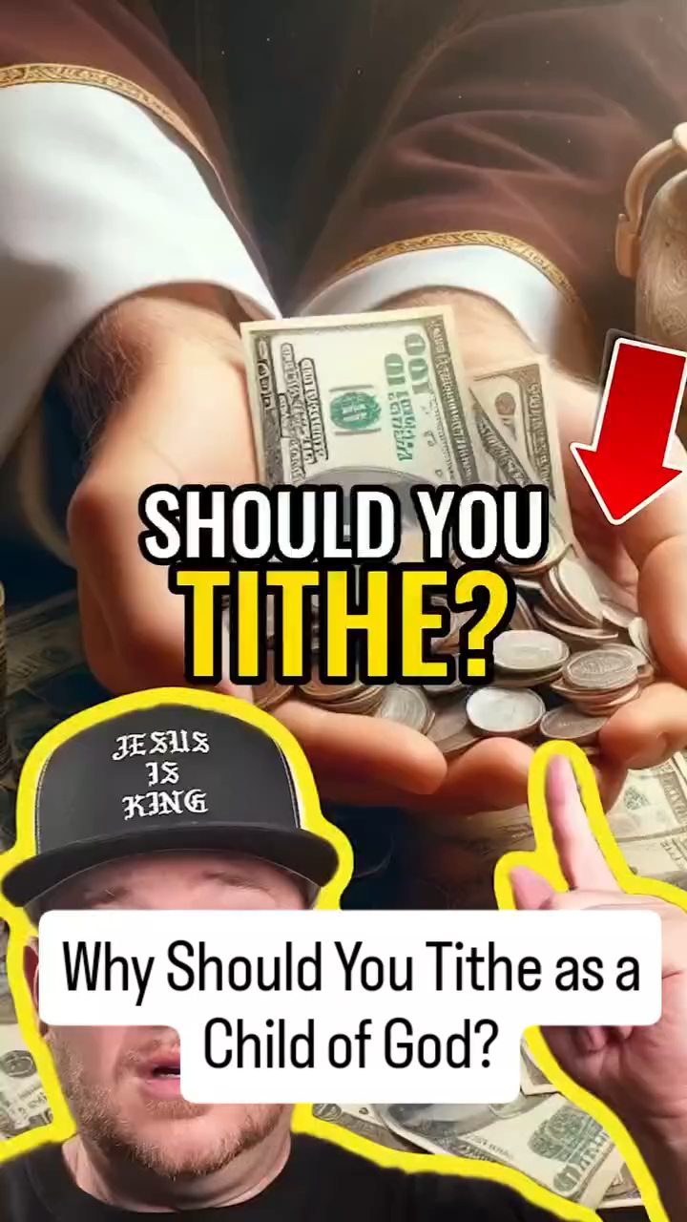

Slide 69
“Revelation Song”
(Kari Jobe)

Slide 70
Worthy is the Lamb who was slain. Holy holy is he.Sing a new songto him who sits on Heaven’s

Slide 71
Mercy seat. Worthy is the Lamb who was slain. Holy, holy is he. Sing a new song to him who sits on

Slide 72
Heaven’s mercy seat. Holy, Holy, holy is the Lord God almighty. Who was and is to come. With all

Slide 73
Creation I sing. Praise to the King of Kings. You are my everything and I will Adore you. Clothed in

Slide 74
Rainbows of living color. Flashes of lightning rolls of thunder. Blessing and honor strength and glory and

Slide 75
Power be. To you the only wise King. Holy, holy, holy is the Lord god Almighty. Who was and is to come.

Slide 76
With all Creation I sing praise to the King of Kings. You are my everything and I will adore you. Filled

Slide 77
With wonder. Awe struck Wonder at the mention of your name. Jesus your name is power, breath and

Slide 78
Living water. Such a marvelous mystery. Holy,holy, holy is the Lord God almighty. Who was and is and is

Slide 79
To come. With all creation I sing. Praise to the king of Kings. You are my everything. And I will Adore you.

Slide 81


Slide 82
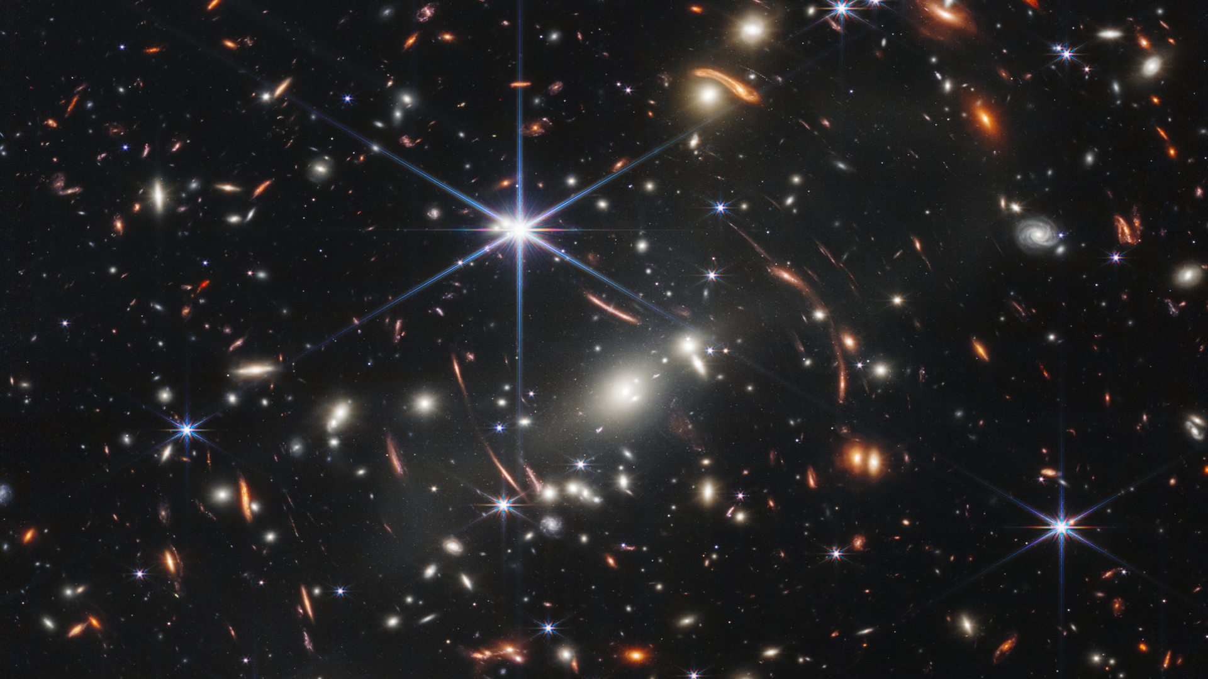

Jesus Our Everything
By Pastor Fee Soliven
Matthew 16:13-16
Sunday Morning
December 15, 2024

Slide 83
Matthew 16:13-16
13 When Jesus came into the region of Caesarea Philippi, He asked His disciples, saying, "Who do men say that I, the Son of Man, am?" 14 So they said, "Some say John the Baptist, some Elijah, and others Jeremiah or one of the prophets." 15 He said to them, "But who do you say that I am?"

Slide 84
16 Simon Peter answered and said, "You are the Christ, the Son of the living God." 17 Jesus answered and said to him, "Blessed are you, Simon Bar-Jonah, for flesh and blood has not revealed this to you, but My Father who is in heaven.

Slide 85
Jesus is not only the most important person who ever lived, but He’s also the most controversial.

Slide 86
Matthew 16:13
“Who do people say that the Son of Man is?”

Slide 87
Matthew 16:15-16
15 He said to them, "But who do you say that I am?" 16 Simon Peter answered and said, "You are the Christ, the Son of the living God."

Slide 88
What are Jesus’ attributes?

Slide 89
Creator

Slide 90
Colossians 1:15-16
15 He is the image of the invisible God, the firstborn over all creation. 16 For by Him all things were created that are in heaven and that are on earth, visible and invisible, whether thrones or dominions or principalities or powers. All things were created through Him and for Him.

Slide 91
Omnipresent
As our Savior, Jesus lives within our hearts and is with us wherever we go.

Slide 92
Omnipotent
God the Son has all power to do whatever fits with His character and is in keeping with His Father’s will.

Slide 93
Omniscient
There are no secrets because our Lord knows all things with complete accuracy. Before we even utter a prayer, He knows what we will say.

Slide 94
Merciful
We may freely call upon Christ to be merciful to us and need never worry that He will mistreat us.

Slide 95
Eternal
Jesus was born of a woman, but this is not when He came into existence. He has always existed as eternal Son of God.

Slide 96
Sinless
Because of His divine nature, Jesus was completely sinless.

Slide 97
Human
Although He never ceased being God, Jesus was also fully human yet without sin. Because He lived as a man, He understands and can help us in our weakness.

Slide 98
Deity
Jesus was also wholly divine with all the attributes and perfections of deity.

Slide 99
Virgin-born
To become the holy, sinless God-man, Jesus had to be conceived by the Holy Spirit in the womb of a virgin. This was the only way He could represent mankind and be the sinless Lamb of God who was qualified to pay for our sins with His death on the cross.

Slide 100
Where is Jesus today?

Slide 101
Romans 8:34
Who is he who condemns? It is Christ who died, and furthermore is also risen, who is even at the right hand of God, who also makes intercession for us.

Slide 102
Romans 8:9-11
9 But you are not in the flesh but in the Spirit, if indeed the Spirit of God dwells in you. Now if anyone does not have the Spirit of Christ, he is not His. 10 And if Christ is in you, the body is dead because of sin, but the Spirit is life because of righteousness.

Slide 103
11 But if the Spirit of Him who raised Jesus from the dead dwells in you, He who raised Christ from the dead will also give life to your mortal bodies through His Spirit who dwells in you.

Slide 104
What was Jesus’ mission on earth?

Slide 105
To Reveal the Father

Slide 106
(What was Jesus’ mission on earth?)

Slide 107
John 14:9
“He who has seen Me has seen the Father”

Slide 108
To Redeem Mankind

Slide 109
Acts 2:38-39
38 Then Peter said to them, "Repent, and let every one of you be baptized in the name of Jesus Christ for the remission of sins; and you shall receive the gift of the Holy Spirit. 39 For the promise is to you and to your children, and to all who are afar off, as many as the Lord our God will call."

Slide 110
To Assure us of Life after Death

Slide 111
2 Corinthians 5:6-8
6 So we are always confident, knowing that while we are at home in the body we are absent from the Lord. 7 For we walk by faith, not by sight. 8 We are confident, yes, well pleased rather to be absent from the body and to be present with the Lord.

Slide 112
(What was Jesus’ mission on earth?)

Slide 113
To Promise Us Resurrection

Slide 114
1 Corinthians 15:20
“But now Christ is risen from the dead, and has become the firstfruits of those who have fallen asleep.”

Slide 115
1 Corinthians 15:51-58
51 Behold, I tell you a mystery: We shall not all sleep, but we shall all be changed-- 52 in a moment, in the twinkling of an eye, at the last trumpet. For the trumpet will sound, and the dead will be raised incorruptible, and we shall be changed.

Slide 116
53 For this corruptible must put on incorruption, and this mortal must put on immortality. 54 So when this corruptible has put on incorruption, and this mortal has put on immortality, then shall be brought to pass the saying that is written: "Death is swallowed up in victory." 55 "O Death, where is your sting? O Hades, where is your victory?"

Slide 117
56 The sting of death is sin, and the strength of sin is the law. 57 But thanks be to God, who gives us the victory through our Lord Jesus Christ. 58 Therefore, my beloved brethren, be steadfast, immovable, always abounding in the work of the Lord, knowing that your labor is not in vain in the Lord.

Slide 118
To Give us Abundant Life

Slide 119
John 10:10
“The thief does not come except to steal, and to kill, and to destroy. I have come that they may have life, and that they may have it more abundantly.”

Slide 120
Who did Jesus say He was?

Slide 121
The Good Shepherd: The Bread of Life: The Vine: The Way, the Truth, and the Life: The Light of the World: The Door

Slide 122
What does Scripture say about Jesus’ name?
\

Slide 123
His Name is Above Every Name

Slide 124
Philippians 2:9-11
9 Therefore God also has highly exalted Him and given Him the name which is above every name, 10 that at the name of Jesus every knee should bow, of those in heaven, and of those on earth, and of those under the earth, 11 and that every tongue should confess that Jesus Christ is Lord, to the glory of God the Father.

Slide 125
His is the Only Name by which
We are Saved

Slide 126
Acts 4:12
“Nor is there salvation in any other, for there is no other name under heaven given among men by which we must be saved."

Slide 127
His Name Indicates His
Mission as Deliverer

Slide 128
Matthew 1:21
“And she will bring forth a Son, and you shall call His name JESUS, for He will save His people from their sins."

Slide 129
Jesus is called the only begotten Son of God

Slide 130
John 3:16
“For God so loved the world that He gave His only begotten Son, that whoever believes in Him should not perish but have everlasting life.”

Slide 131
There is none like Jesus

Slide 132
1. He never wrote a book, but He is the subject of the greatest Book ever written.

Slide 133
2. He never wrote a song, yet He is the subject of many.

Slide 134
3. He never owned a home, but He has prepared one for us.

Slide 135
4. He never traveled more than one hundred miles from home, yet the entire world is in His presence.

Slide 136
5. He didn’t have a medical license but is known as the Great Physician.

Slide 137
6. He never marshaled an army, but He could bring down every kind of kingdom imaginable.

Slide 138
7. Herod could not kill Him.

Slide 139
8. Satan could not seduce Him.

Slide 140
9. Death couldn’t destroy Him.

Slide 141
10. The tomb could not keep Him.

Slide 142
Jesus’ names in Scripture describe His Attributes and His Mission

Slide 143
King of Kings, Son of God, Lamb of God, Rose of Sharon, Lord of Lords, Great High Priest, Morning Star, Prince of Peace, Wonderful, Counselor, Immanuel, Word of God, Prophet, Alpha and Omega

Slide 144
1. Why is Jesus worthy of your faith, devotion, and worship?

Slide 145
2. How can you focus on Him this Christmas instead of being distracted by all the activities, preparations, and expectations of the season?

Slide 146
1 Thessalonians 4:13-18
13 But I do not want you to be ignorant, brethren, concerning those who have fallen asleep, lest you sorrow as others who have no hope. 14 For if we believe that Jesus died and rose again, even so God will bring with Him those who sleep in Jesus.

Slide 147
15 For this we say to you by the word of the Lord, that we who are alive and remain until the coming of the Lord will by no means precede those who are asleep. 16 For the Lord Himself will descend from heaven with a shout, with the voice of an archangel, and with the trumpet of God. And the dead in Christ will rise first.

Slide 148
17 Then we who are alive and remain shall be caught up together with them in the clouds to meet the Lord in the air. And thus we shall always be with the Lord. 18 Therefore comfort one another with these words.

Slide 149
1 Corinthians 15:50-54
50 Now this I say, brethren, that flesh and blood cannot inherit the kingdom of God; nor does corruption inherit incorruption. 51 Behold, I tell you a mystery: We shall not all sleep, but we shall all be changed-- 52 in a moment, in the twinkling of an eye, at the last trumpet. For the trumpet will sound, and the dead will be raised incorruptible, and we shall be changed.

Slide 150
53 For this corruptible must put on incorruption, and this mortal must put on immortality. 54 So when this corruptible has put on incorruption, and this mortal has put on immortality, then shall be brought to pass the saying that is written: "Death is swallowed up in victory."

Slide 151

20 Again, when a righteous man turns from his righteousness and commits iniquity, and I lay a stumbling block before him, he shall die; because you did not give him warning, he shall die in his sin, and his righteousness which he has done shall not be remembered; but his blood I will require at your hand.

Slide 152
Acts 2:38-39
38 Then Peter said to them, "Repent, and let every one of you be baptized in the name of Jesus Christ for the remission of sins; and you shall receive the gift of the Holy Spirit. 39 For the promise is to you and to your children, and to all who are afar off, as many as the Lord our God will call."

Slide 153

Donate with our QR code app to
Amazing Grace Christian Fellowship
Donations are Deeply Appreciated!

