Slide 3
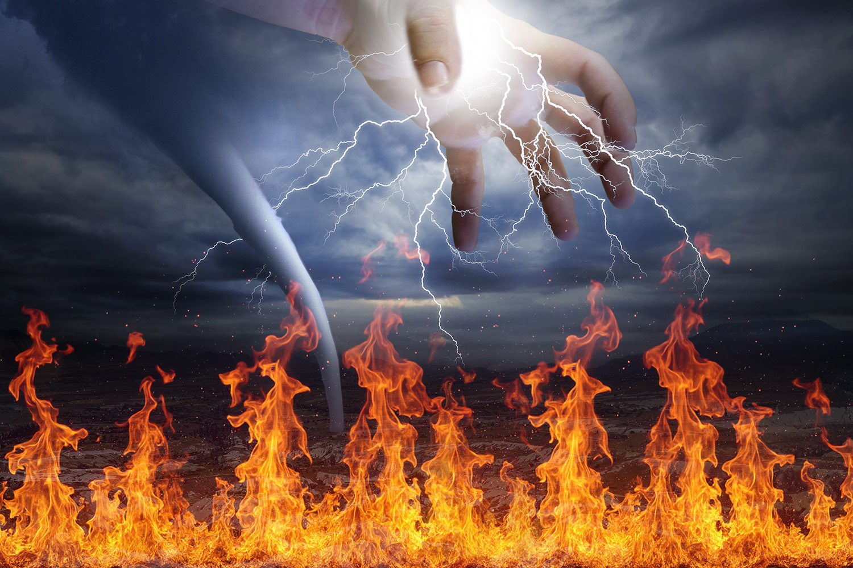
The Coming Judgement of God is Crying Out
By Pastor Fee Soliven
Ecclesiastes 1:1-10
Sunday Morning
February 23, 2025

Slide 4
Ecclesiastes 1:1-10
1 The words of the Preacher, the son of David, king in Jerusalem. 2 "Vanity of vanities," says the Preacher; "Vanity of vanities, all is vanity." 3 What profit has a man from all his labor In which he toils under the sun? 4 One generation passes away, and another generation comes; But the earth abides forever.

Slide 5
5 The sun also rises, and the sun goes down, And hastens to the place where it arose. 6 The wind goes toward the south, And turns around to the north; The wind whirls about continually, And comes again on its circuit. 7 All the rivers run into the sea, Yet the sea is not full; To the place from which the rivers come, There they return again.

Slide 6
8 All things are full of labor; Man cannot express it. The eye is not satisfied with seeing, Nor the ear filled with hearing. 9 That which has been is what will be, That which is done is what will be done,And there is nothing new under the sun. 10 Is there anything of which it may be said, "See, this is new"? It has already been in ancient times before us.

Slide 7
1. The Plain Meaning of Prophesy

Slide 8
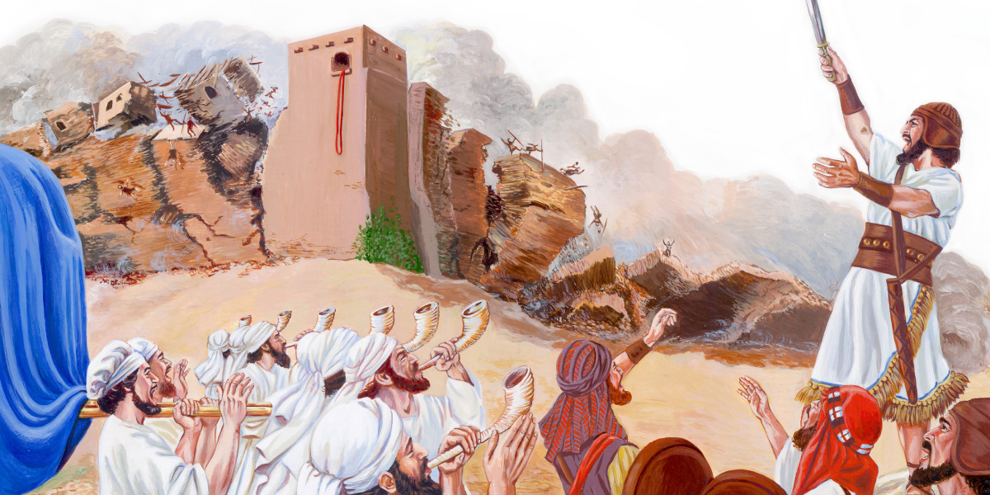
3 Then Moses said, "I will now turn aside and see this great sight, why the bush does not burn." 4 So when the LORD saw that he turned aside to look, God called to him from the midst of the bush and said, "Moses, Moses!" And he said, "Here I am." 5 Then He said, "Do not draw near this place. Take your sandals off your feet, for the place where you stand is holy ground."

Slide 9
2. The Symbolism of the Prophets

Slide 10
Revelation 13:1-3
1 Then I stood on the sand of the sea. And I saw a beast rising up out of the sea, having seven heads and ten horns, and on his horns ten crowns, and on his heads a blasphemous name. 2 Now the beast which I saw was like a leopard, his feet were like the feet of a bear, and his mouth like the mouth of a lion. The dragon gave him his power, his throne, and great authority.

Slide 11
3 And I saw one of his heads as if it had been mortally wounded, and his deadly wound was healed. And all the world marveled and followed the beast.

Slide 12
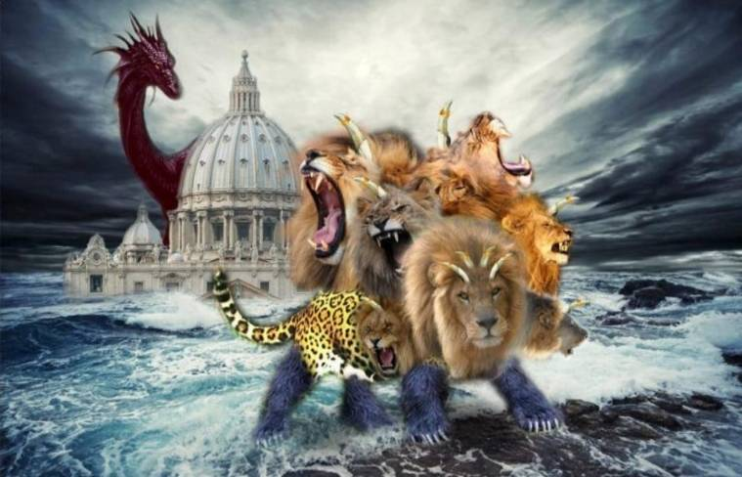
15 If anyone's work is burned, he will suffer loss; but he himself will be saved, yet so as through fire. 16 Do you not know that you are the temple of God and that the Spirit of God dwells in you? 17 If anyone defiles the temple of God, God will destroy him. For the temple of God is holy, which temple you are.

Slide 13
3. The Cycles that are Repeated in History

Slide 14
In 539 BC Cyrus the Great of Persia conquered Babylon

Slide 15
"Handwriting on the Wall"

Slide 16
The Fall of the Past Babylonian Empire and John saw the Fall of the
Future Babylonian Empire!

Slide 17
Revelation 18:1-8
1 After these things I saw another angel coming down from heaven, having great authority, and the earth was illuminated with his glory. 2 And he cried mightily with a loud voice, saying, "Babylon the great is fallen, is fallen, and has become a dwelling place of demons, a prison for every foul spirit, and a cage for every unclean and hated bird!

Slide 18
3 For all the nations have drunk of the wine of the wrath of her fornication, the kings of the earth have committed fornication with her, and the merchants of the earth have become rich through the abundance of her luxury."

Slide 19
4 And I heard another voice from heaven saying, "Come out of her, my people, lest you share in her sins, and lest you receive of her plagues. 5 For her sins have reached to heaven, and God has remembered her iniquities. 6 Render to her just as she rendered to you, and repay her double according to her works; in the cup which she has mixed, mix double for her.

Slide 20
7 In the measure that she glorified herself and lived luxuriously, in the same measure give her torment and sorrow; for she says in her heart, 'I sit as queen, and am no widow, and will not see sorrow.' 8 "Therefore her plagues will come in one day--death and mourning and famine. And she will be utterly burned with fire, for strong is the Lord God who judges her.

Slide 21
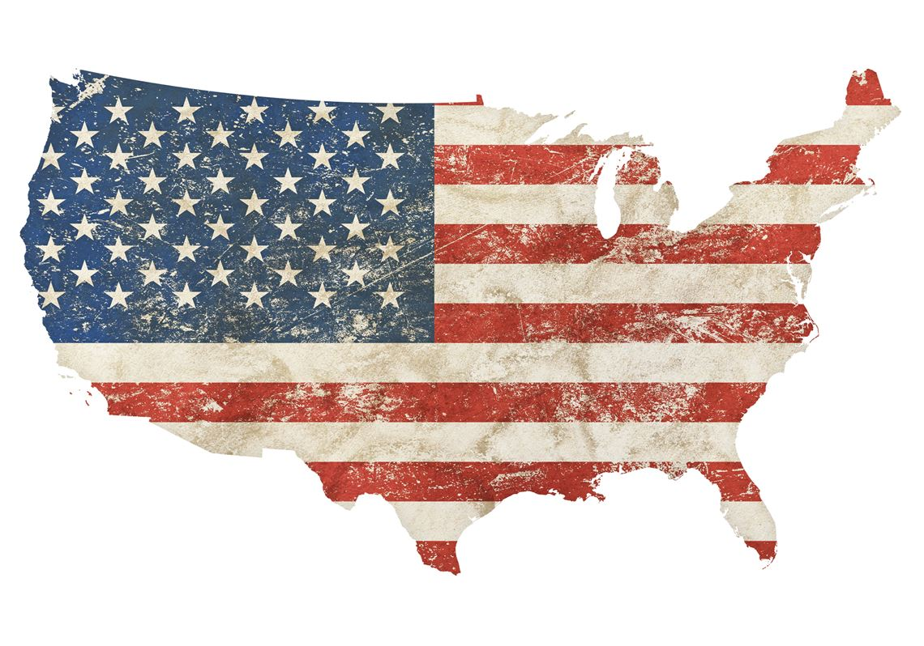
18 Immediately there fell from his eyes something like scales, and he received his sight at once; and he arose and was baptized. 19 So when he had received food, he was strengthened. Then Saul spent some days with the disciples at Damascus. 20 Immediately he preached the Christ in the synagogues, that He is the Son of God.

Slide 22
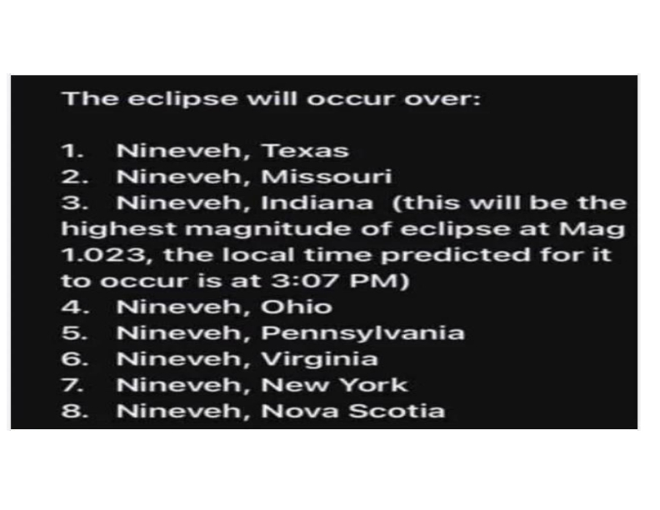
21 Then all who heard were amazed, and said, "Is this not he who destroyed those who called on this name in Jerusalem, and has come here for that purpose, so that he might bring them bound to the chief priests?" 22 But Saul increased all the more in strength, and confounded the Jews who dwelt in Damascus, proving that this Jesus is the Christ.

Slide 23
Ecclesiastes 1:9-10
9 That which has been is what will be, That which is done is what will be done, And there is nothing new under the sun. 10 Is there anything of which it may be said, "See, this is new"? It has already been in ancient times before us.

Slide 24
1 Corinthians 10:1-12
1 Moreover, brethren, I do not want you to be unaware that all our fathers were under the cloud, all passed through the sea, 2 all were baptized into Moses in the cloud and in the sea, 3 all ate the same spiritual food,

Slide 25
4 and all drank the same spiritual drink. For they drank of that spiritual Rock that followed them, and that Rock was Christ. 5 But with most of them God was not well pleased, for their bodies were scattered in the wilderness.

Slide 26
6 Now these things became our examples, to the intent that we should not lust after evil things as they also lusted. 7 And do not become idolaters as were some of them. As it is written, "The people sat down to eat and drink, and rose up to play."

Slide 27
8 Nor let us commit sexual immorality, as some of them did, and in one day twenty-three thousand fell; 9 nor let us tempt Christ, as some of them also tempted, and were destroyed by serpents; 10 nor complain, as some of them also complained, and were destroyed by the destroyer.

Slide 28
11 Now all these things happened to them as examples, and they were written for our admonition, on whom the ends of the ages have come. 12 Therefore let him who thinks he stands take heed lest he fall.

Slide 29
2 Peter 2:4-9
4 For if God did not spare the angels who sinned, but cast them down to hell and delivered them into chains of darkness, to be reserved for judgment; 5 and did not spare the ancient world, but saved Noah, one of eight people, a preacher of righteousness, bringing in the flood on the world of the ungodly;

Slide 30
6 and turning the cities of Sodom and Gomorrah into ashes, condemned them to destruction, making them an example to those who afterward would live ungodly; 7 and delivered righteous Lot, who was oppressed by the filthy conduct of the wicked

Slide 31
8(for that righteous man, dwelling among them, tormented his righteous soul from day to day by seeing and hearing their lawless deeds)-- 9 then the Lord knows how to deliver the godly out of temptations and to reserve the unjust under punishment for the day of judgment.

Slide 32
Jude 5-7
5 But I want to remind you, though you once knew this, that the Lord, having saved the people out of the land of Egypt, afterward destroyed those who did not believe. 6 And the angels who did not keep their proper domain, but left their own abode, He has reserved in everlasting chains under darkness for the judgment of the great day;

Slide 33
7 as Sodom and Gomorrah, and the cities around them in a similar manner to these, having given themselves over to sexual immorality and gone after strange flesh, are set forth as an example, suffering the vengeance of eternal fire.

Slide 34
Jonah 3:1-10
1 Now the word of the LORD came to Jonah the second time, saying, 2 "Arise, go to Nineveh, that great city, and preach to it the message that I tell you." 3 So Jonah arose and went to Nineveh, according to the word of the LORD. Now Nineveh was an exceedingly great city, a three-day journey in extent.

Slide 35
4 And Jonah began to enter the city on the first day's walk. Then he cried out and said, "Yet forty days, and Nineveh shall be overthrown!" 5 So the people of Nineveh believed God, proclaimed a fast, and put on sackcloth, from the greatest to the least of them. 6 Then word came to the king of Nineveh; and he arose from his throne and laid aside his robe, covered himself with sackcloth and sat in ashes.

Slide 36
7 And he caused it to be proclaimed and published throughout Nineveh by the decree of the king and his nobles, saying, Let neither man nor beast, herd nor flock, taste anything; do not let them eat, or drink water. 8 But let man and beast be covered with sackcloth, and cry mightily to God; yes, let every one turn from his evil way and from the violence that is in his hands.

Slide 37
9 Who can tell if God will turn and relent, and turn away from His fierce anger, so that we may not perish? 10 Then God saw their works, that they turned from their evil way; and God relented from the disaster that He had said He would bring upon them, and He did not do it.

Slide 38
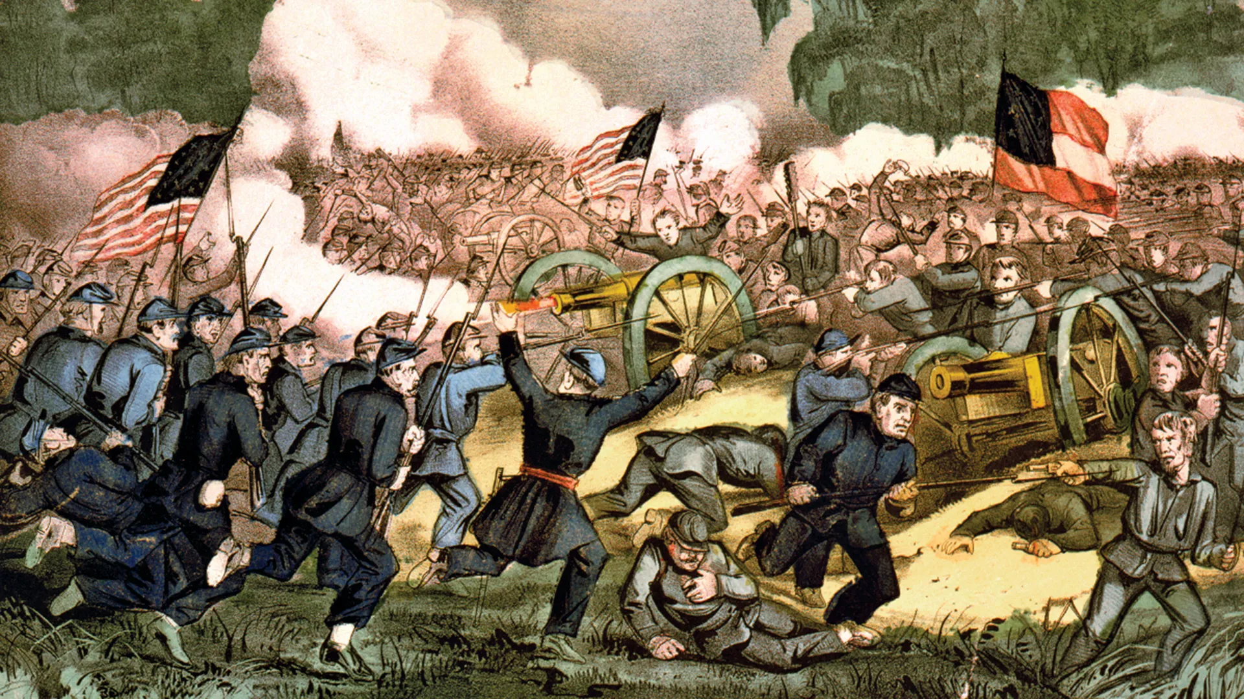
40 And with many other words he testified and exhorted them, saying, "Be saved from this perverse generation." 41 Then those who gladly received his word were baptized; and that day about three thousand souls were added to them.

Slide 39
Oliver Cromwell 1599-1658 Noted Politician from England
‘GODS visible judgments, and terrible remonstrance’s...coming unto our knowledge, should be our observation and admonition, that thereby the inhabitants of the earth may learn Righteousness, for to let them pass by us...unobserved, argues too much regardlessness of GOD in the way of his Judgments...

Slide 40
But to hear and fear and to do wickedly no more, to search our hearts and amend our ways is the best use that can be made of any of GODS remarkable terrors manifested among us.

Slide 41
When GOD is angry with us, it ought to be our wisdom to meet him, and make peace with him...Except we repent, we shall likewise perish...

Slide 42
Therefore this should awe and humble our hearts before the LORD, rising up into more perfection in godliness, doing unto our GOD, more and better service then ever hitherto we have done, reverencing and sanctifying his dreadful Name in our hearts, especially when his Judgments break in upon men,

Slide 43
even in his own house, mingling their blood with their sacrifices, and in that most terrible manner smiting, and wounding, and killing, as in this ensuing Relation may appear...The Lord teach thee to profit thereby, that it may be as a Sermon to thee from Heaven by the Lord himself.’

Slide 44
Nahum 3:1
1 Woe to the bloody city! It is all full of lies and robbery. Its victim never departs.

Slide 45
1. America Has aborted over 70 Million babies since roe verses wade. If you capture or kill a baby eagle you’ll be fined for $25,000 and 2 years of imprisonment.

Slide 46
2. Our politicians believe the more they lie and steal, the better off their chances to be elected. Doge has already discovered 350 Billion dollars that Washington DC politicians have Wasted, Frauded and Abused by laundering our Tax Payers Money!

Slide 47
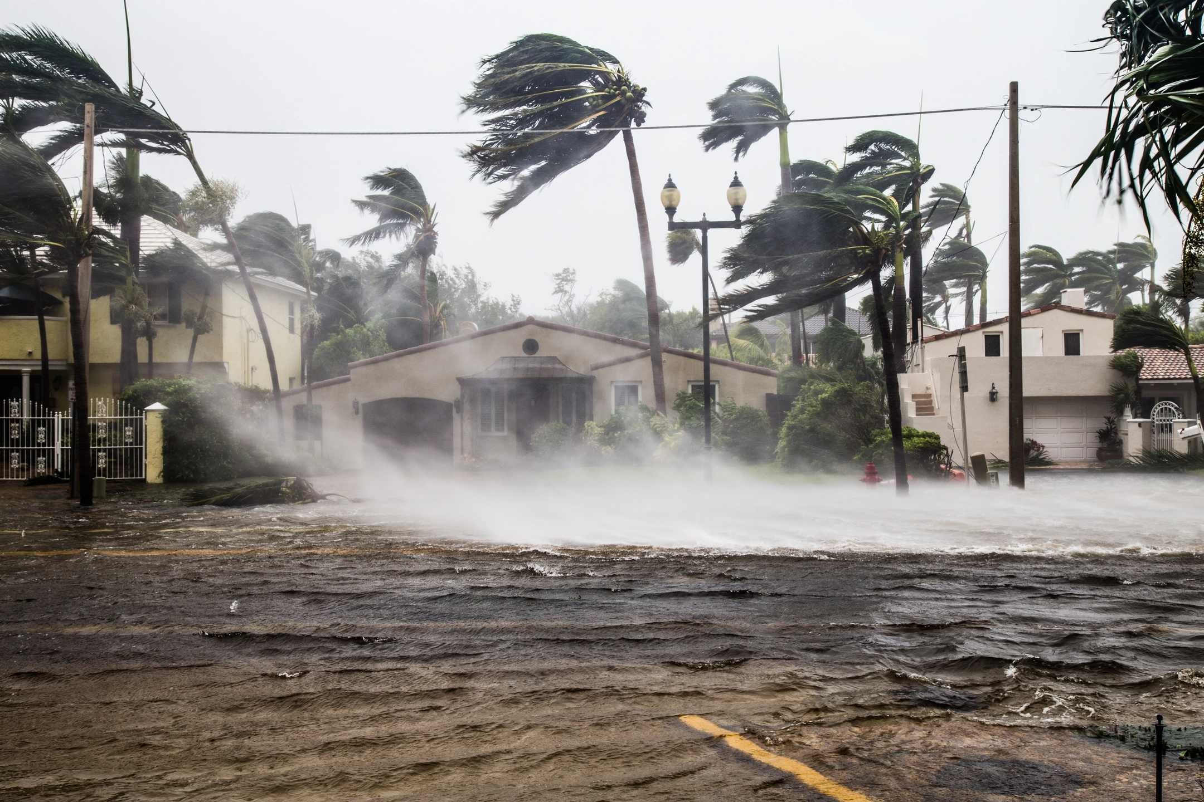
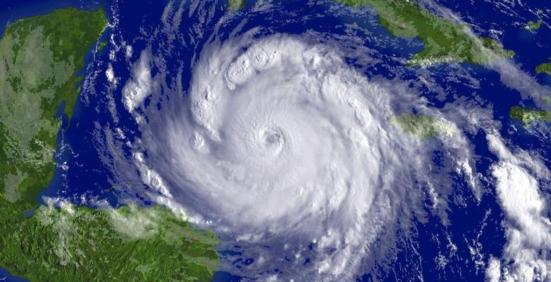
"Handwriting on the Wall"

Slide 48
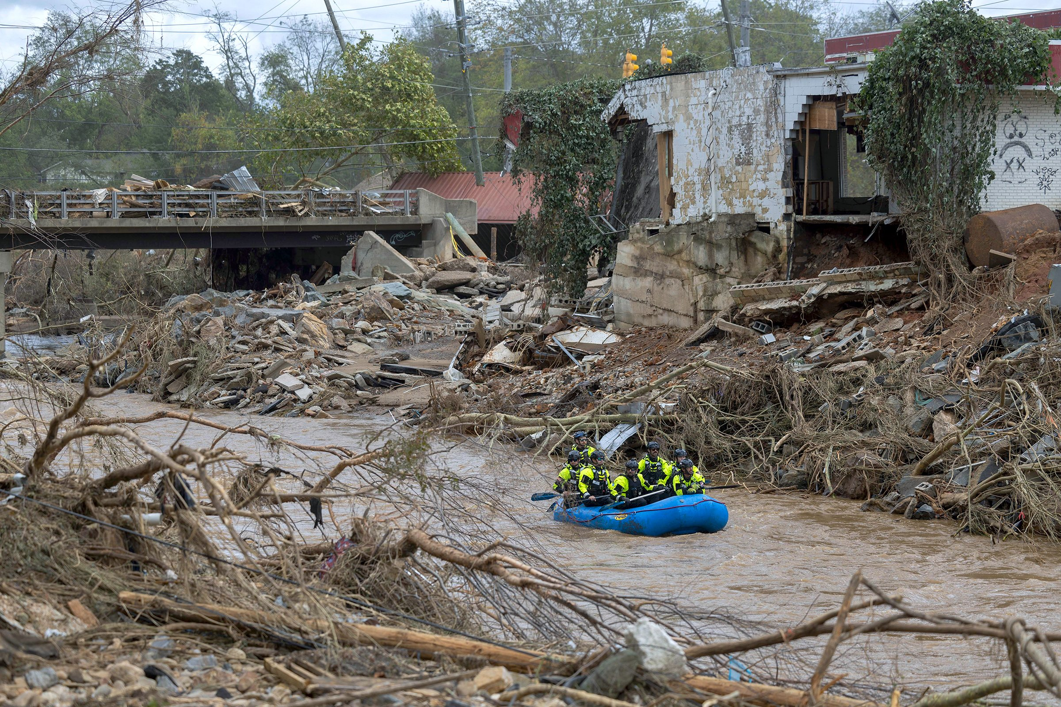
2. Our politicians believe the more they lie and steal, the better off their chances to be elected. Doge has already discovered 350 Billion dollars that Washington DC politicians have Wasted, Frauded and Abused by laundering our Tax Payers Money!

Slide 49
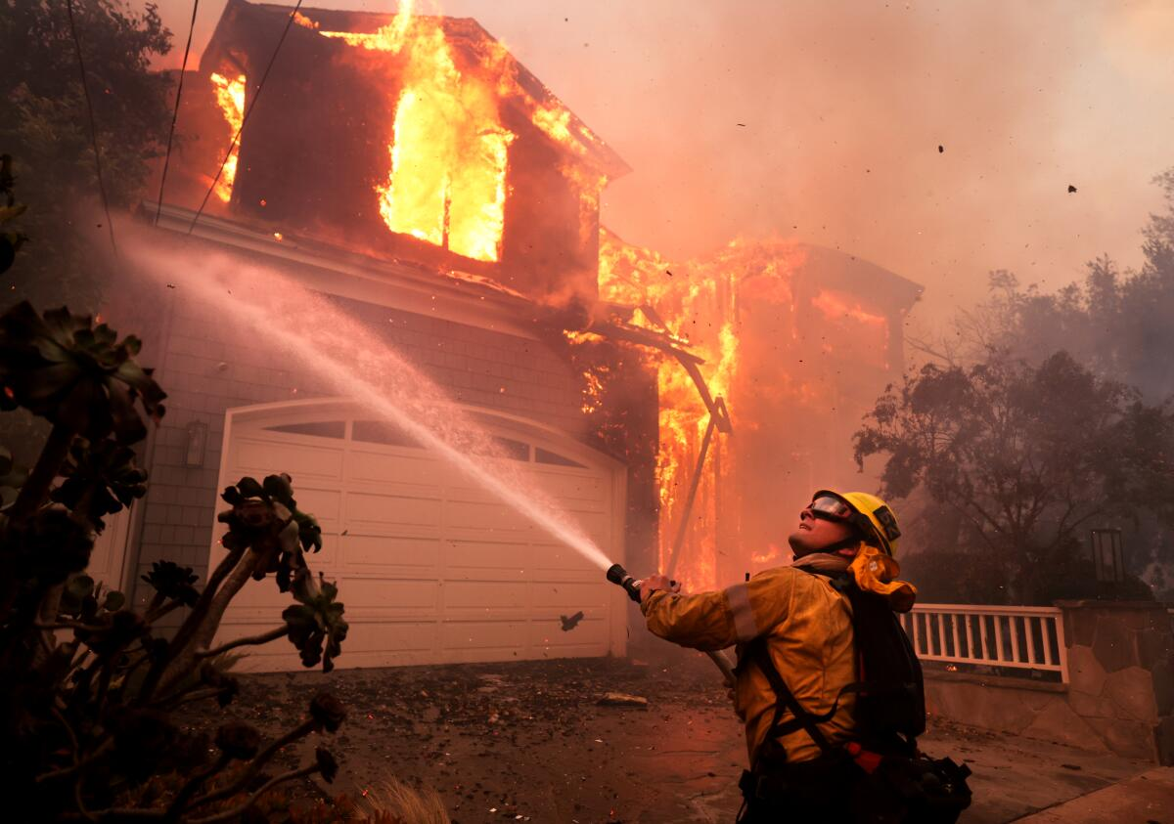
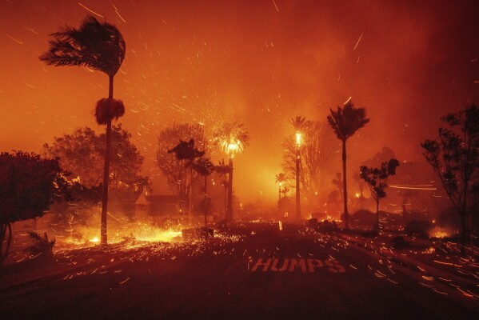
"Handwriting on the Wall"

Slide 50
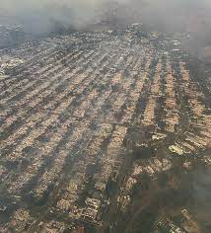
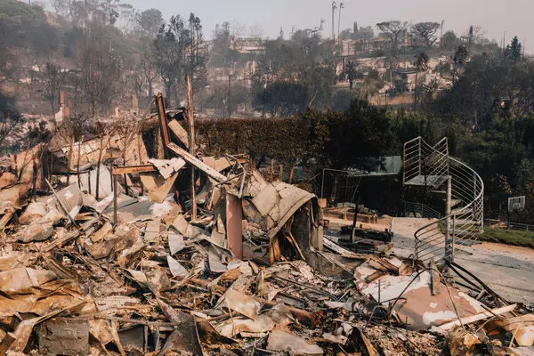
"Handwriting on the Wall"

Slide 51
Nahum 1:1-8
1 The burden against Nineveh. The book of the vision of Nahum the Elkoshite. 2 God is jealous, and the LORD avenges; The LORD avenges and is furious. The LORD will take vengeance on His adversaries, And He reserves wrath for His enemies;

Slide 52
3 The LORD is slow to anger and great in power, And will not at all acquit the wicked. The LORD has His way In the whirlwind and in the storm, And the clouds are the dust of His feet. 4 He rebukes the sea and makes it dry, And dries up all the rivers. Bashan and Carmel wither, And the flower of Lebanon wilts.

Slide 53
5 The mountains quake before Him, The hills melt, And the earth heaves at His presence, Yes, the world and all who dwell in it. 6 Who can stand before His indignation? And who can endure the fierceness of His anger? His fury is poured out like fire, And the rocks are thrown down by Him.

Slide 54
7 The LORD is good, A stronghold in the day of trouble; And He knows those who trust in Him. 8 But with an overflowing flood He will make an utter end of its place, And darkness will pursue His enemies.

Slide 55
Nahum 1:11-14
11 From you comes forth one Who plots evil against the LORD, A wicked counselor. 12 Thus says the LORD: "Though they are safe, and likewise many, Yet in this manner they will be cut down When he passes through. Though I have afflicted you, I will afflict you no more;

Slide 56
13 For now I will break off his yoke from you, And burst your bonds apart." 14 The LORD has given a command concerning you: "Your name shall be perpetuated no longer. Out of the house of your gods I will cut off the carved image and the molded image. I will dig your grave, For you are vile."

Slide 57
2 Chronicles 7:14-16
14 if My people who are called by My name will humble themselves, and pray and seek My face, and turn from their wicked ways, then I will hear from heaven, and will forgive their sin and heal their land. 15 Now My eyes will be open and My ears attentive to prayer made in this place.

Slide 58
1 Thessalonians 4:13-18
13 But I do not want you to be ignorant, brethren, concerning those who have fallen asleep, lest you sorrow as others who have no hope. 14 For if we believe that Jesus died and rose again, even so God will bring with Him those who sleep in Jesus.

Slide 59
15 For this we say to you by the word of the Lord, that we who are alive and remain until the coming of the Lord will by no means precede those who are asleep. 16 For the Lord Himself will descend from heaven with a shout, with the voice of an archangel, and with the trumpet of God. And the dead in Christ will rise first.

Slide 60
17 Then we who are alive and remain shall be caught up together with them in the clouds to meet the Lord in the air. And thus we shall always be with the Lord. 18 Therefore comfort one another with these words.

Slide 61
1 Corinthians 15:50-54
50 Now this I say, brethren, that flesh and blood cannot inherit the kingdom of God; nor does corruption inherit incorruption. 51 Behold, I tell you a mystery: We shall not all sleep, but we shall all be changed-- 52 in a moment, in the twinkling of an eye, at the last trumpet. For the trumpet will sound, and the dead will be raised incorruptible, and we shall be changed.

Slide 62
53 For this corruptible must put on incorruption, and this mortal must put on immortality. 54 So when this corruptible has put on incorruption, and this mortal has put on immortality, then shall be brought to pass the saying that is written: "Death is swallowed up in victory."

Slide 63
20 Again, when a righteous man turns from his righteousness and commits iniquity, and I lay a stumbling block before him, he shall die; because you did not give him warning, he shall die in his sin, and his righteousness which he has done shall not be remembered; but his blood I will require at your hand.

Slide 64
Acts 2:38-39
38 Then Peter said to them, "Repent, and let every one of you be baptized in the name of Jesus Christ for the remission of sins; and you shall receive the gift of the Holy Spirit. 39 For the promise is to you and to your children, and to all who are afar off, as many as the Lord our God will call."

Slide 65
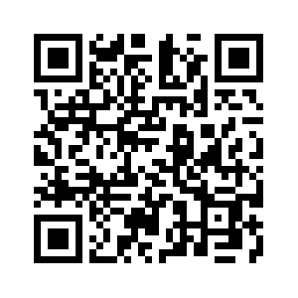
Donate with our QR code app to
Amazing Grace Christian Fellowship
Donations are Deeply Appreciated!

