Slide 1


Slide 2
“Great are you Lord”
(All Sons and Daughters)

Slide 3
You give life, You are love. You bring light in the darkness. You give hope, You restore

Slide 4
Every heart that is broken. And great are you Lord. It’s your breath in our lungs so we

Slide 5
Pour out our praise. We pour out our praise.
It’s your breath in our lungs. So we pour out

Slide 6
Our praise to you only. You give life, you are love. You bring light to the darkness. You

Slide 7
Give hope, You restore. Every heart that is broken. Great are you Lord. It’s your breath

Slide 8
In our lungs. So we pour out our praise we pour out our praise. It’s your breath in our

Slide 9
Lungs so we pour out our praise to you only. It’s your breath in our lungs. So we

Slide 10
Pour out our praise we pour out our praise. It’s your breath in our lungs. So we pour out

Slide 11
Our praise to you only. And all the earth will shout your praise. Our hearts will cry, these

Slide 12
Bones will sing. Great are You, Lord. And all the earth will shout your praise. Our hearts

Slide 13
Will cry these bones will sing. Great are you,Lord. And all the earth will shout your

Slide 14
Praise Our hearts will cry these bones will sing. Great are you, Lord. It’s your breath in

Slide 15
Our Lungs. So we pour out our praise. We pour out our praise. It’s your breath in our

Slide 16
Lungs so we pour out our praise to you only. Great are you, Lord. It’s your breath in

Slide 17
Our lungs so we pour out our praise. Pour out our praise. It’s your breath in our lungs

Slide 18
So we pour out our praise to you only. Great are you , Lord.

Slide 19
We Crown You
(by Jeremy Riddle)

Slide 20
To the One who wore A crown of thorns To the One who took The lash and scourge For the hands and

Slide 21
feet That were pierced by nails For the sacrifice That has torn the veil We crown You We fall face down

Slide 22
and we worship We all cry out, "You are worthy, God“ "You are worthy, God, yes“ We crown You We

Slide 23
fall face down and we worship We all cry out, "You are worthy, God“ "You are worthy, God“ You are

Slide 24
worthy So worthy To the One who gave His very life away Who took upon Himself All our guilt and shame

Slide 25
Hanging on a cross For the world He loved With His precious blood Purchased men for God And we

Slide 26
crown You We fall face down and we worship We all cry out, "You are worthy, God“ "You are worthy, God"

Slide 27
Yes, and we crown You We fall face down and we worship We all cry out, "You are worthy, God“ "You

Slide 28
are worthy, God“ Worthy, worthy, God To the One who endured All the shame of the cross To the Lamb

Slide 29
who was slain As atonement for us To the Son who overcame All the power of death We praise! For the

Slide 30
stripes, for the wounds For the beating You bore For the tears, for the blood That was willingly poured For

Slide 31
the merciful, for wonderful, for majesty of Your love To the One who endured All the shame of the cross

Slide 32
To the Lamb who was slain As atonement for us To the Son who overcame All the power of death We

Slide 33
praise! For the stripes, for the wounds For the beating You bore For the tears and the blood That

Slide 34
was willingly poured For the merciful, for wonderful, for majesty of Your love! We crown You We fall face

Slide 35
down and we worship We all cry out, "You are worthy, God", You are "You are worthy, God“ We

Slide 36
crown You We fall face down and we worship We all cry out, "You are worthy, God“ "You are worthy, Lord"

Slide 37
To the One who endured All the shame of the cross To the Lamb who was slain As atonement for us To

Slide 38
the Son who overcame All the power of death We praise! For the stripes, for the wounds For the

Slide 39
beating You bore For the tears, for the blood That was willingly poured For the merciful, for wonderful,

Slide 40
for majesty of Your love! We crown You We fall face down and we worship We all cry out, "You are

Slide 41
worthy, God“ "You are worthy, God“ We crown You We fall face down and we worship We all cry out, "

Slide 42
You are worthy, God“ "You are worthy, God", yeah, we crown We crown You We fall face down and we

Slide 43
worship We all cry out, "You are worthy, God“ "You are worthy, God“

Slide 44
Only You
(David Crowder)

Slide 45
Take my heart, I lay it down At the feet, of You who's crowned Take my life, letting go I lift it up, to You

Slide 46
who's throned And I will worship You, Lord Only You, Lord And I will bow down before You Only You, Lord

Slide 47
Take my fret, take my fear All I have, I'm leaving here
Be all my hopes, be all my dreams You're my

Slide 48
delights, be my everything And I will worship You, Lord Only You, Lord And I will bow down before You

Slide 49
Only You, Lord And I will worship You, Lord Only You, Lord And I will, I will bow down before You

Slide 50
Only You, Lord And it's just You and me here now
Only You and me here now And it's just You and me

Slide 51
here now Only You and me here now And it's just You and me here now Only You and me here now

Slide 52
And I will worship You, Lord (and it's just You and me here now) Only You, Lord (only You and me here

Slide 53
now) And I will, I will bow down (and it's just You and me here now) Only You, Lord (only You and me here

Slide 54
now) And it's just You and me here now (You should see this view) Only You and me here now (when it's

Slide 55
only You) And it's just You and me here now.

Slide 56
“Jesus We Love You”
(Bethal Music)

Slide 57
Old things have passed away Your love has stayed the same Your constant grace remains the

Slide 58
cornerstone Things that we thought were dead Are breathing in life again You cause your Son to shine

Slide 59
on darkest nights For all that you've done, we will pour out our love This will be our anthem song Jesus

Slide 60
we love you Oh how we love you You are the one our, our hearts adore The hopeless have found their

Slide 61
hope The orphans now have a home All that was lost has found its place in you You lift our weary

Slide 62
head You make us strong instead You took these rags and made us beautiful For all that you've done,

Slide 63
we will pour out our love This will be our anthem song Jesus we love you Oh how we love you You

Slide 64
are the on our, our hearts adore Oh, Jesus we love you Oh how we love you You are the one our, our

Slide 65
hearts adore Our hearts adore (we adore you) Our hearts adore Our hearts adore Our affection, our

Slide 66
devotion Poured out on the feet of Jesus Our affection, our devotion Poured out on the feet of

Slide 67
Jesus Our affection, our devotion Poured out on the feet of Jesus Our affection, our devotion Poured out

Slide 68
on the feet of Jesus We love you Oh how we love you You are the one our, our hearts adore Jesus we

Slide 69
love you Oh how we love you You are the one our, our hearts adore Oh, Jesus we love you Oh how we

Slide 70
love you You are the one our, our hearts adore Just sing out a new song today Oh, oh how we love you

Slide 71
Oh, you are worthy Jesus, of our love, our adoration, we love you God Oh lift your voice, oh Oh we love

Slide 72
you, oh we love you, oh Oh how we love you (sing Jesus) Oh, Jesus we love you Oh how we love you

Slide 73
(you are) You are the one our, our hearts adore

Slide 74
“Show Me Your Glory”
(Jesus Culture)

Slide 75
I see the cloud, I step in I want to see Your glory like Moses did Flashes of light and rolls of thunder But

Slide 76
I'm not afraid I'm not afraid Show me Your glory Show me Your glory, yes Show me Your glory Show

Slide 77
me Your glory I'm marked by Your beauty, lost in Your eyes I long to walk in Your presence like Jesus

Slide 78
did Your glory surrounds me and I'm overwhelmed But I'm not afraid I'm not afraid Show me Your glory

Slide 79
Show me Your glory, my God Show me Your glory Show me Your glory, yeah I long to look on the face

Slide 80
of the One that I love Long to stay in Your presence, it's where I belong Long to look on the face of the

Slide 81
One that I love Long to stay in Your presence, it's where I belong It's where I belong It's where I belong

Slide 82
I belong in Your presence I belong in Your presence
Jesus, yeah Oh Yeah Yeah This is where I belong

Slide 83
'Cause I was made for love And I was born for love Jesus And I see the cloud I step in I see the cloud

Slide 84
And I run in I see the cloud And I jump in But I'm not afraid I'm not afraid I'm not afraid Show me

Slide 85
Your glory Show me Your glory (I long to sing) Show me Your glory Show me Your glory, yeah I long to

Slide 86
look on the face of the One that I love Long to stay in Your presence, it's where I belong Long to look on

Slide 87
the face of the One that I love Long to stay in Your presence, it's where I belong I belong to You I belong

Slide 88
to You I belong to You I belong to You I belong to You I belong to You Yeah Oh yeah Show me Your glory

Slide 89
God (yeah) Show me Your glory Show me Your glory (Jesus) Show me Your glory (I long to sing) Show

Slide 90
me Your glory, God (Show me Your glory) (Show me Your glory) (Show me Your glory)

Slide 92


Slide 93
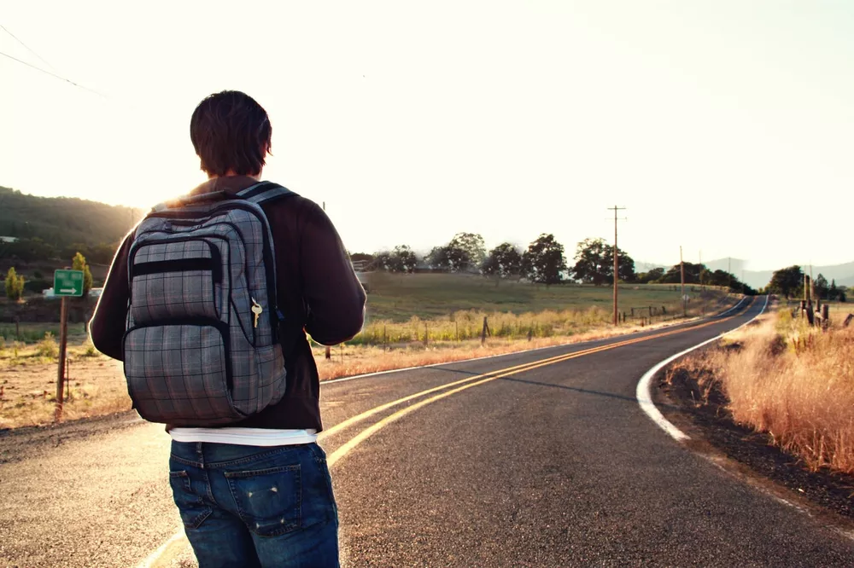

Seven Journey's with God
by Pastor Fee Soliven
1 Corinthians 10:1-13
Sunday Morning
March 16, 2025

Slide 94
1 Corinthians 10:1-13
1 Moreover, brethren, I do not want you to be unaware that all our fathers were under the cloud, all passed through the sea, 2 all were baptized into Moses in the cloud and in the sea, 3 all ate the same spiritual food,

Slide 95
4 and all drank the same spiritual drink. For they drank of that spiritual Rock that followed them, and that Rock was Christ. 5 But with most of them God was not well pleased, for their bodies were scattered in the wilderness. 6 Now these things became our examples, to the intent that we should not lust after evil things as they also lusted.

Slide 96
7 And do not become idolaters as were some of them. As it is written, "The people sat down to eat and drink, and rose up to play." 8 Nor let us commit sexual immorality, as some of them did, and in one day twenty-three thousand fell; 9 nor let us tempt Christ, as some of them also tempted, and were destroyed by serpents; 10 nor complain, as some of them also complained, and were destroyed by the destroyer.

Slide 97
11 Now all these things happened to them as examples, and they were written for our admonition, on whom the ends of the ages have come. 12 Therefore let him who thinks he stands take heed lest he fall.

Slide 98
13 No temptation has overtaken you except such as is common to man; but God is faithful, who will not allow you to be tempted beyond what you are able, but with the temptation will also make the way of escape, that you may be able to bear it.

Slide 99
Ecclesiastics 1:9-10
(New King James Version)
9 That which has been is what will be, That which is done is what will be done, And there is nothing new under the sun. 10 Is there anything of which it may be said, "See, this is new"?

Slide 100
Ecclesiastics 1:9-10
(New Living Translation)
9 History merely repeats itself. It has all been done before. Nothing under the sun is truly new. 10 Sometimes people say, “Here is something new!” But actually it is old; nothing is ever truly new.

Slide 101
1. The Jordon River Experience
Water Baptized and then Baptized in the Holy Ghost

Slide 102
2. Your Wilderness Journey in Judea
Season of Testing and Temptation

Slide 103
3. The Hometown Journey of Nazareth
Rejection of Friends and Family

Slide 104
4. The Town of Capernaum Journey
Spiritual Authority

Slide 105
5. The City of Jerusalem Journey
Religious Tradition

Slide 106
6. The Garden of Gethsemane Journey
Transition

Slide 107
7. Your Pentecost Journey
United through the Spirit of God

Slide 108
1. The Jordon River Experience
Water Baptized and then Baptized in the Holy Ghost

Slide 109
Matthew 3:1-3
1 In those days John the Baptist came preaching in the wilderness of Judea, 2 and saying, "Repent, for the kingdom of heaven is at hand!" 3 For this is he who was spoken of by the prophet Isaiah, saying: "The voice of one crying in the wilderness: 'Prepare the way of the LORD; Make His paths straight.' "

Slide 110
Luke 3:21-24
21 When all the people were baptized, it came to pass that Jesus also was baptized; and while He prayed, the heaven was opened. 22 And the Holy Spirit descended in bodily form like a dove upon Him, and a voice came from heaven which said, "You are My beloved Son; in You I am well pleased." 23 Now Jesus Himself began His ministry at about thirty years of age, being (as was supposed) the son of Joseph, the son of Heli,

Slide 111
Acts 10:44-48
44 While Peter was still speaking these words, the Holy Spirit fell upon all those who heard the word. 45 And those of the circumcision who believed were astonished, as many as came with Peter, because the gift of the Holy Spirit had been poured out on the Gentiles also.

Slide 112
46 For they heard them speak with tongues and magnify God. Then Peter answered, 47 Can anyone forbid water, that these should not be baptized who have received the Holy Spirit just as we have?" 48 And he commanded them to be baptized in the name of the Lord. Then they asked him to stay a few days.

Slide 113
2. Your Wilderness Journey in Judea
Season of Testing and Temptation

Slide 114
Luke 4:1-4
1 Then Jesus, being filled with the Holy Spirit, returned from the Jordan and was led by the Spirit into the wilderness, 2 being tempted for forty days by the devil. And in those days He ate nothing, and afterward, when they had ended, He was hungry. 3 And the devil said to Him, "If You are the Son of God, command this stone to become bread."

Slide 115
4 But Jesus answered him, saying, "It is written, 'Man shall not live by bread alone, but by every word of God.'

Slide 116
3. The Hometown Journey of Nazareth
Rejection of Friends and Family

Slide 117
Luke 4:14-25
14 Then Jesus returned in the power of the Spirit to Galilee, and news of Him went out through all the surrounding region. 15 And He taught in their synagogues, being glorified by all. 16 So He came to Nazareth, where He had been brought up. And as His custom was, He went into the synagogue on the Sabbath day, and stood up to read.

Slide 118
17 And He was handed the book of the prophet Isaiah. And when He had opened the book, He found the place where it was written: 18 "The Spirit of the LORD is upon Me, Because He has anointed Me To preach the gospel to the poor; He has sent Me to heal the brokenhearted, To proclaim liberty to the captives And recovery of sight to the blind, To set at liberty those who are oppressed;

Slide 119
19 To proclaim the acceptable year of the LORD." 20 Then He closed the book, and gave it back to the attendant and sat down. And the eyes of all who were in the synagogue were fixed on Him. 21 And He began to say to them, "Today this Scripture is fulfilled in your hearing."

Slide 120
22 So all bore witness to Him, and marveled at the gracious words which proceeded out of His mouth. And they said, "Is this not Joseph's son?" 23 He said to them, "You will surely say this proverb to Me, 'Physician, heal yourself! Whatever we have heard done in Capernaum, do also here in Your country.' " 24 Then He said, "Assuredly, I say to you, no prophet is accepted in his own country.

Slide 121
Matthew 10:34-39
34 "Do not think that I came to bring peace on earth. I did not come to bring peace but a sword. 35 For I have come to 'set a man against his father, a daughter against her mother, and a daughter-in-law against her mother-in-law'; 36 and 'a man's enemies will be those of his own household.'

Slide 122
37 He who loves father or mother more than Me is not worthy of Me. And he who loves son or daughter more than Me is not worthy of Me. 38 And he who does not take his cross and follow after Me is not worthy of Me. 39 He who finds his life will lose it, and he who loses his life for My sake will find it.

Slide 123
Luke 4:28-30
28 So all those in the synagogue, when they heard these things, were filled with wrath, 29 and rose up and thrust Him out of the city; and they led Him to the brow of the hill on which their city was built, that they might throw Him down over the cliff. 30 Then passing through the midst of them, He went His way.

Slide 124
4. The town of Capernaum Journey
Spiritual Authority

Slide 125
Mark 1:21-28
21 Then they went into Capernaum, and immediately on the Sabbath He entered the synagogue and taught. 22 And they were astonished at His teaching, for He taught them as one having authority, and not as the scribes. 23 Now there was a man in their synagogue with an unclean spirit. And he cried out,

Slide 126
24 saying, "Let us alone! What have we to do with You, Jesus of Nazareth? Did You come to destroy us? I know who You are--the Holy One of God!" 25 But Jesus rebuked him, saying, "Be quiet, and come out of him!" 26 And when the unclean spirit had convulsed him and cried out with a loud voice, he came out of him.

Slide 127
27 Then they were all amazed, so that they questioned among themselves, saying, "What is this? What new doctrine is this? For with authority He commands even the unclean spirits, and they obey Him." 28 And immediately His fame spread throughout all the region around Galilee.

Slide 128
5. The City of Jerusalem Journey
Religious Tradition

Slide 129
Mark 11:15-19
15 So they came to Jerusalem. And Jesus went into the temple and began to drive out those who bought and sold in the temple, and overturned the tables of the money changers and the seats of those who sold doves. 16 And He would not allow anyone to carry wares through the temple.

Slide 130
17 Then He taught, saying to them, "Is it not written, 'My house shall be called a house of prayer for all nations'? But you have made it a 'den of thieves.' " 18 And the scribes and chief priests heard it and sought how they might destroy Him; for they feared Him, because all the people were astonished at His teaching. 19 When evening had come, He went out of the city.

Slide 131
6. The Garden of Gethsemane Journey
Transition

Slide 132
Mark 14:32-37
32 Then they came to a place which was named Gethsemane; and He said to His disciples, "Sit here while I pray." 33 And He took Peter, James, and John with Him, and He began to be troubled and deeply distressed. 34 Then He said to them, "My soul is exceedingly sorrowful, even to death. Stay here and watch."

Slide 133
35 He went a little farther, and fell on the ground, and prayed that if it were possible, the hour might pass from Him. 36 And He said, "Abba, Father, all things are possible for You. Take this cup away from Me; nevertheless, not what I will, but what You will."

Slide 134
7. Your Pentecost Journey
United through the Spirit of God

Slide 135
Acts 2:1-4
1 Now when the Day of Pentecost had fully come, they were all with one accord in one place. 2 And suddenly there came a sound from heaven, as of a rushing mighty wind, and it filled the whole house where they were sitting.

Slide 136
3 Then there appeared to them divided tongues, as of fire, and one sat upon each of them. 4 And they were all filled with the Holy Spirit and began to speak with other tongues, as the Spirit gave them utterance.

Slide 137
Ephesians 4:4-6
4 There is one body and one Spirit, just as you were called in one hope of your calling; 5 one Lord, one faith, one baptism; 6 one God and Father of all, who is above all, and through all, and in you all.

Slide 138
1 Thessalonians 4:13-18
13 But I do not want you to be ignorant, brethren, concerning those who have fallen asleep, lest you sorrow as others who have no hope. 14 For if we believe that Jesus died and rose again, even so God will bring with Him those who sleep in Jesus.

Slide 139
15 For this we say to you by the word of the Lord, that we who are alive and remain until the coming of the Lord will by no means precede those who are asleep. 16 For the Lord Himself will descend from heaven with a shout, with the voice of an archangel, and with the trumpet of God. And the dead in Christ will rise first.

Slide 140
17 Then we who are alive and remain shall be caught up together with them in the clouds to meet the Lord in the air. And thus we shall always be with the Lord. 18 Therefore comfort one another with these words.

Slide 141
1 Corinthians 15:50-54
50 Now this I say, brethren, that flesh and blood cannot inherit the kingdom of God; nor does corruption inherit incorruption. 51 Behold, I tell you a mystery: We shall not all sleep, but we shall all be changed-- 52 in a moment, in the twinkling of an eye, at the last trumpet. For the trumpet will sound, and the dead will be raised incorruptible, and we shall be changed.

Slide 142
53 For this corruptible must put on incorruption, and this mortal must put on immortality. 54 So when this corruptible has put on incorruption, and this mortal has put on immortality, then shall be brought to pass the saying that is written: "Death is swallowed up in victory."

Slide 143

20 Again, when a righteous man turns from his righteousness and commits iniquity, and I lay a stumbling block before him, he shall die; because you did not give him warning, he shall die in his sin, and his righteousness which he has done shall not be remembered; but his blood I will require at your hand.

Slide 144
Acts 2:38-39
38 Then Peter said to them, "Repent, and let every one of you be baptized in the name of Jesus Christ for the remission of sins; and you shall receive the gift of the Holy Spirit. 39 For the promise is to you and to your children, and to all who are afar off, as many as the Lord our God will call."

Slide 145
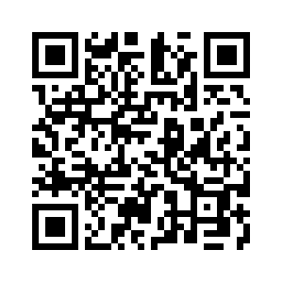
Donate with our QR code app to
Amazing Grace Christian Fellowship
Donations are Deeply Appreciated!

