Slide 1


Slide 2


Slide 3
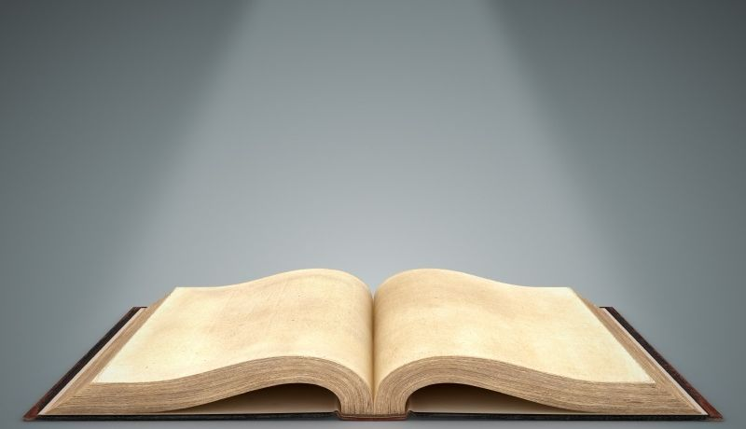

The Book of Life
by Pastor Fee Soliven
Philippians 4:1-7
Sunday Morning
April 6, 2025

Slide 4
Philippians 4:1-7
1 Therefore, my beloved and longed-for brethren, my joy and crown, so stand fast in the Lord, beloved. 2 I implore Euodia and I implore Syntyche to be of the same mind in the Lord. 3 And I urge you also, true companion, help these women who labored with me in the gospel, with Clement also, and the rest of my fellow workers, whose names are in the Book of Life.

Slide 5
4 Rejoice in the Lord always. Again I will say, rejoice! 5 Let your gentleness be known to all men. The Lord is at hand. 6 Be anxious for nothing, but in everything by prayer and supplication, with thanksgiving, let your requests be made known to God; 7 and the peace of God, which surpasses all understanding, will guard your hearts and minds through Christ Jesus

Slide 6
You Must Be Born Again

Slide 7
John 3:1-7
1 There was a man of the Pharisees named Nicodemus, a ruler of the Jews. 2 This man came to Jesus by night and said to Him, "Rabbi, we know that You are a teacher come from God; for no one can do these signs that You do unless God is with him."

Slide 8
3 Jesus answered and said to him, "Most assuredly, I say to you, unless one is born again, he cannot see the kingdom of God." 4 Nicodemus said to Him, "How can a man be born when he is old? Can he enter a second time into his mother's womb and be born?"

Slide 9
5 Jesus answered, "Most assuredly, I say to you, unless one is born of water and the Spirit, he cannot enter the kingdom of God. 6 That which is born of the flesh is flesh, and that which is born of the Spirit is spirit. 7 Do not marvel that I said to you, 'You must be born again.'
we do?"
38 Then Peter said to them, "Repent, and let every one of you be baptized in the name of Jesus Christ for the remission of sins; and you shall receive the gift of the Holy Spirit. 39 For the promise is to you and to your children, and to all who are afar off, as many as the Lord our God will call."
Washed in The Blood of the Lamb
Romans 5:8-11
8 But God demonstrates His own love toward us, in that while we were still sinners, Christ died for us. 9 Much more then, having now been justified by His blood, we shall be saved from wrath through Him. 10 For if when we were enemies we were reconciled to God through the death of His Son, much more, having been reconciled, we shall be saved by His life.

Slide 10
Repentance Leads to Confession

Slide 11
Acts 2:36-39
36 "Therefore let all the house of Israel know assuredly that God has made this Jesus, whom you crucified, both Lord and Christ." 37 Now when they heard this, they were cut to the heart, and said to Peter and the rest of the apostles, "Men and brethren, what shall we do?"

Slide 12
38 Then Peter said to them, "Repent, and let every one of you be baptized in the name of Jesus Christ for the remission of sins; and you shall receive the gift of the Holy Spirit. 39 For the promise is to you and to your children, and to all who are afar off, as many as the Lord our God will call."

Slide 13
Washed in The Blood of the Lamb

Slide 14
Romans 5:8-11
8 But God demonstrates His own love toward us, in that while we were still sinners, Christ died for us. 9 Much more then, having now been justified by His blood, we shall be saved from wrath through Him. 10 For if when we were enemies we were reconciled to God through the death of His Son, much more, having been reconciled, we shall be saved by His life.

Slide 15
Revelation 7:13-14
13 Then one of the elders answered, saying to me, "Who are these arrayed in white robes, and where did they come from?" 14 And I said to him, "Sir, you know." So he said to me, "These are the ones who come out of the great tribulation, and washed their robes and made them white in the blood of the Lamb.

Slide 16
The Father Gives All His Elect to Jesus

Slide 17
John 6:35-40
35 And Jesus said to them, "I am the bread of life. He who comes to Me shall never hunger, and he who believes in Me shall never thirst. 36 But I said to you that you have seen Me and yet do not believe.

Slide 18
37 All that the Father gives Me will come to Me, and the one who comes to Me I will by no means cast out. 38 For I have come down from heaven, not to do My own will, but the will of Him who sent Me.

Slide 19
39 This is the will of the Father who sent Me, that of all He has given Me I should lose nothing, but should raise it up at the last day. 40 And this is the will of Him who sent Me, that everyone who sees the Son and believes in Him may have everlasting life; and I will raise him up at the last day."

Slide 20
1 Corinthians 1:26-29
26 For you see your calling, brethren, that not many wise according to the flesh, not many mighty, not many noble, are called. 27 But God has chosen the foolish things of the world to put to shame the wise, and God has chosen the weak things of the world to put to shame the things which are mighty;

Slide 21
28 and the base things of the world and the things which are despised God has chosen, and the things which are not, to bring to nothing the things that are, 29 that no flesh should glory in His presence.

Slide 22
Translated from Darkness into His Marvelous Light

Slide 23
Matthew 5:14-15
14 You are the light of the world. A city that is set on a hill cannot be hidden. 15 Nor do they light a lamp and put it under a basket, but on a lampstand, and it gives light to all who are in the house.

Slide 24
1 Peter 2:9-12
9 But you are a chosen generation, a royal priesthood, a holy nation, His own special people, that you may proclaim the praises of Him who called you out of darkness into His marvelous light; 10 who once were not a people but are now the people of God, who had not obtained mercy but now have obtained mercy.

Slide 25
11 Beloved, I beg you as sojourners and pilgrims, abstain from fleshly lusts which war against the soul, 12 having your conduct honorable among the Gentiles, that when they speak against you as evildoers, they may, by your good works which they observe, glorify God in the day of visitation.

Slide 26
Malachai 3:17
"They shall be Mine," says the LORD of hosts, "On the day that I make them My jewels. And I will spare them As a man spares his own son who serves him."

Slide 27
Exodus 19:5
“Now therefore, if you will indeed obey My voice and keep My covenant, then you shall be a special treasure to Me above all people; for all the earth is Mine”

Slide 28
All God’s Chosen People Allow God to Sanctify Them for His Glory

Slide 29
1 Corinthians 6:9-11
9 Do you not know that the unrighteous will not inherit the kingdom of God? Do not be deceived. Neither fornicators, nor idolaters, nor adulterers, nor homosexuals, nor sodomites, 10 nor thieves, nor covetous, nor drunkards, nor revilers, nor extortioners will inherit the kingdom of God.

Slide 30
11 And such were some of you. But you were washed, but you were sanctified, but you were justified in the name of the Lord Jesus and by the Spirit of our God.

Slide 31
Hebrews 13:12
“Therefore Jesus also, that He might sanctify the people with His own blood, suffered outside the gate”

Slide 32
God’s Chosen People are Bold and not Ashamed of Him!

Slide 33
Acts 4:29-31
29 Now, Lord, look on their threats, and grant to Your servants that with all boldness they may speak Your word, 30 by stretching out Your hand to heal, and that signs and wonders may be done through the name of Your holy Servant Jesus."

Slide 34
31 And when they had prayed, the place where they were assembled together was shaken; and they were all filled with the Holy Spirit, and they spoke the word of God with boldness.

Slide 35
Romans 1:16-17
16 For I am not ashamed of the gospel of Christ, for it is the power of God to salvation for everyone who believes, for the Jew first and also for the Greek. 17 For in it the righteousness of God is revealed from faith to faith; as it is written, "The just shall live by faith."

Slide 36
Ephesians 6:18-20
18 praying always with all prayer and supplication in the Spirit, being watchful to this end with all perseverance and supplication for all the saints-- 19 and for me, that utterance may be given to me, that I may open my mouth boldly to make known the mystery of the gospel, 20 for which I am an ambassador in chains; that in it I may speak boldly, as I ought to speak.

Slide 37
Written in The Lambs Book of Life

Slide 38
Philippians 4:1-3
1 Therefore, my beloved and longed-for brethren, my joy and crown, so stand fast in the Lord, beloved. 2 I implore Euodia and I implore Syntyche to be of the same mind in the Lord. 3 And I urge you also, true companion, help these women who labored with me in the gospel, with Clement also, and the rest of my fellow workers, whose names are in the Book of Life.

Slide 39
Revelation 21:22-27
22 But I saw no temple in it, for the Lord God Almighty and the Lamb are its temple. 23 The city had no need of the sun or of the moon to shine in it, for the glory of God illuminated it. The Lamb is its light. 24 And the nations of those who are saved shall walk in its light, and the kings of the earth bring their glory and honor into it.

Slide 40
25 Its gates shall not be shut at all by day (there shall be no night there). 26 And they shall bring the glory and the honor of the nations into it. 27 But there shall by no means enter it anything that defiles, or causes an abomination or a lie, but only those who are written in the Lamb's Book of Life.

Slide 41
1 John 2:19-20
19 They went out from us, but they were not of us; for if they had been of us, they would have continued with us; but they went out that they might be made manifest, that none of them were of us. 20 But you have an anointing from the Holy One, and you know all things.

Slide 42
Revelation 22:12-20
12 "And behold, I am coming quickly, and My reward is with Me, to give to every one according to his work. 13 I am the Alpha and the Omega, the Beginning and the End, the First and the Last." 14 Blessed are those who do His commandments, that they may have the right to the tree of life, and may enter through the gates into the city.

Slide 43
15 But outside are dogs and sorcerers and sexually immoral and murderers and idolaters, and whoever loves and practices a lie. 16 I, Jesus, have sent My angel to testify to you these things in the churches. I am the Root and the Offspring of David, the Bright and Morning Star."

Slide 44
17 And the Spirit and the bride say, "Come!" And let him who hears say, "Come!" And let him who thirsts come. Whoever desires, let him take the water of life freely. 18 For I testify to everyone who hears the words of the prophecy of this book: If anyone adds to these things, God will add to him the plagues that are written in this book;

Slide 45
19 and if anyone takes away from the words of the book of this prophecy, God shall take away his part from the Book of Life, from the holy city, and from the things which are written in this book. 20 He who testifies to these things says, "Surely I am coming quickly." Amen. Even so, come, Lord Jesus!

Slide 46
1 Thessalonians 4:13-18
13 But I do not want you to be ignorant, brethren, concerning those who have fallen asleep, lest you sorrow as others who have no hope. 14 For if we believe that Jesus died and rose again, even so God will bring with Him those who sleep in Jesus.

Slide 47
15 For this we say to you by the word of the Lord, that we who are alive and remain until the coming of the Lord will by no means precede those who are asleep. 16 For the Lord Himself will descend from heaven with a shout, with the voice of an archangel, and with the trumpet of God. And the dead in Christ will rise first.

Slide 48
17 Then we who are alive and remain shall be caught up together with them in the clouds to meet the Lord in the air. And thus we shall always be with the Lord. 18 Therefore comfort one another with these words.

Slide 49
1 Corinthians 15:50-54
50 Now this I say, brethren, that flesh and blood cannot inherit the kingdom of God; nor does corruption inherit incorruption. 51 Behold, I tell you a mystery: We shall not all sleep, but we shall all be changed-- 52 in a moment, in the twinkling of an eye, at the last trumpet. For the trumpet will sound, and the dead will be raised incorruptible, and we shall be changed.

Slide 50
53 For this corruptible must put on incorruption, and this mortal must put on immortality. 54 So when this corruptible has put on incorruption, and this mortal has put on immortality, then shall be brought to pass the saying that is written: "Death is swallowed up in victory."

Slide 51

20 Again, when a righteous man turns from his righteousness and commits iniquity, and I lay a stumbling block before him, he shall die; because you did not give him warning, he shall die in his sin, and his righteousness which he has done shall not be remembered; but his blood I will require at your hand.

Slide 52
Acts 2:38-39
38 Then Peter said to them, "Repent, and let every one of you be baptized in the name of Jesus Christ for the remission of sins; and you shall receive the gift of the Holy Spirit. 39 For the promise is to you and to your children, and to all who are afar off, as many as the Lord our God will call."

Slide 53
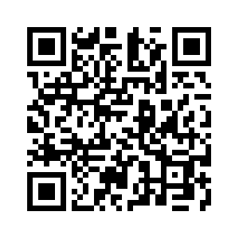
Donate with our QR code app to
Amazing Grace Christian Fellowship
Donations are Deeply Appreciated!

