Slide 1


Slide 2


Slide 3
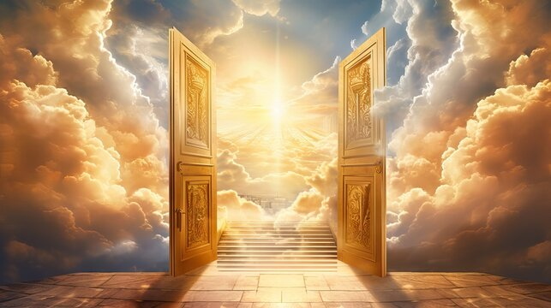

There is Only One Door
by Pastor Fee Soliven
John 10:1-16
Sunday Morning
March 30, 2025

Slide 4
John 10:1-16
1 "Most assuredly, I say to you, he who does not enter the sheepfold by the door, but climbs up some other way, the same is a thief and a robber. 2 But he who enters by the door is the shepherd of the sheep. 3 To him the doorkeeper opens, and the sheep hear his voice; and he calls his own sheep by name and leads them out.

Slide 5
4 And when he brings out his own sheep, he goes before them; and the sheep follow him, for they know his voice. 5 Yet they will by no means follow a stranger, but will flee from him, for they do not know the voice of strangers." 6 Jesus used this illustration, but they did not understand the things which He spoke to them.

Slide 6
7 Then Jesus said to them again, "Most assuredly, I say to you, I am the door of the sheep. 8 All who ever came before Me are thieves and robbers, but the sheep did not hear them. 9 I am the door. If anyone enters by Me, he will be saved, and will go in and out and find pasture.

Slide 7
10 The thief does not come except to steal, and to kill, and to destroy. I have come that they may have life, and that they may have it more abundantly. 11 I am the good shepherd. The good shepherd gives His life for the sheep.

Slide 8
12 But a hireling, he who is not the shepherd, one who does not own the sheep, sees the wolf coming and leaves the sheep and flees; and the wolf catches the sheep and scatters them. 13 The hireling flees because he is a hireling and does not care about the sheep. 14 I am the good shepherd; and I know My sheep, and am known by My own.

Slide 9
15 As the Father knows Me, even so I know the Father; and I lay down My life for the sheep. 16 And other sheep I have which are not of this fold; them also I must bring, and they will hear My voice; and there will be one flock and one shepherd.

Slide 10
I Am the Door

Slide 11
John 10:7-9
7 Then Jesus said to them again, "Most assuredly, I say to you, I am the door of the sheep. 8 All who ever came before Me are thieves and robbers, but the sheep did not hear them. 9 I am the door. If anyone enters by Me, he will be saved, and will go in and out and find pasture.

Slide 12
Truth About God
Jesus is the Good Shepherd who will always lead us through the right doors!

Slide 13
Truth For My Life
I will recognize Jesus’ voice and follow wherever He leads me!

Slide 14
The Sheepgate

Slide 15
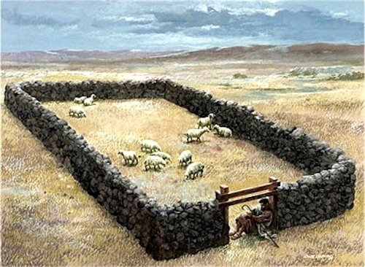
5 Your lamb shall be without blemish, a male of the first year. You may take it from the sheep or from the goats. 6 Now you shall keep it until the fourteenth day of the same month. Then the whole assembly of the congregation of Israel shall kill it at twilight.

Slide 16
John 8:37-45
37 "I know that you are Abraham's descendants, but you seek to kill Me, because My word has no place in you. 38 I speak what I have seen with My Father, and you do what you have seen with your father."

Slide 17
39 They answered and said to Him, "Abraham is our father." Jesus said to them, "If you were Abraham's children, you would do the works of Abraham. 40 But now you seek to kill Me, a Man who has told you the truth which I heard from God. Abraham did not do this.

Slide 18
41 You do the deeds of your father." Then they said to Him, "We were not born of fornication; we have one Father--God." 42 Jesus said to them, "If God were your Father, you would love Me, for I proceeded forth and came from God; nor have I come of Myself, but He sent Me.

Slide 19
43 Why do you not understand My speech? Because you are not able to listen to My word. 44 You are of your father the devil, and the desires of your father you want to do. He was a murderer from the beginning, and does not stand in the truth, because there is no truth in him. When he speaks a lie, he speaks from his own resources, for he is a liar and the father of it.

Slide 20
Recognizing and Following the
Right Voice

Slide 21
John 10:22-30
22 Now it was the Feast of Dedication in Jerusalem, and it was winter. 23 And Jesus walked in the temple, in Solomon's porch. 24 Then the Jews surrounded Him and said to Him, "How long do You keep us in doubt? If You are the Christ, tell us plainly."

Slide 22
25 Jesus answered them, "I told you, and you do not believe. The works that I do in My Father's name, they bear witness of Me. 26 But you do not believe, because you are not of My sheep, as I said to you. 27 My sheep hear My voice, and I know them, and they follow Me.

Slide 23
28 And I give them eternal life, and they shall never perish; neither shall anyone snatch them out of My hand. 29 My Father, who has given them to Me, is greater than all; and no one is able to snatch them out of My Father's hand. 30 I and My Father are one."

Slide 24
Voices of Strangers and Robbers

Slide 25
John 10:4-5
4 And when he brings out his own sheep, he goes before them; and the sheep follow him, for they know his voice. 5 Yet they will by no means follow a stranger, but will flee from him, for they do not know the voice of strangers."

Slide 26
John 10:8
All who ever came before Me are thieves and robbers, but the sheep did not hear them.

Slide 27
Jesus is The Door

Slide 28
John 10:1-5
1 "Most assuredly, I say to you, he who does not enter the sheepfold by the door, but climbs up some other way, the same is a thief and a robber. 2 But he who enters by the door is the shepherd of the sheep. 3 To him the doorkeeper opens, and the sheep hear his voice; and he calls his own sheep by name and leads them out.

Slide 29
4 And when he brings out his own sheep, he goes before them; and the sheep follow him, for they know his voice. 5 Yet they will by no means follow a stranger, but will flee from him, for they do not know the voice of strangers."

Slide 30
John 10:9
I am the door. If anyone enters by Me, he will be saved, and will go in and out and find pasture.

Slide 31
John 14:6
Jesus said to him, "I am the way, the truth, and the life. No one comes to the Father except through Me.

Slide 32
Acts 4:12
“Neither is there salvation in any other: for there is none other name under heaven given among men, whereby we must be saved”

Slide 33
1 Timothy 2:5
“For there is one God and one Mediator between God and men, the Man Christ Jesus….”

Slide 34
Why would someone try to seek another door than Jesus Christ?

Slide 35
How can we demonstrate to others that Jesus is the only door to salvation?

Slide 36
Hebrews 13:8
Jesus Christ is the same yesterday, today, and forever.

Slide 37
Recognizing Jesus’ Voice

Slide 38
1. The first and best way is to read and meditate on God’s Word. The Bible is His story.

Slide 39
2. Complaining about not hearing God’s voice without reading His Word is foolishness.

Slide 40
“The hardest part of following God for most people is not discovering what His secret, hidden will is; the hardest part is obeying what’s written in black and white.”

Slide 41
Ephesians 4:11-15
11 And He Himself gave some to be apostles, some prophets, some evangelists, and some pastors and teachers, 12 for the equipping of the saints for the work of ministry, for the edifying of the body of Christ,

Slide 42
13 till we all come to the unity of the faith and of the knowledge of the Son of God, to a perfect man, to the measure of the stature of the fullness of Christ; 14 that we should no longer be children, tossed to and fro and carried about with every wind of doctrine, by the trickery of men, in the cunning craftiness of deceitful plotting,

Slide 43
Acts 20:28
Therefore take heed to yourselves and to all the flock, among which the Holy Spirit has made you overseers, to shepherd the church of God which He purchased with His own blood.

Slide 44
1 Peter 5:2-4
2 Shepherd the flock of God which is among you, serving as overseers, not by compulsion but willingly, not for dishonest gain but eagerly; 3 nor as being lords over those entrusted to you, but being examples to the flock; 4 and when the Chief Shepherd appears, you will receive the crown of glory that does not fade away.

Slide 45
Following Where Jesus Leads

Slide 46
John 12:25-26
25 He who loves his life will lose it, and he who hates his life in this world will keep it for eternal life. 26 If anyone serves Me, let him follow Me; and where I am, there My servant will be also. If anyone serves Me, him My Father will honor.

Slide 47
Mark 8:34
When He had called the people to Himself, with His disciples also, He said to them, "Whoever desires to come after Me, let him deny himself, and take up his cross, and follow Me.

Slide 48
1 Thessalonians 4:13-18
13 But I do not want you to be ignorant, brethren, concerning those who have fallen asleep, lest you sorrow as others who have no hope. 14 For if we believe that Jesus died and rose again, even so God will bring with Him those who sleep in Jesus.

Slide 49
15 For this we say to you by the word of the Lord, that we who are alive and remain until the coming of the Lord will by no means precede those who are asleep. 16 For the Lord Himself will descend from heaven with a shout, with the voice of an archangel, and with the trumpet of God. And the dead in Christ will rise first.

Slide 50
17 Then we who are alive and remain shall be caught up together with them in the clouds to meet the Lord in the air. And thus we shall always be with the Lord. 18 Therefore comfort one another with these words.

Slide 51
1 Corinthians 15:50-54
50 Now this I say, brethren, that flesh and blood cannot inherit the kingdom of God; nor does corruption inherit incorruption. 51 Behold, I tell you a mystery: We shall not all sleep, but we shall all be changed-- 52 in a moment, in the twinkling of an eye, at the last trumpet. For the trumpet will sound, and the dead will be raised incorruptible, and we shall be changed.

Slide 52
53 For this corruptible must put on incorruption, and this mortal must put on immortality. 54 So when this corruptible has put on incorruption, and this mortal has put on immortality, then shall be brought to pass the saying that is written: "Death is swallowed up in victory."

Slide 53

20 Again, when a righteous man turns from his righteousness and commits iniquity, and I lay a stumbling block before him, he shall die; because you did not give him warning, he shall die in his sin, and his righteousness which he has done shall not be remembered; but his blood I will require at your hand.

Slide 54
Acts 2:38-39
38 Then Peter said to them, "Repent, and let every one of you be baptized in the name of Jesus Christ for the remission of sins; and you shall receive the gift of the Holy Spirit. 39 For the promise is to you and to your children, and to all who are afar off, as many as the Lord our God will call."

Slide 55
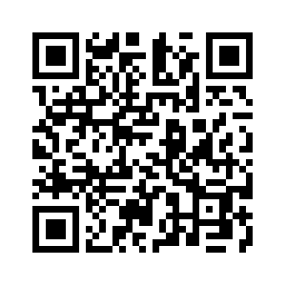
Donate with our QR code app to
Amazing Grace Christian Fellowship
Donations are Deeply Appreciated!

