Slide 3
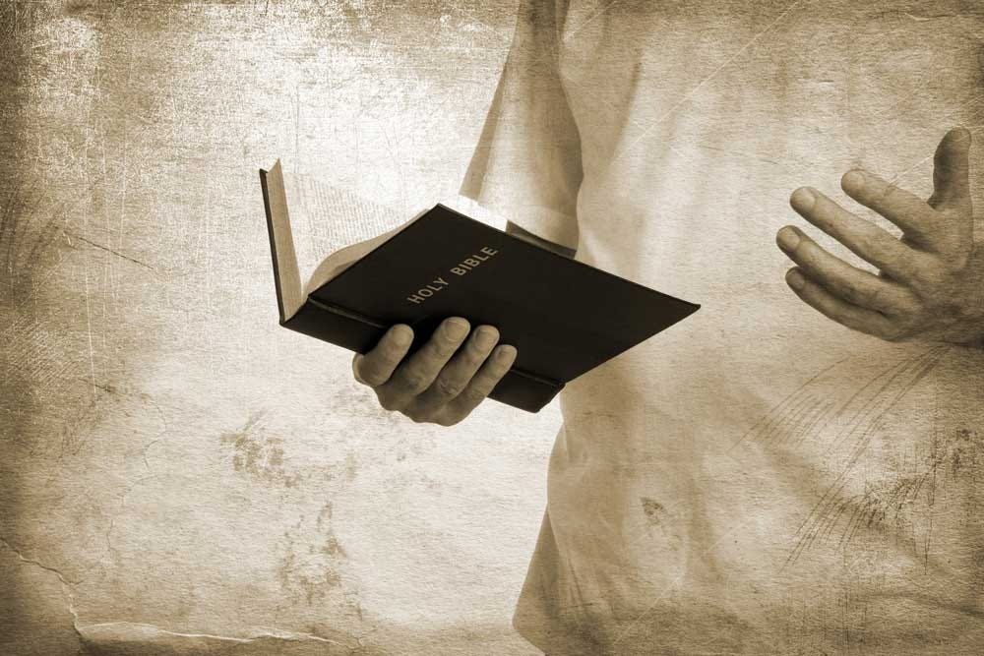
Aim to Preach the Gospel
by Pastor Fee Soliven
Romans 15:20-26
Wednesday Evening
April 30, 2025

Slide 4
Romans 15:20-26
20 And so I have made it my aim to preach the gospel, not where Christ was named, lest I should build on another man's foundation, 21 but as it is written: "To whom He was not announced, they shall see; And those who have not heard shall understand."

Slide 5
22 For this reason I also have been much hindered from coming to you. 23 But now no longer having a place in these parts, and having a great desire these many years to come to you, 24 whenever I journey to Spain, I shall come to you. For I hope to see you on my journey, and to be helped on my way there by you, if first I may enjoy your company for a while. 25 But now I am going to Jerusalem to minister to the saints.

Slide 6
26 For it pleased those from Macedonia and Achaia to make a certain contribution for the poor among the saints who are in Jerusalem.

Slide 7
20 And so I have made it my aim to preach the gospel, not where Christ was named, lest I should build on another man's foundation,

Slide 8
Psalm 37:18-20
18 The LORD knows the days of the upright, And their inheritance shall be forever. 19 They shall not be ashamed in the evil time, And in the days of famine they shall be satisfied. 20 But the wicked shall perish; And the enemies of the LORD, Like the splendor of the meadows, shall vanish. Into smoke they shall vanish away.

Slide 9
Luke 9:26
For whoever is ashamed of Me and My words, of him the Son of Man will be ashamed when He comes in His own glory, and in His Father's, and of the holy angels.

Slide 10
Mark 8:37-38
37 Or what will a man give in exchange for his soul? 38 For whoever is ashamed of Me and My words in this adulterous and sinful generation, of him the Son of Man also will be ashamed when He comes in the glory of His Father with the holy angels."

Slide 11
Romans 1:16-17
16 For I am not ashamed of the gospel of Christ, for it is the power of God to salvation for everyone who believes, for the Jew first and also for the Greek. 17 For in it the righteousness of God is revealed from faith to faith; as it is written, "The just shall live by faith."

Slide 12
21 but as it is written: "To whom He was not announced, they shall see; And those who have not heard shall understand."

Slide 13
Isaiah 52:15
So shall He sprinkle many nations. Kings shall shut their mouths at Him; For what had not been told them they shall see, And what they had not heard they shall consider.

Slide 14
22 For this reason I also have been much hindered from coming to you.

Slide 15
1 Thessalonians 2:17-18
17 But we, brethren, having been taken away from you for a short time in presence, not in heart, endeavored more eagerly to see your face with great desire. 18 Therefore we wanted to come to you--even I, Paul, time and again--but Satan hindered us.

Slide 16
2 Corinthians 4:1-5
1 Therefore, since we have this ministry, as we have received mercy, we do not lose heart. 2 But we have renounced the hidden things of shame, not walking in craftiness nor handling the word of God deceitfully, but by manifestation of the truth commending ourselves to every man's conscience in the sight of God.

Slide 17
3 But even if our gospel is veiled, it is veiled to those who are perishing, 4 whose minds the god of this age has blinded, who do not believe, lest the light of the gospel of the glory of Christ, who is the image of God, should shine on them.

Slide 18
23 But now no longer having a place in these parts, and having a great desire these many years to come to you

Slide 19
1 Corinthians 16:5-7
5 Now I will come to you when I pass through Macedonia (for I am passing through Macedonia). 6 And it may be that I will remain, or even spend the winter with you, that you may send me on my journey, wherever I go. 7 For I do not wish to see you now on the way; but I hope to stay a while with you, if the Lord permits.

Slide 20
24 whenever I journey to Spain, I shall come to you. For I hope to see you on my journey, and to be helped on my way there by you, if first I may enjoy your company for a while.

Slide 21
2 Corinthians 1:15-19
15 And in this confidence I intended to come to you before, that you might have a second benefit-- 16 to pass by way of you to Macedonia, to come again from Macedonia to you, and be helped by you on my way to Judea. 17 Therefore, when I was planning this, did I do it lightly? Or the things I plan, do I plan according to the flesh, that with me there should be Yes, Yes, and No, No?

Slide 22
18 But as God is faithful, our word to you was not Yes and No. 19 For the Son of God, Jesus Christ, who was preached among you by us--by me, Silvanus, and Timothy--was not Yes and No, but in Him was Yes
.

Slide 23
25 But now I am going to Jerusalem to minister to the saints.

Slide 24
Acts 20:2-3
2 Now when he had gone over that region and encouraged them with many words, he came to Greece 3 and stayed three months. And when the Jews plotted against him as he was about to sail to Syria, he decided to return through Macedonia.

Slide 25
Acts 24:16-18
16 This being so, I myself always strive to have a conscience without offense toward God and men. 17 Now after many years I came to bring alms and offerings to my nation, 18 in the midst of which some Jews from Asia found me purified in the temple, neither with a mob nor with tumult.

Slide 26
1 Corinthians 16:1-4
1 Now concerning the collection for the saints, as I have given orders to the churches of Galatia, so you must do also: 2 On the first day of the week let each one of you lay something aside, storing up as he may prosper, that there be no collections when I come. 3 And when I come, whomever you approve by your letters I will send to bear your gift to Jerusalem. 4 But if it is fitting that I go also, they will go with me.

Slide 27
2 Corinthians 9:13
while, through the proof of this ministry, they glorify God for the obedience of your confession to the gospel of Christ, and for your liberal sharing with them and all men,

Slide 28
26 For it pleased those from Macedonia and Achaia to make a certain contribution for the poor among the saints who are in Jerusalem.

Slide 29
Acts 10:1-38
1 There was a certain man in Caesarea called Cornelius, a centurion of what was called the Italian Regiment, 2 a devout man and one who feared God with all his household, who gave alms generously to the people, and prayed to God always. 3 About the ninth hour of the day he saw clearly in a vision an angel of God coming in and saying to him, "Cornelius!"

Slide 30
4 And when he observed him, he was afraid, and said, "What is it, lord?" So he said to him, "Your prayers and your alms have come up for a memorial before God. 5 Now send men to Joppa, and send for Simon whose surname is Peter. 6 He is lodging with Simon, a tanner, whose house is by the sea. He will tell you what you must do."

Slide 31
7 And when the angel who spoke to him had departed, Cornelius called two of his household servants and a devout soldier from among those who waited on him continually. 8 So when he had explained all these things to them, he sent them to Joppa. 9 The next day, as they went on their journey and drew near the city, Peter went up on the housetop to pray, about the sixth hour.

Slide 32
10 Then he became very hungry and wanted to eat; but while they made ready, he fell into a trance 11 and saw heaven opened and an object like a great sheet bound at the four corners, descending to him and let down to the earth.

Slide 33
12 In it were all kinds of four-footed animals of the earth, wild beasts, creeping things, and birds of the air. 13 And a voice came to him, "Rise, Peter; kill and eat." 14 But Peter said, "Not so, Lord! For I have never eaten anything common or unclean."

Slide 34
15 And a voice spoke to him again the second time, "What God has cleansed you must not call common." 16 This was done three times. And the object was taken up into heaven again. 17 Now while Peter wondered within himself what this vision which he had seen meant, behold, the men who had been sent from Cornelius had made inquiry for Simon's house, and stood before the gate.

Slide 35
18 And they called and asked whether Simon, whose surname was Peter, was lodging there. 19 While Peter thought about the vision, the Spirit said to him, "Behold, three men are seeking you. 20 Arise therefore, go down and go with them, doubting nothing; for I have sent them." 21 Then Peter went down to the men who had been sent to him from Cornelius, and said, "Yes, I am he whom you seek. For what reason have you come?"

Slide 36
22 And they said, "Cornelius the centurion, a just man, one who fears God and has a good reputation among all the nation of the Jews, was divinely instructed by a holy angel to summon you to his house, and to hear words from you." 23 Then he invited them in and lodged them. On the next day Peter went away with them, and some brethren from Joppa accompanied him.

Slide 37
24 And the following day they entered Caesarea. Now Cornelius was waiting for them, and had called together his relatives and close friends. 25 As Peter was coming in, Cornelius met him and fell down at his feet and worshiped him. 26 But Peter lifted him up, saying, "Stand up; I myself am also a man."

Slide 38
27 And as he talked with him, he went in and found many who had come together. 28 Then he said to them, "You know how unlawful it is for a Jewish man to keep company with or go to one of another nation. But God has shown me that I should not call any man common or unclean.

Slide 39
29 Therefore I came without objection as soon as I was sent for. I ask, then, for what reason have you sent for me?" 30 So Cornelius said, "Four days ago I was fasting until this hour; and at the ninth hour I prayed in my house, and behold, a man stood before me in bright clothing,

Slide 40
31 and said, 'Cornelius, your prayer has been heard, and your alms are remembered in the sight of God. 32 Send therefore to Joppa and call Simon here, whose surname is Peter. He is lodging in the house of Simon, a tanner, by the sea. When he comes, he will speak to you.'

Slide 41
33 "So I sent to you immediately, and you have done well to come. Now therefore, we are all present before God, to hear all the things commanded you by God." 34 Then Peter opened his mouth and said: "In truth I perceive that God shows no partiality. 35 But in every nation whoever fears Him and works righteousness is accepted by Him.

Slide 42
36 The word which God sent to the children of Israel, preaching peace through Jesus Christ--He is Lord of all—37 that word you know, which was proclaimed throughout all Judea, and began from Galilee after the baptism which John preached: 38 how God anointed Jesus of Nazareth with the Holy Spirit and with power, who went about doing good and healing all who were oppressed by the devil, for God was with Him.

Slide 43
1 Thessalonians 4:13-18
13 But I do not want you to be ignorant, brethren, concerning those who have fallen asleep, lest you sorrow as others who have no hope. 14 For if we believe that Jesus died and rose again, even so God will bring with Him those who sleep in Jesus.

Slide 44
15 For this we say to you by the word of the Lord, that we who are alive and remain until the coming of the Lord will by no means precede those who are asleep. 16 For the Lord Himself will descend from heaven with a shout, with the voice of an archangel, and with the trumpet of God. And the dead in Christ will rise first.

Slide 45
17 Then we who are alive and remain shall be caught up together with them in the clouds to meet the Lord in the air. And thus we shall always be with the Lord. 18 Therefore comfort one another with these words.

Slide 46
1 Corinthians 15:50-54
50 Now this I say, brethren, that flesh and blood cannot inherit the kingdom of God; nor does corruption inherit incorruption. 51 Behold, I tell you a mystery: We shall not all sleep, but we shall all be changed-- 52 in a moment, in the twinkling of an eye, at the last trumpet. For the trumpet will sound, and the dead will be raised incorruptible, and we shall be changed.

Slide 47
53 For this corruptible must put on incorruption, and this mortal must put on immortality. 54 So when this corruptible has put on incorruption, and this mortal has put on immortality, then shall be brought to pass the saying that is written: "Death is swallowed up in victory."

Slide 48
20 Again, when a righteous man turns from his righteousness and commits iniquity, and I lay a stumbling block before him, he shall die; because you did not give him warning, he shall die in his sin, and his righteousness which he has done shall not be remembered; but his blood I will require at your hand.

Slide 49
Acts 2:38-39
38 Then Peter said to them, "Repent, and let every one of you be baptized in the name of Jesus Christ for the remission of sins; and you shall receive the gift of the Holy Spirit. 39 For the promise is to you and to your children, and to all who are afar off, as many as the Lord our God will call."

Slide 50
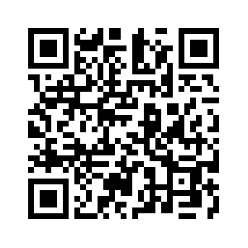
Donate with our QR code app to
Amazing Grace Christian Fellowship
Donations are Deeply Appreciated!

