Slide 3
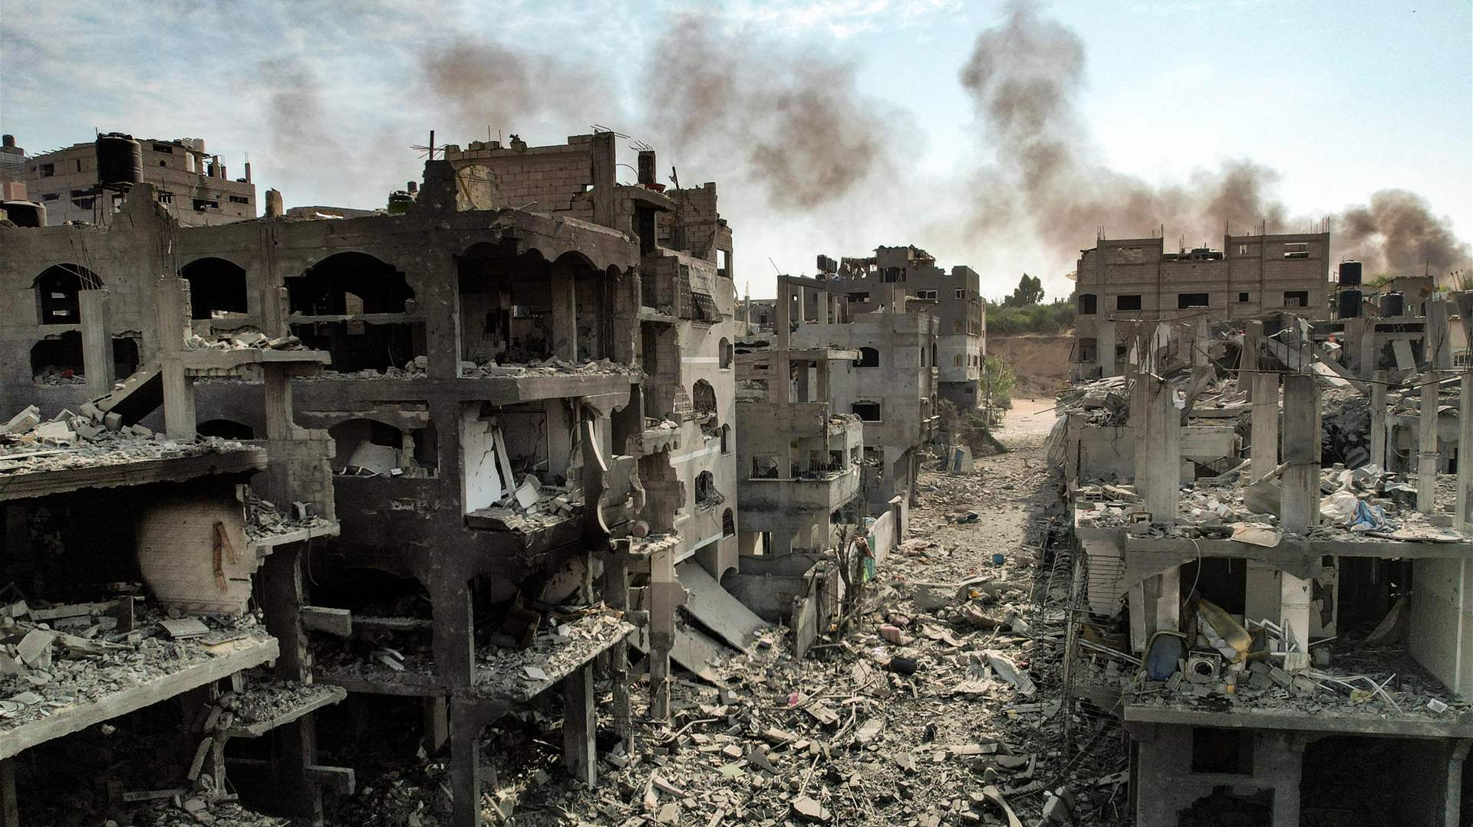
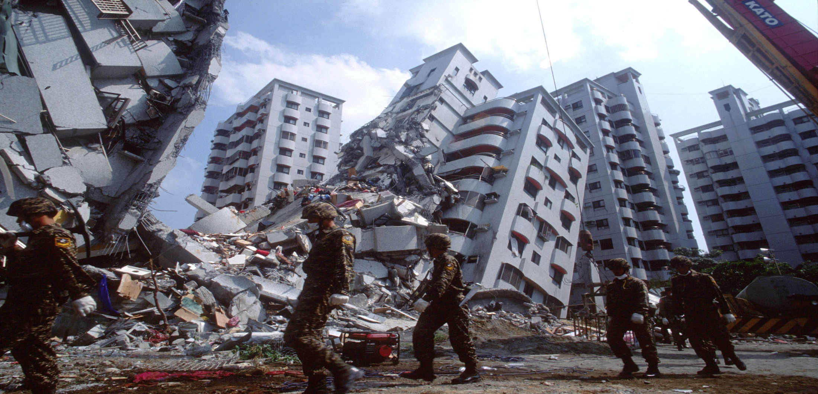
Nations that Rise and Fall
by Pastor Fee Soliven
2 Chronicles 36:15-20
Sunday Morning
May 18, 2025

Slide 4
Examples include Jezebel killing prophets of the Lord and King Manasseh allegedly sawing Isaiah in half. Jerusalem, despite being the chosen city of God, is described as a place that has killed prophets and stoned messengers.

Slide 5
In our modern day, it was a shock but legal and cultural moment for the country. The Supreme Court ruled that same-sex couples in the United States, no matter where they live, have the same legal right to marry as traditional male and female-sex couples.

Slide 6
The Supreme Court acknowledged the executive order by President Obama that gave way to the verdict by the Supreme Court on June 26, 2015 to make it a law. It’s still intact today. And it’s still an Abomination to God!

Slide 7
2 Chronicles 36:15-16
15 And the LORD God of their fathers sent warnings to them by His messengers, rising up early and sending them, because He had compassion on His people and on His dwelling place.

Slide 8
16 But they mocked the messengers of God, despised His words, and scoffed at His prophets, until the wrath of the LORD arose against His people, till there was no remedy.

Slide 9
Leviticus 25:3-6
3 Six years you shall sow your field, and six years you shall prune your vineyard, and gather its fruit; 4 but in the seventh year there shall be a sabbath of solemn rest for the land, a sabbath to the LORD. You shall neither sow your field nor prune your vineyard.

Slide 10
5 What grows of its own accord of your harvest you shall not reap, nor gather the grapes of your untended vine, for it is a year of rest for the land. 6 And the sabbath produce of the land shall be food for you: for you, your male and female servants, your hired man, and the stranger who dwells with you...

Slide 11
The Rise and Fall of a Nation!

Slide 12
1. The Rise of a Nation

Slide 13
Deuteronomy 28:1-14
1 "Now it shall come to pass, if you diligently obey the voice of the LORD your God, to observe carefully all His commandments which I command you today, that the LORD your God will set you high above all nations of the earth. 2 And all these blessings shall come upon you and overtake you, because you obey the voice of the LORD your God:

Slide 14
3 Blessed shall you be in the city, and blessed shall you be in the country. 4 Blessed shall be the fruit of your body, the produce of your ground and the increase of your herds, the increase of your cattle and the offspring of your flocks. 5 Blessed shall be your basket and your kneading bowl.

Slide 15
6 Blessed shall you be when you come in, and blessed shall you be when you go out. 7 "The LORD will cause your enemies who rise against you to be defeated before your face; they shall come out against you one way and flee before you seven ways.

Slide 16
8 The LORD will command the blessing on you in your storehouses and in all to which you set your hand, and He will bless you in the land which the LORD your God is giving you.

Slide 17
9 The LORD will establish you as a holy people to Himself, just as He has sworn to you, if you keep the commandments of the LORD your God and walk in His ways. 10 Then all peoples of the earth shall see that you are called by the name of the LORD, and they shall be afraid of you.

Slide 18
11 And the LORD will grant you plenty of goods, in the fruit of your body, in the increase of your livestock, and in the produce of your ground, in the land of which the LORD swore to your fathers to give you.

Slide 19
12 The LORD will open to you His good treasure, the heavens, to give the rain to your land in its season, and to bless all the work of your hand. You shall lend to many nations, but you shall not borrow. 13 And the LORD will make you the head and not the tail; you shall be above only, and not be beneath, if you heed the commandments of the LORD your God, which I command you today, and are careful to observe them.

Slide 20
14 So you shall not turn aside from any of the words which I command you this day, to the right hand or to the left, to go after other gods to serve them.

Slide 21
2. The Fall of a Nation

Slide 22
Deuteronomy 28:15-19
15 "But it shall come to pass, if you do not obey the voice of the LORD your God, to observe carefully all His commandments and His statutes which I command you today, that all these curses will come upon you and overtake you: 16 Cursed shall you be in the city, and cursed shall you be in the country.

Slide 23
17 Cursed shall be your basket and your kneading bowl. 18 Cursed shall be the fruit of your body and the produce of your land, the increase of your cattle and the offspring of your flocks. 19 Cursed shall you be when you come in, and cursed shall you be when you go out.

Slide 24
3. The Destruction of a Nation

Slide 25
Deuteronomy 28:47-68
47 "Because you did not serve the LORD your God with joy and gladness of heart, for the abundance of everything, 48 therefore you shall serve your enemies, whom the LORD will send against you, in hunger, in thirst, in nakedness, and in need of everything; and He will put a yoke of iron on your neck until He has destroyed you.

Slide 26
49 The LORD will bring a nation against you from afar, from the end of the earth, as swift as the eagle flies, a nation whose language you will not understand, 50 a nation of fierce countenance, which does not respect the elderly nor show favor to the young.

Slide 27
51 And they shall eat the increase of your livestock and the produce of your land, until you are destroyed; they shall not leave you grain or new wine or oil, or the increase of your cattle or the offspring of your flocks, until they have destroyed you.

Slide 28
52 They shall besiege you at all your gates until your high and fortified walls, in which you trust, come down throughout all your land; and they shall besiege you at all your gates throughout all your land which the LORD your God has given you.

Slide 29
53 You shall eat the fruit of your own body, the flesh of your sons and your daughters whom the LORD your God has given you, in the siege and desperate straits in which your enemy shall distress you. 54 The sensitive and very refined man among you will be hostile toward his brother, toward the wife of his bosom, and toward the rest of his children whom he leaves behind,

Slide 30
55 so that he will not give any of them the flesh of his children whom he will eat, because he has nothing left in the siege and desperate straits in which your enemy shall distress you at all your gates. 56 The tender and delicate woman among you, who would not venture to set the sole of her foot on the ground because of her delicateness and sensitivity, will refuse to the husband of her bosom, and to her son and her daughter,

Slide 31
57 her placenta which comes out from between her feet and her children whom she bears; for she will eat them secretly for lack of everything in the siege and desperate straits in which your enemy shall distress you at all your gates. 58 "If you do not carefully observe all the words of this law that are written in this book, that you may fear this glorious and awesome name, THE LORD YOUR GOD,

Slide 32
59 then the LORD will bring upon you and your descendants extraordinary plagues--great and prolonged plagues--and serious and prolonged sicknesses. 60 Moreover He will bring back on you all the diseases of Egypt, of which you were afraid, and they shall cling to you.

Slide 33
61 Also every sickness and every plague, which is not written in the book of this law, will the LORD bring upon you until you are destroyed. 62 You shall be left few in number, whereas you were as the stars of heaven in multitude, because you would not obey the voice of the LORD your God.

Slide 34
63 And it shall be, that just as the LORD rejoiced over you to do you good and multiply you, so the LORD will rejoice over you to destroy you and bring you to nothing; and you shall be plucked from off the land which you go to possess.

Slide 35
64 "Then the LORD will scatter you among all peoples, from one end of the earth to the other, and there you shall serve other gods, which neither you nor your fathers have known--wood and stone. 65 And among those nations you shall find no rest, nor shall the sole of your foot have a resting place; but there the LORD will give you a trembling heart, failing eyes, and anguish of soul.

Slide 36
66 Your life shall hang in doubt before you; you shall fear day and night, and have no assurance of life. 67 In the morning you shall say, 'Oh, that it were evening!' And at evening you shall say, 'Oh, that it were morning!' because of the fear which terrifies your heart, and because of the sight which your eyes see.

Slide 37
68 And the LORD will take you back to Egypt in ships, by the way of which I said to you, 'You shall never see it again.' And there you shall be offered for sale to your enemies as male and female slaves, but no one will buy you."

Slide 38
What would cause a terrible punishment from God to allow a nation to be totally destroyed?

Slide 39
1. God Warned Against Sacrificing Their Children to Satan!

Slide 40
Leviticus 18:21
"And you shall not let any of your descendants pass through the fire to Molech, nor shall you profane the name of your God: I am the LORD."

Slide 41
Leviticus 20:1-5
1 Then the LORD spoke to Moses, saying, 2 "Again, you shall say to the children of Israel: 'Whoever of the children of Israel, or of the strangers who dwell in Israel, who gives any of his descendants to Molech, he shall surely be put to death. The people of the land shall stone him with stones.

Slide 42
3 I will set My face against that man, and will cut him off from his people, because he has given some of his descendants to Molech, to defile My sanctuary and profane My holy name. 4 And if the people of the land should in any way hide their eyes from the man, when he gives some of his descendants to Molech, and they do not kill him,

Slide 43
5 then I will set My face against that man and against his family; and I will cut him off from his people, and all who prostitute themselves with him to commit harlotry with Molech.

Slide 44
Jeremiah 7:28-31
28 "So you shall say to them, 'This is a nation that does not obey the voice of the LORD their God nor receive correction. Truth has perished and has been cut off from their mouth. 29 Cut off your hair and cast it away, and take up a lamentation on the desolate heights; for the LORD has rejected and forsaken the generation of His wrath.'

Slide 45
30 "For the children of Judah have done evil in My sight," says the LORD. "They have set their abominations in the house which is called by My name, to pollute it. 31 And they have built the high places of Tophet, which is in the Valley of the Son of Hinnom, to burn their sons and their daughters in the fire, which I did not command, nor did it come into My heart.

Slide 46
Ezekiel 20:25-26
25 Therefore I also gave them up to statutes that were not good, and judgments by which they could not live; 26 and I pronounced them unclean because of their ritual gifts, in that they caused all their firstborn to pass through the fire, that I might make them desolate and that they might know that I am the LORD." '

Slide 47
2. God Said That a Man Shall Never Lay with Another Man and a Woman Shall Never Lay with Another Women It's an Abomination to God!

Slide 48
Leviticus 18:22-23
22 You shall not lie with a male as with a woman. It is an abomination. 23 Nor shall you mate with any animal, to defile yourself with it. Nor shall any woman stand before an animal to mate with it. It is perversion.

Slide 49
Leviticus 20:13
"If a man lies with a male as he lies with a woman, both of them have committed an abomination. They shall surely be put to death. Their blood shall be upon them."

Slide 50
Jude 5-8
5 But I want to remind you, though you once knew this, that the Lord, having saved the people out of the land of Egypt, afterward destroyed those who did not believe. 6 And the angels who did not keep their proper domain, but left their own abode, He has reserved in everlasting chains under darkness for the judgment of the great day;
7 as Sodom and Gomorrah, and the cities around them in a similar manner to these, having given themselves over to sexual immorality and gone after strange flesh, are set forth as an example, suffering the vengeance of eternal fire. 8 Likewise also these dreamers defile the flesh, reject authority, and speak evil of dignitaries.
1 Corinthians 6:9-10
9 Do you not know that the unrighteous will not inherit the kingdom of God? Do not be deceived. Neither fornicators, nor idolaters, nor adulterers, nor homosexuals, nor sodomites, 10 nor thieves, nor covetous, nor drunkards, nor revilers, nor extortioners will inherit the kingdom of God.
7 as Sodom and Gomorrah, and the cities around them in a similar manner to these, having given themselves over to sexual immorality and gone after strange flesh, are set forth as an example, suffering the vengeance of eternal fire.

Slide 51
7 as Sodom and Gomorrah, and the cities around them in a similar manner to these, having given themselves over to sexual immorality and gone after strange flesh, are set forth as an example, suffering the vengeance of eternal fire. 8 Likewise also these dreamers defile the flesh, reject authority, and speak evil of dignitaries.

Slide 52
1 Corinthians 6:9-10
9 Do you not know that the unrighteous will not inherit the kingdom of God? Do not be deceived. Neither fornicators, nor idolaters, nor adulterers, nor homosexuals, nor sodomites, 10 nor thieves, nor covetous, nor drunkards, nor revilers, nor extortioners will inherit the kingdom of God.

Slide 53
7 as Sodom and Gomorrah, and the cities around them in a similar manner to these, having given themselves over to sexual immorality and gone after strange flesh, are set forth as an example, suffering the vengeance of eternal fire.

Slide 54
Genesis 19:4-11
4 Now before they lay down, the men of the city, the men of Sodom, both old and young, all the people from every quarter, surrounded the house. 5 And they called to Lot and said to him, "Where are the men who came to you tonight? Bring them out to us that we may know them carnally." 6 So Lot went out to them through the doorway, shut the door behind him,

Slide 55
7 and said, "Please, my brethren, do not do so wickedly! 8 See now, I have two daughters who have not known a man; please, let me bring them out to you, and you may do to them as you wish; only do nothing to these men, since this is the reason they have come under the shadow of my roof."

Slide 56
9 And they said, "Stand back!" Then they said, "This one came in to stay here, and he keeps acting as a judge; now we will deal worse with you than with them." So they pressed hard against the man Lot, and came near to break down the door.

Slide 57
10 But the men reached out their hands and pulled Lot into the house with them, and shut the door. 11 And they struck the men who were at the doorway of the house with blindness, both small and great, so that they became weary trying to find the door.

Slide 58
3. Do Not Practice or
Partake with the Occult!

Slide 59
Deuteronomy 18:9-12
9 "When you come into the land which the LORD your God is giving you, you shall not learn to follow the abominations of those nations. 10 There shall not be found among you anyone who makes his son or his daughter pass through the fire, or one who practices witchcraft, or a soothsayer, or one who interprets omens, or a sorcerer,

Slide 60
11 or one who conjures spells, or a medium, or a spiritist, or one who calls up the dead. 12 For all who do these things are an abomination to the LORD, and because of these abominations the LORD your God drives them out from before you.

Slide 61
Our Nation is Soon to be
Judged and Collapse!

Slide 62
Since 1973 when the Roe V. Wade billed was passed, America has sacrificed over 70 Million of her babies on the altars of the Abortion Tables. Their blood is upon this nation.

Slide 63
In 2015 this was the tipping point in America when our President and his administration moved forward to overturn amended laws to redefine the traditional marriage.

Slide 64
There are now 50 States with Legal Gay Marriage and 50 States with Same-Sex Marriage Bans.

Slide 65
IMDb records in the Horror Genre:, 2733 Titles: 1970-2025. Throughout our country there is Voodoo, Witchcraft, Santeria, Fortune Tellers, Soothsayers, Muslin Satanic Killing Rituals and the list goes on...

Slide 66
1 Thessalonians 4:13-18
13 But I do not want you to be ignorant, brethren, concerning those who have fallen asleep, lest you sorrow as others who have no hope. 14 For if we believe that Jesus died and rose again, even so God will bring with Him those who sleep in Jesus.

Slide 67
15 For this we say to you by the word of the Lord, that we who are alive and remain until the coming of the Lord will by no means precede those who are asleep. 16 For the Lord Himself will descend from heaven with a shout, with the voice of an archangel, and with the trumpet of God. And the dead in Christ will rise first.

Slide 68
17 Then we who are alive and remain shall be caught up together with them in the clouds to meet the Lord in the air. And thus we shall always be with the Lord. 18 Therefore comfort one another with these words.

Slide 69
1 Corinthians 15:50-54
50 Now this I say, brethren, that flesh and blood cannot inherit the kingdom of God; nor does corruption inherit incorruption. 51 Behold, I tell you a mystery: We shall not all sleep, but we shall all be changed-- 52 in a moment, in the twinkling of an eye, at the last trumpet. For the trumpet will sound, and the dead will be raised incorruptible, and we shall be changed.

Slide 70
53 For this corruptible must put on incorruption, and this mortal must put on immortality. 54 So when this corruptible has put on incorruption, and this mortal has put on immortality, then shall be brought to pass the saying that is written: "Death is swallowed up in victory."

Slide 71
20 Again, when a righteous man turns from his righteousness and commits iniquity, and I lay a stumbling block before him, he shall die; because you did not give him warning, he shall die in his sin, and his righteousness which he has done shall not be remembered; but his blood I will require at your hand.

Slide 72
Acts 2:38-39
38 Then Peter said to them, "Repent, and let every one of you be baptized in the name of Jesus Christ for the remission of sins; and you shall receive the gift of the Holy Spirit. 39 For the promise is to you and to your children, and to all who are afar off, as many as the Lord our God will call."

Slide 73
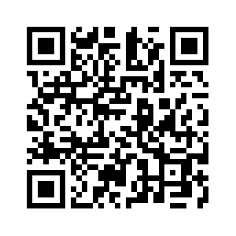
Donate with our QR code app to
Amazing Grace Christian Fellowship
Donations are Deeply Appreciated!

