Slide 1


Slide 2


Slide 3
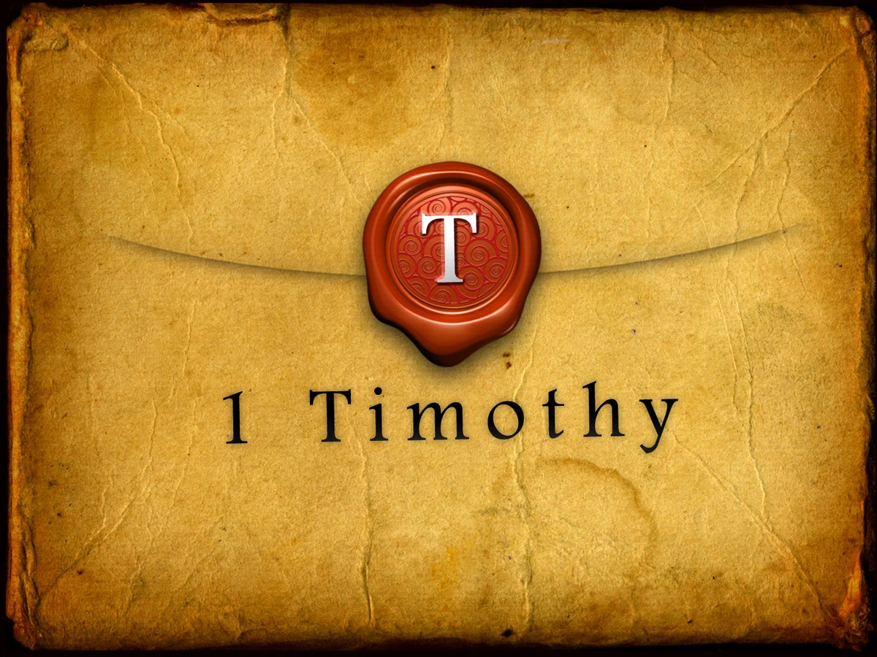

Come to the Knowledge of the Truth
by Pastor Fee Soliven
1 Timothy 2:1-7
Wednesday Evening
June 25, 2025

Slide 4
1 Timothy 2:1-7
1 Therefore I exhort first of all that supplications, prayers, intercessions, and giving of thanks be made for all men, 2 for kings and all who are in authority, that we may lead a quiet and peaceable life in all godliness and reverence. 3 For this is good and acceptable in the sight of God our Savior, 4 who desires all men to be saved and to come to the knowledge of the truth.

Slide 5
5 For there is one God and one Mediator between God and men, the Man Christ Jesus, 6 who gave Himself a ransom for all, to be testified in due time, 7 for which I was appointed a preacher and an apostle--I am speaking the truth in Christ and not lying--a teacher of the Gentiles in faith and truth.

Slide 6
1 Therefore I exhort first of all that supplications, prayers, intercessions, and giving of thanks be made for all men,

Slide 7
1. Supplications
A form of humble and earnest prayer, where one earnestly requests God for help, guidance, or mercy, especially in times of need.

Slide 8
2. Prayers
Prayers is presented as communication with God, encompassing various forms like supplication, thanksgiving, and intercession. It involves praising God, confessing sins, expressing gratitude, and making requests. Prayer can be both personal and communal, and it's a vital part of a believer's relationship with God.

Slide 9
3. Intercessions
Biblical intercession is the act of praying to God on behalf of another person or group. It's a form of prayer where someone stands in the gap, pleading with God for the needs and concerns of others. This can include praying for healing, guidance, protection, or any other need.

Slide 10
Matthew 5:44
But I say to you, love your enemies, bless those who curse you, do good to those who hate you, and pray for those who spitefully use you and persecute you…

Slide 11
2 for kings and all who are in authority, that we may lead a quiet and peaceable life in all godliness and reverence.

Slide 12
Romans 13:1-4
1 Let every soul be subject to the governing authorities. For there is no authority except from God, and the authorities that exist are appointed by God. 2 Therefore whoever resists the authority resists the ordinance of God, and those who resist will bring judgment on themselves.

Slide 13
3 For rulers are not a terror to good works, but to evil. Do you want to be unafraid of the authority? Do what is good, and you will have praise from the same. 4 For he is God's minister to you for good. But if you do evil, be afraid; for he does not bear the sword in vain; for he is God's minister, an avenger to execute wrath on him who practices evil.

Slide 14
1 Peter 2:13-17
13 Therefore submit yourselves to every ordinance of man for the Lord's sake, whether to the king as supreme, 14 or to governors, as to those who are sent by him for the punishment of evildoers and for the praise of those who do good.

Slide 15
15 For this is the will of God, that by doing good you may put to silence the ignorance of foolish men-- 16 as free, yet not using liberty as a cloak for vice, but as bondservants of God. 17 Honor all people. Love the brotherhood. Fear God. Honor the king.

Slide 16
1 Peter 2:12
having your conduct honorable among the Gentiles, that when they speak against you as evildoers, they may, by your good works which they observe, glorify God in the day of visitation.

Slide 17
1 Peter 3:9
not returning evil for evil or reviling for reviling, but on the contrary blessing, knowing that you were called to this, that you may inherit a blessing.

Slide 18
3 For this is good and acceptable in the sight of God our Savior,

Slide 19
1 Corinthians 5:3-5
3 For I indeed, as absent in body but present in spirit, have already judged (as though I were present) him who has so done this deed. 4 In the name of our Lord Jesus Christ, when you are gathered together, along with my spirit, with the power of our Lord Jesus Christ, 5 deliver such a one to Satan for the destruction of the flesh, that his spirit may be saved in the day of the Lord Jesus.

Slide 20
2 Corinthians 2:5-11
5 But if anyone has caused grief, he has not grieved me, but all of you to some extent--not to be too severe. 6 This punishment which was inflicted by the majority is sufficient for such a man, 7 so that, on the contrary, you ought rather to forgive and comfort him, lest perhaps such a one be swallowed up with too much sorrow.

Slide 21
8 Therefore I urge you to reaffirm your love to him. 9 For to this end I also wrote, that I might put you to the test, whether you are obedient in all things. 10 Now whom you forgive anything, I also forgive. For if indeed I have forgiven anything, I have forgiven that one for your sakes in the presence of Christ, 11 lest Satan should take advantage of us; for we are not ignorant of his devices.

Slide 22
4 who desires all men to be saved and to come to the knowledge of the truth.

Slide 23
John 3:13-18
13 No one has ascended to heaven but He who came down from heaven, that is, the Son of Man who is in heaven. 14 And as Moses lifted up the serpent in the wilderness, even so must the Son of Man be lifted up, 15 that whoever believes in Him should not perish but have eternal life. 16 For God so loved the world that He gave His only begotten Son, that whoever believes in Him should not perish but have everlasting life.

Slide 24
17 For God did not send His Son into the world to condemn the world, but that the world through Him might be saved. 18 He who believes in Him is not condemned; but he who does not believe is condemned already, because he has not believed in the name of the only begotten Son of God.

Slide 25
Matthew 25:31-46
31 "When the Son of Man comes in His glory, and all the holy angels with Him, then He will sit on the throne of His glory. 32 All the nations will be gathered before Him, and He will separate them one from another, as a shepherd divides his sheep from the goats. 33 And He will set the sheep on His right hand, but the goats on the left.

Slide 26
34 Then the King will say to those on His right hand, 'Come, you blessed of My Father, inherit the kingdom prepared for you from the foundation of the world: 35 for I was hungry and you gave Me food; I was thirsty and you gave Me drink; I was a stranger and you took Me in; 36 I was naked and you clothed Me; I was sick and you visited Me; I was in prison and you came to Me.'

Slide 27
37 "Then the righteous will answer Him, saying, 'Lord, when did we see You hungry and feed You, or thirsty and give You drink? 38 When did we see You a stranger and take You in, or naked and clothe You? 39 Or when did we see You sick, or in prison, and come to You?' 40 "And the King will answer and say to them, 'Assuredly, I say to you, inasmuch as you did it to one of the least of these My brethren, you did it to Me.'

Slide 28
41 "Then He will also say to those on the left hand, 'Depart from Me, you cursed, into the everlasting fire prepared for the devil and his angels: 42 for I was hungry and you gave Me no food; I was thirsty and you gave Me no drink; 43 I was a stranger and you did not take Me in, naked and you did not clothe Me, sick and in prison and you did not visit Me.'

Slide 29
44 "Then they also will answer Him, saying, 'Lord, when did we see You hungry or thirsty or a stranger or naked or sick or in prison, and did not minister to You?' 45 "Then He will answer them, saying, 'Assuredly, I say to you, inasmuch as you did not do it to one of the least of these, you did not do it to Me.' 46 "And these will go away into everlasting punishment, but the righteous into eternal life."

Slide 30
Hebrews 10:26-29
26 For if we sin willfully after we have received the knowledge of the truth, there no longer remains a sacrifice for sins, 27 but a certain fearful expectation of judgment, and fiery indignation which will devour the adversaries. 28 Anyone who has rejected Moses' law dies without mercy on the testimony of two or three witnesses.

Slide 31
29 Of how much worse punishment, do you suppose, will he be thought worthy who has trampled the Son of God underfoot, counted the blood of the covenant by which he was sanctified a common thing, and insulted the Spirit of grace?

Slide 32
1 Timothy 4:10
For to this end we both labor and suffer reproach, because we trust in the living God, who is the Savior of all men, especially of those who believe.

Slide 33
5 For there is one God and one Mediator between God and men, the Man Christ Jesus, 6 who gave Himself a ransom for all, to be testified in due time,

Slide 34
1. There is only one God

Slide 35
Deuteronomy 6:4-6
4 "Hear, O Israel: The LORD our God, the LORD is one! 5 You shall love the LORD your God with all your heart, with all your soul, and with all your strength. 6 "And these words which I command you today shall be in your heart.

Slide 36
1 Corinthians 8:4
Therefore concerning the eating of things offered to idols, we know that an idol is nothing in the world, and that there is no other God but one.

Slide 37
2. There is also one Mediator who can reconcile God and people, Christ Jesus

Slide 38
John 14:6
“I am the way, the truth, and the life. No one can come to the Father except through me”

Slide 39
3. He gave His Life to Purchase Freedom for Everyone that gets saved

Slide 40
7 for which I was appointed a preacher and an apostle--I am speaking the truth in Christ and not lying--a teacher of the Gentiles in faith and truth.

Slide 41
Ephesians 3:7-8
7 of which I became a minister according to the gift of the grace of God given to me by the effective working of His power. 8 To me, who am less than the least of all the saints, this grace was given, that I should preach among the Gentiles the unsearchable riches of Christ…

Slide 42
1 Thessalonians 4:13-18
13 But I do not want you to be ignorant, brethren, concerning those who have fallen asleep, lest you sorrow as others who have no hope. 14 For if we believe that Jesus died and rose again, even so God will bring with Him those who sleep in Jesus.

Slide 43
15 For this we say to you by the word of the Lord, that we who are alive and remain until the coming of the Lord will by no means precede those who are asleep. 16 For the Lord Himself will descend from heaven with a shout, with the voice of an archangel, and with the trumpet of God. And the dead in Christ will rise first.

Slide 44
17 Then we who are alive and remain shall be caught up together with them in the clouds to meet the Lord in the air. And thus we shall always be with the Lord. 18 Therefore comfort one another with these words.

Slide 45
1 Corinthians 15:50-54
50 Now this I say, brethren, that flesh and blood cannot inherit the kingdom of God; nor does corruption inherit incorruption. 51 Behold, I tell you a mystery: We shall not all sleep, but we shall all be changed-- 52 in a moment, in the twinkling of an eye, at the last trumpet. For the trumpet will sound, and the dead will be raised incorruptible, and we shall be changed.

Slide 46
53 For this corruptible must put on incorruption, and this mortal must put on immortality. 54 So when this corruptible has put on incorruption, and this mortal has put on immortality, then shall be brought to pass the saying that is written: "Death is swallowed up in victory."

Slide 47

20 Again, when a righteous man turns from his righteousness and commits iniquity, and I lay a stumbling block before him, he shall die; because you did not give him warning, he shall die in his sin, and his righteousness which he has done shall not be remembered; but his blood I will require at your hand.

Slide 48
Acts 2:38-39
38 Then Peter said to them, "Repent, and let every one of you be baptized in the name of Jesus Christ for the remission of sins; and you shall receive the gift of the Holy Spirit. 39 For the promise is to you and to your children, and to all who are afar off, as many as the Lord our God will call."

Slide 49

Donate with our QR code app to
Amazing Grace Christian Fellowship
Donations are Deeply Appreciated!

