Slide 1


Slide 2


Slide 3
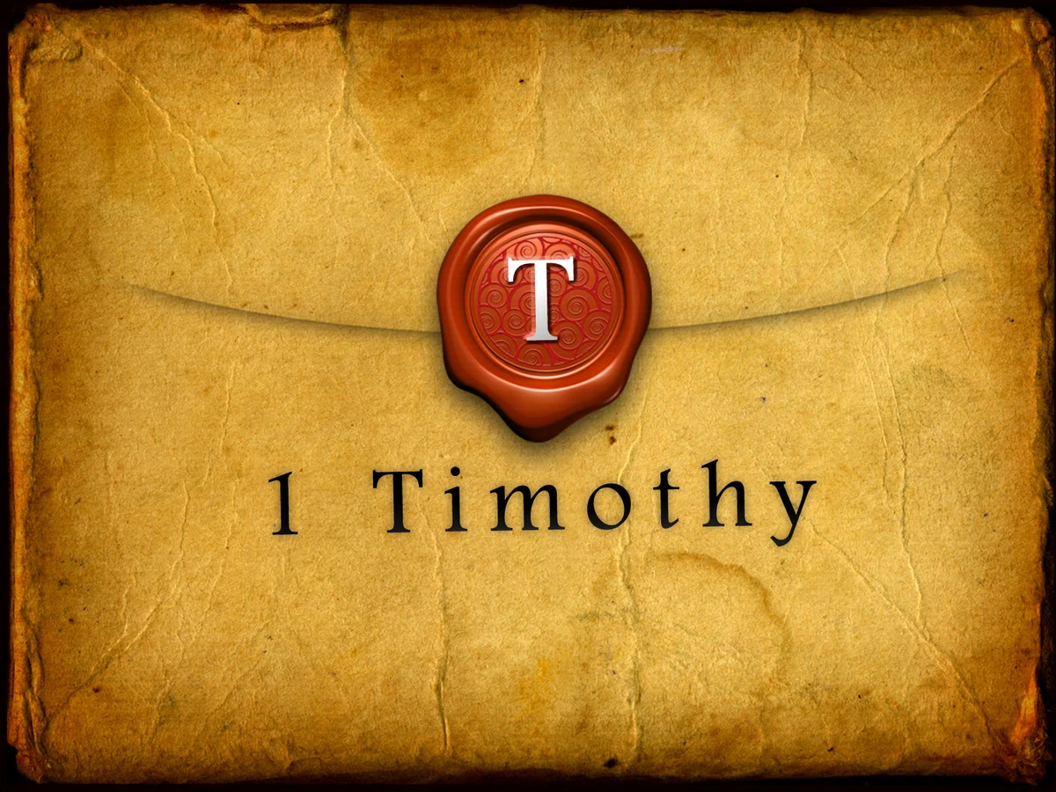

God Who Alone is Wise
by Pastor Fee Soliven
1 Timothy 1:12-20
Wednesday Evening
June 18, 2025

Slide 4
1 Timothy 1:12-20
12 And I thank Christ Jesus our Lord who has enabled me, because He counted me faithful, putting me into the ministry, 13 although I was formerly a blasphemer, a persecutor, and an insolent man; but I obtained mercy because I did it ignorantly in unbelief. 14 And the grace of our Lord was exceedingly abundant, with faith and love which are in Christ Jesus.

Slide 5
15 This is a faithful saying and worthy of all acceptance, that Christ Jesus came into the world to save sinners, of whom I am chief. 16 However, for this reason I obtained mercy, that in me first Jesus Christ might show all longsuffering, as a pattern to those who are going to believe on Him for everlasting life.

Slide 6
17 Now to the King eternal, immortal, invisible, to God who alone is wise, be honor and glory forever and ever. Amen. 18 This charge I commit to you, son Timothy, according to the prophecies previously made concerning you, that by them you may wage the good warfare,

Slide 7
19 having faith and a good conscience, which some having rejected, concerning the faith have suffered shipwreck, 20 of whom are Hymenaeus and Alexander, whom I delivered to Satan that they may learn not to blaspheme.

Slide 8
12 And I thank Christ Jesus our Lord who has enabled me, because He counted me faithful, putting me into the ministry,

Slide 9
Acts 9:15
But the Lord said to him, "Go, for he is a chosen vessel of Mine to bear My name before Gentiles, kings, and the children of Israel.

Slide 10
Acts 11:25-26
25 Then Barnabas departed for Tarsus to seek Saul. 26 And when he had found him, he brought him to Antioch. So it was that for a whole year they assembled with the church and taught a great many people. And the disciples were first called Christians in Antioch.

Slide 11
Acts 13:1-3
1 Now in the church that was at Antioch there were certain prophets and teachers: Barnabas, Simeon who was called Niger, Lucius of Cyrene, Manaen who had been brought up with Herod the tetrarch, and Saul.

Slide 12
2 As they ministered to the Lord and fasted, the Holy Spirit said, "Now separate to Me Barnabas and Saul for the work to which I have called them." 3 Then, having fasted and prayed, and laid hands on them, they sent them away.

Slide 13
13 although I was formerly a blasphemer, a persecutor, and an insolent man; but I obtained mercy because I did it ignorantly in unbelief.

Slide 14
Acts 8:1-3
1 Now Saul was consenting to his death. At that time a great persecution arose against the church which was at Jerusalem; and they were all scattered throughout the regions of Judea and Samaria, except the apostles.

Slide 15
2 And devout men carried Stephen to his burial, and made great lamentation over him. 3 As for Saul, he made havoc of the church, entering every house, and dragging off men and women, committing them to prison.

Slide 16
Acts 9:1-2
1 Then Saul, still breathing threats and murder against the disciples of the Lord, went to the high priest 2 and asked letters from him to the synagogues of Damascus, so that if he found any who were of the Way, whether men or women, he might bring them bound to Jerusalem.

Slide 17
Acts 22:4
I persecuted this Way to the death, binding and delivering into prisons both men and women…

Slide 18
Galatians 1:13
For you have heard of my former conduct in Judaism, how I persecuted the church of God beyond measure and tried to destroy it.

Slide 19
14 And the grace of our Lord was exceedingly abundant, with faith and love which are in Christ Jesus.

Slide 20
Galatians 5:22-23
22 But the fruit of the Spirit is love, joy, peace, longsuffering, kindness, goodness, faithfulness, 23 gentleness, self-control. Against such there is no law.

Slide 21
Titus 3:4-7
4 But when the kindness and the love of God our Savior toward man appeared, 5 not by works of righteousness which we have done, but according to His mercy He saved us, through the washing of regeneration and renewing of the Holy Spirit,

Slide 22
6 whom He poured out on us abundantly through Jesus Christ our Savior, 7 that having been justified by His grace we should become heirs according to the hope of eternal life.

Slide 23
15 This is a faithful saying and worthy of all acceptance, that Christ Jesus came into the world to save sinners, of whom I am chief.

Slide 24
Luke 19:10
for the Son of Man has come to seek and to save that which was lost."

Slide 25
John 3:16-19
16 For God so loved the world that He gave His only begotten Son, that whoever believes in Him should not perish but have everlasting life. 17 For God did not send His Son into the world to condemn the world, but that the world through Him might be saved.

Slide 26
18 He who believes in Him is not condemned; but he who does not believe is condemned already, because he has not believed in the name of the only begotten Son of God. 19 And this is the condemnation, that the light has come into the world, and men loved darkness rather than light, because their deeds were evil.

Slide 27
Have you accepted his offer?

Slide 28
16 However, for this reason I obtained mercy, that in me first Jesus Christ might show all longsuffering, as a pattern to those who are going to believe on Him for everlasting life.

Slide 29
Titus 3:4-6
4 But when the kindness and the love of God our Savior toward man appeared, 5 not by works of righteousness which we have done, but according to His mercy He saved us, through the washing of regeneration and renewing of the Holy Spirit, 6 whom He poured out on us abundantly through Jesus Christ our Savior…

Slide 30
James 2:13
For judgment is without mercy to the one who has shown no mercy. Mercy triumphs over judgment.

Slide 31
17 Now to the King eternal, immortal, invisible, to God who alone is wise, be honor and glory forever and ever. Amen.

Slide 32
Revelation 4:11
“Worthy are You, our Lord and God, to receive glory and honor and power, for You created all things; by Your will they exist and were created.”

Slide 33
Psalm 145:13
Your kingdom is an everlasting kingdom, and Your dominion endures through all generations. The LORD is faithful in all His words and kind in all His actions.

Slide 34
18 This charge I commit to you, son Timothy, according to the prophecies previously made concerning you, that by them you may wage the good warfare,

Slide 35
1. These were Old Testament promises prophesied by the prophets, promises that Timothy claimed

Slide 36
2. These were prophetic utterances at Timothy’s ordination

Slide 37
Acts 14:23
So when they had appointed elders in every church, and prayed with fasting, they commended them to the Lord in whom they had believed…

Slide 38
1 Timothy 4:14
Do not neglect the gift that is in you, which was given to you by prophecy with the laying on of the hands of the eldership…

Slide 39
19 having faith and a good conscience, which some having rejected, concerning the faith have suffered shipwreck,

Slide 40
Hebrews 10:23
Let us hold resolutely to the hope we profess, for He who promised is faithful...

Slide 41
20 of whom are Hymenaeus and Alexander, whom I delivered to Satan that they may learn not to blaspheme.

Slide 42
2 Timothy 2:16-18
16 But shun profane and idle babblings, for they will increase to more ungodliness. 17 And their message will spread like cancer. Hymenaeus and Philetus are of this sort, 18 who have strayed concerning the truth, saying that the resurrection is already past; and they overthrow the faith of some.

Slide 43
1 Corinthians 5:1-5
1 It is actually reported that there is sexual immorality among you, and such sexual immorality as is not even named among the Gentiles--that a man has his father's wife! 2 And you are puffed up, and have not rather mourned, that he who has done this deed might be taken away from among you.

Slide 44
3 For I indeed, as absent in body but present in spirit, have already judged (as though I were present) him who has so done this deed. 4 In the name of our Lord Jesus Christ, when you are gathered together, along with my spirit, with the power of our Lord Jesus Christ,

Slide 45
5 deliver such a one to Satan for the destruction of the flesh, that his spirit may be saved in the day of the Lord Jesus.

Slide 46
2 Thessalonians 3:14
And if anyone does not obey our word in this epistle, note that person and do not keep company with him, that he may be ashamed…

Slide 47
1 Thessalonians 4:13-18
13 But I do not want you to be ignorant, brethren, concerning those who have fallen asleep, lest you sorrow as others who have no hope. 14 For if we believe that Jesus died and rose again, even so God will bring with Him those who sleep in Jesus.

Slide 48
15 For this we say to you by the word of the Lord, that we who are alive and remain until the coming of the Lord will by no means precede those who are asleep. 16 For the Lord Himself will descend from heaven with a shout, with the voice of an archangel, and with the trumpet of God. And the dead in Christ will rise first.

Slide 49
17 Then we who are alive and remain shall be caught up together with them in the clouds to meet the Lord in the air. And thus we shall always be with the Lord. 18 Therefore comfort one another with these words.

Slide 50
1 Corinthians 15:50-54
50 Now this I say, brethren, that flesh and blood cannot inherit the kingdom of God; nor does corruption inherit incorruption. 51 Behold, I tell you a mystery: We shall not all sleep, but we shall all be changed-- 52 in a moment, in the twinkling of an eye, at the last trumpet. For the trumpet will sound, and the dead will be raised incorruptible, and we shall be changed.

Slide 51
53 For this corruptible must put on incorruption, and this mortal must put on immortality. 54 So when this corruptible has put on incorruption, and this mortal has put on immortality, then shall be brought to pass the saying that is written: "Death is swallowed up in victory."

Slide 52

20 Again, when a righteous man turns from his righteousness and commits iniquity, and I lay a stumbling block before him, he shall die; because you did not give him warning, he shall die in his sin, and his righteousness which he has done shall not be remembered; but his blood I will require at your hand.

Slide 53
Acts 2:38-39
38 Then Peter said to them, "Repent, and let every one of you be baptized in the name of Jesus Christ for the remission of sins; and you shall receive the gift of the Holy Spirit. 39 For the promise is to you and to your children, and to all who are afar off, as many as the Lord our God will call."

Slide 54

Donate with our QR code app to
Amazing Grace Christian Fellowship
Donations are Deeply Appreciated!

