Slide 3
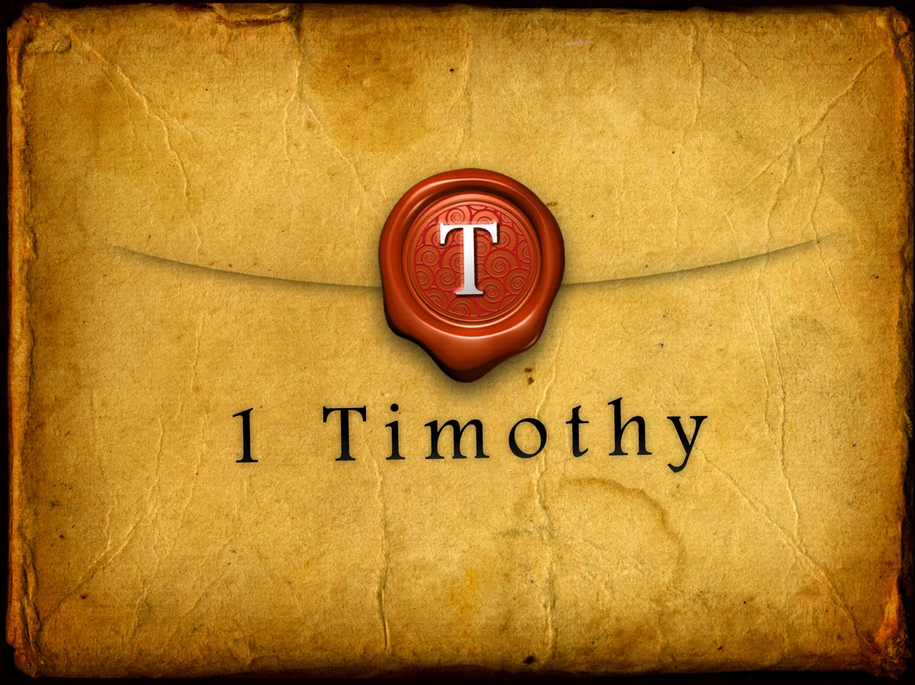
Love from a Pure Heart
by Pastor Fee Soliven
1 Timothy 1:5-11
Wednesday Evening
June 11, 2025

Slide 4
1 Timothy 1:5-11
5 Now the purpose of the commandment is love from a pure heart, from a good conscience, and from sincere faith, 6 from which some, having strayed, have turned aside to idle talk, 7 desiring to be teachers of the law, understanding neither what they say nor the things which they affirm.

Slide 5
8 But we know that the law is good if one uses it lawfully, 9 knowing this: that the law is not made for a righteous person, but for the lawless and insubordinate, for the ungodly and for sinners, for the unholy and profane, for murderers of fathers and murderers of mothers, for manslayers,

Slide 6
10 for fornicators, for sodomites, for kidnappers, for liars, for perjurers, and if there is any other thing that is contrary to sound doctrine, 11 according to the glorious gospel of the blessed God which was committed to my trust.

Slide 7
5 Now the purpose of the commandment is love from a pure heart, from a good conscience, and from sincere faith,

Slide 8
Matthew 5:8
“God blesses those whose hearts are pure.”

Slide 9
1. God purifies us, but there is action we must take to keep morally fit. Daily application of God’s Word has a purifying effect on our heart and mind. It enables us to love freely.

Slide 10
2. In order to love properly, our conscience must be clear. First, it must be clean from unconfessed sin so that guilt doesn’t hinder us.

Slide 11
3. Our motives must be free from pride and personal gain. Then we can love openly.

Slide 12
4. When we attempt to love others without sincere faith in Christ, our efforts to minister become hollow and self-serving. Sincere faith enables us to love genuinely.

Slide 13
1 Corinthians 13:1-8
1 Though I speak with the tongues of men and of angels, but have not love, I have become sounding brass or a clanging cymbal. 2 And though I have the gift of prophecy, and understand all mysteries and all knowledge, and though I have all faith, so that I could remove mountains, but have not love, I am nothing.

Slide 14
3 And though I bestow all my goods to feed the poor, and though I give my body to be burned, but have not love, it profits me nothing. 4 Love suffers long and is kind; love does not envy; love does not parade itself, is not puffed up; 5 does not behave rudely, does not seek its own, is not provoked, thinks no evil; 6 does not rejoice in iniquity, but rejoices in the truth;

Slide 15
7 bears all things, believes all things, hopes all things, endures all things. 8 Love never fails. But whether there are prophecies, they will fail; whether there are tongues, they will cease; whether there is knowledge, it will vanish away.

Slide 16
6 from which some, having strayed, have turned aside to idle talk,

Slide 17
Galatians 1:6-9
6 I marvel that you are turning away so soon from Him who called you in the grace of Christ, to a different gospel, 7 which is not another; but there are some who trouble you and want to pervert the gospel of Christ.

Slide 18
8 But even if we, or an angel from heaven, preach any other gospel to you than what we have preached to you, let him be accursed. 9 As we have said before, so now I say again, if anyone preaches any other gospel to you than what you have received, let him be accursed.

Slide 19
2 Peter 2:1-6
1 But there were also false prophets among the people, even as there will be false teachers among you, who will secretly bring in destructive heresies, even denying the Lord who bought them, and bring on themselves swift destruction. 2 And many will follow their destructive ways, because of whom the way of truth will be blasphemed.

Slide 20
3 By covetousness they will exploit you with deceptive words; for a long time their judgment has not been idle, and their destruction does not slumber. 4 For if God did not spare the angels who sinned, but cast them down to hell and delivered them into chains of darkness, to be reserved for judgment;

Slide 21
5 and did not spare the ancient world, but saved Noah, one of eight people, a preacher of righteousness, bringing in the flood on the world of the ungodly; 6 and turning the cities of Sodom and Gomorrah into ashes, condemned them to destruction, making them an example to those who afterward would live ungodly;

Slide 22
7 desiring to be teachers of the law, understanding neither what they say nor the things which they affirm.

Slide 23
James 3:1-3
1 My brethren, let not many of you become teachers, knowing that we shall receive a stricter judgment. 2 For we all stumble in many things. If anyone does not stumble in word, he is a perfect man, able also to bridle the whole body. 3 Indeed, we put bits in horses' mouths that they may obey us, and we turn their whole body.

Slide 24
Hosea 4:6
My people are destroyed for lack of knowledge. Because you have rejected knowledge, I also will reject you from being priest for Me; Because you have forgotten the law of your God, I also will forget your children.

Slide 25
8 But we know that the law is good if one uses it lawfully,

Slide 26
Galatians 3:24
“Therefore the law was our tutor to bring us to Christ, that we might be justified by faith”

Slide 27
Romans 7:12
“The law itself is holy,”

Slide 28
9 knowing this: that the law is not made for a righteous person, but for the lawless and insubordinate, for the ungodly and for sinners, for the unholy and profane, for murderers of fathers and murderers of mothers, for manslayers,

Slide 29
1. the disobedient—who cannot be taught

Slide 30
2. the rebellious—who cannot be disciplined

Slide 31
3. the ungodly—who show no reverence for God

Slide 32
4. the sinful—who consider nothing sacred and defile what is holy

Slide 33
1. those who murder their father or mother—the ultimate act of dishonoring one’s parents

Slide 34
2. those who murder other people—breaking the command not to murder

Slide 35
3. those who are sexually immoral or homosexual—dealing with adultery and all sexual sin

Slide 36
4. slave traders—also translated “kidnappers,” picturing the worst form of theft

Slide 37
5. liars and oath breakers—those who violate the commandment not to bear false witness

Slide 38
6. those who do anything else that contradicts the right teaching—covers anything that might be missed.

Slide 39
10 for fornicators, for sodomites, for kidnappers, for liars, for perjurers, and if there is any other thing that is contrary to sound doctrine,

Slide 40
Acts 9:15-19
15 But the Lord said to him, "Go, for he is a chosen vessel of Mine to bear My name before Gentiles, kings, and the children of Israel. 16 For I will show him how many things he must suffer for My name's sake."

Slide 41
17 And Ananias went his way and entered the house; and laying his hands on him he said, "Brother Saul, the Lord Jesus, who appeared to you on the road as you came, has sent me that you may receive your sight and be filled with the Holy Spirit."

Slide 42
18 Immediately there fell from his eyes something like scales, and he received his sight at once; and he arose and was baptized. 19 So when he had received food, he was strengthened. Then Saul spent some days with the disciples at Damascus.

Slide 43
1 Thessalonians 2:4
But as we have been approved by God to be entrusted with the gospel, even so we speak, not as pleasing men, but God who tests our hearts.

Slide 44
Titus 1:3
but has in due time manifested His word through preaching, which was committed to me according to the commandment of God our Savior;

Slide 45
11 according to the glorious gospel of the blessed God which was committed to my trust.

Slide 46
Romans 2:16
on the day when God will judge men’s secrets through Christ Jesus, as proclaimed by my gospel.

Slide 47
2 Corinthians 4:4
The god of this age has blinded the minds of unbelievers, so they cannot see the light of the gospel of the glory of Christ, who is the image of God.

Slide 48
Galatians 1:11-12
11 For I want you to know, brothers, that the gospel I preached was not devised by man. 12 I did not receive it from any man, nor was I taught it; rather, I received it by revelation from Jesus Christ.

Slide 49
Romans 16:25
Now to Him who is able to strengthen you by my gospel and by the proclamation of Jesus Christ, according to the revelation of the mystery concealed for ages past

Slide 50
1 Thessalonians 4:13-18
13 But I do not want you to be ignorant, brethren, concerning those who have fallen asleep, lest you sorrow as others who have no hope. 14 For if we believe that Jesus died and rose again, even so God will bring with Him those who sleep in Jesus.

Slide 51
15 For this we say to you by the word of the Lord, that we who are alive and remain until the coming of the Lord will by no means precede those who are asleep. 16 For the Lord Himself will descend from heaven with a shout, with the voice of an archangel, and with the trumpet of God. And the dead in Christ will rise first.

Slide 52
17 Then we who are alive and remain shall be caught up together with them in the clouds to meet the Lord in the air. And thus we shall always be with the Lord. 18 Therefore comfort one another with these words.

Slide 53
1 Corinthians 15:50-54
50 Now this I say, brethren, that flesh and blood cannot inherit the kingdom of God; nor does corruption inherit incorruption. 51 Behold, I tell you a mystery: We shall not all sleep, but we shall all be changed-- 52 in a moment, in the twinkling of an eye, at the last trumpet. For the trumpet will sound, and the dead will be raised incorruptible, and we shall be changed.

Slide 54
53 For this corruptible must put on incorruption, and this mortal must put on immortality. 54 So when this corruptible has put on incorruption, and this mortal has put on immortality, then shall be brought to pass the saying that is written: "Death is swallowed up in victory."

Slide 55
20 Again, when a righteous man turns from his righteousness and commits iniquity, and I lay a stumbling block before him, he shall die; because you did not give him warning, he shall die in his sin, and his righteousness which he has done shall not be remembered; but his blood I will require at your hand.

Slide 56
Acts 2:38-39
38 Then Peter said to them, "Repent, and let every one of you be baptized in the name of Jesus Christ for the remission of sins; and you shall receive the gift of the Holy Spirit. 39 For the promise is to you and to your children, and to all who are afar off, as many as the Lord our God will call."

Slide 57
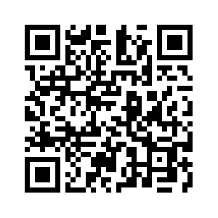
Donate with our QR code app to
Amazing Grace Christian Fellowship
Donations are Deeply Appreciated!

