Slide 3
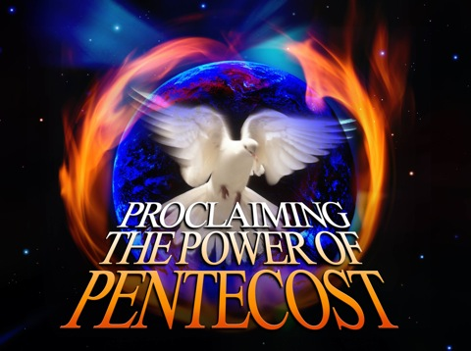
The Feast of Pentecost
by Pastor Fee Soliven
Exodus 23:14-16
Sunday Morning
June 2,2025 – Sivan 6, 5785

Slide 4
Exodus 23:14-16
14 "Three times you shall keep a feast to Me in the year: 15 You shall keep the Feast of Unleavened Bread (you shall eat unleavened bread seven days, as I commanded you, at the time appointed in the month of Abib, for in it you came out of Egypt; none shall appear before Me empty);

Slide 5
16 and the Feast of Harvest, the firstfruits of your labors which you have sown in the field; and the Feast of Ingathering at the end of the year, when you have gathered in the fruit of your labors from the field.

Slide 6
Feast of Weeks,
The Feast of Harvest,
The Latter Firstfruits
The Feast of Pentecost
and
The Feast of Shavuot

Slide 7
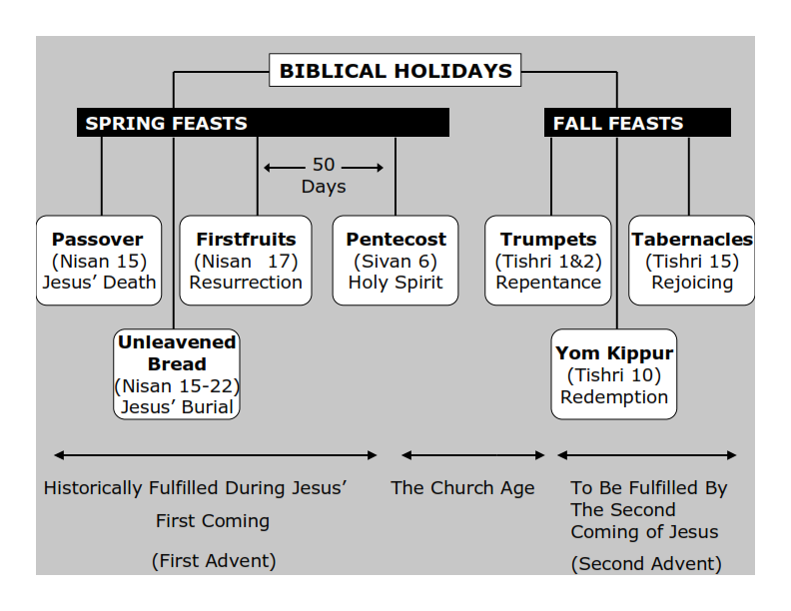
Philippians 3:20-21
20 For our citizenship is in heaven, from which we also eagerly wait for the Savior, the Lord Jesus Christ, 21 who will transform our lowly body that it may be conformed to His glorious body, according to the working by which He is able even to subdue all things to Himself.

Slide 8
Feast of Weeks

Slide 9
Leviticus 23:15-16
15'And you shall count for yourselves from the day after the Sabbath, from the day that you brought the sheaf of the wave offering: seven Sabbaths shall be completed. 16 Count fifty days to the day after the seventh Sabbath; then you shall offer a new grain offering to the LORD.

Slide 10
Latter Firstfruits

Slide 11
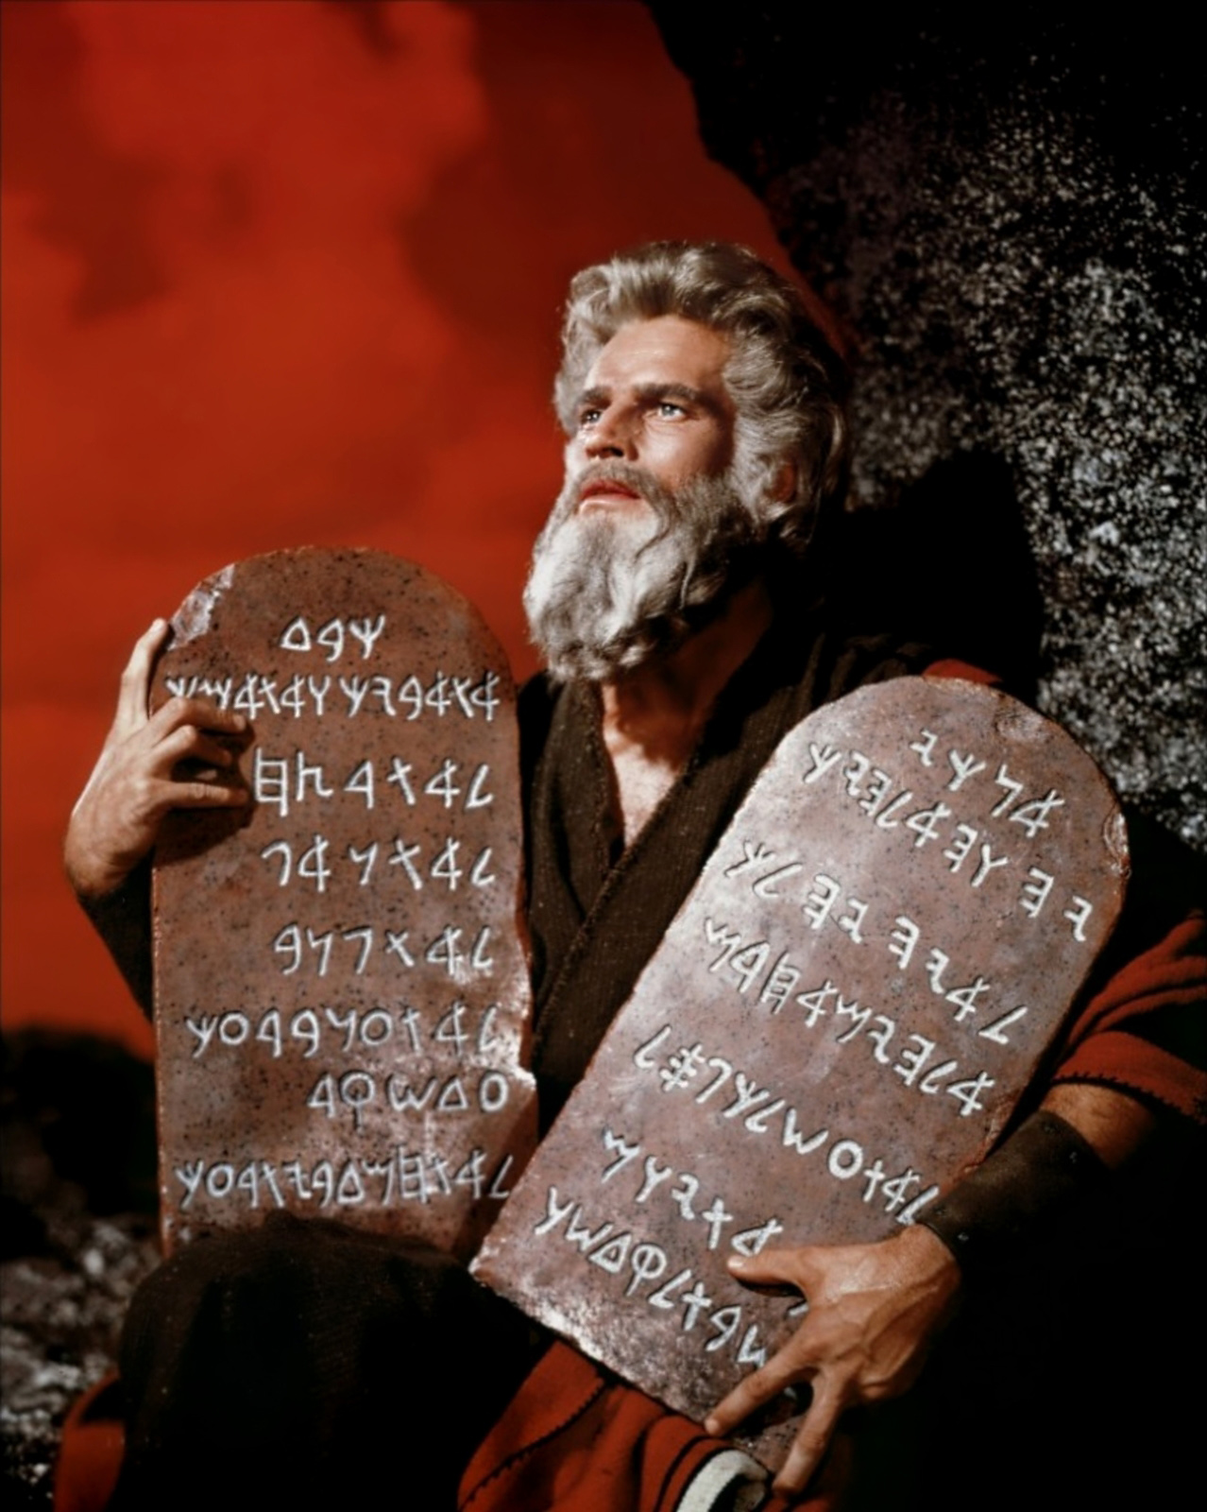

Slide 12
Acts 2:14-21
14 But Peter, standing up with the eleven, raised his voice and said to them, "Men of Judea and all who dwell in Jerusalem, let this be known to you, and heed my words. 15 For these are not drunk, as you suppose, since it is only the third hour of the day. 16 But this is what was spoken by the prophet Joel:

Slide 13
17'And it shall come to pass in the last days, says God, That I will pour out of My Spirit on all flesh; Your sons and your daughters shall prophesy, Your young men shall see visions, Your old men shall dream dreams. 18 And on My menservants and on My maidservants I will pour out My Spirit in those days; And they shall prophesy.

Slide 14
19 I will show wonders in heaven above And signs in the earth beneath: Blood and fire and vapor of smoke. 20 The sun shall be turned into darkness, And the moon into blood, Before the coming of the great and awesome day of the LORD. 21 And it shall come to pass That whoever calls on the name of the LORD Shall be saved.'

Slide 15
1. Pentecost serves as a reminder that God grants His Holy Spirit to the FirstFruits of His Spiritual Harvest.

Slide 16
Philippians 3:20-21
20 For our citizenship is in heaven, from which we also eagerly wait for the Savior, the Lord Jesus Christ, 21 who will transform our lowly body that it may be conformed to His glorious body, according to the working by which He is able even to subdue all things to Himself.

Slide 17
Exodus 23:16
16 and the Feast of Harvest, the firstfruits of your labors which you have sown in the field; and the Feast of Ingathering at the end of the year, when you have gathered in the fruit of your labors from the field.

Slide 18
Numbers 28:26
26'Also on the day of the firstfruits, when you bring a new grain offering to the LORD at your Feast of Weeks, you shall have a holy Convocation.

Slide 19
The Hebrew word for Feasts is also MOED meaning appointed times.
The Hebrew word for convocation is MIQRA meaning a dress rehearsal.

Slide 20
Pentecost
( Pentekostos in the original), which means "fiftieth"

Slide 21
2. The Gift of Pentecost: the Holy Spirit

Slide 22
Acts 1:12-15
12 Then they returned to Jerusalem from the mount called Olivet, which is near Jerusalem, a Sabbath day's journey. 13 And when they had entered, they went up into the upper room where they were staying: Peter, James, John, and Andrew; Philip and Thomas; Bartholomew and Matthew; James the son of Alphaeus and Simon the Zealot; and Judas the son of James.

Slide 23
14 These all continued with one accord in prayer and supplication, with the women and Mary the mother of Jesus, and with His brothers. 15 And in those days Peter stood up in the midst of the disciples (altogether the number of names was about a hundred and twenty)...

Slide 24
Acts 2:1-4
1 "Now when the Day of Pentecost had fully come, they were all with one accord in one place. 2 And suddenly there came a sound from heaven, as of a rushing mighty wind, and it filled the whole house where they were sitting.

Slide 25
3 Then there appeared to them divided tongues, as of fire, and one sat upon each of them. 4 And they were all filled with the Holy Spirit and began to speak with other tongues, as the Spirit gave them utterance"

Slide 26
Acts 2:17, Joel 2:28
"And it shall come to pass in the last days, says God, that I will pour out of My Spirit on all flesh".

Slide 27
Acts 2:38-39
38 "Repent, and let every one of you be baptized in the name of Jesus Christ for the remission of sins; and you shall receive the gift of the Holy Spirit. 39 For the promise is to you and to your children, and to all who are afar off, as many as the Lord our God will call".

Slide 28
The Law and God’s Grace!

Slide 29
Exodus 32:25-29
25 Now when Moses saw that the people were unrestrained (for Aaron had not restrained them, to their shame among their enemies), 26 then Moses stood in the entrance of the camp, and said, "Whoever is on the LORD's side, come to me." And all the sons of Levi gathered themselves together to him.

Slide 30
27 And he said to them, "Thus says the LORD God of Israel: 'Let every man put his sword on his side, and go in and out from entrance to entrance throughout the camp, and let every man kill his brother, every man his companion, and every man his neighbor.' "

Slide 31
28 So the sons of Levi did according to the word of Moses. And about three thousand men of the people fell that day. 29 Then Moses said, "Consecrate yourselves today to the LORD, that He may bestow on you a blessing this day, for every man has opposed his son and his brother."

Slide 32
Acts 2:40-42
40 And with many other words he testified and exhorted them, saying, "Be saved from this perverse generation." 41 Then those who gladly received his word were baptized; and that day about three thousand souls were added to them. 42 And they continued steadfastly in the apostles' doctrine and fellowship, in the breaking of bread, and in prayers.

Slide 33
3. Why we Need God's Spirit

Slide 34
1 Kings 8:46
"When they sin against You
(for there is no one who does not sin)...

Slide 35
John 16:8-9
8 And when He has come, He will convict the world of sin, and of righteousness, and of judgment: 9 of sin, because they do not believe in Me;

Slide 36
Romans 3:23
"for all have sinned and fall short of the glory of God"...

Slide 37
Deuteronomy 5:29
"Oh, that they had such a heart in them that they would fear Me and always keep all My commandments that it might be well with them and with their children forever!"

Slide 38
Jeremiah 17:9-10
9 "The heart is deceitful above all things, And desperately wicked; Who can know it? 10 I, the LORD, search the heart, I test the mind, Even to give every man according to his ways, According to the fruit of his doings.

Slide 39
Luke 10:27
"You shall love the LORD your God with all your heart, with all your soul, with all your strength, and with all your mind" and "[love] your neighbor as yourself."

Slide 40
The Holy Ghost is The Power To Raise Us From The Dead!

Slide 41
Romans 8:10-11
10 And if Christ is in you, the body is dead because of sin, but the Spirit is life because of righteousness. 11 But if the Spirit of Him who raised Jesus from the dead dwells in you, He who raised Christ from the dead will also give life to your mortal bodies through His Spirit who dwells in you.

Slide 42
4. The Holy Spirit at work in Our Lives

Slide 43
Acts 1:8
"But you shall receive power when the Holy Spirit has come upon you; and you shall be witnesses to Me in Jerusalem, and in all Judea and Samaria, and to the end of the earth."

Slide 44
Acts 17:6
"turning the world upside down"

Slide 45
Romans 15:13
"Now may the God of hope fill you with all joy and peace in believing, that you may abound in hope by the power of the Holy Spirit"

Slide 46
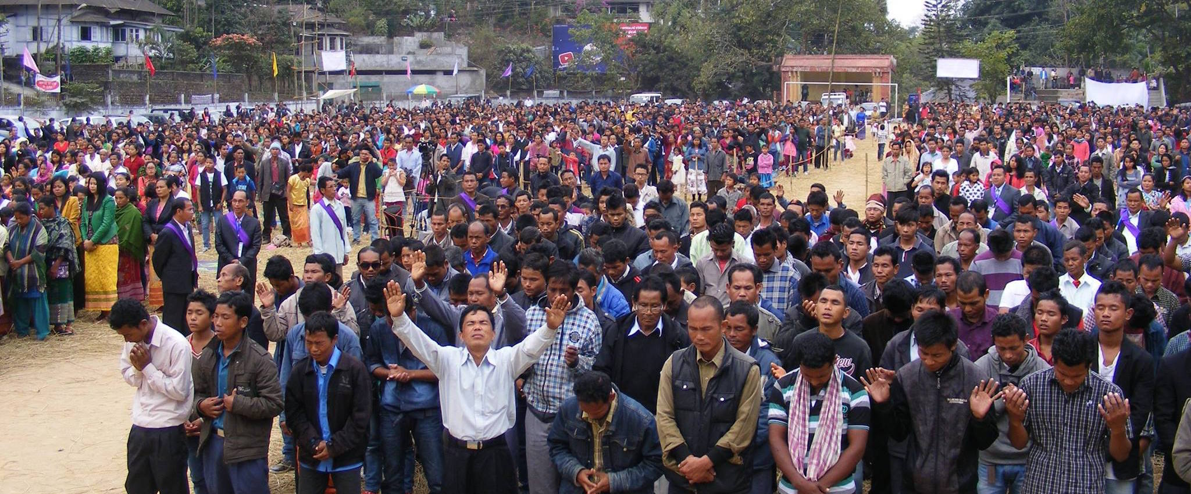
Acts 1:8
"But you shall receive power when the Holy Spirit has come upon you; and you shall be witnesses to Me in Jerusalem, and in all Judea and Samaria, and to the end of the earth."

Slide 47
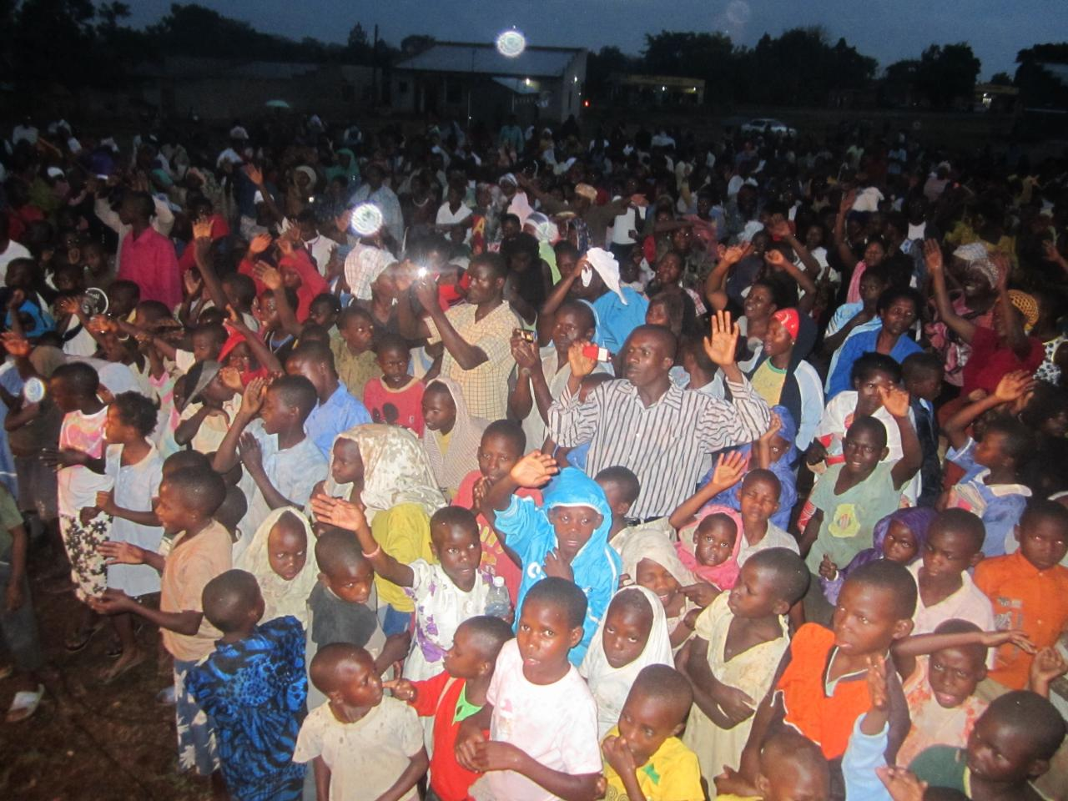
Acts 17:6
"turning the world upside down"

Slide 48
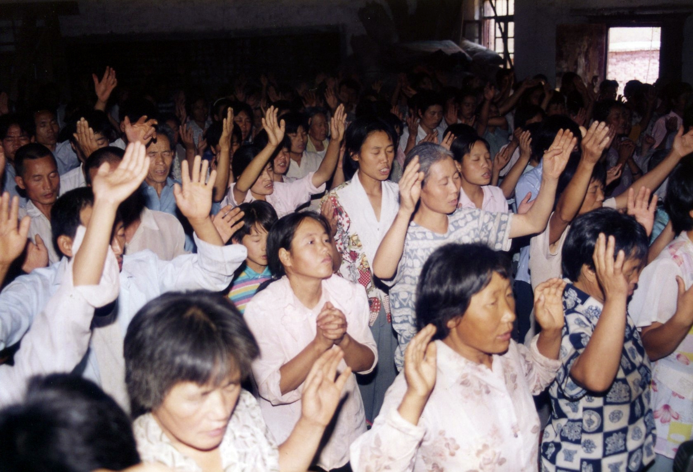
Romans 15:13
"Now may the God of hope fill you with all joy and peace in believing, that you may abound in hope by the power of the Holy Spirit"

Slide 49
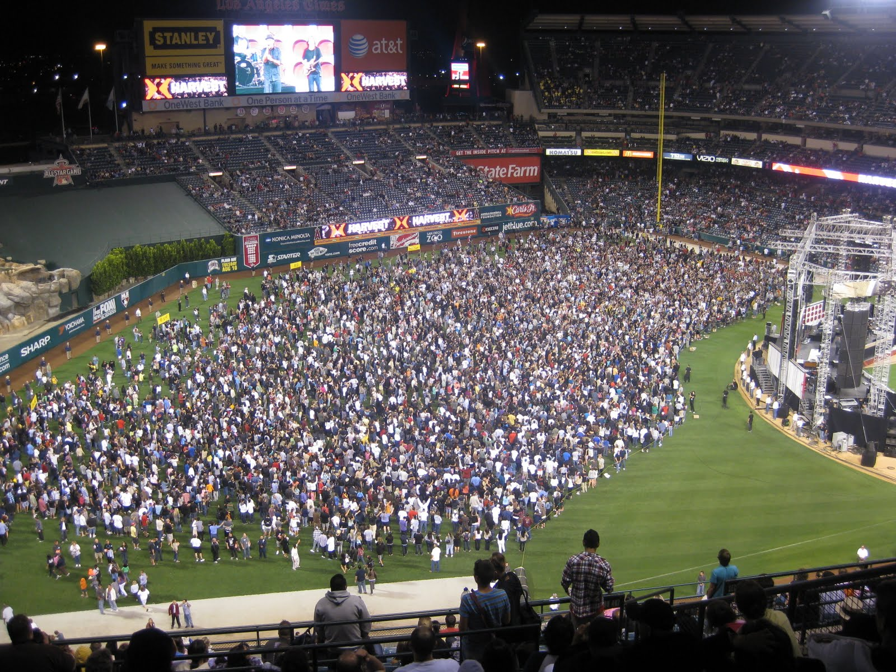

Slide 50
1 Thessalonians 4:13-18
13 But I do not want you to be ignorant, brethren, concerning those who have fallen asleep, lest you sorrow as others who have no hope. 14 For if we believe that Jesus died and rose again, even so God will bring with Him those who sleep in Jesus.

Slide 51
15 For this we say to you by the word of the Lord, that we who are alive and remain until the coming of the Lord will by no means precede those who are asleep. 16 For the Lord Himself will descend from heaven with a shout, with the voice of an archangel, and with the trumpet of God. And the dead in Christ will rise first.

Slide 52
17 Then we who are alive and remain shall be caught up together with them in the clouds to meet the Lord in the air. And thus we shall always be with the Lord. 18 Therefore comfort one another with these words.

Slide 53
1 Corinthians 15:50-54
50 Now this I say, brethren, that flesh and blood cannot inherit the kingdom of God; nor does corruption inherit incorruption. 51 Behold, I tell you a mystery: We shall not all sleep, but we shall all be changed-- 52 in a moment, in the twinkling of an eye, at the last trumpet. For the trumpet will sound, and the dead will be raised incorruptible, and we shall be changed.

Slide 54
53 For this corruptible must put on incorruption, and this mortal must put on immortality. 54 So when this corruptible has put on incorruption, and this mortal has put on immortality, then shall be brought to pass the saying that is written: "Death is swallowed up in victory."

Slide 55
20 Again, when a righteous man turns from his righteousness and commits iniquity, and I lay a stumbling block before him, he shall die; because you did not give him warning, he shall die in his sin, and his righteousness which he has done shall not be remembered; but his blood I will require at your hand.

Slide 56
Acts 2:38-39
38 Then Peter said to them, "Repent, and let every one of you be baptized in the name of Jesus Christ for the remission of sins; and you shall receive the gift of the Holy Spirit. 39 For the promise is to you and to your children, and to all who are afar off, as many as the Lord our God will call."

Slide 57
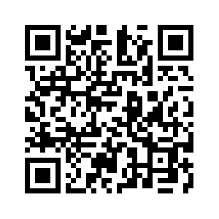
Donate with our QR code app to
Amazing Grace Christian Fellowship
Donations are Deeply Appreciated!

