Slide 1


Slide 2


Slide 3


Be Cleansed in Jesus Name
by Pastor Fee Soliven
Mark 1:40-45
Sunday Morning
July 20, 2025

Slide 4
Mark 1:40-45
40 Then a leper came to Him, imploring Him, kneeling down to Him and saying to Him, "If You are willing, You can make me clean." 41 And Jesus, moved with compassion, put out His hand and touched him, and said to him, "I am willing; be cleansed."

Slide 5
42 As soon as He had spoken, immediately the leprosy left him, and he was cleansed. 43 And He strictly warned him and sent him away at once, 44 and said to him, "See that you say nothing to anyone; but go your way, show yourself to the priest, and offer for your cleansing those things which Moses commanded, as a testimony to them."

Slide 6
45 But he went out and began to proclaim it freely, and to spread the matter, so that Jesus could no longer openly enter the city, but was outside in deserted places; and they came to Him from every quarter.

Slide 7
40 Then a leper came to Him, imploring Him, kneeling down to Him and saying to Him, "If You are willing, You can make me clean."

Slide 8
contagious, disfiguring, and / or deadly; some were as innocuous as ringworm.

Slide 9
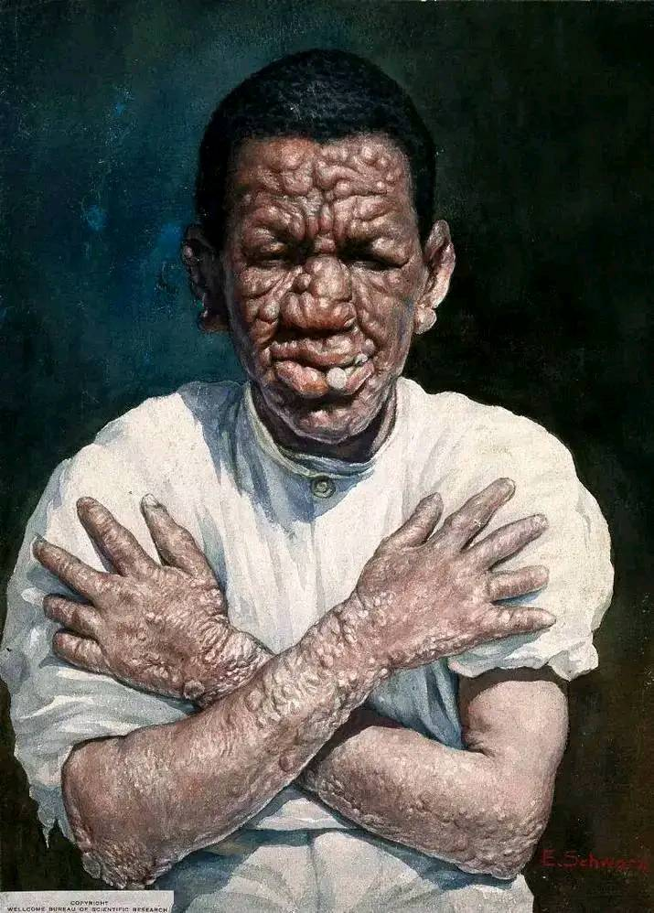

Slide 10
Description of Leprosy
Leprosy, also known as Hansen's disease, is a chronic infectious disease caused by bacteria called Mycobacterium leprae. It primarily affects the skin, peripheral nerves, eyes, and the lining of the nose. Leprosy is curable with multidrug therapy and early treatment can prevent disabilities.

Slide 11
Cause:
Leprosy is caused by bacteria, not by curses or sins.

Slide 12
Transmission:
It is transmitted through respiratory droplets from the nose and mouth of an untreated person during close and prolonged contact.

Slide 13
Symptoms:
Symptoms include skin lesions (discolored or reddish patches), nerve damage (loss of sensation, numbness), and muscle weakness. Clumps of Sore Like Lumps throughout the entire body.

Slide 14
Treatment:
Multidrug therapy is effective in curing leprosy, and treatment is provided free of charge by the World Health

Slide 15
Leviticus 13:1-3
1 And the LORD spoke to Moses and Aaron, saying: 2 "When a man has on the skin of his body a swelling, a scab, or a bright spot, and it becomes on the skin of his body like a leprous sore, then he shall be brought to Aaron the priest or to one of his sons the priests.

Slide 16
3 The priest shall examine the sore on the skin of the body; and if the hair on the sore has turned white, and the sore appears to be deeper than the skin of his body, it is a leprous sore. Then the priest shall examine him, and pronounce him unclean.

Slide 17
Leviticus 14:1-9
1 Then the LORD spoke to Moses, saying, 2 "This shall be the law of the leper for the day of his cleansing: He shall be brought to the priest. 3 And the priest shall go out of the camp, and the priest shall examine him; and indeed, if the leprosy is healed in the leper,

Slide 18
4 then the priest shall command to take for him who is to be cleansed two living and clean birds, cedar wood, scarlet, and hyssop. 5 And the priest shall command that one of the birds be killed in an earthen vessel over running water. 6 As for the living bird, he shall take it, the cedar wood and the scarlet and the hyssop, and dip them and the living bird in the blood of the bird that was killed over the running water.

Slide 19
7 And he shall sprinkle it seven times on him who is to be cleansed from the leprosy, and shall pronounce him clean, and shall let the living bird loose in the open field. 8 He who is to be cleansed shall wash his clothes, shave off all his hair, and wash himself in water, that he may be clean. After that he shall come into the camp, and shall stay outside his tent seven days.

Slide 20
9 But on the seventh day he shall shave all the hair off his head and his beard and his eyebrows--all his hair he shall shave off. He shall wash his clothes and wash his body in water, and he shall be clean.

Slide 21
41 And Jesus, moved with compassion, put out His hand and touched him, and said to him, "I am willing; be cleansed."

Slide 22
Leviticus 5:2-3
2 Or if a person touches any unclean thing, whether it is the carcass of an unclean beast, or the carcass of unclean livestock, or the carcass of unclean creeping things, and he is unaware of it, he also shall be unclean and guilty. 3 Or if he touches human uncleanness-- whatever uncleanness with which a man may be defiled, and he is unaware of it-- when he realizes it, then he shall be guilty.

Slide 23
Leviticus 13:14-15
14 But when raw flesh appears on him, he shall be unclean. 15 And the priest shall examine the raw flesh and pronounce him to be unclean; for the raw flesh is unclean. It is leprosy.

Slide 24
Numbers 5:1-4
1 And the LORD spoke to Moses, saying: 2 "Command the children of Israel that they put out of the camp every leper, everyone who has a discharge, and whoever becomes defiled by a corpse.

Slide 25
3 You shall put out both male and female; you shall put them outside the camp, that they may not defile their camps in the midst of which I dwell." 4 And the children of Israel did so, and put them outside the camp; as the LORD spoke to Moses, so the children of Israel did.

Slide 26
Matthew 8:5-13
5 Now when Jesus had entered Capernaum, a centurion came to Him, pleading with Him, 6 saying, “Lord, my servant is lying at home paralyzed, dreadfully tormented.” 7 And Jesus said to him, “I will come and heal him.”

Slide 27
8 The centurion answered and said, “Lord, I am not worthy that You should come under my roof. But only speak a word, and my servant will be healed. 9 For I also am a man under authority, having soldiers under me. And I say to this one, ‘Go,’ and he goes; and to another, ‘Come,’ and he comes; and to my servant, ‘Do this,’ and he does it.”

Slide 28
10 When Jesus heard it, He marveled, and said to those who followed, “Assuredly, I say to you, I have not found such great faith, not even in Israel! 11 And I say to you that many will come from east and west, and sit down with Abraham, Isaac, and Jacob in the kingdom of heaven. 12 But the sons of the kingdom will be cast out into outer darkness. There will be weeping and gnashing of teeth.”

Slide 29
13 Then Jesus said to the centurion, “Go your way; and as you have believed, so let it be done for you.” And his servant was healed that same hour.

Slide 30
42 As soon as He had spoken, immediately the leprosy left him, and he was cleansed.

Slide 31
Matthew 11:2-6
2 And when John had heard in prison about the works of Christ, he sent two of his disciples 3 and said to Him, "Are You the Coming One, or do we look for another?" 4 Jesus answered and said to them, "Go and tell John the things which you hear and see:

Slide 32
5 The blind see and the lame walk; the lepers are cleansed and the deaf hear; the dead are raised up and the poor have the gospel preached to them. 6 And blessed is he who is not offended because of Me."

Slide 33
43 And He strictly warned him and sent him away at once, 44 and said to him, "See that you say nothing to anyone; but go your way, show yourself to the priest, and offer for your cleansing those things which Moses commanded, as a testimony to them."

Slide 34
John 2:24-25
24 But Jesus did not commit Himself to them, because He knew all men, 25 and had no need that anyone should testify of man, for He knew what was in man.

Slide 35
Matthew 26:62-68
62 And the high priest arose and said to Him, "Do You answer nothing? What is it these men testify against You?" 63 But Jesus kept silent. And the high priest answered and said to Him, "I put You under oath by the living God: Tell us if You are the Christ, the Son of God!"

Slide 36
64 Jesus said to him, "It is as you said. Nevertheless, I say to you, hereafter you will see the Son of Man sitting at the right hand of the Power, and coming on the clouds of heaven." 65 Then the high priest tore his clothes, saying, "He has spoken blasphemy! What further need do we have of witnesses? Look, now you have heard His blasphemy!

Slide 37
66 What do you think?" They answered and said, "He is deserving of death." 67 Then they spat in His face and beat Him; and others struck Him with the palms of their hands, 68 saying, "Prophesy to us, Christ! Who is the one who struck You?"

Slide 38
45 But he went out and began to proclaim it freely, and to spread the matter, so that Jesus could no longer openly enter the city, but was outside in deserted places; and they came to Him from every quarter.

Slide 39
Luke 4:42-44
42 At daybreak, Jesus went out to a solitary place, and the crowds were looking for Him. They came to Him and tried to keep Him from leaving. 43 But Jesus told them, “I must preach the good news of the kingdom of God to the other towns as well, because that is why I was sent.” 44 And He continued to preach in the synagogues of Judea.

Slide 40
1 Thessalonians 4:13-18
13 But I do not want you to be ignorant, brethren, concerning those who have fallen asleep, lest you sorrow as others who have no hope. 14 For if we believe that Jesus died and rose again, even so God will bring with Him those who sleep in Jesus.

Slide 41
15 For this we say to you by the word of the Lord, that we who are alive and remain until the coming of the Lord will by no means precede those who are asleep. 16 For the Lord Himself will descend from heaven with a shout, with the voice of an archangel, and with the trumpet of God. And the dead in Christ will rise first.

Slide 42
17 Then we who are alive and remain shall be caught up together with them in the clouds to meet the Lord in the air. And thus we shall always be with the Lord. 18 Therefore comfort one another with these words.

Slide 43
1 Corinthians 15:50-54
50 Now this I say, brethren, that flesh and blood cannot inherit the kingdom of God; nor does corruption inherit incorruption. 51 Behold, I tell you a mystery: We shall not all sleep, but we shall all be changed-- 52 in a moment, in the twinkling of an eye, at the last trumpet. For the trumpet will sound, and the dead will be raised incorruptible, and we shall be changed.

Slide 44
53 For this corruptible must put on incorruption, and this mortal must put on immortality. 54 So when this corruptible has put on incorruption, and this mortal has put on immortality, then shall be brought to pass the saying that is written: "Death is swallowed up in victory."

Slide 45

20 Again, when a righteous man turns from his righteousness and commits iniquity, and I lay a stumbling block before him, he shall die; because you did not give him warning, he shall die in his sin, and his righteousness which he has done shall not be remembered; but his blood I will require at your hand.

Slide 46
Acts 2:38-39
38 Then Peter said to them, "Repent, and let every one of you be baptized in the name of Jesus Christ for the remission of sins; and you shall receive the gift of the Holy Spirit. 39 For the promise is to you and to your children, and to all who are afar off, as many as the Lord our God will call."

Slide 47

Donate with our QR code app to
Amazing Grace Christian Fellowship
Donations are Deeply Appreciated!

