Slide 1


Slide 2


Slide 3

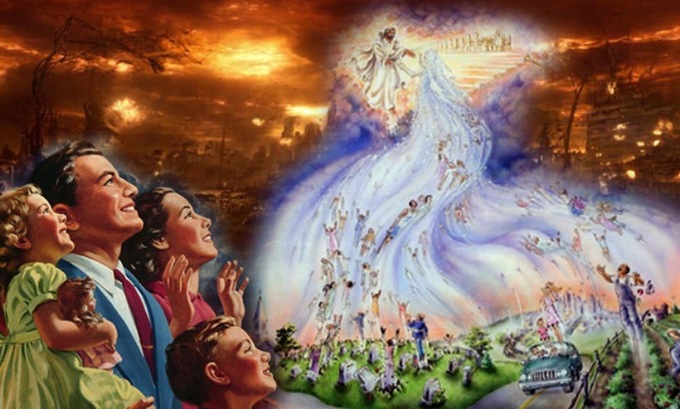
The Great and Mighty Exodus
by Pastor Fee Soliven
Ecclesiastes 1:9
Sunday Morning
July 6, 2025

Slide 4
Ecclesiastes 1:9
“That which has been is what will be, That which is done is what will be done, And there is nothing new under the sun”

Slide 5
Question?
Is the rapture of the Born-Again Church Imminent?

Slide 6
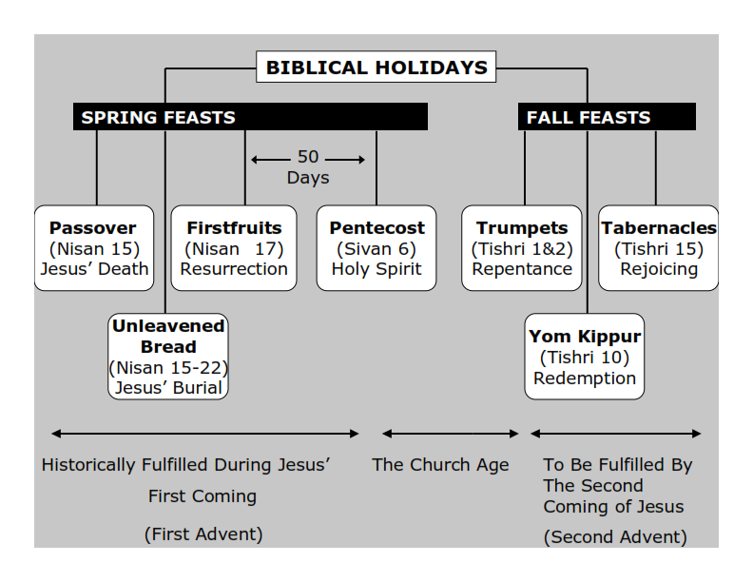
Philippians 3:20-21
20 For our citizenship is in heaven, from which we also eagerly wait for the Savior, the Lord Jesus Christ, 21 who will transform our lowly body that it may be conformed to His glorious body, according to the working by which He is able even to subdue all things to Himself.

Slide 7
The Prophetic Emergence and Convergence

Slide 8
Matthew 24:3-14
3 Now as He sat on the Mount of Olives, the disciples came to Him privately, saying, "Tell us, when will these things be? And what will be the sign of Your coming, and of the end of the age?" 4 And Jesus answered and said to them: "Take heed that no one deceives you. 5 For many will come in My name, saying, 'I am the Christ,' and will deceive many.

Slide 9
6 And you will hear of wars and rumors of wars. See that you are not troubled; for all these things must come to pass, but the end is not yet. 7 For nation will rise against nation, and kingdom against kingdom. And there will be famines, pestilences, and earthquakes in various places. 8 All these are the beginning of sorrows. 9 Then they will deliver you up to tribulation and kill you, and you will be hated by all nations for My name's sake.

Slide 10
10 And then many will be offended, will betray one another, and will hate one another. 11 Then many false prophets will rise up and deceive many. 12 And because lawlessness will abound, the love of many will grow cold. 13 But he who endures to the end shall be saved. 14 And this gospel of the kingdom will be preached in all the world as a witness to all the nations, and then the end will come.

Slide 11
There are 56 Current Wars in
our World Today
The Russia-Ukraine War
The Israel-Palestine conflict
The Sudanese Civil War
The Myanmar Civil War
Conflict in the Sahel region (e.g., Mali, Burkina Faso, Niger)
The Syrian Civil War
The Yemeni Civil War
Pakistan - India Conflict

Slide 12
Current Known Plagues – Pestilences
Aids – HIV
Influenzas – Flues
Measles
Chicken Pox
Smallpox
Mumps
Covid 19

Slide 13
Earthquakes and Tsunamis
2011 Great East Japan Earthquake and

Slide 14
2004 Sumatra, Indonesia Tsunami
9.1 earthquake that ruptured a 1,300-km-long segment of the Sumatran megathrust. This huge rupture caused an uplift on the ocean floor and created a devastating tsunami wave that reached over 98,000 feet high. This terrifying wave hit coastal areas in 14 countries, killing an estimated 228,000 people with Indonesia, Sri Lanka, India and Thailand suffering the most deaths.

Slide 15
 | Location | Date | Magnitude (M_{w})
1 | Valdivia, Chile | May 22, 1960 | 9.5
2 | Alaska, USA | March 27, 1964 | 9.2
3 | Sumatra | December 26, 2004 | 9.1 to 9.3
4 | Tohoku | March 11, 2011 | 9.1
5 | Kamchatka, Russia | November 5, 1952 | 9.0
6 | Chile | February 27, 2010 | 8.8
7 | Rat Island | February 3, 1965 | 8.7
8 | Assam-Tibet | August 15, 1950 | 8.6
9 | Aleutian Islands | April 1, 1946 | 8.6
10 | Indian Ocean | April 11, 2012 | 8.6

Slide 16
False Prophets – Won’t Talk About Sin
Joel Osteen
Steven Furtick
Joyce Meyer

Slide 17
Days Like Lot and Noah
Luke 17:28-30
28 Likewise as it was also in the days of Lot: They ate, they drank, they bought, they sold, they planted, they built; 29 but on the day that Lot went out of Sodom it rained fire and brimstone from heaven and destroyed them all. 30 Even so will it be in the day when the Son of Man is revealed.

Slide 18
Matthew 24:37-39
37 But as the days of Noah were, so also will the coming of the Son of Man be. 38 For as in the days before the flood, they were eating and drinking, marrying and giving in marriage, until the day that Noah entered the ark, 39 and did not know until the flood came and took them all away, so also will the coming of the Son of Man be.

Slide 19
The Return of Israel
1948 the Birth of Israel
In 77 years Israel has become a powerful country with a devastating Masad Intelligence and Powerful Military.
2nd Best Air Force in the World
Enormous exports of Natural Gas and Fruits – Vegetables

Slide 20
Psalm 102:16
"When the LORD shall build up Zion, he shall appear in his glory."

Slide 21
God’s Promise to Take His Church Home Before His
Wrath is Poured Out!

Slide 22
John 14:1-6
1 "Let not your heart be troubled; you believe in God, believe also in Me. 2 In My Father's house are many mansions; if it were not so, I would have told you. I go to prepare a place for you. 3 And if I go and prepare a place for you, I will come again and receive you to Myself; that where I am, there you may be also. 4 And where I go you know, and the way you know."

Slide 23
5 Thomas said to Him, "Lord, we do not know where You are going, and how can we know the way?" 6 Jesus said to him, "I am the way, the truth, and the life. No one comes to the Father except through Me.

Slide 24
The Church is Jesus’ Bride!

Slide 25
Matthew 25:1-13
1 "Then the kingdom of heaven shall be likened to ten virgins who took their lamps and went out to meet the bridegroom. 2 Now five of them were wise, and five were foolish. 3 Those who were foolish took their lamps and took no oil with them, 4 but the wise took oil in their vessels with their lamps.

Slide 26
5 But while the bridegroom was delayed, they all slumbered and slept. 6 And at midnight a cry was heard: 'Behold, the bridegroom is coming; go out to meet him!' 7 "Then all those virgins arose and trimmed their lamps. 8 And the foolish said to the wise, 'Give us some of your oil, for our lamps are going out.'

Slide 27
9 "But the wise answered, saying, 'No, lest there should not be enough for us and you; but go rather to those who sell, and buy for yourselves.' 10 "And while they went to buy, the bridegroom came, and those who were ready went in with him to the wedding; and the door was shut.

Slide 28
11 Afterward the other virgins came also, saying, 'Lord, Lord, open to us!' 12 "But he answered and said, 'Assuredly, I say to you, I do not know you.' 13 "Watch therefore, for you know neither the day nor the hour in which the Son of Man is coming.

Slide 29
The Huge Misconception on Verse 13 on Jesus Coming for His Bride!

Slide 30
1 Thessalonians 4:13-18
13 But I do not want you to be ignorant, brethren, concerning those who have fallen asleep, lest you sorrow as others who have no hope. 14 For if we believe that Jesus died and rose again, even so God will bring with Him those who sleep in Jesus.

Slide 31
15 For this we say to you by the word of the Lord, that we who are alive and remain until the coming of the Lord will by no means precede those who are asleep. 16 For the Lord Himself will descend from heaven with a shout, with the voice of an archangel, and with the trumpet of God. And the dead in Christ will rise first.

Slide 32
17 Then we who are alive and remain shall be caught up together with them in the clouds to meet the Lord in the air. And thus we shall always be with the Lord. 18 Therefore comfort one another with these words.

Slide 33
The Apostle Paul and his disciples clearly understood that the Day and The Hour was the New Moon Citing on the Feast of Trumpets!
The New Moon sighting on the Feast of Trumpets, also known as Rosh Hashanah, is a significant 2 Day event in the Jewish faith, marking the start of the civil new year and the beginning of the fall feast season.

Slide 34
It is a time of introspection, repentance, and seeking forgiveness, observed with the blowing of trumpets, special sacrifices, and a proclamation of the feast.
The sighting of the new moon by witnesses signals the start of the month of Tishri, which includes the Feast of Trumpets.

Slide 35
Feasts of the Lord:
The Rapture
Jesus in the Feast of Trumpets
Here's a more detailed explanation:

Slide 36
Biblical Basis

Slide 37
The Feast of Trumpets is one of the biblical feasts commanded in the Torah, specifically mentioned in:

Slide 38
Leviticus 23:23-25
23 Then the LORD spoke to Moses, saying, 24 "Speak to the children of Israel, saying: 'In the seventh month, on the first day of the month, you shall have a sabbath-rest, a memorial of blowing of trumpets, a holy convocation. 25 You shall do no customary work on it; and you shall offer an offering made by fire to the LORD.' "

Slide 39
It is a day of rest, marked by the blowing of trumpets, a call to assembly, and a reminder of God's presence and sovereignty.

Slide 40
The New Moon
In ancient Israel, the New Moon was a significant event. It marked the start of the Hebrew month and was determined by the sighting of the first sliver of the new moon by two witnesses.

Slide 41
Sighting and Announcement
Once the new moon was sighted and confirmed by witnesses, the month of Tishri began, and the Feast of Trumpets was announced with the blowing of trumpets (shofar).

Slide 42
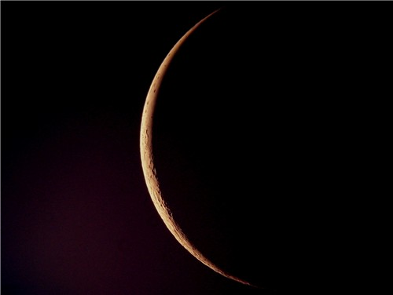
The Great tribulation is going to be a time of horrific trouble this world has never seen nor will it ever see it like that again!

Slide 43
Significance
The Feast of Trumpets is not only a time of remembrance but also a time of judgment, with a strong emphasis on introspection and repentance, leading up to the Day of Atonement (Yom Kippur).

Slide 44
Modern Observance
The Feast of Trumpets, or Rosh Hashanah, is still celebrated as the New Year, with the blowing of the shofar as a central element.

Slide 45
Symbolism
The Feast of Trumpets is associated with several symbolic themes, including the marriage of the Messiah, the resurrection of the dead, and the crowning of the King.

Slide 46
A Time of Mystery
The exact day and hour of the Feast of Trumpets were not known in advance, adding a sense of mystery to its observance.

Slide 47
Mathew 25:13
"Watch therefore, for you know neither the day nor the hour in which the Son of Man is coming.

Slide 48
1 Thessalonians 5:1-11
1 But concerning the times and the seasons, brethren, you have no need that I should write to you. 2 For you yourselves know perfectly that the day of the Lord so comes as a thief in the night.

Slide 49
3 For when they say, "Peace and safety!" then sudden destruction comes upon them, as labor pains upon a pregnant woman. And they shall not escape. 4 But you, brethren, are not in darkness, so that this Day should overtake you as a thief. 5 You are all sons of light and sons of the day. We are not of the night nor of darkness.

Slide 50
6 Therefore let us not sleep, as others do, but let us watch and be sober. 7 For those who sleep, sleep at night, and those who get drunk are drunk at night. 8 But let us who are of the day be sober, putting on the breastplate of faith and love, and as a helmet the hope of salvation.

Slide 51
9 For God did not appoint us to wrath, but to obtain salvation through our Lord Jesus Christ, 10 who died for us, that whether we wake or sleep, we should live together with Him. 11 Therefore comfort each other and edify one another, just as you also are doing.

Slide 52
Daniel 12:4
“But you, Daniel, shut up the words, and seal the book until the time of the end; many shall run to and fro, and knowledge shall increase.”

Slide 53
Philippians 3:20-21
20 For our citizenship is in heaven, from which we also eagerly wait for the Savior, the Lord Jesus Christ, 21 who will transform our lowly body that it may be conformed to His glorious body, according to the working by which He is able even to subdue all things to Himself.

Slide 54
1 Thessalonians 4:13-18
13 But I do not want you to be ignorant, brethren, concerning those who have fallen asleep, lest you sorrow as others who have no hope. 14 For if we believe that Jesus died and rose again, even so God will bring with Him those who sleep in Jesus.

Slide 55
15 For this we say to you by the word of the Lord, that we who are alive and remain until the coming of the Lord will by no means precede those who are asleep. 16 For the Lord Himself will descend from heaven with a shout, with the voice of an archangel, and with the trumpet of God. And the dead in Christ will rise first.

Slide 56
17 Then we who are alive and remain shall be caught up together with them in the clouds to meet the Lord in the air. And thus we shall always be with the Lord. 18 Therefore comfort one another with these words.

Slide 57
1 Corinthians 15:50-54
50 Now this I say, brethren, that flesh and blood cannot inherit the kingdom of God; nor does corruption inherit incorruption. 51 Behold, I tell you a mystery: We shall not all sleep, but we shall all be changed-- 52 in a moment, in the twinkling of an eye, at the last trumpet. For the trumpet will sound, and the dead will be raised incorruptible, and we shall be changed.

Slide 58
53 For this corruptible must put on incorruption, and this mortal must put on immortality. 54 So when this corruptible has put on incorruption, and this mortal has put on immortality, then shall be brought to pass the saying that is written: "Death is swallowed up in victory."

Slide 59

20 Again, when a righteous man turns from his righteousness and commits iniquity, and I lay a stumbling block before him, he shall die; because you did not give him warning, he shall die in his sin, and his righteousness which he has done shall not be remembered; but his blood I will require at your hand.

Slide 60
Acts 2:38-39
38 Then Peter said to them, "Repent, and let every one of you be baptized in the name of Jesus Christ for the remission of sins; and you shall receive the gift of the Holy Spirit. 39 For the promise is to you and to your children, and to all who are afar off, as many as the Lord our God will call."

Slide 61

Donate with our QR code app to
Amazing Grace Christian Fellowship
Donations are Deeply Appreciated!

