Slide 1


Slide 2


Slide 3


"Jesus Came for The Sick"
by Pastor Fee Soliven
Mark 2:13-17
Sunday Morning
August 24, 2025

Slide 4
Mark 2:13-17
13 Then He went out again by the sea; and all the multitude came to Him, and He taught them. 14 As He passed by, He saw Levi the son of Alphaeus sitting at the tax office. And He said to him, "Follow Me." So he arose and followed Him.

Slide 5
15 Now it happened, as He was dining in Levi's house, that many tax collectors and sinners also sat together with Jesus and His disciples; for there were many, and they followed Him. 16 And when the scribes and Pharisees saw Him eating with the tax collectors and sinners, they said to His disciples, "How is it that He eats and drinks with tax collectors and sinners?"

Slide 6
17 When Jesus heard it, He said to them, "Those who are well have no need of a physician, but those who are sick. I did not come to call the righteous, but sinners, to repentance."

Slide 7
13 Then He went out again by the sea; and all the multitude came to Him, and He taught them.

Slide 8
The three towns that Jesus cursed were Chorazin, Bethsaida, and Capernaum.

Slide 9
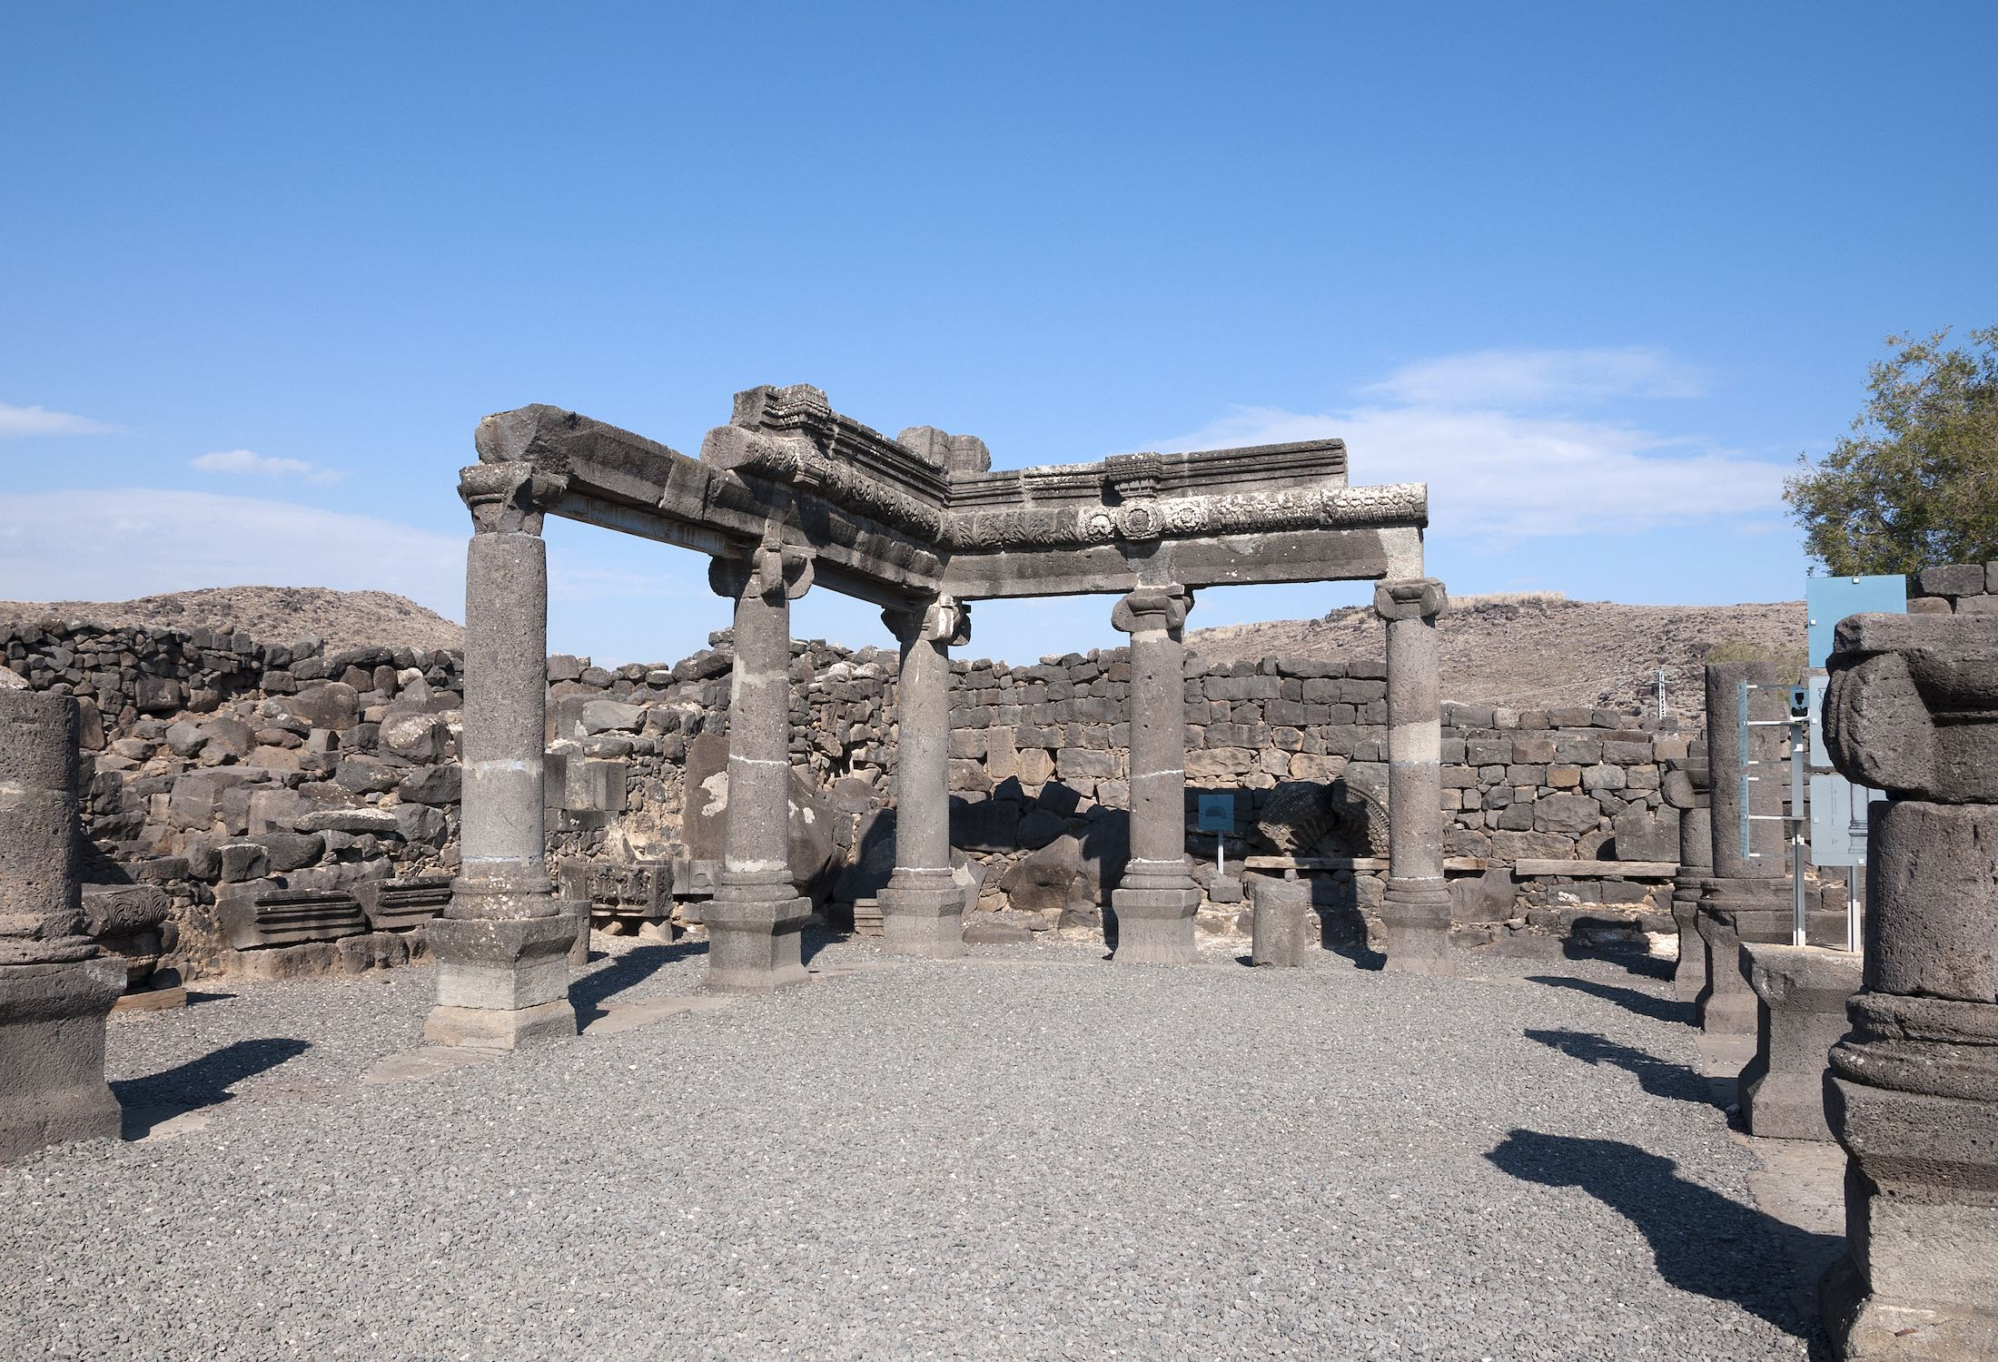
Matthew 28:18
And Jesus came and spoke to them, saying, "All authority has been given to Me in heaven and on earth.

Slide 10
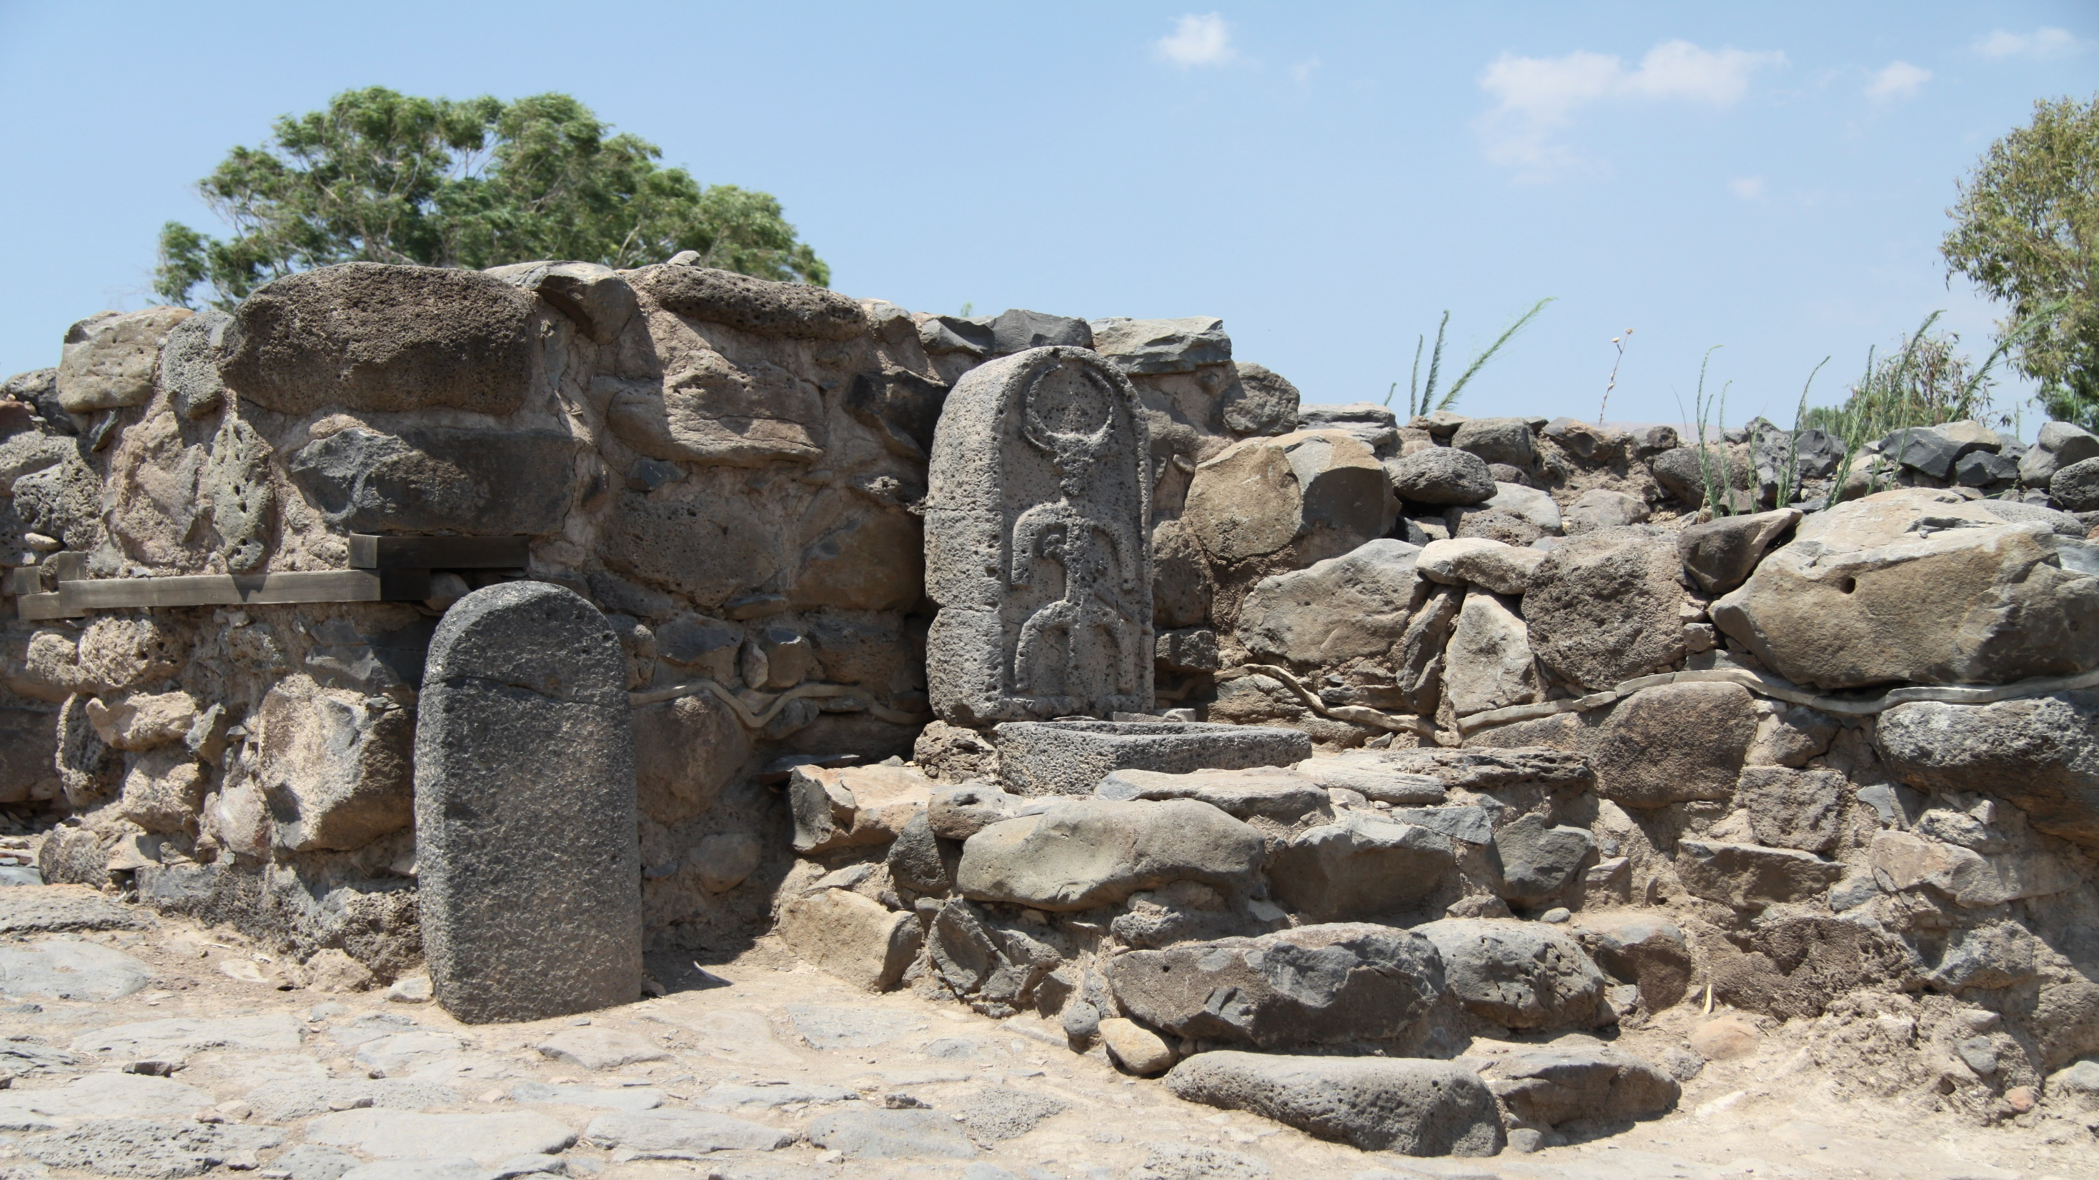
Ephesians 1:19-23
19 and what is the exceeding greatness of His power toward us who believe, according to the working of His mighty power 20 which He worked in Christ when He raised Him from the dead and seated Him at His right hand in the heavenly places,

Slide 11
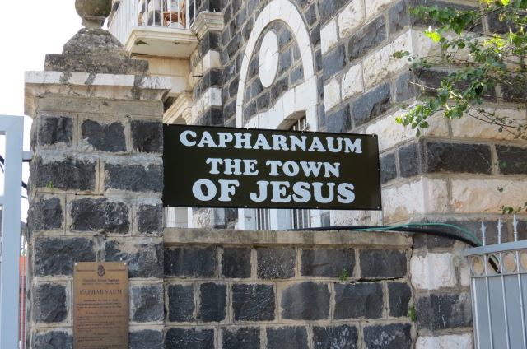
John 3:16-18
16 For God so loved the world that He gave His only begotten Son, that whoever believes in Him should not perish but have everlasting life. 17 For God did not send His Son into the world to condemn the world, but that the world through Him might be saved. 18 He who believes in Him is not condemned; but he who does not believe is condemned already, because he has not believed in the name of the only begotten Son of God.

Slide 12
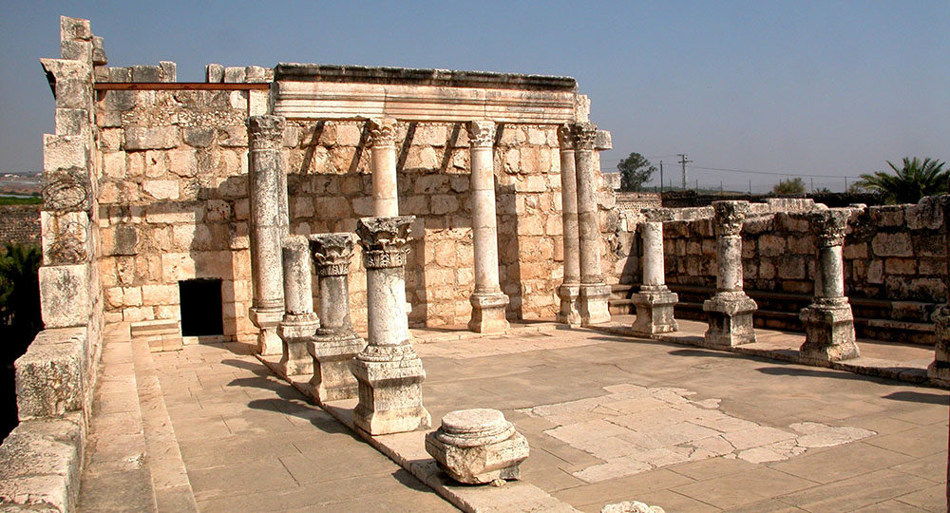
21 far above all principality and power and might and dominion, and every name that is named, not only in this age but also in that which is to come. 22 And He put all things under His feet, and gave Him to be head over all things to the church, 23 which is His body, the fullness of Him who fills all in all.

Slide 13
Why These Towns Were Cursed?

Slide 14
Unrepentant Hearts
The people in these cities saw Jesus's miracles and heard his teachings, but they did not change their minds or turn to God. They were faithless!

Slide 15
Familiarity and Judgment
Jesus notes that if the miracles he performed in these cities had been done in other, more wicked cities, those cities would have repented.

Slide 16
Matthew 11:20-24
20 Then He began to rebuke the cities in which most of His mighty works had been done, because they did not repent: 21 "Woe to you, Chorazin! Woe to you, Bethsaida! For if the mighty works which were done in you had been done in Tyre and Sidon, they would have repented long ago in sackcloth and ashes.

Slide 17
22 But I say to you, it will be more tolerable for Tyre and Sidon in the day of judgment than for you. 23 And you, Capernaum, who are exalted to heaven, will be brought down to Hades; for if the mighty works which were done in you had been done in Sodom, it would have remained until this day.

Slide 18
24 But I say to you that it shall be more tolerable for the land of Sodom in the day of judgment than for you."

Slide 19
The Outcome of the Curse

Slide 20
Destruction and Ruins
Today, the ruins of Chorazin, Bethsaida, and Capernaum lie as archaeological sites, a testament to God's judgment.

Slide 21
Contrast with Other Cities
Neighboring cities like Tiberias and Cana, which were not cursed, remain well-populated.

Slide 22
Matthew 5:1
And seeing the multitudes, He went up on a mountain, and when He was seated His disciples came to Him.

Slide 23
14 As He passed by, He saw Levi the son of Alphaeus sitting at the tax office. And He said to him, "Follow Me." So he arose and followed Him.

Slide 24
The Call of Jesus is Personal and Direct
Jesus calls Levi by name, indicating that His call to follow Him is personal. We, too, are called individually by Christ to follow Him.

Slide 25
Immediate Obedience
Levi’s response to Jesus’ call is immediate. This teaches us the importance of responding promptly to God’s call in our lives.

Slide 26
Leaving the Old Life Behind
Levi leaves his tax booth, symbolizing a departure from his old life. Following Jesus often requires us to leave behind our past and embrace a new identity in Christ.

Slide 27
Inclusivity of Jesus' Call
Jesus calls a tax collector, someone marginalized and despised, showing that His call is for everyone, regardless of their past or social status.

Slide 28
Transformation and Purpose
Levi's transformation from a tax collector to an apostle demonstrates the transformative power of Jesus' call and the new purpose He gives to our lives.

Slide 29
15 Now it happened, as He was dining in Levi's house, that many tax collectors and sinners also sat together with Jesus and His disciples; for there were many, and they followed Him.

Slide 30
Jesus' Inclusive Love
Jesus’ willingness to dine with tax collectors and sinners demonstrates His inclusive love and mission to reach the lost. We are called to extend love and grace to those society may marginalize.

Slide 31
Breaking Social Barriers
Jesus challenges societal norms by associating with those deemed unworthy. As followers of Christ, we should be willing to break social barriers to share the Gospel.

Slide 32
The Call to Repentance
Jesus’ presence among sinners is not an endorsement of sin but a call to repentance and transformation. We should encourage others to turn to Christ for forgiveness and new life.

Slide 33
Community and Fellowship
The gathering at Levi's house illustrates the importance of community and fellowship in the Christian life. We should seek to build relationships that foster spiritual growth and support.

Slide 34
Following Jesus' Example
As disciples, we are to follow Jesus' example in reaching out to those who are lost, offering them hope and the message of salvation.

Slide 35
16 And when the scribes and Pharisees saw Him eating with the tax collectors and sinners, they said to His disciples, "How is it that He eats and drinks with tax collectors and sinners?"

Slide 36
Understanding Jesus' Mission
Jesus came to seek and save the lost, which includes those marginalized by society. His association with sinners demonstrates His mission to bring redemption to all.

Slide 37
Challenging Religious Legalism
The Pharisees' focus on legalism blinded them to the heart of God's law, which is mercy and compassion. Believers are called to prioritize love and grace over rigid adherence to tradition.

Slide 38
Embracing the Outcast
Jesus’ example teaches us to reach out to those whom society often rejects. We are called to be agents of grace and acceptance, reflecting Christ’s love.

Slide 39
Self-Reflection on Sin
Recognizing our own sinfulness helps us to understand our need for Jesus and prevents us from judging others harshly.

Slide 40
Community and Fellowship
True Christian fellowship includes welcoming all people, regardless of their past, into the community of believers.

Slide 41
17 When Jesus heard it, He said to them, "Those who are well have no need of a physician, but those who are sick. I did not come to call the righteous, but sinners, to repentance."

Slide 42
Jesus' Mission to the Marginalized
Jesus intentionally seeks out those who are spiritually and socially marginalized, demonstrating God's love and grace for all people, regardless of their past or social status.

Slide 43
The Role of Spiritual Healing
Just as a doctor is needed for the sick, Jesus is the spiritual healer for those who recognize their need for salvation. This highlights the importance of acknowledging our spiritual brokenness.

Slide 44
Humility and Self-Reflection
The passage challenges us to examine our own hearts and recognize our need for Jesus, rather than assuming self-righteousness or superiority over others.

Slide 45
Mercy Over Sacrifice
Jesus' actions emphasize the importance of mercy and compassion over ritualistic adherence to religious practices. This calls us to prioritize love and grace in our interactions with others.

Slide 46
The Call to Repentance
Jesus' mission includes calling sinners to repentance, inviting us to turn away from sin and towards a life of righteousness through Him.

Slide 47
1 Thessalonians 4:13-18
13 But I do not want you to be ignorant, brethren, concerning those who have fallen asleep, lest you sorrow as others who have no hope. 14 For if we believe that Jesus died and rose again, even so God will bring with Him those who sleep in Jesus.

Slide 48
15 For this we say to you by the word of the Lord, that we who are alive and remain until the coming of the Lord will by no means precede those who are asleep. 16 For the Lord Himself will descend from heaven with a shout, with the voice of an archangel, and with the trumpet of God. And the dead in Christ will rise first.

Slide 49
17 Then we who are alive and remain shall be caught up together with them in the clouds to meet the Lord in the air. And thus we shall always be with the Lord. 18 Therefore comfort one another with these words.

Slide 50
1 Corinthians 15:50-54
50 Now this I say, brethren, that flesh and blood cannot inherit the kingdom of God; nor does corruption inherit incorruption. 51 Behold, I tell you a mystery: We shall not all sleep, but we shall all be changed-- 52 in a moment, in the twinkling of an eye, at the last trumpet. For the trumpet will sound, and the dead will be raised incorruptible, and we shall be changed.

Slide 51
53 For this corruptible must put on incorruption, and this mortal must put on immortality. 54 So when this corruptible has put on incorruption, and this mortal has put on immortality, then shall be brought to pass the saying that is written: "Death is swallowed up in victory."

Slide 52

20 Again, when a righteous man turns from his righteousness and commits iniquity, and I lay a stumbling block before him, he shall die; because you did not give him warning, he shall die in his sin, and his righteousness which he has done shall not be remembered; but his blood I will require at your hand.

Slide 53
Acts 2:38-39
38 Then Peter said to them, "Repent, and let every one of you be baptized in the name of Jesus Christ for the remission of sins; and you shall receive the gift of the Holy Spirit. 39 For the promise is to you and to your children, and to all who are afar off, as many as the Lord our God will call."

Slide 54

Donate with our QR code app to
Amazing Grace Christian Fellowship
Donations are Deeply Appreciated!

