Slide 1


Slide 2


Slide 3


Jesus Heal Our Land
by Pastor Fee Soliven
2 Chronicles 7:12-22
Sunday Morning
August 3, 2025

Slide 4
2 Chronicles 7:12-22
12 Then the LORD appeared to Solomon by night, and said to him: "I have heard your prayer, and have chosen this place for Myself as a house of sacrifice. 13 When I shut up heaven and there is no rain, or command the locusts to devour the land, or send pestilence among My people,

Slide 5
14 if My people who are called by My name will humble themselves, and pray and seek My face, and turn from their wicked ways, then I will hear from heaven, and will forgive their sin and heal their land. 15 Now My eyes will be open and My ears attentive to prayer made in this place. 16 For now I have chosen and sanctified this house, that My name may be there forever; and My eyes and My heart will be there perpetually.

Slide 6
17 As for you, if you walk before Me as your father David walked, and do according to all that I have commanded you, and if you keep My statutes and My judgments, 18 then I will establish the throne of your kingdom, as I covenanted with David your father, saying, 'You shall never fail to have a man as ruler in Israel.'

Slide 7
19 "But if you turn away and forsake My statutes and My commandments which I have set before you, and go and serve other gods, and worship them, 20 then I will uproot them from My land which I have given them; and this house which I have sanctified for My name I will cast out of My sight, and will make it a proverb and a byword among all peoples.

Slide 8
21 And as for this house, which is exalted, everyone who passes by it will be astonished and say, 'Why has the LORD done thus to this land and this house?' 22 "Then they will answer, 'Because they forsook the LORD God of their fathers, who brought them out of the land of Egypt, and embraced other gods, and worshiped them and served them; therefore He has brought all this calamity on them.' "

Slide 9
1. Idolatry and False Worship

Slide 10


Slide 11
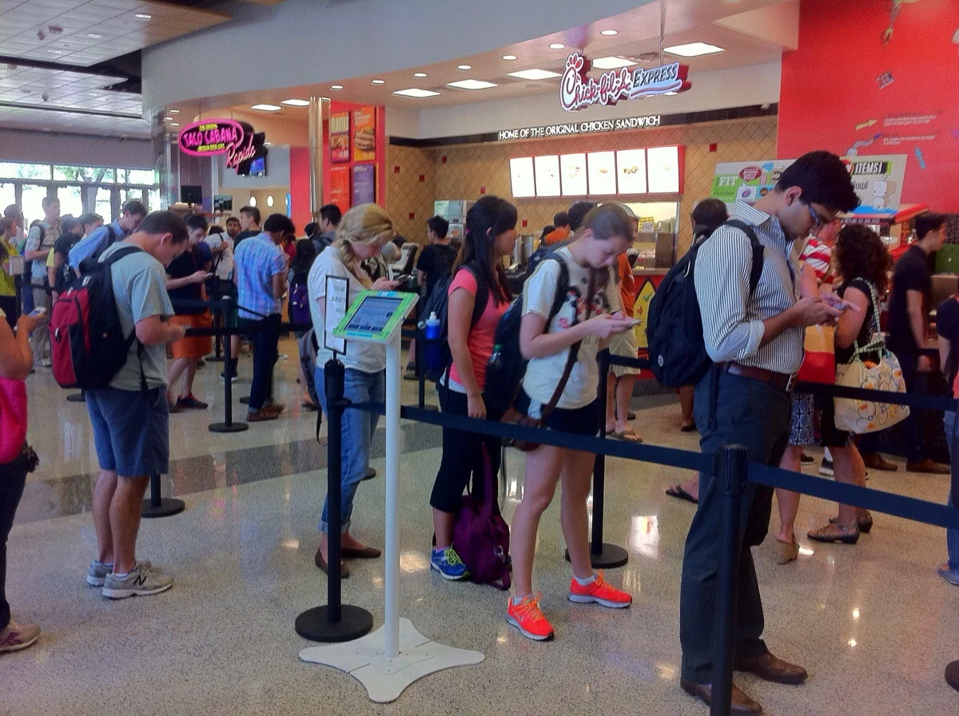

Slide 12
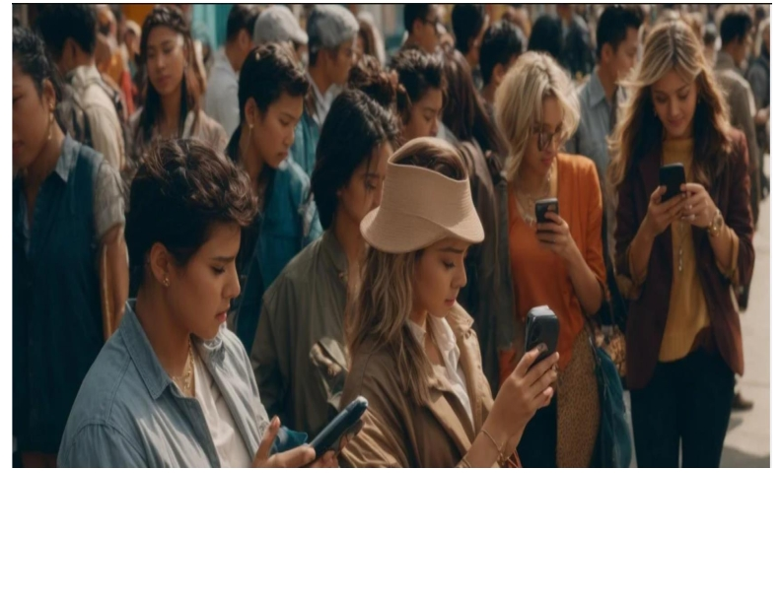

Slide 13
2. Sexual Immorality

Slide 14
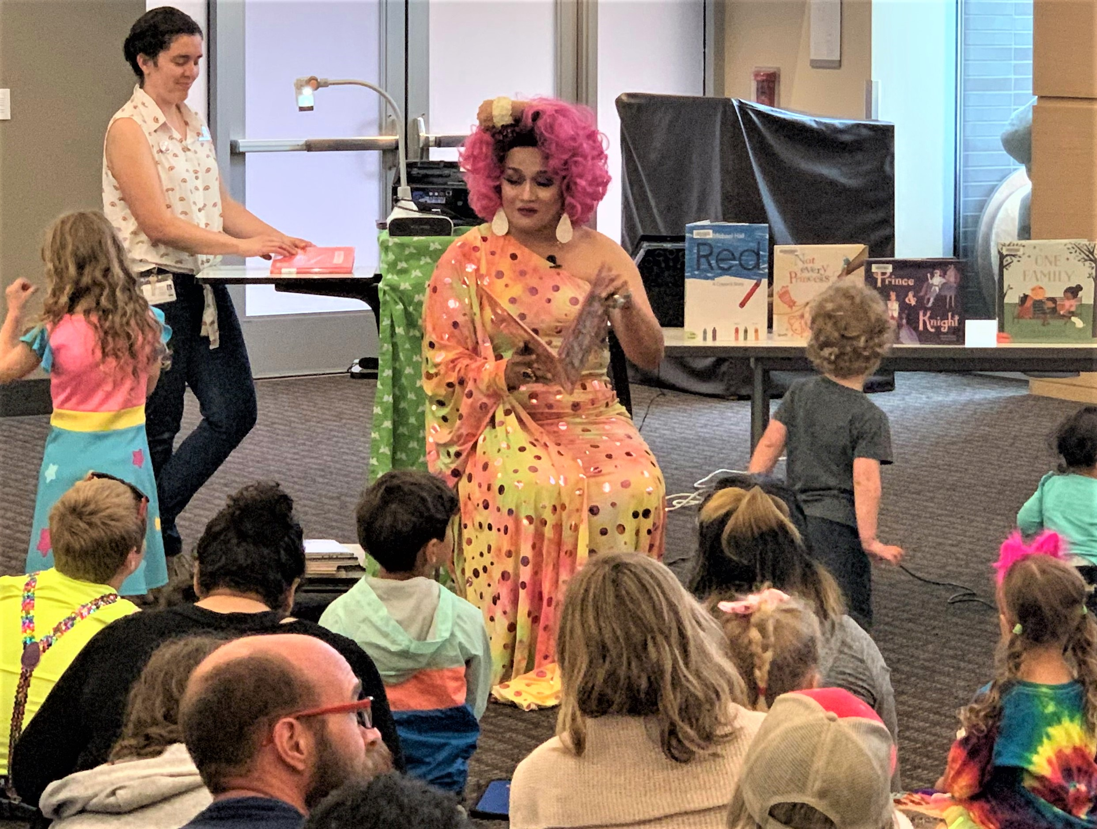

Slide 15
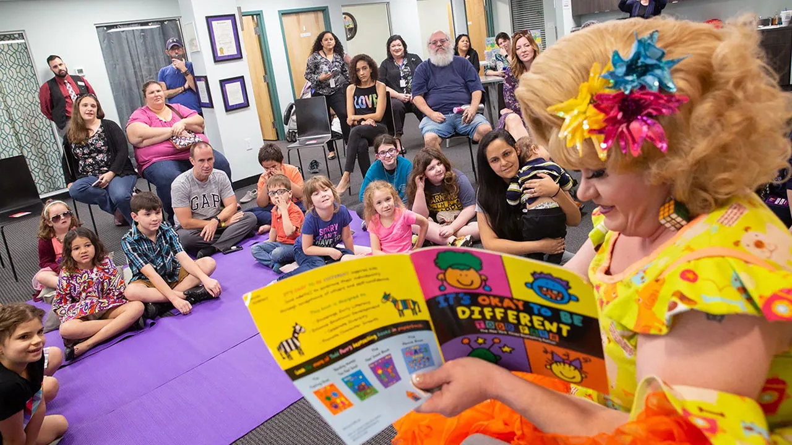

Slide 16
3. Broken Covenants

Slide 17
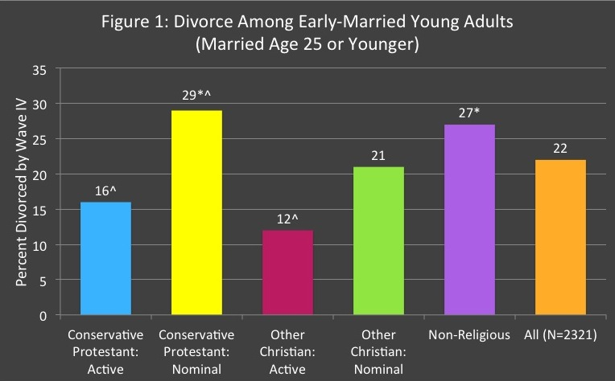

Slide 18
4. Innocent Bloodshed

Slide 19
Genesis 4:8-11
8 Now Cain talked with Abel his brother; and it came to pass, when they were in the field, that Cain rose up against Abel his brother and killed him.

Slide 20
9 Then the LORD said to Cain, "Where is Abel your brother?" He said, "I do not know. Am I my brother's keeper?" 10 And He said, "What have you done? The voice of your brother's blood cries out to Me from the ground. 11 So now you are cursed from the earth, which has opened its mouth to receive your brother's blood from your hand.

Slide 21

 | Location | Date | Magnitude (M_{w})
1 | Valdivia, Chile | May 22, 1960 | 9.5
2 | Alaska, USA | March 27, 1964 | 9.2
3 | Sumatra | December 26, 2004 | 9.1 to 9.3
4 | Tohoku | March 11, 2011 | 9.1
5 | Kamchatka, Russia | November 5, 1952 | 9.0
6 | Chile | February 27, 2010 | 8.8
7 | Rat Island | February 3, 1965 | 8.7
8 | Assam-Tibet | August 15, 1950 | 8.6
9 | Aleutian Islands | April 1, 1946 | 8.6
10 | Indian Ocean | April 11, 2012 | 8.6

Slide 22
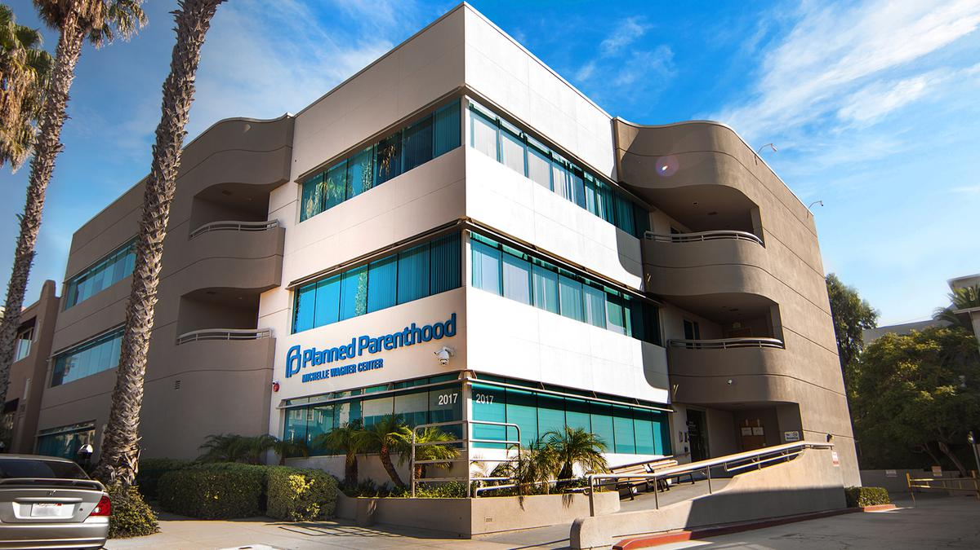
False Prophets – Won’t Talk About Sin
Joel Osteen
Steven Furtick
Joyce Meyer

Slide 23
5. Other Abominations

Slide 24
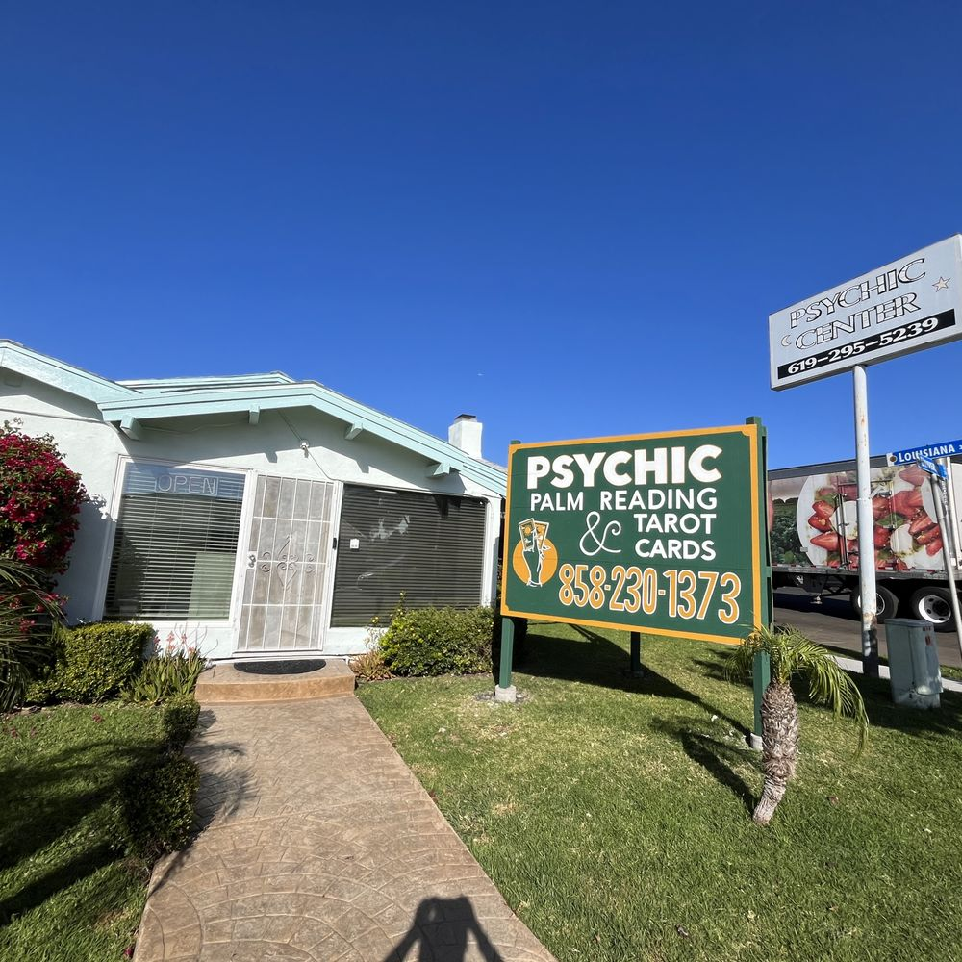

Slide 25
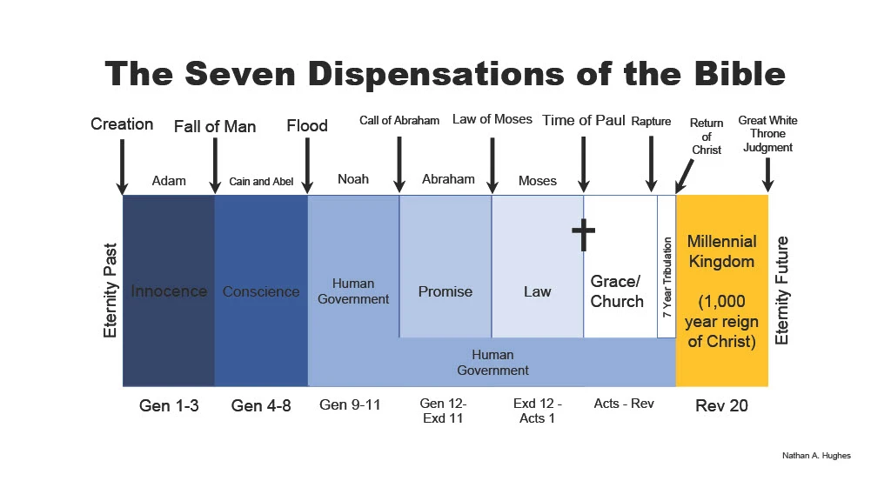

Slide 26
Leviticus 18:24-28
24'Do not defile yourselves with any of these things; for by all these the nations are defiled, which I am casting out before you. 25 For the land is defiled; therefore I visit the punishment of its iniquity upon it, and the land vomits out its inhabitants.

Slide 27
26 You shall therefore keep My statutes and My judgments, and shall not commit any of these abominations, either any of your own nation or any stranger who dwells among you 27(for all these abominations the men of the land have done, who were before you, and thus the land is defiled), 28 lest the land vomit you out also when you defile it, as it vomited out the nations that were before you.

Slide 28
1. Expulsion from the Land

Slide 29
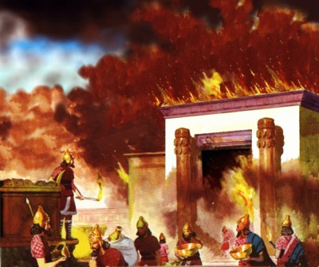

Slide 30
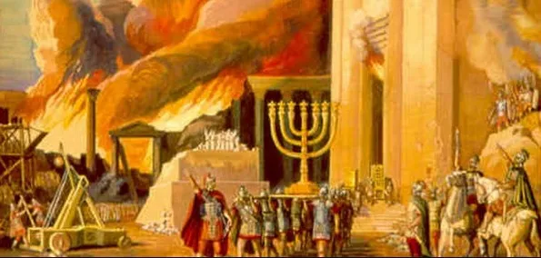

Slide 31
Loss of Divine Favor and Protection

Slide 32
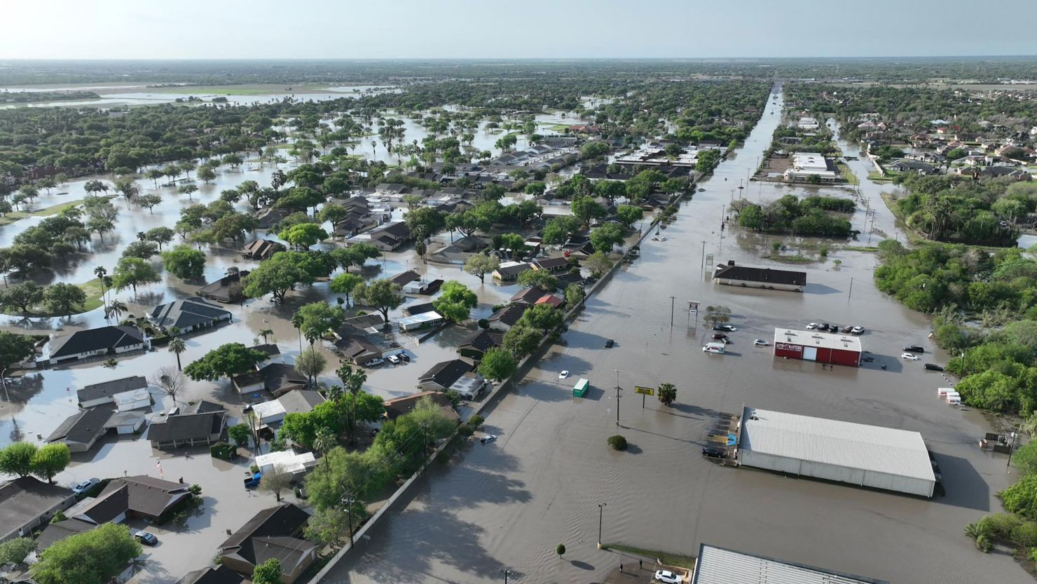

Slide 33
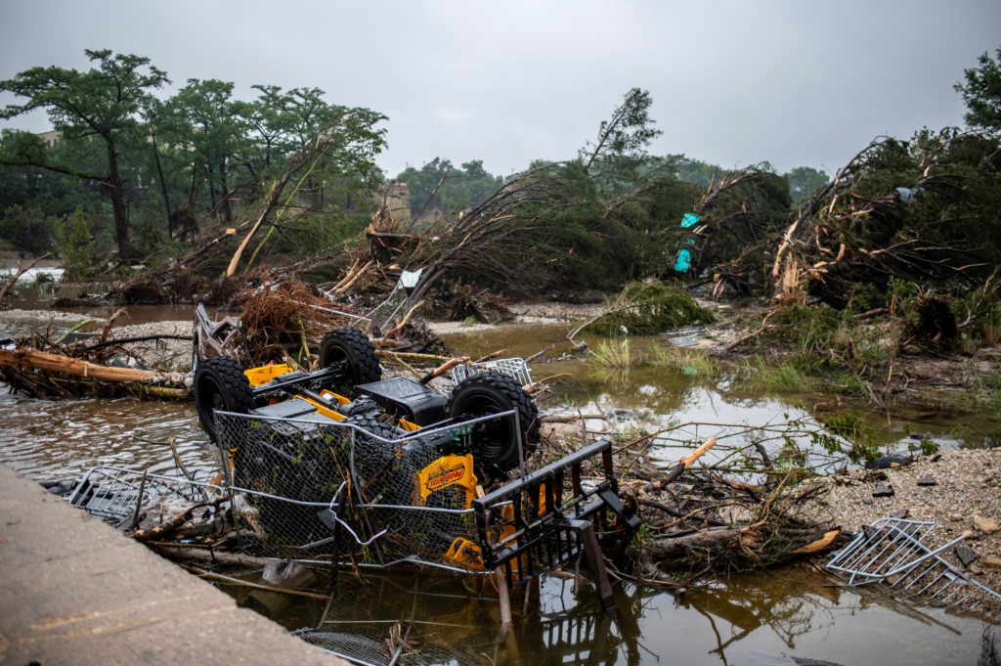

Slide 35
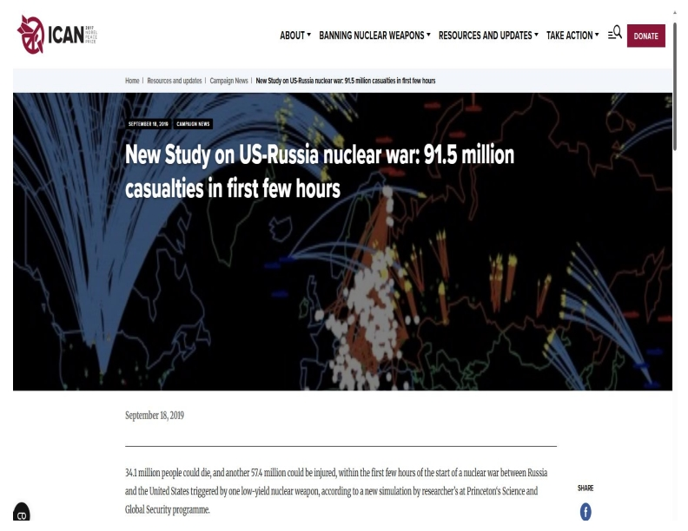

Slide 36
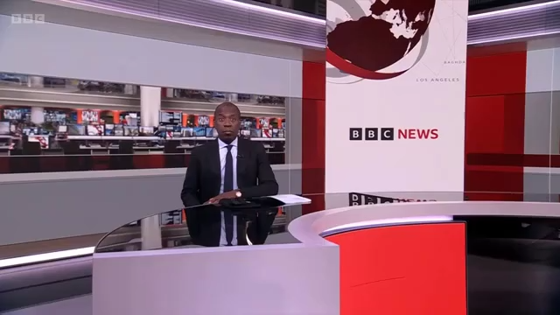

Slide 37
2. Environmental and Agricultural Decline

Slide 38
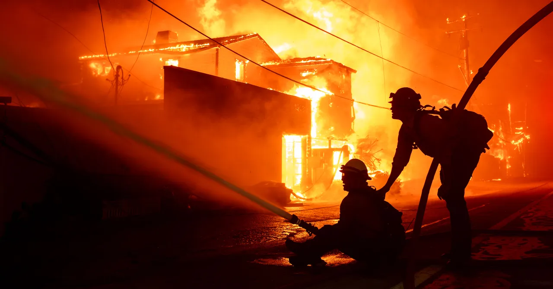

Slide 39
3. Spiritual and Moral Decay

Slide 40
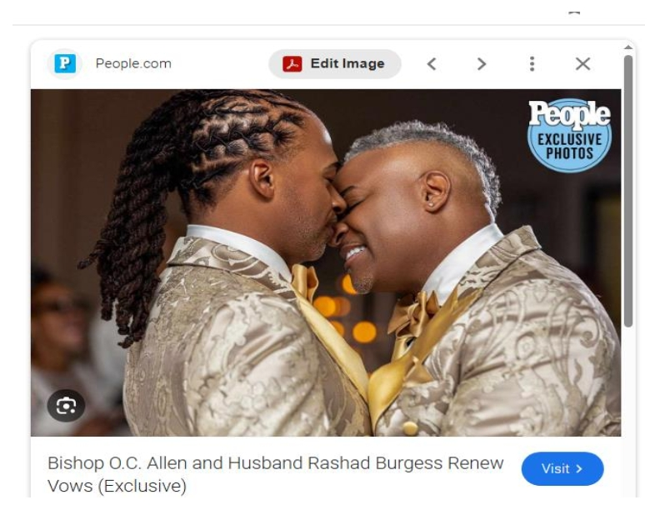

Slide 41
Leviticus 18:22
You shall not lie with a male as with a woman. It is an abomination.

Slide 42
Leviticus 20:13
If a man lies with a male as he lies with a woman, both of them have committed an abomination. They shall surely be put to death. Their blood shall be upon them.

Slide 43
Romans 1:26-27
26 For this reason God gave them up to vile passions. For even their women exchanged the natural use for what is against nature.
27 Likewise also the men, leaving the natural use of the woman, burned in their lust for one another, men with men committing what is shameful, and receiving in themselves the penalty of their error which was due.

Slide 44
1 Corinthians 6:9-11
9 Do you not know that the unrighteous will not inherit the kingdom of God? Do not be deceived. Neither fornicators, nor idolaters, nor adulterers, nor homosexuals, nor sodomites, 10 nor thieves, nor covetous, nor drunkards, nor revilers, nor extortioners will inherit the kingdom of God. 11 And such were some of you. But you were washed, but you were sanctified, but you were justified in the name of the Lord Jesus and by the Spirit of our God.

Slide 45
What is the Remedy?

Slide 46
Repentance!

Slide 47
Turn Back to God!

Slide 48
2 Chronicles 7:14
14 if My people who are called by My name will humble themselves, and pray and seek My face, and turn from their wicked ways, then I will hear from heaven, and will forgive their sin and heal their land.

Slide 49
Isaiah 55:7
"Let the wicked forsake his way, and the unrighteous man his thoughts; let him return to the Lord, that he may have compassion on him, and to our God, for he will abundantly pardon."

Slide 50
Jeremiah 3:12
"Return, O faithless Israel, declares the Lord. I will not look on you in anger, for I am merciful, declares the Lord; I will not be angry forever."

Slide 51
Acts 3:19-21
19 Repent therefore and be converted, that your sins may be blotted out, so that times of refreshing may come from the presence of the Lord, 20 and that He may send Jesus Christ, who

Slide 52
1 Thessalonians 4:13-18
13 But I do not want you to be ignorant, brethren, concerning those who have fallen asleep, lest you sorrow as others who have no hope. 14 For if we believe that Jesus died and rose again, even so God will bring with Him those who sleep in Jesus.

Slide 53
15 For this we say to you by the word of the Lord, that we who are alive and remain until the coming of the Lord will by no means precede those who are asleep. 16 For the Lord Himself will descend from heaven with a shout, with the voice of an archangel, and with the trumpet of God. And the dead in Christ will rise first.

Slide 54
17 Then we who are alive and remain shall be caught up together with them in the clouds to meet the Lord in the air. And thus we shall always be with the Lord. 18 Therefore comfort one another with these words.

Slide 55
The Apostle Paul and his disciples clearly understood that the Day and The Hour was the New Moon Citing on the Feast of Trumpets!
The New Moon sighting on the Feast of Trumpets, also known as Rosh Hashanah, is a significant 2 Day event in the Jewish faith, marking the start of the civil new year and the beginning of the fall feast season.

Slide 56
It is a time of introspection, repentance, and seeking forgiveness, observed with the blowing of trumpets, special sacrifices, and a proclamation of the feast.
The sighting of the new moon by witnesses signals the start of the month of Tishri, which includes the Feast of Trumpets.

Slide 57
Feasts of the Lord:
The Rapture
Jesus in the Feast of Trumpets
Here's a more detailed explanation:

Slide 58
Biblical Basis

Slide 59
The Feast of Trumpets is one of the biblical feasts commanded in the Torah, specifically mentioned in:

Slide 60
Leviticus 23:23-25
23 Then the LORD spoke to Moses, saying, 24 "Speak to the children of Israel, saying: 'In the seventh month, on the first day of the month, you shall have a sabbath-rest, a memorial of blowing of trumpets, a holy convocation. 25 You shall do no customary work on it; and you shall offer an offering made by fire to the LORD.' "

Slide 61
It is a day of rest, marked by the blowing of trumpets, a call to assembly, and a reminder of God's presence and sovereignty.

Slide 62
The New Moon
In ancient Israel, the New Moon was a significant event. It marked the start of the Hebrew month and was determined by the sighting of the first sliver of the new moon by two witnesses.

Slide 63
Sighting and Announcement
Once the new moon was sighted and confirmed by witnesses, the month of Tishri began, and the Feast of Trumpets was announced with the blowing of trumpets (shofar).

Slide 64
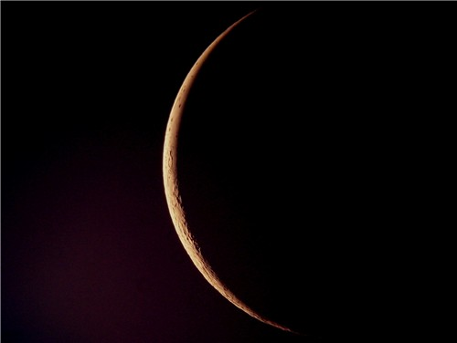
The Great tribulation is going to be a time of horrific trouble this world has never seen nor will it ever see it like that again!

Slide 65
Significance
The Feast of Trumpets is not only a time of remembrance but also a time of judgment, with a strong emphasis on introspection and repentance, leading up to the Day of Atonement (Yom Kippur).

Slide 66
Modern Observance
The Feast of Trumpets, or Rosh Hashanah, is still celebrated as the New Year, with the blowing of the shofar as a central element.

Slide 67
Symbolism
The Feast of Trumpets is associated with several symbolic themes, including the marriage of the Messiah, the resurrection of the dead, and the crowning of the King.

Slide 68
A Time of Mystery
The exact day and hour of the Feast of Trumpets were not known in advance, adding a sense of mystery to its observance.

Slide 69
Mathew 25:13
"Watch therefore, for you know neither the day nor the hour in which the Son of Man is coming.

Slide 70
1 Thessalonians 5:1-11
1 But concerning the times and the seasons, brethren, you have no need that I should write to you. 2 For you yourselves know perfectly that the day of the Lord so comes as a thief in the night.

Slide 71
3 For when they say, "Peace and safety!" then sudden destruction comes upon them, as labor pains upon a pregnant woman. And they shall not escape. 4 But you, brethren, are not in darkness, so that this Day should overtake you as a thief. 5 You are all sons of light and sons of the day. We are not of the night nor of darkness.

Slide 72
6 Therefore let us not sleep, as others do, but let us watch and be sober. 7 For those who sleep, sleep at night, and those who get drunk are drunk at night. 8 But let us who are of the day be sober, putting on the breastplate of faith and love, and as a helmet the hope of salvation.

Slide 73
9 For God did not appoint us to wrath, but to obtain salvation through our Lord Jesus Christ, 10 who died for us, that whether we wake or sleep, we should live together with Him. 11 Therefore comfort each other and edify one another, just as you also are doing.

Slide 74
Daniel 12:4
“But you, Daniel, shut up the words, and seal the book until the time of the end; many shall run to and fro, and knowledge shall increase.”

Slide 75
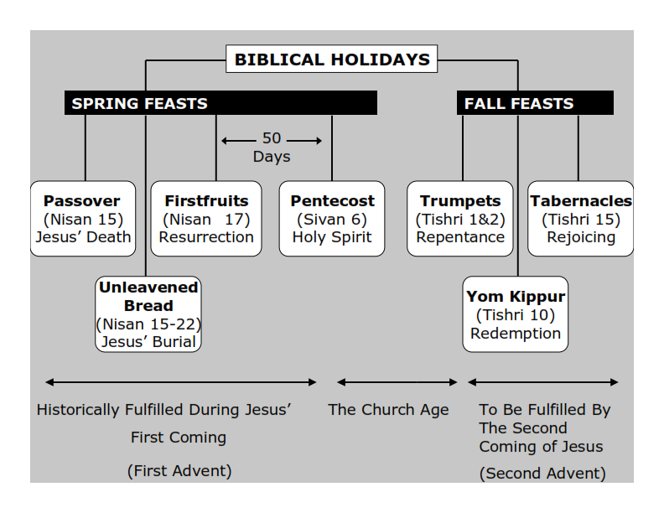
Philippians 3:20-21
20 For our citizenship is in heaven, from which we also eagerly wait for the Savior, the Lord Jesus Christ, 21 who will transform our lowly body that it may be conformed to His glorious body, according to the working by which He is able even to subdue all things to Himself.

Slide 76
1 Thessalonians 4:13-18
13 But I do not want you to be ignorant, brethren, concerning those who have fallen asleep, lest you sorrow as others who have no hope. 14 For if we believe that Jesus died and rose again, even so God will bring with Him those who sleep in Jesus.

Slide 77
15 For this we say to you by the word of the Lord, that we who are alive and remain until the coming of the Lord will by no means precede those who are asleep. 16 For the Lord Himself will descend from heaven with a shout, with the voice of an archangel, and with the trumpet of God. And the dead in Christ will rise first.

Slide 78
17 Then we who are alive and remain shall be caught up together with them in the clouds to meet the Lord in the air. And thus we shall always be with the Lord. 18 Therefore comfort one another with these words.

Slide 79
1 Corinthians 15:50-54
50 Now this I say, brethren, that flesh and blood cannot inherit the kingdom of God; nor does corruption inherit incorruption. 51 Behold, I tell you a mystery: We shall not all sleep, but we shall all be changed-- 52 in a moment, in the twinkling of an eye, at the last trumpet. For the trumpet will sound, and the dead will be raised incorruptible, and we shall be changed.

Slide 80
53 For this corruptible must put on incorruption, and this mortal must put on immortality. 54 So when this corruptible has put on incorruption, and this mortal has put on immortality, then shall be brought to pass the saying that is written: "Death is swallowed up in victory."

Slide 81

20 Again, when a righteous man turns from his righteousness and commits iniquity, and I lay a stumbling block before him, he shall die; because you did not give him warning, he shall die in his sin, and his righteousness which he has done shall not be remembered; but his blood I will require at your hand.

Slide 82
Acts 2:38-39
38 Then Peter said to them, "Repent, and let every one of you be baptized in the name of Jesus Christ for the remission of sins; and you shall receive the gift of the Holy Spirit. 39 For the promise is to you and to your children, and to all who are afar off, as many as the Lord our God will call."

Slide 83

Donate with our QR code app to
Amazing Grace Christian Fellowship
Donations are Deeply Appreciated!

