Slide 1


Slide 2


Slide 3
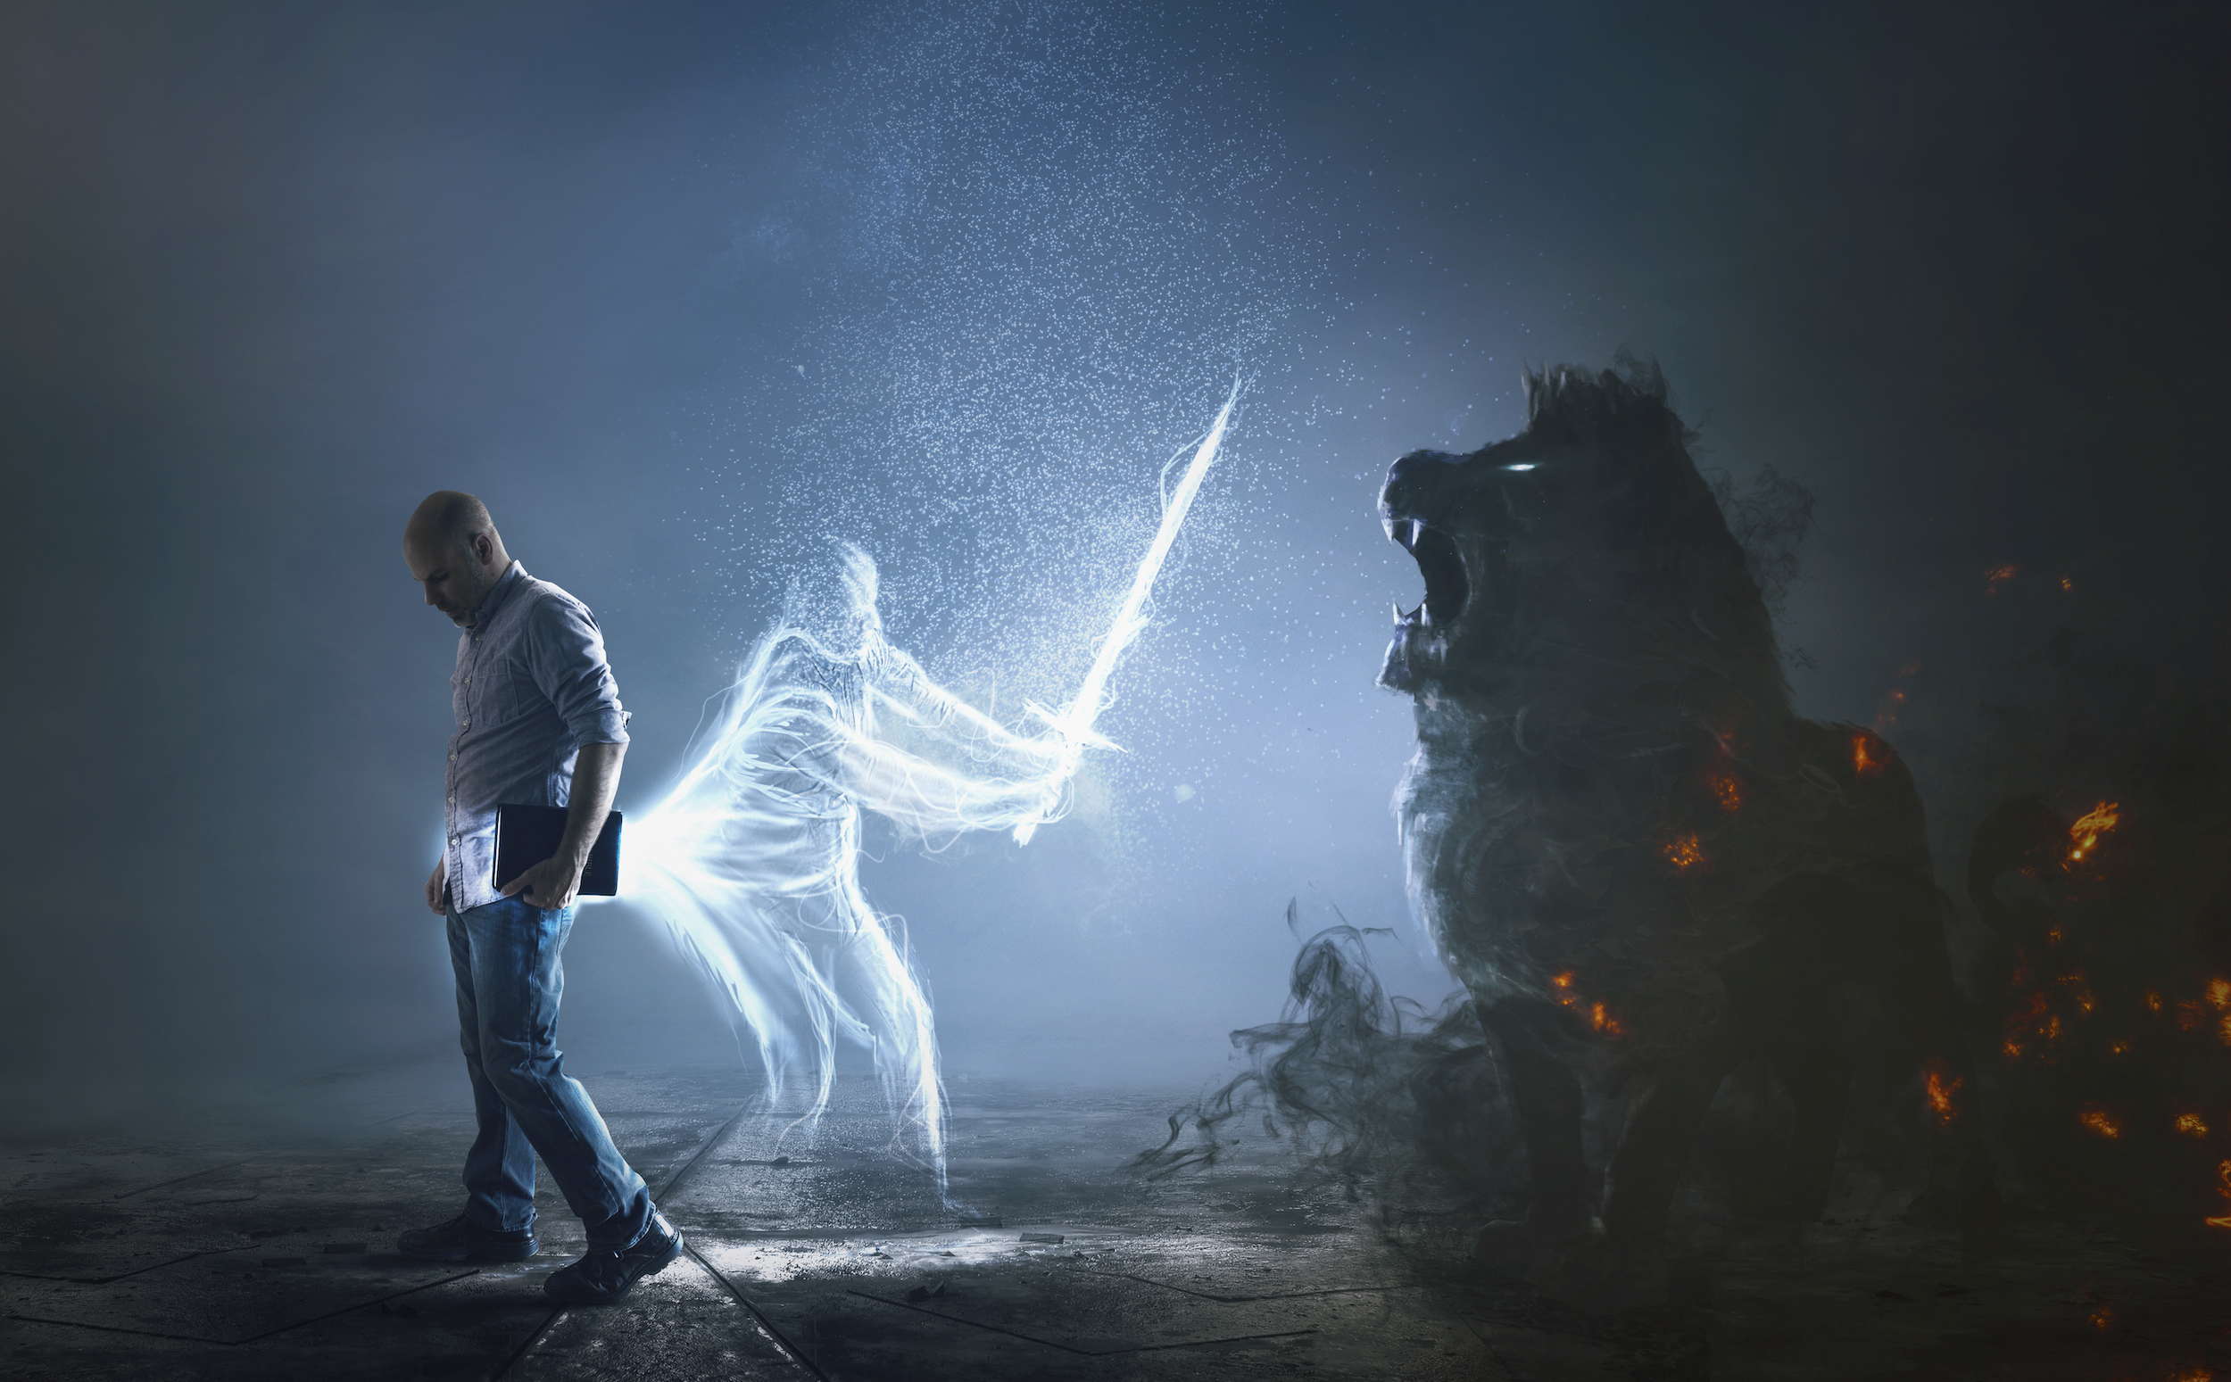

The Church is at War!
by Pastor Fee Soliven
2 Corinthians 10:1-6
Sunday Morning
August 31, 2025

Slide 4
2 Corinthians 10:1-6
1 Now I, Paul, myself am pleading with you by the meekness and gentleness of Christ--who in presence am lowly among you, but being absent am bold toward you. 2 But I beg you that when I am present I may not be bold with that confidence by which I intend to be bold against some, who think of us as if we walked according to the flesh.

Slide 5
3 For though we walk in the flesh, we do not war according to the flesh. 4 For the weapons of our warfare are not carnal but mighty in God for pulling down strongholds, 5 casting down arguments and every high thing that exalts itself against the knowledge of God, bringing every thought into captivity to the obedience of Christ, 6 and being ready to punish all disobedience when your obedience is fulfilled.

Slide 6
Temptations, Deception and Accusations

Slide 7
Offensive vs. Defensive Warfare

Slide 8
Offensive Warfare is tearing down the strongholds the enemy has formed in your mind through deception and accusations.

Slide 9
Defensive Warfare is guarding yourself against the tactics or schemes of the devil.

Slide 10
The Enemy's three Primary Weapons are Deceptions, Temptations and Accusations

Slide 11
Ephesians 6:12
"For we wrestle not against flesh and blood, but against principalities, against powers, against the rulers of the darkness of this world, against spiritual wickedness in high places."

Slide 12
1. Deception

Slide 13
Matthew 24:4-8
4 And Jesus answered and said to them: "Take heed that no one deceives you. 5 For many will come in My name, saying, 'I am the Christ,' and will deceive many. 6 And you will hear of wars and rumors of wars. See that you are not troubled; for all these things must come to pass, but the end is not yet.

Slide 14
7 For nation will rise against nation, and kingdom against kingdom. And there will be famines, pestilences, and earthquakes in various places. 8 All these are the beginning of sorrows.

Slide 15
2 Corinthians 11:13-15
13 For such are false apostles, deceitful workers, transforming themselves into apostles of Christ. 14 And no wonder! For Satan himself transforms himself into an angel of light. 15 Therefore it is no great thing if his ministers also transform themselves into ministers of righteousness, whose end will be according to their works.

Slide 16
Genesis 3:1-4
1 Now the serpent was more cunning than any beast of the field which the LORD God had made. And he said to the woman, "Has God indeed said, 'You shall not eat of every tree of the garden'?" 2 And the woman said to the serpent, "We may eat the fruit of the trees of the garden;

Slide 17
3 but of the fruit of the tree which is in the midst of the garden, God has said, 'You shall not eat it, nor shall you touch it, lest you die.' " 4 Then the serpent said to the woman, "You will not surely die.

Slide 18
Genesis 2:15-17
16 And the LORD God commanded the man, saying, "Of every tree of the garden you may freely eat; 17 but of the tree of the knowledge of good and evil you shall not eat, for in the day that you eat of it you shall surely die."

Slide 19
2. Temptation

Slide 20
James 1:2-5
2 My brethren, count it all joy when you fall into various trials, 3 knowing that the testing of your faith produces patience. 4 But let patience have its perfect work, that you may be perfect and complete, lacking nothing. 5 If any of you lacks wisdom, let him ask of God, who gives to all liberally and without reproach, and it will be given to him.

Slide 21
Luke 4:1-8
1 Then Jesus, being filled with the Holy Spirit, returned from the Jordan and was led by the Spirit into the wilderness, 2 being tempted for forty days by the devil. And in those days He ate nothing, and afterward, when they had ended, He was hungry.

Slide 22
3 And the devil said to Him, "If You are the Son of God, command this stone to become bread." 4 But Jesus answered him, saying, "It is written, 'Man shall not live by bread alone, but by every word of God.' " 5 Then the devil, taking Him up on a high mountain, showed Him all the kingdoms of the world in a moment of time.

Slide 23
6 And the devil said to Him, "All this authority I will give You, and their glory; for this has been delivered to me, and I give it to whomever I wish. 7 Therefore, if You will worship before me, all will be Yours." 8 And Jesus answered and said to him, "Get behind Me, Satan! For it is written, 'You shall worship the LORD your God, and Him only you shall serve.'

Slide 24
Psalms 119:11
"Thy word have I hid in mine heart, that I might not sin against thee."

Slide 25
3. Accusations

Slide 26
Revelation 12:10
"Then I heard a loud voice saying in heaven, "Now salvation, and strength, and the kingdom of our God, and the power of His Christ have come, for the accuser of our brethren, who accused them before our God day and night, has been cast down."

Slide 27
Proverbs 10:18
"Whoever hides hatred has lying lips, And whoever spreads slander is a fool."

Slide 28
Dealing with Deception

Slide 29
Ephesians 6:14
"Stand therefore, having girded your waist with truth..."

Slide 30
Ephesians 6:17
" and the sword of the Spirit, which is the word of God"

Slide 31
Why are they given two different names (a sword and a belt)?

Slide 32
Romans 12:2
"be not conformed to this world: but be ye transformed by the renewing of your mind."

Slide 33
How do we Renew our Minds?

Slide 34
Ephesians 5:26
"That he might sanctify and cleanse it with the washing of water by the word."

Slide 35
Dealing with Temptation

Slide 36
James 4:7-10
7 Therefore submit to God. Resist the devil and he will flee from you. 8 Draw near to God and He will draw near to you. Cleanse your hands, you sinners; and purify your hearts, you double-minded. 9 Lament and mourn and weep! Let your laughter be turned to mourning and your joy to gloom. 10 Humble yourselves in the sight of the Lord, and He will lift you up.

Slide 37
The Tearing Down of Strongholds

Slide 38
2 Corinthians 10:4-6
4 For the weapons of our warfare are not carnal but mighty in God for pulling down strongholds, 5 casting down arguments and every high thing that exalts itself against the knowledge of God, bringing every thought into captivity to the obedience of Christ, 6 and being ready to punish all disobedience when your obedience is fulfilled.

Slide 39
1 Thessalonians 4:13-18
13 But I do not want you to be ignorant, brethren, concerning those who have fallen asleep, lest you sorrow as others who have no hope. 14 For if we believe that Jesus died and rose again, even so God will bring with Him those who sleep in Jesus.

Slide 40
15 For this we say to you by the word of the Lord, that we who are alive and remain until the coming of the Lord will by no means precede those who are asleep. 16 For the Lord Himself will descend from heaven with a shout, with the voice of an archangel, and with the trumpet of God. And the dead in Christ will rise first.

Slide 41
17 Then we who are alive and remain shall be caught up together with them in the clouds to meet the Lord in the air. And thus we shall always be with the Lord. 18 Therefore comfort one another with these words.

Slide 42
1 Corinthians 15:50-54
50 Now this I say, brethren, that flesh and blood cannot inherit the kingdom of God; nor does corruption inherit incorruption. 51 Behold, I tell you a mystery: We shall not all sleep, but we shall all be changed-- 52 in a moment, in the twinkling of an eye, at the last trumpet. For the trumpet will sound, and the dead will be raised incorruptible, and we shall be changed.

Slide 43
53 For this corruptible must put on incorruption, and this mortal must put on immortality. 54 So when this corruptible has put on incorruption, and this mortal has put on immortality, then shall be brought to pass the saying that is written: "Death is swallowed up in victory."

Slide 44

20 Again, when a righteous man turns from his righteousness and commits iniquity, and I lay a stumbling block before him, he shall die; because you did not give him warning, he shall die in his sin, and his righteousness which he has done shall not be remembered; but his blood I will require at your hand.

Slide 45
Acts 2:38-39
38 Then Peter said to them, "Repent, and let every one of you be baptized in the name of Jesus Christ for the remission of sins; and you shall receive the gift of the Holy Spirit. 39 For the promise is to you and to your children, and to all who are afar off, as many as the Lord our God will call."

Slide 46

Donate with our QR code app to
Amazing Grace Christian Fellowship
Donations are Deeply Appreciated!

