Slide 1


Slide 2


Slide 3


Are You Sold Out to Christ
by Pastor Fee Soliven
Genesis 6:5-8
Sunday Morning
September 28, 2025

Slide 4
Genesis 6:5-8
5 Then the LORD saw that the wickedness of man was great in the earth, and that every intent of the thoughts of his heart was only evil continually. 6 And the LORD was sorry that He had made man on the earth, and He was grieved in His heart.

Slide 5
7 So the LORD said, "I will destroy man whom I have created from the face of the earth, both man and beast, creeping thing and birds of the air, for I am sorry that I have made them." 8 But Noah found grace in the eyes of the LORD.

Slide 6
Hebrews 11:7
"By faith Noah, being divinely warned of things not yet seen, moved with godly fear, prepared an ark for the saving of his household, by which he condemned the world and became heir of the righteousness which is according to faith."

Slide 7
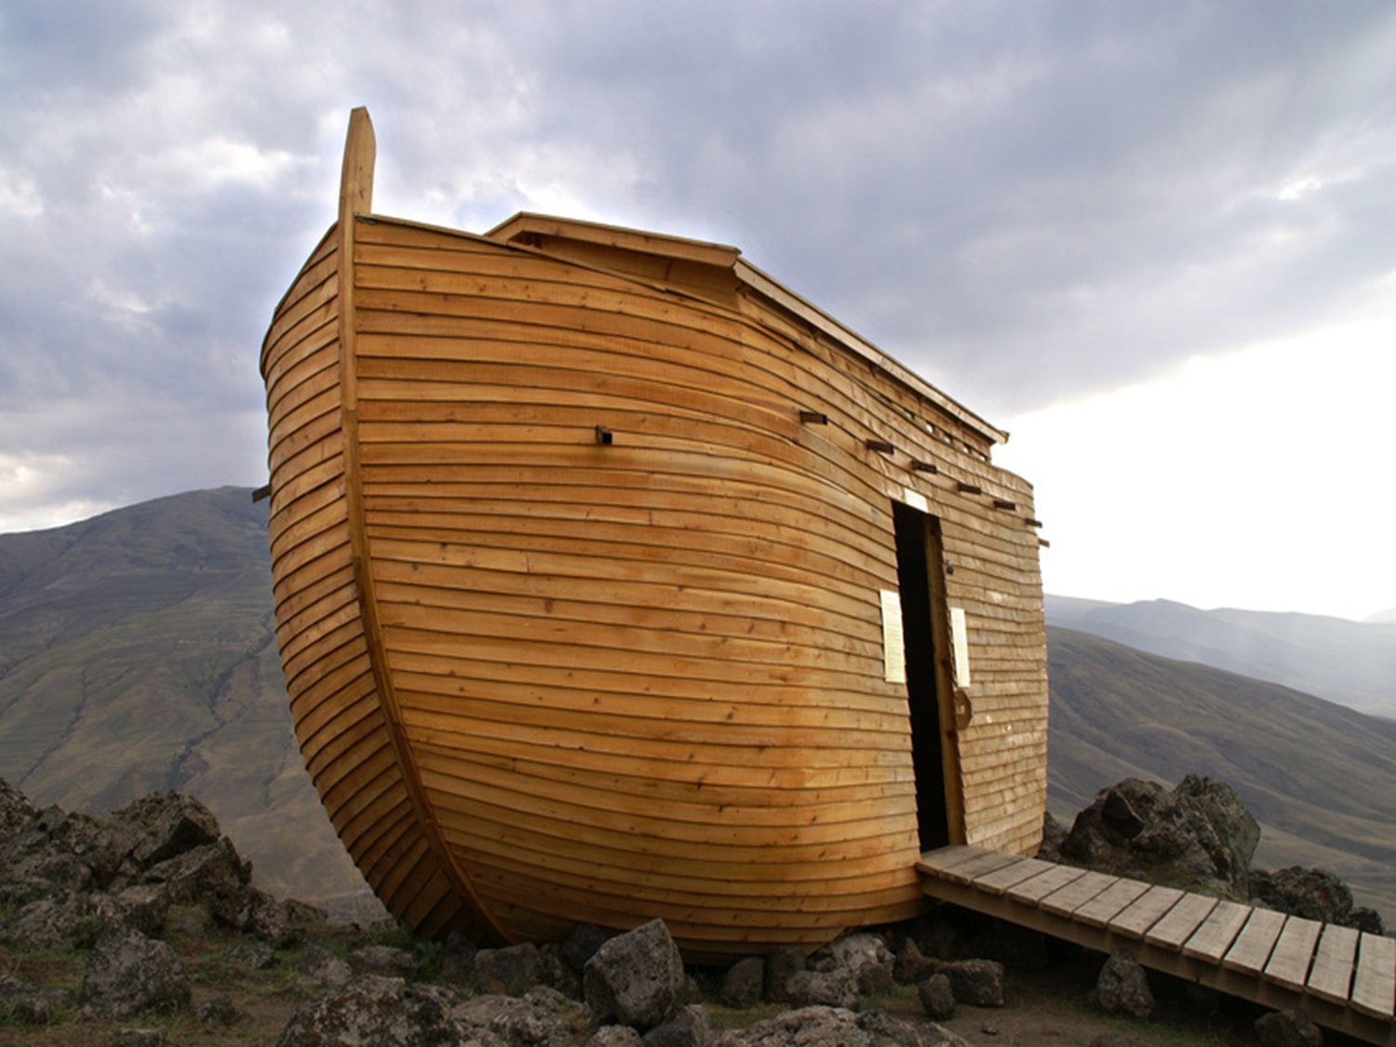
13 Then He went out again by the sea; and all the multitude came to Him, and He taught them.

Slide 8
2 Peter 2:4-7
4 For if God did not spare the angels who sinned, but cast them down to hell and delivered them into chains of darkness, to be reserved for judgment; 5 and did not spare the ancient world, but saved Noah, one of eight people, a preacher of righteousness, bringing in the flood on the world of the ungodly;

Slide 9
6 and turning the cities of Sodom and Gomorrah into ashes, condemned them to destruction, making them an example to those who afterward would live ungodly; 7 and delivered righteous Lot, who was oppressed by the filthy conduct of the wicked

Slide 10
GOD WARNED OF DESTRUCTION

Slide 11
Genesis 6:5-8
5 Then the LORD saw that the wickedness of man was great in the earth, and that every intent of the thoughts of his heart was only evil continually. 6 And the LORD was sorry that He had made man on the earth, and He was grieved in His heart.

Slide 12
7 So the LORD said, "I will destroy man whom I have created from the face of the earth, both man and beast, creeping thing and birds of the air, for I am sorry that I have made them." 8 But Noah found grace in the eyes of the LORD.

Slide 13
Jeremiah 17:9-10
9 "The heart is deceitful above all things, And desperately wicked; Who can know it? 10 I, the LORD, search the heart, I test the mind, Even to give every man according to his ways, According to the fruit of his doings.

Slide 14
1. God Warned Noah

Slide 15
Genesis 6:13
"And God said to Noah, "The end of all flesh has come before Me, for the earth is filled with violence through them; and behold, I will destroy them with the earth."

Slide 16
Hebrews 11:5
"By faith Enoch was taken away so that he did not see death, "and was not found, because God had taken him"; for before he was taken he had this testimony, that he pleased God."

Slide 17
Genesis 6:8
"But Noah found grace in the eyes of the LORD"

Slide 18
2. Noah Warned His World

Slide 19
2 Peter 2:5
"and did not spare the ancient world, but saved Noah, one of eight people, a preacher of righteousness, bringing in the flood on the world of the ungodly"

Slide 20
Hebrews 11:7
By faith Noah, being divinely warned of things not yet seen, moved with godly fear, prepared an ark for the saving of his household, by which he condemned the world and became heir of the righteousness which is according to faith.

Slide 21
John 3:17-18
17 For God did not send His Son into the world to condemn the world, but that the world through Him might be saved. 18 He who believes in Him is not condemned; but he who does not believe is condemned already, because he has not believed in the name of the only begotten Son of God

Slide 22
3. God Gives Warning for Today

Slide 23
Matthew 24:37-39
37 But as the days of Noah were, so also will the coming of the Son of Man be. 38 For as in the days before the flood, they were eating and drinking, marrying and giving in marriage, until the day that Noah entered the ark, 39 and did not know until the flood came and took them all away, so also will the coming of the Son of Man be.

Slide 24
2 Timothy 3:1-4
1 But know this, that in the last days perilous times will come: 2 For men will be lovers of themselves, lovers of money, boasters, proud, blasphemers, disobedient to parents, unthankful, unholy, 3 unloving, unforgiving, slanderers, without self-control, brutal, despisers of good, 4 traitors, headstrong, haughty, lovers of pleasure rather than lovers of God...

Slide 25
FBI & Wikipedia Survey
1970–Present: Between 1970 and July 2025, California had the highest number of K-12 school shootings of any state, with 277 incidents.

Slide 26
Lifetime Exposure
Since the 1999 Columbine shooting, over 390,000 students in the U.S. have experienced gun violence at school. The U.S. has experienced more school shootings than all other major industrialized nations combined. All 50 States in our Union that have legalized Homosexual Marriages.

Slide 27
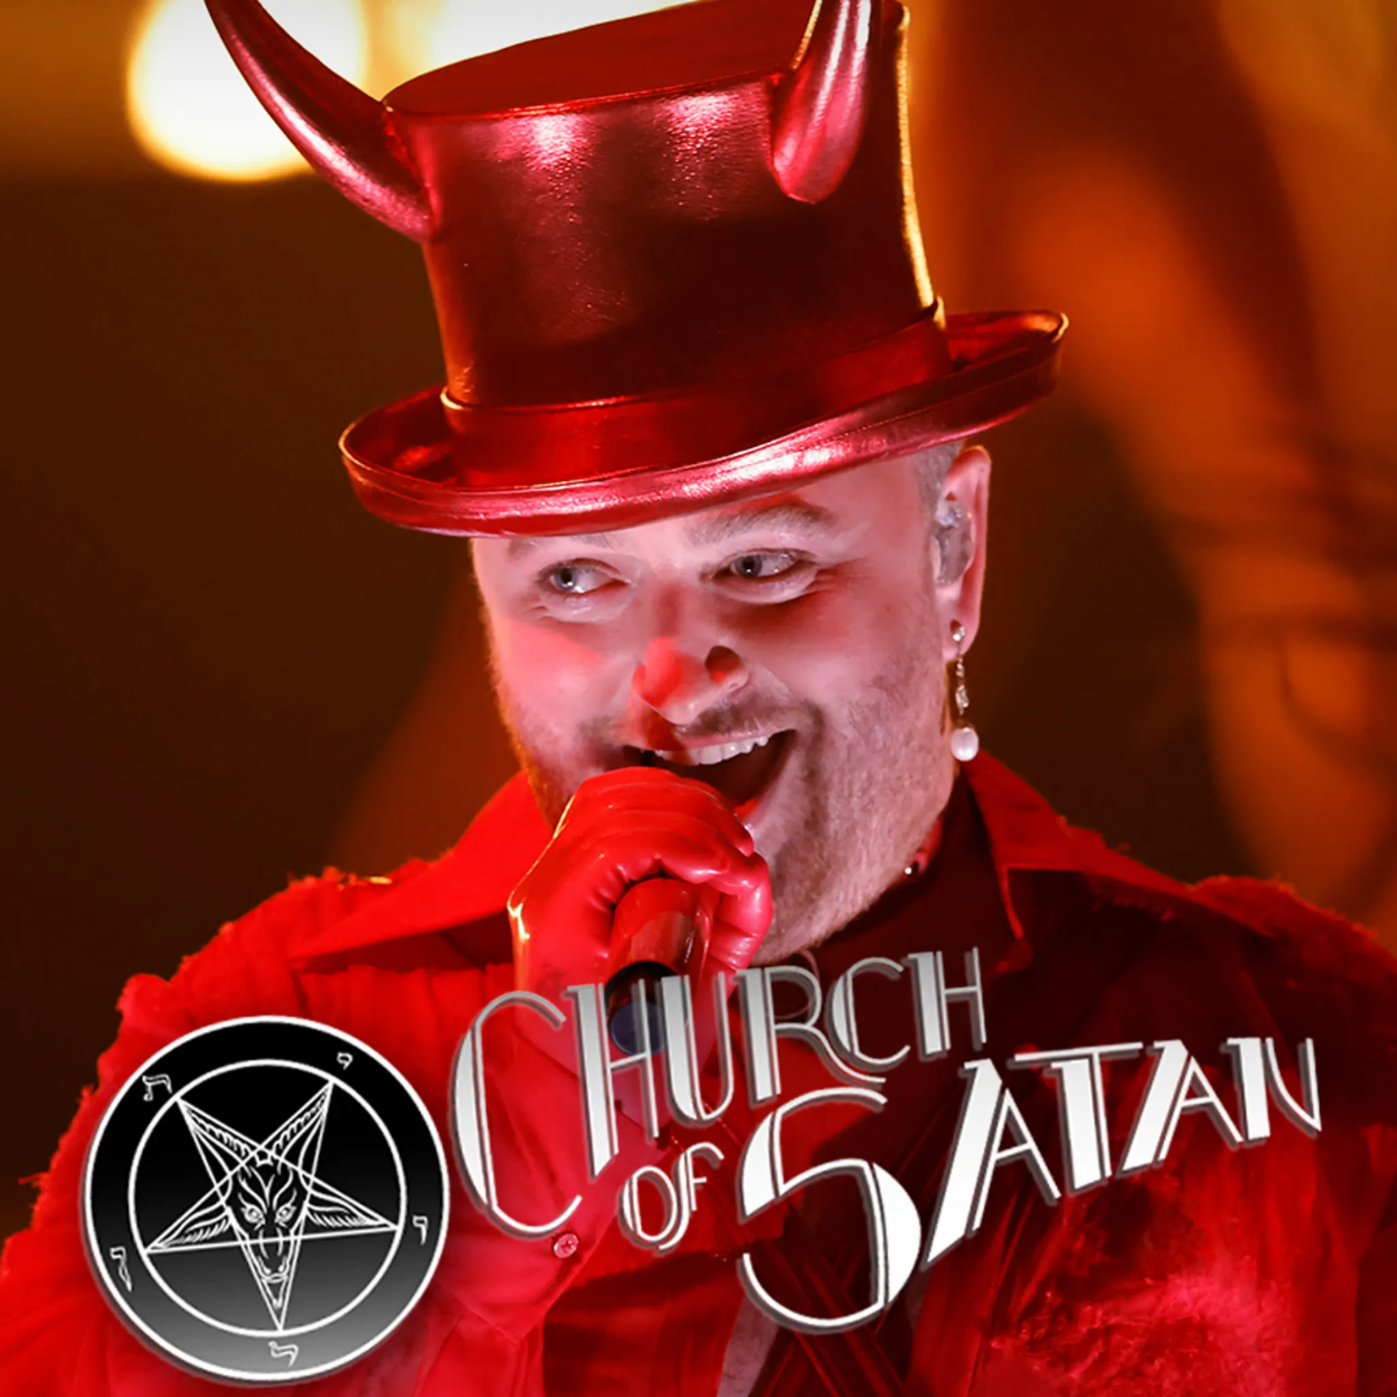
Sam Smith 2023 Grammy Awards

Slide 28
GODLY FEAR ACTIVATES OBEDIENCE

Slide 29
The Fear of God Initiates Innumerable Blessings

Slide 30
“The Fear of the LORD.”

Slide 31
1. Proverbs 1:7
"The fear of the LORD is the beginning of knowledge, But fools despise wisdom and instruction"

Slide 32
2. Proverbs 8:13
"The fear of the LORD is to hate evil; Pride and arrogance and the evil way And the perverse mouth I hate"

Slide 33
3. Proverbs 9:10
"The fear of the LORD is the beginning of wisdom, And the knowledge of the Holy One is understanding"

Slide 34
4. Proverbs 10:27
"The fear of the LORD prolongs days, But the years of the wicked will be shortened"

Slide 35
5. “Proverbs 14:27
"The fear of the LORD is a fountain of life, To turn one away from the snares of death"

Slide 36
6. Proverbs 15:33
"The fear of the LORD is the instruction of wisdom, And before honor is humility"

Slide 37
7. Proverbs 19:23
"The fear of the LORD leads to life, And he who has it will abide in satisfaction; He will not be visited with evil"

Slide 38
Godly Fear Motivated Noah to
Build an Altar

Slide 39
Matthew 6:33
"But seek first the kingdom of God and His righteousness, and all these things shall be added to you"

Slide 40
BECOMING HEIRS OF RIGHTEOUSNESS

Slide 41
Genesis 6:8
"But Noah found grace in the eyes of the LORD"

Slide 42
God was not Obligated to Warn Noah

Slide 43
Philippians 3:9
"and be found in Him, not having my own righteousness, which is from the law, but that which is through faith in Christ, the righteousness which is from God by faith"

Slide 44
4. Noah Was Prosperous in God

Slide 45
Genesis 9:1
"So God blessed Noah and his sons, and said to them: "Be fruitful and multiply, and fill the earth"

Slide 46
3 John 2
"Beloved, I pray that you may prosper in all things and be in health, just as your soul prospers"

Slide 47
God Has Heirs of Righteousness Today

Slide 48
Galatians 3:26-29
26 For you are all sons of God through faith in Christ Jesus. 27 For as many of you as were baptized into Christ have put on Christ. 28 There is neither Jew nor Greek, there is neither slave nor free, there is neither male nor female; for you are all one in Christ Jesus. 29 And if you are Christ's, then you are Abraham's seed, and heirs according to the promise.

Slide 49
Romans 10:3-4
3 For they being ignorant of God's righteousness, and seeking to establish their own righteousness, have not submitted to the righteousness of God. 4 For Christ is the end of the law for righteousness to everyone who believes.

Slide 50
1 Corinthians 1:30
But of Him you are in Christ Jesus, who became for us wisdom from God--and righteousness and sanctification and redemption...

Slide 51
1 Thessalonians 4:13-18
13 But I do not want you to be ignorant, brethren, concerning those who have fallen asleep, lest you sorrow as others who have no hope. 14 For if we believe that Jesus died and rose again, even so God will bring with Him those who sleep in Jesus.

Slide 52
15 For this we say to you by the word of the Lord, that we who are alive and remain until the coming of the Lord will by no means precede those who are asleep. 16 For the Lord Himself will descend from heaven with a shout, with the voice of an archangel, and with the trumpet of God. And the dead in Christ will rise first.

Slide 53
17 Then we who are alive and remain shall be caught up together with them in the clouds to meet the Lord in the air. And thus we shall always be with the Lord. 18 Therefore comfort one another with these words.

Slide 54
1 Corinthians 15:50-54
50 Now this I say, brethren, that flesh and blood cannot inherit the kingdom of God; nor does corruption inherit incorruption. 51 Behold, I tell you a mystery: We shall not all sleep, but we shall all be changed-- 52 in a moment, in the twinkling of an eye, at the last trumpet. For the trumpet will sound, and the dead will be raised incorruptible, and we shall be changed.

Slide 55
53 For this corruptible must put on incorruption, and this mortal must put on immortality. 54 So when this corruptible has put on incorruption, and this mortal has put on immortality, then shall be brought to pass the saying that is written: "Death is swallowed up in victory."

Slide 56

20 Again, when a righteous man turns from his righteousness and commits iniquity, and I lay a stumbling block before him, he shall die; because you did not give him warning, he shall die in his sin, and his righteousness which he has done shall not be remembered; but his blood I will require at your hand.

Slide 57
Acts 2:38-39
38 Then Peter said to them, "Repent, and let every one of you be baptized in the name of Jesus Christ for the remission of sins; and you shall receive the gift of the Holy Spirit. 39 For the promise is to you and to your children, and to all who are afar off, as many as the Lord our God will call."

Slide 58

Donate with our QR code app to
Amazing Grace Christian Fellowship
Donations are Deeply Appreciated!

