Slide 1


Slide 2


Slide 3
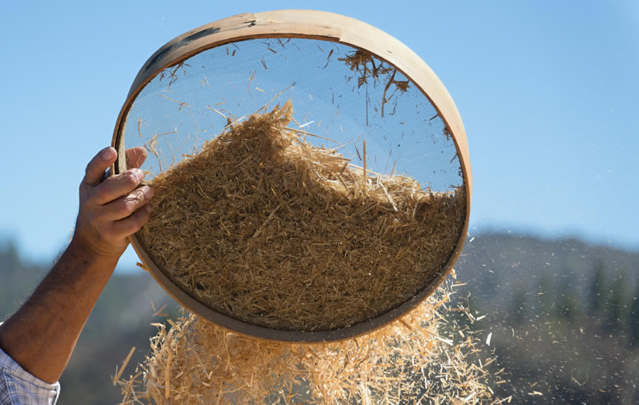

When God Chooses to Sift You
by Pastor Fee Soliven
Luke 22:31-34
Sunday Morning
October 12, 2025

Slide 4
Luke 22:31-34
31 And the Lord said, "Simon, Simon! Indeed, Satan has asked for you, that he may sift you as wheat. 32 But I have prayed for you, that your faith should not fail; and when you have returned to Me, strengthen your brethren." 33 But he said to Him, "Lord, I am ready to go with You, both to prison and to death." 34 Then He said, "I tell you, Peter, the rooster shall not crow this day before you will deny three times that you know Me."

Slide 5
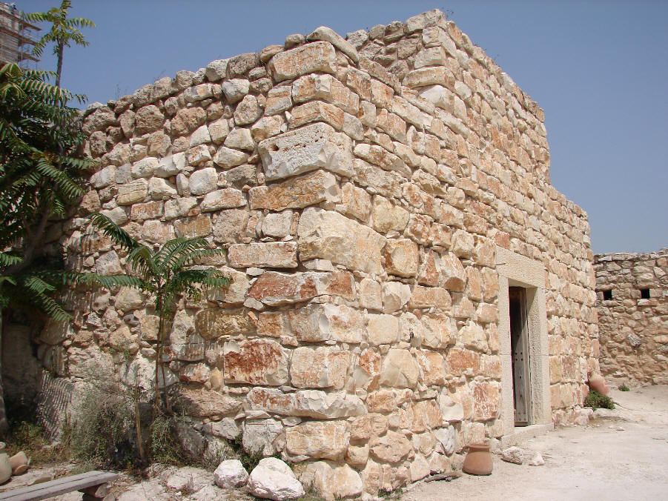

Slide 6
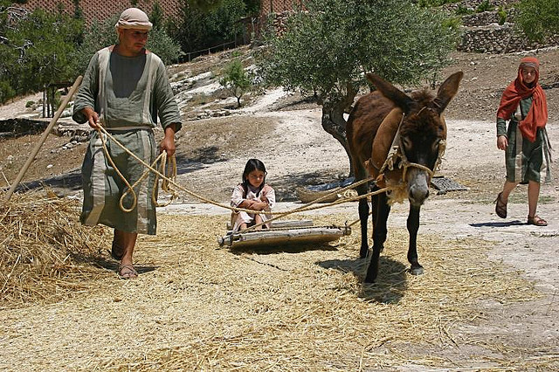
John 15:16
"You did not choose Me, but I chose you and appointed you that you should go and bear fruit, and that your fruit should remain, that whatever you ask the Father in My name He may give you"

Slide 7
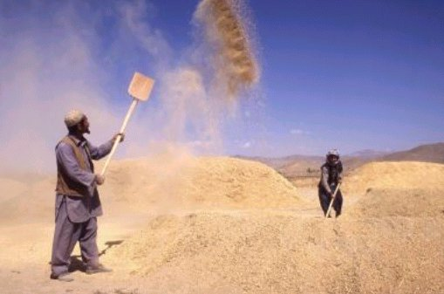
Ephesians 1:3-6
3 Blessed be the God and Father of our Lord Jesus Christ, who has blessed us with every spiritual blessing in the heavenly places in Christ, 4 just as He chose us in Him before the foundation of the world, that we should be holy and without blame before Him in love,

Slide 8
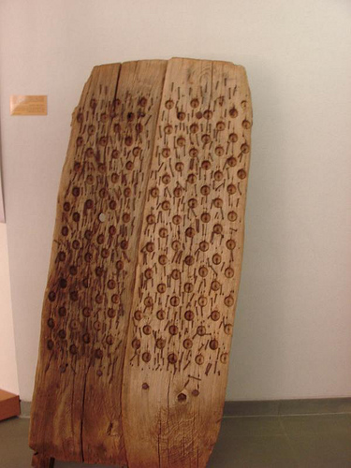
5 having predestined us to adoption as sons by Jesus Christ to Himself, according to the good pleasure of His will, 6 to the praise of the glory of His grace, by which He has made us accepted in the Beloved.

Slide 9
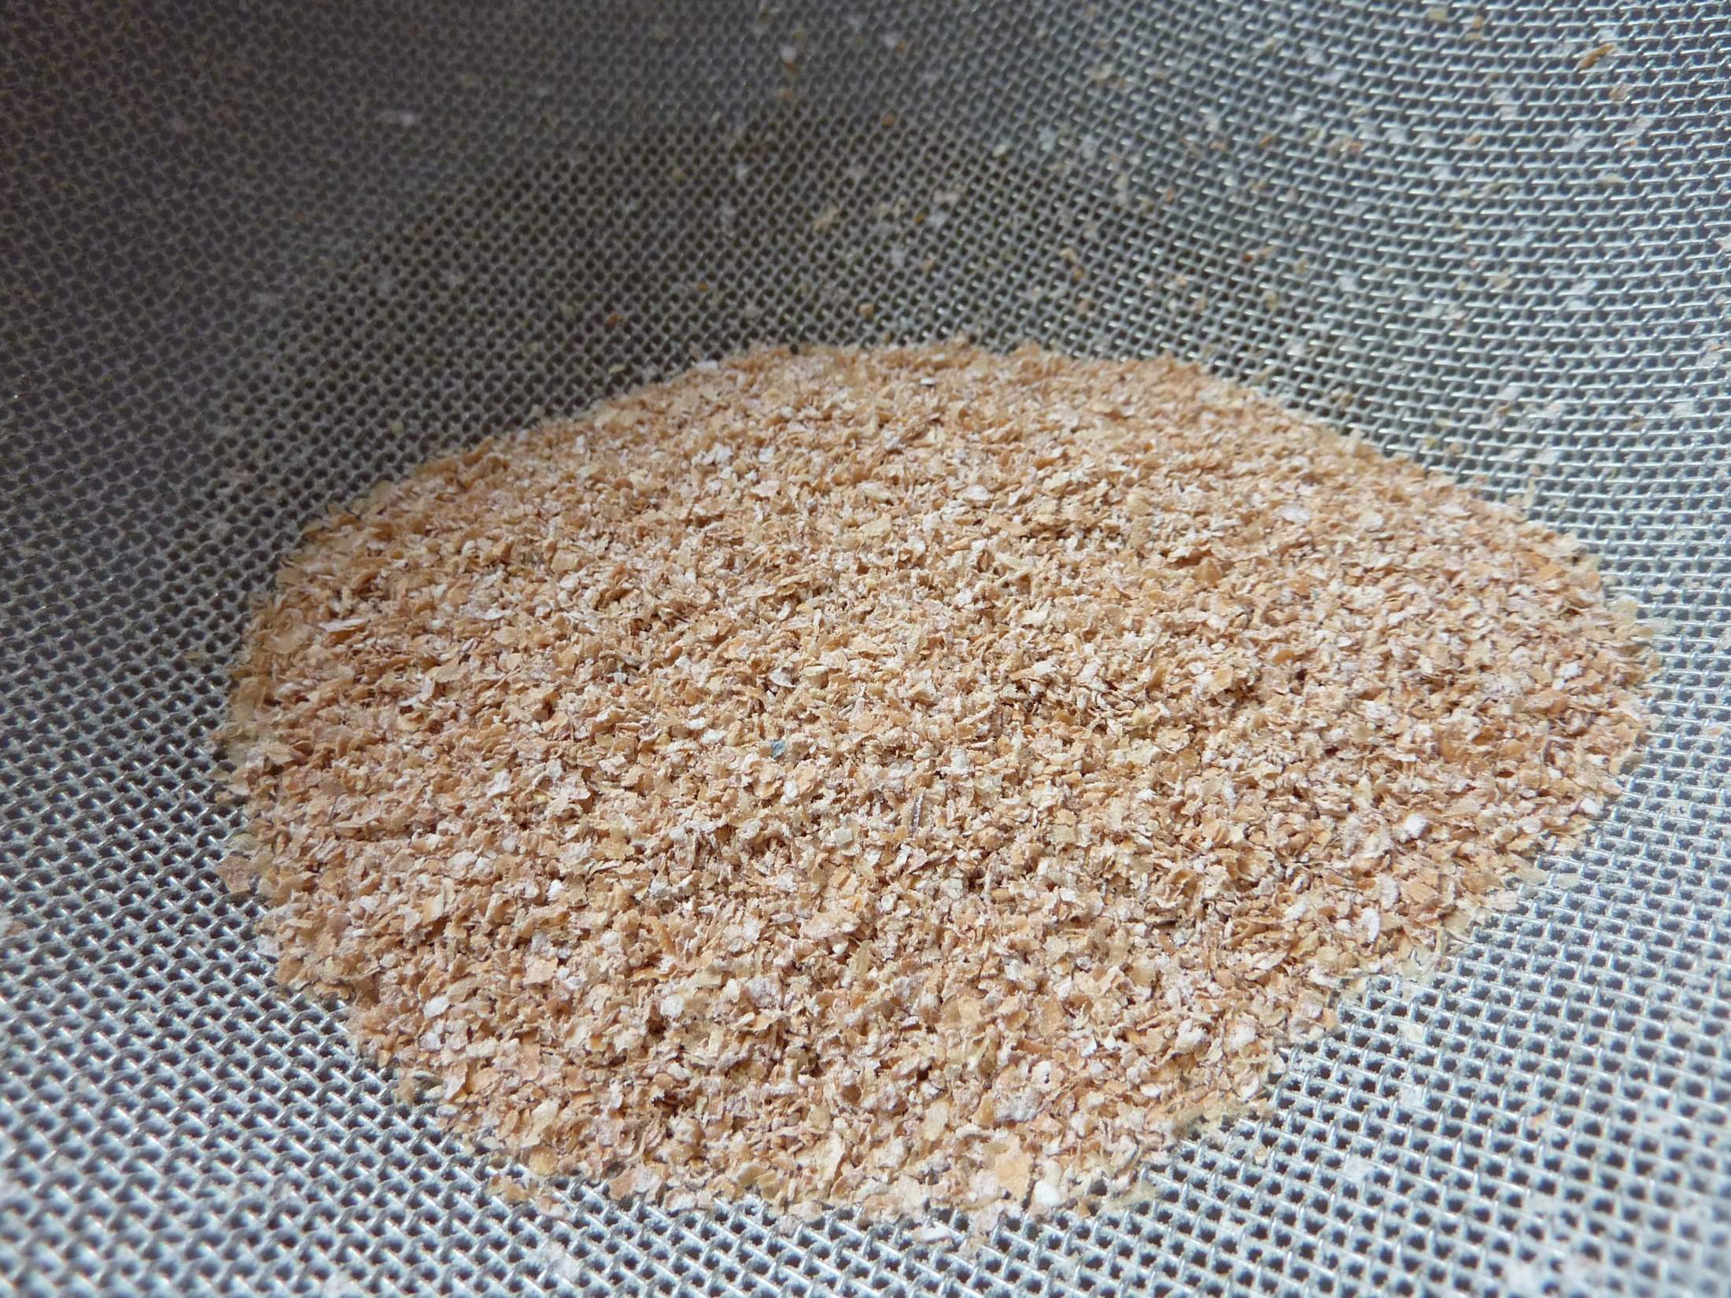
1 Corinthians 1:26-29
26 For you see your calling, brethren, that not many wise according to the flesh, not many mighty, not many noble, are called. 27 But God has chosen the foolish things of the world to put to shame the wise, and God has chosen the weak things of the world to put to shame the things which are mighty;

Slide 10
Deuteronomy 8:7-10
7 For the LORD your God is bringing you into a good land, a land of brooks of water, of fountains and springs, that flow out of valleys and hills; 8 a land of wheat and barley, of vines and fig trees and pomegranates, a land of olive oil and honey;

Slide 11
9 a land in which you will eat bread without scarcity, in which you will lack nothing; a land whose stones are iron and out of whose hills you can dig copper. 10 When you have eaten and are full, then you shall bless the LORD your God for the good land which He has given you.

Slide 12
Deuteronomy 16:16-17
16 Three times a year all your males shall appear before the LORD your God in the place which He chooses: at the Feast of Unleavened Bread, at the Feast of Weeks, and at the Feast of Tabernacles; and they shall not appear before the LORD empty-handed. 17 Every man shall give as he is able, according to the blessing of the LORD your God which He has given you.

Slide 13
James 5:7-8
7 Therefore be patient, brethren, until the coming of the Lord. See how the farmer waits for the precious fruit of the earth, waiting patiently for it until it receives the early and latter rain. 8 You also be patient. Establish your hearts, for the coming of the Lord is at hand.

Slide 14
Joel 2:23-24
23 Be glad then, you children of Zion, And rejoice in the LORD your God; For He has given you the former rain faithfully, And He will cause the rain to come down for you--The former rain, And the latter rain in the first month. 24 The threshing floors shall be full of wheat, And the vats shall overflow with new wine and oil.

Slide 15
Reaping, Threshing, Tribulation
and Sieving

Slide 16
Matthew 13:36-43
36 Then Jesus sent the multitude away and went into the house. And His disciples came to Him, saying, "Explain to us the parable of the tares of the field." 37 He answered and said to them: "He who sows the good seed is the Son of Man. 38 The field is the world, the good seeds are the sons of the kingdom, but the tares are the sons of the wicked one. 39 The enemy who sowed them is the devil, the harvest is the end of the age, and the reapers are the angels.

Slide 17
40 Therefore as the tares are gathered and burned in the fire, so it will be at the end of this age. 41 The Son of Man will send out His angels, and they will gather out of His kingdom all things that offend, and those who practice lawlessness, 42 and will cast them into the furnace of fire. There will be wailing and gnashing of teeth. 43 Then the righteous will shine forth as the sun in the kingdom of their Father. He who has ears to hear, let him hear!

Slide 18
1. The Seed has to be Planted to be Matured

Slide 19
Matthew 24:14
"And this gospel of the kingdom will be preached in all the world as a witness to all the nations, and then the end will come"

Slide 20
2. The Reaping is centered around
Rain Cycles

Slide 21
James 5:7-8
7 Therefore be patient, brethren, until the coming of the Lord. See how the farmer waits for the precious fruit of the earth, waiting patiently for it until it receives the early and latter rain.

Slide 22
3. Threshing is the most important part of the Harvest

Slide 23
Leviticus 26:4-6
4 then I will give you rain in its season, the land shall yield its produce, and the trees of the field shall yield their fruit. 5 Your threshing shall last till the time of vintage, and the vintage shall last till the time of sowing; you shall eat your bread to the full, and dwell in your land safely.

Slide 24
Our Personal Application

Slide 25
1. Jesus Came to Reap

Slide 26
Matthew 3:1-12
1 In those days John the Baptist came preaching in the wilderness of Judea, 2 and saying, "Repent, for the kingdom of heaven is at hand!" 3 For this is he who was spoken of by the prophet Isaiah, saying: "The voice of one crying in the wilderness: Prepare the way of the LORD; Make His paths straight.' "

Slide 27
4 And John himself was clothed in camel's hair, with a leather belt around his waist; and his food was locusts and wild honey. 5 Then Jerusalem, all Judea, and all the region around the Jordan went out to him 6 and were baptized by him in the Jordan, confessing their sins. 7 But when he saw many of the Pharisees and Sadducees coming to his baptism, he said to them, "Brood of vipers! Who warned you to flee from the wrath to come?

Slide 28
8 Therefore bear fruits worthy of repentance, 9 and do not think to say to yourselves, 'We have Abraham as our father.' For I say to you that God is able to raise up children to Abraham from these stones. 10 And even now the ax is laid to the root of the trees. Therefore every tree which does not bear good fruit is cut down and thrown into the fire.

Slide 29
11 I indeed baptize you with water unto repentance, but He who is coming after me is mightier than I, whose sandals I am not worthy to carry. He will baptize you with the Holy Spirit and fire. 12 His winnowing fan is in His hand, and He will thoroughly clean out His threshing floor, and gather His wheat into the barn; but He will burn up the chaff with unquenchable fire."

Slide 30
For the past 2,000 years Jesus has been reaping the fields on earth and gathering the wheat separating the tares that will be eventually thrown into the fire. There must be a separation!

Slide 31
Matthew 13:24-30
24 Another parable He put forth to them, saying: "The kingdom of heaven is like a man who sowed good seed in his field; 25 but while men slept, his enemy came and sowed tares among the wheat and went his way. 26 But when the grain had sprouted and produced a crop, then the tares also appeared. 27 So the servants of the owner came and said to him, 'Sir, did you not sow good seed in your field? How then does it have tares?'

Slide 32
28 "He said to them, 'An enemy has done this.' The servants said to him, 'Do you want us then to go and gather them up?' 29 "But he said, 'No, lest while you gather up the tares you also uproot the wheat with them. 30 Let both grow together until the harvest, and at the time of harvest I will say to the reapers, "First gather together the tares and bind them in bundles to burn them, but gather the wheat into my barn." '

Slide 33
2 Corinthians 6:17-18
17 Therefore "Come out from among them And be separate, says the Lord. Do not touch what is unclean, And I will receive you." 18 "I will be a Father to you, And you shall be My sons and daughters, Says the LORD Almighty."

Slide 34
2. Jesus Sanctifies His people
by Threshing

Slide 35
June 5th, 1967
Israel makes a pre-emptive strike against Egypt while President Nasser is preparing another war of annihilation against Israel in conjunction with Syria and Jordan. In defending herself against the invading armies Israel captures the Golan Heights, the Sinai

Slide 36
Peninsula, the ‘West Bank’ and ‘East Jerusalem’, including the Temple Mount – the holiest site to the Jewish people. Several years later the Golan Heights and the eastern part of Jerusalem were formally annexed to Israel.

Slide 37
2 Corinthians 11:23-29
23 Are they ministers of Christ?--I speak as a fool--I am more: in labors more abundant, in stripes above measure, in prisons more frequently, in deaths often. 24 From the Jews five times I received forty stripes minus one. 25 Three times I was beaten with rods; once I was stoned; three times I was shipwrecked; a night and a day I have been in the deep;

Slide 38
26 in journeys often, in perils of waters, in perils of robbers, in perils of my own countrymen, in perils of the Gentiles, in perils in the city, in perils in the wilderness, in perils in the sea, in perils among false brethren; 27 in weariness and toil, in sleeplessness often, in hunger and thirst, in fastings often, in cold and nakedness-- 28 besides the other things, what comes upon me daily: my deep concern for all the churches.

Slide 39
John 16:32-33
32 Indeed the hour is coming, yes, has now come, that you will be scattered, each to his own, and will leave Me alone. And yet I am not alone, because the Father is with Me. 33 These things I have spoken to you, that in Me you may have peace. In the world you will have tribulation; but be of good cheer, I have overcome the world."

Slide 40
Hebrews 12:1-2
1 Therefore we also, since we are surrounded by so great a cloud of witnesses, let us lay aside every weight, and the sin which so easily ensnares us, and let us run with endurance the race that is set before us, 2 looking unto Jesus, the author and finisher of our faith, who for the joy that was set before Him endured the cross, despising the shame, and has sat down at the right hand of the throne of God.

Slide 41
3. God than sieves us for His Glorification

Slide 42
Romans 8:29-30
29 For whom He foreknew, He also predestined to be conformed to the image of His Son, that He might be the firstborn among many brethren. 30 Moreover whom He predestined, these He also called; whom He called, these He also justified; and whom He justified, these He also glorified.

Slide 43
1 Thessalonians 4:13-18
13 But I do not want you to be ignorant, brethren, concerning those who have fallen asleep, lest you sorrow as others who have no hope. 14 For if we believe that Jesus died and rose again, even so God will bring with Him those who sleep in Jesus.

Slide 44
15 For this we say to you by the word of the Lord, that we who are alive and remain until the coming of the Lord will by no means precede those who are asleep. 16 For the Lord Himself will descend from heaven with a shout, with the voice of an archangel, and with the trumpet of God. And the dead in Christ will rise first.

Slide 45
17 Then we who are alive and remain shall be caught up together with them in the clouds to meet the Lord in the air. And thus we shall always be with the Lord. 18 Therefore comfort one another with these words.

Slide 46
1 Corinthians 15:50-54
50 Now this I say, brethren, that flesh and blood cannot inherit the kingdom of God; nor does corruption inherit incorruption. 51 Behold, I tell you a mystery: We shall not all sleep, but we shall all be changed-- 52 in a moment, in the twinkling of an eye, at the last trumpet. For the trumpet will sound, and the dead will be raised incorruptible, and we shall be changed.

Slide 47
53 For this corruptible must put on incorruption, and this mortal must put on immortality. 54 So when this corruptible has put on incorruption, and this mortal has put on immortality, then shall be brought to pass the saying that is written: "Death is swallowed up in victory."

Slide 48

20 Again, when a righteous man turns from his righteousness and commits iniquity, and I lay a stumbling block before him, he shall die; because you did not give him warning, he shall die in his sin, and his righteousness which he has done shall not be remembered; but his blood I will require at your hand.

Slide 49
Acts 2:38-39
38 Then Peter said to them, "Repent, and let every one of you be baptized in the name of Jesus Christ for the remission of sins; and you shall receive the gift of the Holy Spirit. 39 For the promise is to you and to your children, and to all who are afar off, as many as the Lord our God will call."

Slide 50

Donate with our QR code app to
Amazing Grace Christian Fellowship
Donations are Deeply Appreciated!

