Slide 1


Slide 2


Slide 3
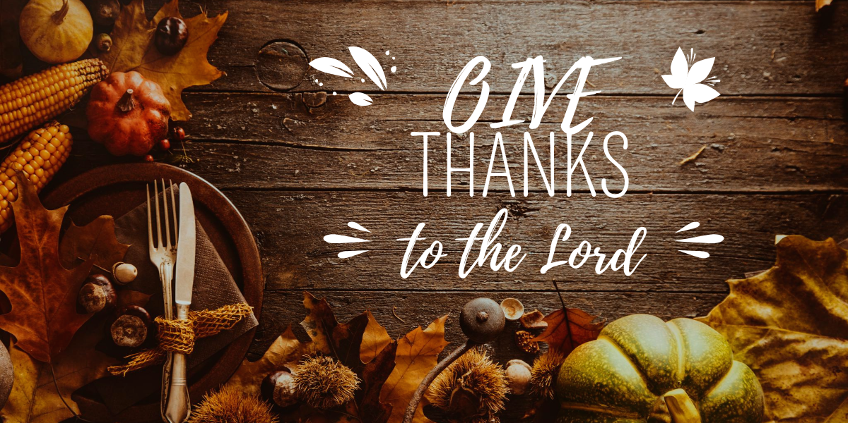

Giving Thanks unto Thee
by Pastor Fee Soliven
1 Thessalonians 5:16-22
Sunday Morning
November 23, 2025

Slide 4
1 Thessalonians 5:14-22
14 Now we exhort you, brethren, warn those who are unruly, comfort the fainthearted, uphold the weak, be patient with all. 15 See that no one renders evil for evil to anyone, but always pursue what is good both for yourselves and for all. 16 Rejoice always,

Slide 5
17 pray without ceasing, 18 in everything give thanks; for this is the will of God in Christ Jesus for you. 19 Do not quench the Spirit. 20 Do not despise prophecies. 21 Test all things; hold fast what is good. 22 Abstain from every form of evil.

Slide 6
“In Everything Give Thanks.”

Slide 7
1 Thessalonians 5:18
“In everything give thanks; for this is God’s will for you in Christ Jesus.”

Slide 8
Ephesians 5:20
“Always giving thanks for all things in the name of our Lord Jesus Christ to God, even the Father.”

Slide 9
“For All Things,”

Slide 10
Romans 8:28
“And we know that all things work together for good to those who love God, to those who are the called according to His purpose”

Slide 11
Why Should we be Grateful to
God in Everything?

Slide 12
1. It keeps us continually aware that we are Walking in His Presence, which contributes to a Godly Life.

Slide 13
Omnipresent – God Fills All Space.
Omnipotent – God is All Powerful.
Omniscient – God is All Knowing.

Slide 14
2. Gratitude motivates us to look for the Lord’s purpose in everything that happens.

Slide 15
1 Timothy 1:15-16
15 This is a faithful saying and worthy of all acceptance, that Christ Jesus came into the world to save sinners, of whom I am chief.
16 However, for this reason I obtained mercy, that in me first Jesus Christ might show all longsuffering, as a pattern to those who are going to believe on Him for everlasting life.

Slide 16
Psalm 125:1
“Those who trust in the LORD Are as Mount Zion, which cannot be moved but abides forever.”

Slide 17
3. Being Grateful brings us into Submission to God’s will when we’re Suffering Pain and Heartache.

Slide 18
Acts 16:16-34
16 Now it happened, as we went to prayer, that a certain slave girl possessed with a spirit of divination met us, who brought her masters much profit by fortune-telling. 17 This girl followed Paul and us, and cried out, saying, "These men are the servants of the Most High God, who proclaim to us the way of salvation."

Slide 19
18 And this she did for many days. But Paul, greatly annoyed, turned and said to the spirit, "I command you in the name of Jesus Christ to come out of her." And he came out that very hour.19 But when her masters saw that their hope of profit was gone, they seized Paul and Silas and dragged them into the marketplace to the authorities.

Slide 20
20 And they brought them to the magistrates, and said, "These men, being Jews, exceedingly trouble our city; 21 and they teach customs which are not lawful for us, being Romans, to receive or observe." 22 Then the multitude rose up together against them; and the magistrates tore off their clothes and commanded them to be beaten with rods. 23 And when they had laid many stripes on them, they threw them into prison, commanding the jailer to keep them securely.

Slide 21
24 Having received such a charge, he put them into the inner prison and fastened their feet in the stocks.25 But at midnight Paul and Silas were praying and singing hymns to God, and the prisoners were listening to them. 26 Suddenly there was a great earthquake, so that the foundations of the prison were shaken; and immediately all the doors were opened and everyone's chains were loosed.

Slide 22
27 And the keeper of the prison, awaking from sleep and seeing the prison doors open, supposing the prisoners had fled, drew his sword and was about to kill himself. 28 But Paul called with a loud voice, saying, "Do yourself no harm, for we are all here." 29 Then he called for a light, ran in, and fell down trembling before Paul and Silas. 30 And he brought them out and said, "Sirs, what must I do to be saved?"

Slide 23
31 So they said, "Believe on the Lord Jesus Christ, and you will be saved, you and your household."32 Then they spoke the word of the Lord to him and to all who were in his house.

Slide 24
33 And he took them the same hour of the night and washed their stripes. And immediately he and all his family were baptized. 34 Now when he had brought them into his house, he set food before them; and he rejoiced, having believed in God with all his household.

Slide 25
4. Being Thankful reminds us of our Continual Dependence Upon the Lord.

Slide 26
Psalm 37:39-40
39 But the salvation of the righteous is from the LORD; He is their strength in the time of trouble. 40 And the LORD shall help them and deliver them; He shall deliver them from the wicked, And save them, Because they trust in Him.

Slide 27
5. Gratitude helps us Trust the Lord when we don’t Understand Why.

Slide 28
6. Thanksgiving is essential for rejoicing in the midst of our suffering.

Slide 29
1 Thessalonians 5:16, 18
16 “Rejoice always” 18 in everything give thanks; for this is the will of God in Christ Jesus for you.

Slide 30
Matthew 27:46
“My God, My God, why have You forsaken Me?”

Slide 31
7. Gratitude to God in difficult times gives our Witness a Greater Impact.

Slide 32
1 Peter 4:12-13
12 Beloved, do not think it strange concerning the fiery trial which is to try you, as though some strange thing happened to you; 13 but rejoice to the extent that you partake of Christ's sufferings, that when His glory is revealed, you may also be glad with exceeding joy.

Slide 33
8. Thankfulness Displaces Anxiety
with Peace

Slide 34
“Greek word for peace, eirene, means to bind together.

Slide 35
Philippians 4:6-7
6 Be anxious for nothing, but in everything by prayer and supplication, with thanksgiving, let your requests be made known to God; 7 and the peace of God, which surpasses all understanding, will guard your hearts and minds through Christ Jesus.

Slide 36
9. Thanksgiving focuses our attention on God rather than our circumstances.

Slide 37
We’re not alone!

Slide 38
Hebrews 13:5
“Let your conduct be without covetousness; be content with such things as you have. For He Himself has said, "I will never leave you nor forsake you."

Slide 39
God is with us!

Slide 40
Matthew 28:20
“teaching them to observe all things that I have commanded you; and lo, I am with you always, even to the end of the age." Amen.”

Slide 41
He loves us!

Slide 42
1 John 3:16
“By this we know love, because He laid down His life for us. And we also ought to lay down our lives for the brethren.”

Slide 43
We’re Eternally Secure

Slide 44
John 10:27-30
27 My sheep hear My voice, and I know them, and they follow Me. 28 And I give them eternal life, and they shall never perish; neither shall anyone snatch them out of My hand. 29 My Father, who has given them to Me, is greater than all; and no one is able to snatch them out of My Father's hand. 30 I and My Father are one."

Slide 45
He will Bring us Through

Slide 46
James 1:12
“Blessed is the man who endures temptation; for when he has been approved, he will receive the crown of life which the Lord has promised to those who love Him.”

Slide 47
God will turn this experience into something profitable in our lives.

Slide 48
Romans 8:27-30
28 And we know that all things work together for good to those who love God, to those who are the called according to His purpose. 29 For whom He foreknew, He also predestined to be conformed to the image of His Son, that He might be the firstborn among many brethren.

Slide 49
30 Moreover whom He predestined, these He also called; whom He called, these He also justified; and whom He justified, these He also glorified.

Slide 50
1. When adversity or suffering comes into your life, do you tend to judge God by the circumstance or judge the situation by what Scripture has said about Him?

Slide 51
2. How would each perspective affect your gratitude and your ability to trust the Lord?

Slide 52
3. How would a life of consistent gratitude to God equip you for the most difficult moments you might encounter?

Slide 53
1 Thessalonians 4:13-18
13 But I do not want you to be ignorant, brethren, concerning those who have fallen asleep, lest you sorrow as others who have no hope. 14 For if we believe that Jesus died and rose again, even so God will bring with Him those who sleep in Jesus.

Slide 54
15 For this we say to you by the word of the Lord, that we who are alive and remain until the coming of the Lord will by no means precede those who are asleep. 16 For the Lord Himself will descend from heaven with a shout, with the voice of an archangel, and with the trumpet of God. And the dead in Christ will rise first.

Slide 55
17 Then we who are alive and remain shall be caught up together with them in the clouds to meet the Lord in the air. And thus we shall always be with the Lord. 18 Therefore comfort one another with these words.

Slide 56
1 Corinthians 15:50-54
50 Now this I say, brethren, that flesh and blood cannot inherit the kingdom of God; nor does corruption inherit incorruption. 51 Behold, I tell you a mystery: We shall not all sleep, but we shall all be changed-- 52 in a moment, in the twinkling of an eye, at the last trumpet. For the trumpet will sound, and the dead will be raised incorruptible, and we shall be changed.

Slide 57
53 For this corruptible must put on incorruption, and this mortal must put on immortality. 54 So when this corruptible has put on incorruption, and this mortal has put on immortality, then shall be brought to pass the saying that is written: "Death is swallowed up in victory."

Slide 58

20 Again, when a righteous man turns from his righteousness and commits iniquity, and I lay a stumbling block before him, he shall die; because you did not give him warning, he shall die in his sin, and his righteousness which he has done shall not be remembered; but his blood I will require at your hand.

Slide 59
Acts 2:38-39
38 Then Peter said to them, "Repent, and let every one of you be baptized in the name of Jesus Christ for the remission of sins; and you shall receive the gift of the Holy Spirit. 39 For the promise is to you and to your children, and to all who are afar off, as many as the Lord our God will call."

Slide 60

Donate with our QR code app to
Amazing Grace Christian Fellowship
Donations are Deeply Appreciated!

