Slide 1


Slide 2


Slide 3
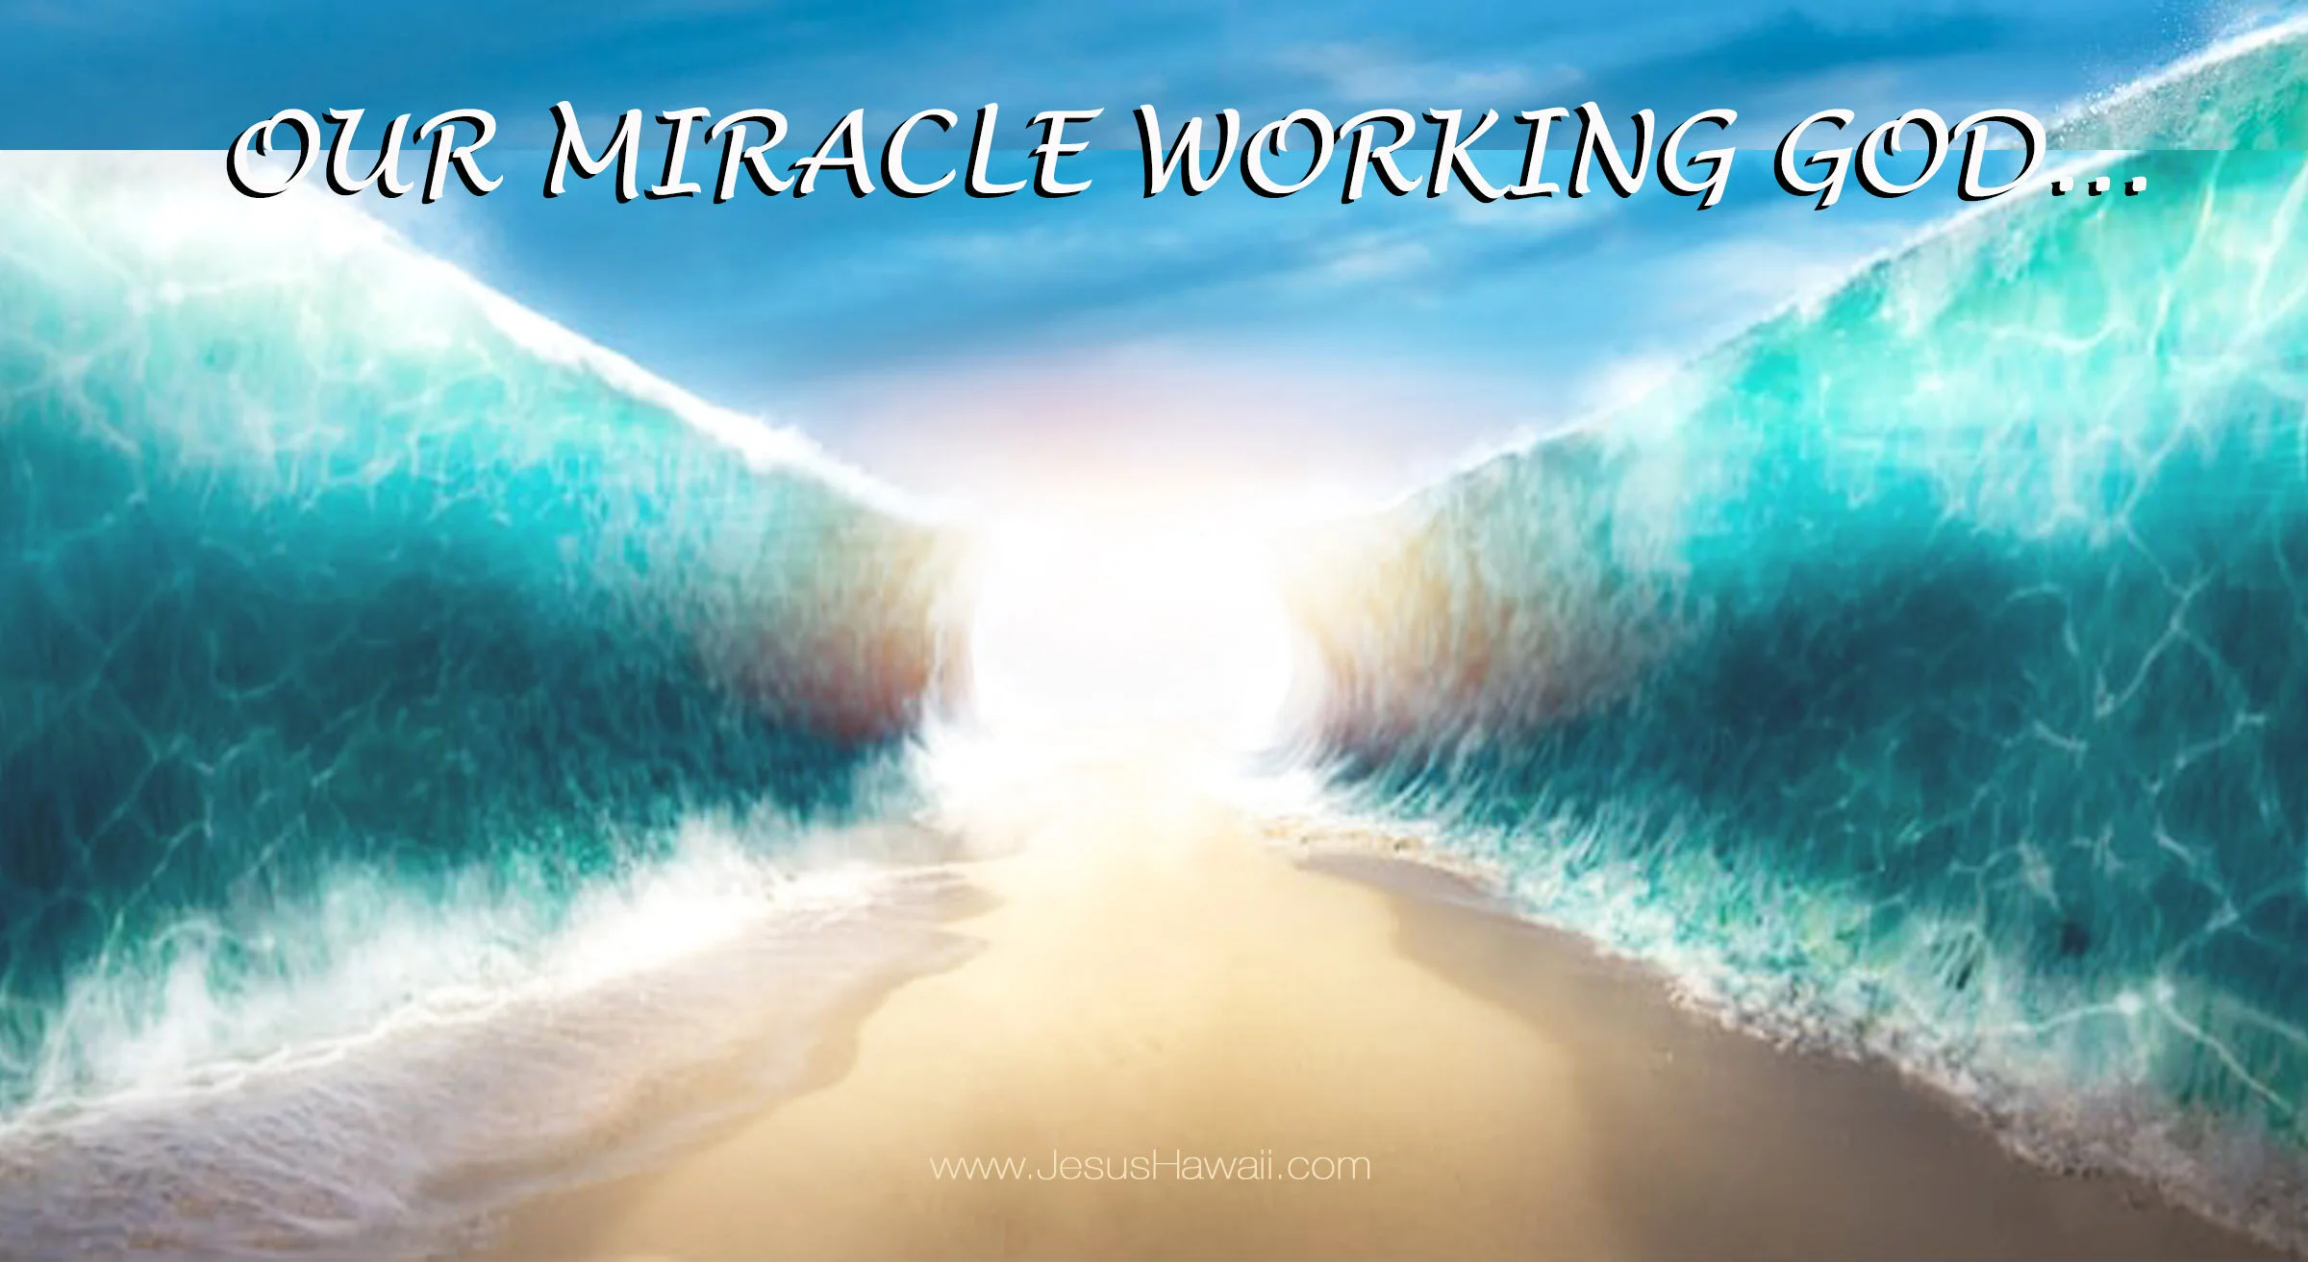

Our Miracle Working God
by Pastor Fee Soliven
Daniel 3:13-18
Sunday Morning
November 2, 2025

Slide 4
Daniel 3:13-18
13 Then Nebuchadnezzar, in rage and fury, gave the command to bring Shadrach, Meshach, and Abed-nego. So they brought these men before the king. 14 Nebuchadnezzar spoke, saying to them, "Is it true, Shadrach, Meshach, and Abed-nego, that you do not serve my gods or worship the gold image which I have set up?

Slide 5
15 Now if you are ready at the time you hear the sound of the horn, flute, harp, lyre, and psaltery, in symphony with all kinds of music, and you fall down and worship the image which I have made, good! But if you do not worship, you shall be cast immediately into the midst of a burning fiery furnace. And who is the god who will deliver you from my hands?"

Slide 6
16 Shadrach, Meshach, and Abed-nego answered and said to the king, "O Nebuchadnezzar, we have no need to answer you in this matter. 17 If that is the case, our God whom we serve is able to deliver us from the burning fiery furnace, and He will deliver us from your hand, O king. 18 But if not, let it be known to you, O king, that we do not serve your gods, nor will we worship the gold image which you have set up."

Slide 7
1. God is Able to Save to the Uttermost

Slide 8
Hebrew 7:25
"Therefore He is also able to save to the uttermost those who come to God through Him, since He always lives to make intercession for them"

Slide 9
Ezekiel 11:17-20
17 "Therefore say, 'Thus says the Lord GOD: "I will gather you from the peoples, assemble you from the countries where you have been scattered, and I will give you the land of Israel." ' 18 "And they will go there, and they will take away all its detestable things and all its abominations from there.

Slide 10
19 Then I will give them one heart, and I will put a new spirit within them, and take the stony heart out of their flesh, and give them a heart of flesh, 20 that they may walk in My statutes and keep My judgments and do them; and they shall be My people, and I will be their God.

Slide 11
2. God is Able to Help Us When
We are Tempted

Slide 12
Hebrews 2:17-18
17 Therefore, in all things He had to be made like His brethren, that He might be a merciful and faithful High Priest in things pertaining to God, to make propitiation for the sins of the people. 18 For in that He Himself has suffered, being tempted, He is able to aid those who are tempted.

Slide 13
1 Peter 4:12-13
12 Beloved, do not think it strange concerning the fiery trial which is to try you, as though some strange thing happened to you; 13 but rejoice to the extent that you partake of Christ's sufferings, that when His glory is revealed, you may also be glad with exceeding joy.

Slide 14
1 Corinthians 10:12-13
12 Therefore let him who thinks he stands take heed lest he fall. 13 No temptation has overtaken you except such as is common to man; but God is faithful, who will not allow you to be tempted beyond what you are able, but with the temptation will also make the way of escape, that you may be able to bear it.

Slide 15
3. God is Able to Subdue All
Things Unto Himself

Slide 16
Philippians 3:20-21
20 For our citizenship is in heaven, from which we also eagerly wait for the Savior, the Lord Jesus Christ, 21 who will transform
our lowly body that it may be conformed to His glorious body, according to the working by which He is able even to subdue all things to Himself.

Slide 17
4. God is Able to Deliver from the
Fires of Life

Slide 18
Daniel 3:17
17 If that is the case, our God whom we serve is able to deliver us from the burning fiery furnace, and He will deliver us from your hand, O king.

Slide 19
2 Corinthians 5:7
"For we walk by faith, not by sight".

Slide 20
1 Peter 2:9-10
9 But you are a chosen generation, a royal priesthood, a holy nation, His own special people, that you may proclaim the praises
of Him who called you out of darkness into His marvelous light; 10 who once were not a people but are now the people of God, who had not obtained mercy but now have obtained mercy.

Slide 21
5. God is Able to Build Us Up

Slide 22
Acts 20:32
"So now, brethren, I commend you to God and to the word of His grace, which is able to build you up and give you an inheritance among all those who are sanctified"

Slide 23
Jude 20-21
20 But you, beloved, building yourselves up on your most holy faith, praying in the Holy Spirit, 21 keep yourselves in the love of God, looking for the mercy of our Lord Jesus Christ unto eternal life.

Slide 24
6. God is Able to Exceed our Expectations

Slide 25
Ephesians 3:20
"Now to Him who is able to do exceedingly abundantly above all that we ask or think, according to the power that works in us"

Slide 26
Psalm 145:14-20
14 The LORD upholds all who fall, And raises up all who are bowed down. 15 The eyes of all look expectantly to You, And You give them their food in due season. 16 You open Your hand And satisfy the desire of every living thing. 17 The LORD is righteous in all His ways, Gracious in all His works.

Slide 27
18 The LORD is near to all who call upon Him, To all who call upon Him in truth. 19 He will fulfill the desire of those who fear Him; He also will hear their cry and save them. 20 The LORD preserves all who love Him, But all the wicked He will destroy.

Slide 28
7. God is Able to Heal and Set Us Free

Slide 29
Matthew 9:28-29
28 And when He had come into the house, the blind men came to Him. And Jesus said to them, "Do you believe that I am able to do this?" They said to Him, "Yes, Lord." 29 Then He touched their eyes, saying, "According to your faith let it be to you." 30 And their eyes were opened...

Slide 30
99% of doctors are convinced that religious belief can heal

Slide 31
75% of doctors believe the prayers of others can help a patient's recovery

Slide 32
38 % of doctors believe that faith in Christ can make people well

Slide 33
8. God is Able to Keep us from Falling

Slide 34
Jude 24
"Now to Him who is able to keep you from stumbling, And to present you faultless Before the presence of His glory with exceeding joy"

Slide 35
1 John 1:8-10
8 If we say that we have no sin, we deceive ourselves, and the truth is not in us. 9 If we confess our sins, He is faithful and just to forgive us our sins and to cleanse us from all unrighteousness. 10 If we say that we have not sinned, we make Him a liar, and His word is not in us.

Slide 36
9. God is Able to Keep Us after Salvation!

Slide 37
John 6:35-40
35 And Jesus said to them, "I am the bread of life. He who comes to Me shall never hunger, and he who believes in Me shall never thirst. 36 But I said to you that you have seen Me and yet do not believe.

Slide 38
37 All that the Father gives Me will come to Me, and the one who comes to Me I will by no means cast out. 38 For I have come down from heaven, not to do My own will, but the will of Him who sent Me. 39 This is the will of the Father who sent Me, that of all He has given Me I should lose nothing, but should raise it up at the last day.

Slide 39
40 And this is the will of Him who sent Me, that everyone who sees the Son and believes in Him may have everlasting life; and I will raise him up at the last day."

Slide 40
John 6:44-45
44 No one can come to Me unless the Father who sent Me draws him; and I will raise him up at the last day. 45 It is written in the prophets, 'And they shall all be taught by God.'

Slide 41
10. God is Able to Rebuke the Enemies of Our Lives!

Slide 42
Romans 8:31-39
31 What then shall we say to these things? If God is for us, who can be against us? 32 He who did not spare His own Son, but delivered Him up for us all, how shall He not with Him also freely give us all things? 33 Who shall bring a charge against God's elect? It is God who justifies.

Slide 43
34 Who is he who condemns? It is Christ who died, and furthermore is also risen, who is even at the right hand of God, who also makes intercession for us. 35 Who shall separate us from the love of Christ? Shall tribulation, or distress, or persecution, or famine, or nakedness, or peril, or sword?

Slide 44
36 As it is written: "For Your sake we are killed all day long; We are accounted as sheep for the slaughter." 37 Yet in all these things we are more than conquerors through Him who loved us. 38 For I am persuaded that neither death nor life, nor angels nor principalities nor powers, nor things present nor things to come, 39 nor height nor depth, nor any other created thing, shall be able to separate us from the love of God which is in Christ Jesus our Lord.

Slide 45
2 Corinthians 9:8-11
8 And God is able to make all grace abound toward you, that you, always having all sufficiency in all things, may have an abundance for every good work. 9 As it is written: "He has dispersed abroad, He has given to the poor; His righteousness endures forever." 10 Now may He who supplies seed to the sower, and bread for food, supply and multiply the seed you have sown and increase the fruits of your righteousness...

Slide 46
1 Thessalonians 4:13-18
13 But I do not want you to be ignorant, brethren, concerning those who have fallen asleep, lest you sorrow as others who have no hope. 14 For if we believe that Jesus died and rose again, even so God will bring with Him those who sleep in Jesus.

Slide 47
15 For this we say to you by the word of the Lord, that we who are alive and remain until the coming of the Lord will by no means precede those who are asleep. 16 For the Lord Himself will descend from heaven with a shout, with the voice of an archangel, and with the trumpet of God. And the dead in Christ will rise first.

Slide 48
17 Then we who are alive and remain shall be caught up together with them in the clouds to meet the Lord in the air. And thus we shall always be with the Lord. 18 Therefore comfort one another with these words.

Slide 49
1 Corinthians 15:50-54
50 Now this I say, brethren, that flesh and blood cannot inherit the kingdom of God; nor does corruption inherit incorruption. 51 Behold, I tell you a mystery: We shall not all sleep, but we shall all be changed-- 52 in a moment, in the twinkling of an eye, at the last trumpet. For the trumpet will sound, and the dead will be raised incorruptible, and we shall be changed.

Slide 50
53 For this corruptible must put on incorruption, and this mortal must put on immortality. 54 So when this corruptible has put on incorruption, and this mortal has put on immortality, then shall be brought to pass the saying that is written: "Death is swallowed up in victory."

Slide 51

20 Again, when a righteous man turns from his righteousness and commits iniquity, and I lay a stumbling block before him, he shall die; because you did not give him warning, he shall die in his sin, and his righteousness which he has done shall not be remembered; but his blood I will require at your hand.

Slide 52
Acts 2:38-39
38 Then Peter said to them, "Repent, and let every one of you be baptized in the name of Jesus Christ for the remission of sins; and you shall receive the gift of the Holy Spirit. 39 For the promise is to you and to your children, and to all who are afar off, as many as the Lord our God will call."

Slide 53

Donate with our QR code app to
Amazing Grace Christian Fellowship
Donations are Deeply Appreciated!

