Slide 1


Slide 2


Slide 3
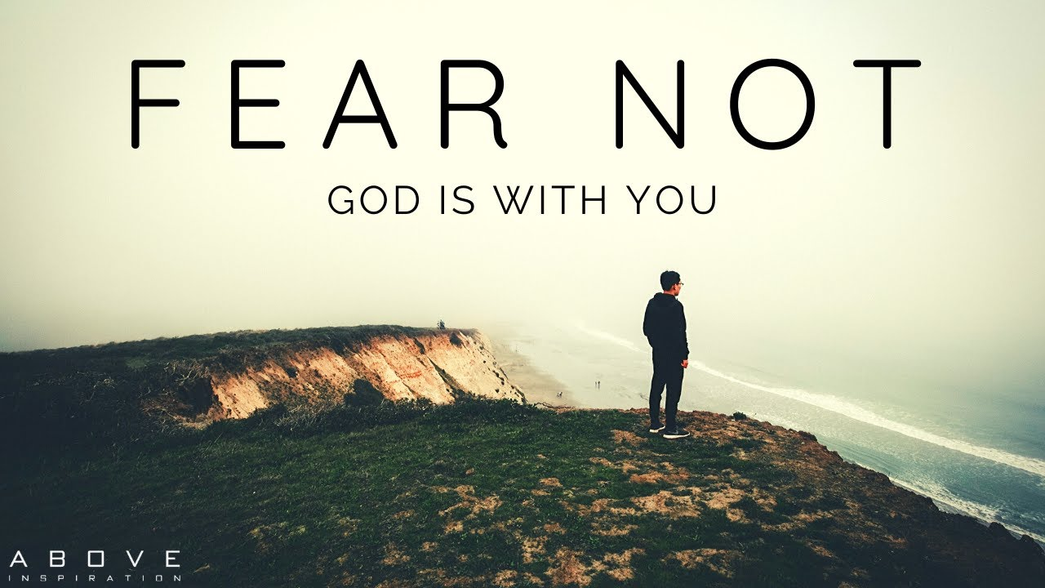
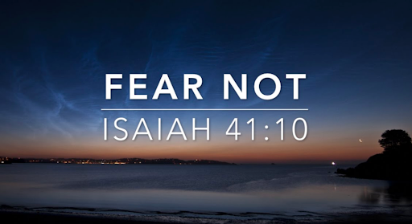

Fear Not for I Am with You
by Pastor Fee Soliven
Isaiah 43:5-11
Sunday Morning
January 18, 2026

Slide 4
Isaiah 43:5-11
5 Fear not, for I am with you; I will bring your descendants from the east, And gather you from the west; 6 I will say to the north, 'Give them up!' And to the south, 'Do not keep them back!' Bring My sons from afar, And My daughters from the ends of the earth-

Slide 5
7 Everyone who is called by My name, Whom I have created for My glory; I have formed him, yes, I have made him." 8 Bring out the blind people who have eyes, And the deaf who have ears. 9 Let all the nations be gathered together, And let the people be assembled. Who among them can declare this, And show us former things? Let them bring out their witnesses, that they may be justified; Or let them hear and say, "It is truth."

Slide 6
10 "You are My witnesses," says the LORD, "And My servant whom I have chosen, That you may know and believe Me, And understand that I am He. Before Me there was no God formed, Nor shall there be after Me. 11 I, even I, am the LORD, And besides Me there is no savior.

Slide 7
Human Fear

Slide 8
Fear: a distressing emotion aroused by impending danger, evil, pain, etc., whether the threat is real or imagined; the feeling or condition of being afraid.

Slide 9
Synonyms:
qualm, trepidation, horror, panic, fright, terror, dread, dismay, consternation, apprehension, foreboding

Slide 10
Exodus 14:10-31
10 And when Pharaoh drew near, the children of Israel lifted their eyes, and behold, the Egyptians marched after them. So they were very afraid, and the children of Israel cried out to the LORD. 11 Then they said to Moses, "Because there were no graves in Egypt, have you taken us away to die in the wilderness? Why have you so dealt with us, to bring us up out of Egypt?

Slide 11
12 Is this not the word that we told you in Egypt, saying, 'Let us alone that we may serve the Egyptians?' For it would have been better for us to serve the Egyptians than that we should die in the wilderness." 13 And Moses said to the people, "Do not be afraid. Stand still, and see the salvation of the LORD, which He will accomplish for you today. For the Egyptians whom you see today, you shall see again no more forever.

Slide 12
14 The LORD will fight for you, and you shall hold your peace." 15 And the LORD said to Moses, "Why do you cry to Me? Tell the children of Israel to go forward. 16 But lift up your rod, and stretch out your hand over the sea and divide it. And the children of Israel shall go on dry ground through the midst of the sea.

Slide 13
17 And I indeed will harden the hearts of the Egyptians, and they shall follow them. So I will gain honor over Pharaoh and over all his army, his chariots, and his horsemen. 18 Then the Egyptians shall know that I am the LORD, when I have gained honor for Myself over Pharaoh, his chariots, and his horsemen."

Slide 14
19 And the Angel of God, who went before the camp of Israel, moved and went behind them; and the pillar of cloud went from before them and stood behind them. 20 So it came between the camp of the Egyptians and the camp of Israel. Thus it was a cloud and darkness to the one, and it gave light by night to the other, so that the one did not come near the other all that night.

Slide 15
21 Then Moses stretched out his hand over the sea; and the LORD caused the sea to go back by a strong east wind all that night, and made the sea into dry land, and the waters were divided. 22 So the children of Israel went into the midst of the sea on the dry ground, and the waters were a wall to them on their right hand and on their left.

Slide 16
23 And the Egyptians pursued and went after them into the midst of the sea, all Pharaoh's horses, his chariots, and his horsemen. 24 Now it came to pass, in the morning watch, that the LORD looked down upon the army of the Egyptians through the pillar of fire and cloud, and He troubled the army of the Egyptians.

Slide 17
25 And He took off their chariot wheels, so that they drove them with difficulty; and the Egyptians said, "Let us flee from the face of Israel, for the LORD fights for them against the Egyptians." 26 Then the LORD said to Moses, "Stretch out your hand over the sea, that the waters may come back upon the Egyptians, on their chariots, and on their horsemen."

Slide 18
27 And Moses stretched out his hand over the sea; and when the morning appeared, the sea returned to its full depth, while the Egyptians were fleeing into it. So the LORD overthrew the Egyptians in the midst of the sea.

Slide 19
28 Then the waters returned and covered the chariots, the horsemen, and all the army of Pharaoh that came into the sea after them. Not so much as one of them remained. 29 But the children of Israel had walked on dry land in the midst of the sea, and the waters were a wall to them on their right hand and on their left.

Slide 20
30 So the LORD saved Israel that day out of the hand of the Egyptians, and Israel saw the Egyptians dead on the seashore. 31 Thus Israel saw the great work which the LORD had done in Egypt; so the people feared the LORD, and believed the LORD and His servant Moses.

Slide 21
A negative doctor’s report of a
terminal condition
2. The loss of a loved one and being now alone
3. Being fired or laid off from your job
4. No longer have health insurance

Slide 22
5. Lawlessness throughout our country
6. House invasions and auto robery

Slide 23
Godly Fear

Slide 24
Psalm 34:8-22
8 Oh, taste and see that the LORD is good; Blessed is the man who trusts in Him! 9 Oh, fear the LORD, you His saints! There is no want to those who fear Him. 10 The young lions lack and suffer hunger; But those who seek the LORD shall not lack any good thing.

Slide 25
11 Come, you children, listen to me; I will teach you the fear of the LORD. 12 Who is the man who desires life, And loves many days, that he may see good? 13 Keep your tongue from evil, And your lips from speaking deceit. 14 Depart from evil and do good; Seek peace and pursue it.

Slide 26
15 The eyes of the LORD are on the righteous, And His ears are open to their cry. 16 The face of the LORD is against those who do evil, To cut off the remembrance of them from the earth. 17 The righteous cry out, and the LORD hears, And delivers them out of all their troubles. 18 The LORD is near to those who have a broken heart, And saves such as have a contrite spirit.

Slide 27
19 Many are the afflictions of the righteous, But the LORD delivers him out of them all. 20 He guards all his bones; Not one of them is broken. 21 Evil shall slay the wicked, And those who hate the righteous shall be condemned. 22 The LORD redeems the soul of His servants, And none of those who trust in Him shall be condemned.

Slide 28
1 John 4:17-19
17 Love has been perfected among us in this: that we may have boldness in the day of judgment; because as He is, so are we in this world. 18 There is no fear in love; but perfect love casts out fear, because fear involves torment. But he who fears has not been made perfect in love. 19 We love Him because He first loved us.

Slide 29
Sometimes we believe that God is leading us in a certain direction, but as we continue down that path, we become discouraged and uncertain because it’s not working out as we expected

Slide 30
Isaiah 55:8-9
8 "For My thoughts are not your thoughts, Nor are your ways My ways," says the LORD. 9 "For as the heavens are higher than the earth, So are My ways higher than your ways, And My thoughts than your thoughts.

Slide 31
When we forget the unconditional promises of God, we begin to fear man

Slide 32
2 Corinthians 1:20-23
20 For all the promises of God in Him are Yes, and in Him Amen, to the glory of God through us. 21 Now He who establishes us with you in Christ and has anointed us is God, 22 who also has sealed us and given us the Spirit in our hearts as a guarantee.

Slide 33
When we stop trusting God and start fearing circumstances, we’re willing to cause others pain and great harm in order to protect ourselves

Slide 34
2 Timothy 1:7
“For God has not given us a spirit of fear, but of power and of love and of a sound mind”

Slide 35
What is Fear and what is it's Origin?

Slide 36
Genesis 3:8-11
8 And they heard the sound of the LORD God walking in the garden in the cool of the day, and Adam and his wife hid themselves from the presence of the LORD God among the trees of the garden. 9 Then the LORD God called to Adam and said to him, "Where are you?" 10 So he said, "I heard Your voice in the garden, and I was afraid because I was naked; and I hid myself."

Slide 37
Here are 5 Helpful Connotations Regarding Fear

Slide 38
How should you Deal with Fear?

Slide 39
Acknowledge It
Before you can begin to deal with your fear, you must admit it’s a problem in your life.

Slide 40
2. Identify its Source

Slide 41
3. Change your Focus

Slide 42
4. Rely on Isaiah 41:10

Slide 43
Isaiah 41:10
10 Fear not, for I am with you; Be not dismayed, for I am your God. I will strengthen you, Yes, I will help you, I will uphold you with My righteous right hand.'

Slide 44
5. Lay Down your Fear

Slide 45
1 Thessalonians 4:13-18
13 But I do not want you to be ignorant, brethren, concerning those who have fallen asleep, lest you sorrow as others who have no hope. 14 For if we believe that Jesus died and rose again, even so God will bring with Him those who sleep in Jesus.

Slide 46
15 For this we say to you by the word of the Lord, that we who are alive and remain until the coming of the Lord will by no means precede those who are asleep. 16 For the Lord Himself will descend from heaven with a shout, with the voice of an archangel, and with the trumpet of God. And the dead in Christ will rise first.

Slide 47
17 Then we who are alive and remain shall be caught up together with them in the clouds to meet the Lord in the air. And thus we shall always be with the Lord. 18 Therefore comfort one another with these words.

Slide 48
1 Corinthians 15:50-54
50 Now this I say, brethren, that flesh and blood cannot inherit the kingdom of God; nor does corruption inherit incorruption. 51 Behold, I tell you a mystery: We shall not all sleep, but we shall all be changed-- 52 in a moment, in the twinkling of an eye, at the last trumpet. For the trumpet will sound, and the dead will be raised incorruptible, and we shall be changed.

Slide 49
53 For this corruptible must put on incorruption, and this mortal must put on immortality. 54 So when this corruptible has put on incorruption, and this mortal has put on immortality, then shall be brought to pass the saying that is written: "Death is swallowed up in victory."

Slide 50

20 Again, when a righteous man turns from his righteousness and commits iniquity, and I lay a stumbling block before him, he shall die; because you did not give him warning, he shall die in his sin, and his righteousness which he has done shall not be remembered; but his blood I will require at your hand.

Slide 51
Acts 2:38-39
38 Then Peter said to them, "Repent, and let every one of you be baptized in the name of Jesus Christ for the remission of sins; and you shall receive the gift of the Holy Spirit. 39 For the promise is to you and to your children, and to all who are afar off, as many as the Lord our God will call."

Slide 52

Donate with our QR code app to
Amazing Grace Christian Fellowship
Donations are Deeply Appreciated!

