Slide 1


Slide 2


Slide 3
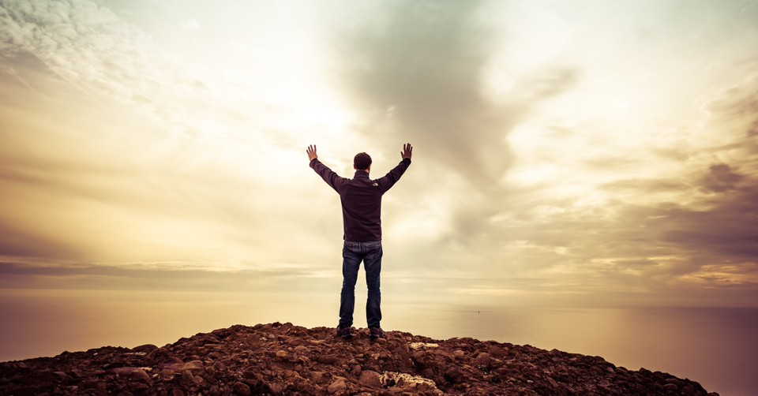

God is On Our Side
by Pastor Fee Soliven
Psalm 5:11-12
Sunday Morning
January 25, 2026

Slide 4
Psalm 5:11-12
11 But let all those rejoice who put their trust in You; Let them ever shout for joy, because You defend them; Let those also who love Your name Be joyful in You. 12 For You, O LORD, will bless the righteous; With favor You will surround him as with a shield.

Slide 5
1. The Description of Divine Favor

Slide 6
2. The Direction of Divine Favor

Slide 7
3. The Destruction of Divine Favor

Slide 8
1. The Description of Divine Favor

Slide 9
Daniel 1:9
Now God had brought Daniel into the favor and goodwill of the chief of the eunuchs.

Slide 10
Esther 2:15-17
15 Now when the turn came for Esther the daughter of Abihail the uncle of Mordecai, who had taken her as his daughter, to go in to the king, she requested nothing but what Hegai the king's eunuch, the custodian of the women, advised. And Esther obtained favor in the sight of all who saw her.

Slide 11
16 So Esther was taken to King Ahasuerus, into his royal palace, in the tenth month, which is the month of Tebeth, in the seventh year of his reign. 17 The king loved Esther more than all the other women, and she obtained grace and favor in his sight more than all the virgins; so he set the royal crown upon her head and made her queen instead of Vashti.

Slide 12
1 Samuel 16:11-13
11 And Samuel said to Jesse, "Are all the young men here?" Then he said, "There remains yet the youngest, and there he is, keeping the sheep." And Samuel said to Jesse, "Send and bring him. For we will not sit down till he comes here." 12 So he sent and brought him in. Now he was ruddy, with bright eyes, and good-looking. And the LORD said, "Arise, anoint him; for this is the one!"

Slide 13
13 Then Samuel took the horn of oil and anointed him in the midst of his brothers; and the Spirit of the LORD came upon David from that day forward. So Samuel arose and went to Ramah.

Slide 14
1 Chronicles 4:9-10
9 Now Jabez was more honorable than his brothers, and his mother called his name Jabez, saying, "Because I bore him in pain." 10 And Jabez called on the God of Israel saying, "Oh, that You would bless me indeed, and enlarge my territory, that Your hand would be with me, and that You would keep me from evil, that I may not cause pain!" So God granted him what he requested.

Slide 15
Acts 9:1-19
1 Then Saul, still breathing threats and murder against the disciples of the Lord, went to the high priest 2 and asked letters from him to the synagogues of Damascus, so that if he found any who were of the Way, whether men or women, he might bring them bound to Jerusalem. 3 And as he journeyed he came near Damascus, and suddenly a light shone around him from heaven.

Slide 16
4 Then he fell to the ground, and heard a voice saying to him, "Saul, Saul, why are you persecuting Me?" 5 And he said, "Who are You, Lord?" And the Lord said, "I am Jesus, whom you are persecuting. It is hard for you to kick against the goads." 6 So he, trembling and astonished, said, "Lord, what do You want me to do?" And the Lord said to him, "Arise and go into the city, and you will be told what you must do."

Slide 17
7 And the men who journeyed with him stood speechless, hearing a voice but seeing no one. 8 Then Saul arose from the ground, and when his eyes were opened he saw no one. But they led him by the hand and brought him into Damascus. 9 And he was three days without sight, and neither ate nor drank. 10 Now there was a certain disciple at Damascus named Ananias; and to him the Lord said in a vision, "Ananias." And he said, "Here I am, Lord."

Slide 18
11 So the Lord said to him, "Arise and go to the street called Straight, and inquire at the house of Judas for one called Saul of Tarsus, for behold, he is praying. 12 And in a vision he has seen a man named Ananias coming in and putting his hand on him, so that he might receive his sight." 13 Then Ananias answered, "Lord, I have heard from many about this man, how much harm he has done to Your saints in Jerusalem.

Slide 19
14 And here he has authority from the chief priests to bind all who call on Your name." 15 But the Lord said to him, "Go, for he is a chosen vessel of Mine to bear My name before Gentiles, kings, and the children of Israel. 16 For I will show him how many things he must suffer for My name's sake." 17 And Ananias went his way and entered the house; and laying his hands on him he said, "Brother Saul, the Lord Jesus, who appeared to you on the road as you came, has sent me that you may receive your sight and be filled with the Holy Spirit."

Slide 20
18 Immediately there fell from his eyes something like scales, and he received his sight at once; and he arose and was baptized. 19 So when he had received food, he was strengthened. Then Saul spent some days with the disciples at Damascus.

Slide 21
2. The Direction of Divine Favor

Slide 22
John 3:5
Jesus answered, "Most assuredly, I say to you, unless one is born of water and the Spirit, he cannot enter the kingdom of God.

Slide 23
1 Corinthians 2:14
But the natural man does not receive the things of the Spirit of God, for they are foolishness to him; nor can he know them, because they are spiritually discerned.

Slide 24
Romans 8:6-9
6 For to be carnally minded is death, but to be spiritually minded is life and peace. 7 Because the carnal mind is enmity against God; for it is not subject to the law of God, nor indeed can be. 8 So then, those who are in the flesh cannot please God. 9 But you are not in the flesh but in the Spirit, if indeed the Spirit of God dwells in you. Now if anyone does not have the Spirit of Christ, he is not His.

Slide 25
3. Destruction of Divine Favor

Slide 26
Disobedience to God

Slide 27
King Saul’s Walk of Disobedience

Slide 28
1 Samuel 15:23-27
23 For rebellion is as the sin of witchcraft, And stubbornness is as iniquity and idolatry. Because you have rejected the word of the LORD, He also has rejected you from being king." 24 Then Saul said to Samuel, "I have sinned, for I have transgressed the commandment of the LORD and your words, because I feared the people and obeyed their voice.

Slide 29
25 Now therefore, please pardon my sin, and return with me, that I may worship the LORD." 26 But Samuel said to Saul, "I will not return with you, for you have rejected the word of the LORD, and the LORD has rejected you from being king over Israel."

Slide 30
Samson’s Thirst for Lust

Slide 31
Judges 16:18-20
18 When Delilah saw that he had told her all his heart, she sent and called for the lords of the Philistines, saying, "Come up once more, for he has told me all his heart." So the lords of the Philistines came up to her and brought the money in their hand. 19 Then she lulled him to sleep on her knees, and called for a man and had him shave off the seven locks of his head. Then she began to torment him, and his strength left him.

Slide 32
20 And she said, "The Philistines are upon you, Samson!" So he awoke from his sleep, and said, "I will go out as before, at other times, and shake myself free!" But he did not know that the LORD had departed from him.

Slide 33
1.Produce Supernatural Promotion
and Increase

Slide 34
2. Bring Restoration of everything the Enemy has Stolen

Slide 35
3. Bring Honor in the midst of Adversaries

Slide 36
4. Produce Increased Assets

Slide 37
5. Give Great and Unusual Victories even against Impossible Odds

Slide 38
6. Give Recognition and Promotion even when you seem to the least likely one to receive it

Slide 39
7. Produce Prominence and Preferential Treatment

Slide 40
8. Get Petitions Granted, even by Ungodly Civil Authority

Slide 41
9. Win Battles you did not even have to Fight because God will Fight them for you!

Slide 42
1 Thessalonians 4:13-18
13 But I do not want you to be ignorant, brethren, concerning those who have fallen asleep, lest you sorrow as others who have no hope. 14 For if we believe that Jesus died and rose again, even so God will bring with Him those who sleep in Jesus.

Slide 43
15 For this we say to you by the word of the Lord, that we who are alive and remain until the coming of the Lord will by no means precede those who are asleep. 16 For the Lord Himself will descend from heaven with a shout, with the voice of an archangel, and with the trumpet of God. And the dead in Christ will rise first.

Slide 44
17 Then we who are alive and remain shall be caught up together with them in the clouds to meet the Lord in the air. And thus we shall always be with the Lord. 18 Therefore comfort one another with these words.

Slide 45
1 Corinthians 15:50-54
50 Now this I say, brethren, that flesh and blood cannot inherit the kingdom of God; nor does corruption inherit incorruption. 51 Behold, I tell you a mystery: We shall not all sleep, but we shall all be changed-- 52 in a moment, in the twinkling of an eye, at the last trumpet. For the trumpet will sound, and the dead will be raised incorruptible, and we shall be changed.

Slide 46
53 For this corruptible must put on incorruption, and this mortal must put on immortality. 54 So when this corruptible has put on incorruption, and this mortal has put on immortality, then shall be brought to pass the saying that is written: "Death is swallowed up in victory."

Slide 47

20 Again, when a righteous man turns from his righteousness and commits iniquity, and I lay a stumbling block before him, he shall die; because you did not give him warning, he shall die in his sin, and his righteousness which he has done shall not be remembered; but his blood I will require at your hand.

Slide 48
Acts 2:38-39
38 Then Peter said to them, "Repent, and let every one of you be baptized in the name of Jesus Christ for the remission of sins; and you shall receive the gift of the Holy Spirit. 39 For the promise is to you and to your children, and to all who are afar off, as many as the Lord our God will call."

Slide 49

Donate with our QR code app to
Amazing Grace Christian Fellowship
Donations are Deeply Appreciated!

