Slide 1


Slide 2


Slide 3

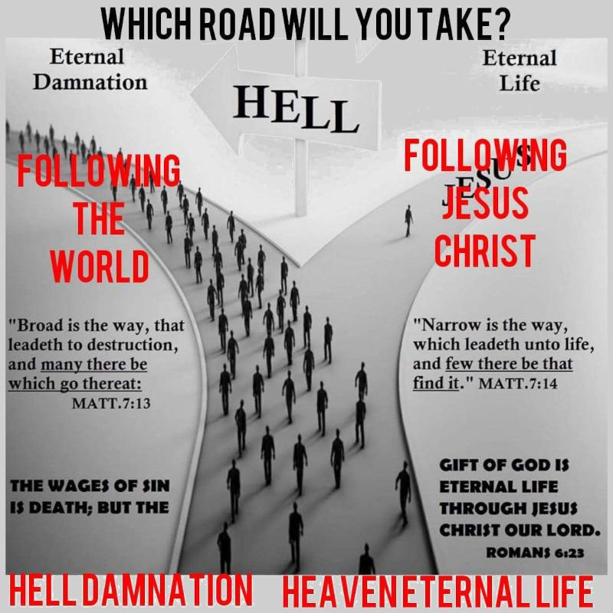
Come Out from Among Them
by Pastor Fee Soliven
2 Corinthians 6:14-18
Sunday Morning
February 15, 2026

Slide 4
2 Corinthians 6:14-18
14 Do not be unequally yoked together with unbelievers. For what fellowship has righteousness with lawlessness? And what communion has light with darkness? 15 And what accord has Christ with Belial? Or what part has a believer with an unbeliever?

Slide 5
16 And what agreement has the temple of God with idols? For you are the temple of the living God. As God has said: "I will dwell in them And walk among them. I will be their God, And they shall be My people." 17 Therefore "Come out from among them And be separate, says the Lord. Do not touch what is unclean, And I will receive you." 18 "I will be a Father to you, And you shall be My sons and daughters, Says the LORD Almighty."

Slide 6
1. A Definitive Transformation of
the Mind
2. Walking in Obedience to The Lord
3. A Life of Sacrifice and Praise

Slide 7
A Definitive Transformation of
the Mind

Slide 8
Love as the Foundation

Slide 9
Luke 10:25-28
25 And behold, a certain lawyer stood up and tested Him, saying, "Teacher, what shall I do to inherit eternal life?" 26 He said to him, "What is written in the law? What is your reading of it?" 27 So he answered and said, " 'You shall love the LORD your God with all your heart, with all your soul, with all your strength, and with all your mind,' and 'your neighbor as yourself.' " 28 And He said to him, "You have answered rightly; do this and you will live."

Slide 10
Transformation of Mind

Slide 11
Romans 12:2
And do not be conformed to this world, but be transformed by the renewing of your mind, that you may prove what is that good and acceptable and perfect will of God.

Slide 12
Faith and Obedience

Slide 13
Trust in the Lord, obey His commandments, and live by faith.

Slide 14
Psalm 37:3-5
3 Trust in the LORD, and do good; Dwell in the land, and feed on His faithfulness. 4 Delight yourself also in the LORD, And He shall give you the desires of your heart. 5 Commit your way to the LORD, Trust also in Him, And He shall bring it to pass.

Slide 15
John 14:15-18
15 "If you love Me, keep My commandments. 16 And I will pray the Father, and He will give you another Helper, that He may abide with you forever-- 17 the Spirit of truth, whom the world cannot receive, because it neither sees Him nor knows Him; but you know Him, for He dwells with you and will be in you. 18 I will not leave you orphans; I will come to you.

Slide 16
Conduct and Character

Slide 17
Righteous Living

Slide 18
Live in purity, avoiding immorality, idolatry, and malicious behavior.

Slide 19
1 Thessalonians 4:3-4
3 For this is the will of God, your sanctification: that you should abstain from sexual immorality; 4 that each of you should know how to possess his own vessel in sanctification and honor…

Slide 20
Psalm 119:9
How can a young man cleanse his way? By taking heed according to Your word.

Slide 21
Philippians 4:8
Whatever things are pure, whatever things are lovely, whatever things are of good report, if there is any virtue and if there is anything praiseworthy--meditate on these things.

Slide 22
Relationships

Slide 23
Forgive others, love enemies, and be kind, compassionate, and humble.

Slide 24
Ephesians 4:30-32
30 And do not grieve the Holy Spirit of God, by whom you were sealed for the day of redemption. 31 Let all bitterness, wrath, anger, clamor, and evil speaking be put away from you, with all malice. 32 And be kind to one another, tenderhearted, forgiving one another, just as God in Christ forgave you.

Slide 25
Matthew 6:14-15
14 "For if you forgive men their trespasses, your heavenly Father will also forgive you. 15 But if you do not forgive men their trespasses, neither will your Father forgive your trespasses.

Slide 26
Work Ethic

Slide 27
Work heartily as for the Lord, not just for human masters.

Slide 28
Colossians 3:23-24
23 And whatever you do, do it heartily, as to the Lord and not to men, 24 knowing that from the Lord you will receive the reward of the inheritance; for you serve the Lord Christ…

Slide 29
Speech

Slide 30
Avoid foul language, grumbling, disputes, and gossip, ensuring your words are encouraging.

Slide 31
Colossians 3:8-10
8 But now you yourselves are to put off all these: anger, wrath, malice, blasphemy, filthy language out of your mouth. 9 Do not lie to one another, since you have put off the old man with his deeds, 10 and have put on the new man who is renewed in knowledge according to the image of Him who created him…

Slide 32
Spiritual Discipline

Slide 33
Train yourself for godliness, engage in prayer, and stay vigilant

Slide 34
1 Timothy 4:6-7
6 If you instruct the brethren in these things, you will be a good minister of Jesus Christ, nourished in the words of faith and of the good doctrine which you have carefully followed. 7 But reject profane and old wives' fables, and exercise yourself toward godliness.

Slide 35
2. Walking in Obedience to The Lord

Slide 36
Deuteronomy 5:33
You shall walk in all the ways which the LORD your God has commanded you, that you may live and that it may be well with you, and that you may prolong your days in the land which you shall possess.

Slide 37
Deuteronomy 13:4
You shall walk after the LORD your God and fear Him, and keep His commandments and obey His voice, and you shall serve Him and hold fast to Him.

Slide 38
John 14:15
"If you love Me, keep My commandments.

Slide 39
1 John 2:3-5
3 Now by this we know that we know Him, if we keep His commandments. 4 He who says, "I know Him," and does not keep His commandments, is a liar, and the truth is not in him. 5 But whoever keeps His word, truly the love of God is perfected in him. By this we know that we are in Him…

Slide 40
3. A Life of Sacrifice and Praise

Slide 41
Luke 9:23-26
23 Then He said to them all, "If anyone desires to come after Me, let him deny himself, and take up his cross daily, and follow Me. 24 For whoever desires to save his life will lose it, but whoever loses his life for My sake will save it.

Slide 42
25 For what profit is it to a man if he gains the whole world, and is himself destroyed or lost? 26 For whoever is ashamed of Me and My words, of him the Son of Man will be ashamed when He comes in His own glory, and in His Father's, and of the holy angels.

Slide 43
Do Not Hinder Others if Your Walk is in Disobedience to God

Slide 44
Matthew 18:4-7
4 Therefore whoever humbles himself as this little child is the greatest in the kingdom of heaven. 5 Whoever receives one little child like this in My name receives Me. 6 "But whoever causes one of these little ones who believe in Me to sin, it would be better for him if a millstone were hung around his neck, and he were drowned in the depth of the sea. 7 Woe to the world because of offenses! For offenses must come, but woe to that man by whom the offense comes!

Slide 45
Romans 12:1-2
1 I beseech you therefore, brethren, by the mercies of God, that you present your bodies a living sacrifice, holy, acceptable to God, which is your reasonable service. 2 And do not be conformed to this world, but be transformed by the renewing of your mind, that you may prove what is that good and acceptable and perfect will of God.

Slide 46
Romans 6:5-8
6 knowing this, that our old man was crucified with Him, that the body of sin might be done away with, that we should no longer be slaves of sin. 7 For he who has died has been freed from sin. 8 Now if we died with Christ, we believe that we shall also live with Him…

Slide 47
We need to learn how to die to self!

Slide 48
Meaning of Dying to Self

Slide 49
Daily Action

Slide 50
It is not a one-time event, but a daily, continuous process of setting aside selfish interests for Christ.

Slide 51
Spiritual Transformation

Slide 52
It involves putting to death the sinful nature and allowing the Holy Spirit to produce fruit.

Slide 53
Surrender

Slide 54
It means trusting God over personal, earthly, or selfish desires.

Slide 55
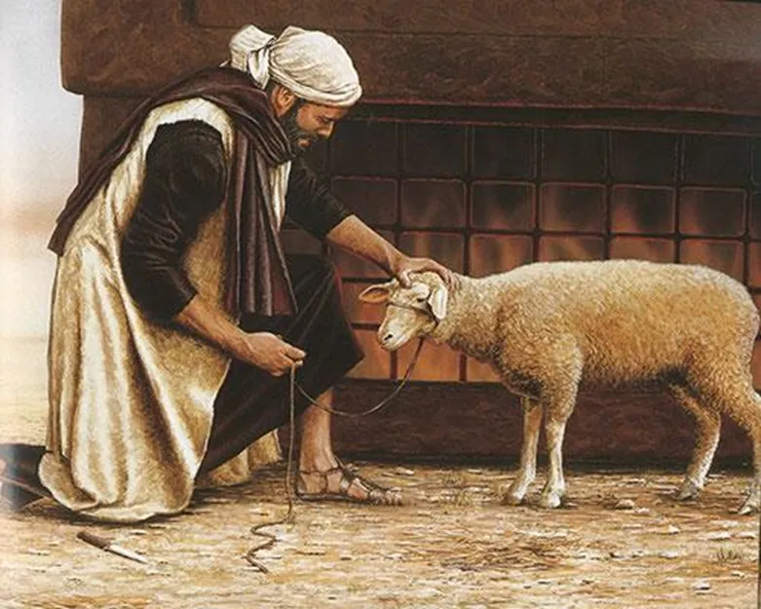
Do Not Hinder Others if Your Walk is in Disobedience to God

Slide 56
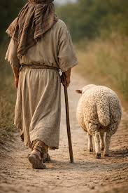

Slide 57
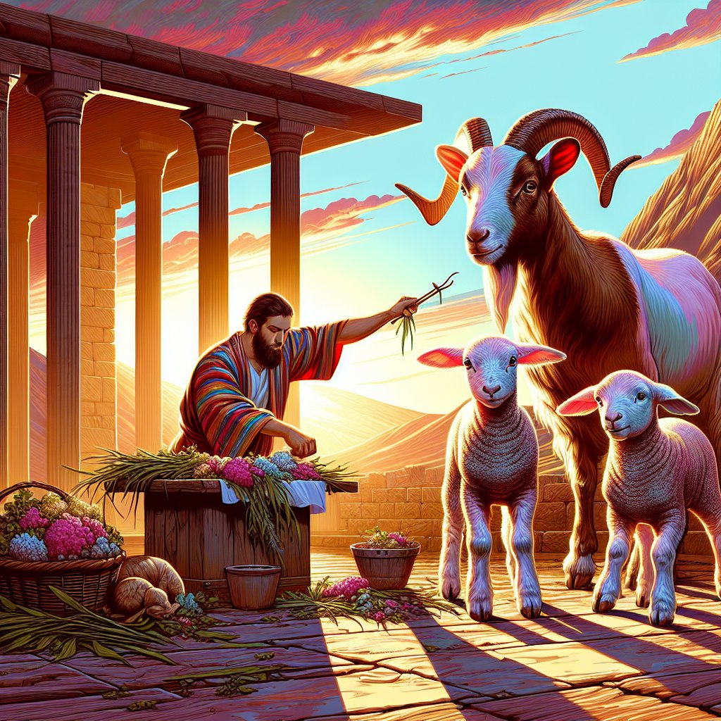
Do Not Hinder Others if Your Walk is in Disobedience to God

Slide 58
1 Thessalonians 4:13-18
13 But I do not want you to be ignorant, brethren, concerning those who have fallen asleep, lest you sorrow as others who have no hope. 14 For if we believe that Jesus died and rose again, even so God will bring with Him those who sleep in Jesus.

Slide 59
15 For this we say to you by the word of the Lord, that we who are alive and remain until the coming of the Lord will by no means precede those who are asleep. 16 For the Lord Himself will descend from heaven with a shout, with the voice of an archangel, and with the trumpet of God. And the dead in Christ will rise first.

Slide 60
17 Then we who are alive and remain shall be caught up together with them in the clouds to meet the Lord in the air. And thus we shall always be with the Lord. 18 Therefore comfort one another with these words.

Slide 61
1 Corinthians 15:50-54
50 Now this I say, brethren, that flesh and blood cannot inherit the kingdom of God; nor does corruption inherit incorruption. 51 Behold, I tell you a mystery: We shall not all sleep, but we shall all be changed-- 52 in a moment, in the twinkling of an eye, at the last trumpet. For the trumpet will sound, and the dead will be raised incorruptible, and we shall be changed.

Slide 62
53 For this corruptible must put on incorruption, and this mortal must put on immortality. 54 So when this corruptible has put on incorruption, and this mortal has put on immortality, then shall be brought to pass the saying that is written: "Death is swallowed up in victory."

Slide 63

20 Again, when a righteous man turns from his righteousness and commits iniquity, and I lay a stumbling block before him, he shall die; because you did not give him warning, he shall die in his sin, and his righteousness which he has done shall not be remembered; but his blood I will require at your hand.

Slide 64
Acts 2:38-39
38 Then Peter said to them, "Repent, and let every one of you be baptized in the name of Jesus Christ for the remission of sins; and you shall receive the gift of the Holy Spirit. 39 For the promise is to you and to your children, and to all who are afar off, as many as the Lord our God will call."

Slide 65

Donate with our QR code app to
Amazing Grace Christian Fellowship
Donations are Deeply Appreciated!

