Slide 1


Slide 2


Slide 3
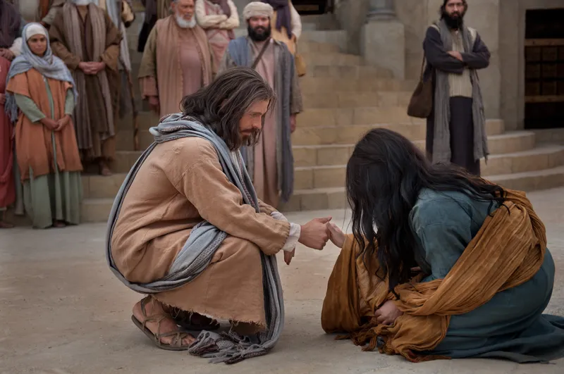

God has Forgiven You!
by Pastor Fee Soliven
John 8:1-11
Sunday Morning
February 1, 2026

Slide 4
John 8:1-11
1 But Jesus went to the Mount of Olives. 2 Now early in the morning He came again into the temple, and all the people came to Him; and He sat down and taught them. 3 Then the scribes and Pharisees brought to Him a woman caught in adultery. And when they had set her in the midst, 4 they said to Him, "Teacher, this woman was caught in adultery, in the very act.

Slide 5
5 Now Moses, in the law, commanded us that such should be stoned. But what do You say?" 6 This they said, testing Him, that they might have something of which to accuse Him. But Jesus stooped down and wrote on the ground with His finger, as though He did not hear.

Slide 6
7 So when they continued asking Him, He raised Himself up and said to them, "He who is without sin among you, let him throw a stone at her first." 8 And again He stooped down and wrote on the ground. 9 Then those who heard it, being convicted by their conscience, went out one by one, beginning with the oldest even to the last. And Jesus was left alone, and the woman standing in the midst.

Slide 7
10 When Jesus had raised Himself up and saw no one but the woman, He said to her, "Woman, where are those accusers of yours? Has no one condemned you?" 11 She said, "No one, Lord." And Jesus said to her, "Neither do I condemn you; go and sin no more."

Slide 8
Biblical Example of Forgiveness

Slide 9
David

Slide 10
1 Samuel 24:1-7
1 Now it happened, when Saul had returned from following the Philistines, that it was told him, saying, "Take note! David is in the Wilderness of En Gedi." 2 Then Saul took three thousand chosen men from all Israel, and went to seek David and his men on the Rocks of the Wild Goats.

Slide 11
3 So he came to the sheepfolds by the road, where there was a cave; and Saul went in to attend to his needs. (David and his men were staying in the recesses of the cave.) 4 Then the men of David said to him, "This is the day of which the LORD said to you, 'Behold, I will deliver your enemy into your hand, that you may do to him as it seems good to you.' " And David arose and secretly cut off a corner of Saul's robe.

Slide 12
5 Now it happened afterward that David's heart troubled him because he had cut Saul's robe. 6 And he said to his men, "The LORD forbid that I should do this thing to my master, the LORD's anointed, to stretch out my hand against him, seeing he is the anointed of the LORD." 7 So David restrained his servants with these words, and did not allow them to rise against Saul. And Saul got up from the cave and went on his way.

Slide 13
1 Samuel 24:6
And he said to his men, "The LORD forbid that I should do this thing to my master, the LORD's anointed, to stretch out my hand against him, seeing he is the anointed of the LORD."

Slide 14
1 Samuel 24:17-22
17 Then he said to David: "You are more righteous than I; for you have rewarded me with good, whereas I have rewarded you with evil. 18 And you have shown this day how you have dealt well with me; for when the LORD delivered me into your hand, you did not kill me. 19 For if a man finds his enemy, will he let him get away safely? Therefore may the LORD reward you with good for what you have done to me this day.

Slide 15
20 And now I know indeed that you shall surely be king, and that the kingdom of Israel shall be established in your hand. 21 Therefore swear now to me by the LORD that you will not cut off my descendants after me, and that you will not destroy my name from my father's house." 22 So David swore to Saul. And Saul went home, but David and his men went up to the stronghold.

Slide 16
1 Samuel 26:1-2
1 Now the Ziphites came to Saul at Gibeah, saying, "Is David not hiding in the hill of Hachilah, opposite Jeshimon?" 2 Then Saul arose and went down to the Wilderness of Ziph, having three thousand chosen men of Israel with him, to seek David in the Wilderness of Ziph.

Slide 17
1 Samuel 26:6-12
6 Then David answered, and said to Ahimelech the Hittite and to Abishai the son of Zeruiah, brother of Joab, saying, "Who will go down with me to Saul in the camp?" And Abishai said, "I will go down with you." 7 So David and Abishai came to the people by night; and there Saul lay sleeping within the camp, with his spear stuck in the ground by his head. And Abner and the people lay all around him.

Slide 18
8 Then Abishai said to David, "God has delivered your enemy into your hand this day. Now therefore, please, let me strike him at once with the spear, right to the earth; and I will not have to strike him a second time!" 9 And David said to Abishai, "Do not destroy him; for who can stretch out his hand against the LORD's anointed, and be guiltless?"

Slide 19
10 David said furthermore, "As the LORD lives, the LORD shall strike him, or his day shall come to die, or he shall go out to battle and perish. 11 The LORD forbid that I should stretch out my hand against the LORD's anointed. But please, take now the spear and the jug of water that are by his head, and let us go."

Slide 20
12 So David took the spear and the jug of water by Saul's head, and they got away; and no man saw it or knew it or awoke. For they were all asleep, because a deep sleep from the LORD had fallen on them.

Slide 21
1 Samuel 24:12-13
12 Let the LORD judge between you and me, and let the LORD avenge me on you. But my hand shall not be against you. 13 As the proverb of the ancients says, 'Wickedness proceeds from the wicked.' But my hand shall not be against you.

Slide 22
1 Samuel 26:17-25
17 Then Saul knew David's voice, and said, "Is that your voice, my son David?" And David said, "It is my voice, my lord, O king." 18 And he said, "Why does my lord thus pursue his servant? For what have I done, or what evil is in my hand?

Slide 23
19 Now therefore, please, let my lord the king hear the words of his servant: If the LORD has stirred you up against me, let Him accept an offering. But if it is the children of men, may they be cursed before the LORD, for they have driven me out this day from sharing in the inheritance of the LORD, saying, 'Go, serve other gods.' 20 "So now, do not let my blood fall to the earth before the face of the LORD. For the king of Israel has come out to seek a flea, as when one hunts a partridge in the mountains."

Slide 24
21 Then Saul said, "I have sinned. Return, my son David. For I will harm you no more, because my life was precious in your eyes this day. Indeed I have played the fool and erred exceedingly." 22 And David answered and said, "Here is the king's spear. Let one of the young men come over and get it. 23 May the LORD repay every man for his righteousness and his faithfulness; for the LORD delivered you into my hand today, but I would not stretch out my hand against the LORD's anointed.

Slide 25
24 And indeed, as your life was valued much this day in my eyes, so let my life be valued much in the eyes of the LORD, and let Him deliver me out of all tribulation." 25 Then Saul said to David, "May you be blessed, my son David! You shall both do great things and also still prevail." So David went on his way, and Saul returned to his place.

Slide 26
How to Forgive

Slide 27
1. Recognize that you have been
totally Forgiven

Slide 28
Ephesians 2:1-6
1 And you He made alive, who were dead in trespasses and sins, 2 in which you once walked according to the course of this world, according to the prince of the power of the air, the spirit who now works in the sons of disobedience, 3 among whom also we all once conducted ourselves in the lusts of our flesh, fulfilling the desires of the flesh and of the mind, and were by nature children of wrath, just as the others.

Slide 29
4 But God, who is rich in mercy, because of His great love with which He loved us, 5 even when we were dead in trespasses, made us alive together with Christ (by grace you have been saved), 6 and raised us up together, and made us sit together in the heavenly places in Christ Jesus...

Slide 30
2. Forgive the Debt

Slide 31
Romans 12:17-21
17 Repay no one evil for evil. Have regard for good things in the sight of all men. 18 If it is possible, as much as depends on you, live peaceably with all men. 19 Beloved, do not avenge yourselves, but rather give place to wrath; for it is written, "Vengeance is Mine, I will repay," says the Lord. 20 Therefore "If your enemy is hungry, feed him; If he is thirsty, give him a drink; For in so doing you will heap coals of fire on his head." 21 Do not be overcome by evil, but overcome evil with good.

Slide 32
Hebrews 12:15
"looking diligently lest anyone fall short of the grace of God; lest any root of bitterness springing up cause trouble, and by this many become defiled"

Slide 33
3. Confess your Anger and Unforgiveness to the Lord

Slide 34
Ephesians 4:30-32
30 And do not grieve the Holy Spirit of God, by whom you were sealed for the day of redemption. 31 Let all bitterness, wrath, anger, clamor, and evil speaking be put away from you, with all malice. 32 And be kind to one another, tenderhearted, forgiving one another, just as God in Christ forgave you.

Slide 35
4. Accept Others Especially in The Church Even When They Fall to
Restore Them

Slide 36
Psalm 37:23-26
23 The steps of a good man are ordered by the LORD, And He delights in his way. 24 Though he fall, he shall not be utterly cast down; For the LORD upholds him with His hand. 25 I have been young, and now am old; Yet I have not seen the righteous forsaken, Nor his descendants begging bread. 26 He is ever merciful, and lends; And his descendants are blessed.

Slide 37
Romans 8:28-29
28 And we know that all things work together for good to those who love God, to those who are the called according to His purpose. 29 For whom He foreknew, He also predestined to be conformed to the image of His Son, that He might be the firstborn among many brethren. 30 Moreover whom He predestined, these He also called; whom He called, these He also justified; and whom He justified, these He also glorified.

Slide 38
5. Seek to Reconcile
with the other Person
(This Is Not an Option but A Command)!

Slide 39
2 Corinthians 5:17-21
17 Therefore, if anyone is in Christ, he is a new creation; old things have passed away; behold, all things have become new. 18 Now all things are of God, who has reconciled us to Himself through Jesus Christ, and has given us the ministry of reconciliation, 19 that is, that God was in Christ reconciling the world to Himself, not imputing their trespasses to them, and has committed to us the word of reconciliation.

Slide 40
20 Now then, we are ambassadors for Christ, as though God were pleading through us: we implore you on Christ's behalf, be reconciled to God. 21 For He made Him who knew no sin to be sin for us, that we might become the righteousness of God in Him.

Slide 41
1 Thessalonians 4:13-18
13 But I do not want you to be ignorant, brethren, concerning those who have fallen asleep, lest you sorrow as others who have no hope. 14 For if we believe that Jesus died and rose again, even so God will bring with Him those who sleep in Jesus.

Slide 42
15 For this we say to you by the word of the Lord, that we who are alive and remain until the coming of the Lord will by no means precede those who are asleep. 16 For the Lord Himself will descend from heaven with a shout, with the voice of an archangel, and with the trumpet of God. And the dead in Christ will rise first.

Slide 43
17 Then we who are alive and remain shall be caught up together with them in the clouds to meet the Lord in the air. And thus we shall always be with the Lord. 18 Therefore comfort one another with these words.

Slide 44
1 Corinthians 15:50-54
50 Now this I say, brethren, that flesh and blood cannot inherit the kingdom of God; nor does corruption inherit incorruption. 51 Behold, I tell you a mystery: We shall not all sleep, but we shall all be changed-- 52 in a moment, in the twinkling of an eye, at the last trumpet. For the trumpet will sound, and the dead will be raised incorruptible, and we shall be changed.

Slide 45
53 For this corruptible must put on incorruption, and this mortal must put on immortality. 54 So when this corruptible has put on incorruption, and this mortal has put on immortality, then shall be brought to pass the saying that is written: "Death is swallowed up in victory."

Slide 46

20 Again, when a righteous man turns from his righteousness and commits iniquity, and I lay a stumbling block before him, he shall die; because you did not give him warning, he shall die in his sin, and his righteousness which he has done shall not be remembered; but his blood I will require at your hand.

Slide 47
Acts 2:38-39
38 Then Peter said to them, "Repent, and let every one of you be baptized in the name of Jesus Christ for the remission of sins; and you shall receive the gift of the Holy Spirit. 39 For the promise is to you and to your children, and to all who are afar off, as many as the Lord our God will call."

Slide 48

Donate with our QR code app to
Amazing Grace Christian Fellowship
Donations are Deeply Appreciated!

