Slide 1


Slide 2


Slide 3
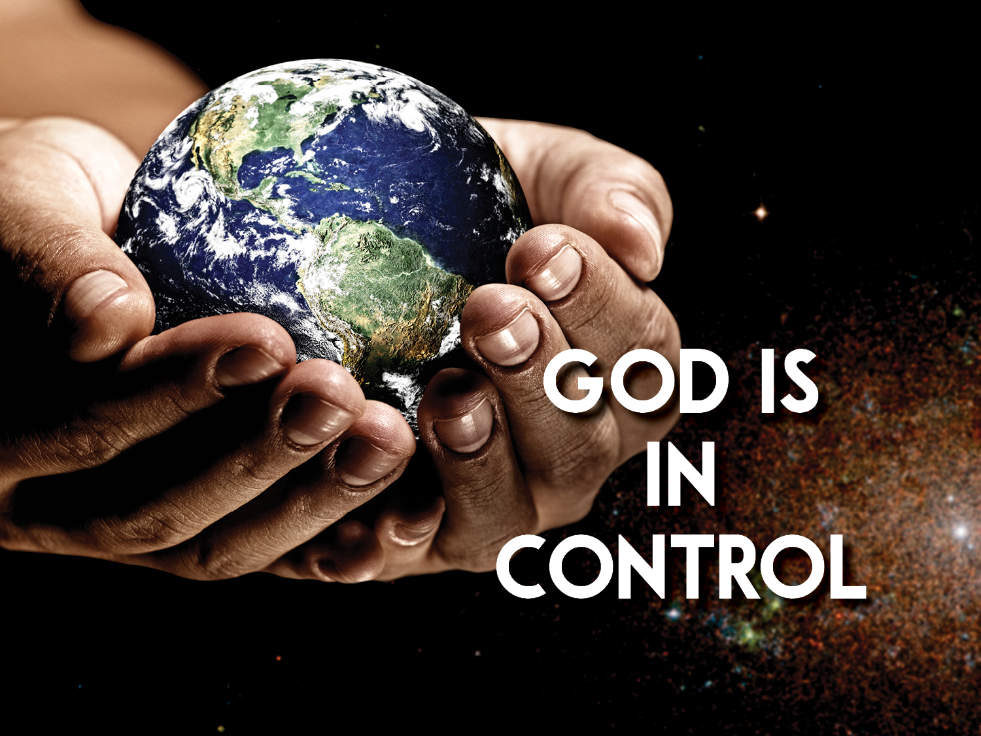

God is in Total Control
by Pastor Fee Soliven
Exodus 17:1-16
Sunday Morning
March 8, 2026

Slide 4
Exodus 17:1-16
1 Then all the congregation of the children of Israel set out on their journey from the Wilderness of Sin, according to the commandment of the LORD, and camped in Rephidim; but there was no water for the people to drink. 2 Therefore the people contended with Moses, and said, "Give us water, that we may drink." And Moses said to them, "Why do you contend with me? Why do you tempt the LORD?"

Slide 5
3 And the people thirsted there for water, and the people complained against Moses, and said, "Why is it you have brought us up out of Egypt, to kill us and our children and our livestock with thirst?" 4 So Moses cried out to the LORD, saying, "What shall I do with this people? They are almost ready to stone me!" 5 And the LORD said to Moses, "Go on before the people, and take with you some of the elders of Israel. Also take in your hand your rod with which you struck the river, and go.

Slide 6
6 Behold, I will stand before you there on the rock in Horeb; and you shall strike the rock, and water will come out of it, that the people may drink." And Moses did so in the sight of the elders of Israel. 7 So he called the name of the place Massah and Meribah, because of the contention of the children of Israel, and because they tempted the LORD, saying, "Is the LORD among us or not?" 8 Now Amalek came and fought with Israel in Rephidim.

Slide 7
9 And Moses said to Joshua, "Choose us some men and go out, fight with Amalek. Tomorrow I will stand on the top of the hill with the rod of God in my hand." 10 So Joshua did as Moses said to him, and fought with Amalek. And Moses, Aaron, and Hur went up to the top of the hill. 11 And so it was, when Moses held up his hand, that Israel prevailed; and when he let down his hand, Amalek prevailed.

Slide 8
12 But Moses' hands became heavy; so they took a stone and put it under him, and he sat on it. And Aaron and Hur supported his hands, one on one side, and the other on the other side; and his hands were steady until the going down of the sun. 13 So Joshua defeated Amalek and his people with the edge of the sword.

Slide 9
14 Then the LORD said to Moses, "Write this for a memorial in the book and recount it in the hearing of Joshua, that I will utterly blot out the remembrance of Amalek from under heaven." 15 And Moses built an altar and called its name, The-Lord-Is-My-Banner; 16 for he said, "Because the LORD has sworn: the LORD will have war with Amalek from generation to generation."

Slide 10
Biblical Origin

Slide 11
Ancestry

Slide 12
Relationship

Slide 13
Territory

Slide 14
History of Conflict

Slide 15
The Wilderness

Slide 16
The Judges

Slide 17
The Monarchy

Slide 18
1 Samuel 15:7-23
7 And Saul attacked the Amalekites, from Havilah all the way to Shur, which is east of Egypt. 8 He also took Agag king of the Amalekites alive, and utterly destroyed all the people with the edge of the sword.

Slide 19
9 But Saul and the people spared Agag and the best of the sheep, the oxen, the fatlings, the lambs, and all that was good, and were unwilling to utterly destroy them. But everything despised and worthless, that they utterly destroyed. 10 Now the word of the LORD came to Samuel, saying, 11 "I greatly regret that I have set up Saul as king, for he has turned back from following Me, and has not performed My commandments." And it grieved Samuel, and he cried out to the LORD all night.

Slide 20
12 So when Samuel rose early in the morning to meet Saul, it was told Samuel, saying, "Saul went to Carmel, and indeed, he set up a monument for himself; and he has gone on around, passed by, and gone down to Gilgal." 13 Then Samuel went to Saul, and Saul said to him, "Blessed are you of the LORD! I have performed the commandment of the LORD."

Slide 21
14 But Samuel said, "What then is this bleating of the sheep in my ears, and the lowing of the oxen which I hear?" 15 And Saul said, "They have brought them from the Amalekites; for the people spared the best of the sheep and the oxen, to sacrifice to the LORD your God; and the rest we have utterly destroyed."

Slide 22
16 Then Samuel said to Saul, "Be quiet! And I will tell you what the LORD said to me last night." And he said to him, "Speak on." 17 So Samuel said, "When you were little in your own eyes, were you not head of the tribes of Israel? And did not the LORD anoint you king over Israel? 18 Now the LORD sent you on a mission, and said, 'Go, and utterly destroy the sinners, the Amalekites, and fight against them until they are consumed.'

Slide 23
19 "Why then did you not obey the voice of the LORD? Why did you swoop down on the spoil, and do evil in the sight of the LORD?" 20 And Saul said to Samuel, "But I have obeyed the voice of the LORD, and gone on the mission on which the LORD sent me, and brought back Agag king of Amalek; I have utterly destroyed the Amalekites.

Slide 24
21 But the people took of the plunder, sheep and oxen, the best of the things which should have been utterly destroyed, to sacrifice to the LORD your God in Gilgal." 22 Then Samuel said: "Has the LORD as great delight in burnt offerings and sacrifices, As in obeying the voice of the LORD? Behold, to obey is better than sacrifice, And to heed than the fat of rams.

Slide 25
23 For rebellion is as the sin of witchcraft, And stubbornness is as iniquity and idolatry. Because you have rejected the word of the LORD, He also has rejected you from being king."

Slide 26
Let’s Look in Daniel

Slide 27
Daniel 10:13-20
13 But the prince of the kingdom of Persia withstood me twenty-one days; and behold, Michael, one of the chief princes, came to help me, for I had been left alone there with the kings of Persia. 14 Now I have come to make you understand what will happen to your people in the latter days, for the vision refers to many days yet to come."

Slide 28
15 When he had spoken such words to me, I turned my face toward the ground and became speechless. 16 And suddenly, one having the likeness of the sons of men touched my lips; then I opened my mouth and spoke, saying to him who stood before me, "My lord, because of the vision my sorrows have overwhelmed me, and I have retained no strength. 17 For how can this servant of my lord talk with you, my lord? As for me, no strength remains in me now, nor is any breath left in me."

Slide 29
18 Then again, the one having the likeness of a man touched me and strengthened me. 19 And he said, "O man greatly beloved, fear not! Peace be to you; be strong, yes, be strong!" So when he spoke to me I was strengthened, and said, "Let my lord speak, for you have strengthened me." 20 Then he said, "Do you know why I have come to you? And now I must return to fight with the prince of Persia; and when I have gone forth, indeed the prince of Greece will come.

Slide 30
Esther 7:1-10
1 So the king and Haman went to dine with Queen Esther. 2 And on the second day, at the banquet of wine, the king again said to Esther, "What is your petition, Queen Esther? It shall be granted you. And what is your request, up to half the kingdom? It shall be done!" 3 Then Queen Esther answered and said, "If I have found favor in your sight, O king, and if it pleases the king, let my life be given me at my petition, and my people at my request.

Slide 31
4 For we have been sold, my people and I, to be destroyed, to be killed, and to be annihilated. Had we been sold as male and female slaves, I would have held my tongue, although the enemy could never compensate for the king's loss." 5 So King Ahasuerus answered and said to Queen Esther, "Who is he, and where is he, who would dare presume in his heart to do such a thing?"

Slide 32
6 And Esther said, "The adversary and enemy is this wicked Haman!" So Haman was terrified before the king and queen. 7 Then the king arose in his wrath from the banquet of wine and went into the palace garden; but Haman stood before Queen Esther, pleading for his life, for he saw that evil was determined against him by the king.

Slide 33
8 When the king returned from the palace garden to the place of the banquet of wine, Haman had fallen across the couch where Esther was. Then the king said, "Will he also assault the queen while I am in the house?" As the word left the king's mouth, they covered Haman's face.

Slide 34
9 Now Harbonah, one of the eunuchs, said to the king, "Look! The gallows, fifty cubits high, which Haman made for Mordecai, who spoke good on the king's behalf, is standing at the house of Haman." Then the king said, "Hang him on it!" 10 So they hanged Haman on the gallows that he had prepared for Mordecai. Then the king's wrath subsided.

Slide 35
On February 28, 2026 Jews from around the world on a Saturday-Shabbat morning they read their Torah Portion “Parshat Zachor”
It means you shall command!

Slide 36
Deuteronomy 25:17-19
17 "Remember what Amalek did to you on the way as you were coming out of Egypt, 18 how he met you on the way and attacked your rear ranks, all the stragglers at your rear, when you were tired and weary; and he did not fear God. 19 Therefore it shall be, when the LORD your God has given you rest from your enemies all around, in the land which the LORD your God is giving you to possess as an inheritance, that you will blot out the remembrance of Amalek from under heaven. You shall not forget.

Slide 37
Jeremiah 49:34-39
34 The word of the LORD that came to Jeremiah the prophet against Elam, in the beginning of the reign of Zedekiah king of Judah, saying, 35 "Thus says the LORD of hosts: 'Behold, I will break the bow of Elam, The foremost of their might. 36 Against Elam I will bring the four winds From the four quarters of heaven, And scatter them toward all those winds; There shall be no nations where the outcasts of Elam will not go.

Slide 38
37 For I will cause Elam to be dismayed before their enemies And before those who seek their life. I will bring disaster upon them, My fierce anger,' says the LORD; 'And I will send the sword after them Until I have consumed them. 38 I will set My throne in Elam, And will destroy from there the king and the princes,' says the LORD. 39'But it shall come to pass in the latter days: I will bring back the captives of Elam,' says the LORD."

Slide 39
1 Thessalonians 4:13-18
13 But I do not want you to be ignorant, brethren, concerning those who have fallen asleep, lest you sorrow as others who have no hope. 14 For if we believe that Jesus died and rose again, even so God will bring with Him those who sleep in Jesus.

Slide 40
15 For this we say to you by the word of the Lord, that we who are alive and remain until the coming of the Lord will by no means precede those who are asleep. 16 For the Lord Himself will descend from heaven with a shout, with the voice of an archangel, and with the trumpet of God. And the dead in Christ will rise first.

Slide 41
17 Then we who are alive and remain shall be caught up together with them in the clouds to meet the Lord in the air. And thus we shall always be with the Lord. 18 Therefore comfort one another with these words.

Slide 42
1 Corinthians 15:50-54
50 Now this I say, brethren, that flesh and blood cannot inherit the kingdom of God; nor does corruption inherit incorruption. 51 Behold, I tell you a mystery: We shall not all sleep, but we shall all be changed-- 52 in a moment, in the twinkling of an eye, at the last trumpet. For the trumpet will sound, and the dead will be raised incorruptible, and we shall be changed.

Slide 43
53 For this corruptible must put on incorruption, and this mortal must put on immortality. 54 So when this corruptible has put on incorruption, and this mortal has put on immortality, then shall be brought to pass the saying that is written: "Death is swallowed up in victory."

Slide 44

20 Again, when a righteous man turns from his righteousness and commits iniquity, and I lay a stumbling block before him, he shall die; because you did not give him warning, he shall die in his sin, and his righteousness which he has done shall not be remembered; but his blood I will require at your hand.

Slide 45
Acts 2:38-39
38 Then Peter said to them, "Repent, and let every one of you be baptized in the name of Jesus Christ for the remission of sins; and you shall receive the gift of the Holy Spirit. 39 For the promise is to you and to your children, and to all who are afar off, as many as the Lord our God will call."

Slide 46

Donate with our QR code app to
Amazing Grace Christian Fellowship
Donations are Deeply Appreciated!

