Slide 1


Slide 2


Slide 3

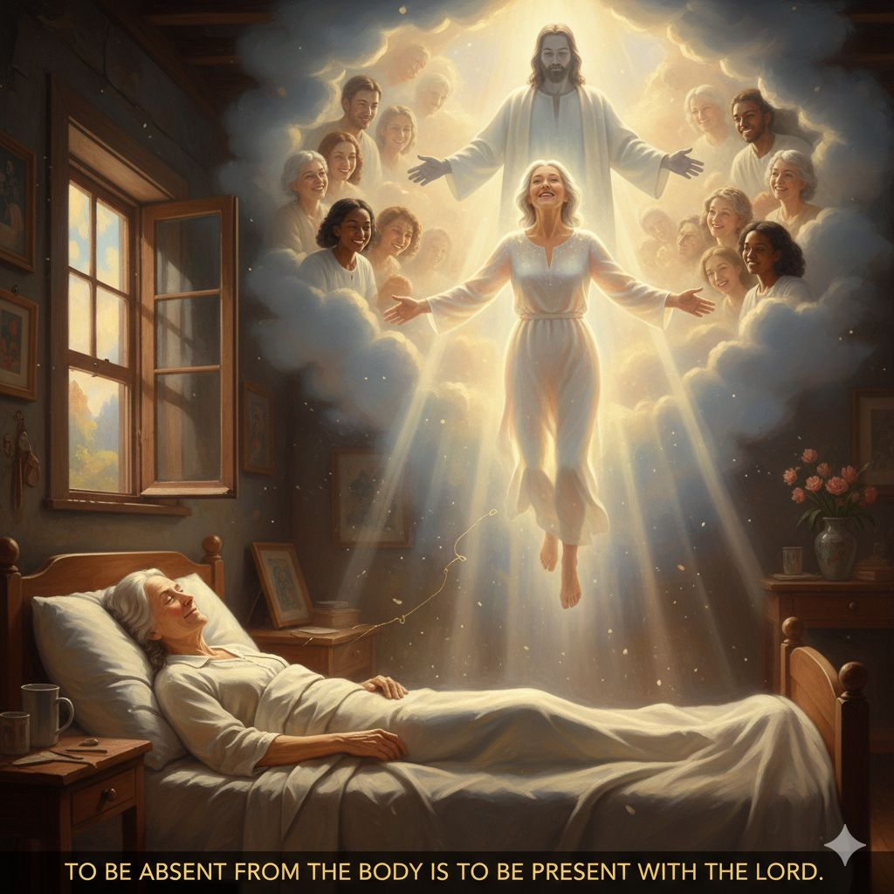
To Be Absent from the Body
Is to Be Present with The Lord
by Pastor Fee Soliven
2 Corinthians 5:1-8
Sunday Morning
March 1, 2026

Slide 4
2 Corinthians 5:1-8
1 For we know that if our earthly house, this tent, is destroyed, we have a building from God, a house not made with hands, eternal in the heavens. 2 For in this we groan, earnestly desiring to be clothed with our habitation which is from heaven, 3 if indeed, having been clothed, we shall not be found naked.

Slide 5
4 For we who are in this tent groan, being burdened, not because we want to be unclothed, but further clothed, that mortality may be swallowed up by life. 5 Now He who has prepared us for this very thing is God, who also has given us the Spirit as a guarantee. 6 So we are always confident, knowing that while we are at home in the body we are absent from the Lord.

Slide 6
7 For we walk by faith, not by sight. 8 We are confident, yes, well pleased rather to be absent from the body and to be present with the Lord.

Slide 7
2 Corinthians 5:8
We are confident, yes, well pleased rather to be absent from the body and to be present with the Lord.

Slide 8
"Being With Jesus"

Slide 9
John 15:5
I am the vine, you are the branches. He who abides in Me, and I in him, bears much fruit; for without Me you can do nothing.

Slide 10
Matthew 28:20
teaching them to observe all things that I have commanded you; and lo, I am with you always, even to the end of the age." Amen.

Slide 11
Revelation 3:20
Behold, I stand at the door and knock. If anyone hears My voice and opens the door, I will come in to him and dine with him, and he with Me.

Slide 12
2 Corinthians 5:8
We are confident, yes, well pleased rather to be absent from the body and to be present with the Lord.

Slide 13
Acts 4:13
Now when they saw the boldness of Peter and John, and perceived that they were uneducated and untrained men, they marveled. And they realized that they had been with Jesus.

Slide 14
Colossians 3:3
For you died, and your life is hidden with Christ in God.

Slide 15
The Reality of Ultimate Healing

Slide 16
Revelation 21:4
“And God will wipe away every tear from their eyes; there shall be no more death, nor sorrow, nor crying. There shall be no more pain, for the former things have passed away."

Slide 17
2 Corinthians 1:20
For all the promises of God in Him are Yes, and in Him Amen, to the glory of God through us.

Slide 18
1 Thessalonians 5:23-24
23 Now may the God of peace Himself sanctify you completely; and may your whole spirit, soul, and body be preserved blameless at the coming of our Lord Jesus Christ. 24 He who calls you is faithful, who also will do it.

Slide 19
Colossians 2:9-10
9 For in Him dwells all the fullness of the Godhead bodily; 10 and you are complete in Him, who is the head of all principality and power.

Slide 20
Grieving, But Not Without Hope

Slide 21
1 Thessalonians 4:13-15
13 But I do not want you to be ignorant, brethren, concerning those who have fallen asleep, lest you sorrow as others who have no hope. 14 For if we believe that Jesus died and rose again, even so God will bring with Him those who sleep in Jesus. 15 For this we say to you by the word of the Lord, that we who are alive and remain until the coming of the Lord will by no means precede those who are asleep

Slide 22
Did you catch that?

Slide 23
1 Corinthians 15:54
So when this corruptible has put on incorruption, and this mortal has put on immortality, then shall be brought to pass the saying that is written: "Death is swallowed up in victory."

Slide 24
Hopelessness says, “I’ll never see them again.”
Hope says, “This separation is temporary.”
Hopelessness drains us!
Hope anchors us!

Slide 25
How We Can Minister to Those
Without Hope

Slide 26
So how do we minister to them?

Slide 27
John 14:6
Jesus said to him, "I am the way, the truth, and the life. No one comes to the Father except through Me.

Slide 28
John 14:27
Peace I leave with you, My peace I give to you; not as the world gives do I give to you. Let not your heart be troubled, neither let it be afraid.

Slide 29
Acts 8:26-40
26 Now an angel of the Lord spoke to Philip, saying, "Arise and go toward the south along the road which goes down from Jerusalem to Gaza." This is desert. 27 So he arose and went. And behold, a man of Ethiopia, a eunuch of great authority under Candace the queen of the Ethiopians, who had charge of all her treasury, and had come to Jerusalem to worship,

Slide 30
28 was returning. And sitting in his chariot, he was reading Isaiah the prophet. 29 Then the Spirit said to Philip, "Go near and overtake this chariot." 30 So Philip ran to him, and heard him reading the prophet Isaiah, and said, "Do you understand what you are reading?" 31 And he said, "How can I, unless someone guides me?" And he asked Philip to come up and sit with him.

Slide 31
32 The place in the Scripture which he read was this: "He was led as a sheep to the slaughter; And as a lamb before its shearer is silent, So He opened not His mouth. 33 In His humiliation His justice was taken away, And who will declare His generation? For His life is taken from the earth."

Slide 32
34 So the eunuch answered Philip and said, "I ask you, of whom does the prophet say this, of himself or of some other man?" 35 Then Philip opened his mouth, and beginning at this Scripture, preached Jesus to him.

Slide 33
36 Now as they went down the road, they came to some water. And the eunuch said, "See, here is water. What hinders me from being baptized?" 37 Then Philip said, "If you believe with all your heart, you may." And he answered and said, "I believe that Jesus Christ is the Son of God." 38 So he commanded the chariot to stand still. And both Philip and the eunuch went down into the water, and he baptized him.

Slide 34
39 Now when they came up out of the water, the Spirit of the Lord caught Philip away, so that the eunuch saw him no more; and he went on his way rejoicing. 40 But Philip was found at Azotus. And passing through, he preached in all the cities till he came to Caesarea.

Slide 35
1 Corinthians 3:5-7
5 Who then is Paul, and who is Apollos, but ministers through whom you believed, as the Lord gave to each one? 6 I planted, Apollos watered, but God gave the increase. 7 So then neither he who plants is anything, nor he who waters, but God who gives the increase.

Slide 36
Hope That Holds Us

Slide 37
John 11:25–26
25 Jesus said to her, "I am the resurrection and the life. He who believes in Me, though he may die, he shall live. 26 And whoever lives and believes in Me shall never die. Do you believe this?"

Slide 38
Romans 6:9-11
9 knowing that Christ, having been raised from the dead, dies no more. Death no longer has dominion over Him. 10 For the death that He died, He died to sin once for all; but the life that He lives, He lives to God. 11 Likewise you also, reckon yourselves to be dead indeed to sin, but alive to God in Christ Jesus our Lord.

Slide 39
1 Thessalonians 4:13-18
13 But I do not want you to be ignorant, brethren, concerning those who have fallen asleep, lest you sorrow as others who have no hope. 14 For if we believe that Jesus died and rose again, even so God will bring with Him those who sleep in Jesus.

Slide 40
15 For this we say to you by the word of the Lord, that we who are alive and remain until the coming of the Lord will by no means precede those who are asleep. 16 For the Lord Himself will descend from heaven with a shout, with the voice of an archangel, and with the trumpet of God. And the dead in Christ will rise first.

Slide 41
17 Then we who are alive and remain shall be caught up together with them in the clouds to meet the Lord in the air. And thus we shall always be with the Lord. 18 Therefore comfort one another with these words.

Slide 42
1 Corinthians 15:50-54
50 Now this I say, brethren, that flesh and blood cannot inherit the kingdom of God; nor does corruption inherit incorruption. 51 Behold, I tell you a mystery: We shall not all sleep, but we shall all be changed-- 52 in a moment, in the twinkling of an eye, at the last trumpet. For the trumpet will sound, and the dead will be raised incorruptible, and we shall be changed.

Slide 43
53 For this corruptible must put on incorruption, and this mortal must put on immortality. 54 So when this corruptible has put on incorruption, and this mortal has put on immortality, then shall be brought to pass the saying that is written: "Death is swallowed up in victory."

Slide 44

20 Again, when a righteous man turns from his righteousness and commits iniquity, and I lay a stumbling block before him, he shall die; because you did not give him warning, he shall die in his sin, and his righteousness which he has done shall not be remembered; but his blood I will require at your hand.

Slide 45
Acts 2:38-39
38 Then Peter said to them, "Repent, and let every one of you be baptized in the name of Jesus Christ for the remission of sins; and you shall receive the gift of the Holy Spirit. 39 For the promise is to you and to your children, and to all who are afar off, as many as the Lord our God will call."

Slide 46

Donate with our QR code app to
Amazing Grace Christian Fellowship
Donations are Deeply Appreciated!

