Slide 1


Slide 2


Slide 3
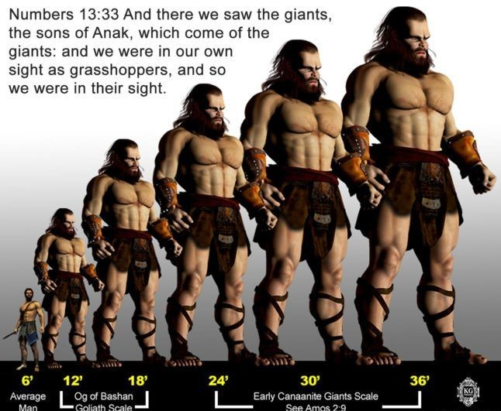

Destroying the Anakim’s in Your Life
by Pastor Fee Soliven
Deuteronomy 9:1-3
Sunday Morning
May 24, 2026

Slide 4
Deuteronomy 9:1-3
1 "Hear, O Israel: You are to cross over the Jordan today, and go in to dispossess nations greater and mightier than yourself, cities great and fortified up to heaven, 2 a people great and tall, the descendants of the Anakim, whom you know, and of whom you heard it said, 'Who can stand before the descendants of Anak?'

Slide 5
3 "Therefore understand today that the LORD your God is He who goes over before you as a consuming fire. He will destroy them and bring them down before you; so you shall drive them out and destroy them quickly, as the LORD has said to you.

Slide 6
What are the Anakim’s in Our
Lives Today?

Slide 7
Fear, Discouragement, Loneliness, Worry, Guilt, Temptation, Anger, Resentment, Doubt, Procrastination, Failure

Slide 8
Fear

Slide 9
2 Timothy 1:7
“For God has not given us a spirit of fear, but of power and of love and of a sound mind”

Slide 10
1 John 4:18-19
18 There is no fear in love; but perfect love casts out fear, because fear involves torment. But he who fears has not been made perfect in love. 19 We love Him because He first loved us.

Slide 11
Isaiah 41:13
For I, the LORD your God, will hold your right hand, Saying to you, 'Fear not, I will help you.'

Slide 12
Isaiah 41:10
“Fear not, for I am with you; Be not dismayed, for I am your God. I will strengthen you, Yes, I will help you, I will uphold you with My righteous right hand”

Slide 13
Discouragement

Slide 14
Romans 8:28
“And we know that all things work together for good to those who love God, to those who are the called according to His purpose”

Slide 15
Psalm 42:5
Why are you cast down, O my soul? And why are you disquieted within me? Hope in God, for I shall yet praise Him For the help of His countenance.

Slide 16
Psalm 34:17-19
17 The righteous cry out, and the LORD hears, And delivers them out of all their troubles. 18 The LORD is near to those who have a broken heart, And saves such as have a contrite spirit. 19 Many are the afflictions of the righteous, But the LORD delivers him out of them all.

Slide 17
Loneliness

Slide 18
Joshua 1:6
“Be strong and of good courage, for to this people you shall divide as an inheritance the land which I swore to their fathers to give them”

Slide 19
Hebrews 13:5
Let your conduct be without covetousness; be content with such things as you have. For He Himself has said, "I will never leave you nor forsake you."

Slide 20
1 Peter 5:7
casting all your care upon Him, for He cares for you.

Slide 21
Worry

Slide 22
Philippians 4:6-7
6 Be anxious for nothing, but in everything by prayer and supplication, with thanksgiving, let your requests be made known to God; 7 and the peace of God, which surpasses all understanding, will guard your hearts and minds through Christ Jesus.

Slide 23
Matthew 6:33-34
33 But seek first the kingdom of God and His righteousness, and all these things shall be added to you. 34 Therefore do not worry about tomorrow, for tomorrow will worry about its own things. Sufficient for the day is its own trouble.

Slide 24
Guilt

Slide 25
Romans 8:1
There is therefore now no condemnation to those who are in Christ Jesus, who do not walk according to the flesh, but according to the Spirit.

Slide 26
Proverbs 28:13
He who covers his sins will not prosper, But whoever confesses and forsakes them will have mercy

Slide 27
1 John 1:9
“If we confess our sins, He is faithful and just to forgive us our sins and to cleanse us from all unrighteousness”

Slide 28
Psalm 103:12
“As far as the east is from the west, So far has He removed our transgressions from us”

Slide 29
Temptation

Slide 30
1 Corinthians 10:13
No temptation has overtaken you except such as is common to man; but God is faithful, who will not allow you to be tempted beyond what you are able, but with the temptation will also make the way of escape, that you may be able to bear it.

Slide 31
Psalm 119:11
Your word I have hidden in my heart, That I might not sin against You!

Slide 32
Matthew 26:41
“Watch and pray, lest you enter into temptation. The spirit indeed is willing, but the flesh is weak."

Slide 33
2 Timothy 2:22
“Flee also youthful lusts; but pursue righteousness, faith, love, peace with those who call on the Lord out of a pure heart”

Slide 34
Anger

Slide 35
James 1:19-20
19 So then, my beloved brethren, let every man be swift to hear, slow to speak, slow to wrath; 20 for the wrath of man does not produce the righteousness of God.

Slide 36
Psalm 37:8
Cease from anger, and forsake wrath; Do not fret--it only causes harm.

Slide 37
Ephesians 4:26-27
26 Be angry, and do not sin": do not let the sun go down on your wrath, 27 nor give place to the devil.

Slide 38
James 1:19-20
19 So then, my beloved brethren, let every man be swift to hear, slow to speak, slow to wrath; 20 for the wrath of man does not produce the righteousness of God.

Slide 39
Colossians 3:8-10
8 But now you yourselves are to put off all these: anger, wrath, malice, blasphemy, filthy language out of your mouth. 9 Do not lie to one another, since you have put off the old man with his deeds, 10 and have put on the new man who is renewed in knowledge according to the image of Him who created him…

Slide 40
Resentment

Slide 41
Release all Bitterness and Resentment

Slide 42
Ephesians 4:31-32
31 Let all bitterness, wrath, anger, clamor, and evil speaking be put away from you, with all malice. 32 And be kind to one another, tenderhearted, forgiving one another, just as God in Christ forgave you.

Slide 43
Hebrews 12:14-15
14 Pursue peace with all people, and holiness, without which no one will see the Lord: 15 looking diligently lest anyone fall short of the grace of God; lest any root of bitterness springing up cause trouble, and by this many become defiled…

Slide 44
The Trap of Resentment

Slide 45
Job 5:2
"Resentment kills a fool, and envy slays the simple."

Slide 46
Proverbs 19:11
"A person’s wisdom yields patience; it is to one’s glory to overlook an offense."

Slide 47
Forgiveness Frees You from Resentment

Slide 48
Colossians 3:13
“bearing with one another, and forgiving one another, if anyone has a complaint against another; even as Christ forgave you, so you also must do.”

Slide 49
Romans 12:19
“Beloved, do not avenge yourselves, but rather give place to wrath; for it is written, "Vengeance is Mine, I will repay," says the Lord.

Slide 50
Doubt

Slide 51
When You Need Reassurance & Peace

Slide 52
Mark 9:17-24
17 Then one of the crowd answered and said, "Teacher, I brought You my son, who has a mute spirit. 18 And wherever he seizes him, he throws him down; he foams at the mouth, gnashes his teeth, and becomes rigid. So I spoke to Your disciples, that they should cast him out, but they could not."

Slide 53
19 He answered him and said, "O faithless generation, how long shall I be with you? How long shall I bear with you? Bring him to Me." 20 Then they brought him to Him. And when he saw Him, immediately the spirit convulsed him, and he fell on the ground and wallowed, foaming at the mouth. 21 So He asked his father, "How long has this been happening to him?" And he said, "From childhood.

Slide 54
22 And often he has thrown him both into the fire and into the water to destroy him. But if You can do anything, have compassion on us and help us." 23 Jesus said to him, "If you can believe, all things are possible to him who believes." 24 Immediately the father of the child cried out and said with tears, "Lord, I believe; help my unbelief!"

Slide 55
John 20:26-27
26 And after eight days His disciples were again inside, and Thomas with them. Jesus came, the doors being shut, and stood in the midst, and said, "Peace to you!" 27 Then He said to Thomas, "Reach your finger here, and look at My hands; and reach your hand here, and put it into My side. Do not be unbelieving, but believing."

Slide 56
When You Need Wisdom & Guidance

Slide 57
James 1:6
But let him ask in faith, with no doubting, for he who doubts is like a wave of the sea driven and tossed by the wind.

Slide 58
Romans 10:17
“So then faith comes by hearing, and hearing by the word of God”

Slide 59
Isaiah 41:10
Fear not, for I am with you; Be not dismayed, for I am your God. I will strengthen you, Yes, I will help you, I will uphold you with My righteous right hand.'

Slide 60
2 Corinthians 5:7
“For we walk by faith, not by sight”

Slide 61
Procrastination

Slide 62
Ecclesiastics 11:4
“He who observes the wind will not sow, And he who regards the clouds will not reap.”

Slide 63
Proverbs 12:24
“The hand of the diligent will rule, But the lazy man will be put to forced labor.”

Slide 64
Failure

Slide 65
Proverbs 24:16
“For a righteous man may fall seven times And rise again, But the wicked shall fall by calamity.”

Slide 66
Psalm 37:23-24
23 The steps of a good man are ordered by the LORD, And He delights in his way. 24 Though he fall, he shall not be utterly cast down; For the LORD upholds him with His hand.

Slide 67
Keep Pressing Forward

Slide 68
Philippians 3:13-14
13 Brethren, I do not count myself to have apprehended; but one thing I do, forgetting those things which are behind and reaching forward to those things which are ahead, 14 I press toward the goal for the prize of the upward call of God in Christ Jesus.

Slide 69
1 Thessalonians 4:13-18
13 But I do not want you to be ignorant, brethren, concerning those who have fallen asleep, lest you sorrow as others who have no hope. 14 For if we believe that Jesus died and rose again, even so God will bring with Him those who sleep in Jesus.

Slide 70
15 For this we say to you by the word of the Lord, that we who are alive and remain until the coming of the Lord will by no means precede those who are asleep. 16 For the Lord Himself will descend from heaven with a shout, with the voice of an archangel, and with the trumpet of God. And the dead in Christ will rise first.

Slide 71
17 Then we who are alive and remain shall be caught up together with them in the clouds to meet the Lord in the air. And thus we shall always be with the Lord. 18 Therefore comfort one another with these words.

Slide 72
1 Corinthians 15:50-54
50 Now this I say, brethren, that flesh and blood cannot inherit the kingdom of God; nor does corruption inherit incorruption. 51 Behold, I tell you a mystery: We shall not all sleep, but we shall all be changed-- 52 in a moment, in the twinkling of an eye, at the last trumpet. For the trumpet will sound, and the dead will be raised incorruptible, and we shall be changed.

Slide 73
53 For this corruptible must put on incorruption, and this mortal must put on immortality. 54 So when this corruptible has put on incorruption, and this mortal has put on immortality, then shall be brought to pass the saying that is written: "Death is swallowed up in victory."

Slide 74

20 Again, when a righteous man turns from his righteousness and commits iniquity, and I lay a stumbling block before him, he shall die; because you did not give him warning, he shall die in his sin, and his righteousness which he has done shall not be remembered; but his blood I will require at your hand.

Slide 75
Acts 2:38-39
38 Then Peter said to them, "Repent, and let every one of you be baptized in the name of Jesus Christ for the remission of sins; and you shall receive the gift of the Holy Spirit. 39 For the promise is to you and to your children, and to all who are afar off, as many as the Lord our God will call."

Slide 76
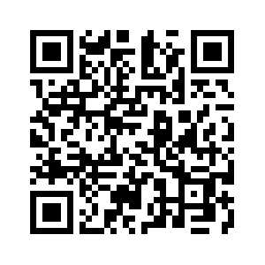
Donate with our QR code app to
Amazing Grace Christian Fellowship
Donations are Deeply Appreciated!

