Slide 1


Slide 2


Slide 3
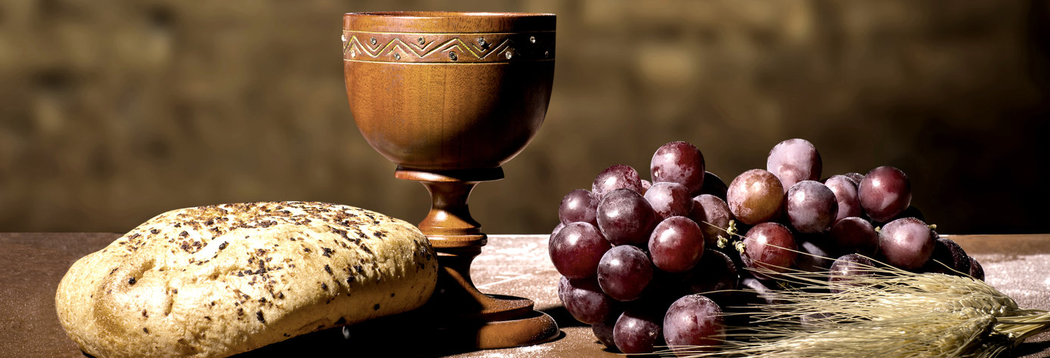

Jesus the Wonder Bread
by Pastor Fee Soliven
John 6:22-40
Sunday Morning
May 3, 2026

Slide 4
John 6:22-40
22 On the following day, when the people who were standing on the other side of the sea saw that there was no other boat there, except that one which His disciples had entered, and that Jesus had not entered the boat with His disciples, but His disciples had gone away alone-- 23 however, other boats came from Tiberias, near the place where they ate bread after the Lord had given thanks—

Slide 5
24 when the people therefore saw that Jesus was not there, nor His disciples, they also got into boats and came to Capernaum, seeking Jesus. 25 And when they found Him on the other side of the sea, they said to Him, "Rabbi, when did You come here?“ 26 Jesus answered them and said, "Most assuredly, I say to you, you seek Me, not because you saw the signs, but because you ate of the loaves and were filled.

Slide 6
27 Do not labor for the food which perishes, but for the food which endures to everlasting life, which the Son of Man will give you, because God the Father has set His seal on Him." 28 Then they said to Him, "What shall we do, that we may work the works of God?" 29 Jesus answered and said to them, "This is the work of God, that you believe in Him whom He sent."

Slide 7
30 Therefore they said to Him, "What sign will You perform then, that we may see it and believe You? What work will You do? 31 Our fathers ate the manna in the desert; as it is written, 'He gave them bread from heaven to eat.' " 32 Then Jesus said to them, "Most assuredly, I say to you, Moses did not give you the bread from heaven, but My Father gives you the true bread from heaven.

Slide 8
33 For the bread of God is He who comes down from heaven and gives life to the world." 34 Then they said to Him, "Lord, give us this bread always." 35 And Jesus said to them, "I am the bread of life. He who comes to Me shall never hunger, and he who believes in Me shall never thirst. 36 But I said to you that you have seen Me and yet do not believe.

Slide 9
37 All that the Father gives Me will come to Me, and the one who comes to Me I will by no means cast out. 38 For I have come down from heaven, not to do My own will, but the will of Him who sent Me. 39 This is the will of the Father who sent Me, that of all He has given Me I should lose nothing, but should raise it up at the last day.

Slide 10
40 And this is the will of Him who sent Me, that everyone who sees the Son and believes in Him may have everlasting life; and I will raise him up at the last day."

Slide 11
22 On the following day, when the people who were standing on the other side of the sea saw that there was no other boat there, except that one which His disciples had entered, and that Jesus had not entered the boat with His disciples, but His disciples had gone away alone-- 23 however, other boats came from Tiberias, near the place where they ate bread after the Lord had given thanks—

Slide 12
24 when the people therefore saw that Jesus was not there, nor His disciples, they also got into boats and came to Capernaum, seeking Jesus. 25 And when they found Him on the other side of the sea, they said to Him, "Rabbi, when did You come here?"

Slide 13
26 Jesus answered them and said, "Most assuredly, I say to you, you seek Me, not because you saw the signs, but because you ate of the loaves and were filled.27 Do not labor for the food which perishes, but for the food which endures to everlasting life, which the Son of Man will give you, because God the Father has set His seal on Him."

Slide 14
“You were so intent on being fed that you haven’t yet seen who provided the food.”

Slide 15
“Spend your energy seeking the eternal life that I, the Son of Man, can give you.”

Slide 16
28 Then they said to Him, "What shall we do, that we may work the works of God?" 29 Jesus answered and said to them, "This is the work of God, that you believe in Him whom He sent."

Slide 17
“What does God want us to do?”

Slide 18
“This is what God wants you to do: Believe in the one he has sent.”

Slide 19
30 Therefore they said to Him, "What sign will You perform then, that we may see it and believe You? What work will You do? 31 Our fathers ate the manna in the desert; as it is written, 'He gave them bread from heaven to eat.' "

Slide 20
Exodus 16:4
Then the LORD said to Moses, "Behold, I will rain bread from heaven for you. And the people shall go out and gather a certain quota every day, that I may test them, whether they will walk in My law or not.

Slide 21
Psalm 78:24-25
24 Had rained down manna on them to eat, And given them of the bread of heaven. 25 Men ate angels' food; He sent them food to the full.

Slide 22
32 Then Jesus said to them, "Most assuredly, I say to you, Moses did not give you the bread from heaven, but My Father gives you the true bread from heaven. 33 For the bread of God is He who comes down from heaven and gives life to the world."

Slide 23
34 Then they said to Him, "Lord, give us this bread always." 35 And Jesus said to them, "I am the bread of life. He who comes to Me shall never hunger, and he who believes in Me shall never thirst.

Slide 24
“Give us that bread every day of our lives.”

Slide 25
“I am the bread of life.”

Slide 26
“I the Lord God am here to provide you with everything you need for your spiritual life.”

Slide 27
“I am the sustenance of your life.”

Slide 28
36 But I said to you that you have seen Me and yet do not believe.

Slide 29
“You have seen me.”

Slide 30
“You have seen and still you do not believe.”

Slide 31
37 All that the Father gives Me will come to Me, and the one who comes to Me I will by no means cast out.

Slide 32
John 17:1-2
1 Jesus spoke these words, lifted up His eyes to heaven, and said: "Father, the hour has come. Glorify Your Son, that Your Son also may glorify You, 2 as You have given Him authority over all flesh, that He should give eternal life to as many as You have given Him.

Slide 33
“I will never reject them.”

Slide 34
John 10:28-29
28 And I give them eternal life, and they shall never perish; neither shall anyone snatch them out of My hand. 29 My Father, who has given them to Me, is greater than all; and no one is able to snatch them out of My Father's hand.

Slide 35
38 For I have come down from heaven, not to do My own will, but the will of Him who sent Me.

Slide 36
John 17:11
Now I am no longer in the world, but these are in the world, and I come to You. Holy Father, keep through Your name those whom You have given Me, that they may be one as We are.

Slide 37
39 This is the will of the Father who sent Me, that of all He has given Me I should lose nothing, but should raise it up at the last day. 40 And this is the will of Him who sent Me, that everyone who sees the Son and believes in Him may have everlasting life; and I will raise him up at the last day."

Slide 38
1 Thessalonians 4:13-18
13 But I do not want you to be ignorant, brethren, concerning those who have fallen asleep, lest you sorrow as others who have no hope. 14 For if we believe that Jesus died and rose again, even so God will bring with Him those who sleep in Jesus.

Slide 39
15 For this we say to you by the word of the Lord, that we who are alive and remain until the coming of the Lord will by no means precede those who are asleep. 16 For the Lord Himself will descend from heaven with a shout, with the voice of an archangel, and with the trumpet of God. And the dead in Christ will rise first.

Slide 40
17 Then we who are alive and remain shall be caught up together with them in the clouds to meet the Lord in the air. And thus we shall always be with the Lord. 18 Therefore comfort one another with these words.

Slide 41
1 Corinthians 15:50-54
50 Now this I say, brethren, that flesh and blood cannot inherit the kingdom of God; nor does corruption inherit incorruption. 51 Behold, I tell you a mystery: We shall not all sleep, but we shall all be changed-- 52 in a moment, in the twinkling of an eye, at the last trumpet. For the trumpet will sound, and the dead will be raised incorruptible, and we shall be changed.

Slide 42
53 For this corruptible must put on incorruption, and this mortal must put on immortality. 54 So when this corruptible has put on incorruption, and this mortal has put on immortality, then shall be brought to pass the saying that is written: "Death is swallowed up in victory."

Slide 43

20 Again, when a righteous man turns from his righteousness and commits iniquity, and I lay a stumbling block before him, he shall die; because you did not give him warning, he shall die in his sin, and his righteousness which he has done shall not be remembered; but his blood I will require at your hand.

Slide 44
Acts 2:38-39
38 Then Peter said to them, "Repent, and let every one of you be baptized in the name of Jesus Christ for the remission of sins; and you shall receive the gift of the Holy Spirit. 39 For the promise is to you and to your children, and to all who are afar off, as many as the Lord our God will call."

Slide 45

Donate with our QR code app to
Amazing Grace Christian Fellowship
Donations are Deeply Appreciated!

