Slide 1


Slide 2


Slide 3



Surviving and Thriving in Perilous Times
by Pastor Fee Soliven
2 Timothy 3:1-11
Sunday Morning
May 17, 2026

Slide 4
2 Timothy 3:1-11
1 But know this, that in the last days perilous times will come: 2 For men will be lovers of themselves, lovers of money, boasters, proud, blasphemers, disobedient to parents, unthankful, unholy, 3 unloving, unforgiving, slanderers, without self-control, brutal, despisers of good, 4 traitors, headstrong, haughty, lovers of pleasure rather than lovers of God,

Slide 5
5 having a form of godliness but denying its power. And from such people turn away! 6 For of this sort are those who creep into households and make captives of gullible women loaded down with sins, led away by various lusts, 7 always learning and never able to come to the knowledge of the truth. 8 Now as Jannes and Jambres resisted Moses, so do these also resist the truth: men of corrupt minds, disapproved concerning the faith;

Slide 6
9 but they will progress no further, for their folly will be manifest to all, as theirs also was. 10 But you have carefully followed my doctrine, manner of life, purpose, faith, longsuffering, love, perseverance, 11 persecutions, afflictions, which happened to me at Antioch, at Iconium, at Lystra--what persecutions I endured. And out of them all the Lord delivered me.

Slide 7
1 But know this, that in the last days perilous times will come:

Slide 9


Slide 10


Slide 11
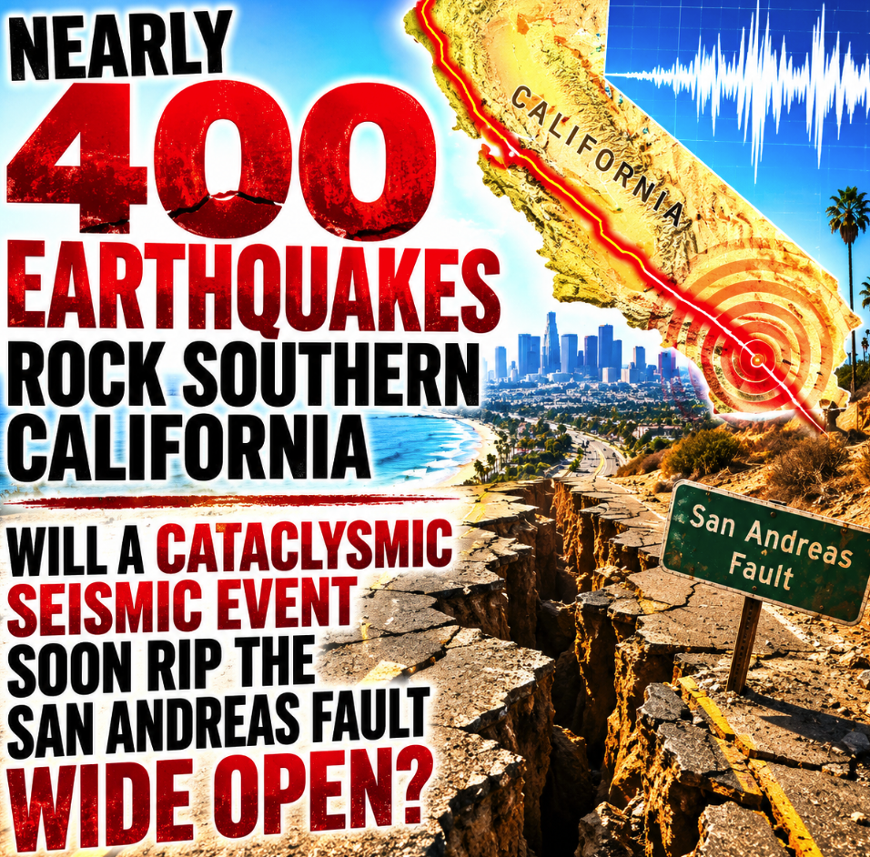

Slide 12


Slide 13
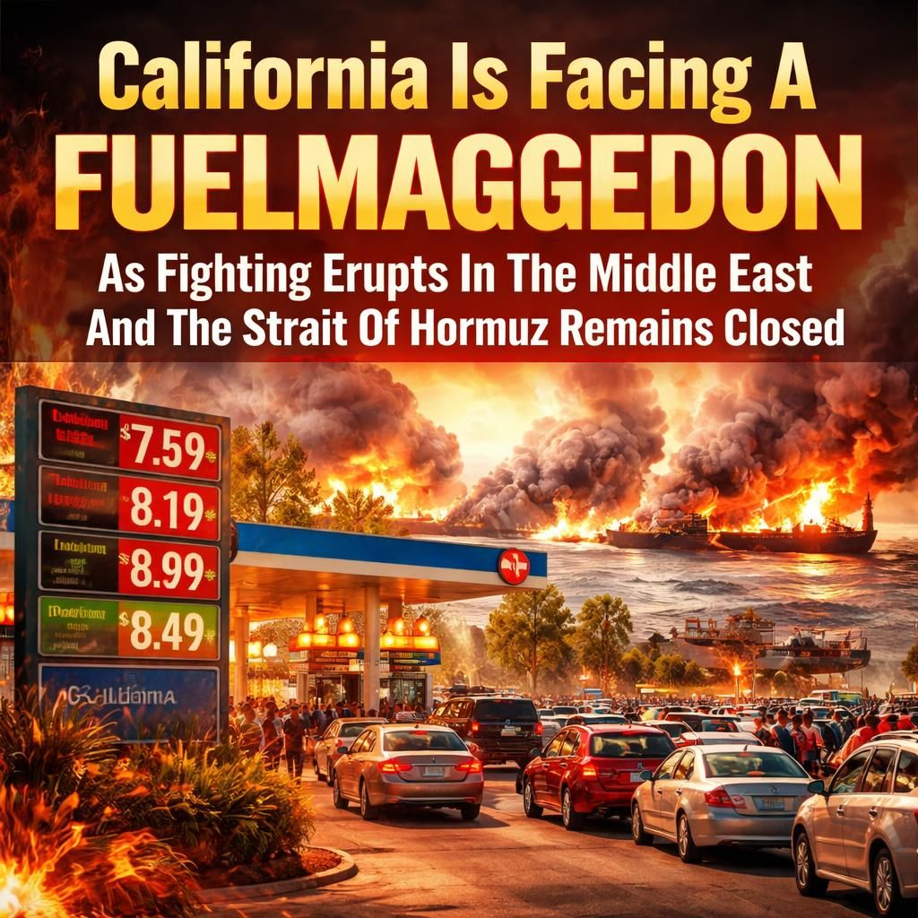

Slide 14
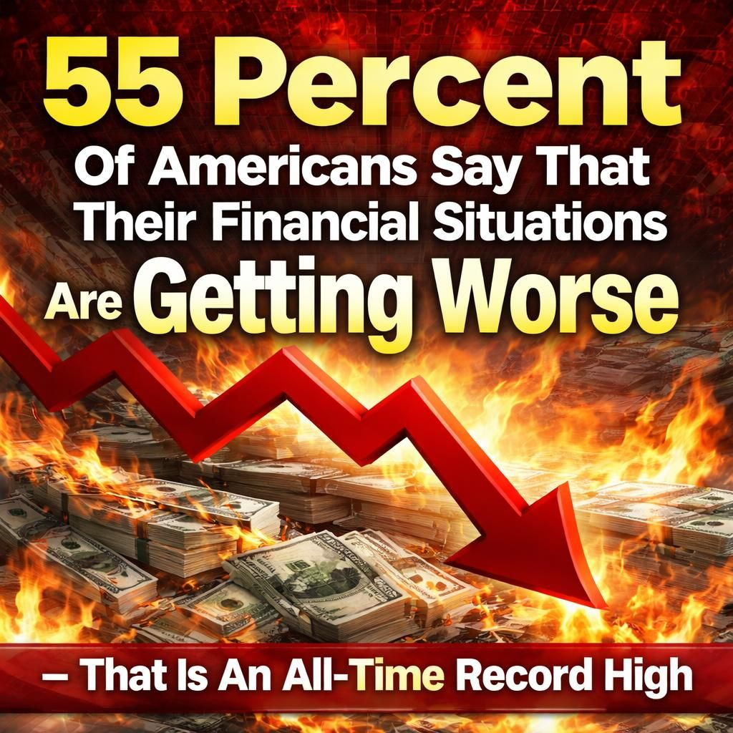

Slide 15
In 1985, the typical cost of a home in Spring Valley and the broader San Diego County ranged between $80,000 and $95,000 Property records for the area from that exact year show specific single-family home sales reflecting these figures, with nearby communities like La Mesa mirroring these rates.
<<41 years later>>
In early 2026, the median cost of a home in Spring Valley, CA, ranged between $650,000 and $770,000. Single-family detached homes sit at the higher end of this spectrum, typically commanding prices around $770,000 to $785,000, while condos and townhomes are generally priced lower, from $525,000 to $675,000

Slide 16


Slide 17


Slide 18


Slide 19


Slide 20
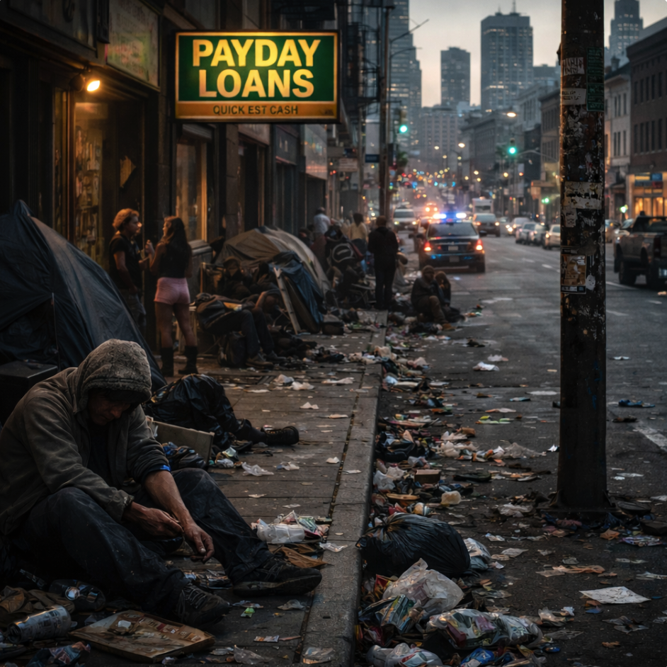

Slide 21
“hard to bear, dangerous, troublesome”

Slide 22
2 For men will be lovers of themselves, lovers of money, boasters, proud, blasphemers, disobedient to parents, unthankful, unholy,

Slide 23
3 unloving, unforgiving, slanderers, without self-control, brutal, despisers of good,

Slide 24
Romans 1:31-32
31 undiscerning, untrustworthy, unloving, unforgiving, unmerciful; 32 who, knowing the righteous judgment of God, that those who practice such things are worthy of death, not only do the same but also approve of those who practice them.

Slide 25
4 traitors, headstrong, haughty, lovers of pleasure rather than lovers of God, 5 having a form of godliness but denying its power. And from such people turn away!

Slide 26
6 For of this sort are those who creep into households and make captives of gullible women loaded down with sins, led away by various lusts,

Slide 27
1 Timothy 5:3-10
3 Honor widows who are really widows. 4 But if any widow has children or grandchildren, let them first learn to show piety at home and to repay their parents; for this is good and acceptable before God.

Slide 28
5 Now she who is really a widow, and left alone, trusts in God and continues in supplications and prayers night and day. 6 But she who lives in pleasure is dead while she lives. 7 And these things command, that they may be blameless. 8 But if anyone does not provide for his own, and especially for those of his household, he has denied the faith and is worse than an unbeliever.

Slide 29
9 Do not let a widow under sixty years old be taken into the number, and not unless she has been the wife of one man, 10 well reported for good works: if she has brought up children, if she has lodged strangers, if she has washed the saints' feet, if she has relieved the afflicted, if she has diligently followed every good work.

Slide 30
7 always learning and never able to come to the knowledge of the truth.

Slide 31
8 Now as Jannes and Jambres resisted Moses, so do these also resist the truth: men of corrupt minds, disapproved concerning the faith; 9 but they will progress no further, for their folly will be manifest to all, as theirs also was.

Slide 32
Exodus 7:11-12
11 But Pharaoh also called the wise men and the sorcerers; so the magicians of Egypt, they also did in like manner with their enchantments. 12 For every man threw down his rod, and they became serpents. But Aaron's rod swallowed up their rods.

Slide 33
Exodus 8:18-19
18 Now the magicians so worked with their enchantments to bring forth lice, but they could not. So there were lice on man and beast. 19 Then the magicians said to Pharaoh, "This is the finger of God." But Pharaoh's heart grew hard, and he did not heed them, just as the LORD had said.

Slide 34
10 But you have carefully followed my doctrine, manner of life, purpose, faith, longsuffering, love, perseverance,

Slide 35
1 Timothy 6:11
But you, O man of God, flee these things and pursue righteousness, godliness, faith, love, patience, gentleness.

Slide 36
The word endurance can also be translated “steadfastness,” referring to a person’s ability to remain strong under pressure.

Slide 37
11 persecutions, afflictions, which happened to me at Antioch, at Iconium, at Lystra--what persecutions I endured. And out of them all the Lord delivered me.

Slide 38
2 Corinthians 11:23-28
23 Are they ministers of Christ?--I speak as a fool--I am more: in labors more abundant, in stripes above measure, in prisons more frequently, in deaths often. 24 From the Jews five times I received forty stripes minus one.

Slide 39
25 Three times I was beaten with rods; once I was stoned; three times I was shipwrecked; a night and a day I have been in the deep; 26 in journeys often, in perils of waters, in perils of robbers, in perils of my own countrymen, in perils of the Gentiles, in perils in the city, in perils in the wilderness, in perils in the sea, in perils among false brethren;

Slide 40
27 in weariness and toil, in sleeplessness often, in hunger and thirst, in fastings often, in cold and nakedness-- 28 besides the other things, what comes upon me daily: my deep concern for all the churches.

Slide 41
Psalm 37:3-4
3 Trust in the LORD, and do good; Dwell in the land, and feed on His faithfulness. 4 Delight yourself also in the LORD, And He shall give you the desires of your heart.

Slide 42
Proverbs 3:5-6
5 Trust in the LORD with all your heart, And lean not on your own understanding; 6 In all your ways acknowledge Him, And He shall direct your paths.

Slide 43
Psalm 91:1-4
1 He who dwells in the secret place of the Most High Shall abide under the shadow of the Almighty. 2 I will say of the LORD, "He is my refuge and my fortress; My God, in Him I will trust." 3 Surely He shall deliver you from the snare of the fowler And from the perilous pestilence. 4 He shall cover you with His feathers, And under His wings you shall take refuge; His truth shall be your shield and buckler.

Slide 44
1 Thessalonians 4:13-18
13 But I do not want you to be ignorant, brethren, concerning those who have fallen asleep, lest you sorrow as others who have no hope. 14 For if we believe that Jesus died and rose again, even so God will bring with Him those who sleep in Jesus.

Slide 45
15 For this we say to you by the word of the Lord, that we who are alive and remain until the coming of the Lord will by no means precede those who are asleep. 16 For the Lord Himself will descend from heaven with a shout, with the voice of an archangel, and with the trumpet of God. And the dead in Christ will rise first.

Slide 46
17 Then we who are alive and remain shall be caught up together with them in the clouds to meet the Lord in the air. And thus we shall always be with the Lord. 18 Therefore comfort one another with these words.

Slide 47
1 Corinthians 15:50-54
50 Now this I say, brethren, that flesh and blood cannot inherit the kingdom of God; nor does corruption inherit incorruption. 51 Behold, I tell you a mystery: We shall not all sleep, but we shall all be changed-- 52 in a moment, in the twinkling of an eye, at the last trumpet. For the trumpet will sound, and the dead will be raised incorruptible, and we shall be changed.

Slide 48
53 For this corruptible must put on incorruption, and this mortal must put on immortality. 54 So when this corruptible has put on incorruption, and this mortal has put on immortality, then shall be brought to pass the saying that is written: "Death is swallowed up in victory."

Slide 49

20 Again, when a righteous man turns from his righteousness and commits iniquity, and I lay a stumbling block before him, he shall die; because you did not give him warning, he shall die in his sin, and his righteousness which he has done shall not be remembered; but his blood I will require at your hand.

Slide 50
Acts 2:38-39
38 Then Peter said to them, "Repent, and let every one of you be baptized in the name of Jesus Christ for the remission of sins; and you shall receive the gift of the Holy Spirit. 39 For the promise is to you and to your children, and to all who are afar off, as many as the Lord our God will call."

Slide 51
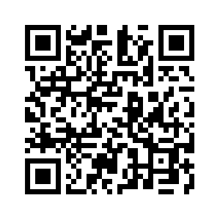
Donate with our QR code app to
Amazing Grace Christian Fellowship
Donations are Deeply Appreciated!

