Slide 1


Slide 2


Slide 3
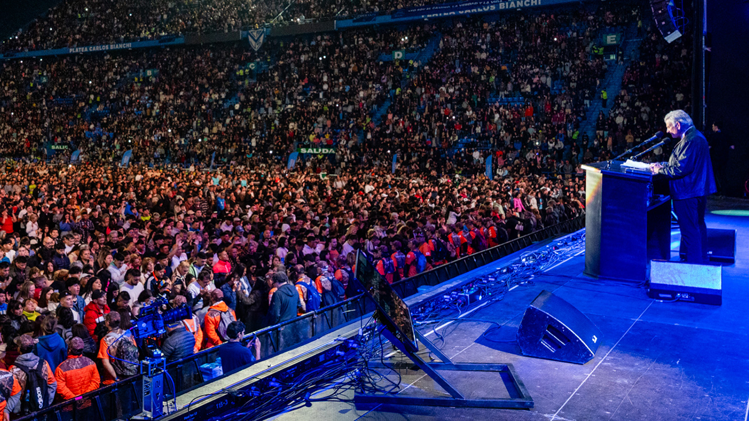

Spreading and Seeking God’s Hope
by Minister Marty Sesma
1 Peter 3:13-17
Sunday Morning
June 28, 2026

Slide 4
1 Peter 3:13-17
13 And who is he who will harm you if you become followers of what is good? 14 But even if you should suffer for righteousness' sake, you are blessed. "And do not be afraid of their threats, nor be troubled." 15 But sanctify the Lord God in your hearts, and always be ready to give a defense to everyone who asks you a reason for the hope that is in you, with meekness and fear;

Slide 5
16 having a good conscience, that when they defame you as evildoers, those who revile your good conduct in Christ may be ashamed. 17 For it is better, if it is the will of God, to suffer for doing good than for doing evil.

Slide 6
1 Peter 3:8-9
8 Finally, all of you be of one mind, having compassion for one another; love as brothers, be tenderhearted, be courteous; 9 not returning evil for evil or reviling for reviling, but on the contrary blessing, knowing that you were called to this, that you may inherit a blessing.

Slide 7
Romans 15:13
Now may the God of hope fill you with all joy and peace in believing, that you may abound in hope by the power of the Holy Spirit.

Slide 8
Romans 8:24-25
24 For we were saved in this hope, but hope that is seen is not hope; for why does one still hope for what he sees? 25 But if we hope for what we do not see, we eagerly wait for it with perseverance.

Slide 9
Psalm 62:5-6
5 My soul, wait silently for God alone, For my expectation is from Him. 6 He only is my rock and my salvation; He is my defense; I shall not be moved.

Slide 10
Colossians 1:27
To them God willed to make known what are the riches of the glory of this mystery among the Gentiles: which is Christ in you, the hope of glory.

Slide 11
Hebrews 6:19
This hope we have as an anchor of the soul, both sure and steadfast, and which enters the Presence behind the veil.

Slide 12
Jeremiah 29:11
For I know the thoughts that I think toward you, says the LORD, thoughts of peace and not of evil, to give you a future and a hope.

Slide 13
Hebrews 11:1
Now faith is the substance of things hoped for, the evidence of things not seen.

Slide 14
1 Thessalonians 4:13-18
13 But I do not want you to be ignorant, brethren, concerning those who have fallen asleep, lest you sorrow as others who have no hope. 14 For if we believe that Jesus died and rose again, even so God will bring with Him those who sleep in Jesus.

Slide 15
15 For this we say to you by the word of the Lord, that we who are alive and remain until the coming of the Lord will by no means precede those who are asleep. 16 For the Lord Himself will descend from heaven with a shout, with the voice of an archangel, and with the trumpet of God. And the dead in Christ will rise first.

Slide 16
17 Then we who are alive and remain shall be caught up together with them in the clouds to meet the Lord in the air. And thus we shall always be with the Lord. 18 Therefore comfort one another with these words.

Slide 17
1 Corinthians 15:50-54
50 Now this I say, brethren, that flesh and blood cannot inherit the kingdom of God; nor does corruption inherit incorruption. 51 Behold, I tell you a mystery: We shall not all sleep, but we shall all be changed-- 52 in a moment, in the twinkling of an eye, at the last trumpet. For the trumpet will sound, and the dead will be raised incorruptible, and we shall be changed.

Slide 18
53 For this corruptible must put on incorruption, and this mortal must put on immortality. 54 So when this corruptible has put on incorruption, and this mortal has put on immortality, then shall be brought to pass the saying that is written: "Death is swallowed up in victory."

Slide 19

20 Again, when a righteous man turns from his righteousness and commits iniquity, and I lay a stumbling block before him, he shall die; because you did not give him warning, he shall die in his sin, and his righteousness which he has done shall not be remembered; but his blood I will require at your hand.

Slide 20
Acts 2:38-39
38 Then Peter said to them, "Repent, and let every one of you be baptized in the name of Jesus Christ for the remission of sins; and you shall receive the gift of the Holy Spirit. 39 For the promise is to you and to your children, and to all who are afar off, as many as the Lord our God will call."

Slide 21

Donate with our QR code app to
Amazing Grace Christian Fellowship
Donations are Deeply Appreciated!

