Slide 1


Slide 2


Slide 3


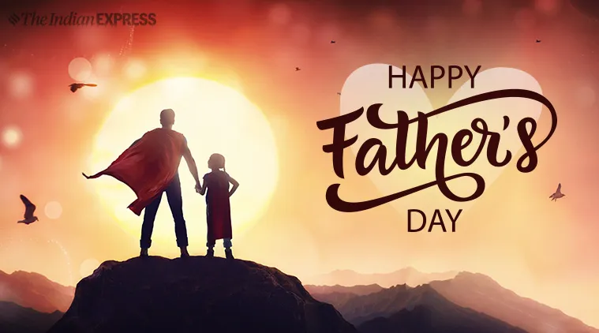

The Faithfulness of a Father
by Pastor Fee Soliven
Galatians 5:22-23
Sunday Morning
June 21, 2026

Slide 4
Galatians 5:22-23
22 But the fruit of the Spirit is love, joy, peace, longsuffering, kindness, goodness, faithfulness, 23 gentleness, self-control. Against such there is no law.

Slide 5
Faithfulness is one of the most important qualities in a person’s life

Slide 6
Genesis 32:9-10
9 Then Jacob said, "O God of my father Abraham and God of my father Isaac, the LORD who said to me, 'Return to your country and to your family, and I will deal well with you': 10 I am not worthy of the least of all the mercies and of all the truth which You have shown Your servant; for I crossed over this Jordan with my staff, and now I have become two companies.

Slide 7
Scripture Affirms
God’s Faithfulness

Slide 8
Deuteronomy 7:9
“Know therefore that the Lord your God, He is God, the faithful God, who keeps His covenant and His lovingkindness to a thousandth generation with those who love Him and keep His commandments.”

Slide 9
Psalm 33:4
“For the word of the Lord is upright, and all His work is done in faithfulness.”

Slide 10
Psalm 36:5
“Your lovingkindness, O Lord, extends to the heavens, Your faithfulness reaches to the skies.”

Slide 11
Psalm 119:90
“Your faithfulness continues throughout all generations.”

Slide 12
Lamentations 3:22-23
“The Lord’s loving kindnesses indeed never cease, for His compassions never fail. They are new every morning; great is Your faithfulness.”

Slide 13
2 Timothy 2:13
“If we are faithless, He remains faithful, for He cannot deny Himself.”

Slide 14
Hebrews 13:5
“I will never leave you, nor will I ever forsake you,”

Slide 15
Luke 24:49
“Behold, I send the Promise of My Father upon you; but tarry in the city of Jerusalem until you are endued with power from on high."

Slide 16
God has Promised to be
Faithful to Us

Slide 17
1 John 1:9
“If we confess our sins, He is faithful and righteous to forgive us our sins and to cleanse us from all unrighteousness”

Slide 18
God’s Faithfulness Limits the
Power of our Temptation

Slide 19
1 Corinthians 10:13
“No temptation has overtaken you but such as is common to man; and God is faithful, who will not allow you to be tempted beyond what you are able, but with the temptation will provide the way of escape also, so that you will be able to endure it”

Slide 20
Fathers we can have the
Peace of God

Slide 21
Philippians 4:7
“And the peace of God, which surpasses all comprehension, will guard your hearts and your minds in Christ Jesus”

Slide 22
The Holy Spirit limits the Power of Satan in our Lives

Slide 23
2 Thessalonians 3:3
“But the Lord is faithful, and He will strengthen and protect you from the evil one”

Slide 24
Fathers when we walk in the Spirit, we’ll have the following Characteristics

Slide 25
Devoted to God, Loyal, Unwavering,
Steadfast, Trustworthy, Dependable, Obedient, Faithful

Slide 26
Fruitful
Our lives will have a positive influence on others

Slide 27
John 15:1-17
1 "I am the true vine, and My Father is the vinedresser. 2 Every branch in Me that does not bear fruit He takes away; and every branch that bears fruit He prunes, that it may bear more fruit. 3 You are already clean because of the word which I have spoken to you. 4 Abide in Me, and I in you. As the branch cannot bear fruit of itself, unless it abides in the vine, neither can you, unless you abide in Me.

Slide 28
5 I am the vine, you are the branches. He who abides in Me, and I in him, bears much fruit; for without Me you can do nothing. 6 If anyone does not abide in Me, he is cast out as a branch and is withered; and they gather them and throw them into the fire, and they are burned.

Slide 29
7 If you abide in Me, and My words abide in you, you will ask what you desire, and it shall be done for you. 8 By this My Father is glorified, that you bear much fruit; so you will be My disciples. 9 "As the Father loved Me, I also have loved you; abide in My love. 10 If you keep My commandments, you will abide in My love, just as I have kept My Father's commandments and abide in His love.

Slide 30
11 These things I have spoken to you, that My joy may remain in you, and that your joy may be full. 12 This is My commandment, that you love one another as I have loved you. 13 Greater love has no one than this, than to lay down one's life for his friends. 14 You are My friends if you do whatever I command you.

Slide 31
15 No longer do I call you servants, for a servant does not know what his master is doing; but I have called you friends, for all things that I heard from My Father I have made known to you. 16 You did not choose Me, but I chose you and appointed you that you should go and bear fruit, and that your fruit should remain, that whatever you ask the Father in My name He may give you. 17 These things I command you, that you love one another.

Slide 32
John 15:2
“Every branch in Me that does not bear fruit He takes away; and every branch that bears fruit He prunes, that it may bear more fruit.”

Slide 33
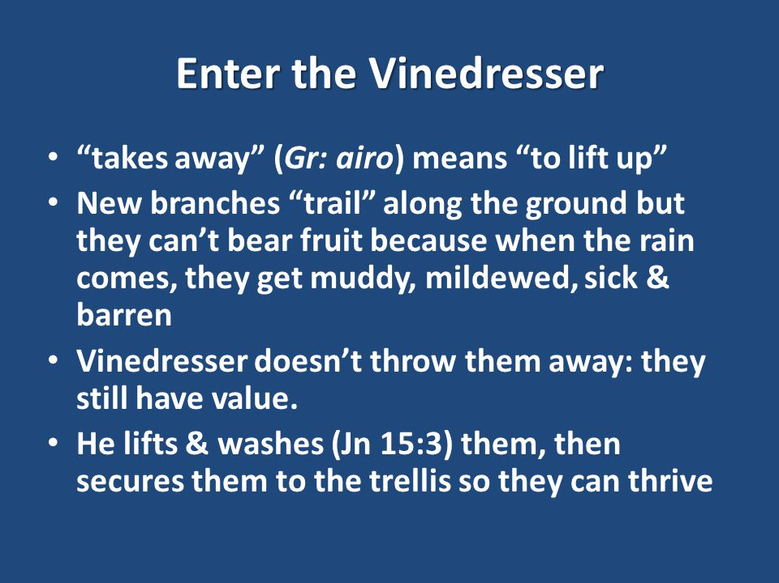
Obedient
Although we won’t do it perfectly, our desire and aim will be to obey God

Slide 34
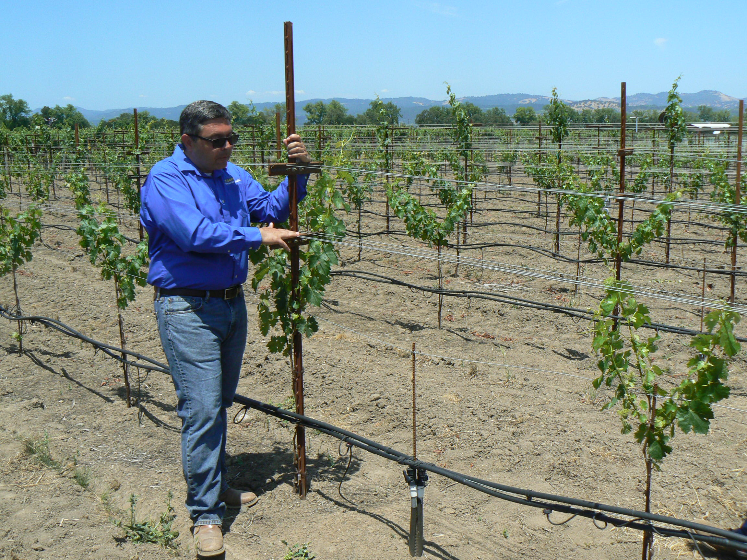
Obedient
Although we won’t do it perfectly, our desire and aim will be to obey God

Slide 35
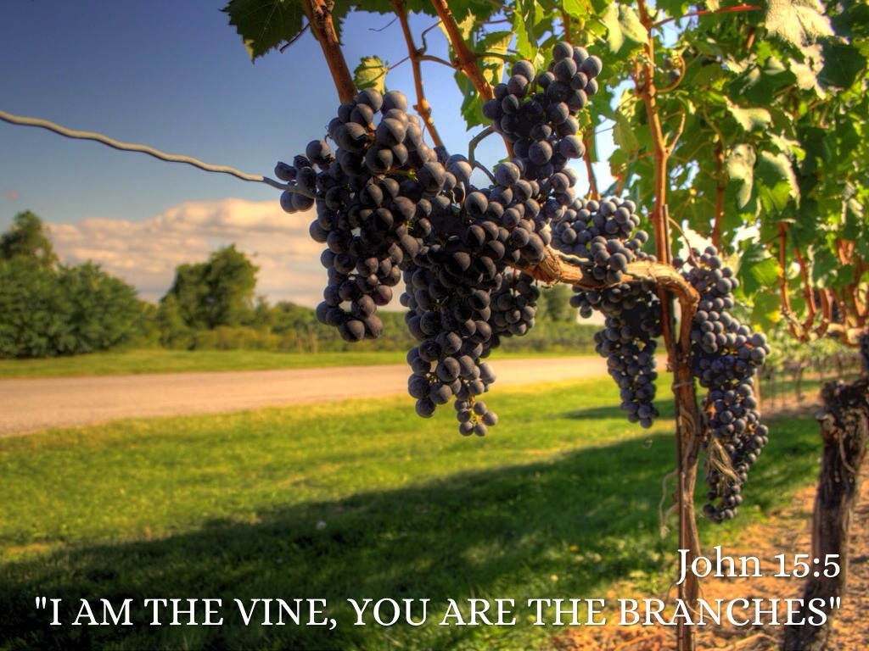
Obedient
Although we won’t do it perfectly, our desire and aim will be to obey God

Slide 36
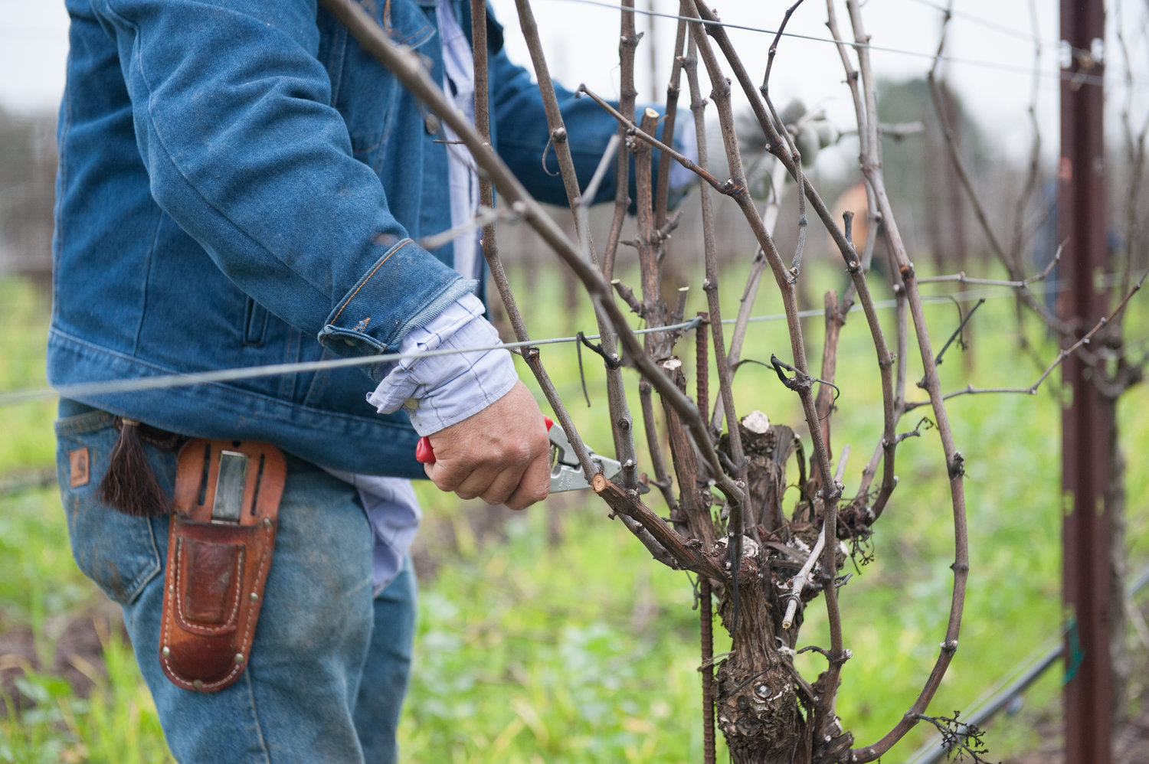
Obedient
Although we won’t do it perfectly, our desire and aim will be to obey God

Slide 37
Ezekiel 3:20
“Again, when a righteous man turns from his righteousness and commits iniquity, and I lay a stumbling block before him, he shall die; because you did not give him warning, he shall die in his sin, and his righteousness which he has done shall not be remembered; but his blood I will require at your hand.”

Slide 38
Romans 6:14
“For sin shall not have dominion over you, for you are not under law but under grace.”

Slide 39
The law demanded perfect human righteousness
and condemned every sin

Slide 40
Ezekiel 18:4
"Behold, all souls are Mine; The soul of the father As well as the soul of the son is Mine; The soul who sins shall die.

Slide 41
Romans 5:15-21
15 But the free gift is not like the offense. For if by the one man's offense many died, much more the grace of God and the gift by the grace of the one Man, Jesus Christ, abounded to many.

Slide 42
16 And the gift is not like that which came through the one who sinned. For the judgment which came from one offense resulted in condemnation, but the free gift which came from many offenses resulted in justification. 17 For if by the one man's offense death reigned through the one, much more those who receive abundance of grace and of the gift of righteousness will reign in life through the One, Jesus Christ.)

Slide 43
18 Therefore, as through one man's offense judgment came to all men, resulting in condemnation, even so through one Man's righteous act the free gift came to all men, resulting in justification of life. 19 For as by one man's disobedience many were made sinners, so also by one Man's obedience many will be made righteous.

Slide 44
20 Moreover the law entered that the offense might abound. But where sin abounded, grace abounded much more, 21 so that as sin reigned in death, even so grace might reign through righteousness to eternal life through Jesus Christ our Lord.

Slide 45
The only salvation God offers us is "Eternal Salvation"

Slide 46
Hebrews 5:9
“And having been perfected, He became the author of eternal salvation to all who obey Him…”

Slide 47
Christ is Savior,
not probation officer!

Slide 48
1. How confident are you that you can trust the Lord in every circumstance?

Slide 49
2. In what ways has He demonstrated His faithfulness in your life?

Slide 50
3. How faithful are you to other people in your life?

Slide 51
4. How faithful are you to the Lord?

Slide 52
1 Thessalonians 4:13-18
13 But I do not want you to be ignorant, brethren, concerning those who have fallen asleep, lest you sorrow as others who have no hope. 14 For if we believe that Jesus died and rose again, even so God will bring with Him those who sleep in Jesus.

Slide 53
15 For this we say to you by the word of the Lord, that we who are alive and remain until the coming of the Lord will by no means precede those who are asleep. 16 For the Lord Himself will descend from heaven with a shout, with the voice of an archangel, and with the trumpet of God. And the dead in Christ will rise first.

Slide 54
17 Then we who are alive and remain shall be caught up together with them in the clouds to meet the Lord in the air. And thus we shall always be with the Lord. 18 Therefore comfort one another with these words.

Slide 55
1 Corinthians 15:50-54
50 Now this I say, brethren, that flesh and blood cannot inherit the kingdom of God; nor does corruption inherit incorruption. 51 Behold, I tell you a mystery: We shall not all sleep, but we shall all be changed-- 52 in a moment, in the twinkling of an eye, at the last trumpet. For the trumpet will sound, and the dead will be raised incorruptible, and we shall be changed.

Slide 56
53 For this corruptible must put on incorruption, and this mortal must put on immortality. 54 So when this corruptible has put on incorruption, and this mortal has put on immortality, then shall be brought to pass the saying that is written: "Death is swallowed up in victory."

Slide 57

20 Again, when a righteous man turns from his righteousness and commits iniquity, and I lay a stumbling block before him, he shall die; because you did not give him warning, he shall die in his sin, and his righteousness which he has done shall not be remembered; but his blood I will require at your hand.

Slide 58
Acts 2:38-39
38 Then Peter said to them, "Repent, and let every one of you be baptized in the name of Jesus Christ for the remission of sins; and you shall receive the gift of the Holy Spirit. 39 For the promise is to you and to your children, and to all who are afar off, as many as the Lord our God will call."

Slide 59
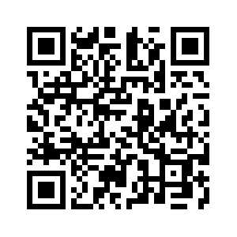
Donate with our QR code app to
Amazing Grace Christian Fellowship
Donations are Deeply Appreciated!

Slide 60


