Slide 1


Slide 2


Slide 3
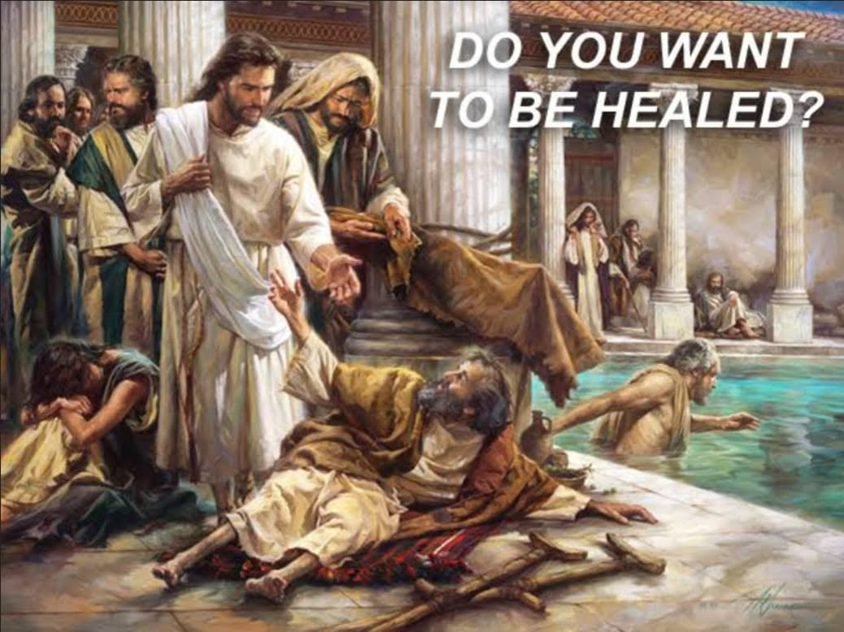
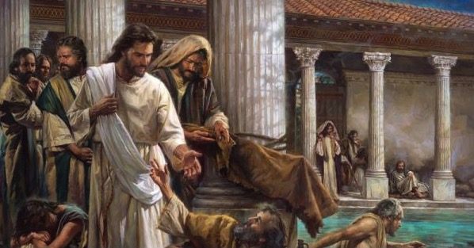

The God that Healeth Thee
by Pastor Fee Soliven
Isaiah 6:6-10
Psalms 103:1-5
July 12, 2026

Slide 4
Psalms 103:1-5
1 Bless the LORD, O my soul; And all that is within me, bless His holy name! 2 Bless the LORD, O my soul, And forget not all His benefits: 3 Who forgives all your iniquities, Who heals all your diseases, 4 Who redeems your life from destruction, Who crowns you with lovingkindness and tender mercies, 5 Who satisfies your mouth with good things, So that your youth is renewed like the eagle's.

Slide 5
Born Spiritually Dead

Slide 6
Romans 5:12-14
12 Therefore, just as through one man sin entered the world, and death through sin, and thus death spread to all men, because all sinned-- 13(For until the law sin was in the world, but sin is not imputed when there is no law. 14 Nevertheless death reigned from Adam to Moses, even over those who had not sinned according to the likeness of the transgression of Adam, who is a type of Him who was to come.

Slide 7
Romans 6:23
For the wages of sin is death….

Slide 8
Why does God require death for sin?

Slide 9
Isaiah 64:6-7
6 But we are all like an unclean thing, And all our righteousnesses are like filthy rags; We all fade as a leaf, And our iniquities, like the wind, Have taken us away. 7 And there is no one who calls on Your name, Who stirs himself up to take hold of You; For You have hidden Your face from us, And have consumed us because of our iniquities.

Slide 10
Galatians 5:19-21
19 Now the works of the flesh are evident, which are: adultery, fornication, uncleanness, lewdness, 20 idolatry, sorcery, hatred, contentions, jealousies, outbursts of wrath, selfish ambitions, dissensions, heresies, 21 envy, murders, drunkenness, revelries, and the like; of which I tell you beforehand, just as I also told you in time past, that those who practice such things will not inherit the kingdom of God.

Slide 11
The Prophets Saw a
New Day Coming of Hope

Slide 12
Jeremiah 24:7
Then I will give them a heart to know Me, that I am the LORD; and they shall be My people, and I will be their God, for they shall return to Me with their whole heart.

Slide 13
Ezekiel 11:17-21
17 "Therefore say, 'Thus says the Lord GOD: "I will gather you from the peoples, assemble you from the countries where you have been scattered, and I will give you the land of Israel." ' 18 "And they will go there, and they will take away all its detestable things and all its abominations from there.

Slide 14
19 Then I will give them one heart, and I will put a new spirit within them, and take the stony heart out of their flesh, and give them a heart of flesh, 20 that they may walk in My statutes and keep My judgments and do them; and they shall be My people, and I will be their God. 21 But as for those whose hearts follow the desire for their detestable things and their abominations, I will recompense their deeds on their own heads," says the Lord GOD.

Slide 15
We All Must Be Raised from
The Dead to Life

Slide 16
Ephesians 2:1-10
1 And you He made alive, who were dead in trespasses and sins, 2 in which you once walked according to the course of this world, according to the prince of the power of the air, the spirit who now works in the sons of disobedience, 3 among whom also we all once conducted ourselves in the lusts of our flesh, fulfilling the desires of the flesh and of the mind, and were by nature children of wrath, just as the others.

Slide 17
4 But God, who is rich in mercy, because of His great love with which He loved us, 5 even when we were dead in trespasses, made us alive together with Christ (by grace you have been saved), 6 and raised us up together, and made us sit together in the heavenly places in Christ Jesus, 7 that in the ages to come He might show the exceeding riches of His grace in His kindness toward us in Christ Jesus.

Slide 18
8 For by grace you have been saved through faith, and that not of yourselves; it is the gift of God, 9 not of works, lest anyone should boast. 10 For we are His workmanship, created in Christ Jesus for good works, which God prepared beforehand that we should walk in them.

Slide 19
Philippians 3:17-21
17 Brethren, join in following my example, and note those who so walk, as you have us for a pattern. 18 For many walk, of whom I have told you often, and now tell you even weeping, that they are the enemies of the cross of Christ: 19 whose end is destruction, whose god is their belly, and whose glory is in their shame--who set their mind on earthly things.

Slide 20
20 For our citizenship is in heaven, from which we also eagerly wait for the Savior, the Lord Jesus Christ, 21 who will transform our lowly body that it may be conformed to His glorious body, according to the working by which He is able even to subdue all things to Himself.

Slide 21
Colossians 2:9-13
9 For in Him dwells all the fullness of the Godhead bodily; 10 and you are complete in Him, who is the head of all principality and power.

Slide 22
11 In Him you were also circumcised with the circumcision made without hands, by putting off the body of the sins of the flesh, by the circumcision of Christ, 12 buried with Him in baptism, in which you also were raised with Him through faith in the working of God, who raised Him from the dead. 13 And you, being dead in your trespasses and the uncircumcision of your flesh, He has made alive together with Him, having forgiven you all trespasses…

Slide 23
Jesus Came to Heal Us and
Deliver Us from The Dead

Slide 24
Psalms 147:3
“He heals the brokenhearted And binds up their wounds”

Slide 25
Luke 4:14-19
14 Then Jesus returned in the power of the Spirit to Galilee, and news of Him went out through all the surrounding region. 15 And He taught in their synagogues, being glorified by all.

Slide 26
16 So He came to Nazareth, where He had been brought up. And as His custom was, He went into the synagogue on the Sabbath day, and stood up to read. 17 And He was handed the book of the prophet Isaiah. And when He had opened the book, He found the place where it was written:

Slide 27
18 "The Spirit of the LORD is upon Me, Because He has anointed Me To preach the gospel to the poor; He has sent Me to heal the brokenhearted, To proclaim liberty to the captives And recovery of sight to the blind, To set at liberty those who are oppressed; 19 To proclaim the acceptable year of the LORD."

Slide 28
Romans 8:8-11
8 So then, those who are in the flesh cannot please God. 9 But you are not in the flesh but in the Spirit, if indeed the Spirit of God dwells in you. Now if anyone does not have the Spirit of Christ, he is not His. 10 And if Christ is in you, the body is dead because of sin, but the Spirit is life because of righteousness. 11 But if the Spirit of Him who raised Jesus from the dead dwells in you, He who raised Christ from the dead will also give life to your mortal bodies through His Spirit who dwells in you.

Slide 29
Jeremiah 33:8-9
8 I will cleanse them from all their iniquity by which they have sinned against Me, and I will pardon all their iniquities by which they have sinned and by which they have transgressed against Me.

Slide 30
9 Then it shall be to Me a name of joy, a praise, and an honor before all nations of the earth, who shall hear all the good that I do to them; they shall fear and tremble for all the goodness and all the prosperity that I provide for it.'

Slide 31
Jesus said, “You Must Be Born Again”

Slide 32
Happy Birthday to you, only one will not do, Born Again means Salvation, aren’t you Glad you had two!

Slide 33
John 3:1-7
1 There was a man of the Pharisees named Nicodemus, a ruler of the Jews. 2 This man came to Jesus by night and said to Him, "Rabbi, we know that You are a teacher come from God; for no one can do these signs that You do unless God is with him." 3 Jesus answered and said to him, "Most assuredly, I say to you, unless one is born again, he cannot see the kingdom of God."

Slide 34
4 Nicodemus said to Him, "How can a man be born when he is old? Can he enter a second time into his mother's womb and be born?" 5 Jesus answered, "Most assuredly, I say to you, unless one is born of water and the Spirit, he cannot enter the kingdom of God. 6 That which is born of the flesh is flesh, and that which is born of the Spirit is spirit. 7 Do not marvel that I said to you, 'You must be born again.'
.

Slide 35
1 Peter 1:18-23
18 knowing that you were not redeemed with corruptible things, like silver or gold, from your aimless conduct received by tradition from your fathers, 19 but with the precious blood of Christ, as of a lamb without blemish and without spot. 20 He indeed was foreordained before the foundation of the world, but was manifest in these last times for you

Slide 36
21 who through Him believe in God, who raised Him from the dead and gave Him glory, so that your faith and hope are in God. 22 Since you have purified your souls in obeying the truth through the Spirit in sincere love of the brethren, love one another fervently with a pure heart, 23 having been born again, not of corruptible seed but incorruptible, through the word of God which lives and abides forever

Slide 37
1 Thessalonians 4:13-18
13 But I do not want you to be ignorant, brethren, concerning those who have fallen asleep, lest you sorrow as others who have no hope. 14 For if we believe that Jesus died and rose again, even so God will bring with Him those who sleep in Jesus.

Slide 38
15 For this we say to you by the word of the Lord, that we who are alive and remain until the coming of the Lord will by no means precede those who are asleep. 16 For the Lord Himself will descend from heaven with a shout, with the voice of an archangel, and with the trumpet of God. And the dead in Christ will rise first.

Slide 39
17 Then we who are alive and remain shall be caught up together with them in the clouds to meet the Lord in the air. And thus we shall always be with the Lord. 18 Therefore comfort one another with these words.

Slide 40
1 Corinthians 15:50-54
50 Now this I say, brethren, that flesh and blood cannot inherit the kingdom of God; nor does corruption inherit incorruption. 51 Behold, I tell you a mystery: We shall not all sleep, but we shall all be changed-- 52 in a moment, in the twinkling of an eye, at the last trumpet. For the trumpet will sound, and the dead will be raised incorruptible, and we shall be changed.

Slide 41
53 For this corruptible must put on incorruption, and this mortal must put on immortality. 54 So when this corruptible has put on incorruption, and this mortal has put on immortality, then shall be brought to pass the saying that is written: "Death is swallowed up in victory."

Slide 42

20 Again, when a righteous man turns from his righteousness and commits iniquity, and I lay a stumbling block before him, he shall die; because you did not give him warning, he shall die in his sin, and his righteousness which he has done shall not be remembered; but his blood I will require at your hand.

Slide 43
Acts 2:38-39
38 Then Peter said to them, "Repent, and let every one of you be baptized in the name of Jesus Christ for the remission of sins; and you shall receive the gift of the Holy Spirit. 39 For the promise is to you and to your children, and to all who are afar off, as many as the Lord our God will call."

Slide 44

Donate with our QR code app to
Amazing Grace Christian Fellowship
Donations are Deeply Appreciated!

